Slide 1
ZEALOUS TECHNOLOGIES • PRODUCT OVERVIEW
ePRC
Electronic Proceed Realization Certificate
Automated issuance and real-time verification of PRCs
Developed by Zealous Technologies
zealoustechnologies.com

Slide 2



OVERVIEW
Project Summary
Digital Pakistan Vision
Automated PRC Delivery
Fewer Branch Visits
SBP is progressively digitizing banking operations. With significant growth in Home Remittances, demand for PRC as proof of legitimate fund sources has increased substantially.
Streamlines PRC issuance and enhances customer experience by providing instant, automated PRC delivery via registered email.
Eliminates the need for branch visits and reduces verification delays caused by manual processes.
EPRC
2

Slide 3





OVERVIEW
Project Highlights & Impact
PROJECT HIGHLIGHTS
IMPACT
Automated PRC Issuance
Faster Processing
PRCs are generated digitally and sent directly to customers' registered email addresses
Reduced manual processing and customer wait times
e-PRC Verification Portal
Regulatory agencies (Customs, FBR, SBP) can verify PRCs online in real time
Better Verification
Improved regulatory verification efficiency
Efficiency & Transparency
Instant access to verified PRC information speeds regulatory compliance
Stronger Compliance
Strengthened transparency and compliance in remittance-related transactions
Innovation in Banking
Reflects Citibank's commitment to digital transformation and customer-centric solutions
EPRC
3

Slide 4

PLATFORM
System Architecture
A secure, enterprise-grade platform built in C# and .NET Framework to manage and verify PRCs efficiently.
User Management
Manual PRC Upload
Scalable Platform
Maker-checker approvals for managing accounts, roles, and permissions across Client Setup, Verifying Officers/Agencies, and Departmental Assignments.
Authorized users can securely upload PRC data, which clients can access in real time.
Reliable, scalable, and secure management of high-volume transactions and complex workflows.
EPRC
4

Slide 5
OVERVIEW
Description
Need to automate the process of issuance and verification of PRC emerged based on the following facts:
SBP has advised the banks to devise an end-to-end digital process which connects with the core banking system for issuance of PRC for the client and third party, and its verification for Government Authorities.
The web portal will be connected with an already developed local application (semi-automated process) for the issuance of PRC and verification.
Email feature for the issuance of E-PRC/sPRC to clients.
EPRC
5

Slide 6
OVERVIEW
Objectives
Automate the issuance of PRC (ePRC and sPRC) as per prescribed formats
Delivery of ePRC and sPRC to the beneficiary's registered email address where Citi is the beneficiary bank (same bank model)
Passing of required PRC data to the beneficiary bank where Citi is the intermediary bank (different bank model), via RTGS (MT 102 and MT 103) and IBFT payment messages
Develop a system for verification of ePRC — notifying the requestor of any prior verifications by other government agencies
EPRC
6

Slide 7
OVERVIEW
ePRC Users
Customs Authorities for import of vehicles (per SRO of 2019)
SBP for inward investment & repatriation of profits/disinvestment
Export realization, remittances, and borrowing-from-abroad purposes
Any other regulatory authority or agency
EPRC
7

Slide 8
OVERVIEW
Proposed Solution
ePRC/sPRC will be issued electronically and sent to the beneficiary's registered email address
e-PRC/sPRC will bear a system-generated unique ID number
Same bank model: the bank receiving remittance will issue ePRC/sPRC to its own account holder
ePRC/sPRC can be verified online by the relevant agency — the system flags any prior verification by another agency
EPRC
8

Slide 9


PLATFORM OVERVIEW
System Modules
User creation follows the standard Citibank user-creation procedure
User Creation
sPRC/ePRC Process
Verification
Generate ePRC/sPRC
Generate Report
Issuance
EPRC
9

Slide 10
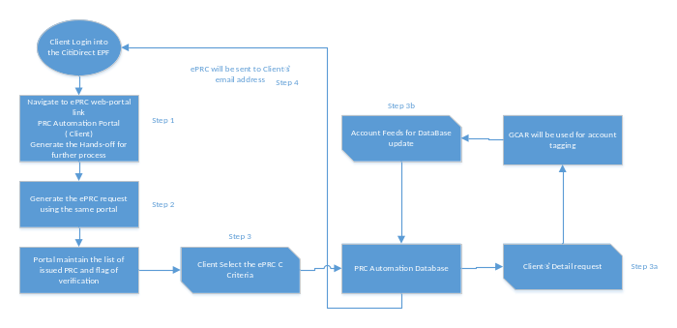
PLATFORM
System Architecture Diagram
EPRC
10

Slide 11
PLATFORM
Dependencies Hands-off Template
GCAR layout templates and parameters
EPF hands-off template
Email template for ePRC/sPRC
Core banking template
Format of Government Agencies hands-off
EPRC
11

Slide 12
WORKFLOW
Process Explanation
Generating bulk foreign currency transactions using an Excel file or system-generated text/XML file from the core system.
Dashboard where the user can view verification status and upload an XML or text-based generated file from the core system, tied to a unique PRC code.
Authorized agency verification.
ePRC/sPRC can be sent using the proposed template, either in bulk or individually using date ranges.
AD user can extract the agency's activity log report.
The IS report section covers user creation, modification, and deletion.
The Operations report section traces sPRC/ePRC issuance according to filters.
EPRC
12

Slide 13
PLATFORM
Dependencies
In order to produce system-generated ePRC/sPRC issuance as per the SBP-provided template, there is a dependency on the following parameters, sourced from core banking or another repository:
Beneficiary detail
Transaction detail
Proceed Realization Certificate
Remitter detail
EPRC
13

Slide 14

DEPLOYMENT
Hardware & Software Requirements
Preferable development environment: ASP.NET MVC.
A Windows Server with IIS Manager installed is required to deploy the ASP.NET MVC application.
Application | Specs | OS
Minimum | RAM: 8 GB • Cores: 4 • Storage (SSD): 50 GB | Any
Recommended | RAM: 16 GB • Cores: 8 • Storage (SSD): 50–100 GB | Any
EPRC
14

Slide 15
01
Admin Portal
Login, PRC upload, client, and group management
EPRC
15

Slide 16
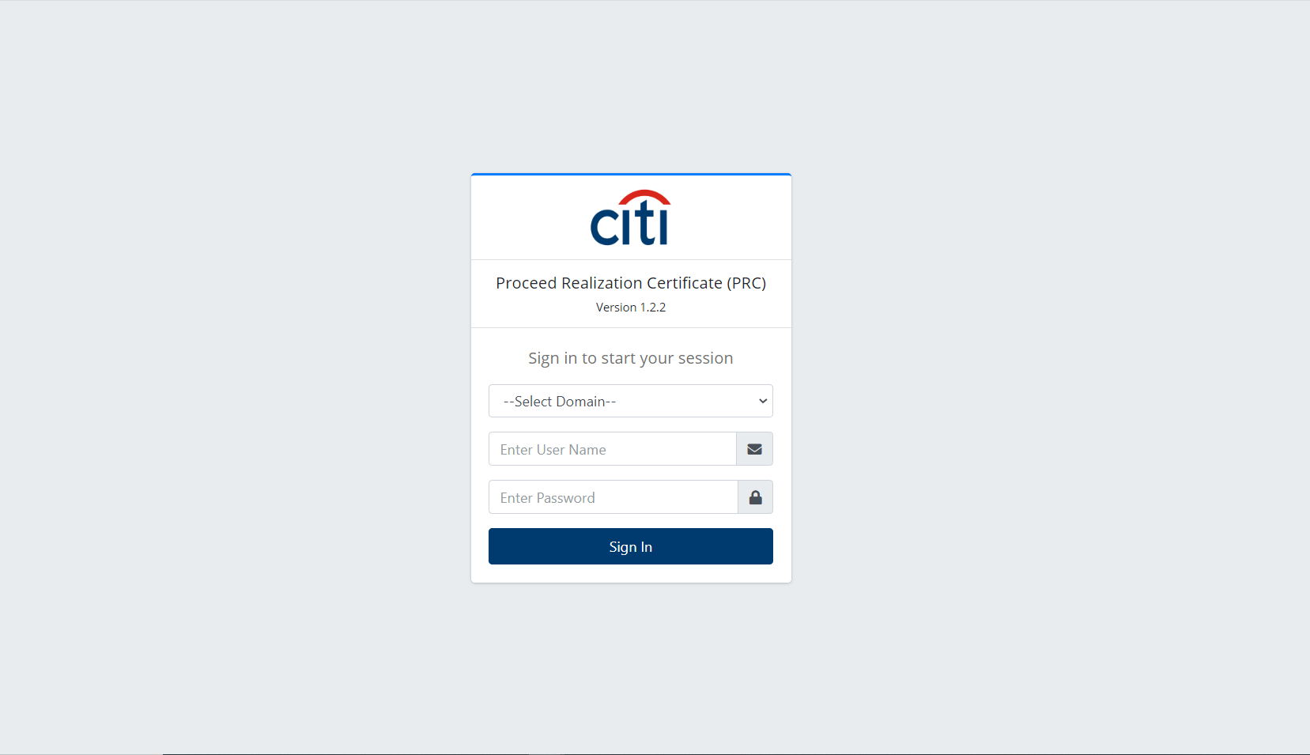
ADMIN PORTAL
Login
EPRC
16

Slide 17
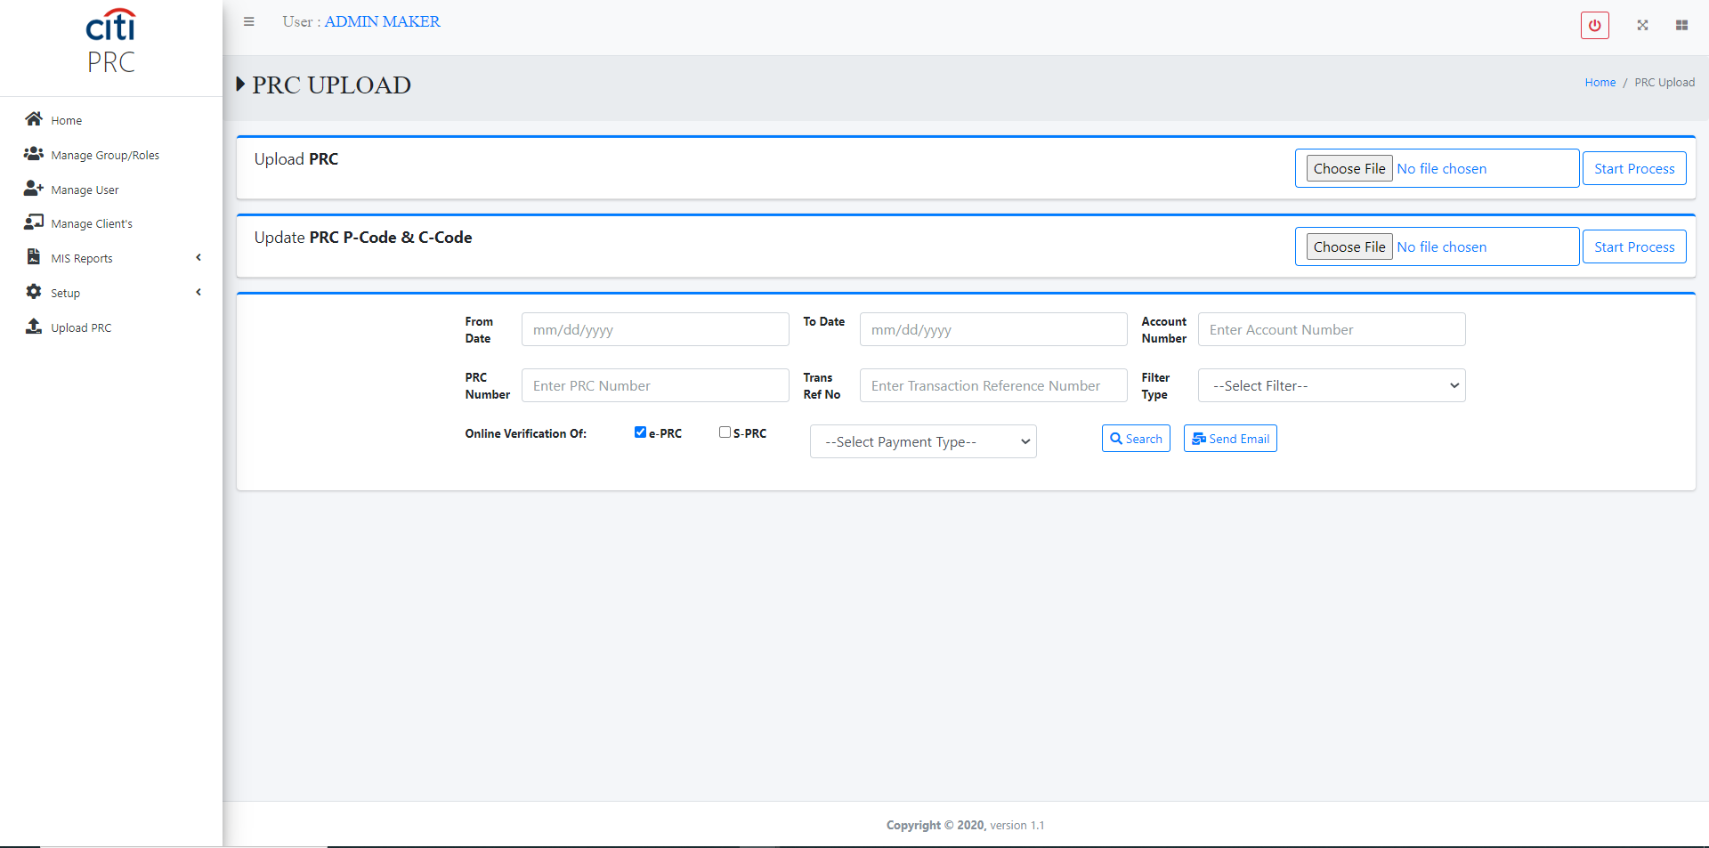
ADMIN PORTAL
Documents and Upload PRC
EPRC
17

Slide 18
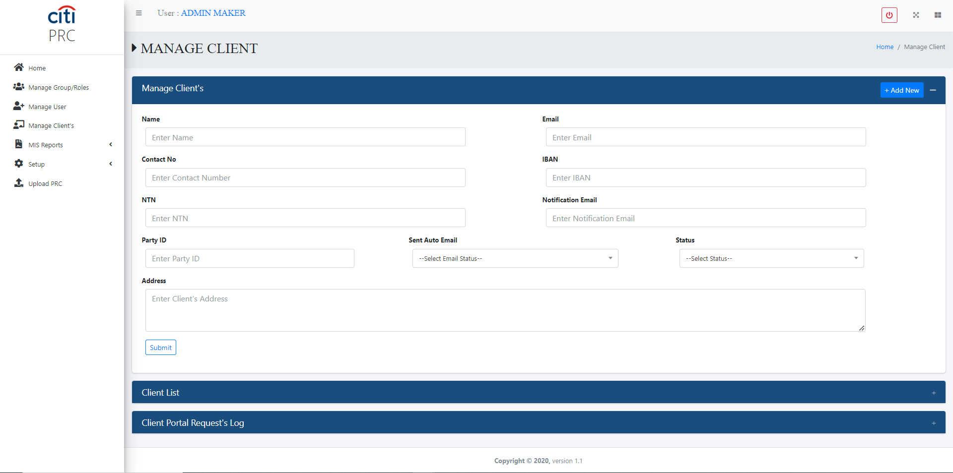
ADMIN PORTAL
Client Management Form
EPRC
18

Slide 19
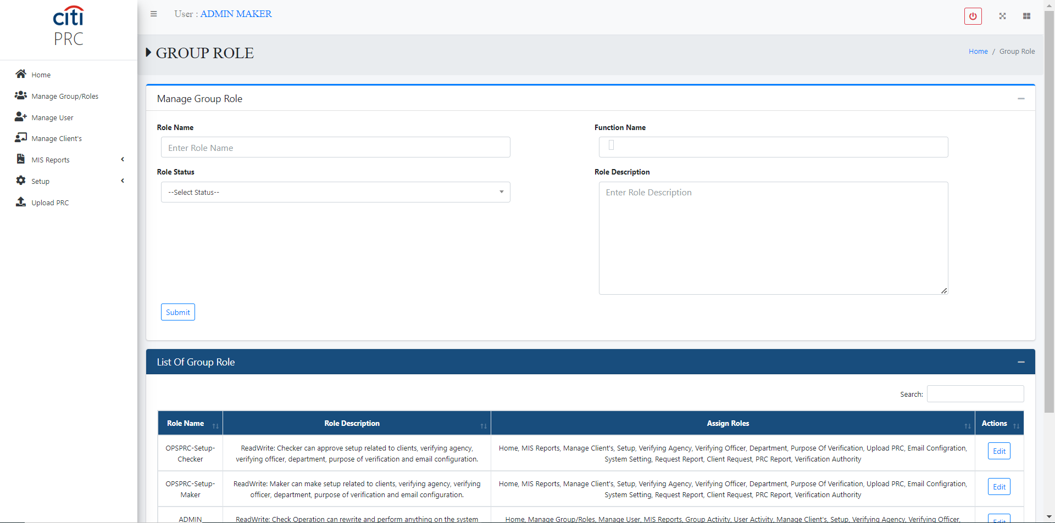
ADMIN PORTAL
Groups Management Form
EPRC
19

Slide 20
PLATFORM ENHANCEMENT
New User Creation Module
STEP 1
STEP 2
Dynamic User Creation
Portal Integration
Users can be created and managed using the new proposed dynamic module, as per Citi standard.
This dynamic user-creation module will be incorporated into the ePRC/sPRC web portal.
EPRC
20

Slide 21
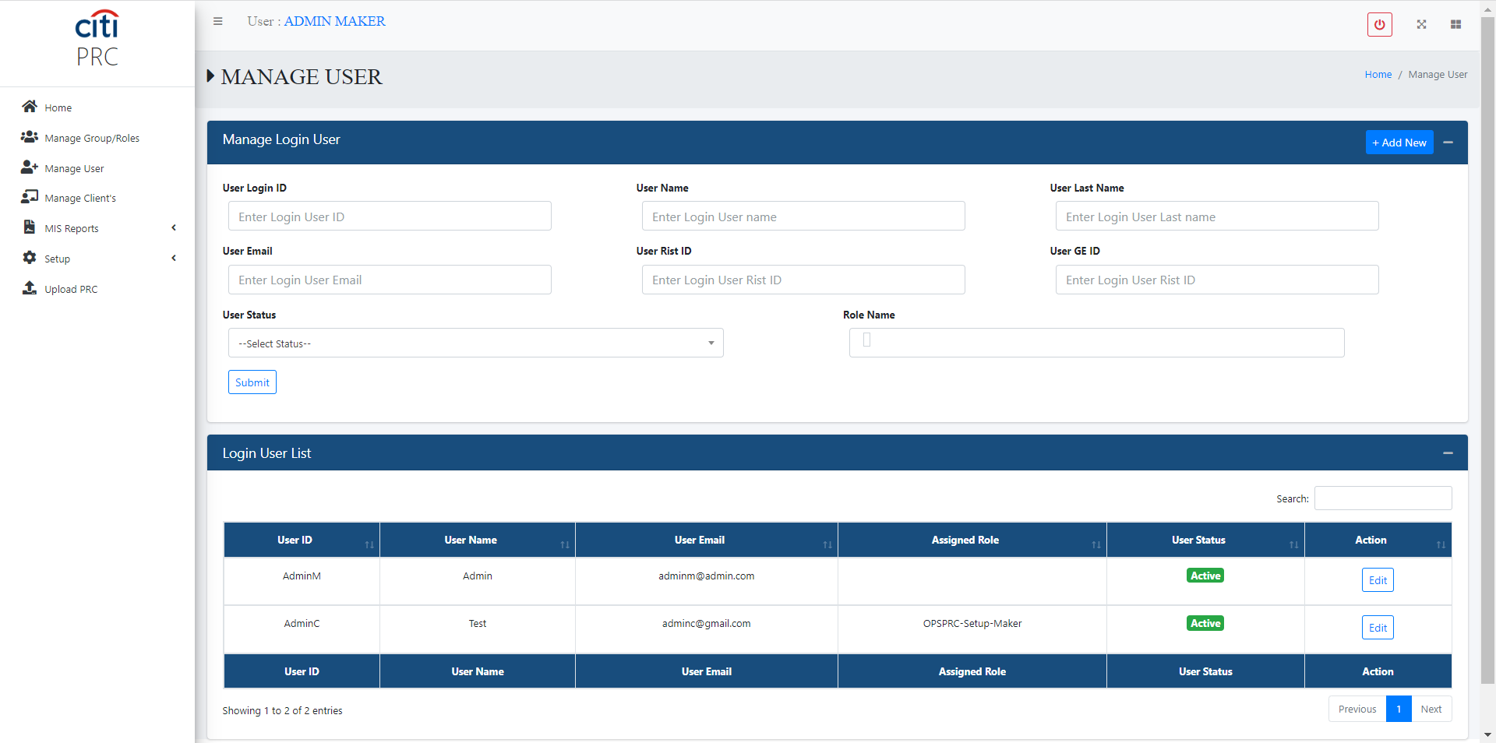
ADMIN PORTAL
User Management Form
EPRC
21

Slide 22
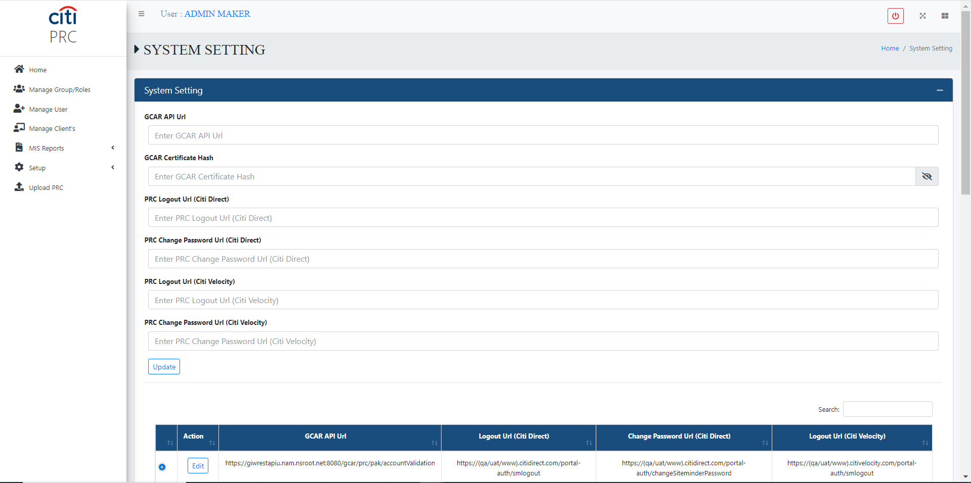
ADMIN PORTAL
System Setup Form
EPRC
22

Slide 23
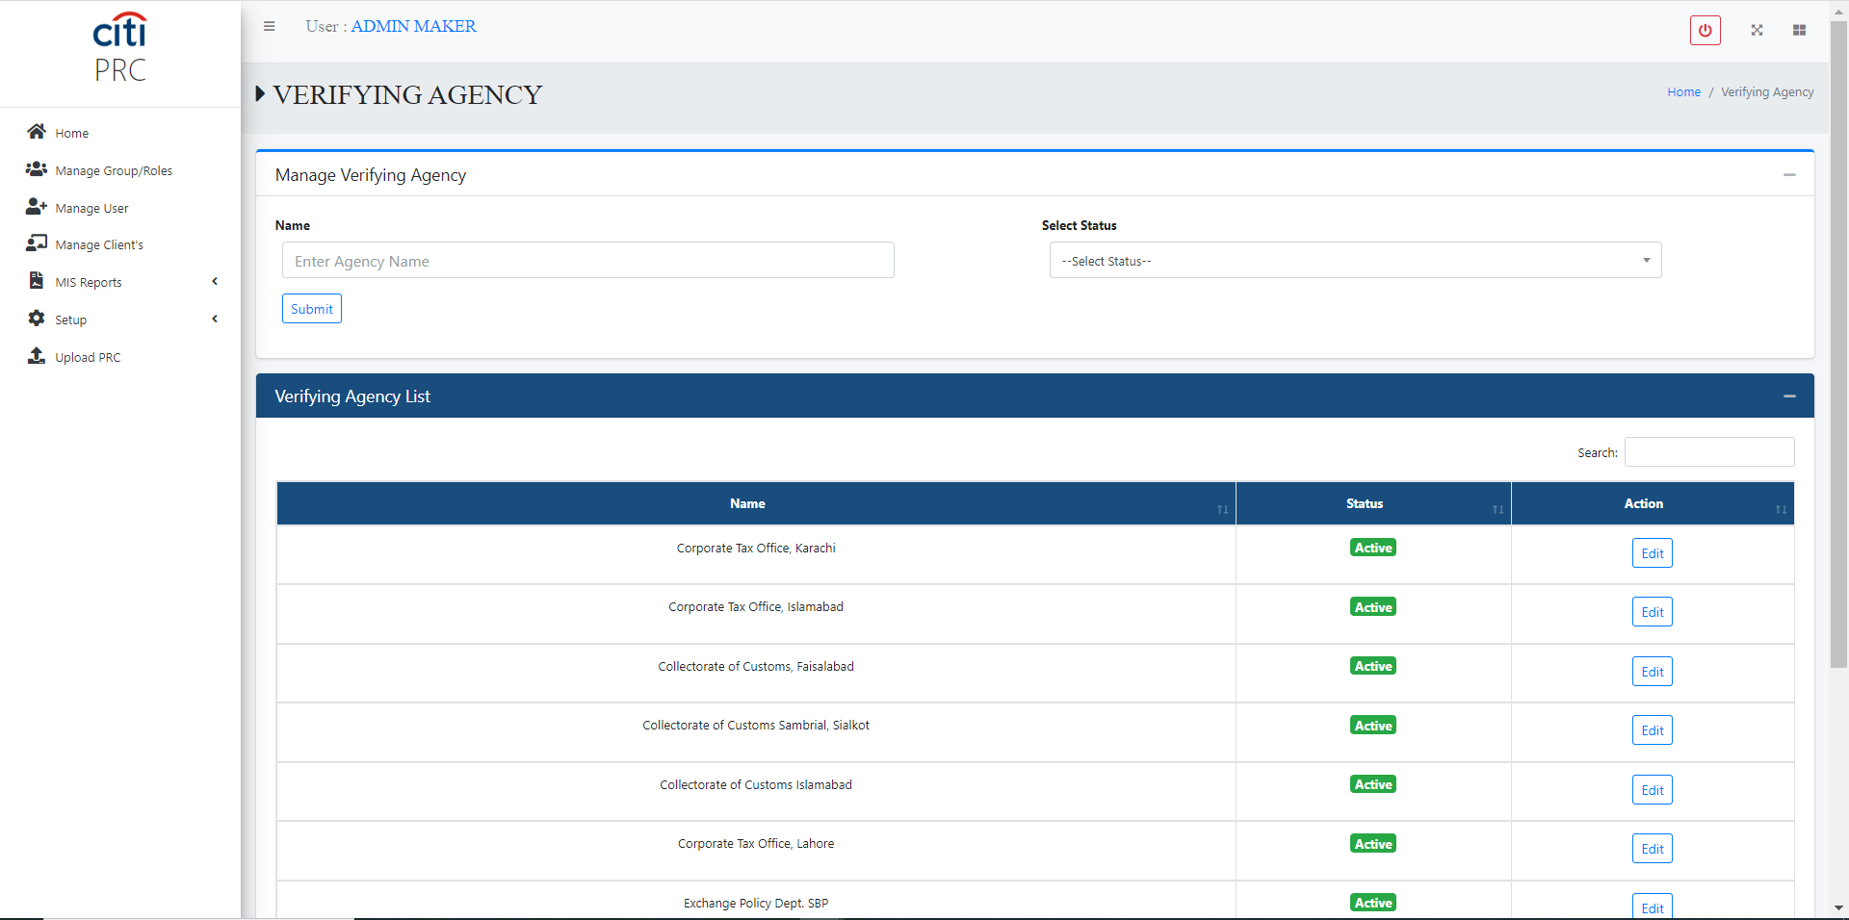
ADMIN PORTAL
Verifying Agency Setup Form
EPRC
23

Slide 24
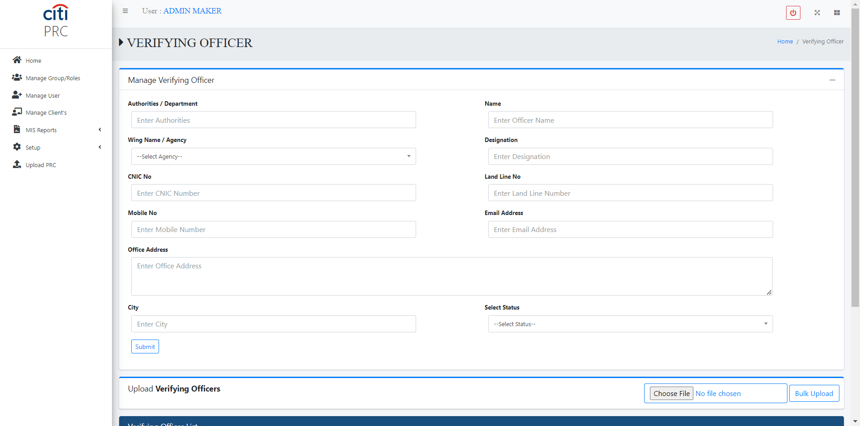
ADMIN PORTAL
Verifying Officer Setup Form
EPRC
24

Slide 25
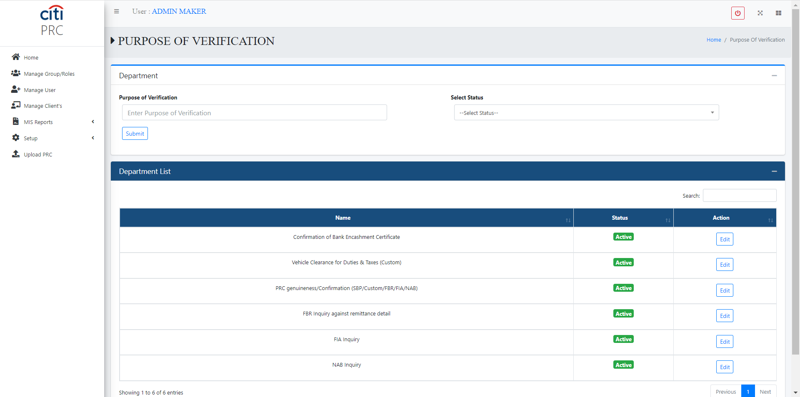
ADMIN PORTAL
Purpose of Verification Setup Form
EPRC
25

Slide 26
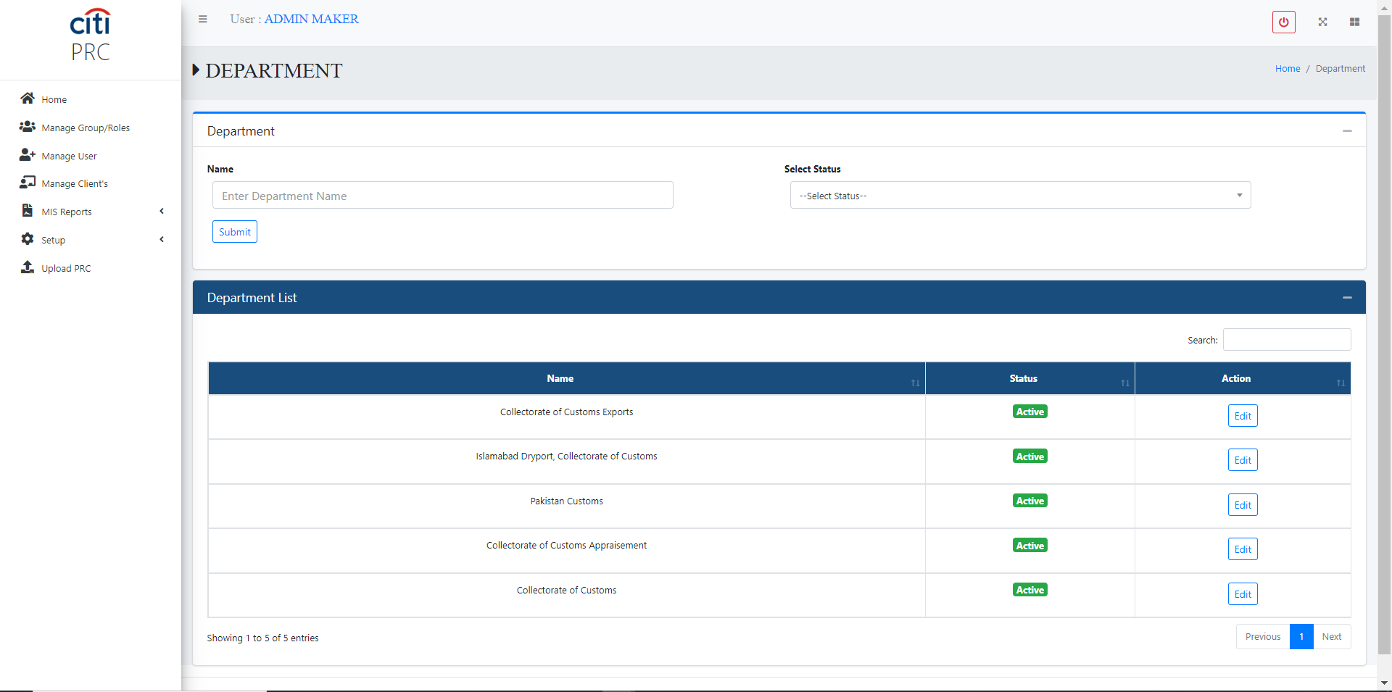
ADMIN PORTAL
Department Setup Form
EPRC
26

Slide 27
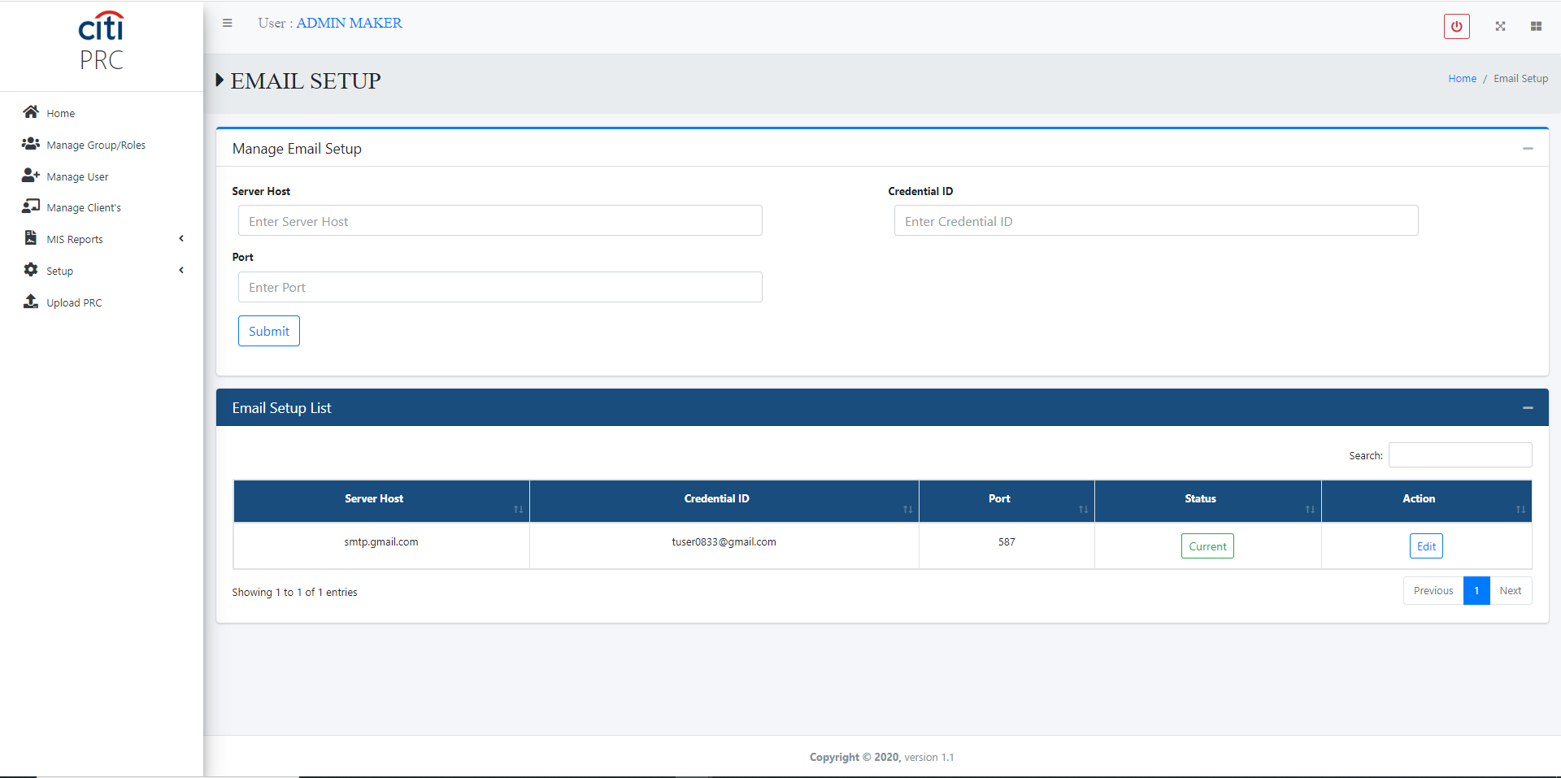
ADMIN PORTAL
Email Configuration Setup Form
EPRC
27

Slide 28
02
Reports
Client, group, user, and PRC activity reports
EPRC
28

Slide 29
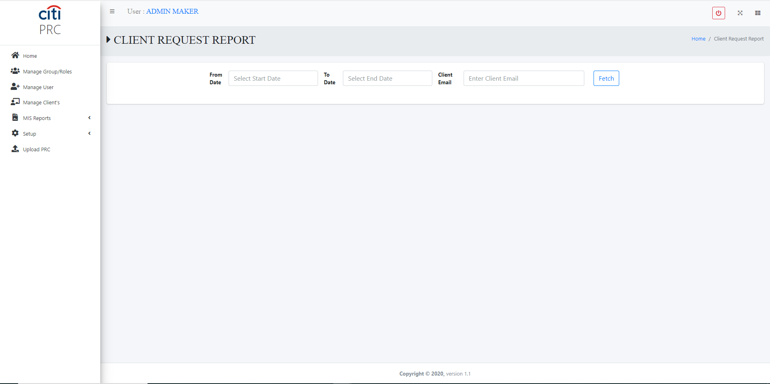
REPORTS
Client Request Report
EPRC
29

Slide 30
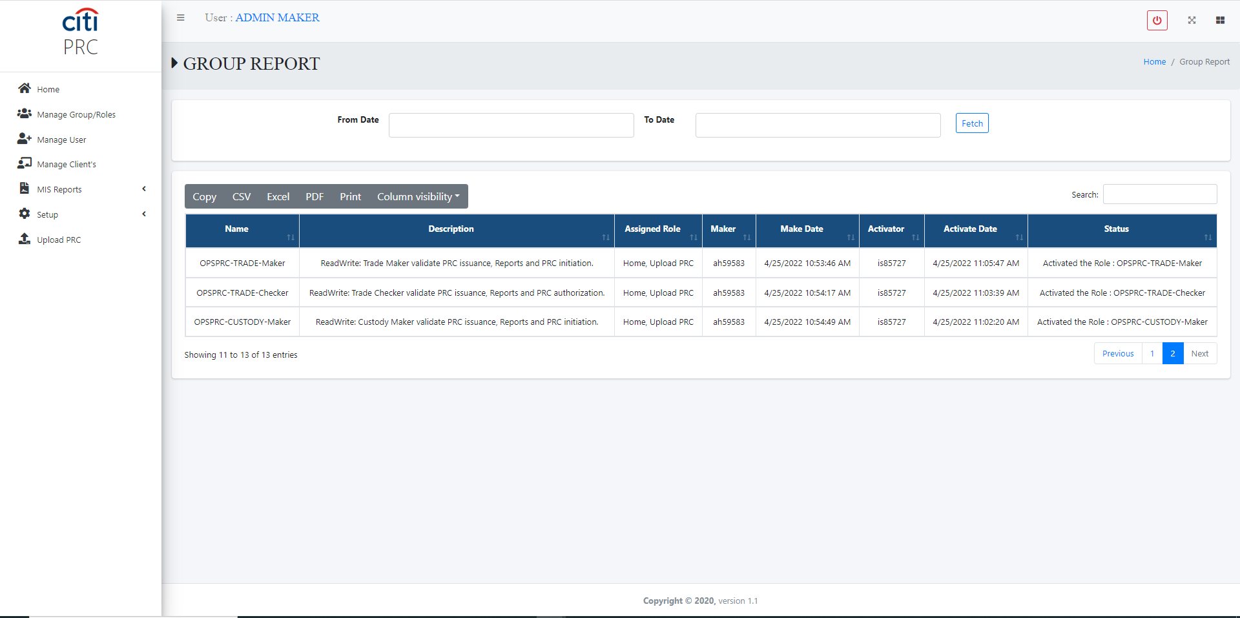
REPORTS
Group Activity Report
EPRC
30

Slide 31
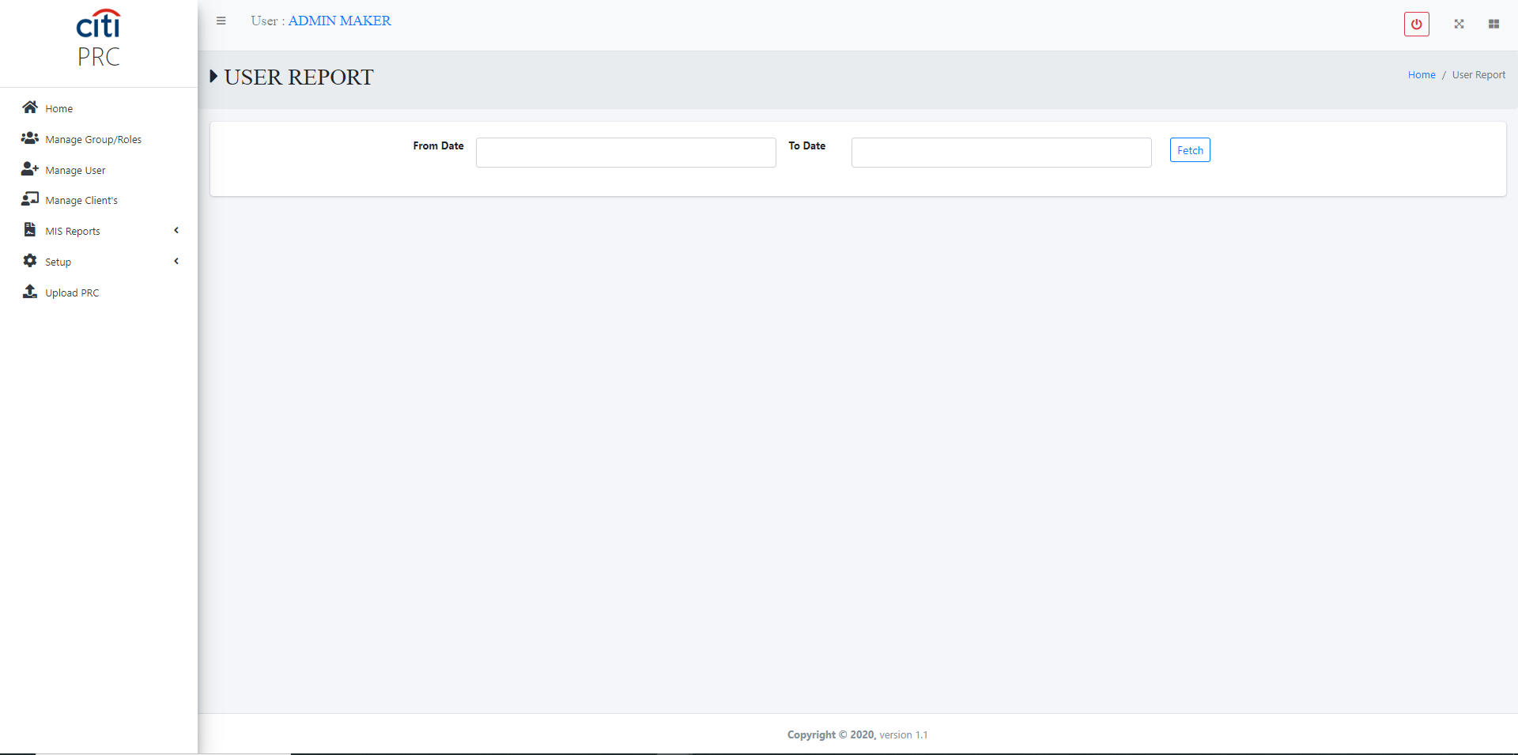
REPORTS
User Activity Report
EPRC
31

Slide 32
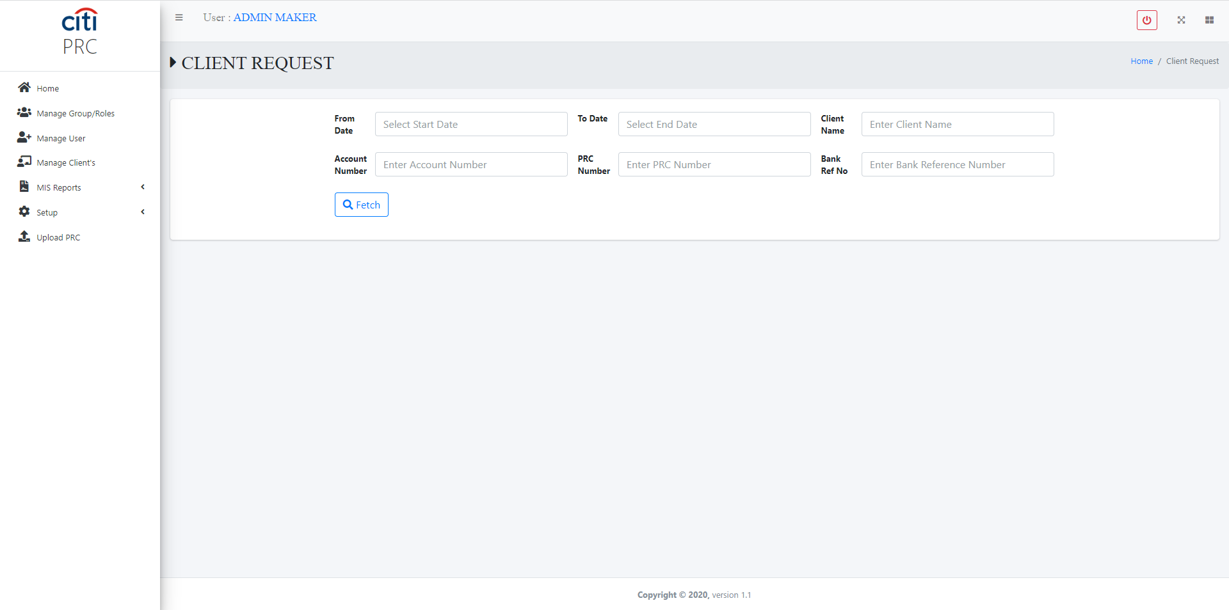
REPORTS
Client Request for PRC Report
EPRC
32

Slide 33
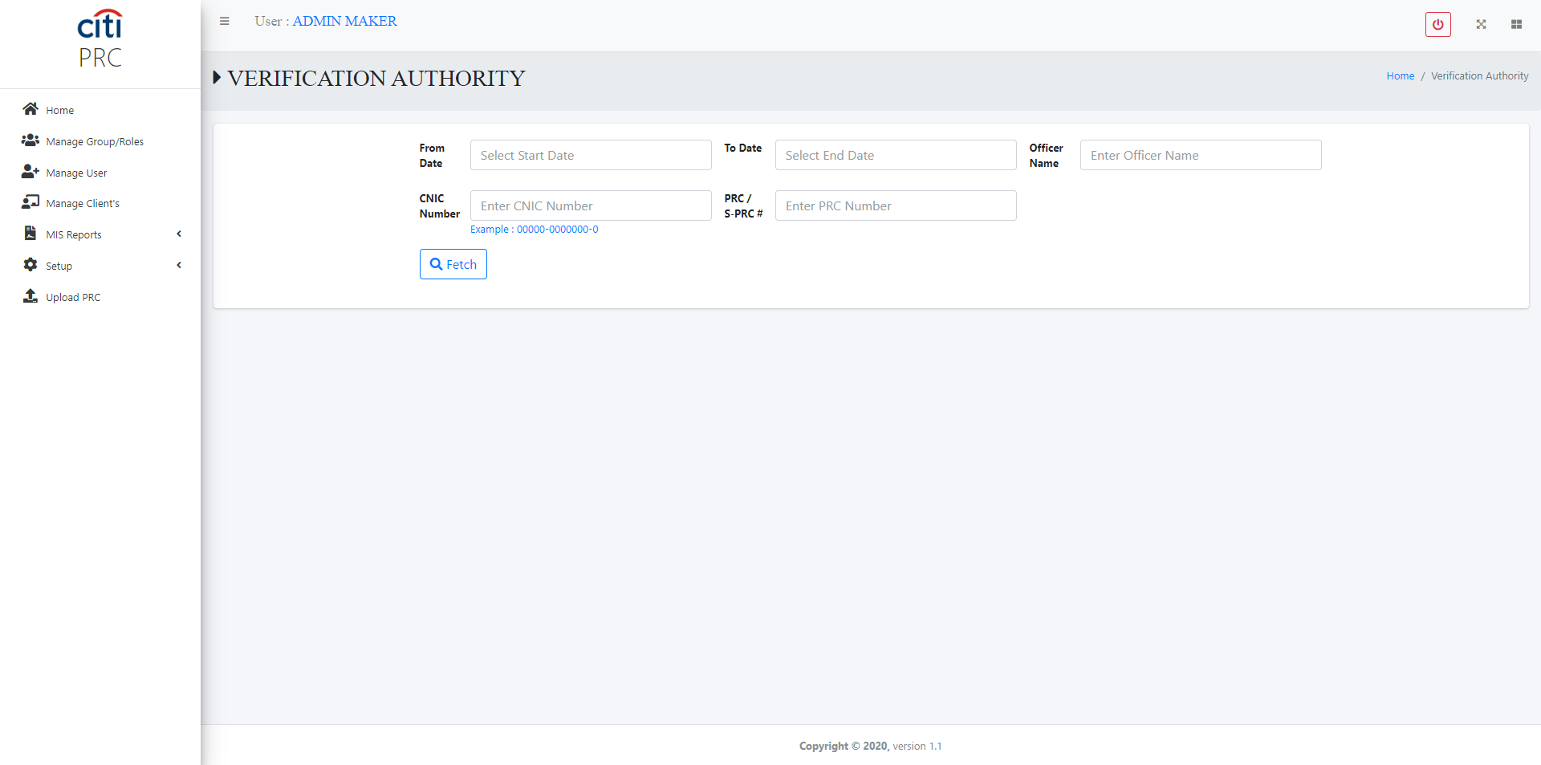
REPORTS
Verification Authority Report
EPRC
33

Slide 34

REPORTS
PRC Report
EPRC
34

Slide 35
03
Client Portal
PRC and e-PRC request forms for clients
EPRC
35

Slide 36
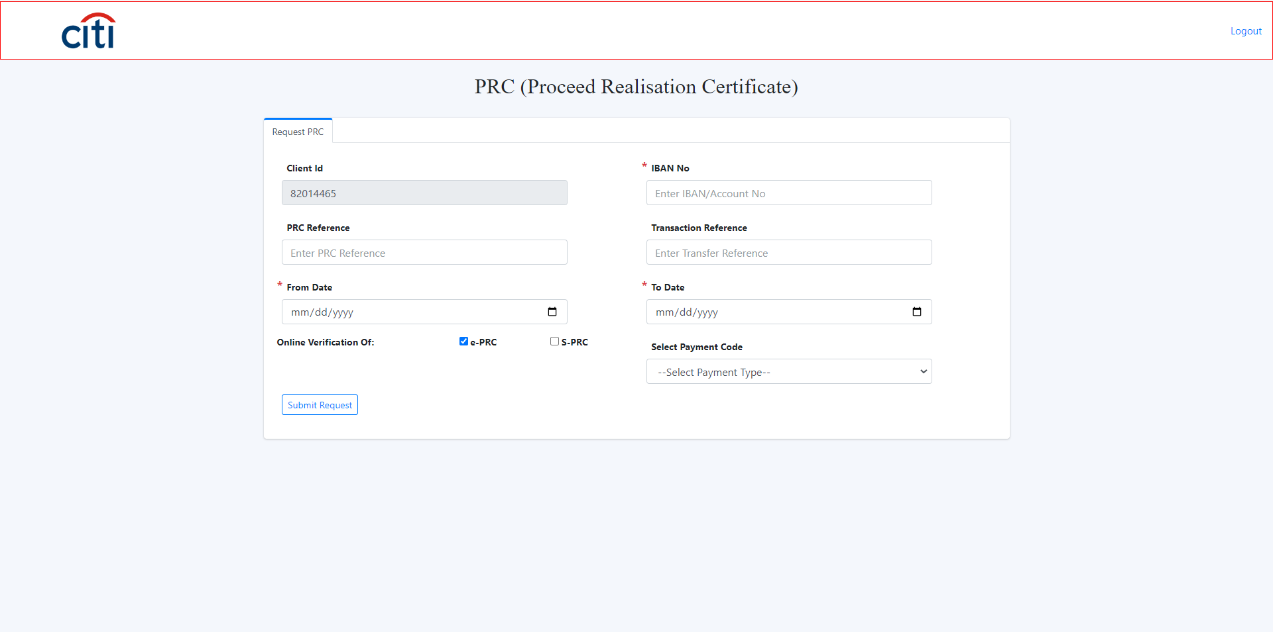
CLIENT PORTAL
Request Form — PRC
EPRC
36

Slide 37
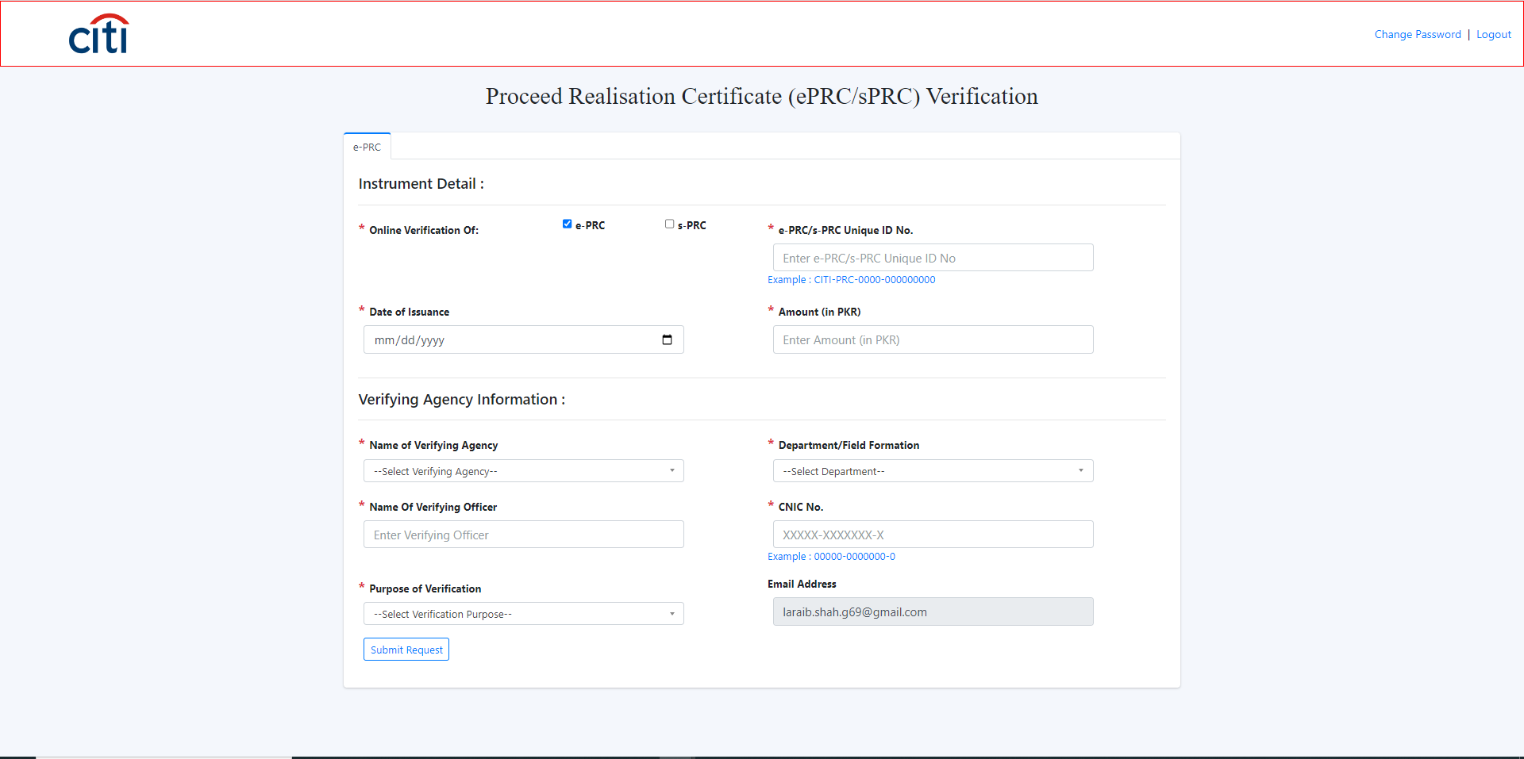
CLIENT PORTAL
Request Form — e-PRC
EPRC
37

Slide 38
REPORTING
Reports Section
IS REPORTS
OPERATIONS REPORTS
User Login report
Individual issuance of ePRC/sPRC
User Activity Logs report
Bulk issuance of ePRC/sPRC
User creation, modification, and deletion tracking report
Date range report of ePRC/sPRC issuance
Group creation, modification, and deletion tracking report
Pending for approval/authorization
User scrutiny report (maker-checker)
Rejected ePRC/sPRC issuance request
User rights and roles within the application
EPRC
38

Slide 39
Thank You
Questions & discussion welcome
Developed by Zealous Technologies
zealoustechnologies.com

