Slide 1
ZEALOUS TECHNOLOGIES • PRODUCT OVERVIEW
Viztech
Centralized Bio-Metrics Verification
Real-time CNIC and fingerprint verification integrated with NADRA
Developed by Zealous Technologies
zealoustechnologies.com

Slide 2



OVERVIEW
Project Summary
Secure Biometric Platform
NADRA Integration
Regulatory Compliance
An enterprise-grade platform built on C# and .NET Framework to digitize and automate client identity verification for Citibank.
Integrates directly with NADRA's API for real-time authentication of CNIC and fingerprints, replacing manual verification processes.
Meets strict regulatory compliance standards while streamlining the onboarding and verification of financial clients.
VIZTECH
2

Slide 3






OVERVIEW
Project Highlights & Impact
PROJECT HIGHLIGHTS
IMPACT
NADRA Verification
Reduced Fraud
Automates NIC and fingerprint verification via the NADRA API
Secure biometric authentication reduces fraud risk
Real-Time Authentication
Less Manual Work
Provides real-time identity authentication for financial institutions
Lowers manual workload by digitizing verification processes
Maker-Checker Approval
Faster Onboarding
A secure approval system for user management
Decreases turnaround time for client onboarding
Centralized Control
Data-Driven Decisions
Central management of accounts, roles, and permissions
Detailed audit reports support compliance and operational analysis
VIZTECH
3

Slide 4


PLATFORM
System Architecture
Built on ASP.NET MVC and C# .NET Framework, hosted on Windows Server with IIS, bridging Citibank's service points and NADRA.
Client & Hardware Layer
NADRA Integration
Backend & Compliance
Interfaces with biometric hardware via a REST API, capturing fingerprint data and converting it to a Base64 string.
Bundles the request into an XSD format with franchise credentials, transmitted securely for a 1:1 match against NADRA's database.
A SQL-backed system manages maker-checker logic, role-based access, and comprehensive audit logging.
VIZTECH
4

Slide 5
CAPABILITIES
Key Functionality
Secure, scalable, and reliable platform with full regulatory compliance
Account & Role Management
NADRA Verification
Audit & Activity Reports
Manage accounts with roles and maker-checker approvals
Automate NIC and fingerprint verification via the NADRA API
Generate detailed audit and activity reports
Permission Management
Real-Time Compliance
Reliable Platform
Centralized user and permission management
Real-time verification with full regulatory compliance
Secure, scalable, and reliable enterprise platform
VIZTECH
5

Slide 6


PLATFORM ENHANCEMENT
New User Creation Module
STEP 1
STEP 2
Dynamic User Creation
Portal Integration
Users can be created and managed through the new proposed dynamic module.
This dynamic user-creation module will be incorporated directly into the Viztech Portal.
VIZTECH
6

Slide 7
PLATFORM OVERVIEW
System Modules
Four core procedures power the complete verification workflow
User Creation Module
Role Creation Module
Biometric Verification
Generate Report
VIZTECH
7

Slide 8
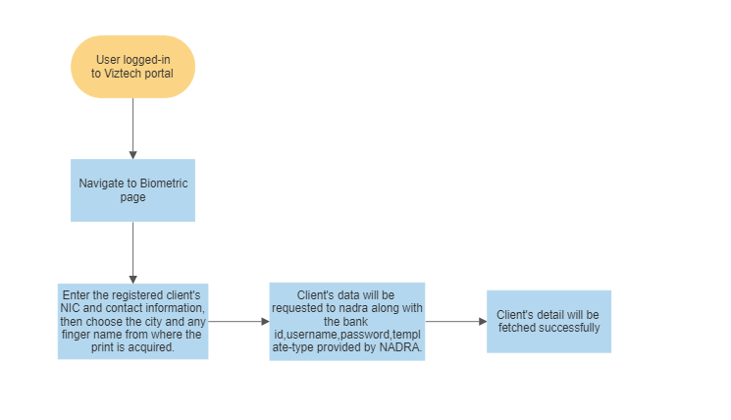
WORKFLOW
How It Works
1
The application reads the fingerprint through a REST API service provided by the hardware vendor.
2
Once the fingerprint is scanned successfully, the application sends a request to the NADRA API and displays the response.
VIZTECH
8

Slide 9
DEPLOYMENT
Hardware & Software Requirements
Preferable development environment: ASP.NET MVC.
A Windows Server with IIS Manager installed is required to deploy the ASP.NET MVC application.
Application | Specs | OS
Minimum | RAM: 8 GB • Cores: 4 • Storage (SSD): 50 GB | Any
Recommended | RAM: 16 GB • Cores: 8 • Storage (SSD): 50–100 GB | Any
VIZTECH
9

Slide 10
01
Developed System Modules
Login, biometric verification, configuration, and reporting screens
VIZTECH
10

Slide 11
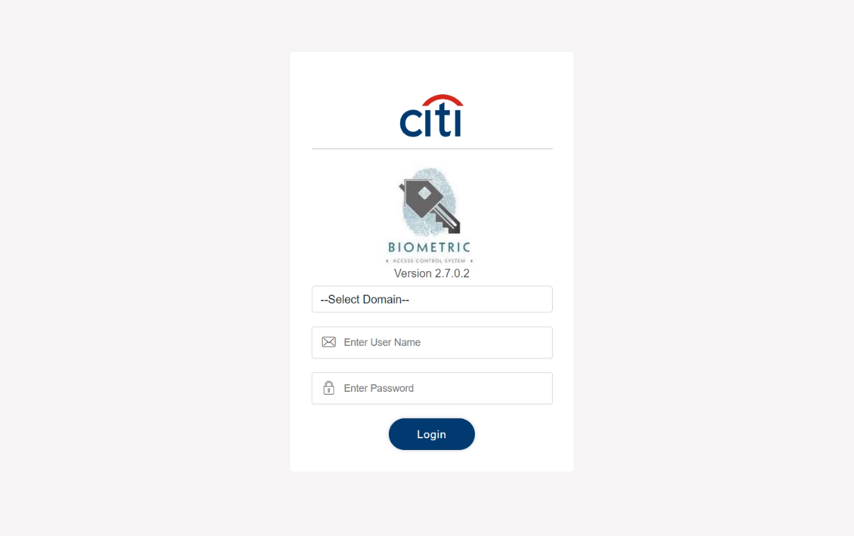
DEVELOPED SYSTEM MODULES
Login
VIZTECH
11

Slide 12
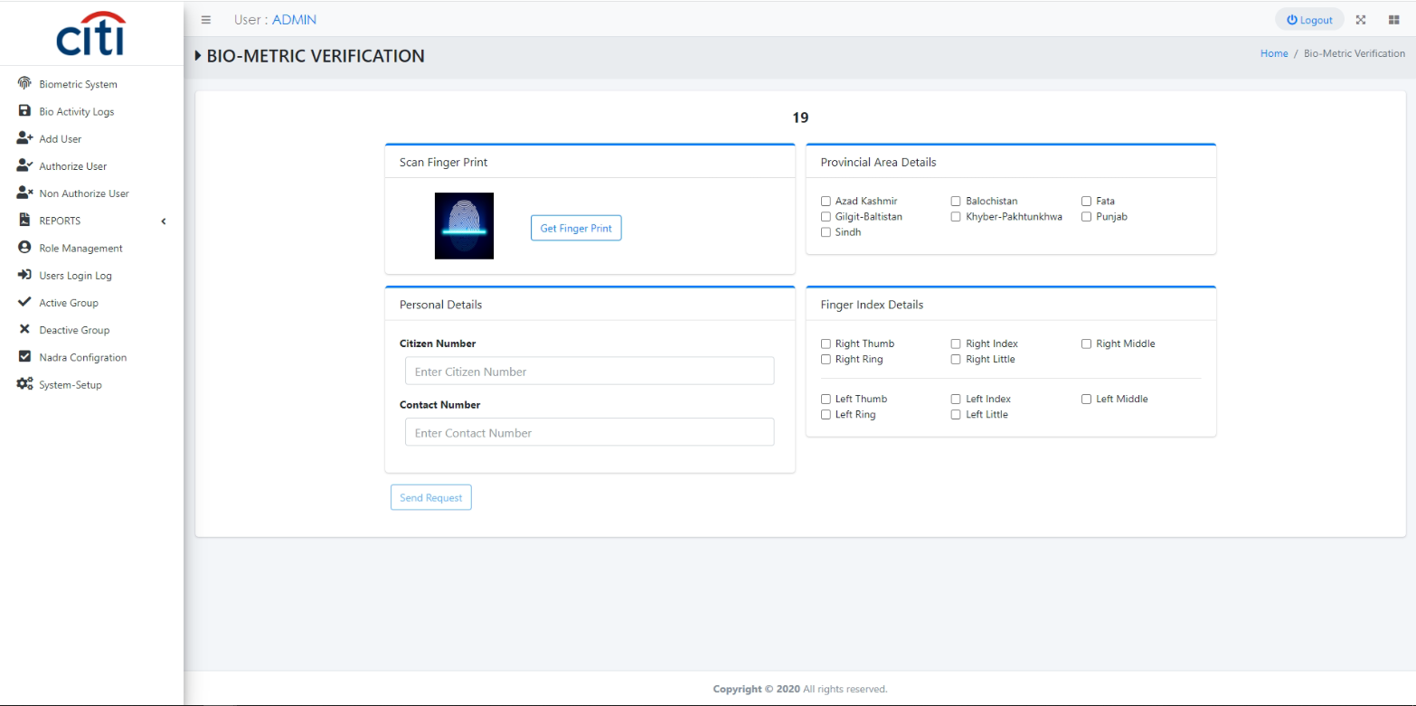
DEVELOPED SYSTEM MODULES
Biometric Verification Request Form
VIZTECH
12

Slide 13
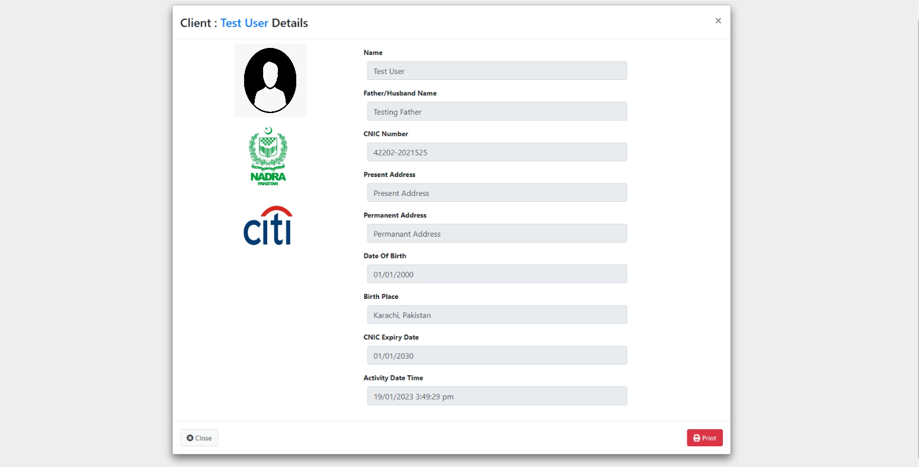
DEVELOPED SYSTEM MODULES
Response from NADRA
VIZTECH
13

Slide 14
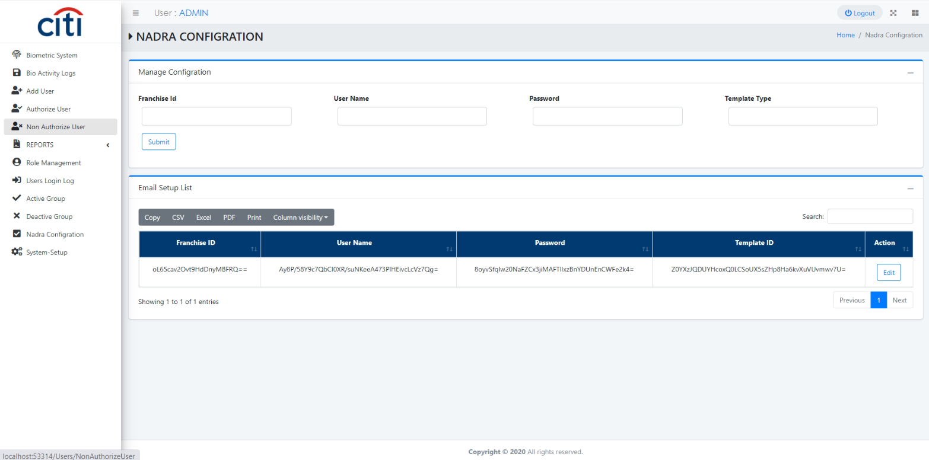
DEVELOPED SYSTEM MODULES
Configuration Setup
VIZTECH
14

Slide 15
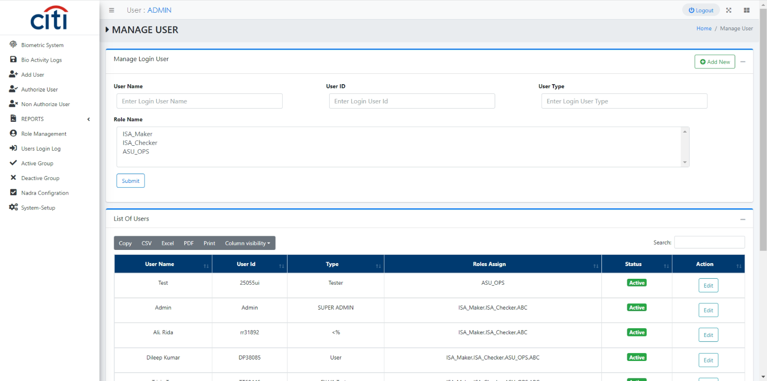
DEVELOPED SYSTEM MODULES
User Setup
VIZTECH
15

Slide 16
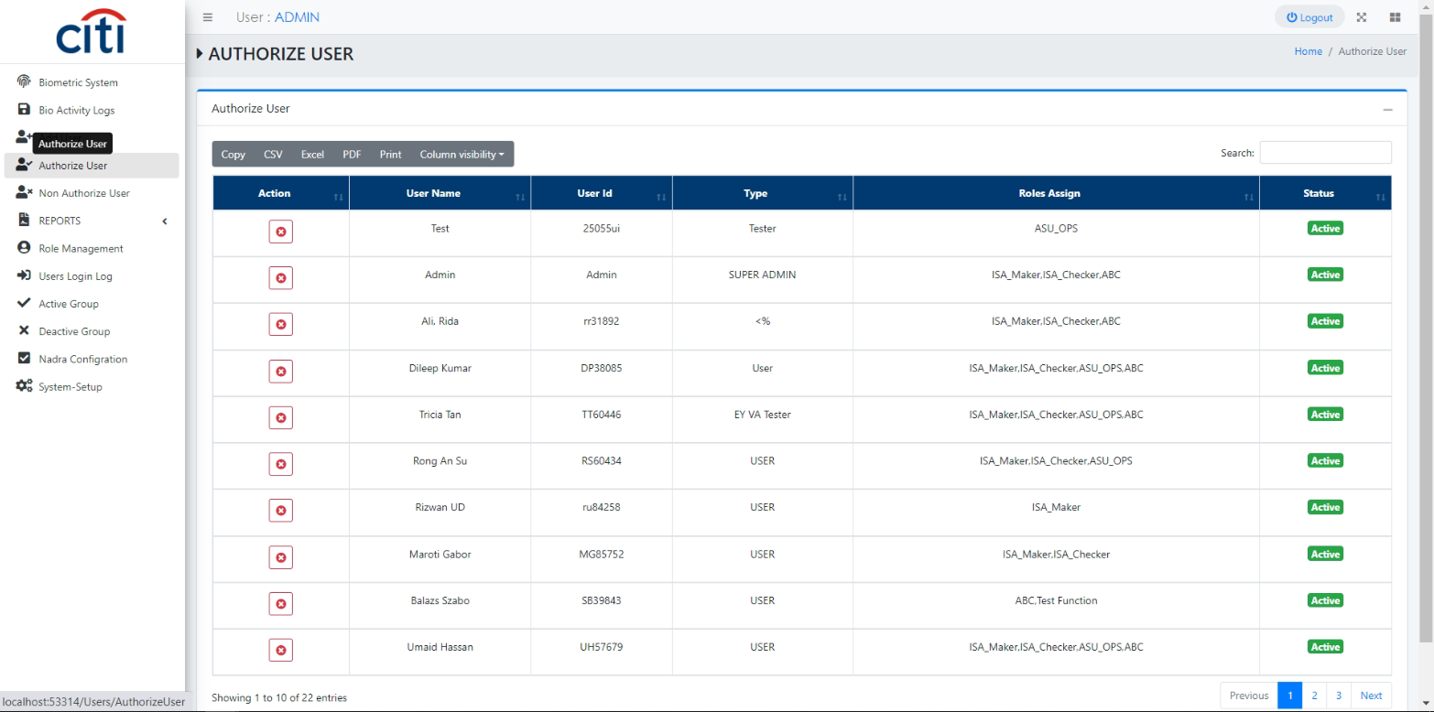
DEVELOPED SYSTEM MODULES
User Authorization
VIZTECH
16

Slide 17
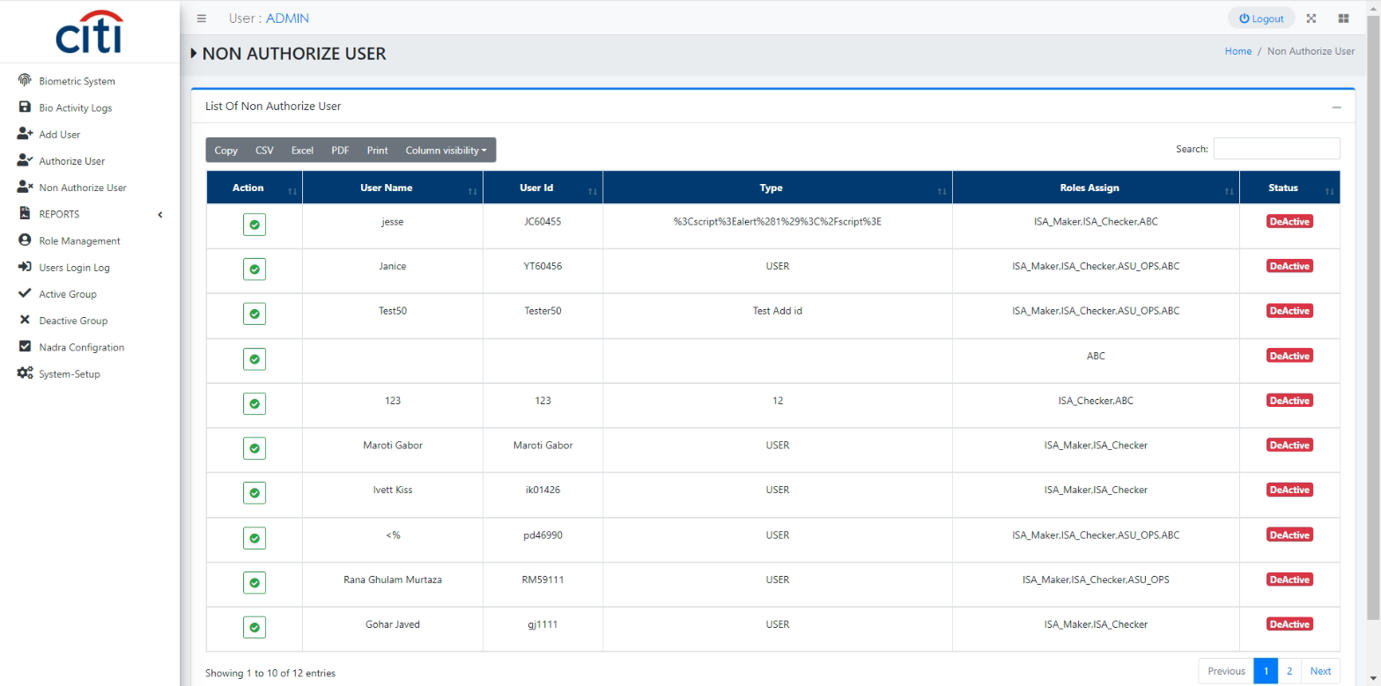
DEVELOPED SYSTEM MODULES
Unauthorized User
VIZTECH
17

Slide 18
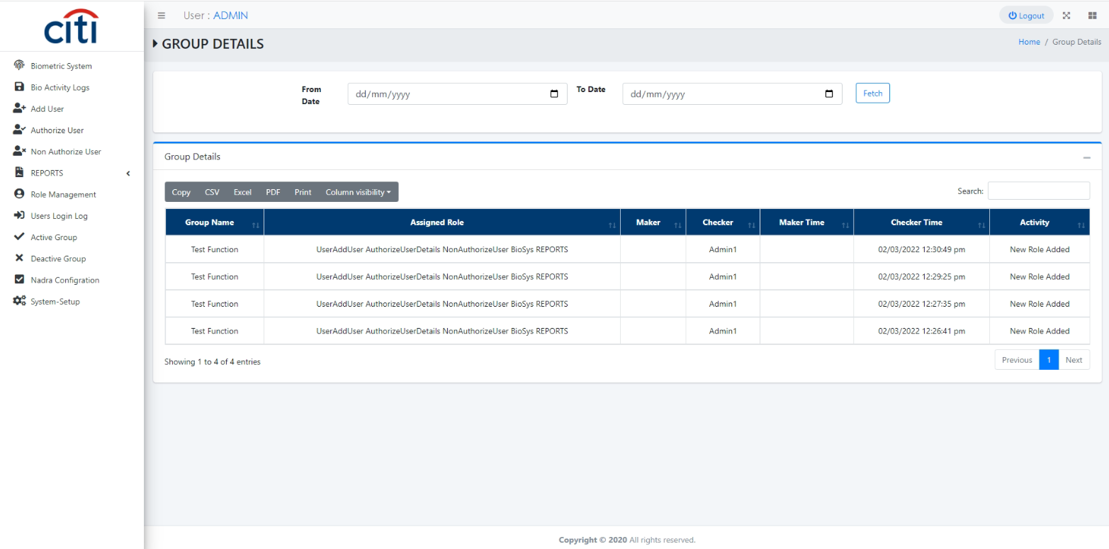
DEVELOPED SYSTEM MODULES
Group Management
VIZTECH
18

Slide 19
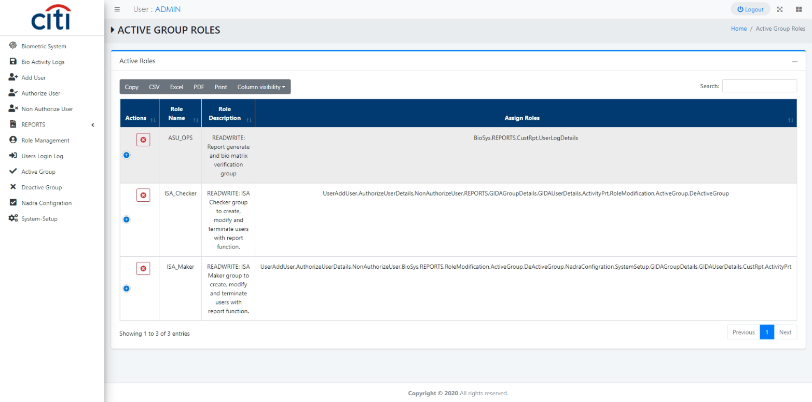
DEVELOPED SYSTEM MODULES
Group Authorization
VIZTECH
19

Slide 20
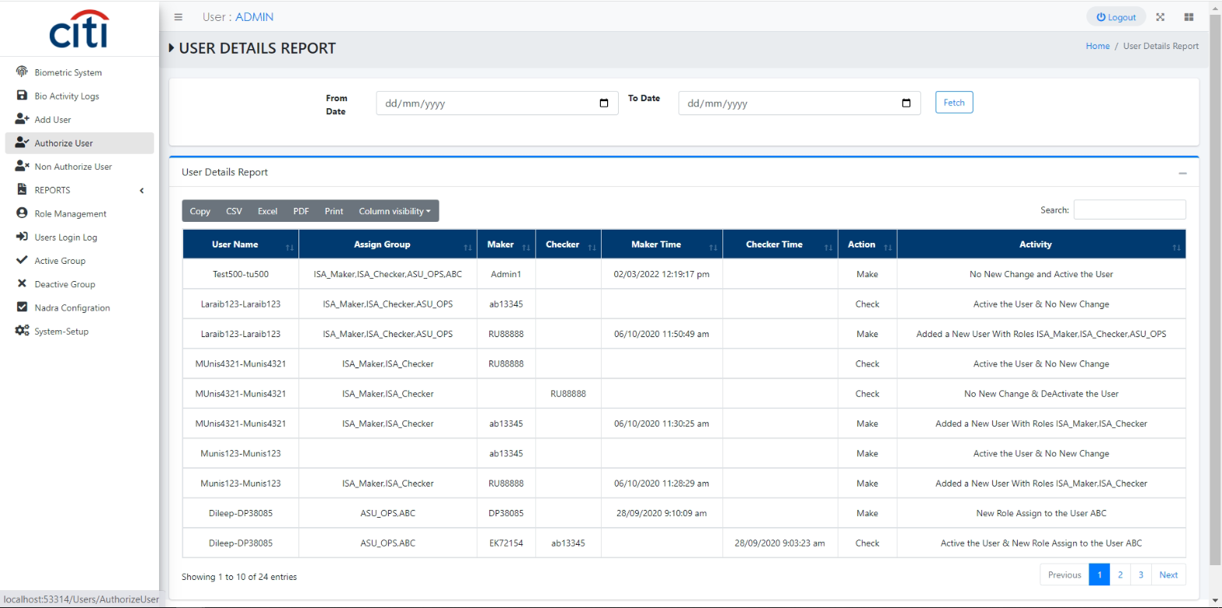
DEVELOPED SYSTEM MODULES
User Activity Report
VIZTECH
20

Slide 21
DEVELOPED SYSTEM MODULES
Group Activity Report
VIZTECH
21

Slide 22
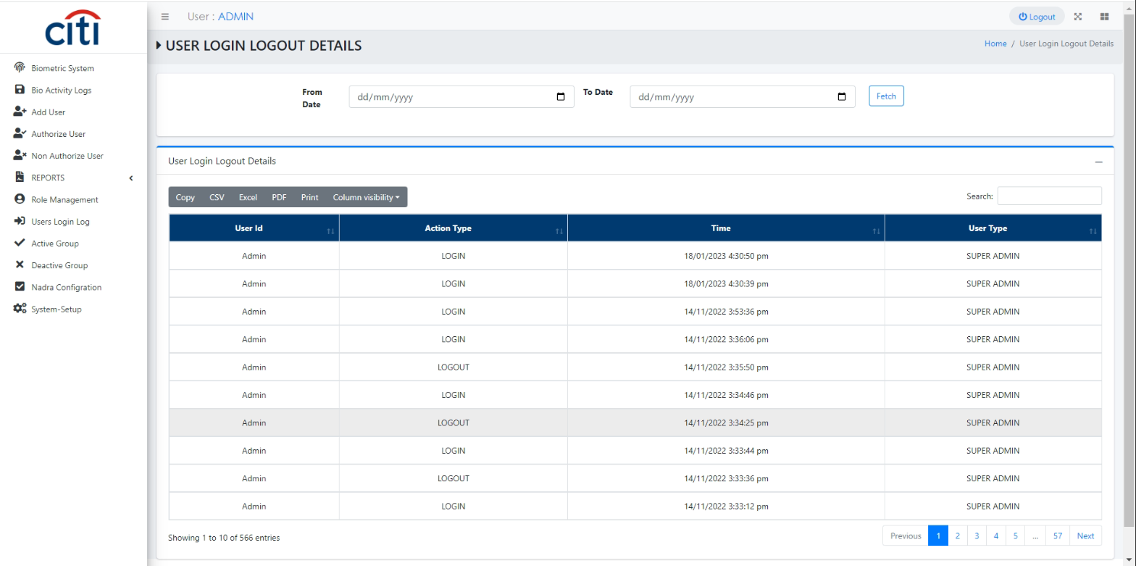
DEVELOPED SYSTEM MODULES
User Last Login Report
VIZTECH
22

Slide 23
Thank You
Questions & discussion welcome
Developed by Zealous Technologies
zealoustechnologies.com

