Slide 1

Viztech
(Centralized Bio-Metrics Verification)
Developed By
https://zealoustechnologies.com/

Slide 2
Project Summary
VIZTECH is a secure, enterprise-grade biometric verification platform developed using C# and the .NET Framework. Its primary purpose is to digitize and automate client identity verification for Citibank by integrating directly with the National Database & Registration Authority (NADRA) API.
The system provides a web-based interface for real-time authentication of CNIC (Computerized National Identity Card) and fingerprints, replacing manual processes with a secure, instant digital workflow. It is designed to meet strict regulatory compliance standards while streamlining the onboarding and verification of financial clients.

Slide 3
Project Summary
Project Highlights
Automates NIC and fingerprint verification via the NADRA API.
Provides real-time identity authentication for financial institutions.
Features a maker-checker approval system for secure user management.
Includes centralized control for accounts, roles, and permissions.
Built as a secure, scalable, and reliable enterprise platform.
Impact
Reduces fraud through secure biometric authentication.
Lowers manual workload by digitizing verification processes.
Decreases turnaround time for client onboarding.
Ensures operational accuracy and regulatory compliance.
Supports data-driven decisions with detailed audit reports.nt to analyze verification trends and operational bottlenecks through automated reports.

Slide 4
System Architecture
VIZTECH is built on a robust, enterprise-grade framework designed to bridge the gap between Citibank’s service points and the National Database & Registration Authority (NADRA). Developed using ASP.NET MVC and the C# .NET Framework, the application is hosted on a Windows Server utilizing Internet Information Services (IIS) for high availability and secure request handling.
The workflow begins at the client level, where the application interfaces with biometric hardware through a specialized REST API service provided by the hardware vendor. This service captures fingerprint data and converts it into a Base64 string, which is then bundled into an XSD-formatted request containing the organization's franchise credentials. This request is securely transmitted to the NADRA API, which performs a 1:1 match against the central national database.
The backend infrastructure, supported by a SQL database, manages the system's "maker-checker" logic, role-based access controls, and comprehensive audit logging, ensuring that every verification attempt is authenticated, authorized, and recorded for regulatory compliance.

Slide 5
Key Functionality
Manage accounts with roles and maker-checker approvals Slide 10
Automate NIC and fingerprint verification via NADRA API Slide 11
Generate detailed audit and activity reports
Centralized user and permission management Slide 14
Real-time verification with full compliance
Secure, scalable, and reliable platform

Slide 6
New User creation Module
User can be created and managed using the new proposed dynamic module.
This new dynamic user creation module will be incorporated in the Viztech Portal.

Slide 7
System Modules:
Following are the procedures,
User creation module
Role creation module.
Biometric Verification
Generate report

Slide 8
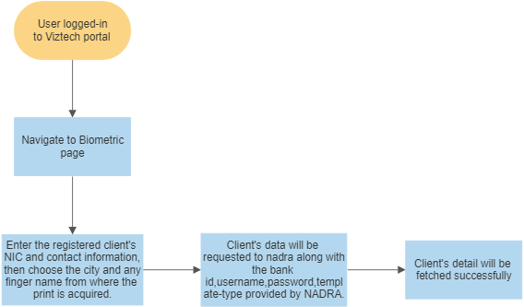
System Architecture

Slide 9
How it works
Applications reads fingerprint through rest Api service provided by the hardware vendor,
Once fingerprint is scanned successfully application sends request to the NADRA Api and in result it show response respectively.

Slide 10
Hardware & Software Requirements
Preferable development environment of the application would be ASP.NET MVC.
For ASP.NET MVC application, a windows server with IIS manager installed is required in order to deploy the application.
Application | Specs | OS
Minimum | RAM: 8GB core: 4 : HDD (SSD) : 50GB | Any
Recommended | Ram : 16GB core : 8 : HDD( SSD) : 50/100GB | Any

Slide 11
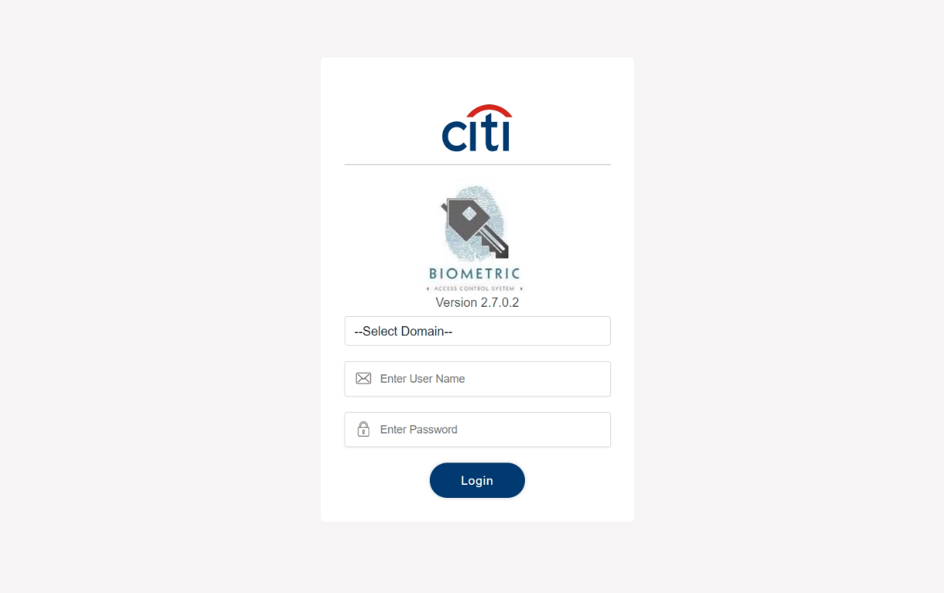
Developed System Modules:
Login

Slide 12
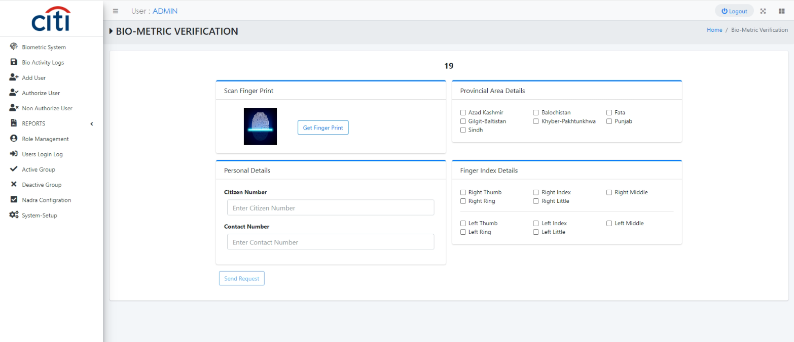
Developed System Modules:
Biometric Verification Request Form

Slide 13
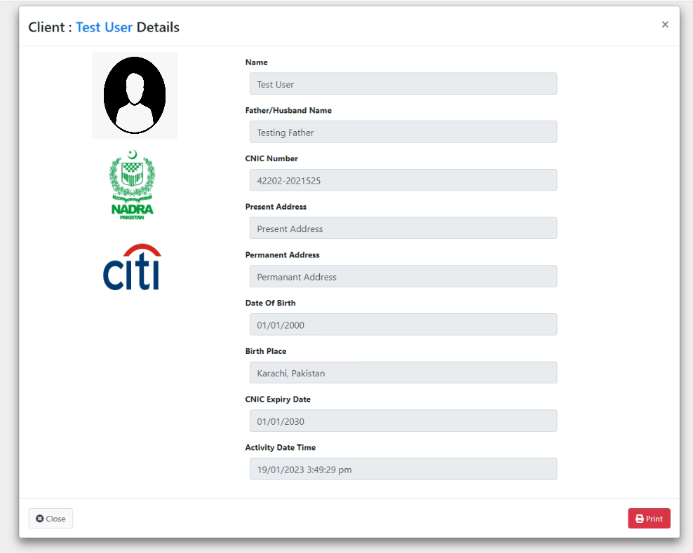
Developed System Modules:
Response from Nadra

Slide 14
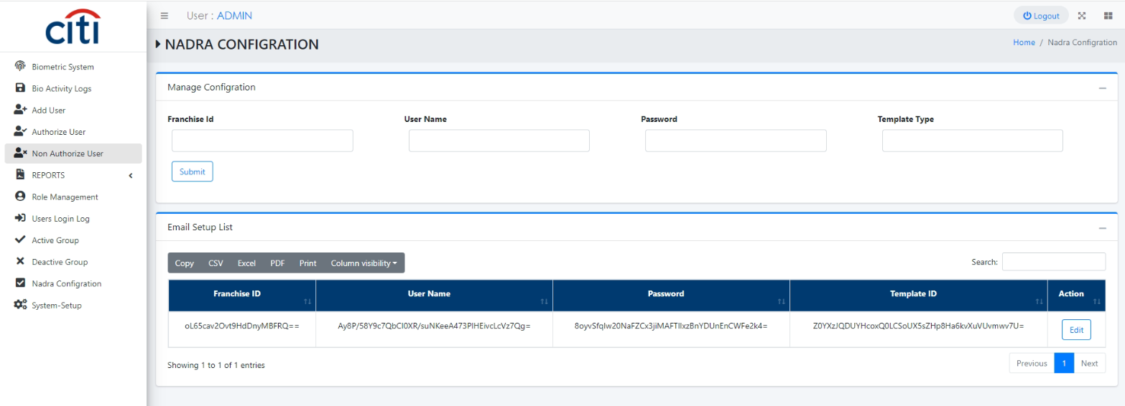
Developed System Modules:
Configration Setup

Slide 15
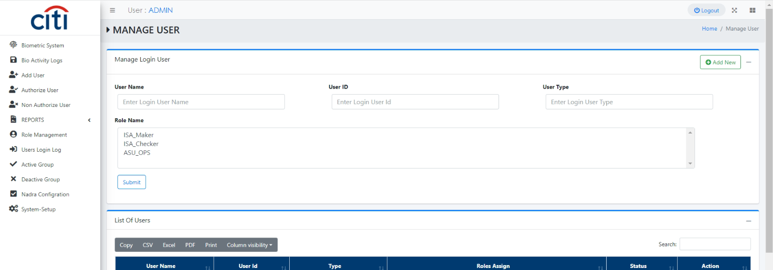
Developed System Modules:
User Setup

Slide 16
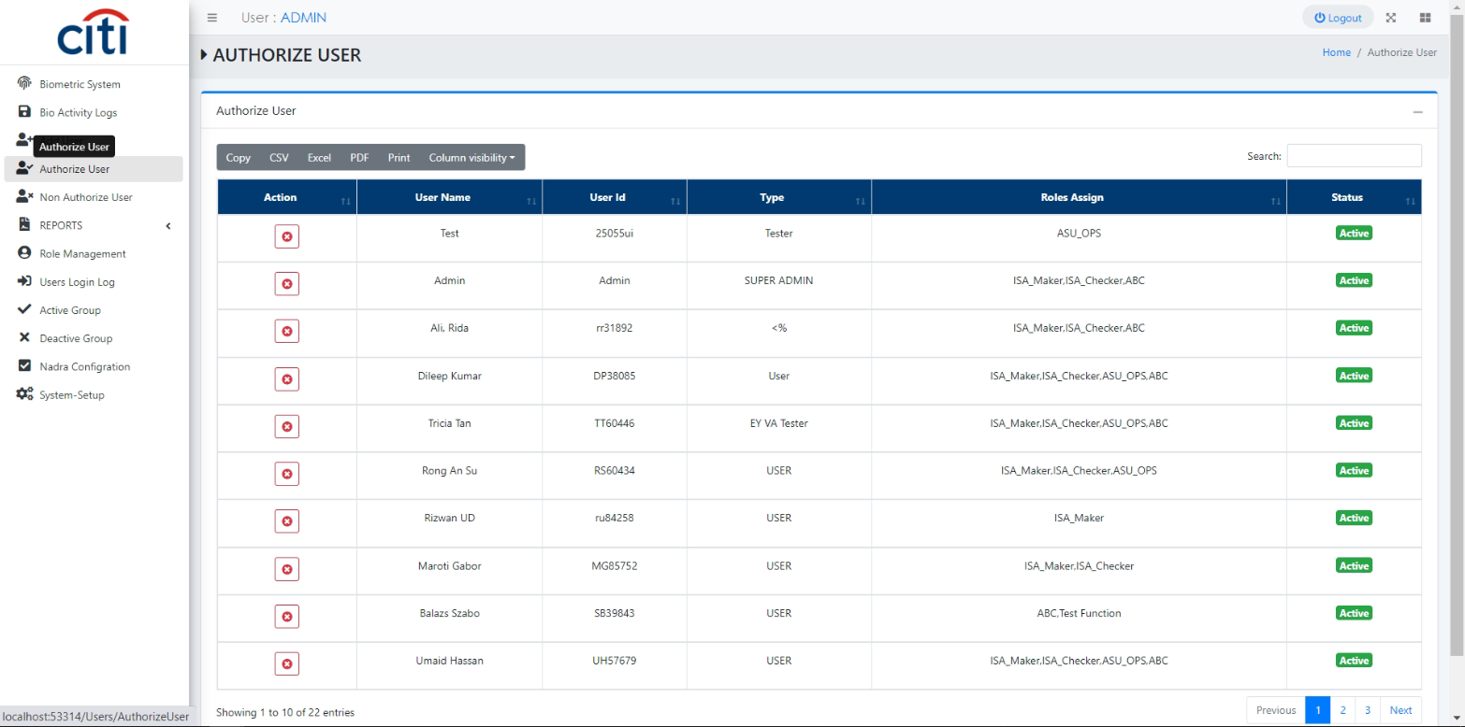
Developed System Modules:
User Authorization

Slide 17
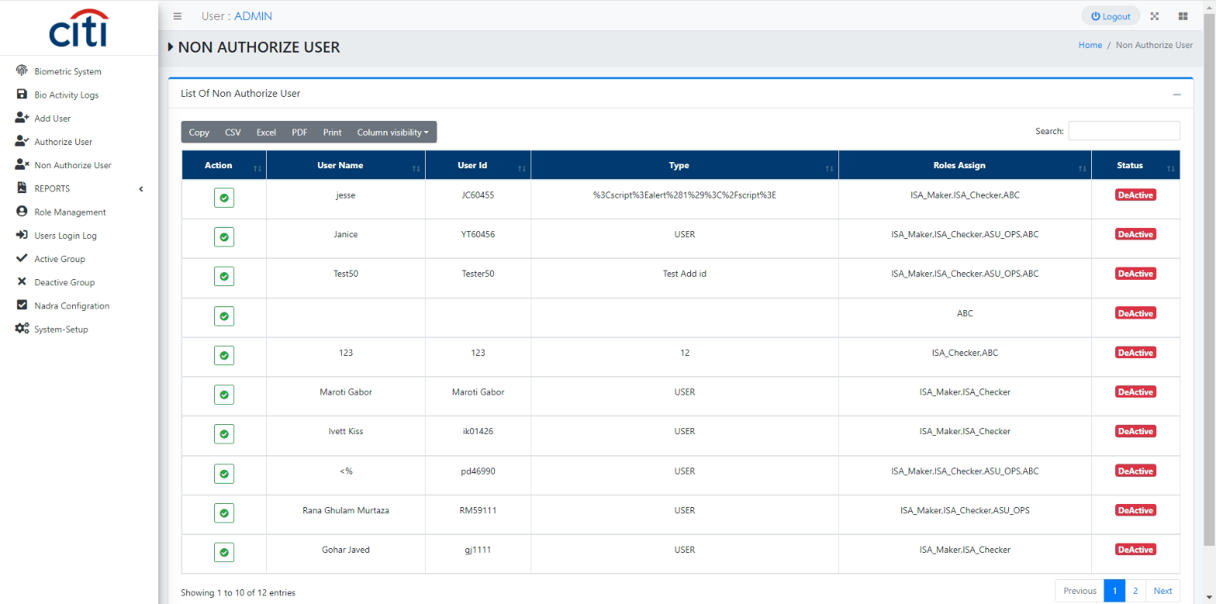
Developed System Modules:
Unauthorize User

Slide 18
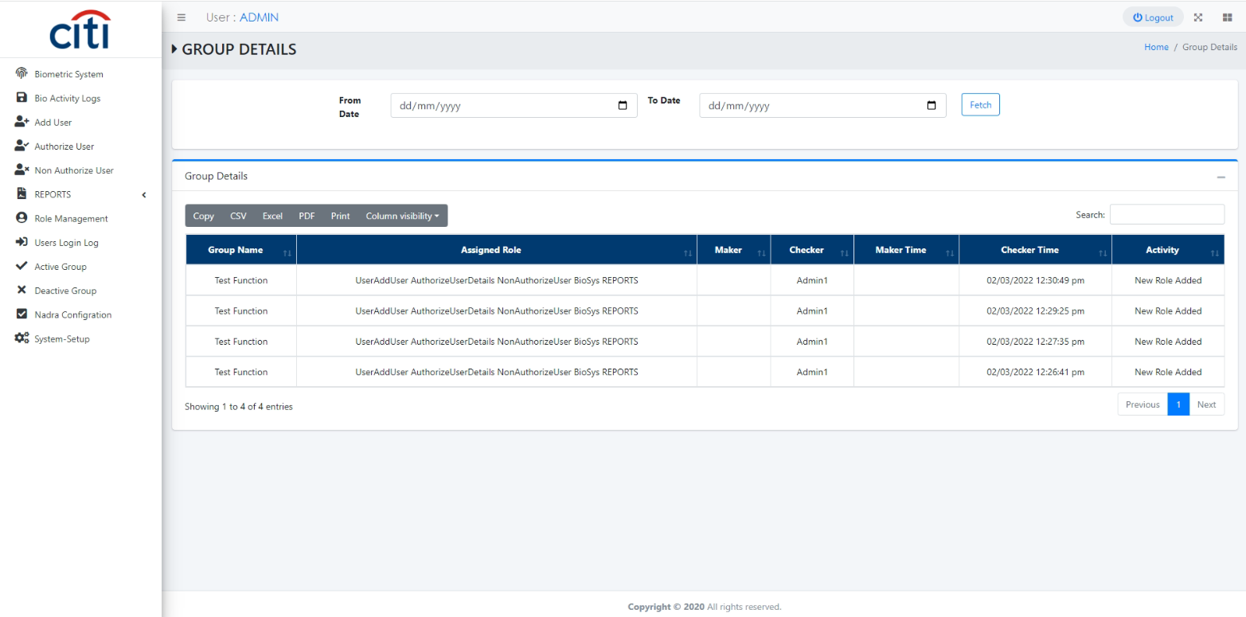
Developed System Modules:
Group Managment

Slide 19
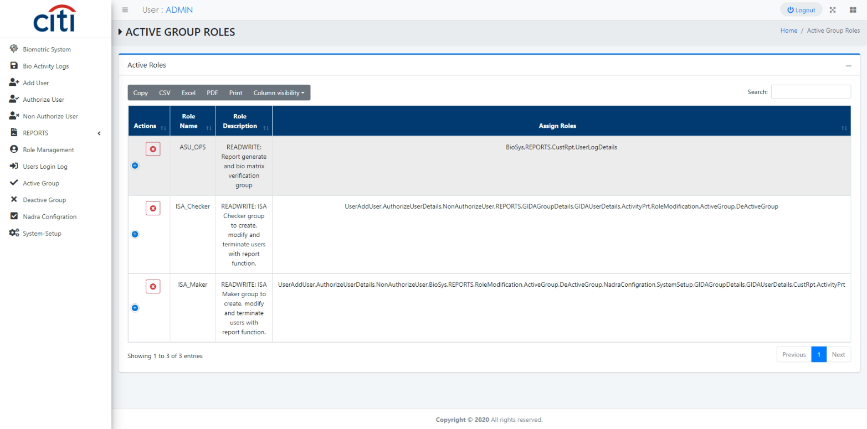
Developed System Modules:
Group Authorization

Slide 20
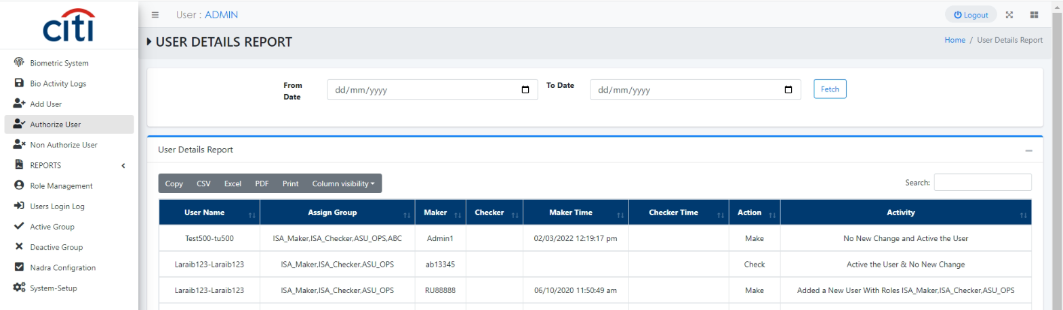
Developed System Modules:
User Activity Report

Slide 21
Developed System Modules:
Group Activity Report

Slide 22
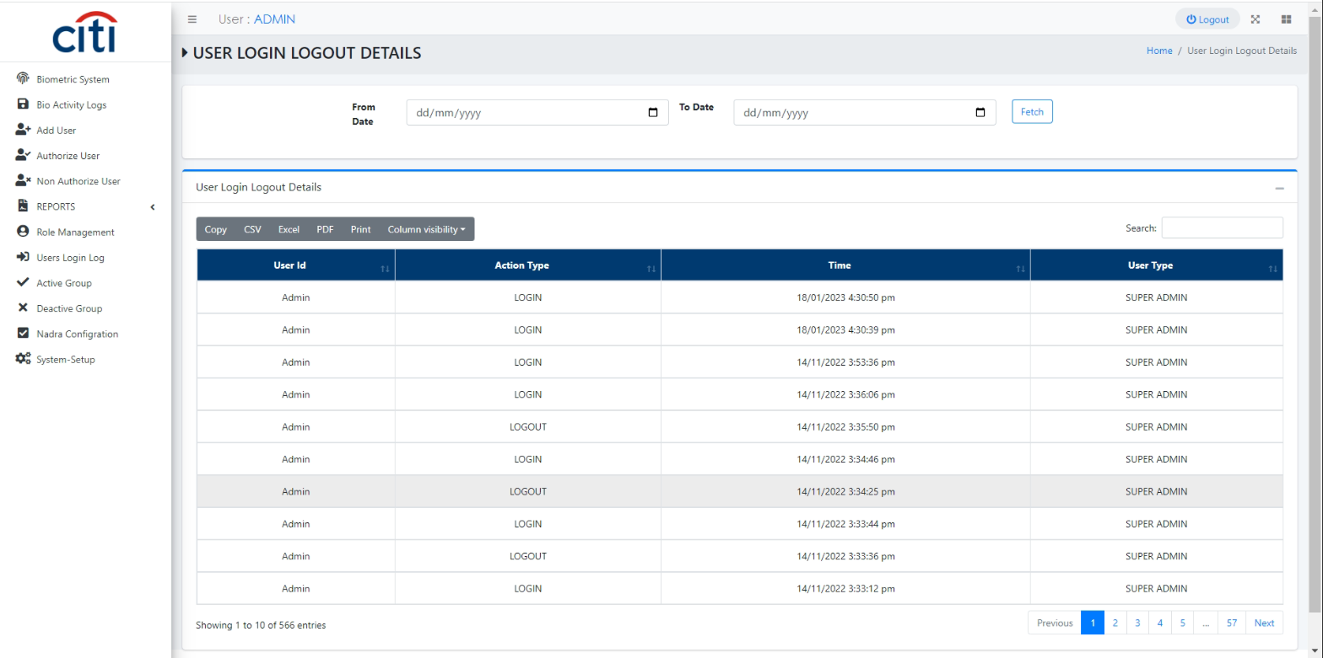
Developed System Modules:
User Last Login Report

Slide 23
THE END

