Slide 1
ZEALOUS TECHNOLOGIES • PRODUCT OVERVIEW
Pakistan Single Window
Bank integration with the national trade facilitation platform
Developed by Zealous Technologies
zealoustechnologies.com

Slide 2



OVERVIEW
Project Summary
Cross-Border Trade Platform
Bank Operational Workflow
Global Value Chain
A transformative facilitation initiative by the Government of Pakistan — a secure enterprise platform allowing trade and transport parties to lodge standardized information at a single entry point.
Our integration solution optimizes a bank's operational workflow by connecting the Banking Operations Department directly with the PSW hub, automating exchange of EIF and EEF documents.
Integrates Pakistan into the global value chain through transparent, efficient, and digitized trade processes — implemented in Citibank and Deutsche Bank.
PAKISTAN SINGLE WINDOW
2

Slide 3






OVERVIEW
Project Highlights & Impact
PROJECT HIGHLIGHTS
IMPACT
Single-Entry Point
Faster Turnaround
For EIF, EEF, BDA, and BCA processing to minimize business costs
Eliminates manual data entry and paperwork, accelerating trade turnaround times
Real-Time Sync
Token-based, real-time data synchronization with Pakistan Customs and PSW
Fewer Errors
Standardizes documentation to remove human error and discretionary delays
Maker-Checker
Full compliance verification in trade finance
Global Alignment
Aligns Pakistan with international standards for better global value chain integration
SBP Reporting
Instant generation of SBP-mandated reports, including ITRS
Stronger FX Tracking
Unified Dashboards
Strengthens FX tracking by ensuring all payments are backed by verified digital records
Track Goods Declarations and endorsed documents
PAKISTAN SINGLE WINDOW
3

Slide 4

PLATFORM
System Architecture
A multi-tier, secure enterprise application designed to streamline trade operations between banks and regulatory bodies
Core Logic Layer
Integration Layer
Regulatory Reporting Node
A mandatory maker-checker mechanism for all critical actions, plus client profiles and operational parameters like currencies and delivery terms.
REST APIs over HTTPS for real-time data exchange with PSW and Customs, secured by JWT-based token authentication.
Automated synchronization of EIF/EEF and Goods Declarations, with regulatory submissions to the State Bank of Pakistan.
PAKISTAN SINGLE WINDOW
4

Slide 5




CAPABILITIES
Key Functionality
User Management
Maker-Checker Approval
Client Profile Management
Create, modify, and control user access
Governs all critical actions across the platform
Trade type, payment modes, and other configuration
Operational Configuration
EIF & EEF Processing
ITRS Regulatory Reporting
Currency, delivery terms, suppliers, ports, and more
Real-time synchronization with PSW through token-based APIs
Monthly SBP-compliant data submission, plus detailed audit reports
PAKISTAN SINGLE WINDOW
5

Slide 6
OVERVIEW
Goals & Objectives
1
Purpose of integration currently: prior issuance of an EIF/EEF by Authorized Dealers is required for the Trader to order to file the Goods Declaration with Customs for clearance of each import and export consignment.
2
The Trader applies for EIF/EFE, which is either approved or rejected by the concerned authorized dealer.
3
Issuance of EIF/EFE is a time-consuming process and being a pre-requisite for filing of any import/export transaction increases time, cost, and complication in cross-border trade.
4
PSW system will real-time data exchange amongst the PSW and authorized dealers have been identified as a 'priority' return to be included in PSW.
5
The proposed system is predicated on pre-approved banking profiles of the traders developed after due diligence utilizing KYC principles by the Authorized dealers.
6
The authorized dealers will share the trader profile, import/export financial transaction information, and BCA/BDA information with the PSW.
PAKISTAN SINGLE WINDOW
6

Slide 7
DEPLOYMENT
Hardware & Software Requirements
OPERATING SYSTEMS
HARDWARE ENVIRONMENT
Windows Server 2012 SP1 (Full Server or Server Core)
Processor: x86 or x64
Windows Server 2012 R2 (Full Server or Server Core)
RAM: 8 GB (minimum), 16 GB (recommended)
Windows Server 2016 (Full Server, Server Core, or Nano)
Hard disk: up to 300 GB of available space may be required
Mac OS X 10.11, 10.12
Red Hat Enterprise Linux 7
Ubuntu 14.04, 16.04, 17
Application | Specs | OS
Minimum | RAM: 8 GB • Cores: 4 • Storage (SSD): 50 GB | Any
Recommended | RAM: 16 GB • Cores: 8 • Storage (SSD): 50–100 GB | Any
PAKISTAN SINGLE WINDOW
7

Slide 8
PLANNING
Specials & Assumptions
SPECIALS
ASSUMPTIONS
Secure IIS Module
Automated handoff of HS Code is not clear, has to clear in one or two months
Communication through Active Directory
Assuming total 10 reports; in case of more reports, need clarification
Maker Checker at every level
Email mechanism
Account opening information is not clear
HS Code manual upload
Customer library for email automation is also not clear
HS Code automated upload option for future transactions
PAKISTAN SINGLE WINDOW
8

Slide 9
01
Technical Integration
EDI concept, procedures, and secure token-based authentication
PAKISTAN SINGLE WINDOW
9

Slide 10
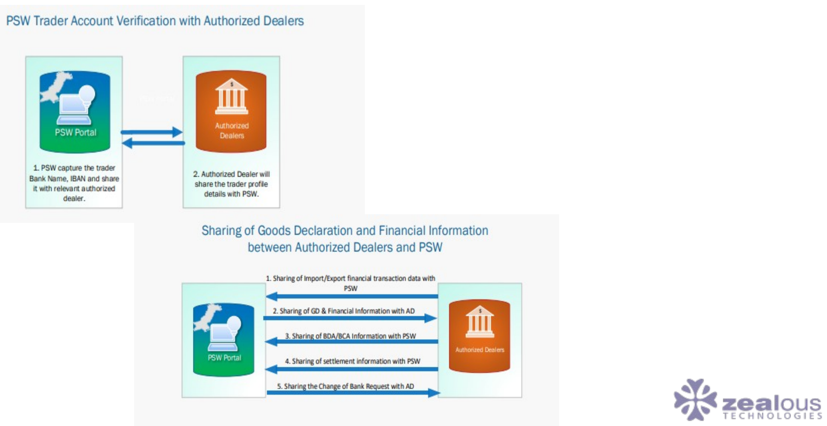
TECHNICAL INTEGRATION
EDI (Electronic Data Integration) Concept Model
PAKISTAN SINGLE WINDOW
10

Slide 11
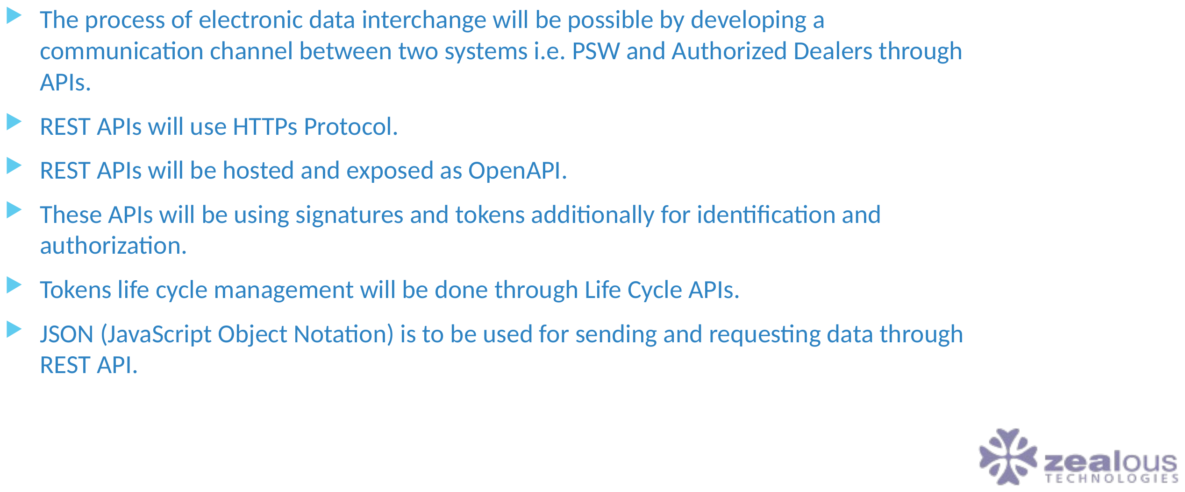
TECHNICAL INTEGRATION
EDI Procedure Involved between Pakistan Single Window & Authorized Dealers
PAKISTAN SINGLE WINDOW
11

Slide 12
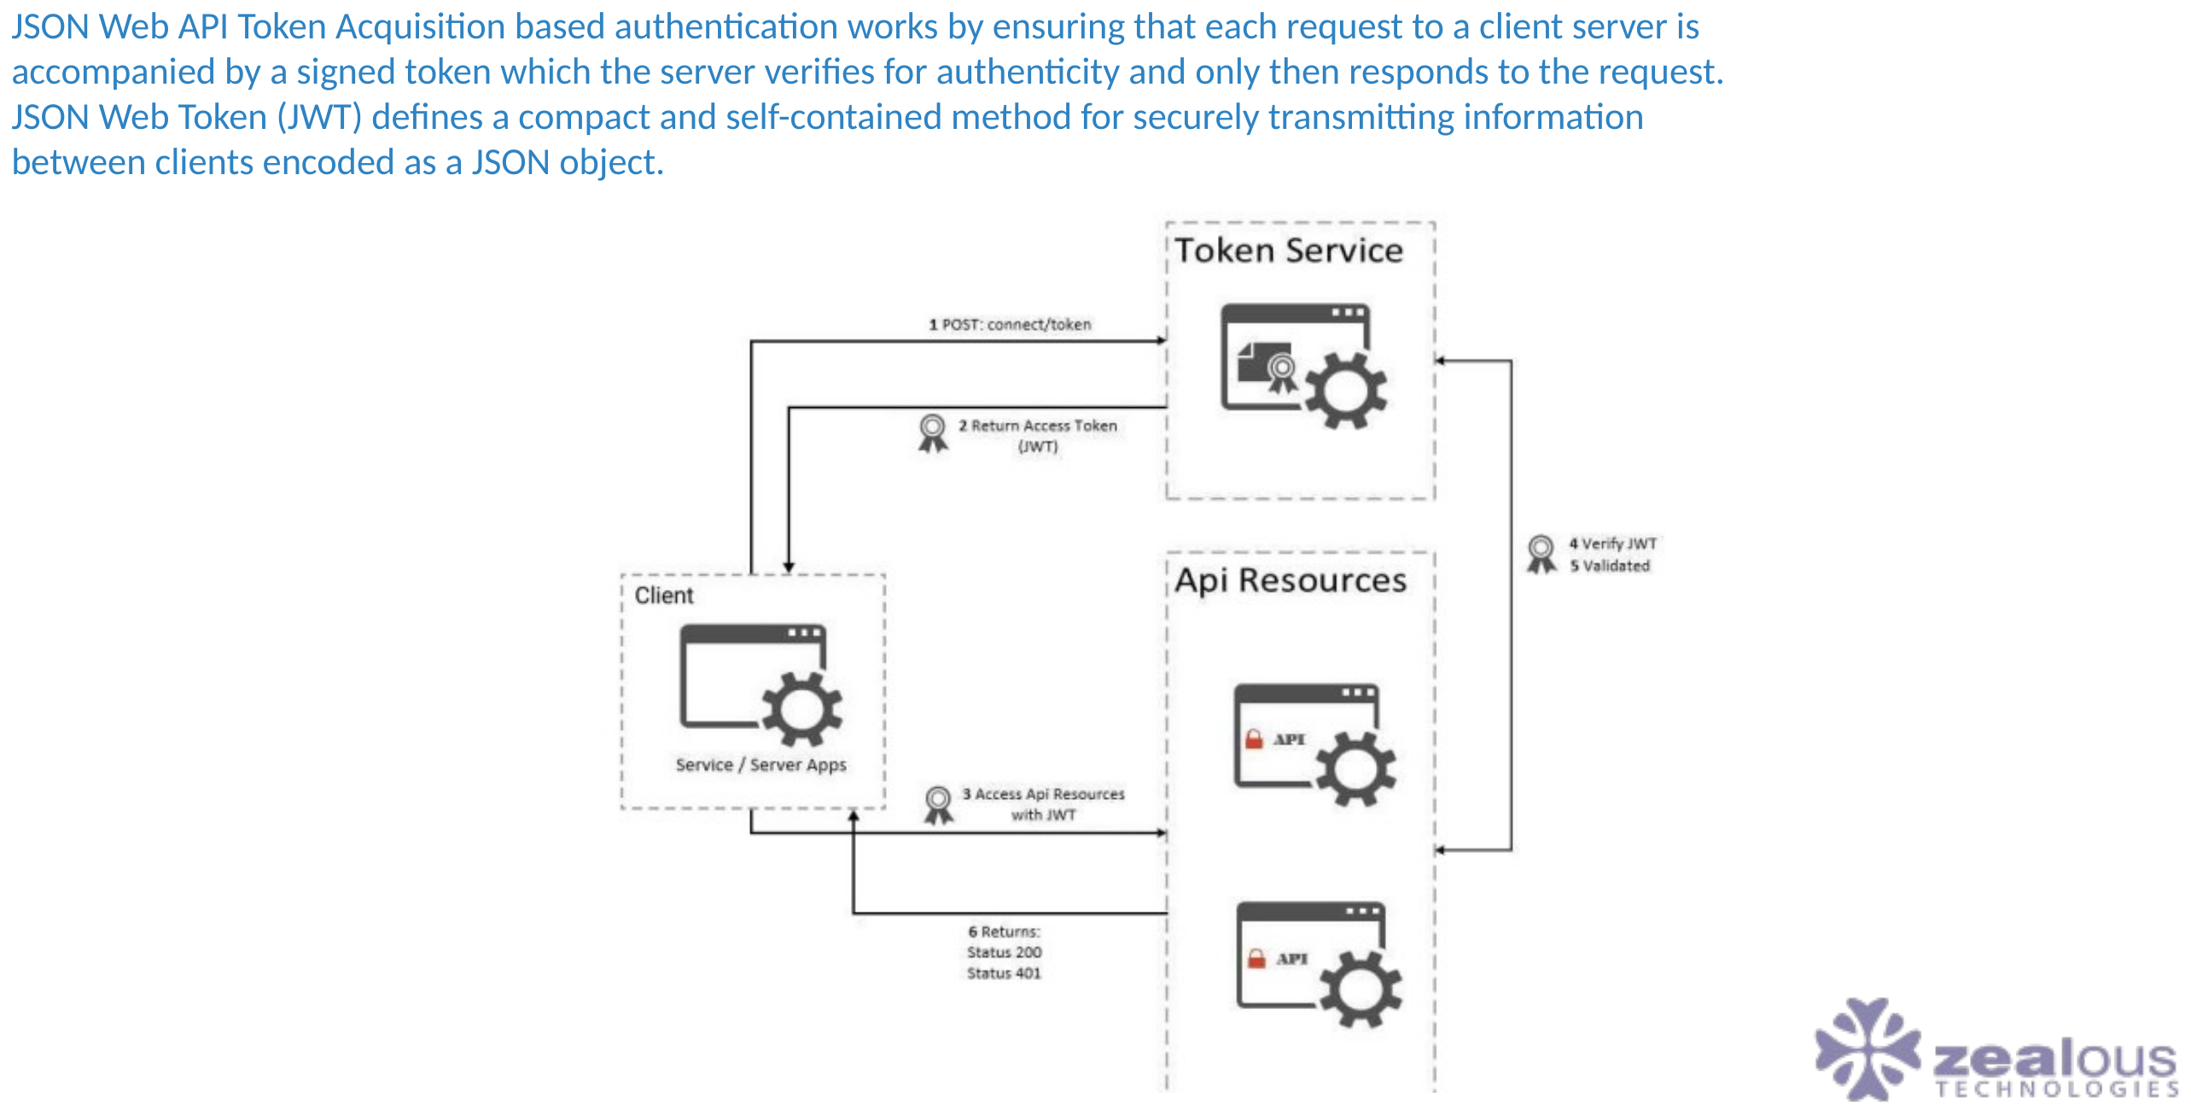
TECHNICAL INTEGRATION
Data Exchange Mechanism
PAKISTAN SINGLE WINDOW
12

Slide 13
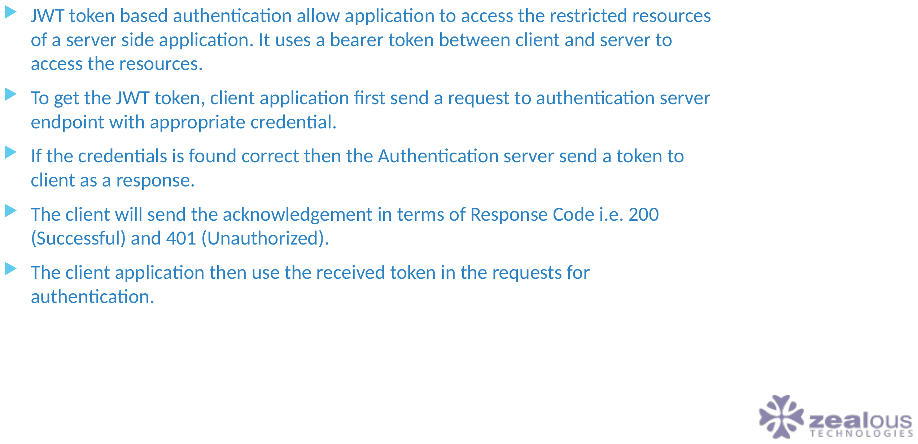
TECHNICAL INTEGRATION
Token based authentication description
PAKISTAN SINGLE WINDOW
13

Slide 14
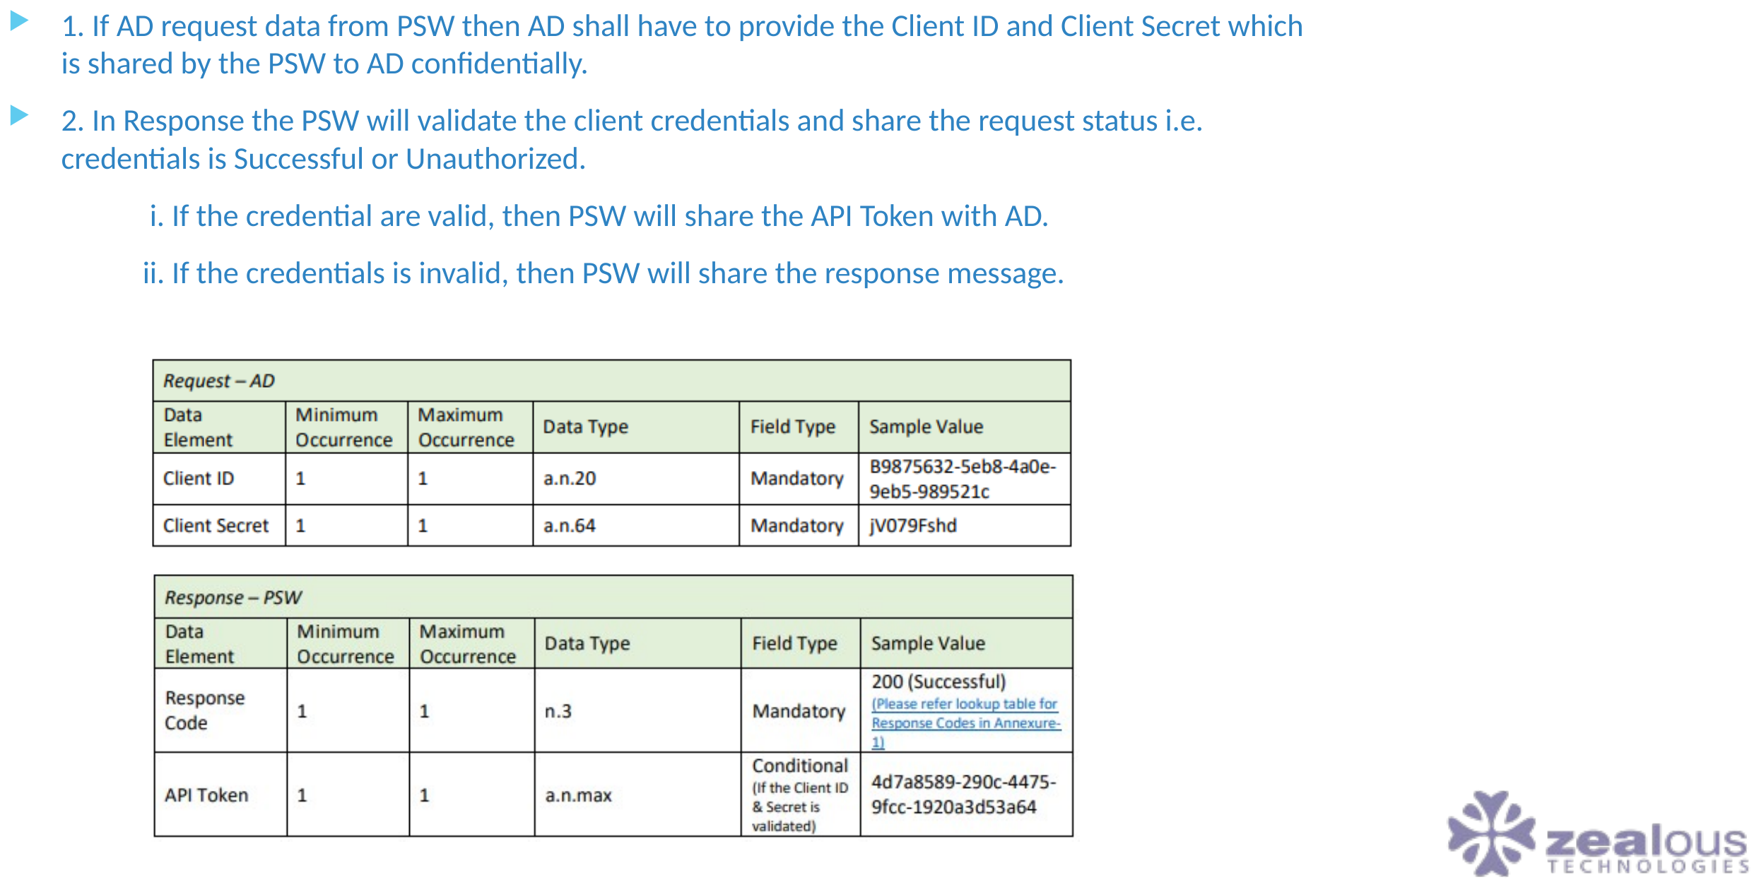
TECHNICAL INTEGRATION
Token Authentication Message Description
PAKISTAN SINGLE WINDOW
14

Slide 15
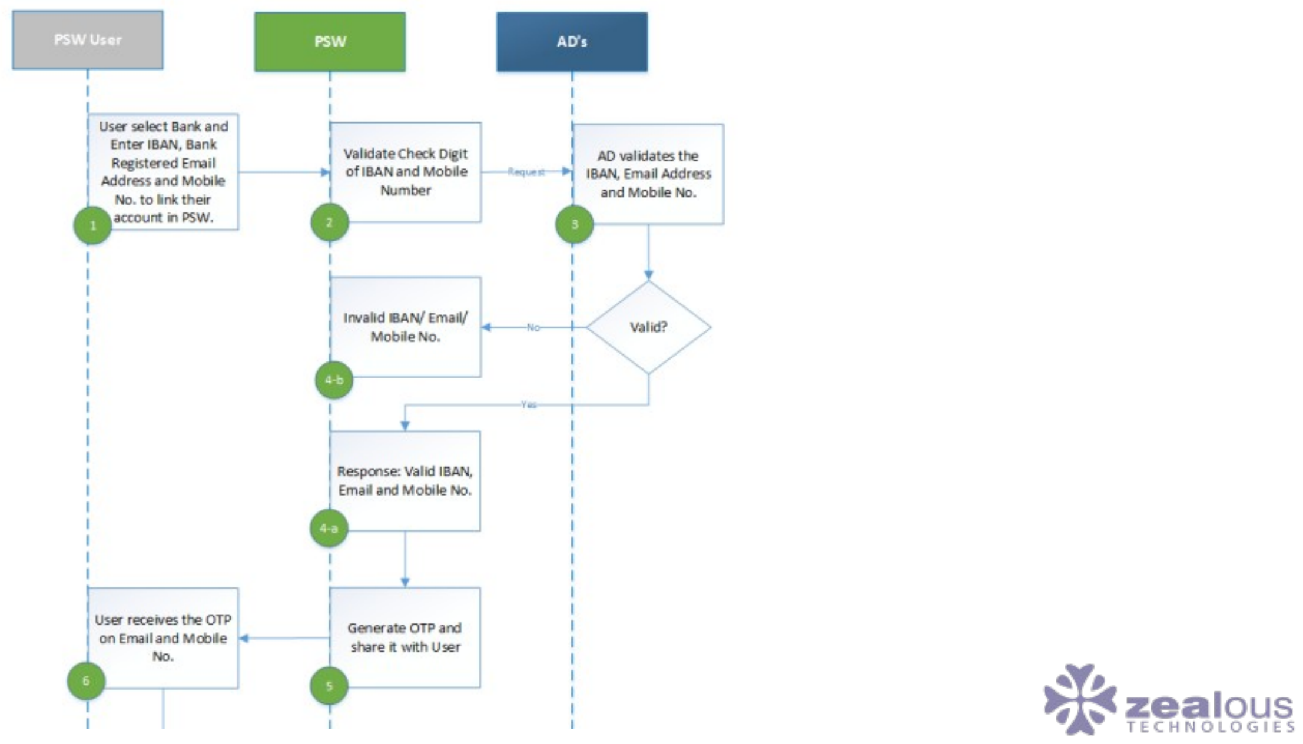
TECHNICAL INTEGRATION
The process flow of profiling between Traders with Authorized Dealers
PAKISTAN SINGLE WINDOW
15

Slide 16
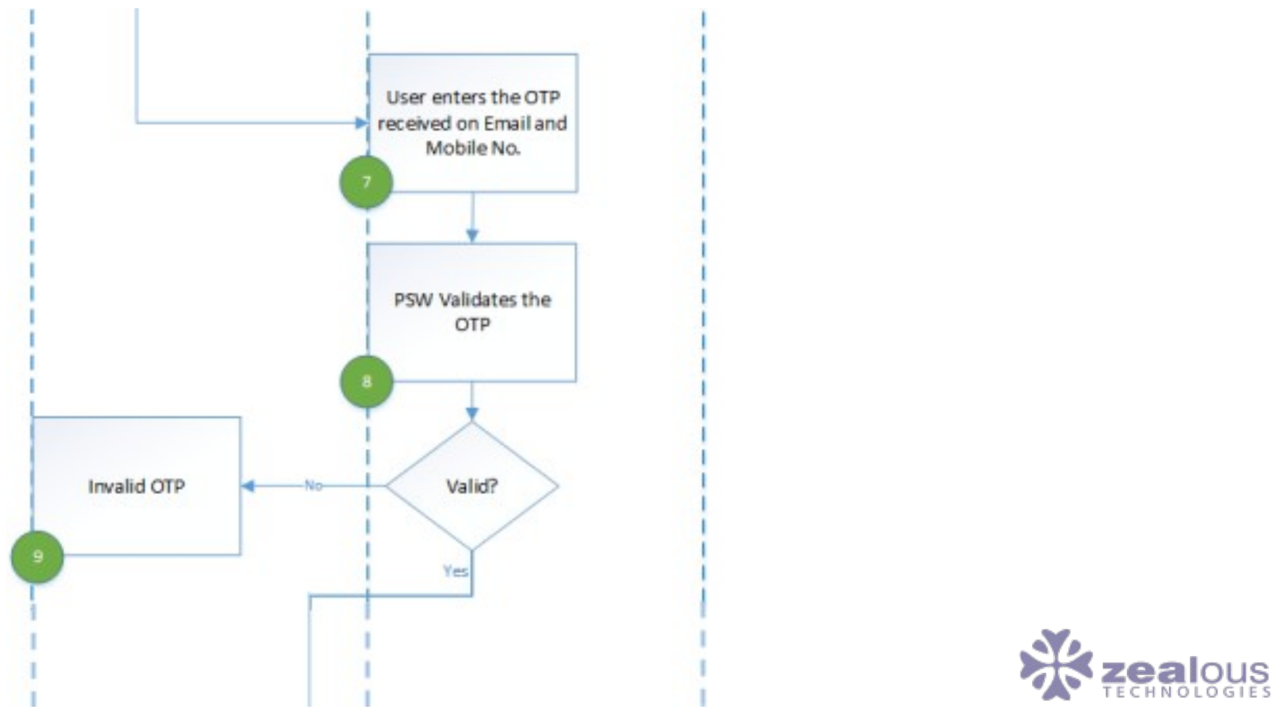
TECHNICAL INTEGRATION
The process flow of profiling between Traders with Authorized Dealers (Part 2)
PAKISTAN SINGLE WINDOW
16

Slide 17
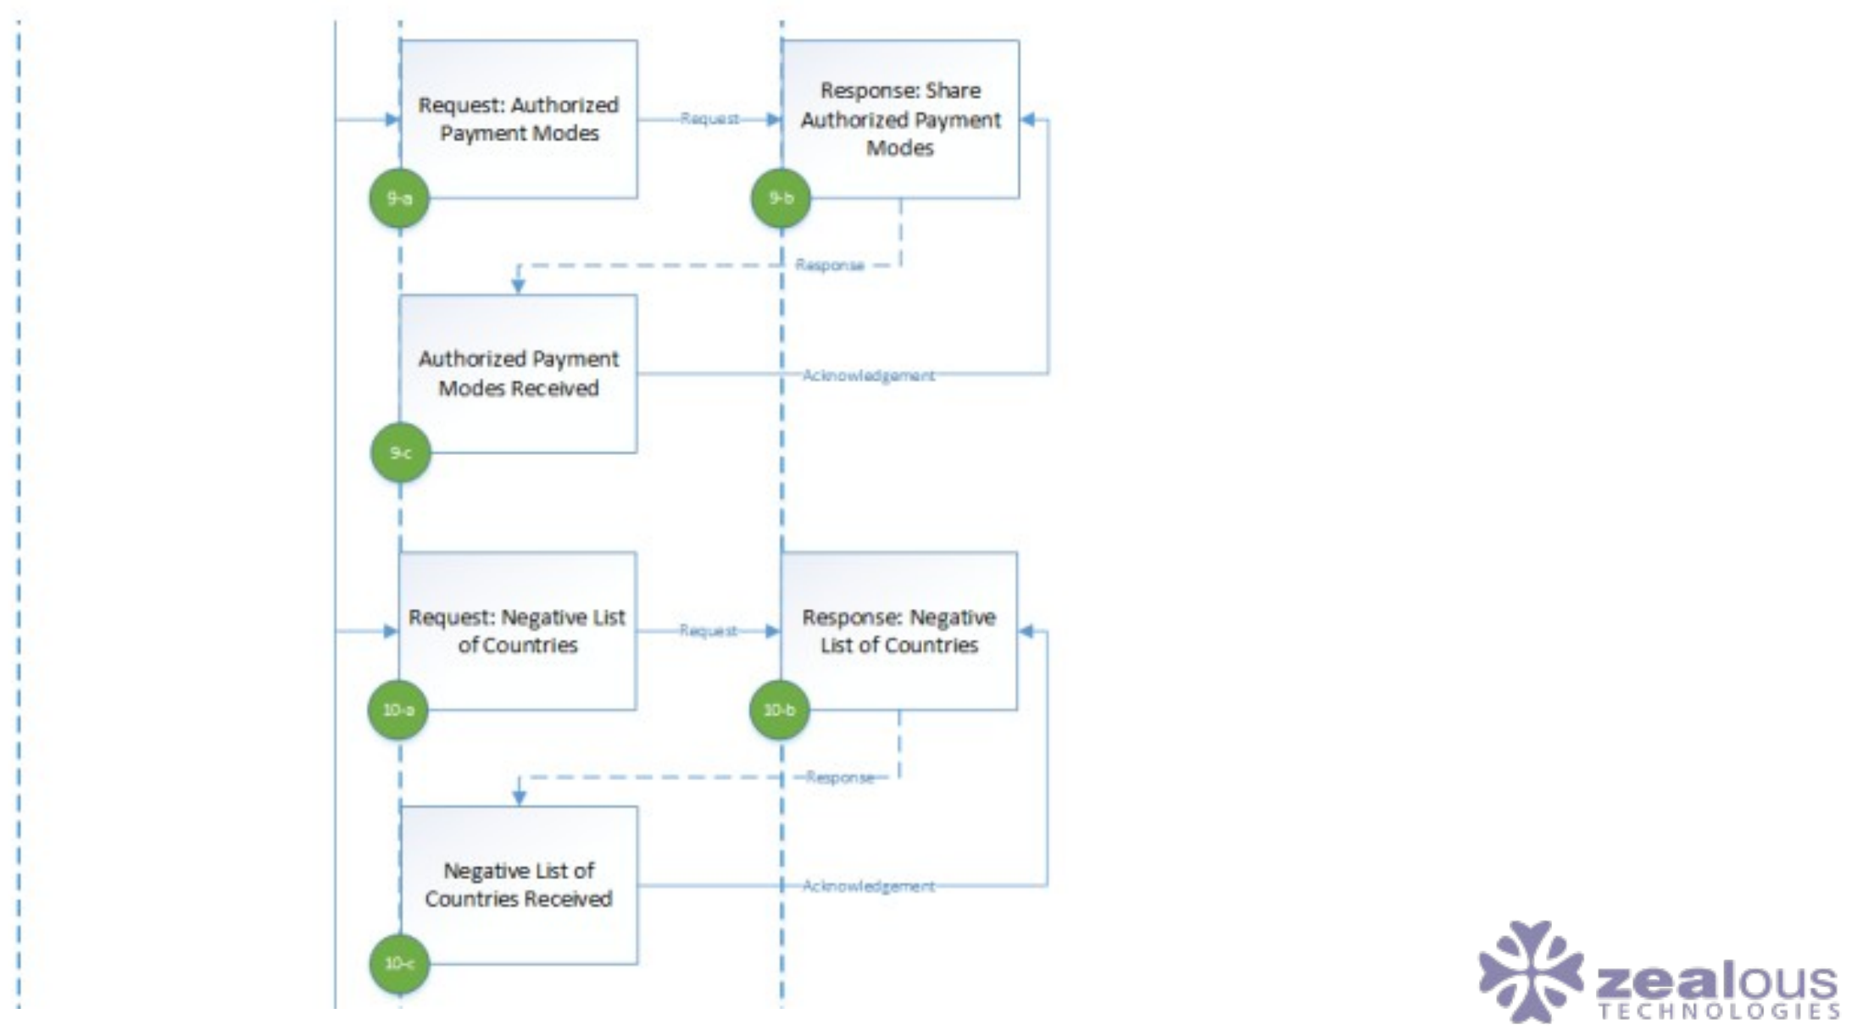
TECHNICAL INTEGRATION
The process flow of profiling between Traders with Authorized Dealers (Part 3)
PAKISTAN SINGLE WINDOW
17

Slide 18
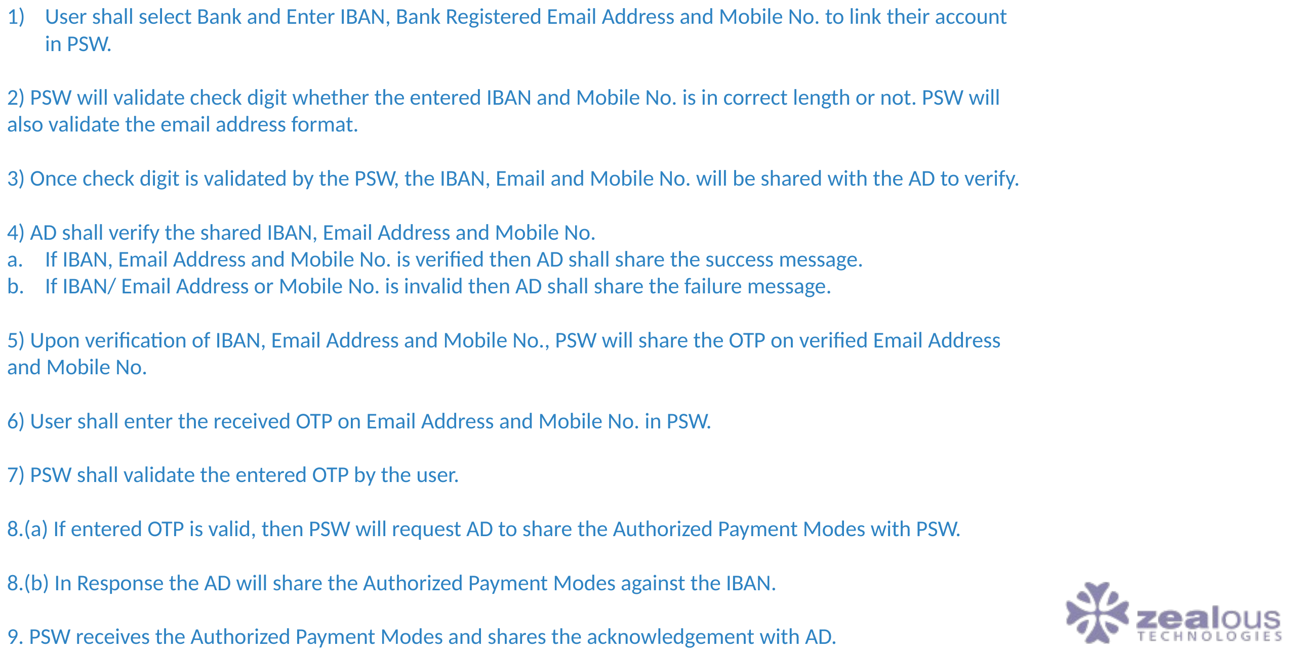
TECHNICAL INTEGRATION
Description of the Process flow
PAKISTAN SINGLE WINDOW
18

Slide 19
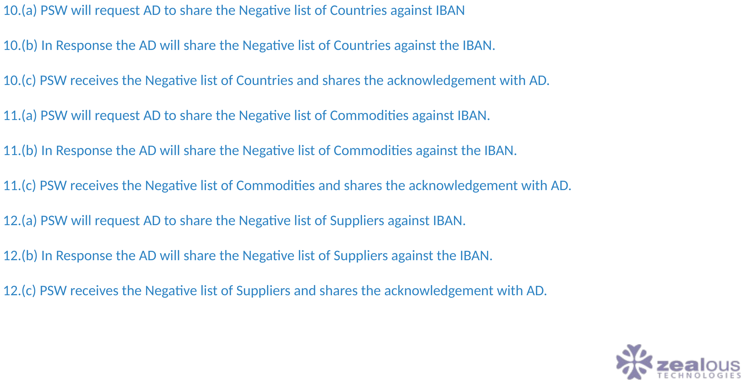
TECHNICAL INTEGRATION
Description of the Process flow (Part 2)
PAKISTAN SINGLE WINDOW
19

Slide 20
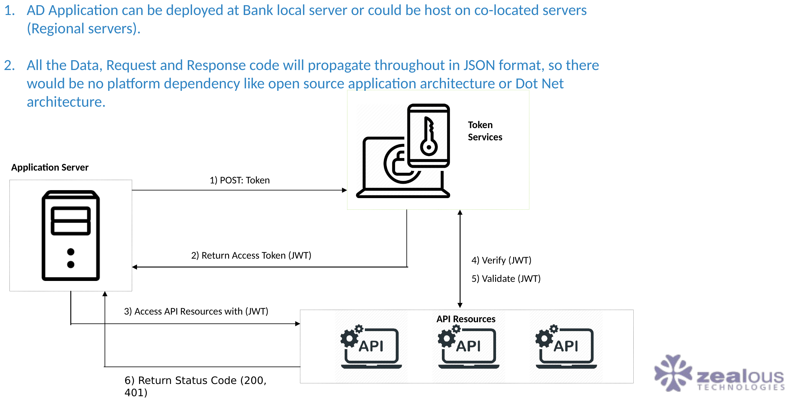
TECHNICAL INTEGRATION
Communication between Application Server and PSW
PAKISTAN SINGLE WINDOW
20

Slide 21
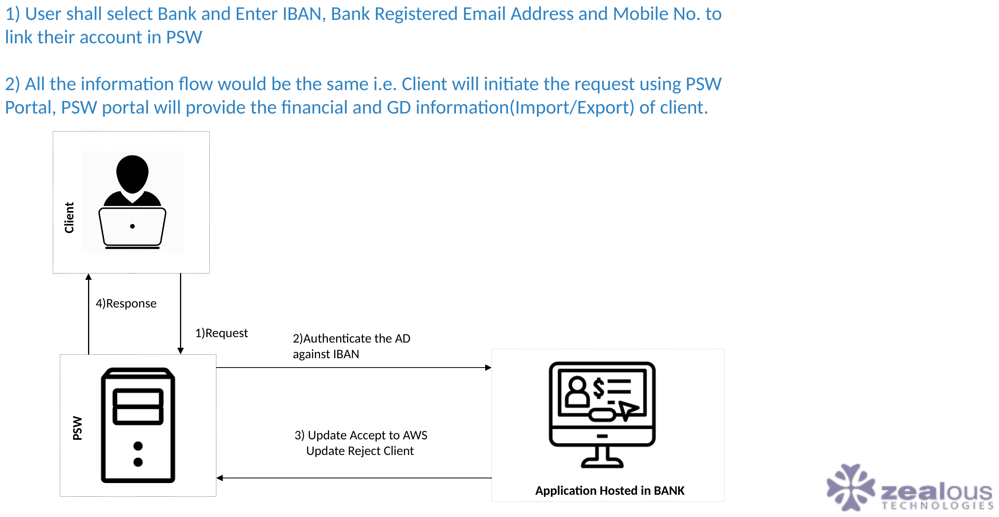
TECHNICAL INTEGRATION
Communication between Application Server and PSW (Part 2)
PAKISTAN SINGLE WINDOW
21

Slide 22
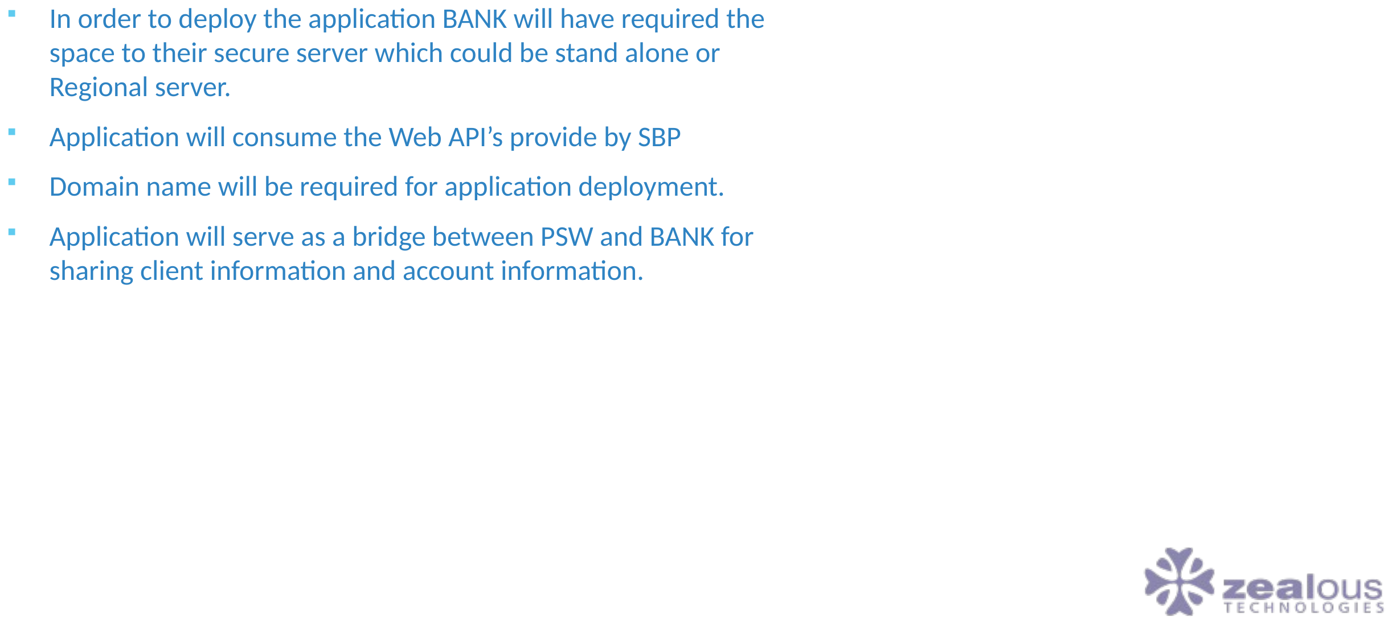
TECHNICAL INTEGRATION
Application Server Deployment
PAKISTAN SINGLE WINDOW
22

Slide 23
02
EDI Messages & Annexures
Message specifications, response codes, and reference tables
PAKISTAN SINGLE WINDOW
23

Slide 24
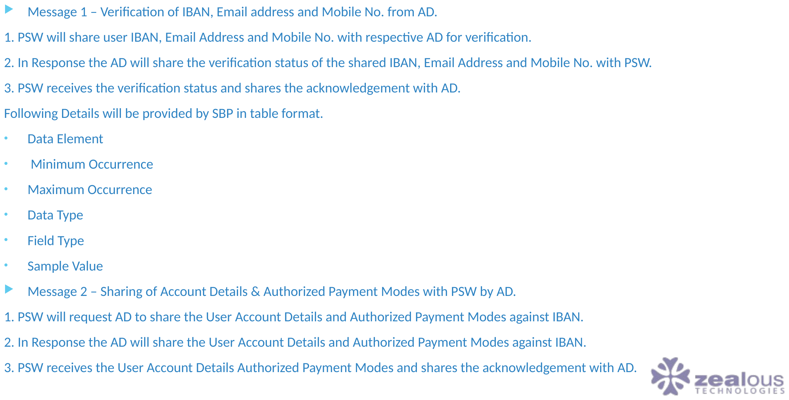
EDI MESSAGES & ANNEXURES
EDI Messages Exchange for Trader Profiling
PAKISTAN SINGLE WINDOW
24

Slide 25
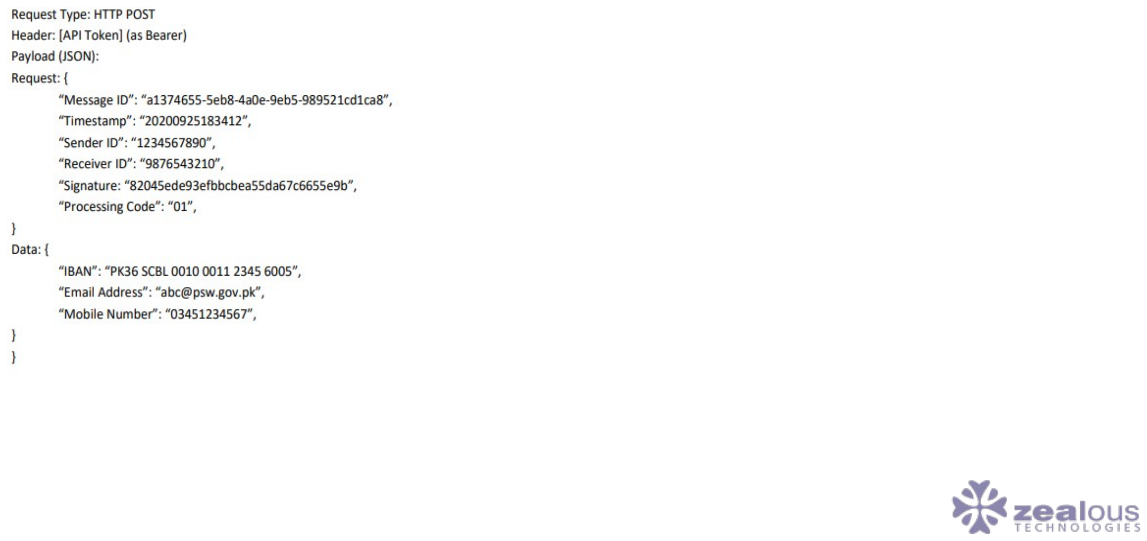
EDI MESSAGES & ANNEXURES
Sample Message
PAKISTAN SINGLE WINDOW
25

Slide 26
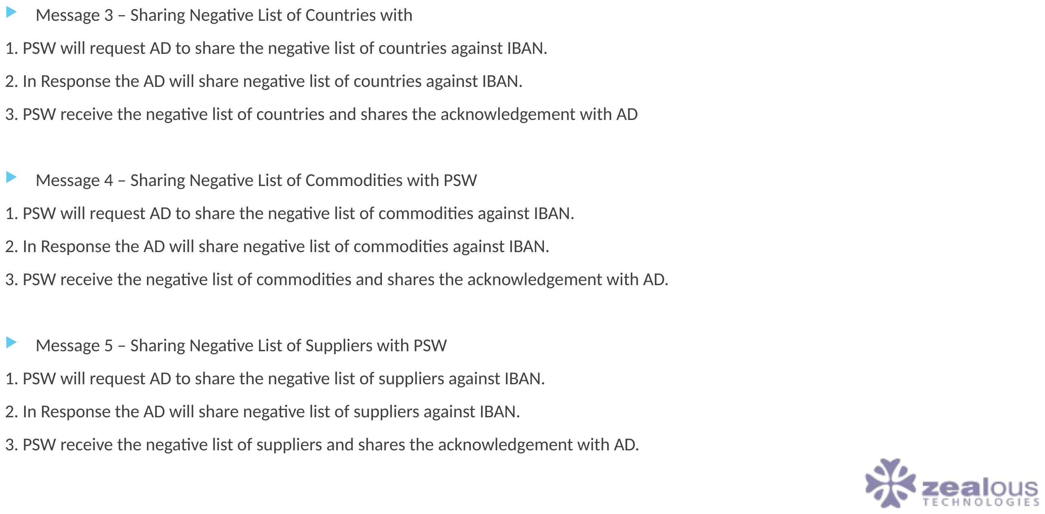
EDI MESSAGES & ANNEXURES
EDI Messages Exchange for Trader Profiling (Part 2)
PAKISTAN SINGLE WINDOW
26

Slide 27
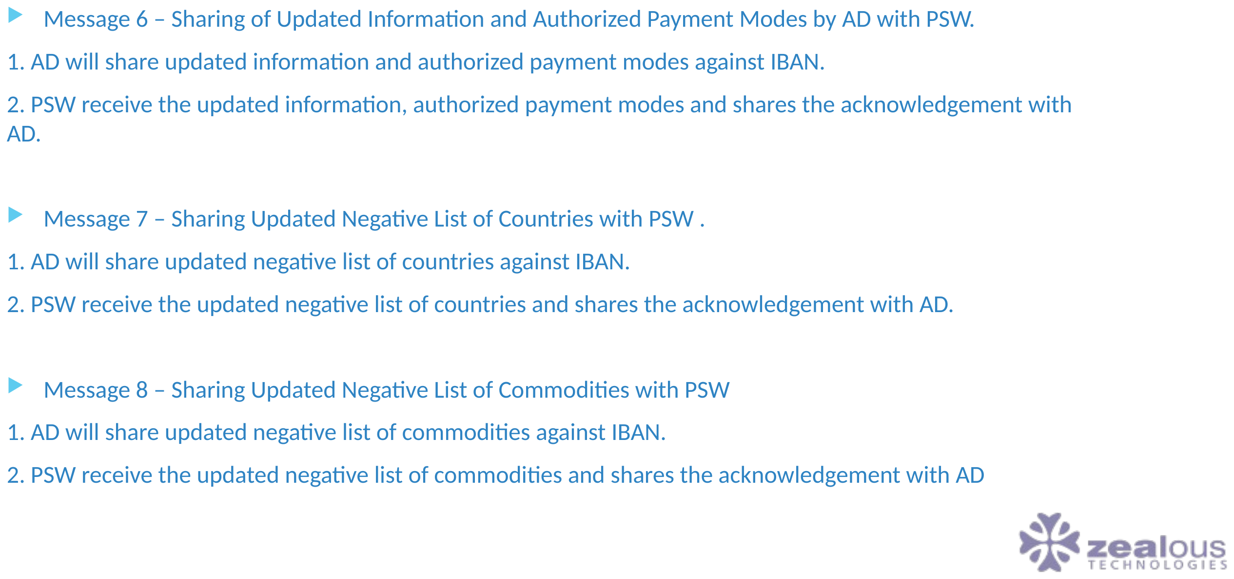
EDI MESSAGES & ANNEXURES
EDI Messages Exchange for Trader Profiling (Part 3)
PAKISTAN SINGLE WINDOW
27

Slide 28
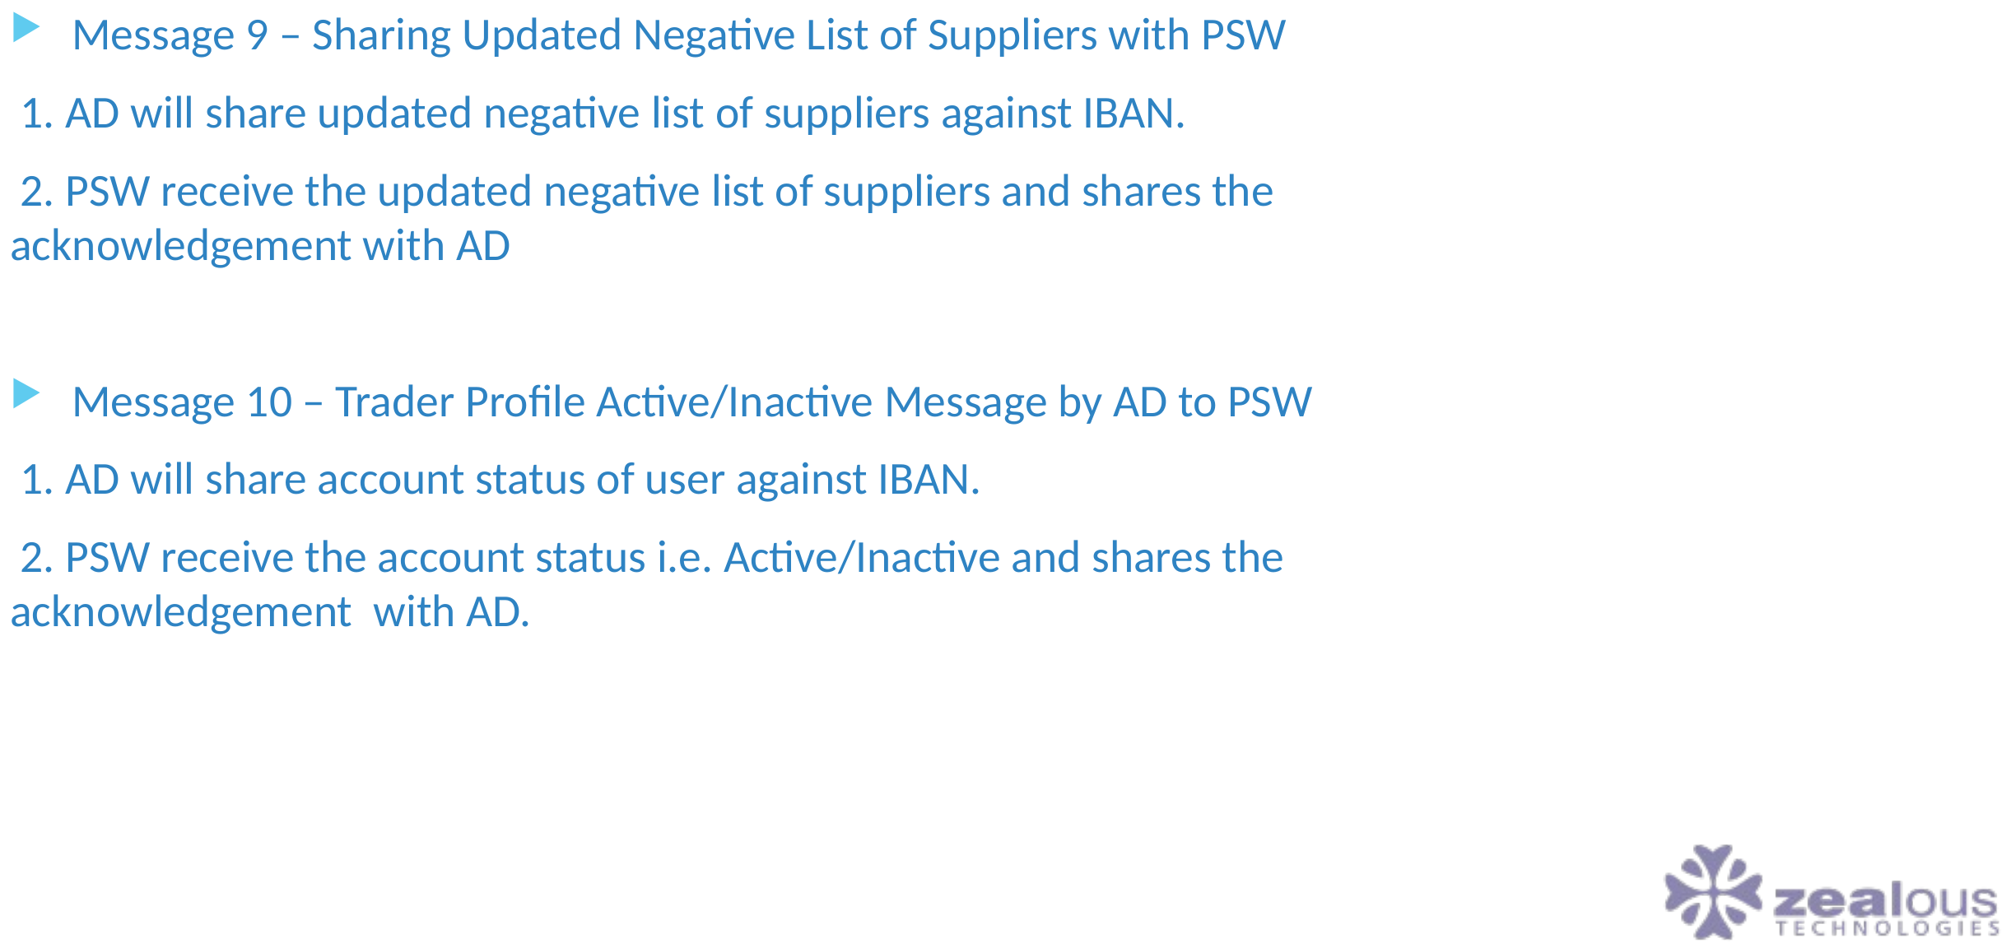
EDI MESSAGES & ANNEXURES
Message 9 – Sharing Updated Negative List of Suppliers with PSW
PAKISTAN SINGLE WINDOW
28

Slide 29
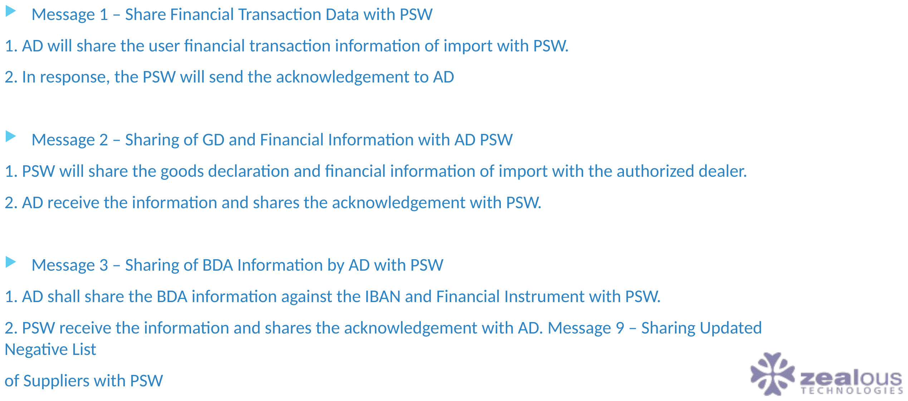
EDI MESSAGES & ANNEXURES
Sharing of GD & Financial Information
PAKISTAN SINGLE WINDOW
29

Slide 30
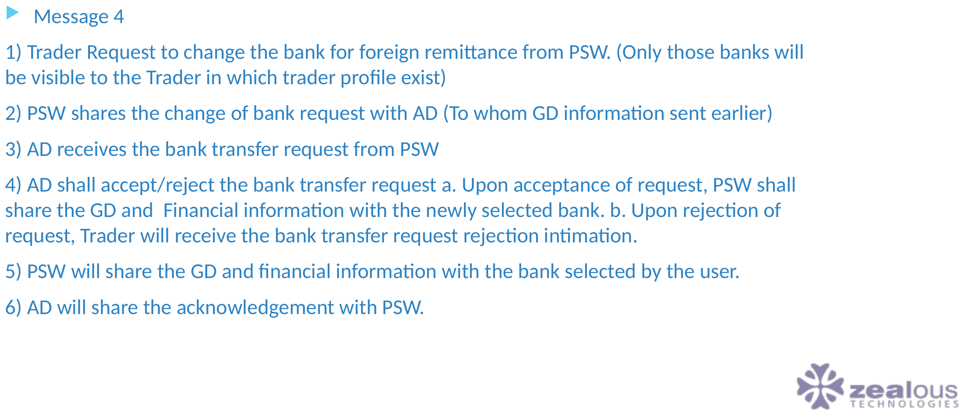
EDI MESSAGES & ANNEXURES
Sharing of GD & Financial Information (Part 2)
PAKISTAN SINGLE WINDOW
30

Slide 31
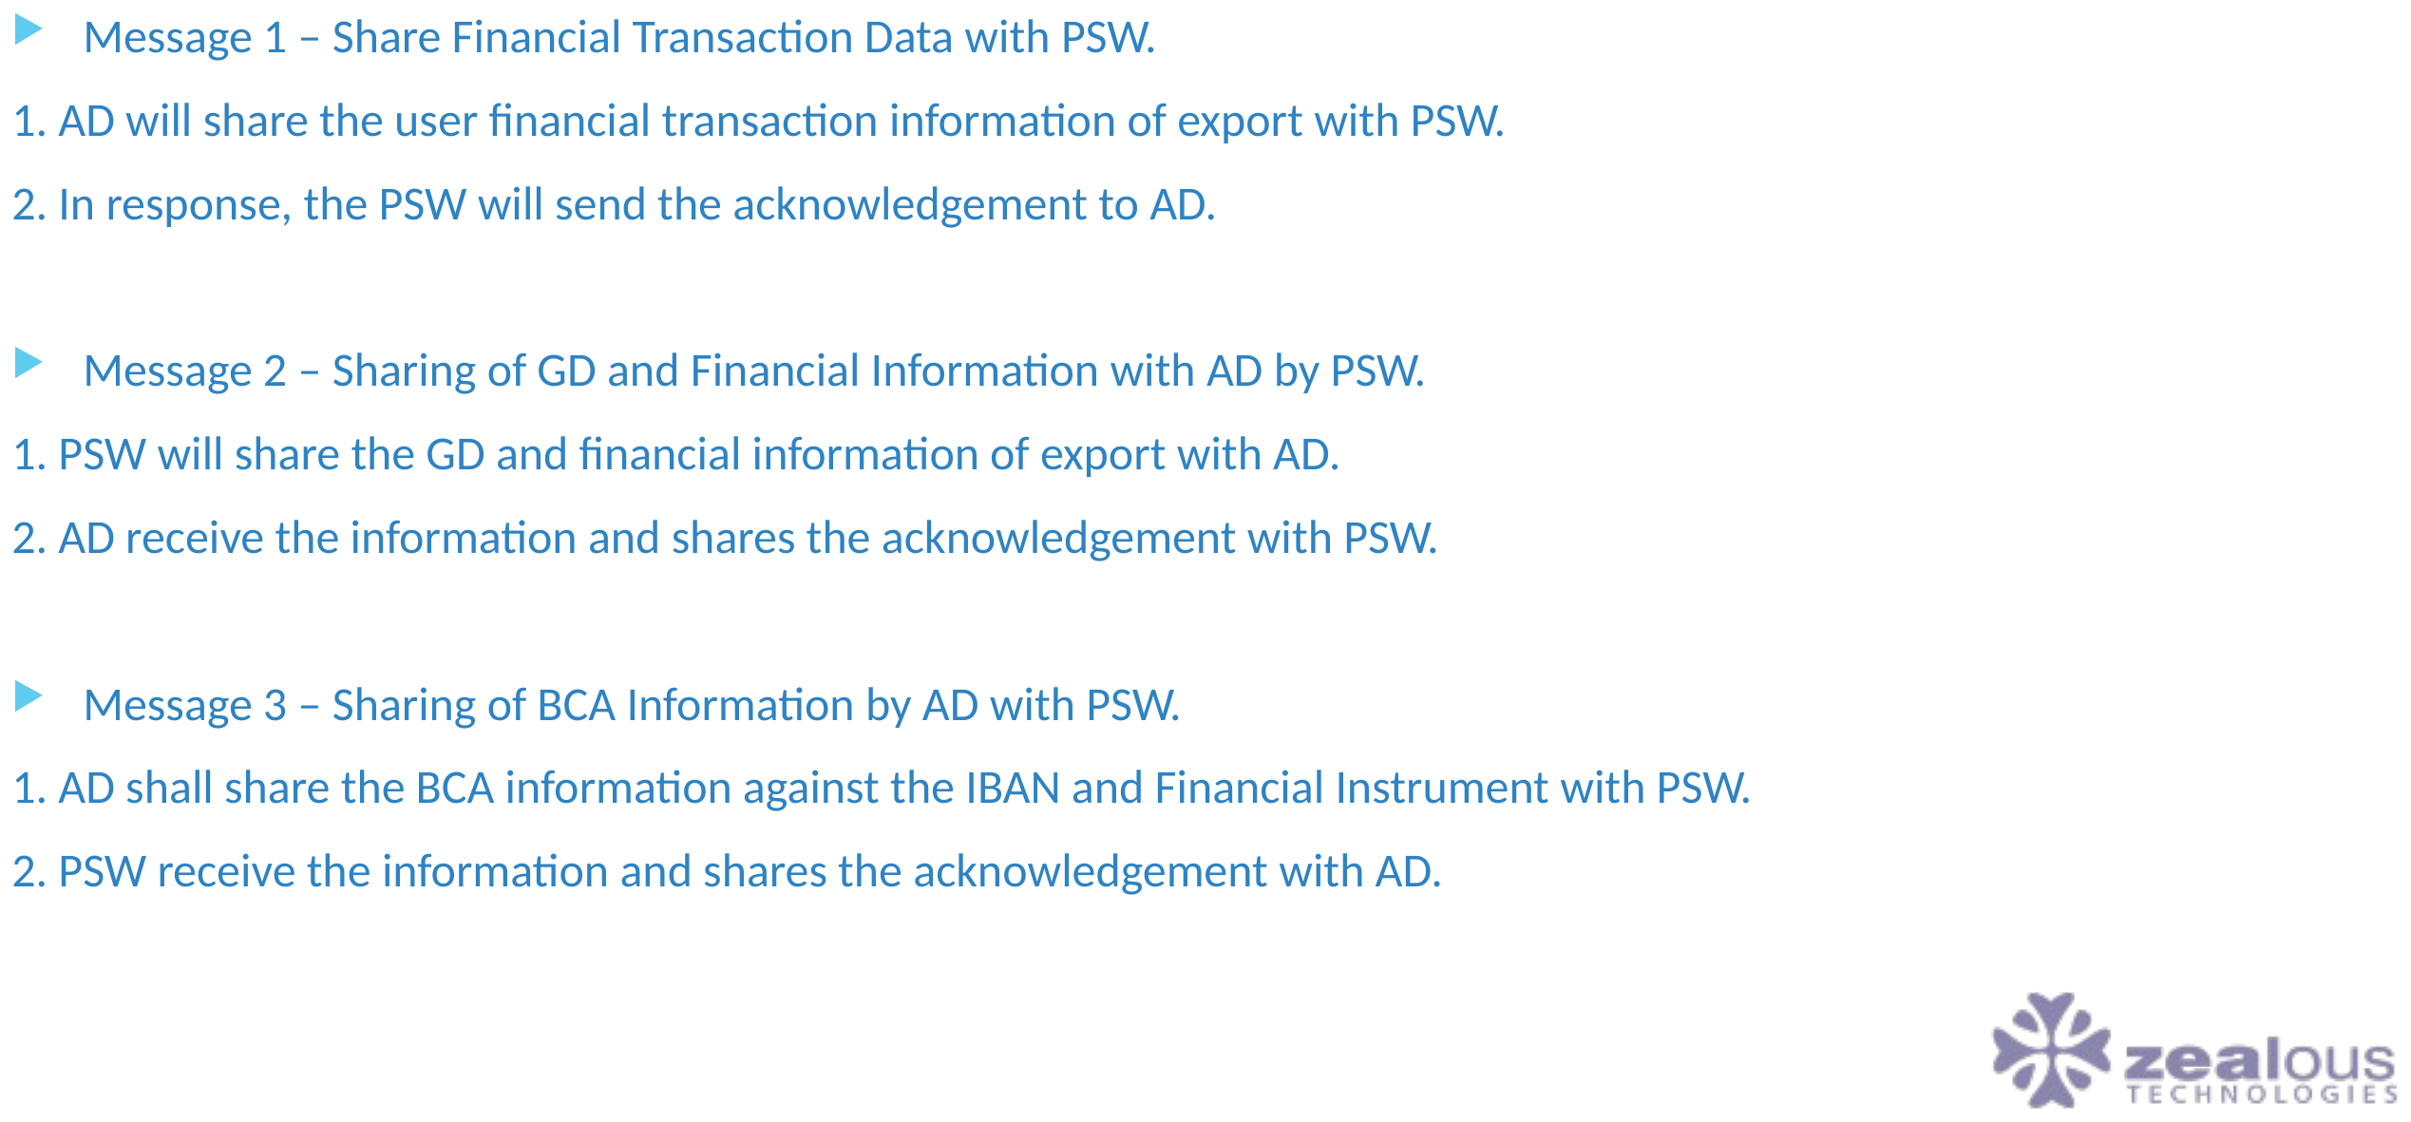
EDI MESSAGES & ANNEXURES
Sharing of GD & Financial Information (Part 3)
PAKISTAN SINGLE WINDOW
31

Slide 32
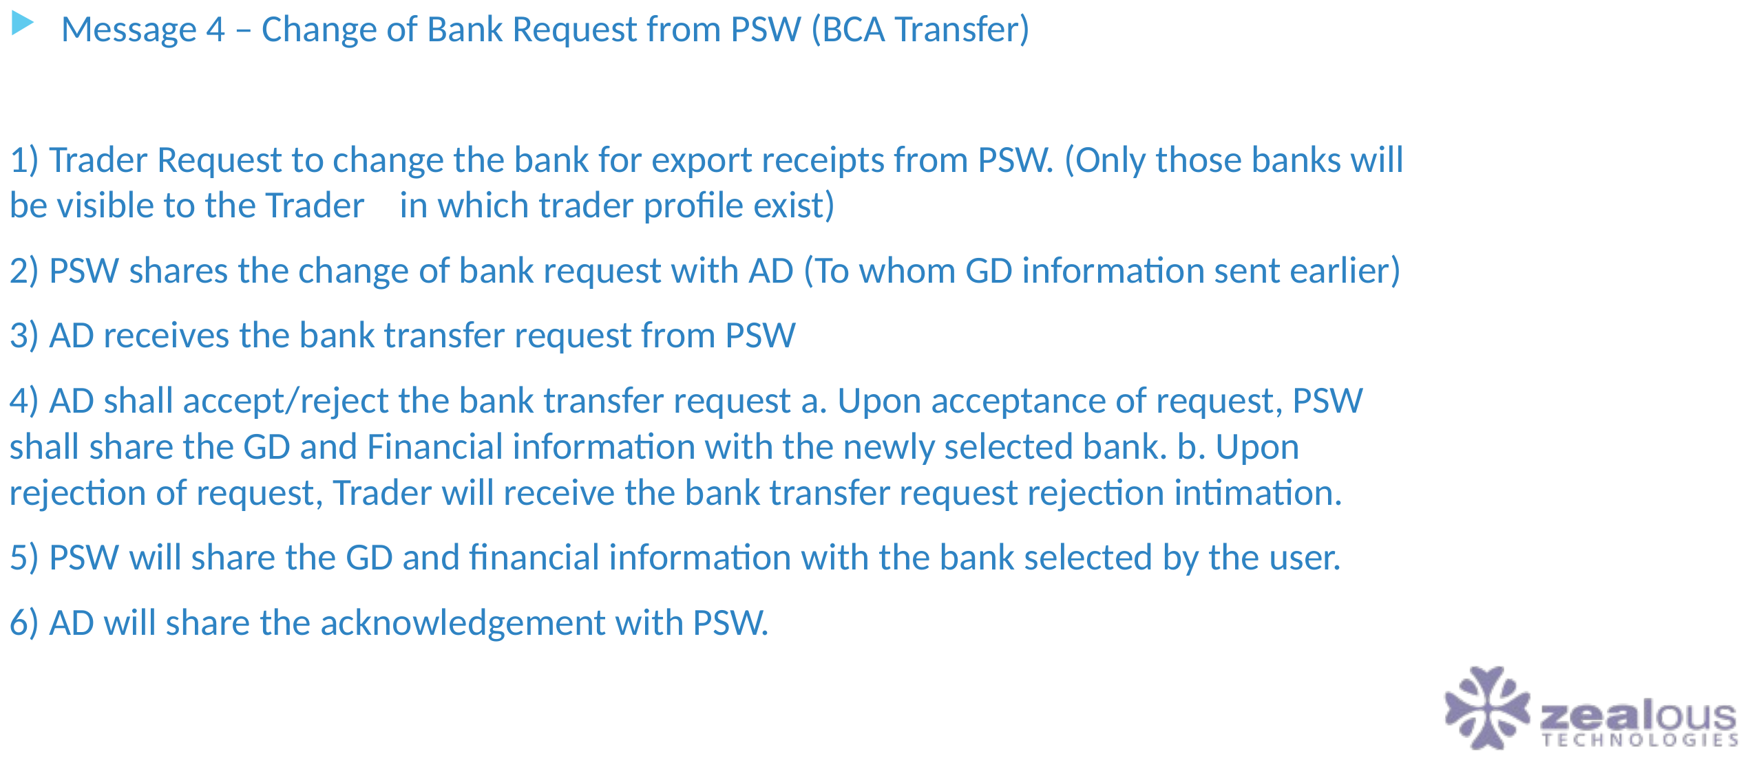
EDI MESSAGES & ANNEXURES
Sharing of GD & Financial Information (Part 4)
PAKISTAN SINGLE WINDOW
32

Slide 33
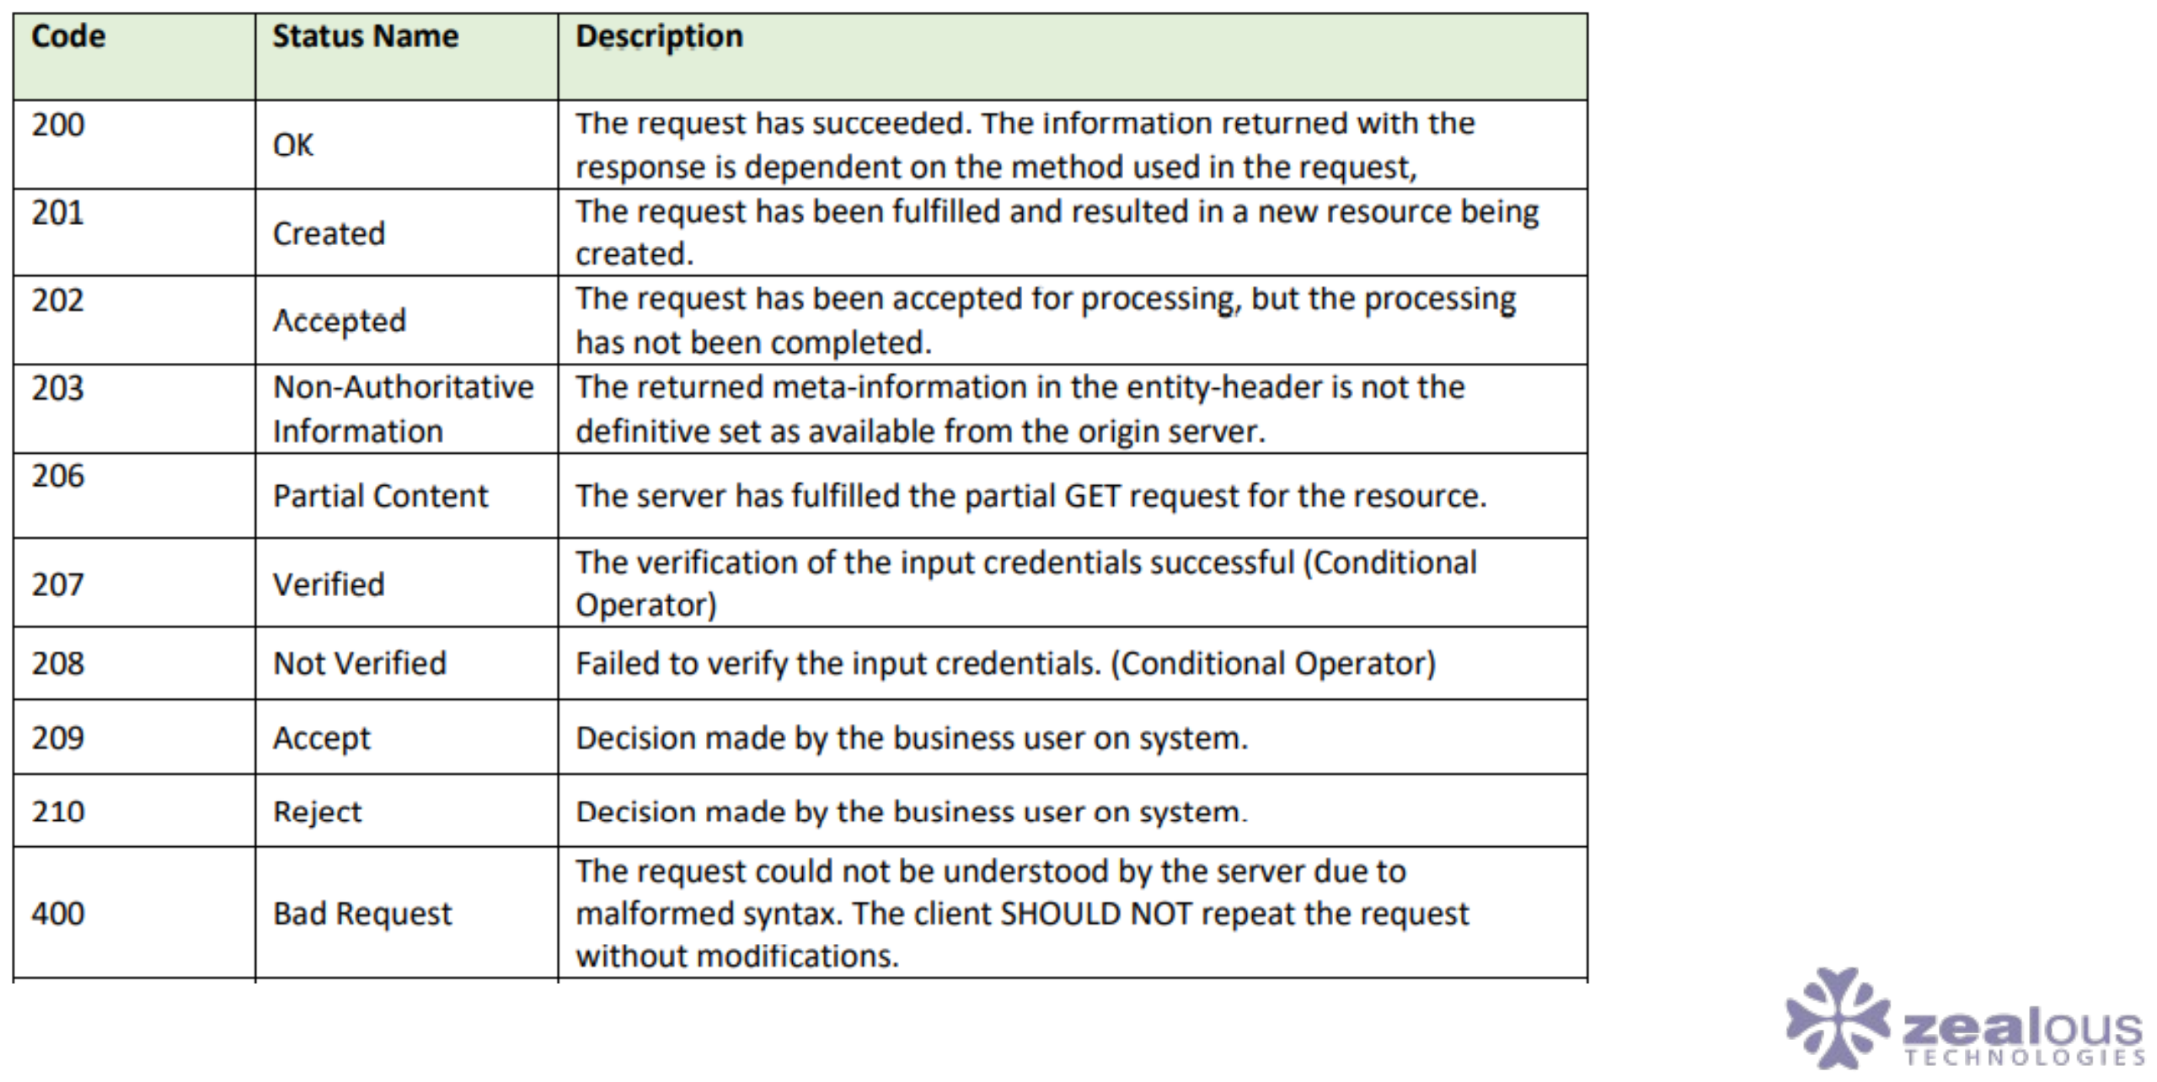
EDI MESSAGES & ANNEXURES
Annexure – 1 (Response Codes)
PAKISTAN SINGLE WINDOW
33

Slide 34
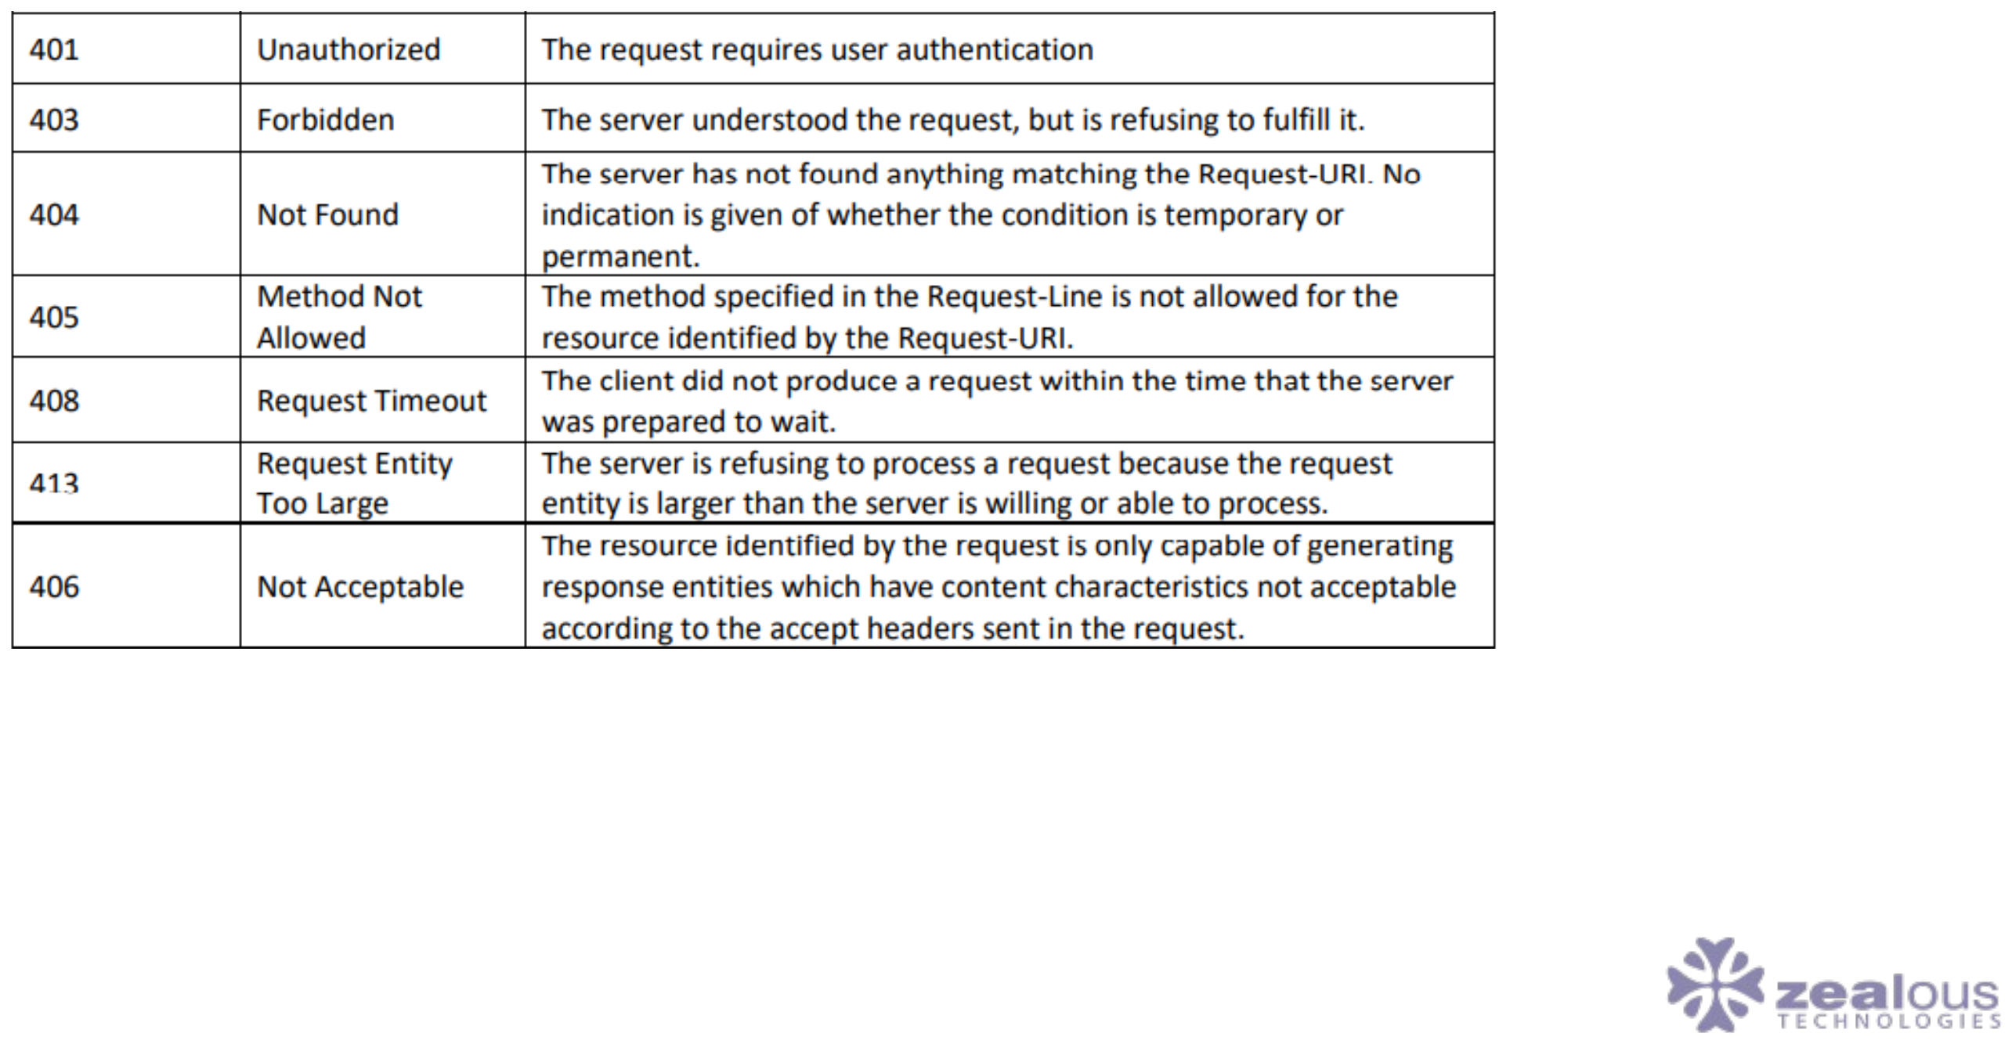
EDI MESSAGES & ANNEXURES
Annexure – 1 (Response Codes) (Part 2)
PAKISTAN SINGLE WINDOW
34

Slide 35
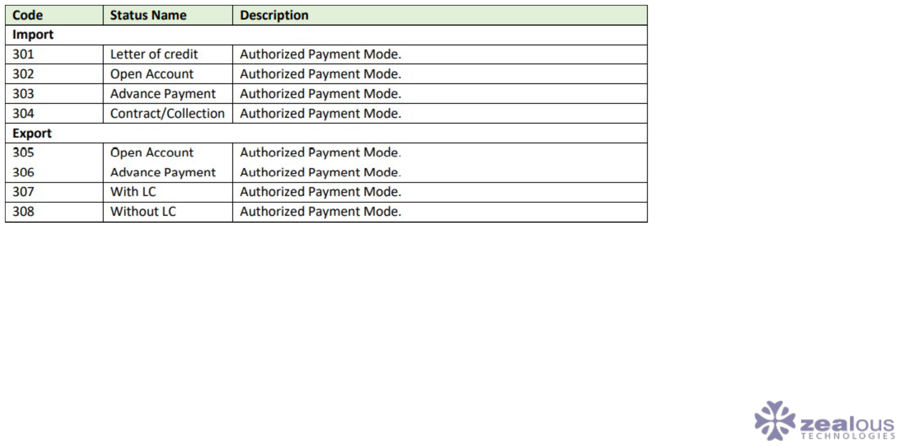
EDI MESSAGES & ANNEXURES
Annexure – 2 (Authorized Payment Modes)
PAKISTAN SINGLE WINDOW
35

Slide 36
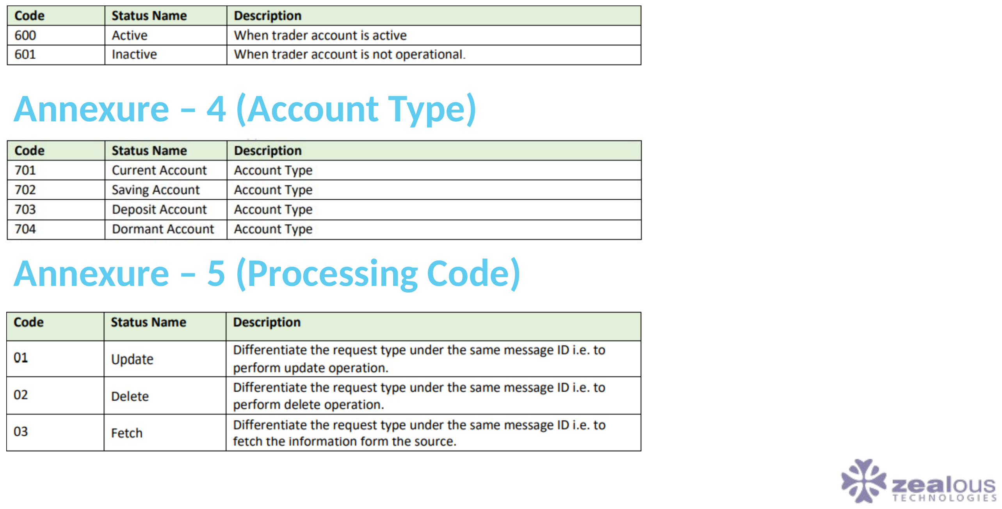
EDI MESSAGES & ANNEXURES
Annexure – 3 (Account Status)
PAKISTAN SINGLE WINDOW
36

Slide 37
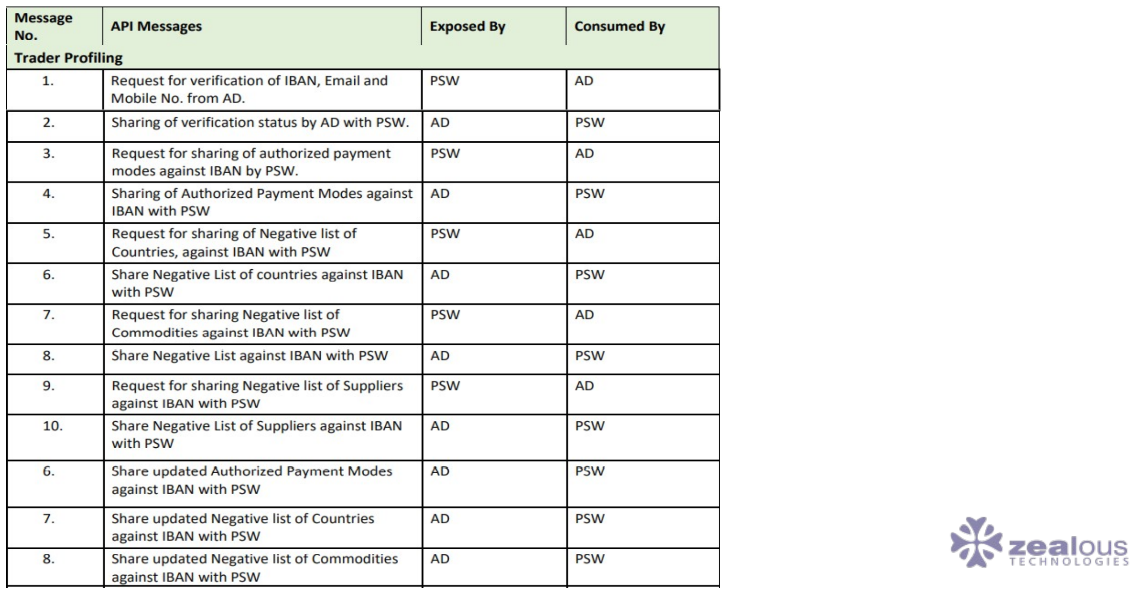
EDI MESSAGES & ANNEXURES
Annexure – 6 (List of API Messages which will be exchanged among PSW & AD)
PAKISTAN SINGLE WINDOW
37

Slide 38
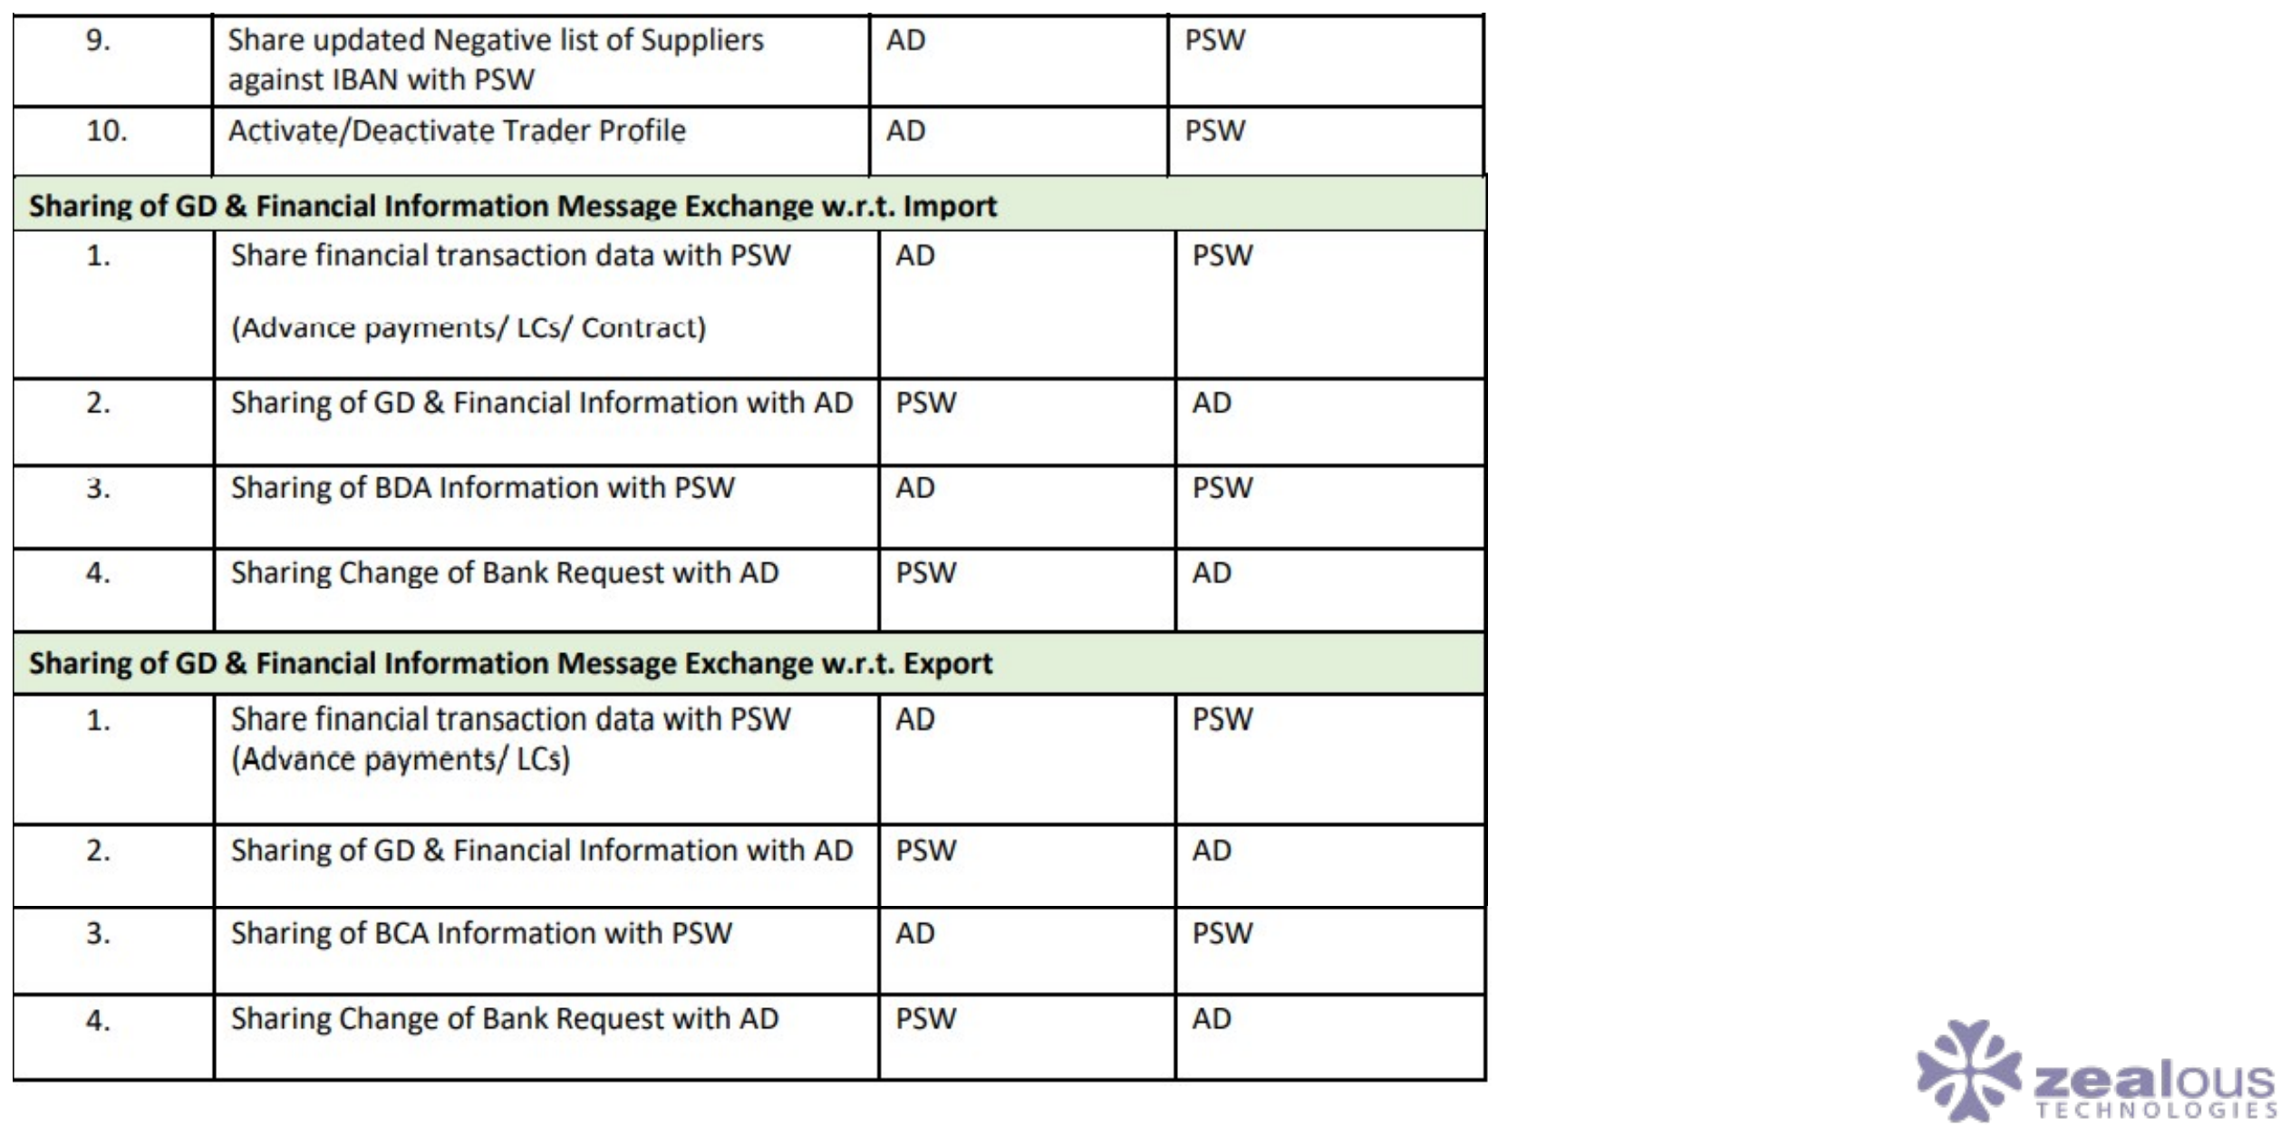
EDI MESSAGES & ANNEXURES
Annexure – 6 (List of API Messages which will be exchanged among PSW & AD) (Part 2)
PAKISTAN SINGLE WINDOW
38

Slide 39
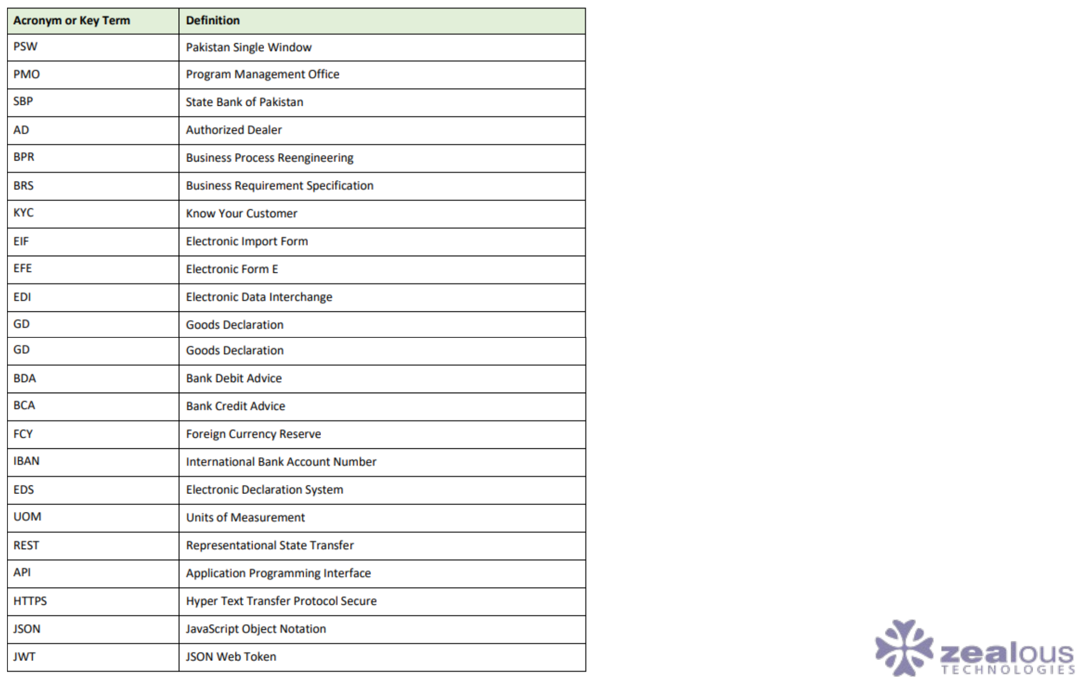
EDI MESSAGES & ANNEXURES
Glossary
PAKISTAN SINGLE WINDOW
39

Slide 40

03
Application Flow
Client setup, EIF/EEF forms, and user management
PAKISTAN SINGLE WINDOW
40

Slide 41
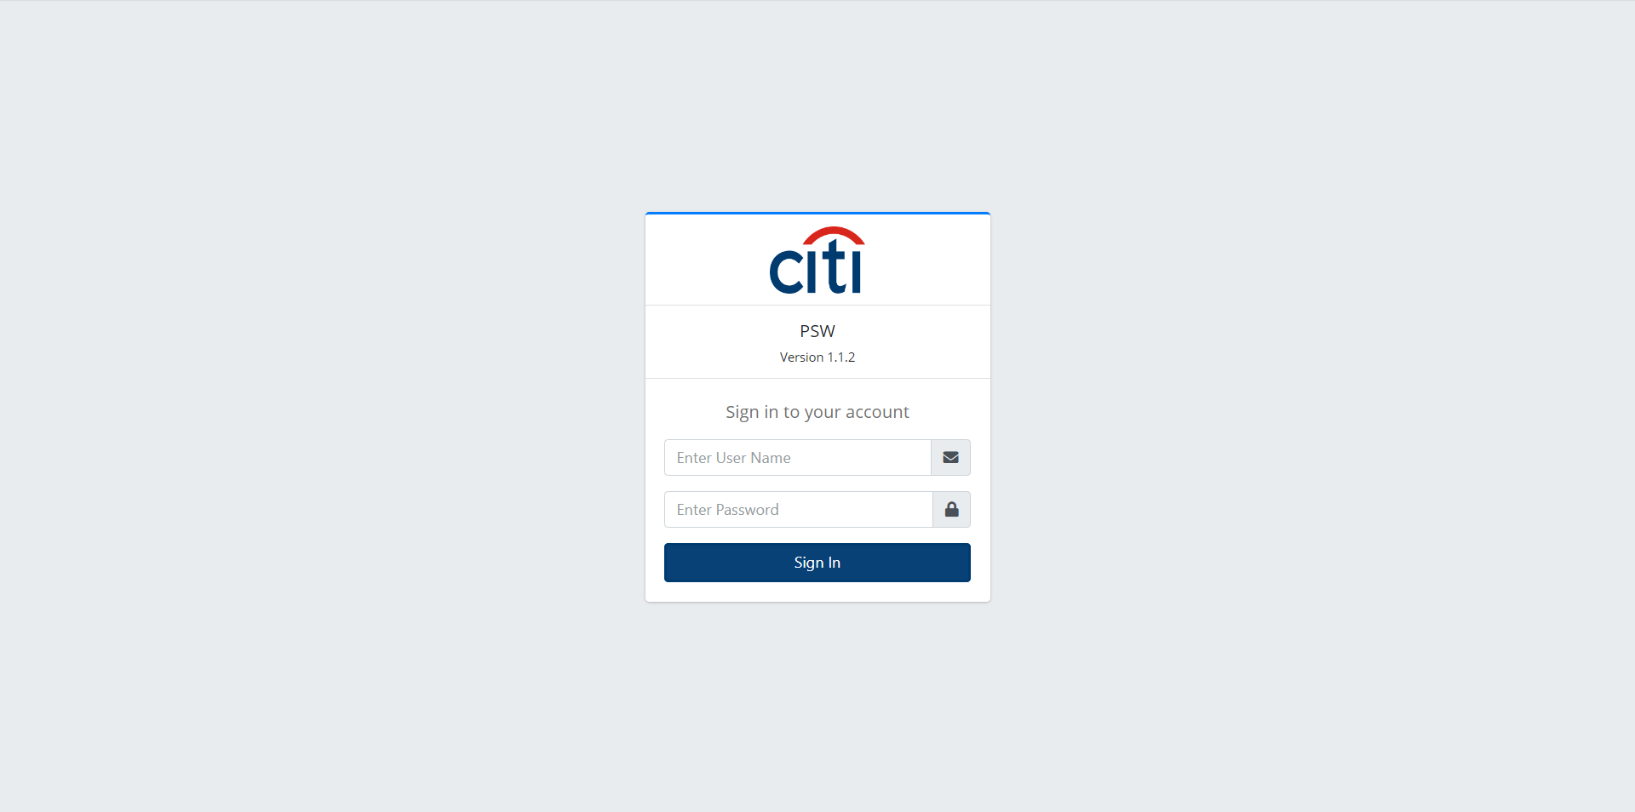
APPLICATION FLOW
Login Form
PAKISTAN SINGLE WINDOW
41

Slide 42
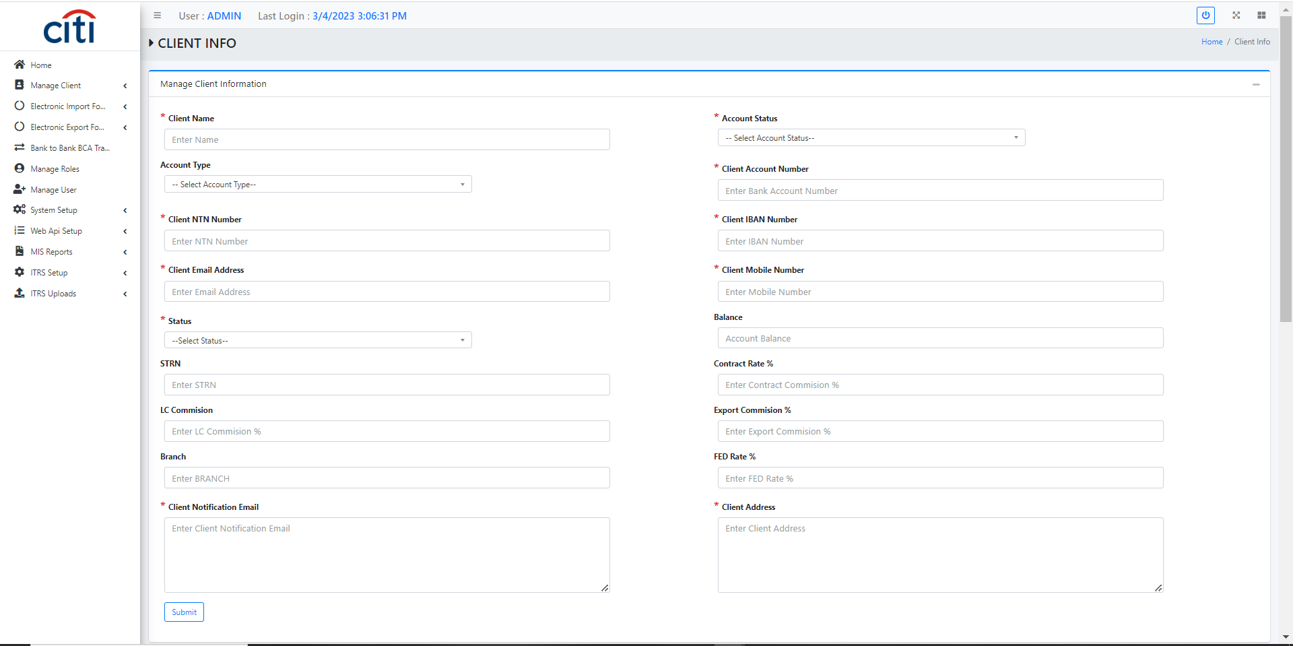
APPLICATION FLOW
Clients add/share with PSW form
PAKISTAN SINGLE WINDOW
42

Slide 43
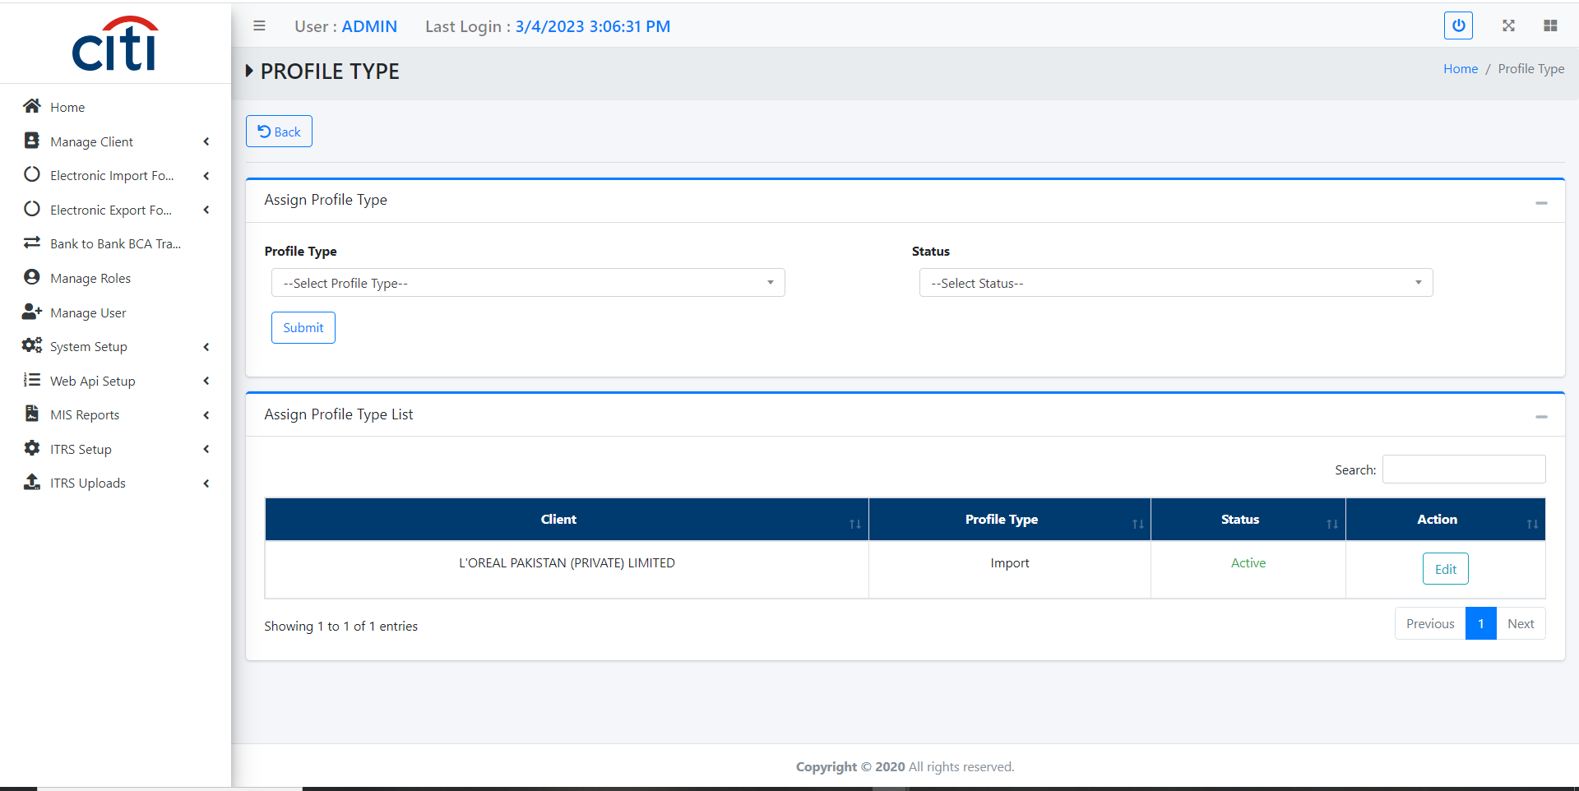
APPLICATION FLOW
Clients profile type add/share with PSW
PAKISTAN SINGLE WINDOW
43

Slide 44
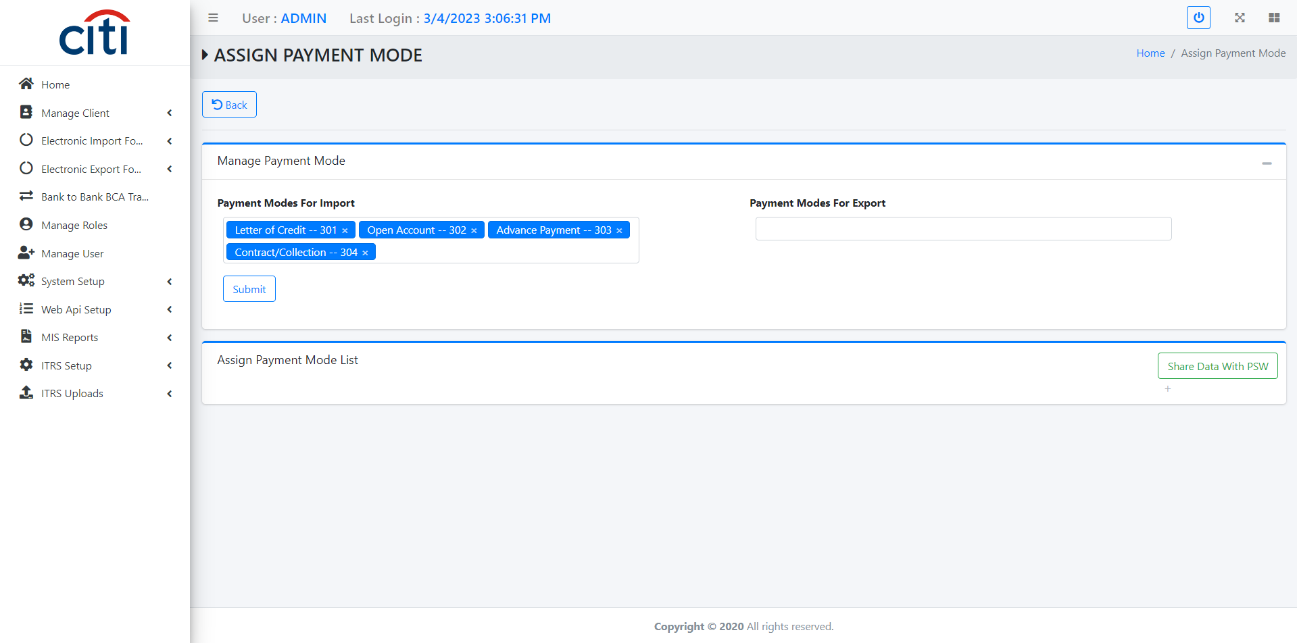
APPLICATION FLOW
Clients payment modes add/share with PSW form
PAKISTAN SINGLE WINDOW
44

Slide 45
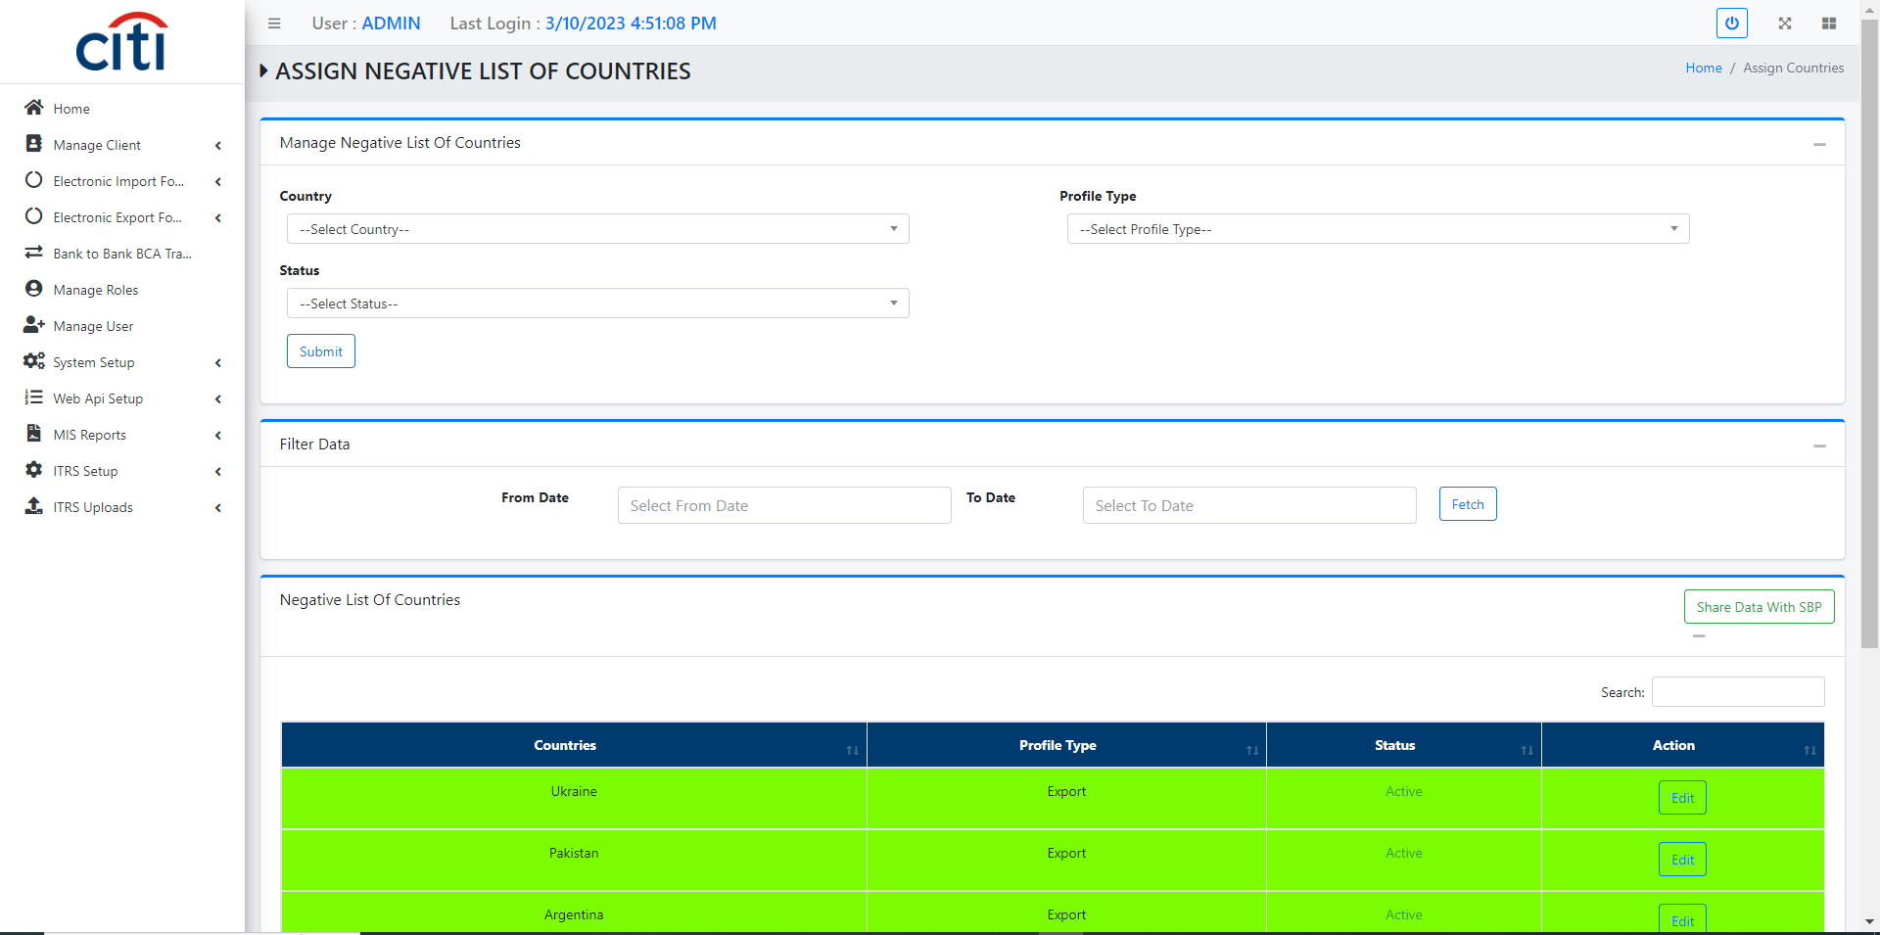
APPLICATION FLOW
Clients negative country add/share with PSW form
PAKISTAN SINGLE WINDOW
45

Slide 46
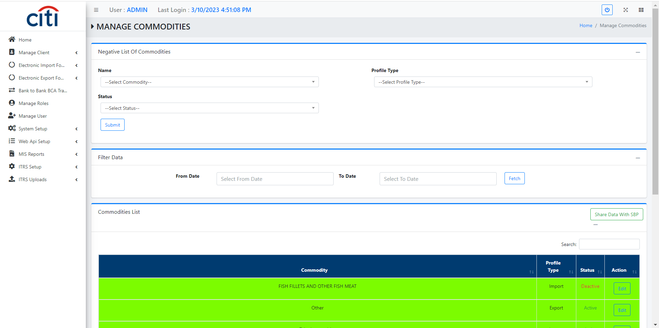
APPLICATION FLOW
Clients negative commodity add/share with PSW form
PAKISTAN SINGLE WINDOW
46

Slide 47
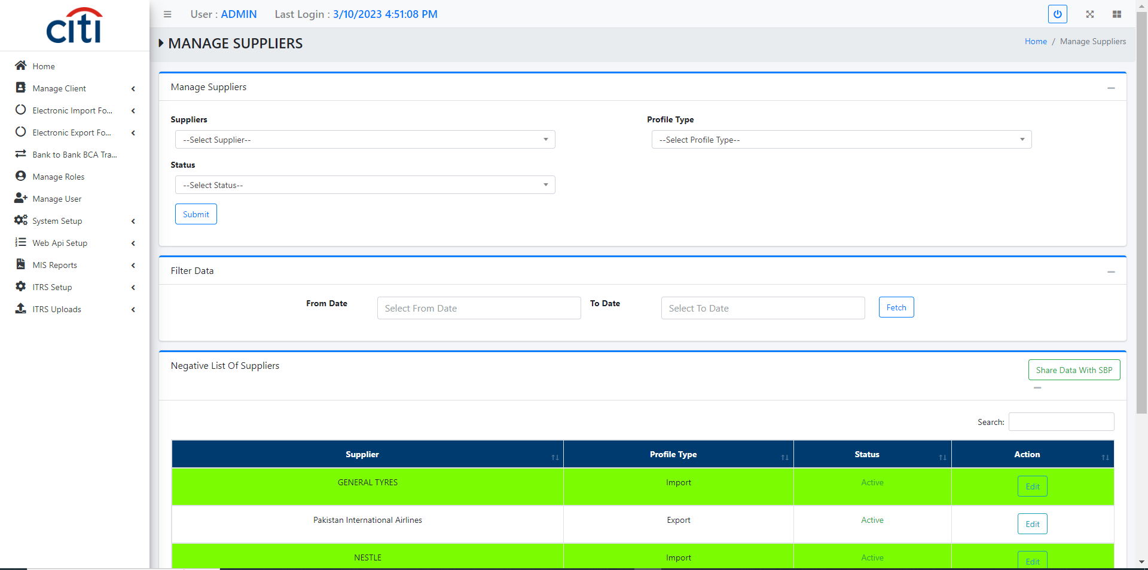
APPLICATION FLOW
Clients negative supplier add/share with PSW form
PAKISTAN SINGLE WINDOW
47

Slide 48
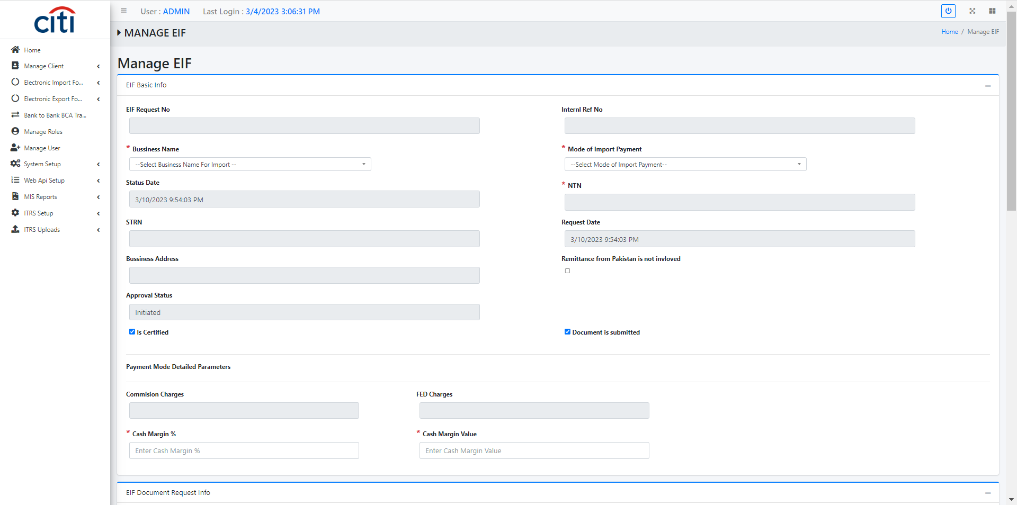
APPLICATION FLOW
EIF (Electronic Import Form) creation form
PAKISTAN SINGLE WINDOW
48

Slide 49
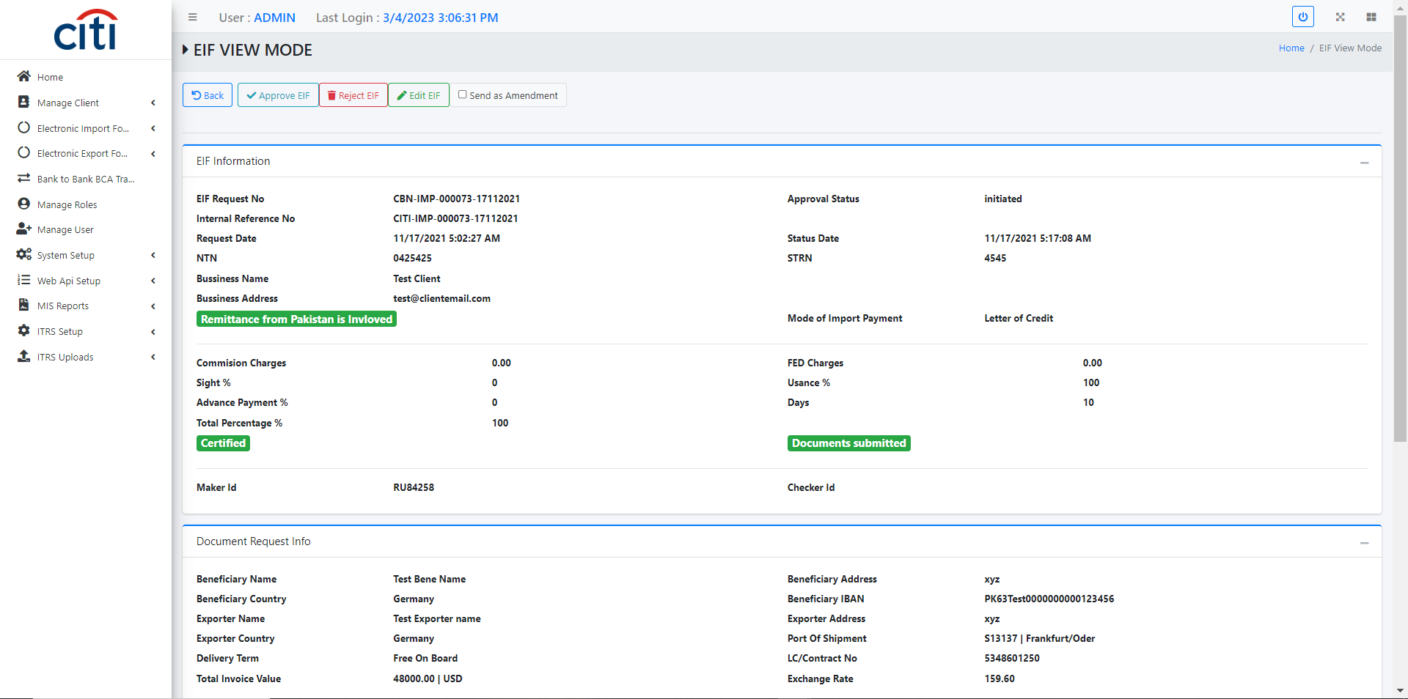
APPLICATION FLOW
EIF sharing with PSW form
PAKISTAN SINGLE WINDOW
49

Slide 50
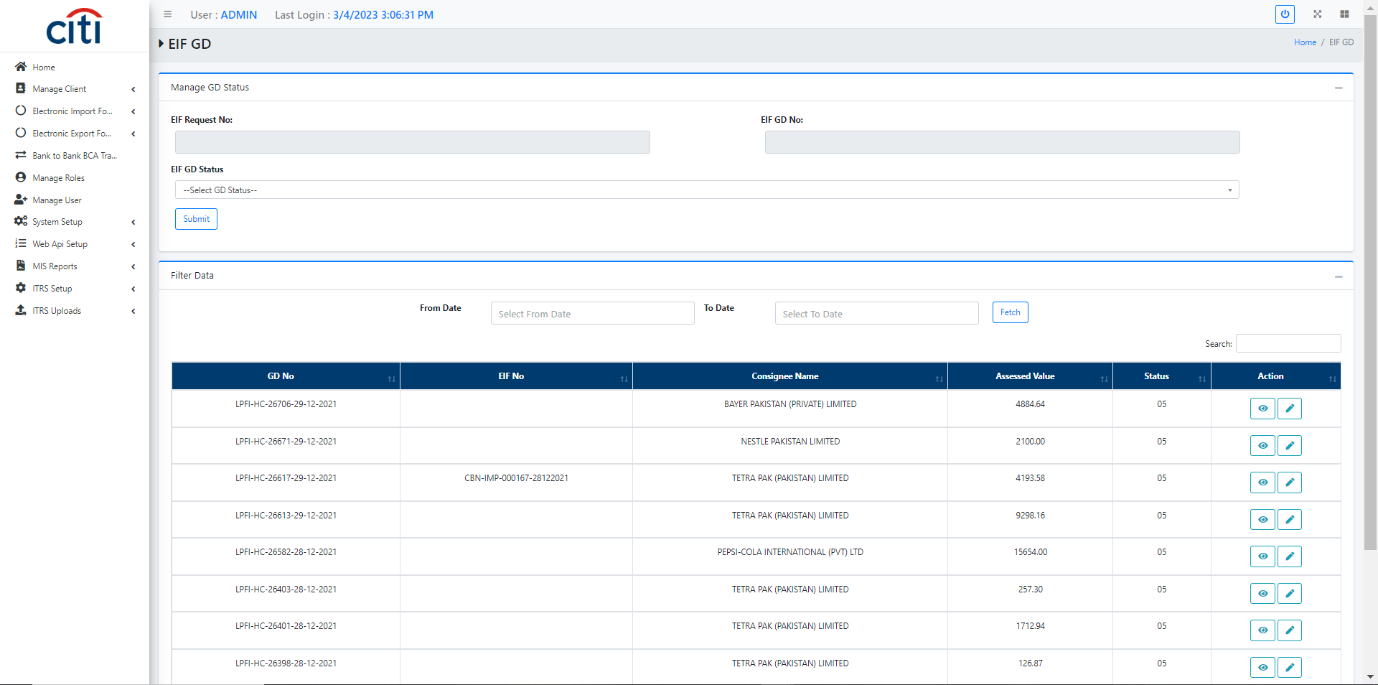
APPLICATION FLOW
EIF GDs share with PSW
PAKISTAN SINGLE WINDOW
50

Slide 51
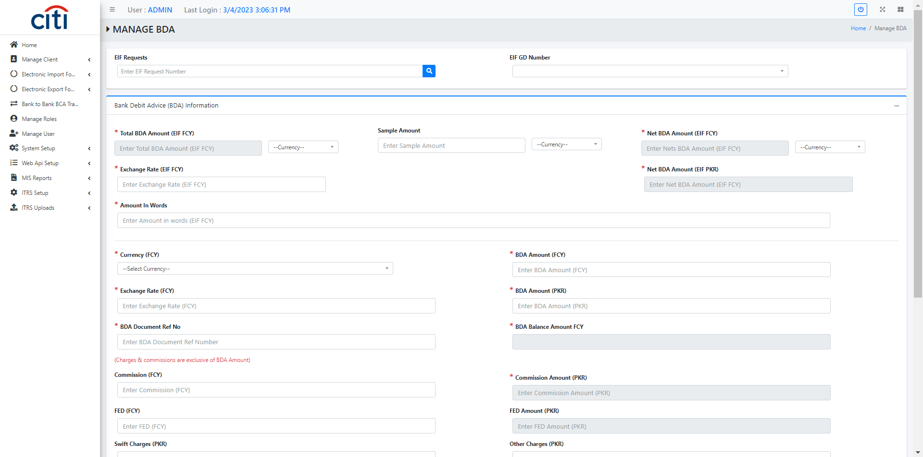
APPLICATION FLOW
EIF BDA add/share with PSW
PAKISTAN SINGLE WINDOW
51

Slide 52
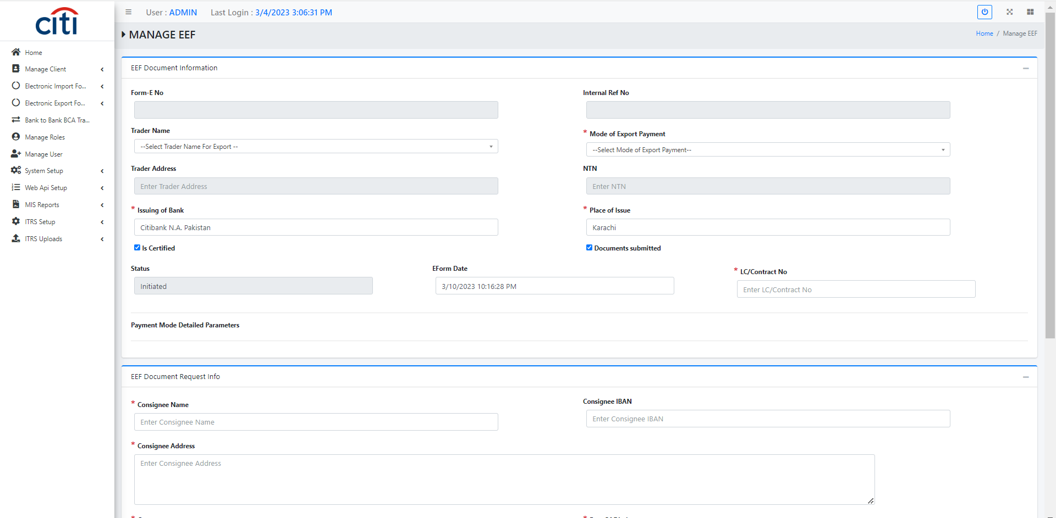
APPLICATION FLOW
EEF (Electrinic Export Form) add/share with PSW
PAKISTAN SINGLE WINDOW
52

Slide 53
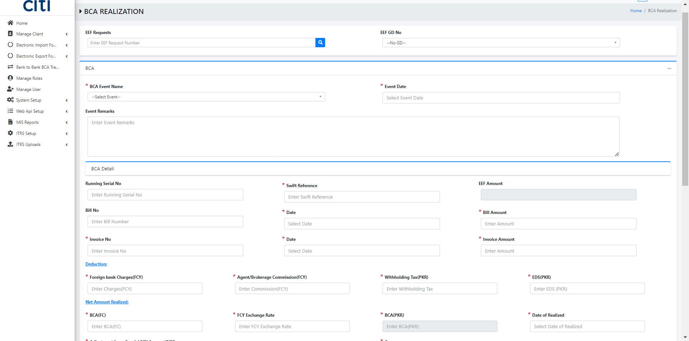
APPLICATION FLOW
EEF BCA add/share with PSW
PAKISTAN SINGLE WINDOW
53

Slide 54
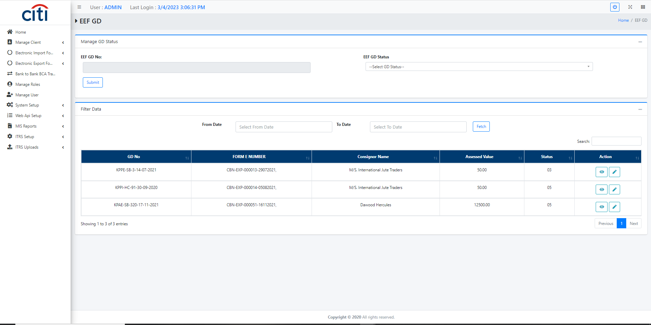
APPLICATION FLOW
EEF GDs share with PSW
PAKISTAN SINGLE WINDOW
54

Slide 55
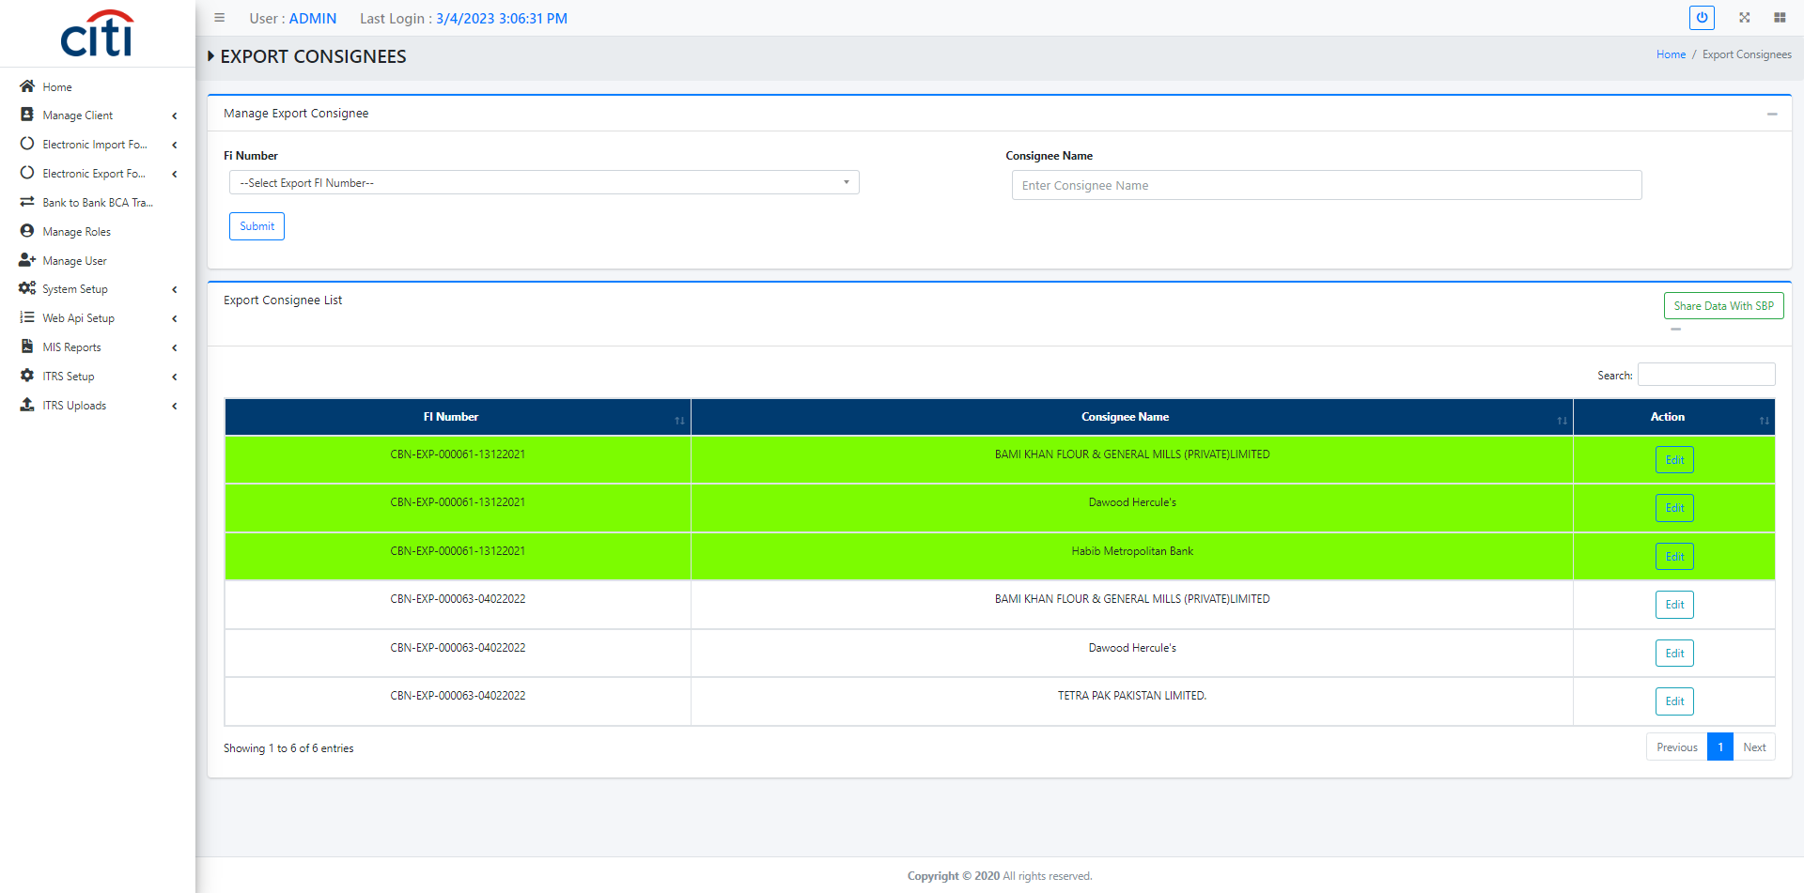
APPLICATION FLOW
Export consignee add/share with PSW
PAKISTAN SINGLE WINDOW
55

Slide 56
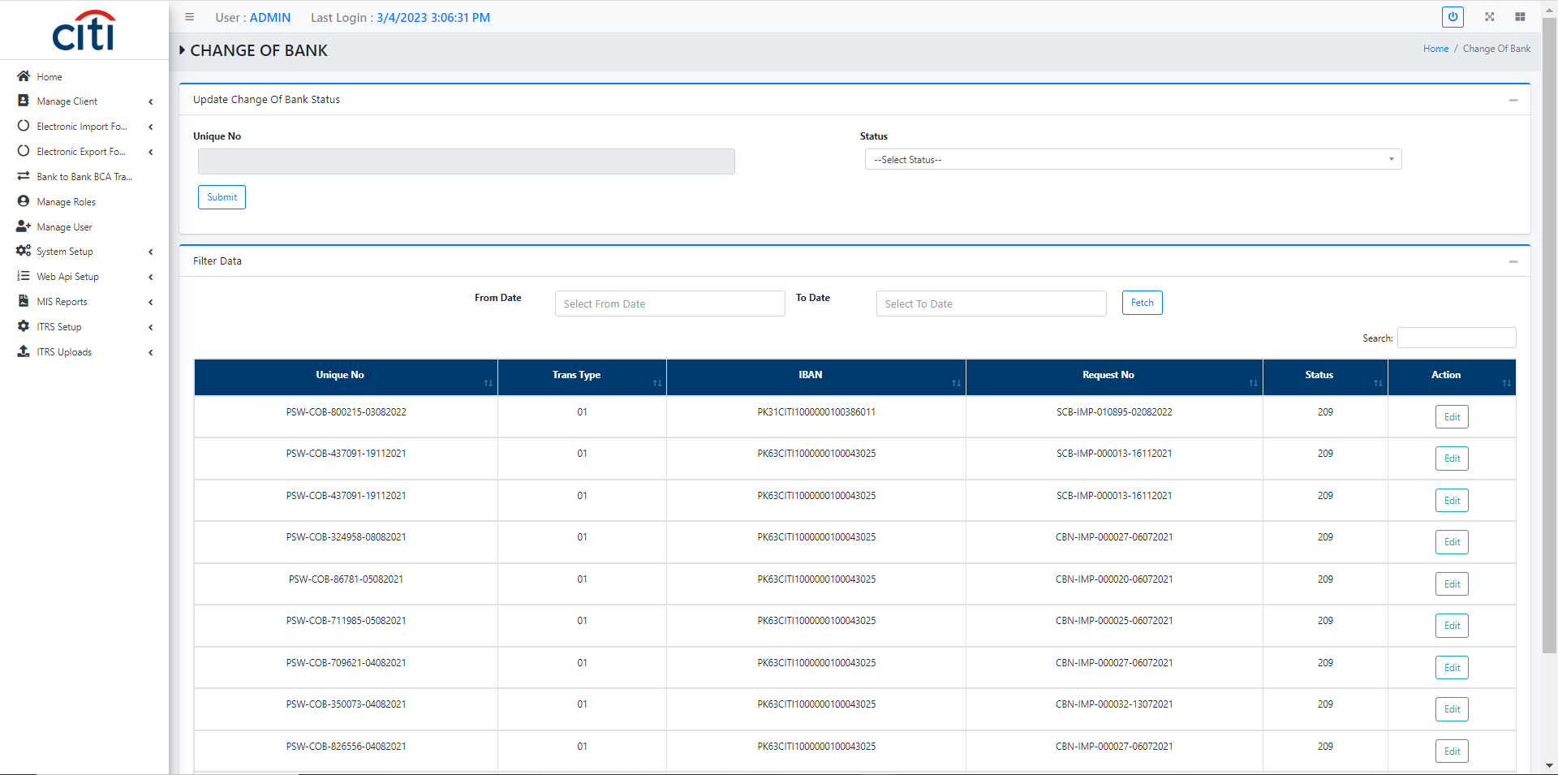
APPLICATION FLOW
Change of bank request
PAKISTAN SINGLE WINDOW
56

Slide 57
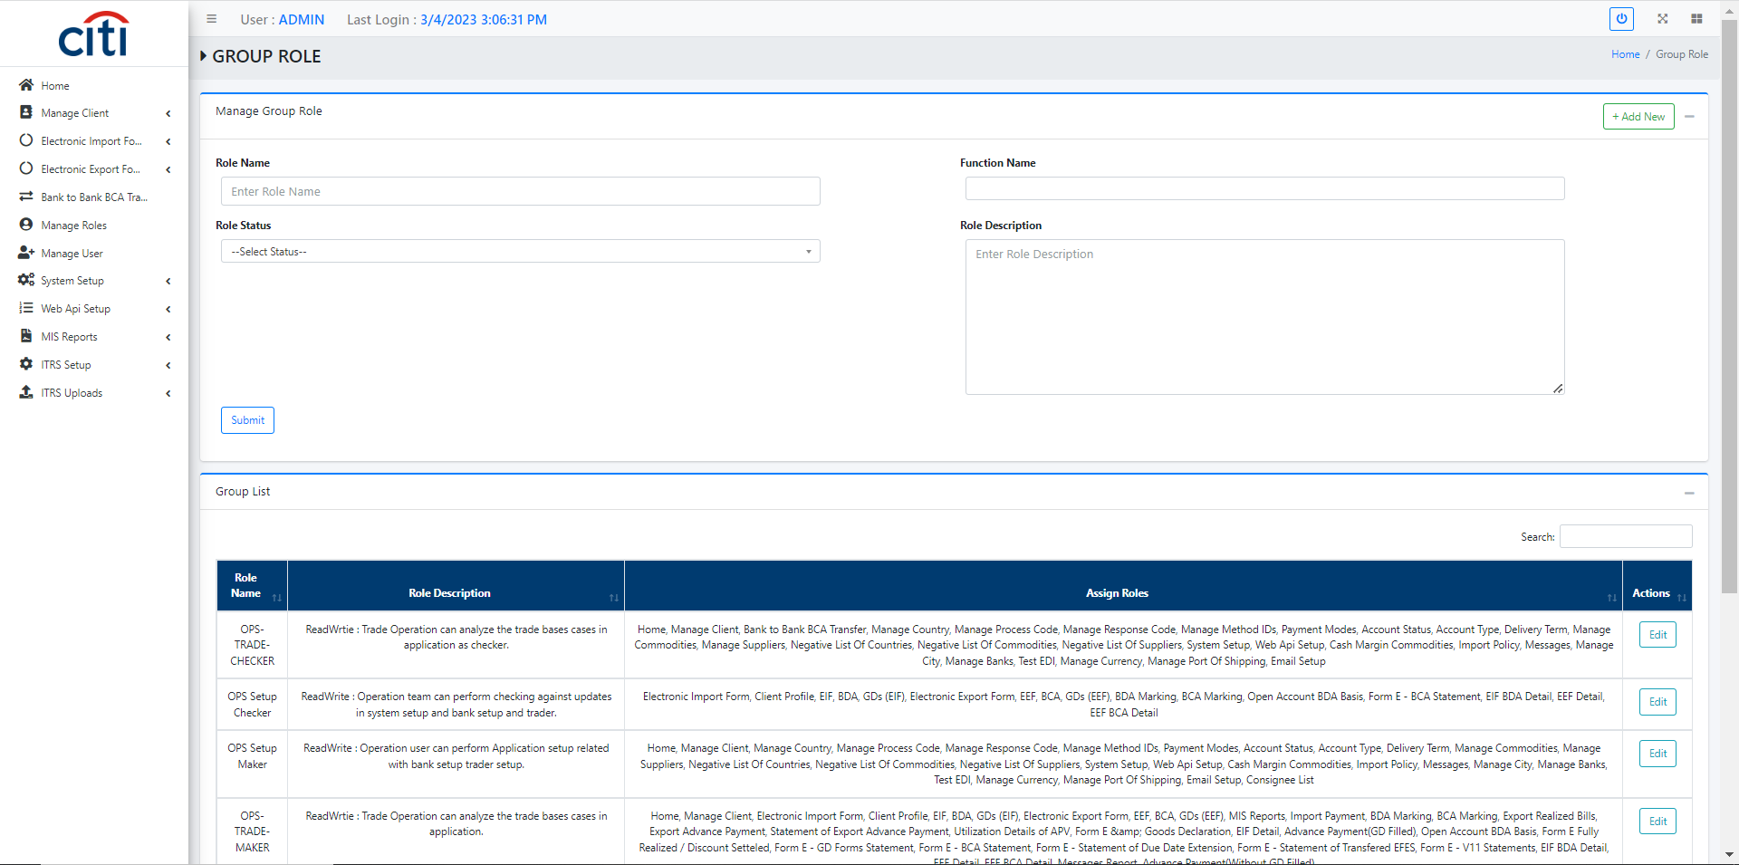
APPLICATION FLOW
Role creation form
PAKISTAN SINGLE WINDOW
57

Slide 58
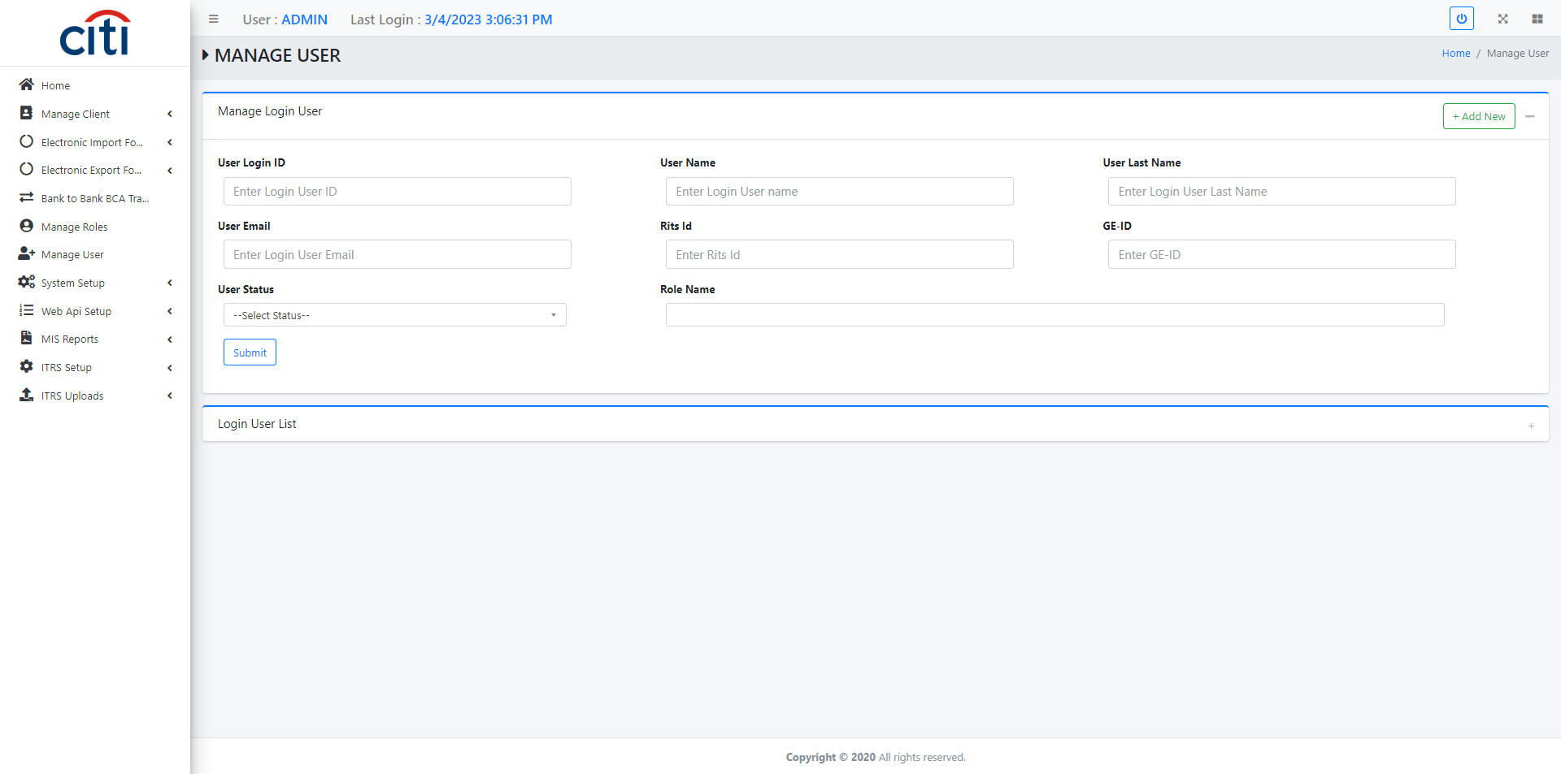
APPLICATION FLOW
User creation form
PAKISTAN SINGLE WINDOW
58

Slide 59
04
Setup
Reference data for countries, payment modes, delivery terms, and commodities
PAKISTAN SINGLE WINDOW
59

Slide 60
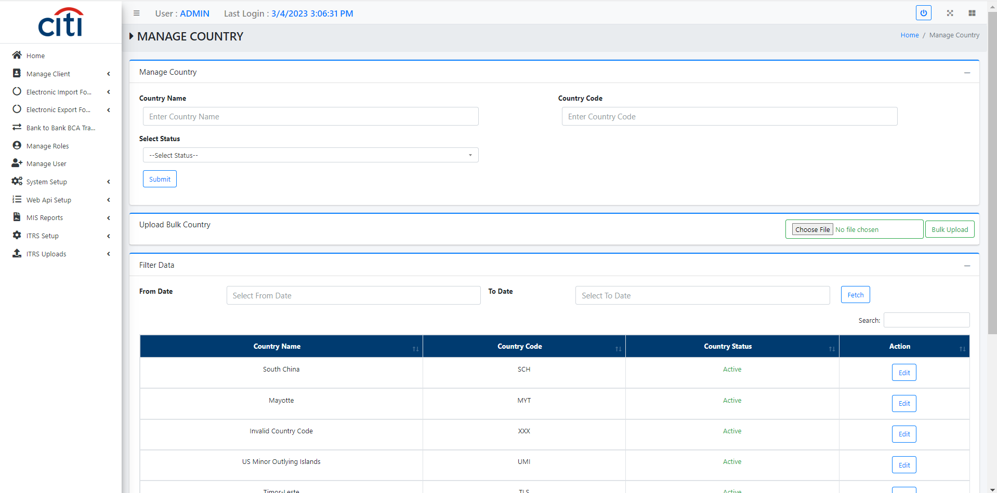
SETUP
Country setup
PAKISTAN SINGLE WINDOW
60

Slide 61
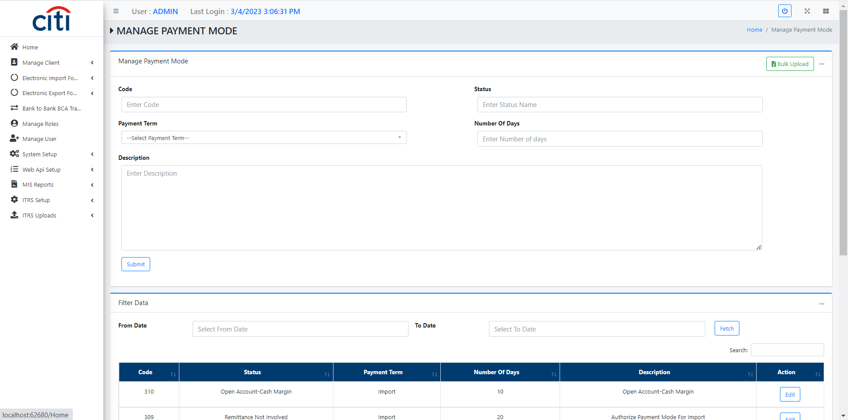
SETUP
Payment mode setup
PAKISTAN SINGLE WINDOW
61

Slide 62
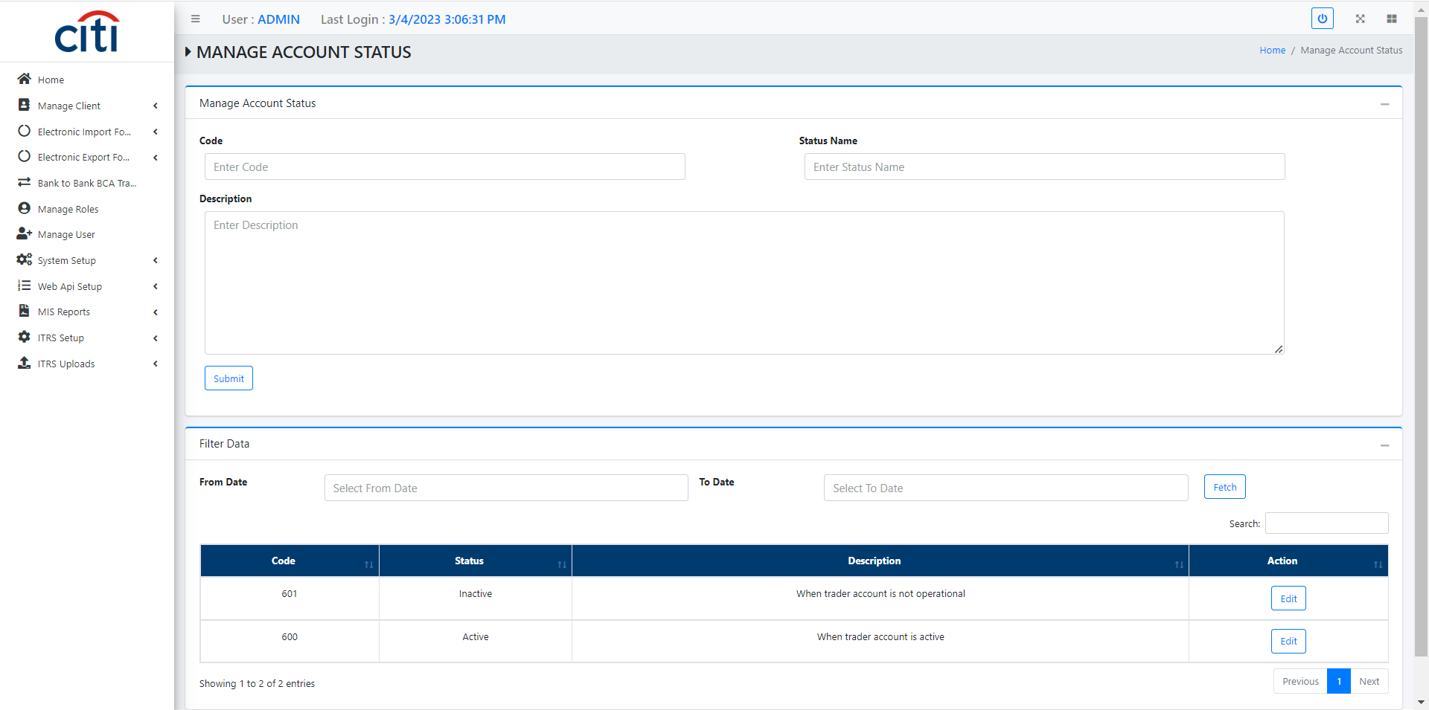
SETUP
Account status setup
PAKISTAN SINGLE WINDOW
62

Slide 63

SETUP
Delivery term setup
PAKISTAN SINGLE WINDOW
63

Slide 64

SETUP
Commodity setup
PAKISTAN SINGLE WINDOW
64

Slide 65

SETUP
Suppliers setup
PAKISTAN SINGLE WINDOW
65

Slide 66

SETUP
Commodity setup
PAKISTAN SINGLE WINDOW
66

Slide 67

SETUP
Cities setup
PAKISTAN SINGLE WINDOW
67

Slide 68
SETUP
Country setup
PAKISTAN SINGLE WINDOW
68

Slide 69

SETUP
Email setup
PAKISTAN SINGLE WINDOW
69

Slide 70

SETUP
UOM setup
PAKISTAN SINGLE WINDOW
70

Slide 71
05
Reports
Activity, transaction, and regulatory reports across EIF, EEF, and payments
PAKISTAN SINGLE WINDOW
71

Slide 72

REPORTS
Group activity report
PAKISTAN SINGLE WINDOW
72

Slide 73

REPORTS
User activity report
PAKISTAN SINGLE WINDOW
73

Slide 74

REPORTS
EIF report
PAKISTAN SINGLE WINDOW
74

Slide 75

REPORTS
EIF BDA report
PAKISTAN SINGLE WINDOW
75

Slide 76

REPORTS
EEF report
PAKISTAN SINGLE WINDOW
76

Slide 77

REPORTS
EEF BCA report
PAKISTAN SINGLE WINDOW
77

Slide 78

REPORTS
Request/response with PSW report
PAKISTAN SINGLE WINDOW
78

Slide 79

REPORTS
Import Payment report
PAKISTAN SINGLE WINDOW
79

Slide 80

REPORTS
EIF BDA marking report
PAKISTAN SINGLE WINDOW
80

Slide 81

REPORTS
EEF BCA marking report
PAKISTAN SINGLE WINDOW
81

Slide 82

REPORTS
FORM-E and Goods declaration report
PAKISTAN SINGLE WINDOW
82

Slide 83

REPORTS
Advanced payment with Gd filled
PAKISTAN SINGLE WINDOW
83

Slide 84
06
Deutsche Bank Reference
Reference screens from Deutsche Bank's application
PAKISTAN SINGLE WINDOW
84

Slide 85

DEUTSCHE BANK REFERENCE
Screenshot from Deutsche Bank's application
PAKISTAN SINGLE WINDOW
85

Slide 86

DEUTSCHE BANK REFERENCE
EIF Request Draft
PAKISTAN SINGLE WINDOW
86

Slide 87

DEUTSCHE BANK REFERENCE
BCA Regularization Draft
PAKISTAN SINGLE WINDOW
87

Slide 88

DEUTSCHE BANK REFERENCE
Manage GDA Draft
PAKISTAN SINGLE WINDOW
88

Slide 89
07
ITRS
International Transaction Reporting System setup and SBP data upload
PAKISTAN SINGLE WINDOW
89

Slide 90

ITRS
Ac-700 upload form
PAKISTAN SINGLE WINDOW
91

Slide 91

ITRS
FT801 upload form
PAKISTAN SINGLE WINDOW
92

Slide 92

ITRS
The final report will return an Excel file containing all ITRS data
PAKISTAN SINGLE WINDOW
93

Slide 93
Thank You
Questions & discussion welcome
Developed by Zealous Technologies
zealoustechnologies.com

