Slide 1
ZEALOUS TECHNOLOGIES • PRODUCT OVERVIEW
MMSEC
Money Market & Securities Management System
A unified treasury platform for securities, money market, and regulatory compliance
Developed by Zealous Technologies
zealoustechnologies.com

Slide 2



OVERVIEW
Project Summary
Enterprise Treasury Platform
End-to-End Automation
Controls & Transparency
Used by Citibank Pakistan's Treasury Department to manage securities, money market, repo/reverse repo, FX rates, and portfolios in compliance with SBP regulations.
Covers deal initiation, authorization, settlement, accounting entries, regulatory reporting, and portfolio monitoring — integrated with SBP's FXCRS and MMCRS systems.
Strengthens operational controls, ensures regulatory compliance, and enhances transparency across all treasury activities.
MMSEC
2

Slide 3






OVERVIEW
Project Highlights & Impact
PROJECT HIGHLIGHTS
IMPACT
Full Instrument Coverage
Less Manual Work
Money Market, Securities, Repo/Reverse Repo, FX rates, bidding, pledge securities, MAT and TP instruments
Reduction in manual processing and spreadsheet-based treasury operations
Automated Deal Uploads
Timely SBP Submission
Deal uploads and reporting automated through FXCRS and MMCRS
Accurate, on-time submission of treasury deals via FXCRS and MMCRS
System-Generated Entries
Enforced Controls
Financial entries for settlements, interest accruals, cash flows, and reversals
Tenor limits, volume limits, exposure controls, and authorization hierarchies
Maker-Checker Controls
Full Traceability
Authorization limits, trader setup, and counterparty validation
Complete deal traceability, accounting audit trails, and historical reporting
MMSEC
3

Slide 4

PLATFORM
System Architecture
A centralized treasury platform built on a secure enterprise architecture
Front Office
Middle Office
Back Office
Regulatory Integration
Reporting & MIS
Deal capture, bidding, rate input, trader setup, counterparty management
Limit monitoring, exposure management, tenor validation, compliance checks
Settlement processing, accounting entries, interest calculations, day-end operations
Automated connectivity with SBP FXCRS and MMCRS systems
Operational, regulatory, and management information reports
MMSEC
4

Slide 5
OVERVIEW
What MMSEC Does
DESCRIPTION
OBJECTIVE
MMSEC provides structured screens and workflows for the complete lifecycle of treasury instruments, all following controlled maker-checker workflows.
MMSEC is designed to deliver on five core objectives for the Treasury Department:
Automate Money Market & Securities treasury operations
Securities issuance, purchase, sale, pledging, and portfolio management
Ensure full compliance with SBP regulatory requirements
Money Market and Repo / Reverse Repo deal processing
Integrate seamlessly with FXCRS and MMCRS systems
FX rate input and valuation support
Strengthen internal controls and authorization mechanisms
Automated financial entries and cash flow generation
Provide real-time visibility of treasury positions and exposures
Regulatory and management reporting
MMSEC
5

Slide 6
OVERVIEW
MMSEC Users
Treasury Front Office (Dealers / Traders)
Treasury Middle Office (Risk & Compliance)
Treasury Back Office (Settlements & Accounting)
Finance & Accounting Teams
Internal Audit & Compliance
Senior Management
State Bank of Pakistan (via FXCRS & MMCRS)
MMSEC FUNCTIONAL MODULES
Securities Management
Money Market & Repo
Accounting & Financials
System Setup & Controls
Reports & Compliance
Issue setup, security types, portfolio setup, pledging, purchase/sale, position tracking
Money market deals, bidding, acceptance, PKRV tenors, repo and reverse repo processing
Interest accruals, settlements, cash flows, reserve interest, receivables
Traders, branches, counterparties, authorization limits, system parameters
Daily activity, weekly position, SBP reports, audit and history reports
MMSEC
6

Slide 7

WORKFLOW
Process Explanation
1
2
3
4
5
Deal Initiation
Maker-Checker Authorization
Back Office Processing
Regulatory Upload
Day-End & Reporting
The Treasury Front Office (or a parent software feed) captures deal details — instrument type, counterparty, tenor, rate, and settlement instructions.
Deals follow independent validation before execution; the system performs limit checks, tenor validations, and exposure controls.
MMSEC generates settlement instructions, accounting entries, interest accruals, and cash flow schedules automatically.
Relevant deal data is uploaded to SBP regulatory systems (FXCRS / MMCRS) as per prescribed formats.
Day-end processing, portfolio position updates, and generation of regulatory, operational, and management reports.
MMSEC
7

Slide 8
PLATFORM
Dependencies
MMSEC relies on the availability and accuracy of key upstream and downstream systems
Core Banking System
SBP Regulatory Systems
Source of settlement accounts, customer data, and accounting integration
FXCRS and MMCRS for regulatory deal reporting and compliance (optional)
Reference Data Repositories
Email / Network Services
PKRV rates, FX rates, security issue details, tenor definitions, counterparty master data
Required for system notifications, alerts, and operational communications
MMSEC
8

Slide 9
DEPLOYMENT
Hardware & Software Requirements
Preferable development environment: ASP.NET MVC.
A Windows Server with IIS Manager installed is required to deploy the ASP.NET MVC application.
Application | Specs | OS
Minimum | RAM: 8 GB • Cores: 4 • Storage (SSD): 50 GB | Any
Recommended | RAM: 16 GB • Cores: 8 • Storage (SSD): 50–100 GB | Any
MMSEC
9

Slide 10
REPORTING
Reports Framework
A comprehensive reporting framework supporting operations, management oversight, audit, and regulatory compliance
Operational Reports
Management & MIS Reports
Regulatory & SBP Reports
Audit & Control Reports
Daily Activity Report
Portfolio and Position Reports
FXCRS Deal Upload Reports
User Activity and Access Logs
Deal Transaction Reports
Weekly and Monthly Treasury Position
MMCRS Regulatory Reports
Authorization and Limit Override Reports
Settlement and Cash Flow Reports
Exposure and Limit Monitoring Reports
SBP Prescribed Returns and Statements
Historical Deal and Accounting Trace Reports
Repo / Reverse Repo Reports
MMSEC
10

Slide 11
01
Admin Portal
Login, dashboard, accounting entries, and deal booking
MMSEC
11

Slide 12
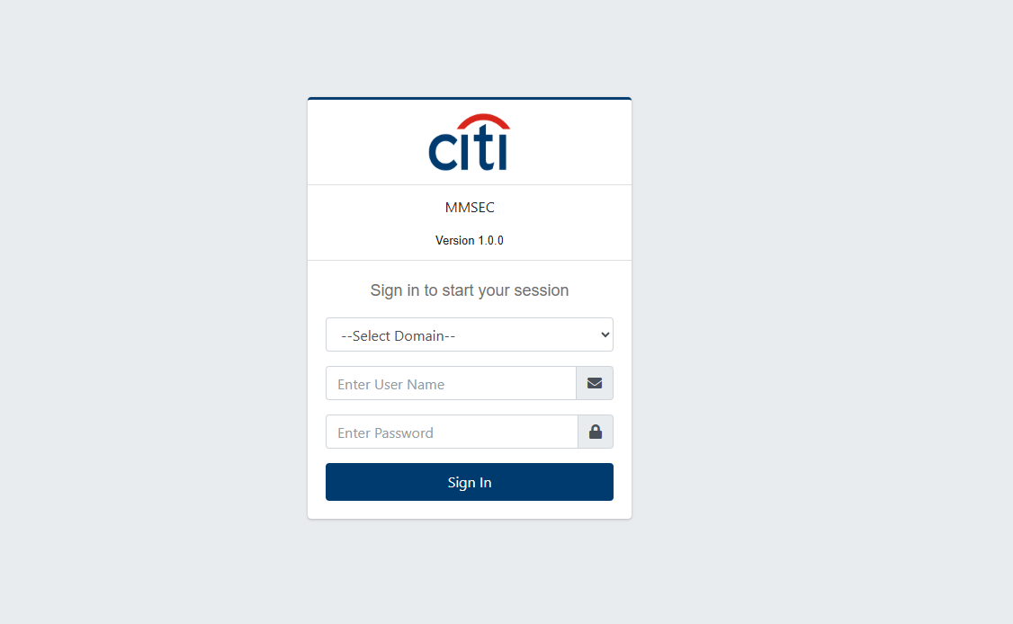
ADMIN PORTAL
Login
MMSEC
12

Slide 13
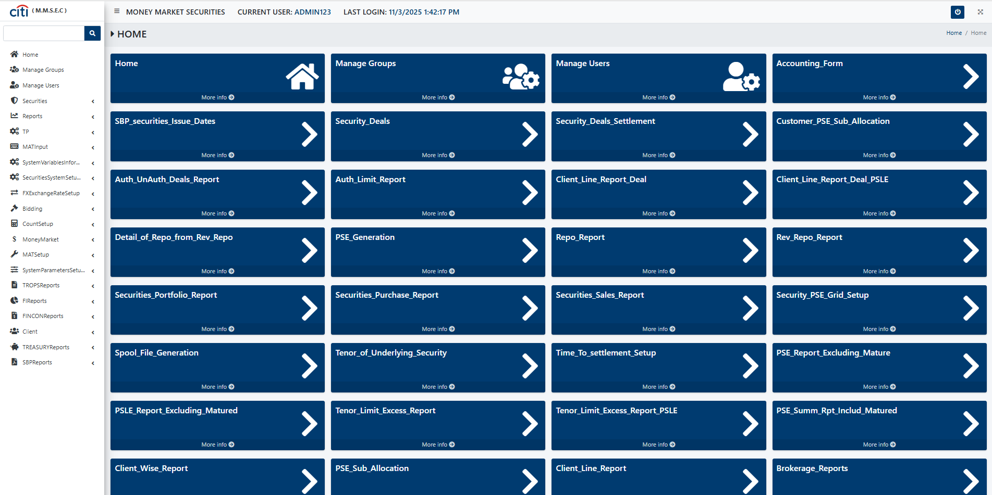
ADMIN PORTAL
Dashboard (full access to all screens)
MMSEC
13

Slide 14
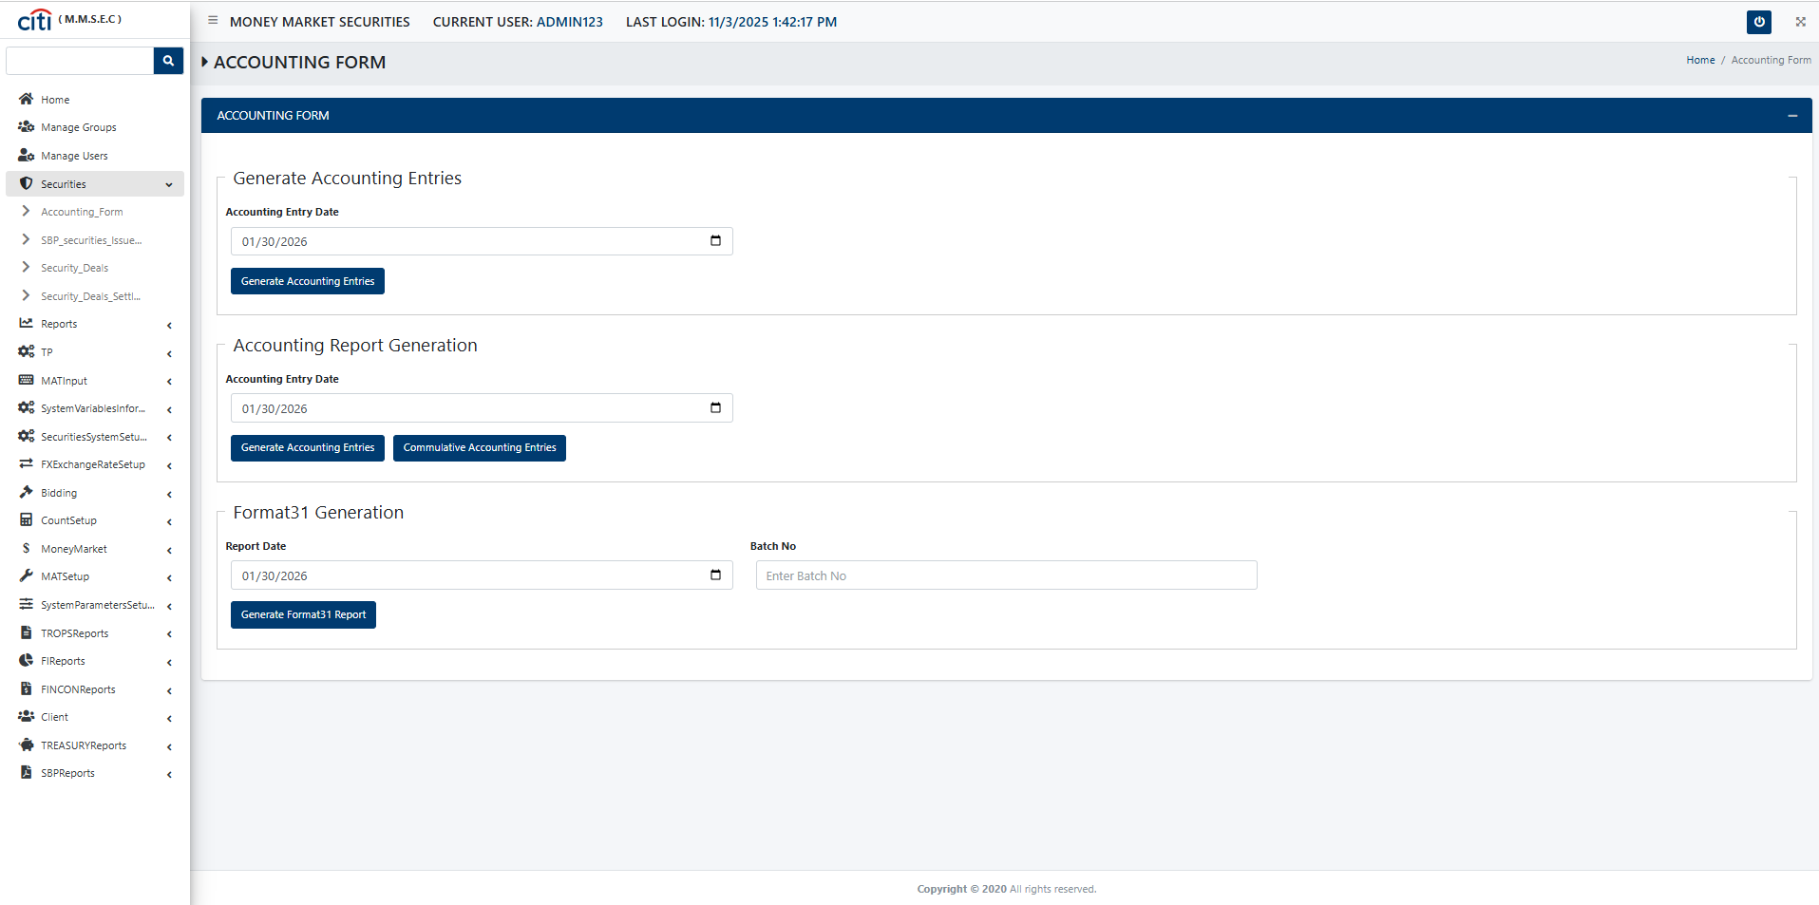
ADMIN PORTAL
Accounting Entries & Format 31 generation
MMSEC
14

Slide 15
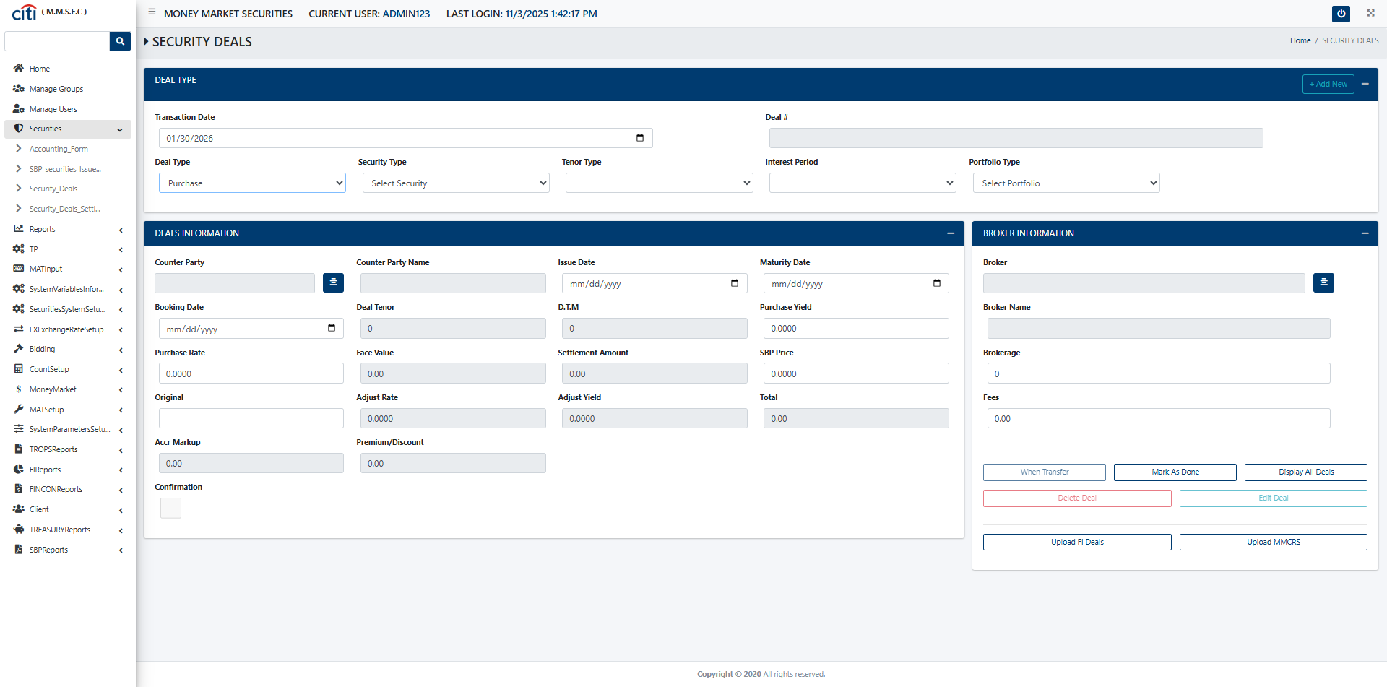
ADMIN PORTAL
Deal Booking Form with precise calculations of accruals settlement and rates
MMSEC
15

Slide 16

02
Securities
Purchase, sale, repo, reverse repo, and settlement forms
MMSEC
16

Slide 17
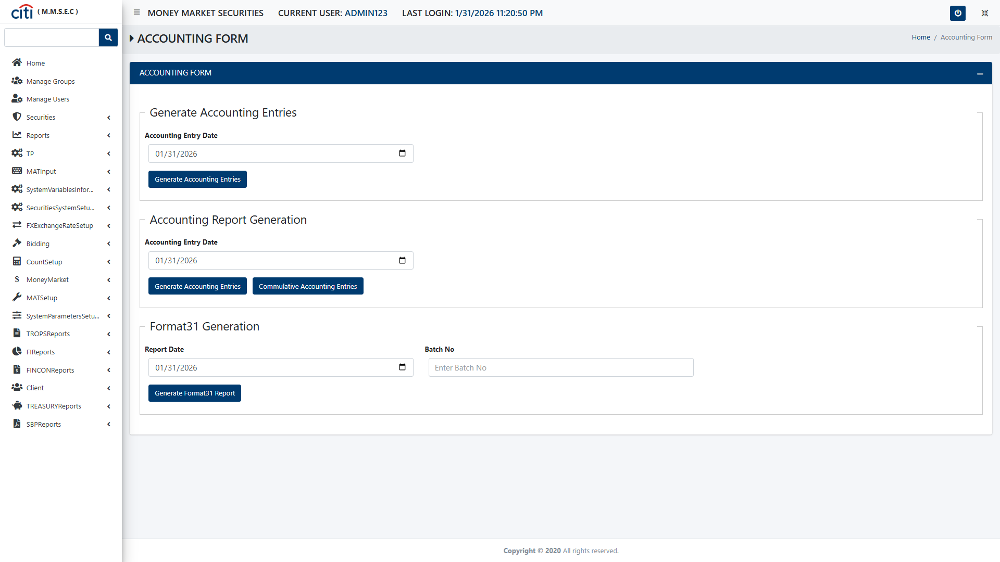
SECURITIES
Securities Accounting form
MMSEC
17

Slide 18
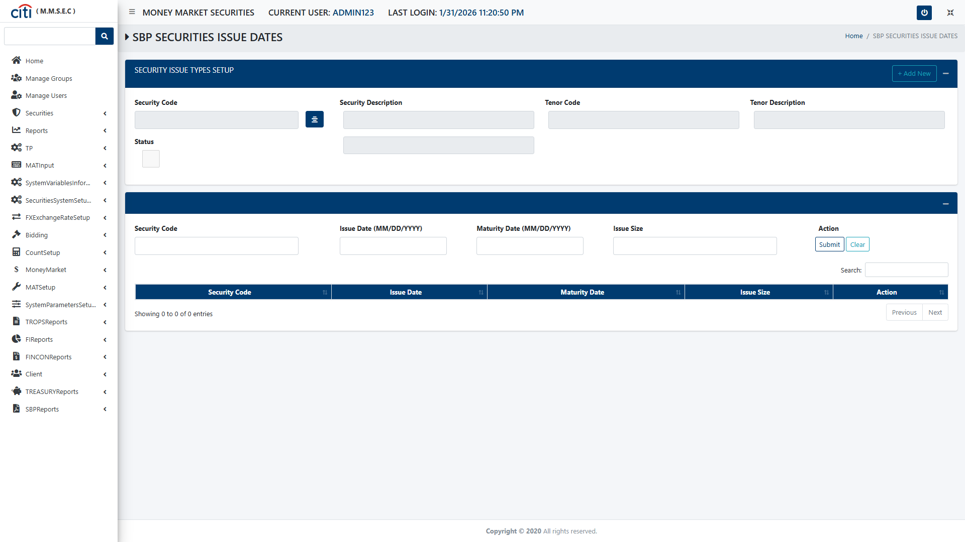
SECURITIES
SBP Securities Issue Dates form
MMSEC
18

Slide 19
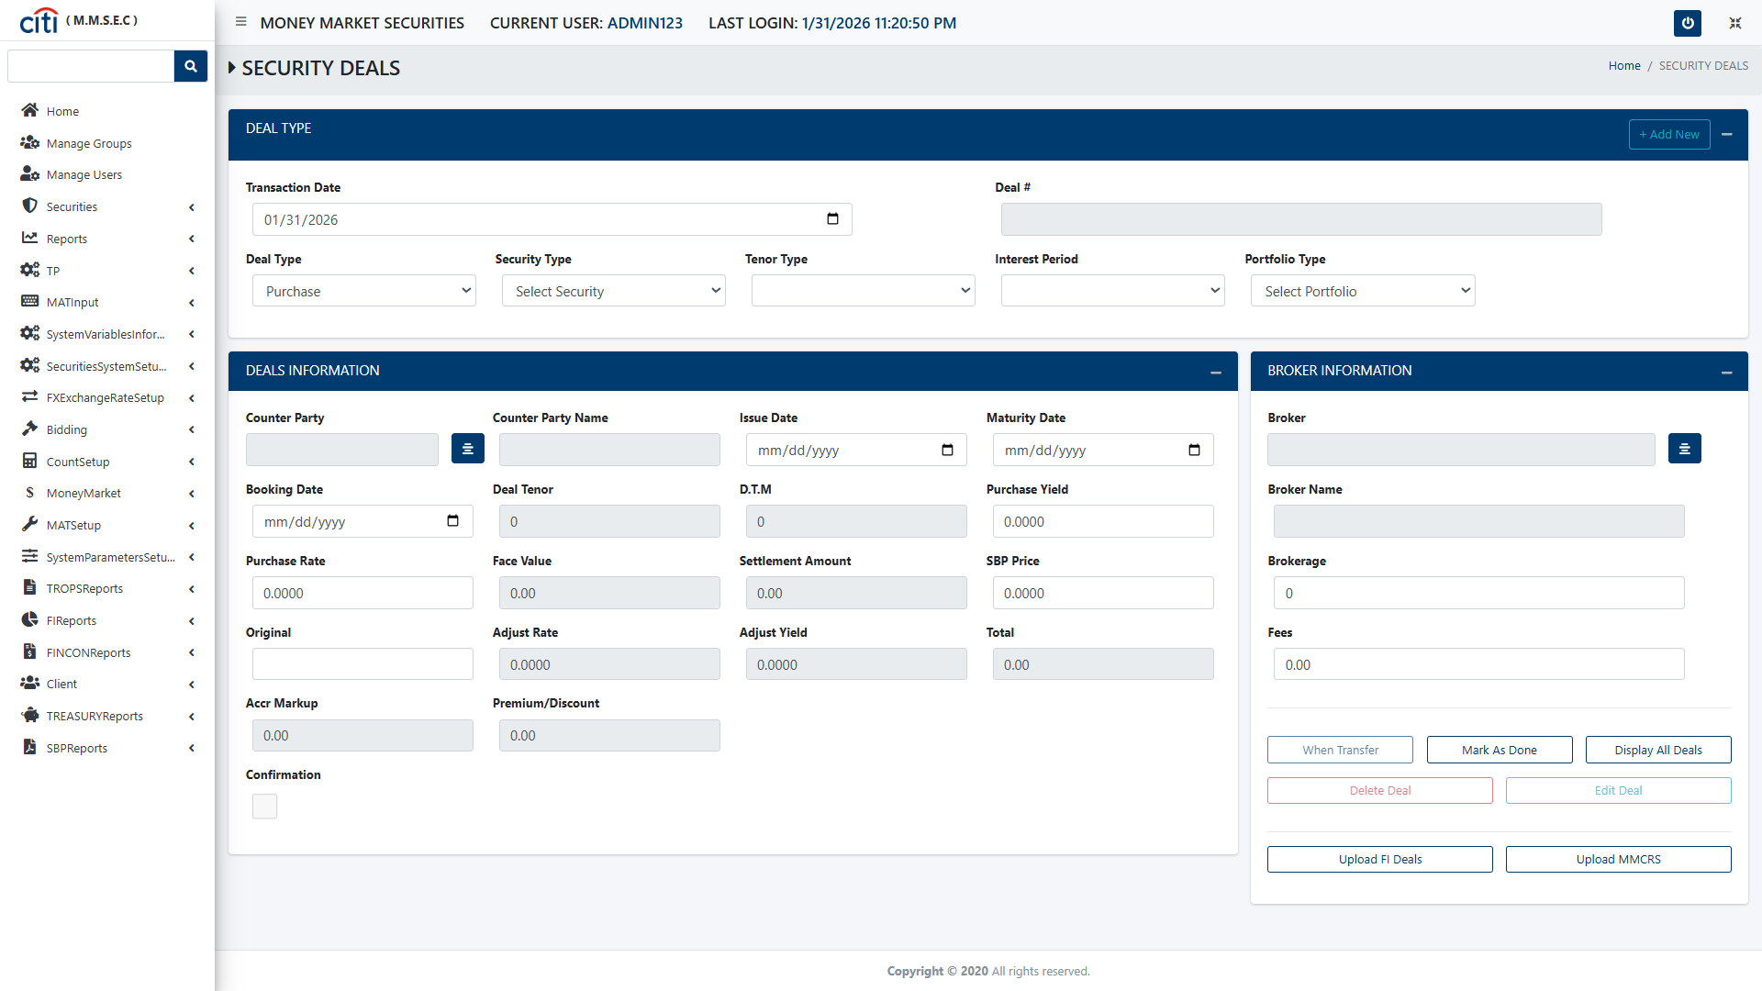
SECURITIES
Security Deals Purchase Form
MMSEC
19

Slide 20
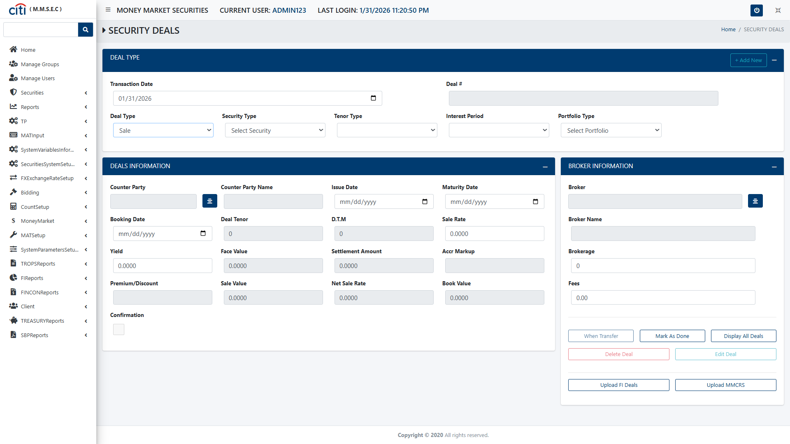
SECURITIES
Security Deals Sales Form
MMSEC
20

Slide 21
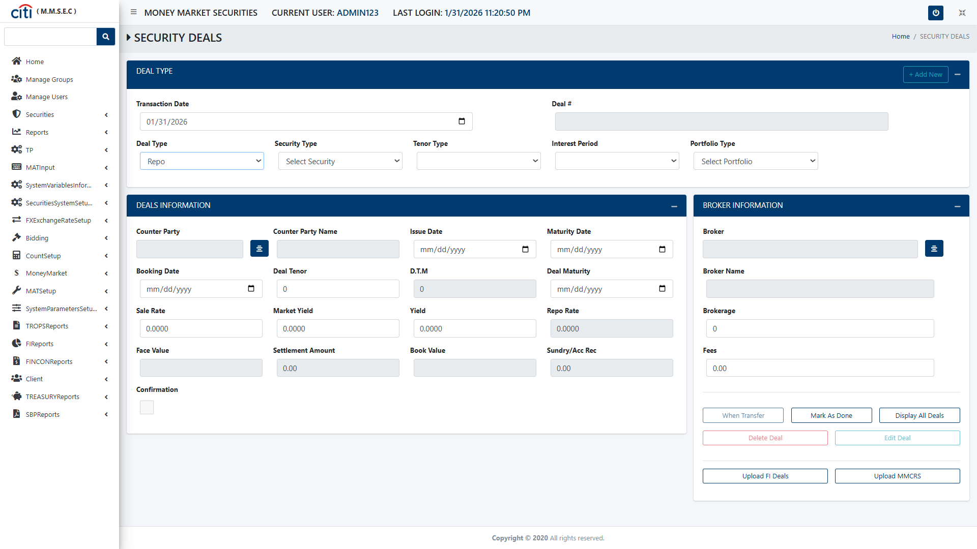
SECURITIES
Security Deals Repo Form
MMSEC
21

Slide 22
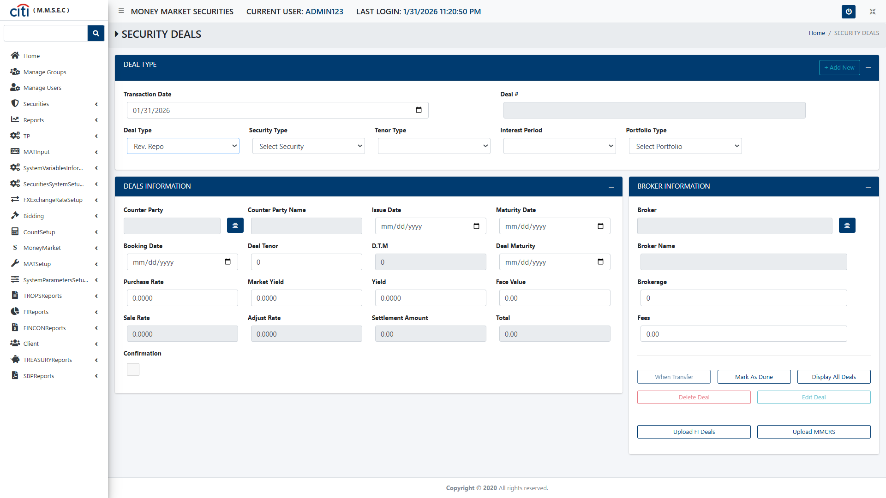
SECURITIES
Security Deals Reverse Repo Form
MMSEC
22

Slide 23
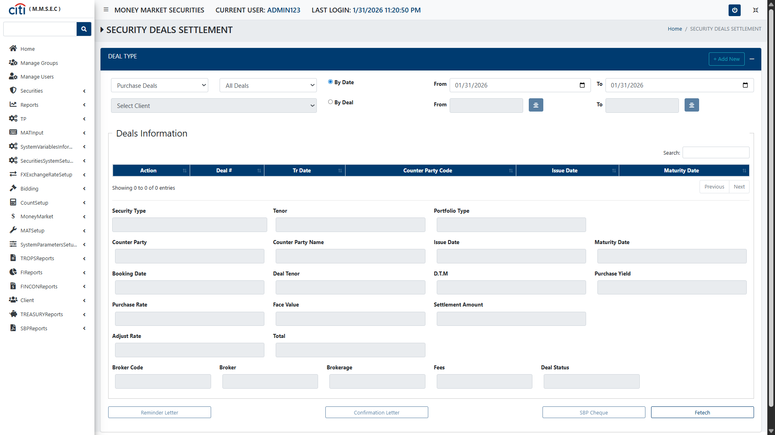
SECURITIES
Security Deals Purchase Settlement Form
MMSEC
23

Slide 24
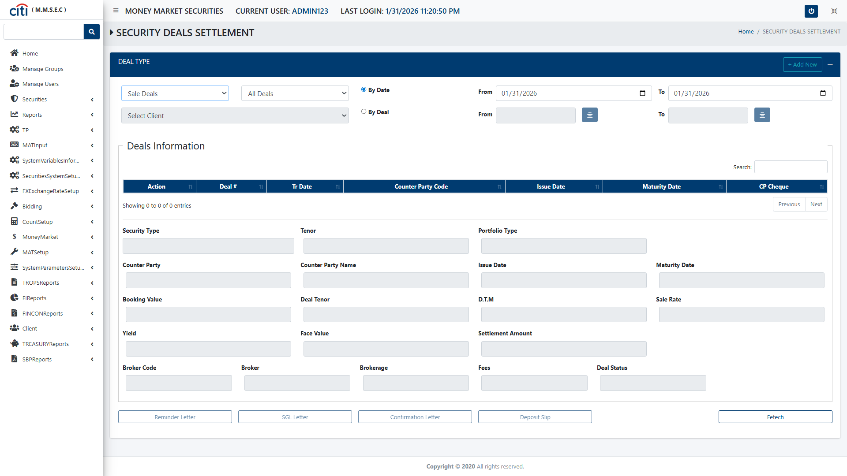
SECURITIES
Security Deals Sales Settlement form
MMSEC
24

Slide 25
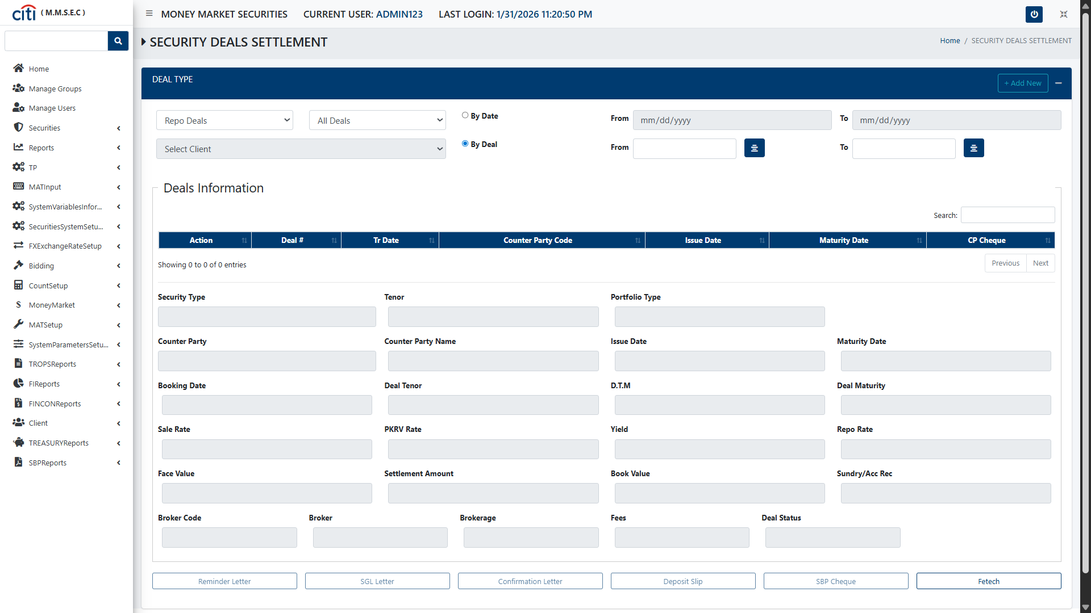
SECURITIES
Security Deals Repo Settlement form
MMSEC
25

Slide 26

SECURITIES
Security Deals Reverse Repo Settlement
MMSEC
26

Slide 27
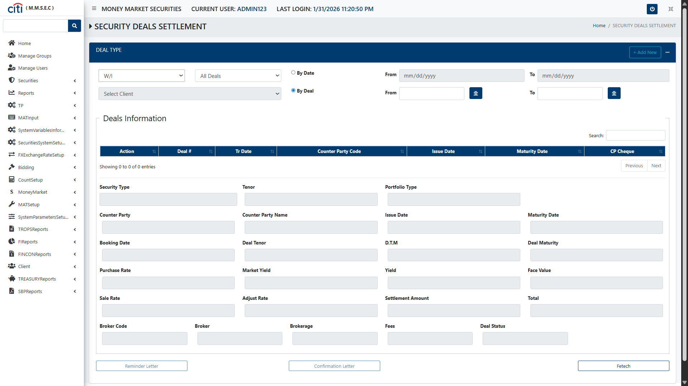
SECURITIES
Security Deals W/1 Settlement form
MMSEC
27

Slide 28
03
Reports
Deal, limit, client line, and settlement reporting
MMSEC
28

Slide 29
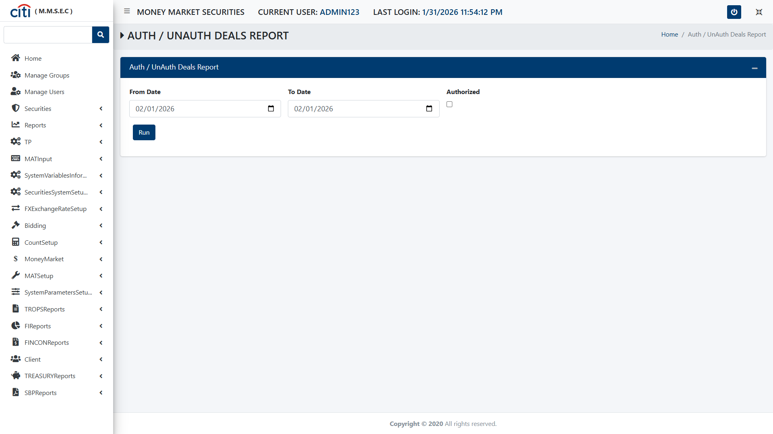
REPORTS
Authorized/Unauthorized Deals Report form
MMSEC
29

Slide 30
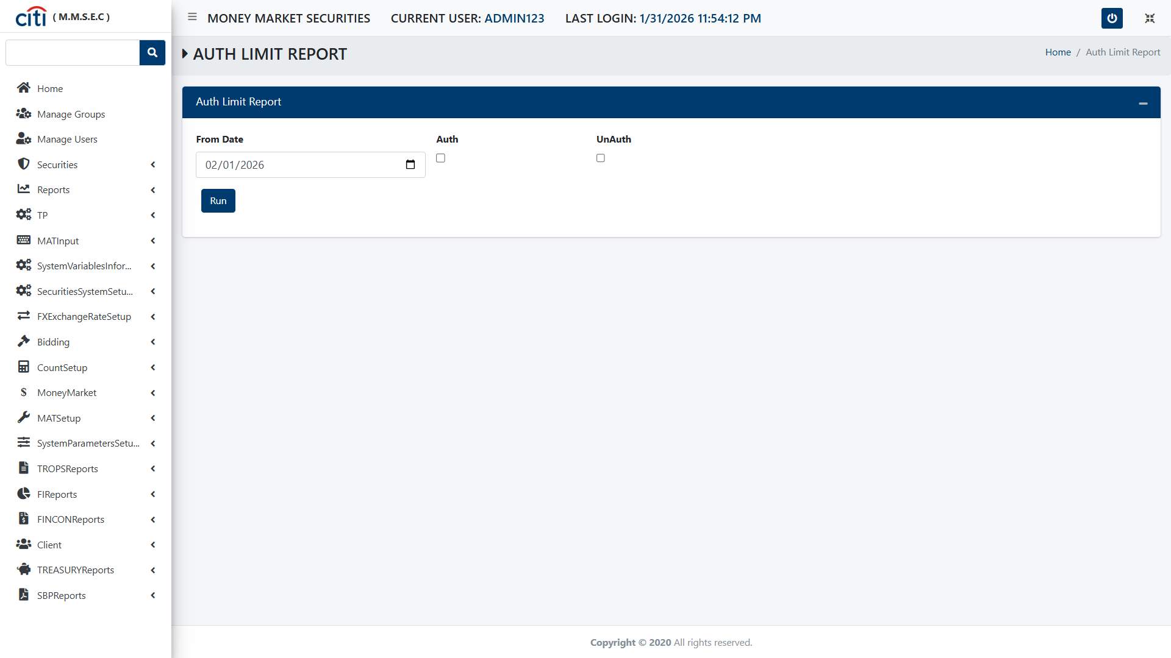
REPORTS
Authorized Limit Report form
MMSEC
30

Slide 31
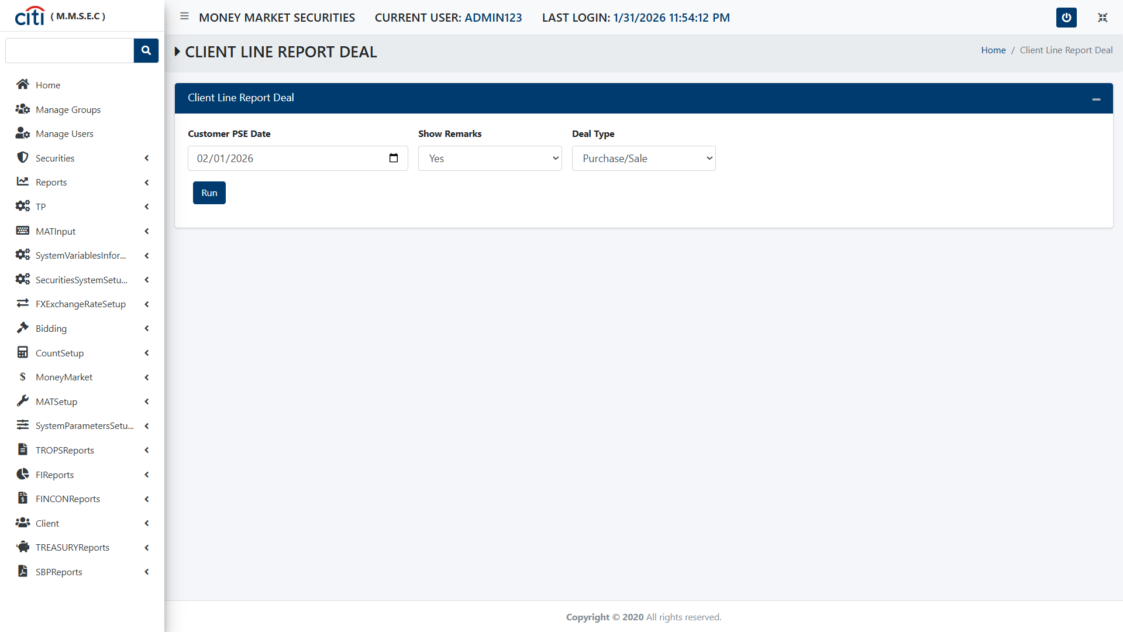
REPORTS
Client Line Report Deal form
MMSEC
31

Slide 32
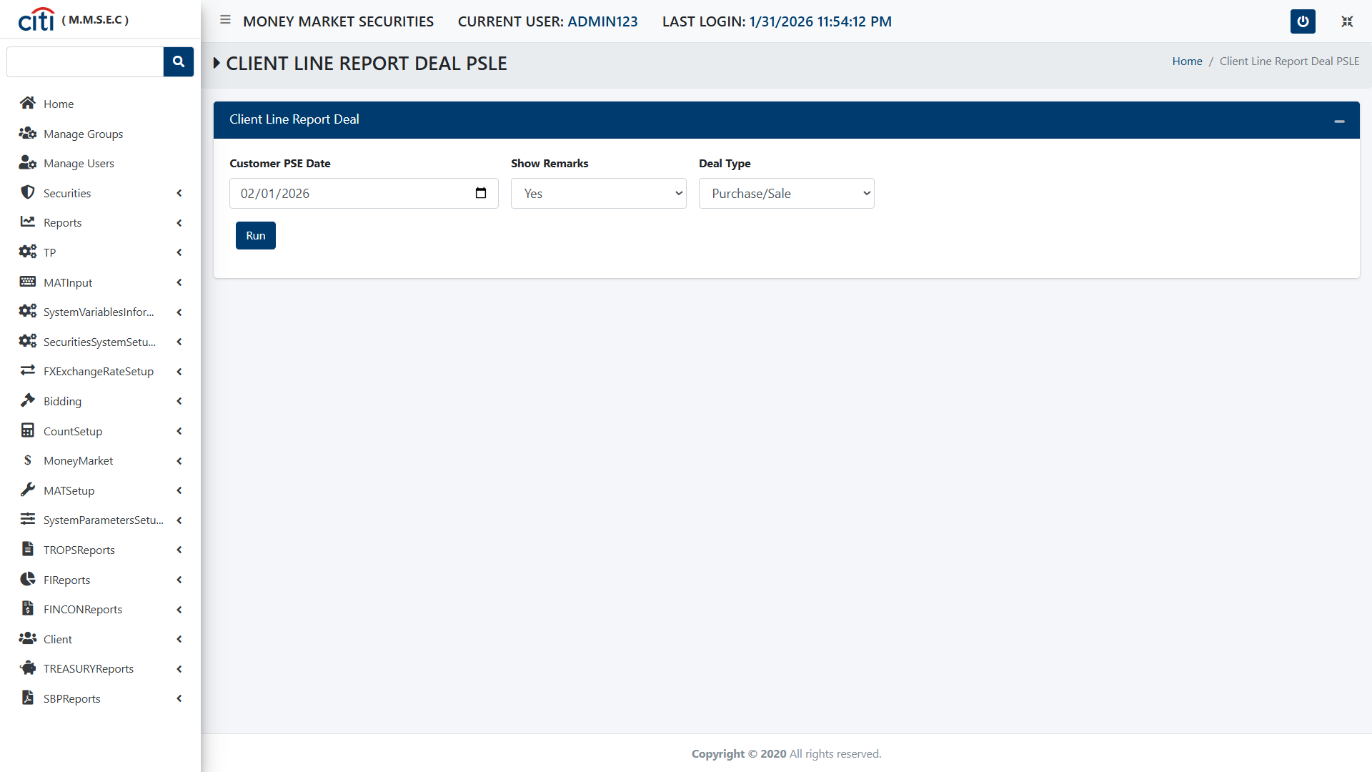
REPORTS
Client Line Report Deal form
MMSEC
32

Slide 33
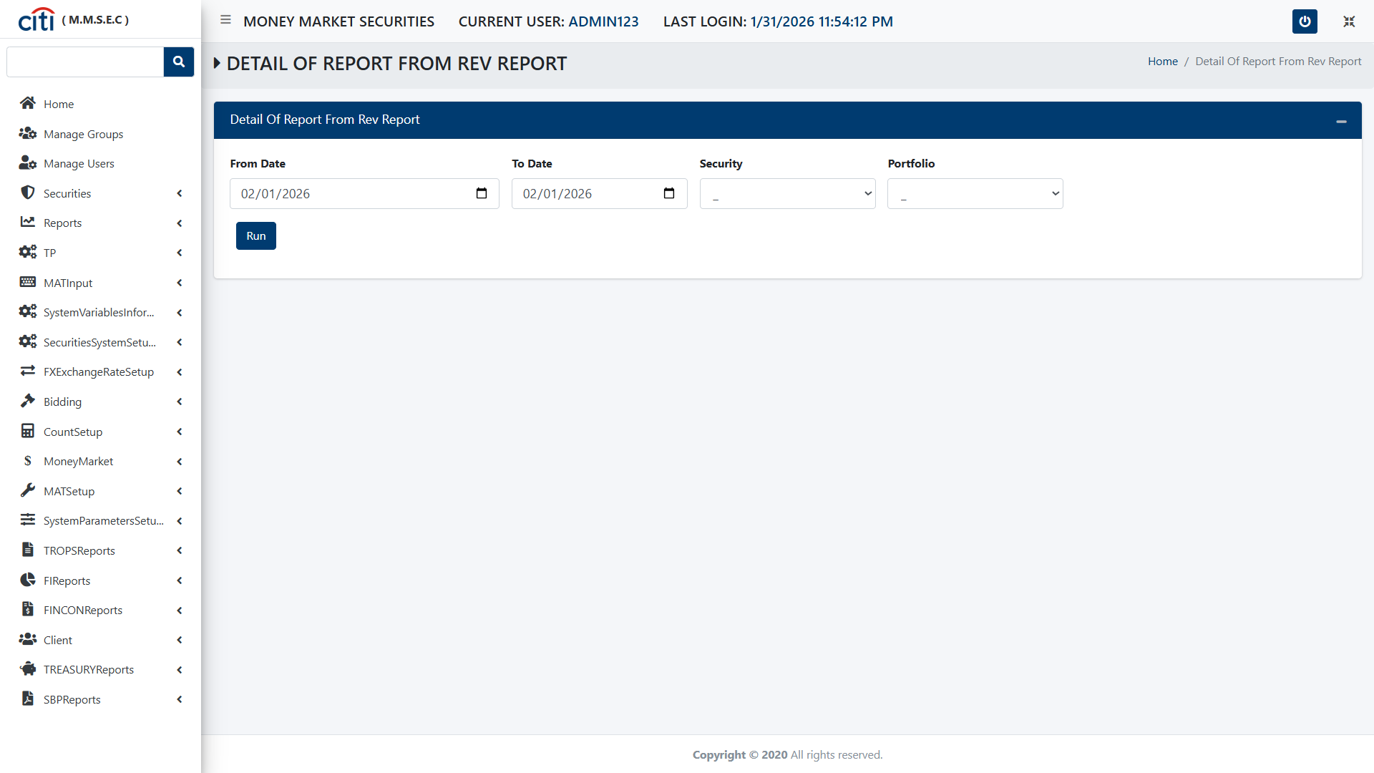
REPORTS
Detail of Report from Rev Report form
MMSEC
33

Slide 34
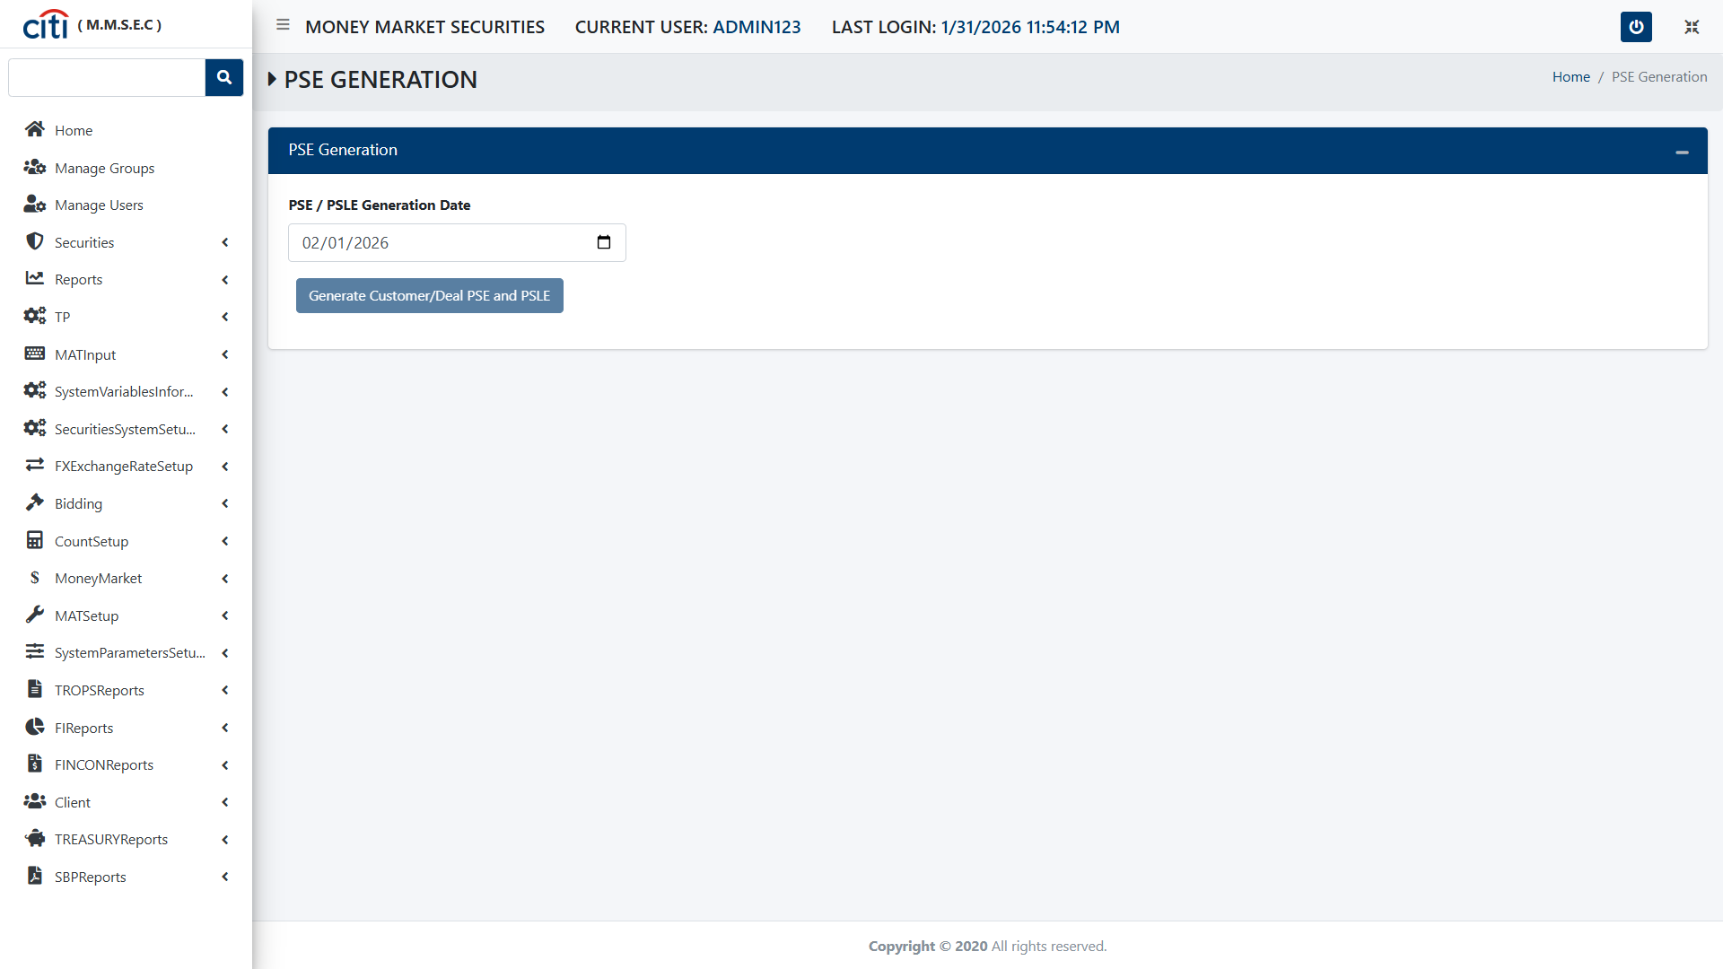
REPORTS
PSE Generation form
MMSEC
34

Slide 35
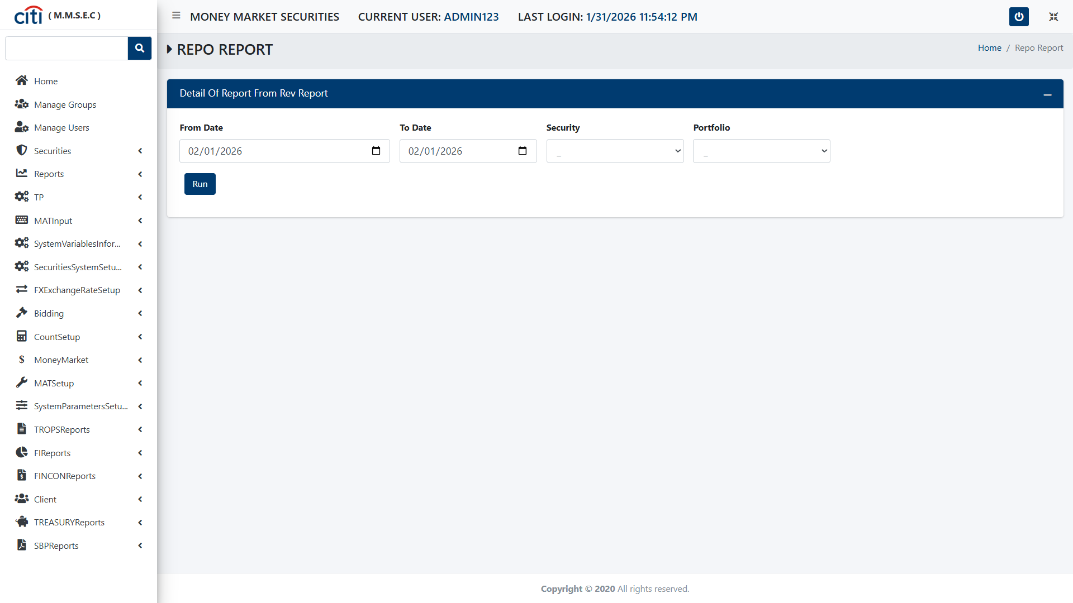
REPORTS
Repo Report form
MMSEC
35

Slide 36

REPORTS
Reverse Repo Report form
MMSEC
36

Slide 37

REPORTS
Securities Purchase Report form
MMSEC
37

Slide 38
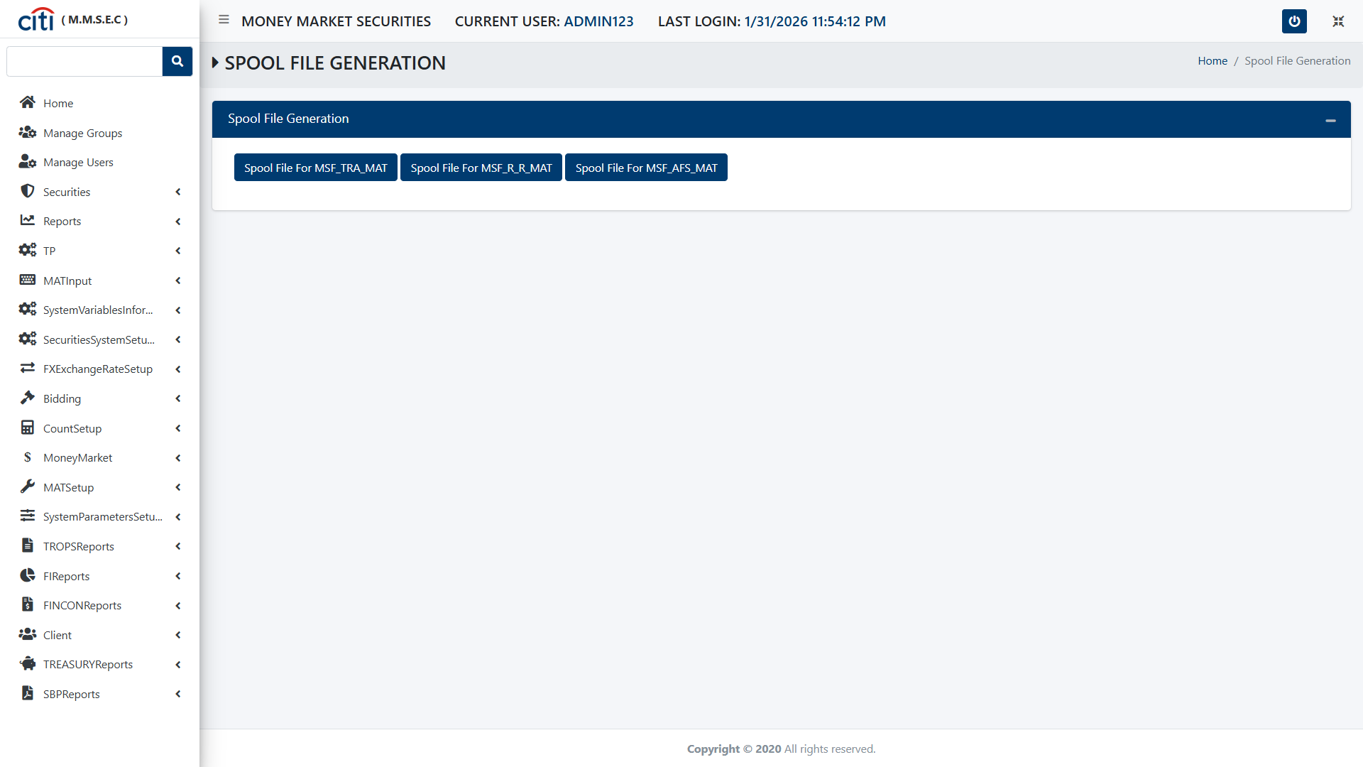
REPORTS
Spool File Generation form
MMSEC
38

Slide 39
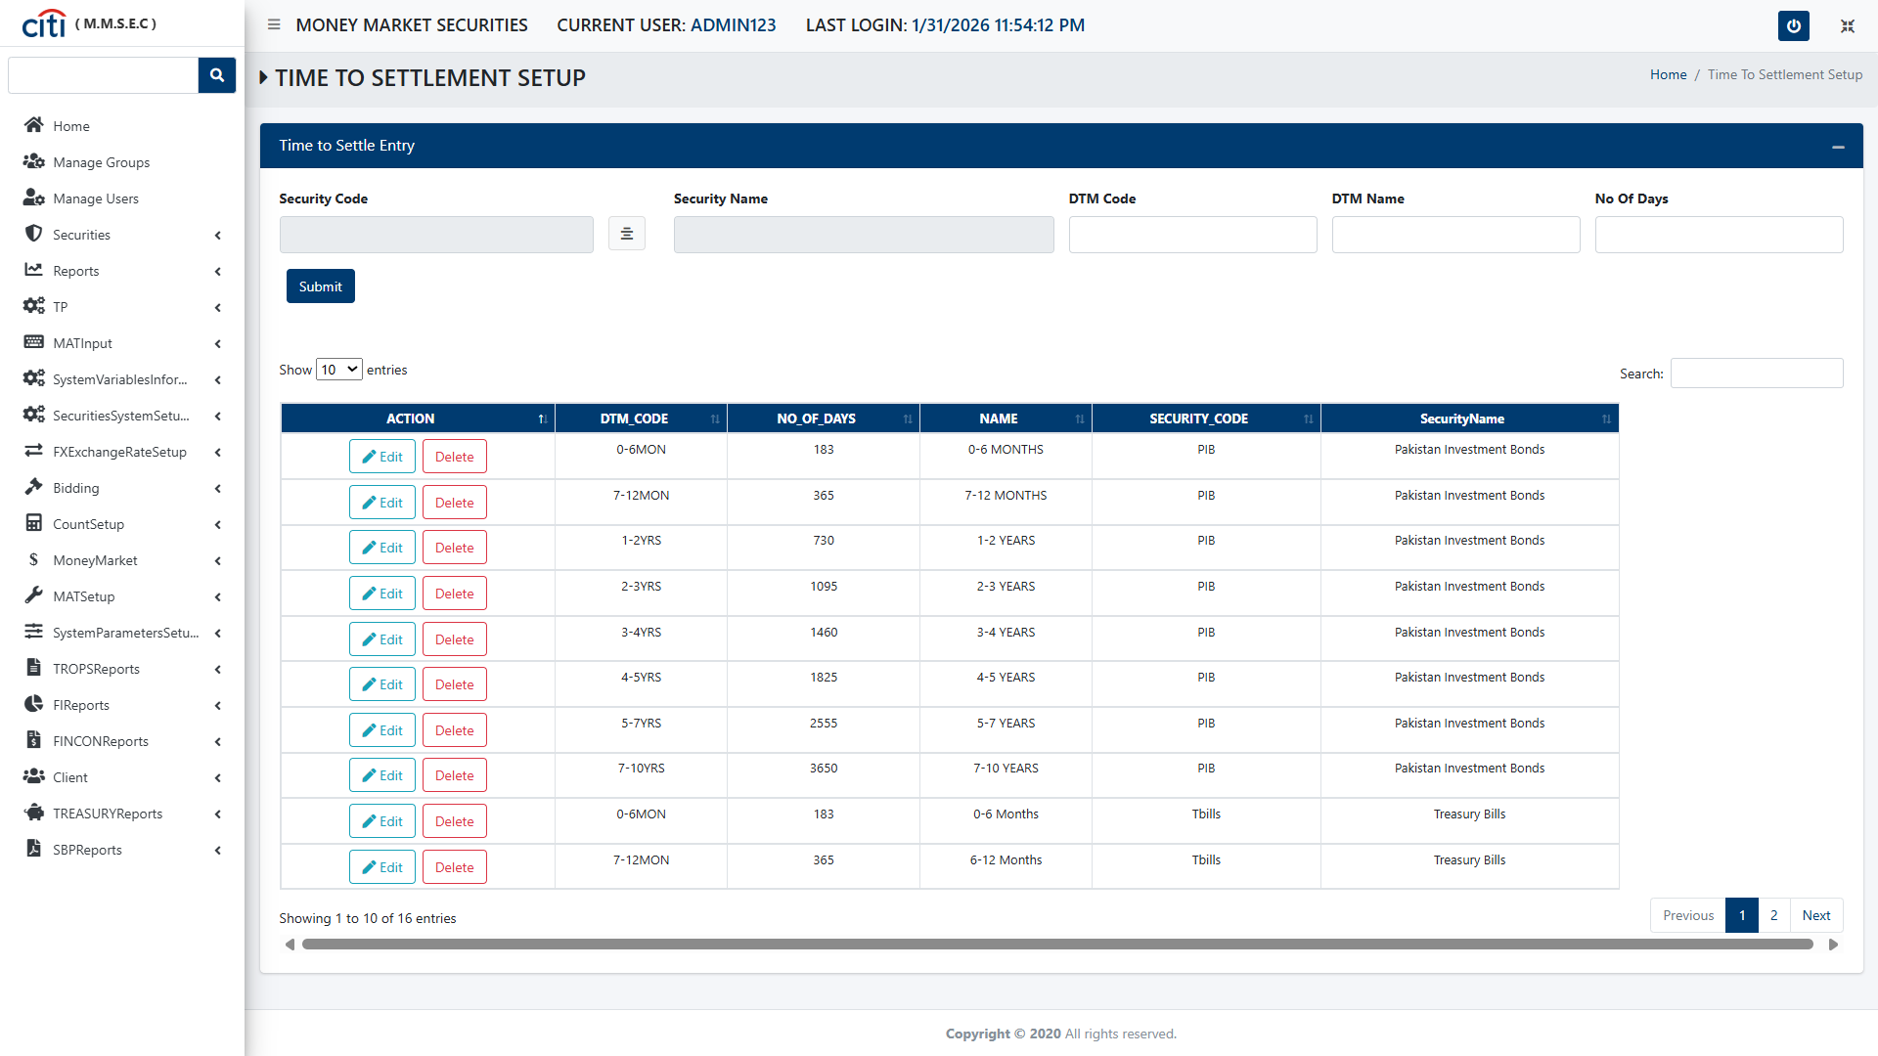
REPORTS
Time to Settlement Setup form
MMSEC
39

Slide 40
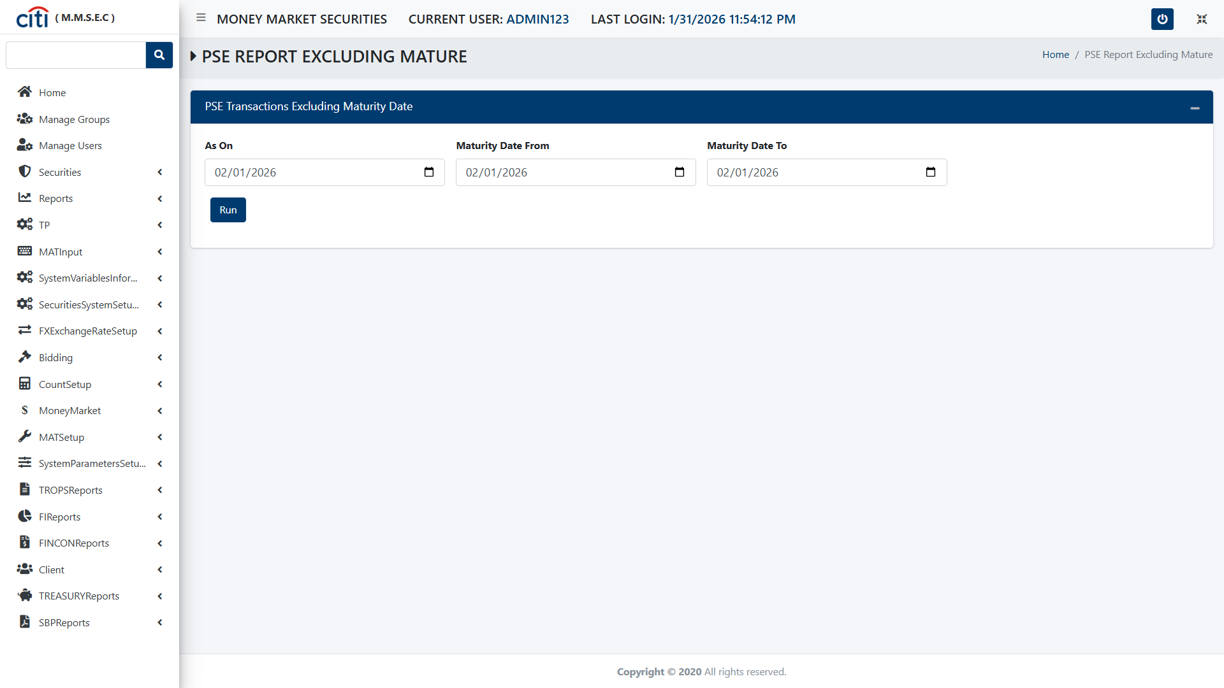
REPORTS
PSE Report Exchange Mature form
MMSEC
40

Slide 41
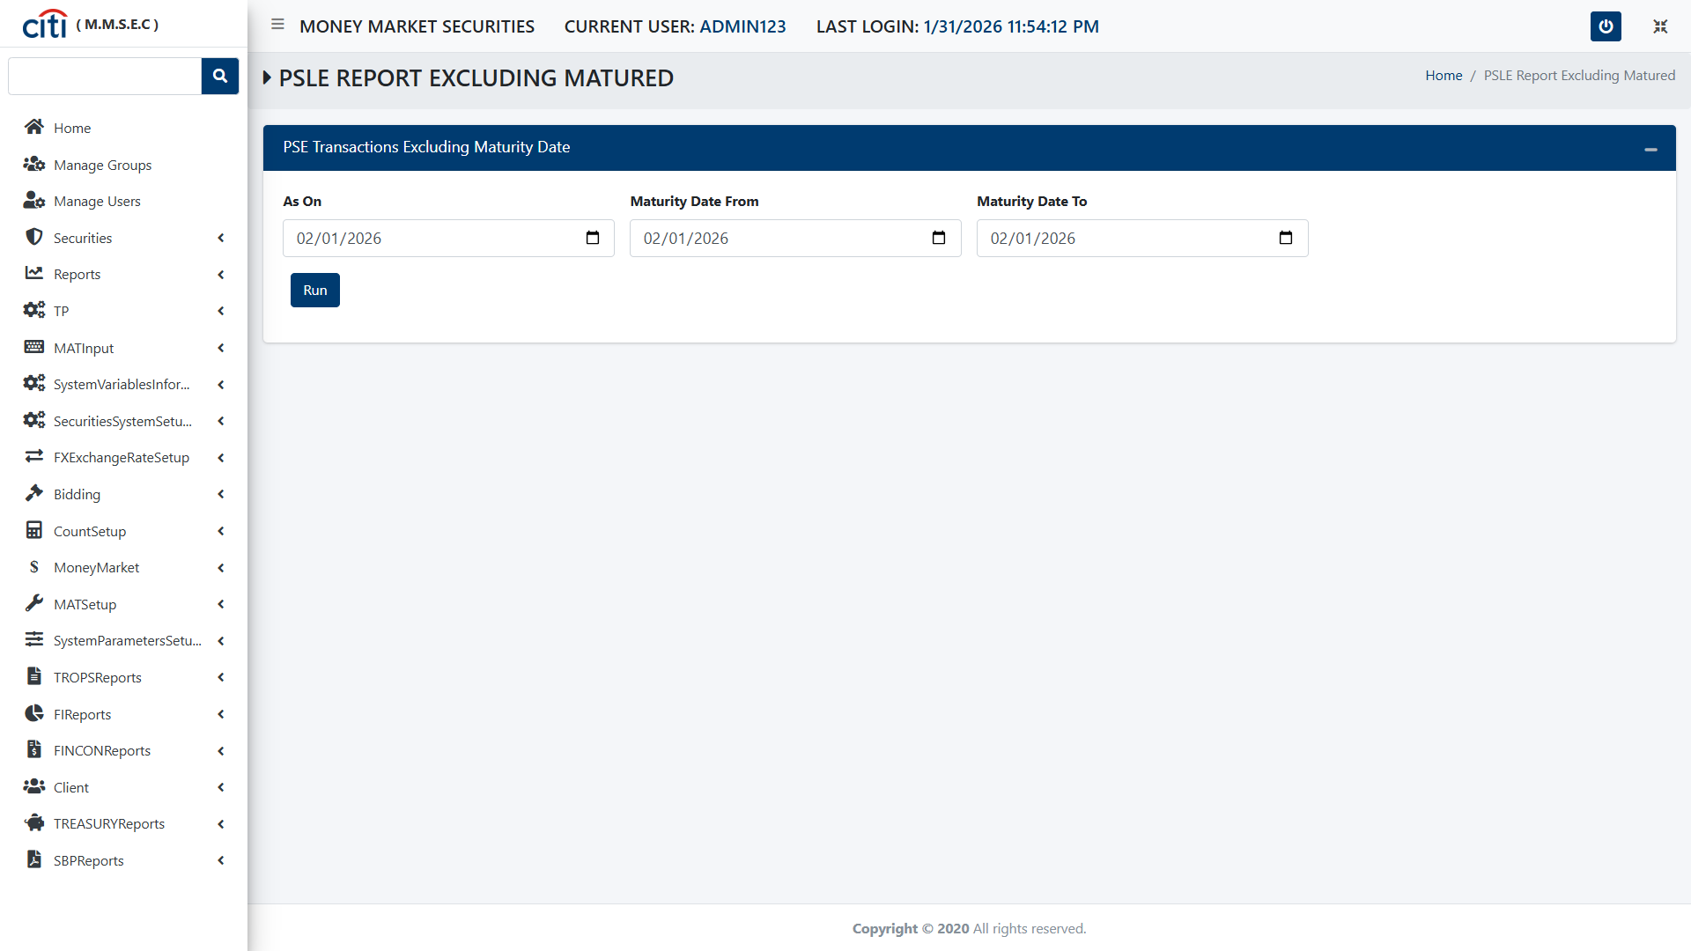
REPORTS
PSLE Report Excluding Matured form
MMSEC
41

Slide 42

REPORTS
Tenor Limit Export Sale form
MMSEC
42

Slide 43
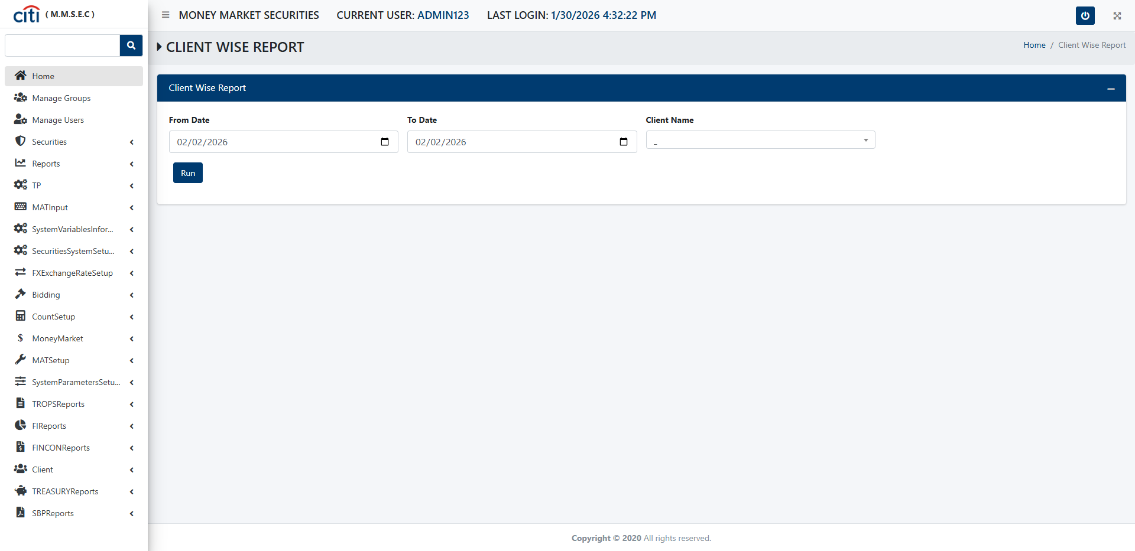
REPORTS
Client Wise Report form
MMSEC
43

Slide 44

REPORTS
PSE SUB Allocation form
MMSEC
44

Slide 45

REPORTS
Client Line Report form
MMSEC
45

Slide 46

REPORTS
Brokerage Reports form
MMSEC
46

Slide 47

REPORTS
PSLE Including Mature
MMSEC
47

Slide 48
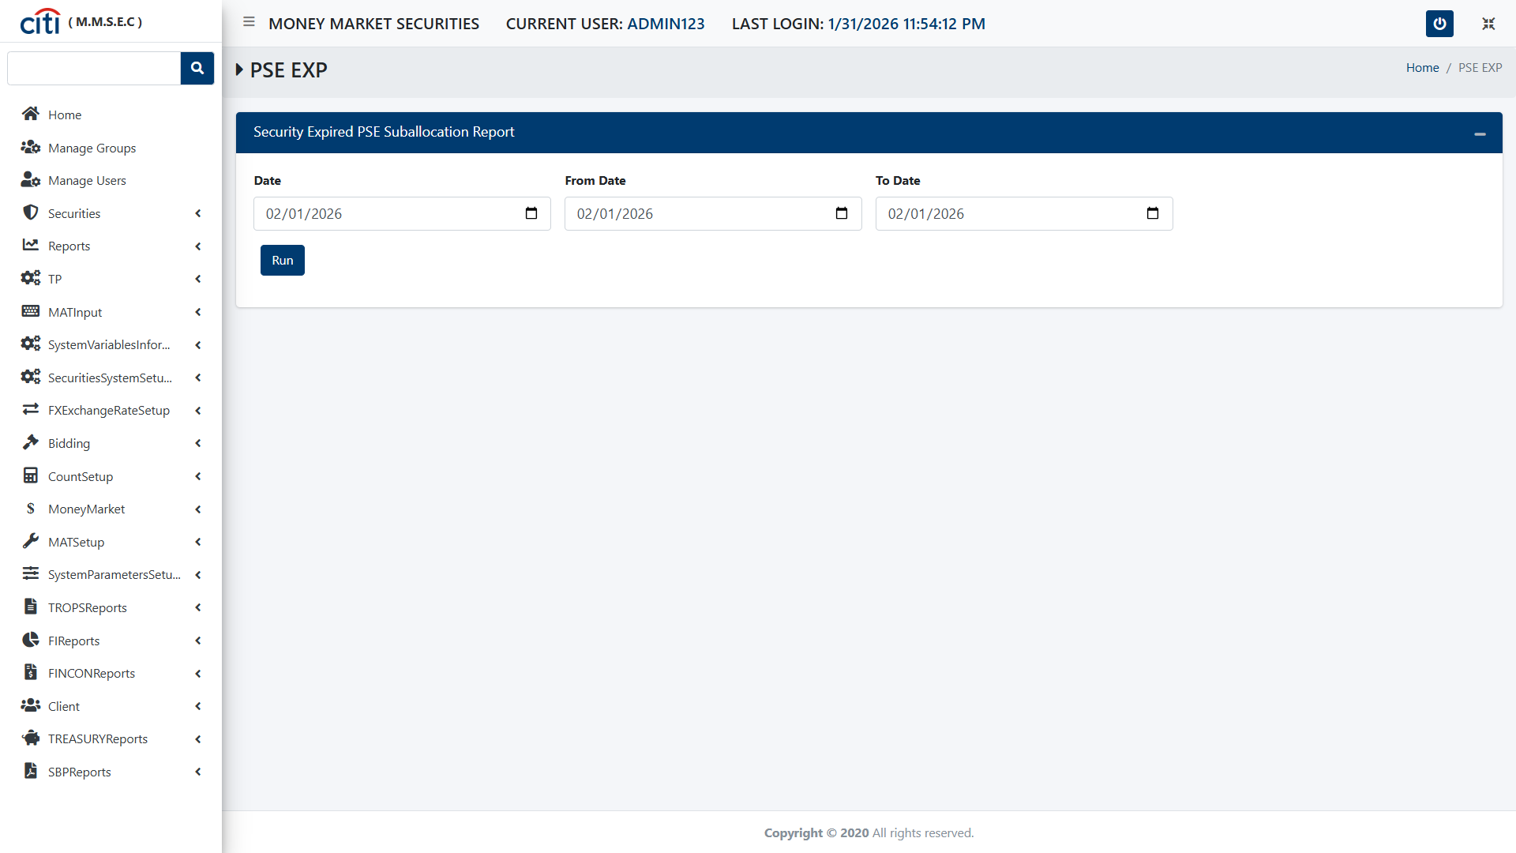
REPORTS
PSE EXP form
MMSEC
48

Slide 49

REPORTS
Client Line Report Sale form
MMSEC
49

Slide 50
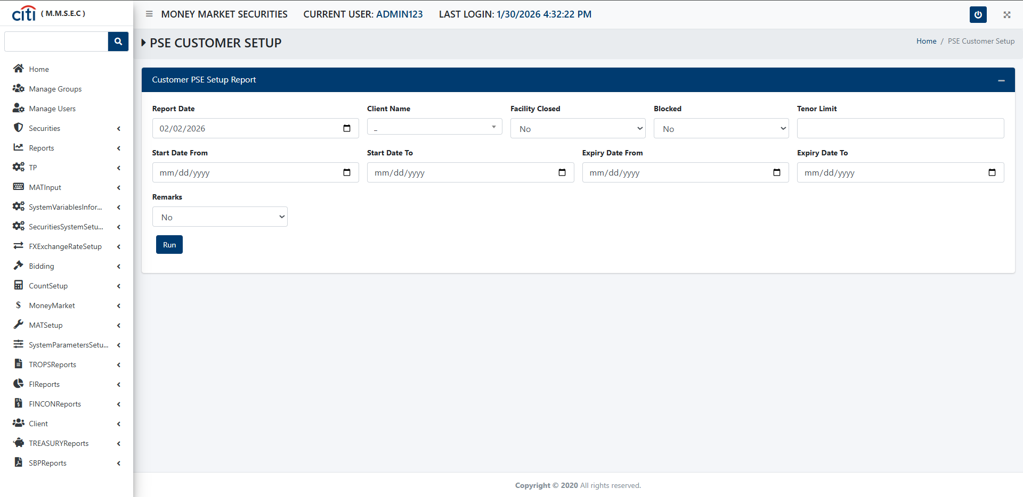
REPORTS
PSE Customer Setup form
MMSEC
50

Slide 51
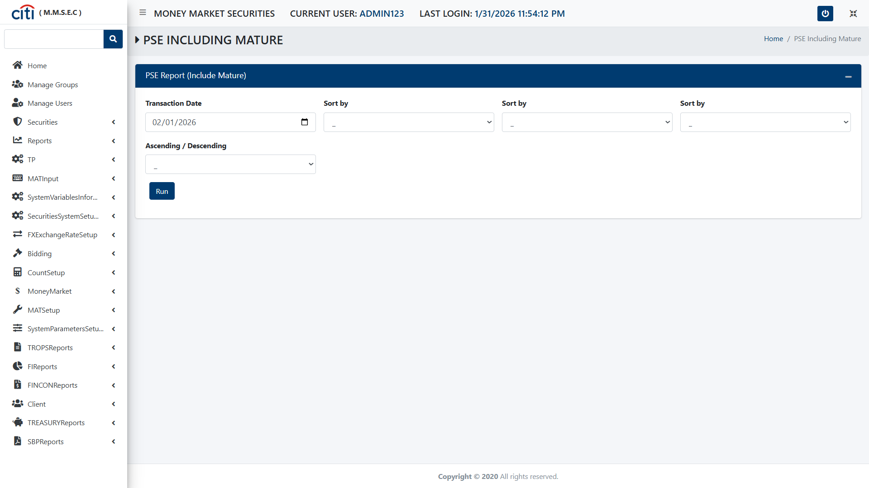
REPORTS
PSE Including Mature form
MMSEC
51

Slide 52
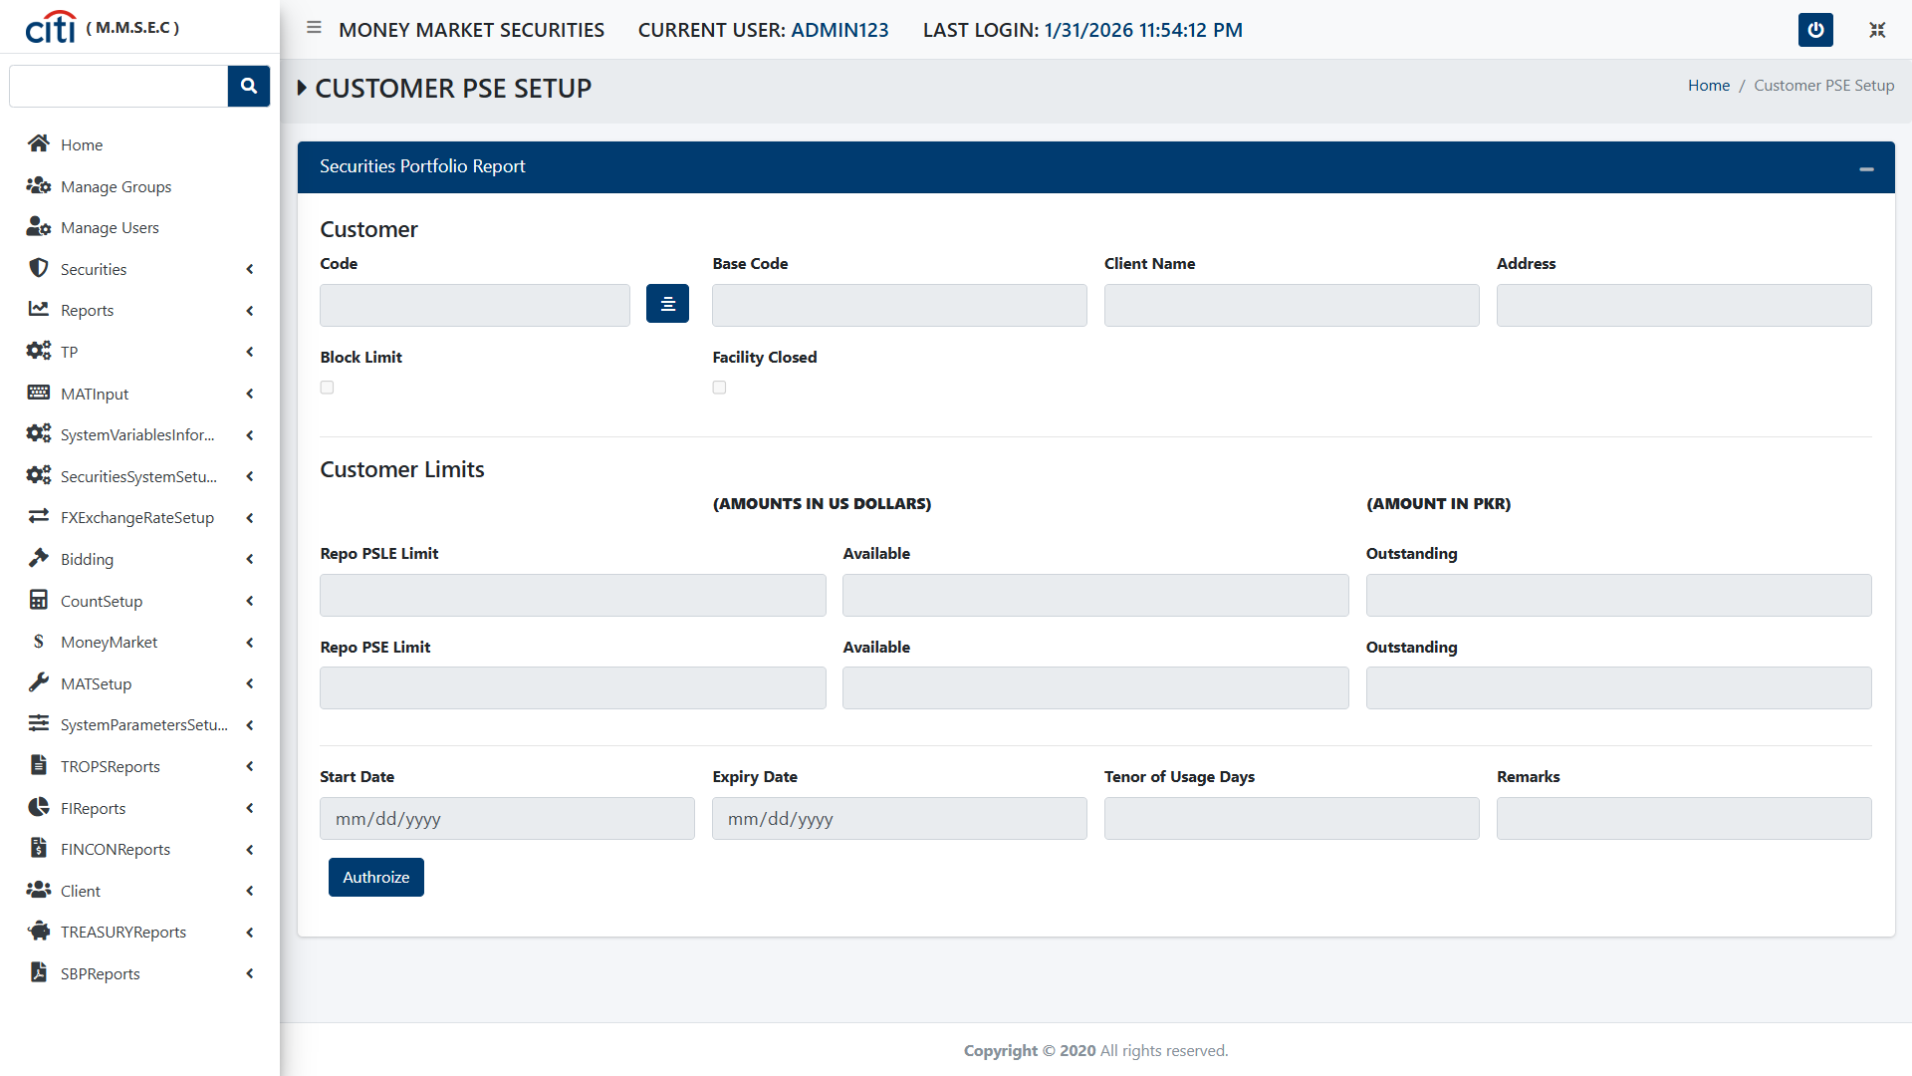
REPORTS
Customer PSE Setup form
MMSEC
52

Slide 53

REPORTS
MSF R Portfolio form
MMSEC
53

Slide 54

REPORTS
PSLE SUMM Report Matured form
MMSEC
54

Slide 55
04
TP
Trader, branch, client, and SBP-required setups
MMSEC
55

Slide 56
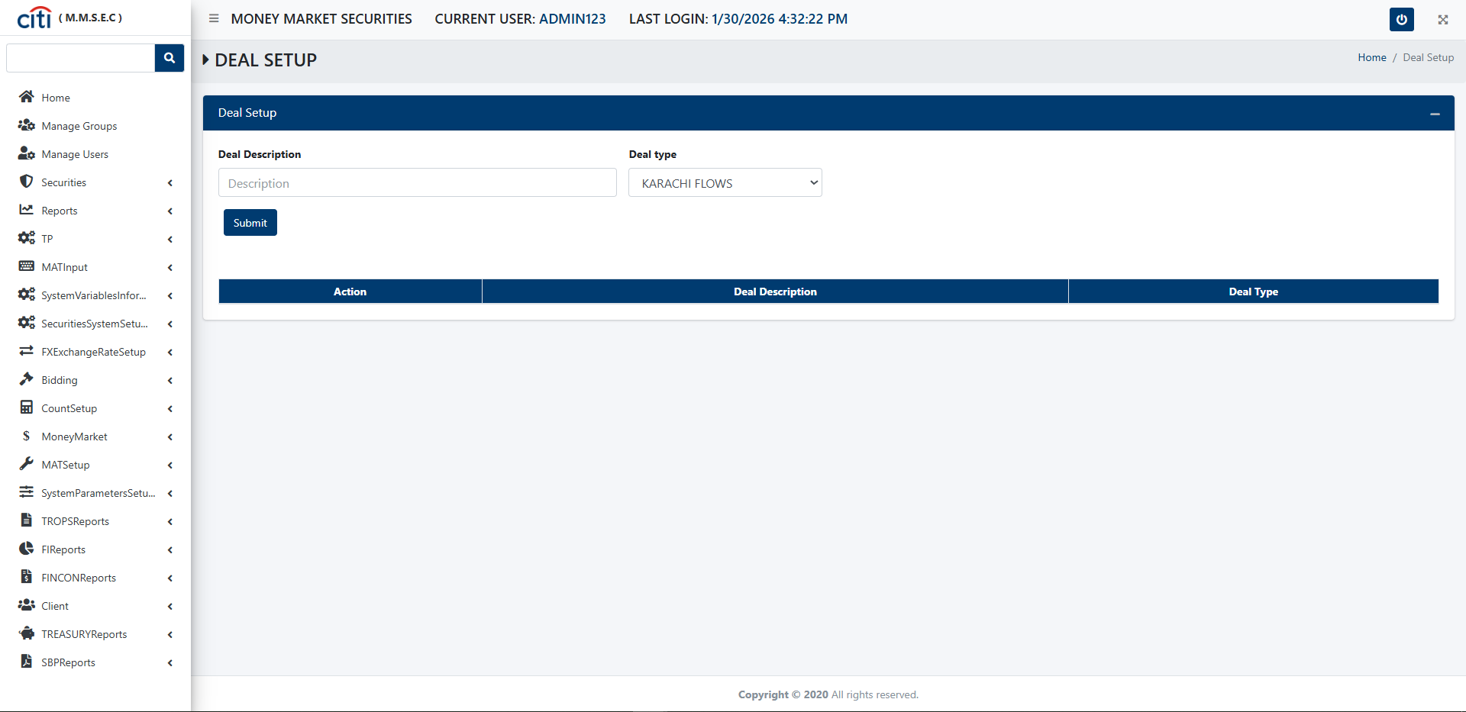
TP
Deal Setup form
MMSEC
56

Slide 57
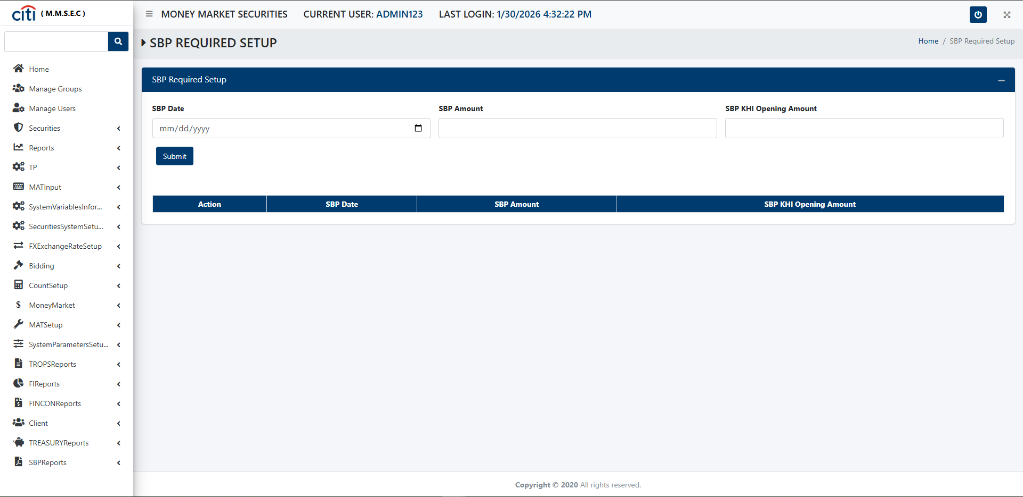
TP
SBP Required Setup form
MMSEC
57

Slide 58
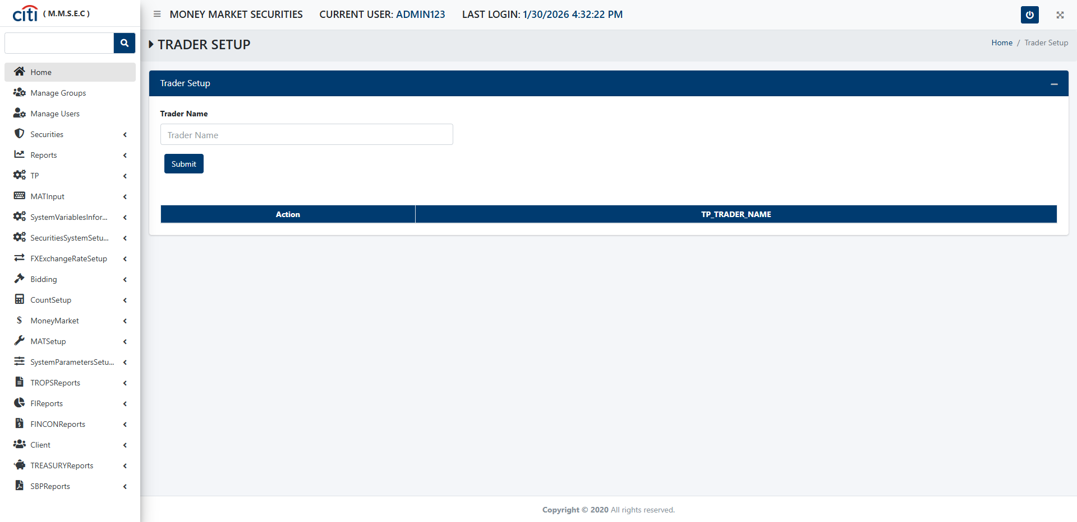
TP
Trader Setup form
MMSEC
58

Slide 59
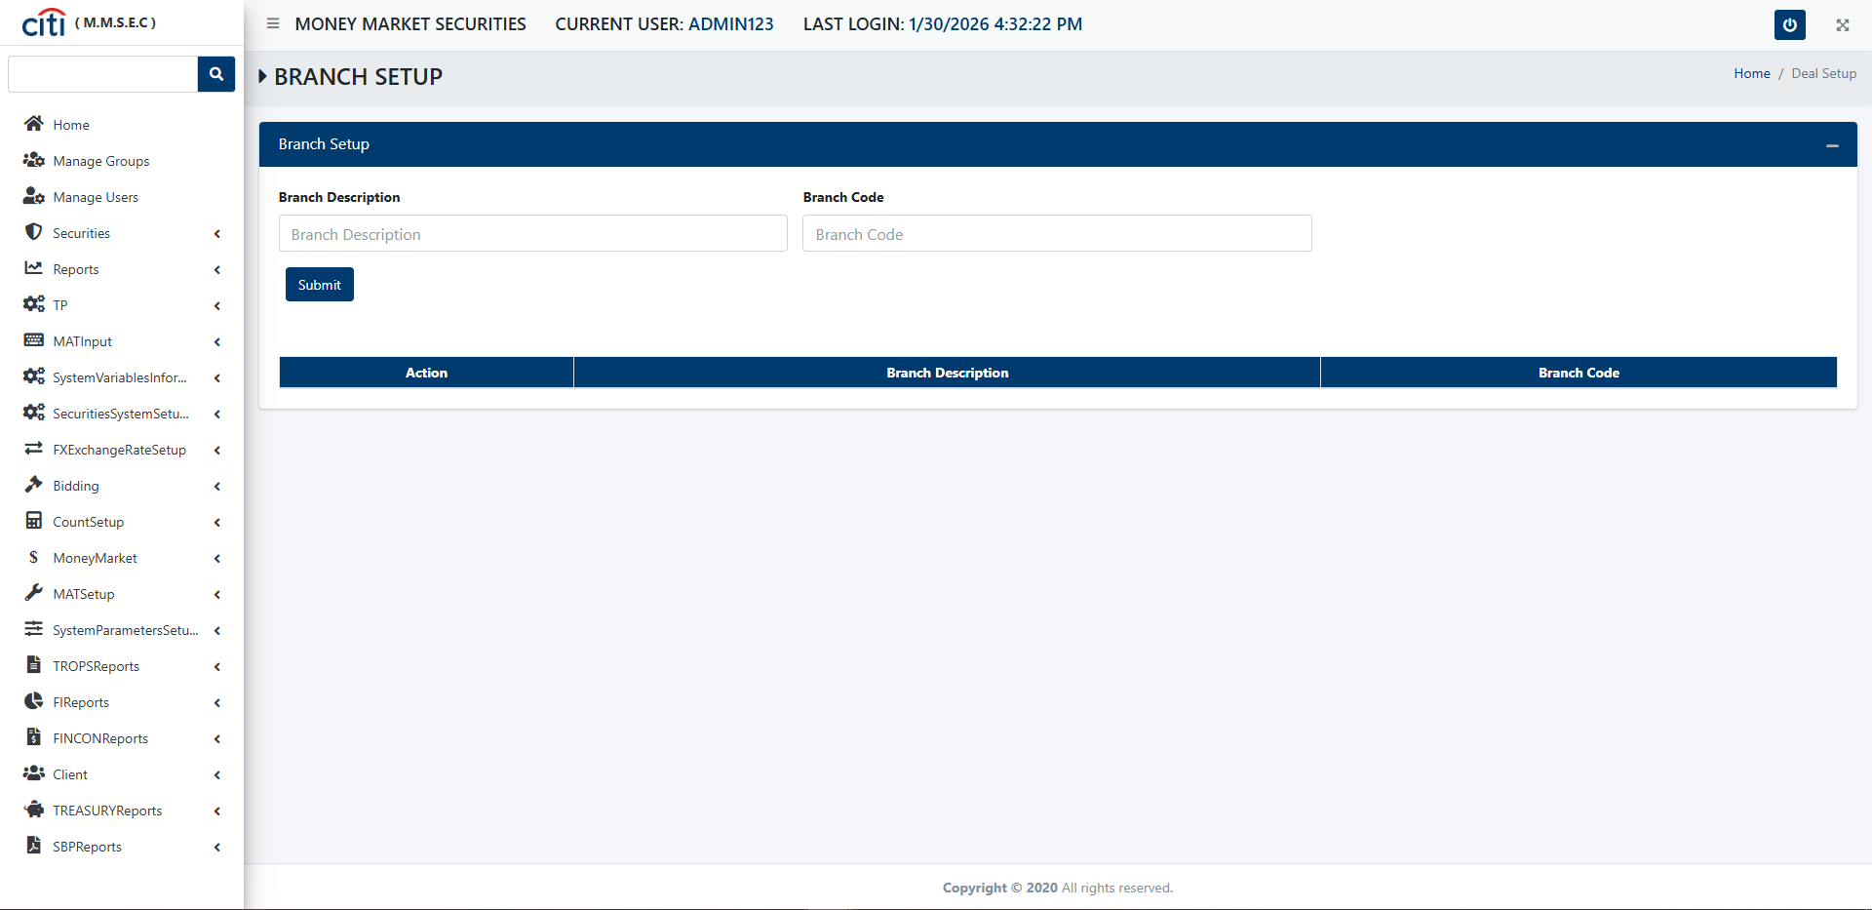
TP
Branch Setup form
MMSEC
59

Slide 60
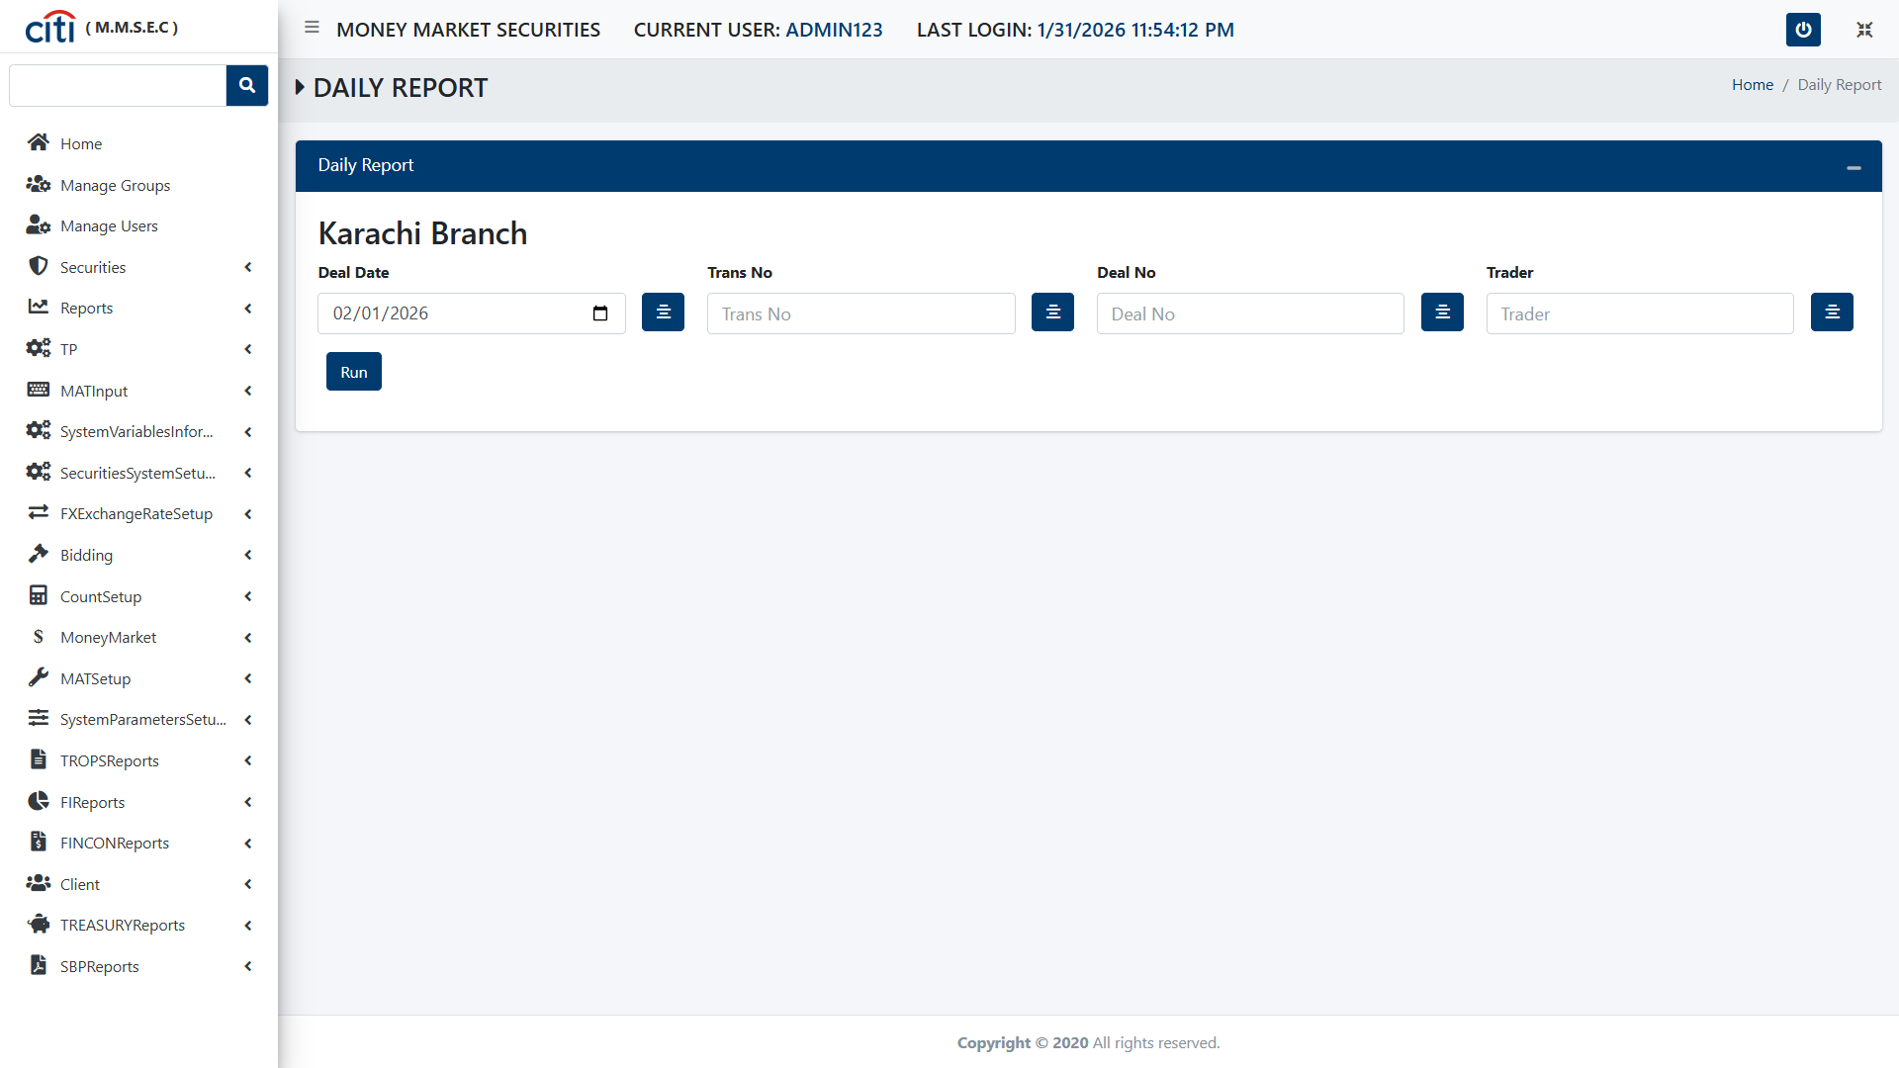
TP
Daily Report form
MMSEC
60

Slide 61
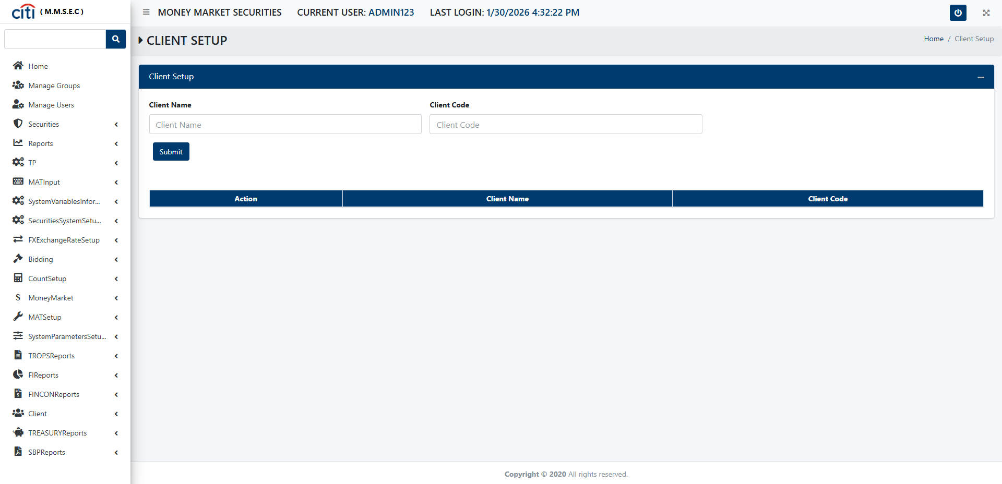
TP
Client Setup form
MMSEC
61

Slide 62
05
MAT Input
Funding cost, PKR rate, and volume limit inputs
MMSEC
62

Slide 63
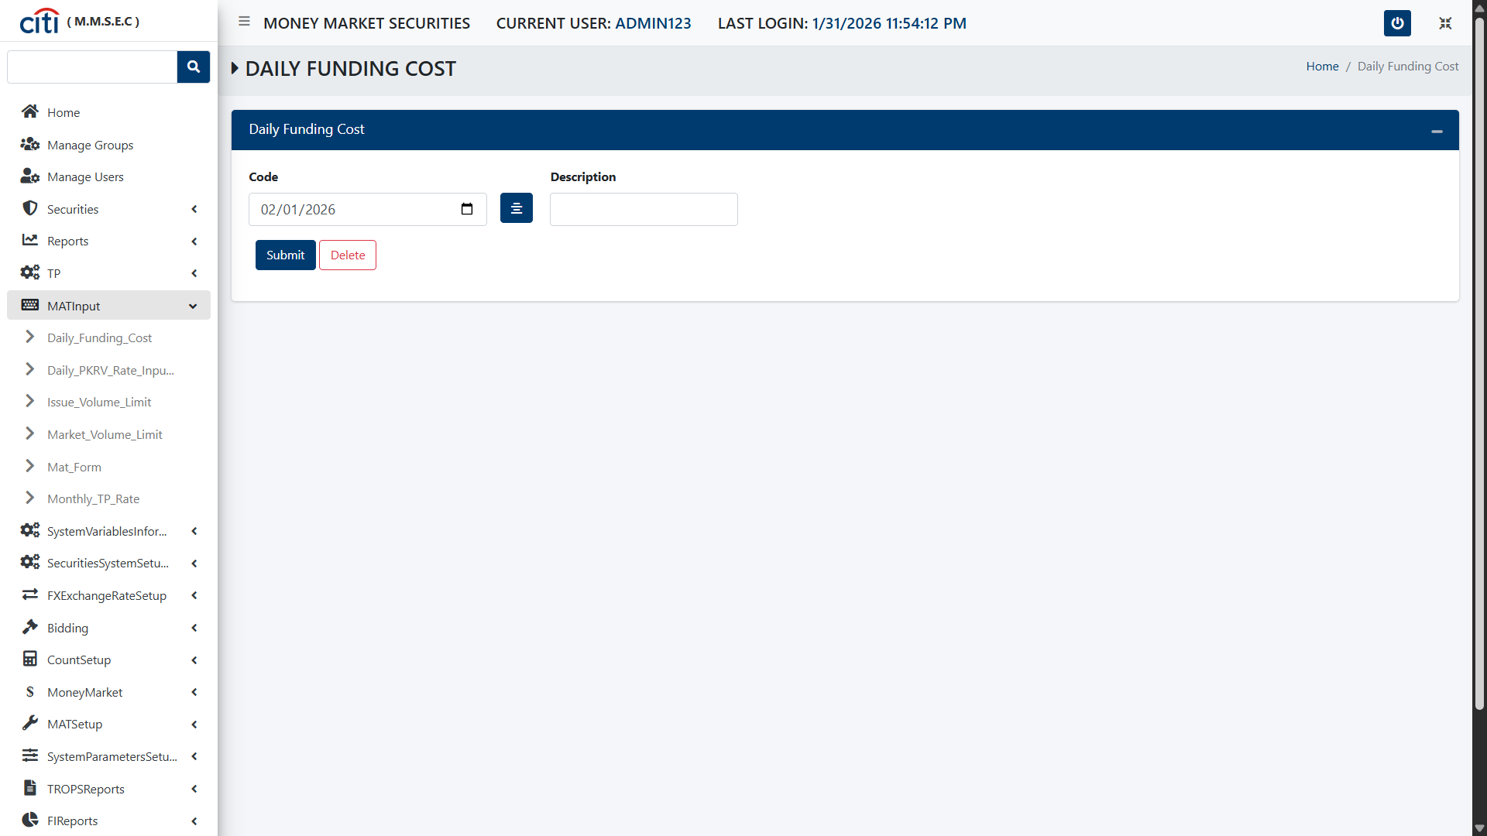
MAT INPUT
Daily Funding Cost form
MMSEC
63

Slide 64
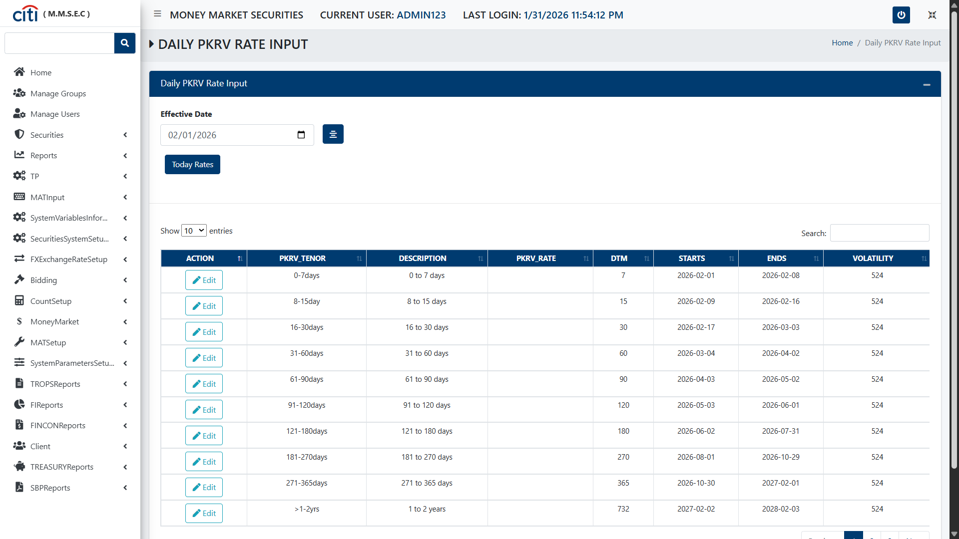
MAT INPUT
Daily PKR Rate Input form
MMSEC
64

Slide 65
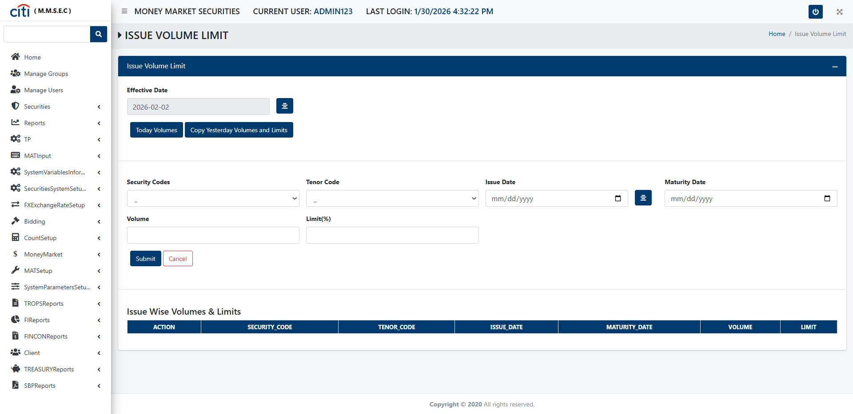
MAT INPUT
Issue Volume Limit form
MMSEC
65

Slide 66
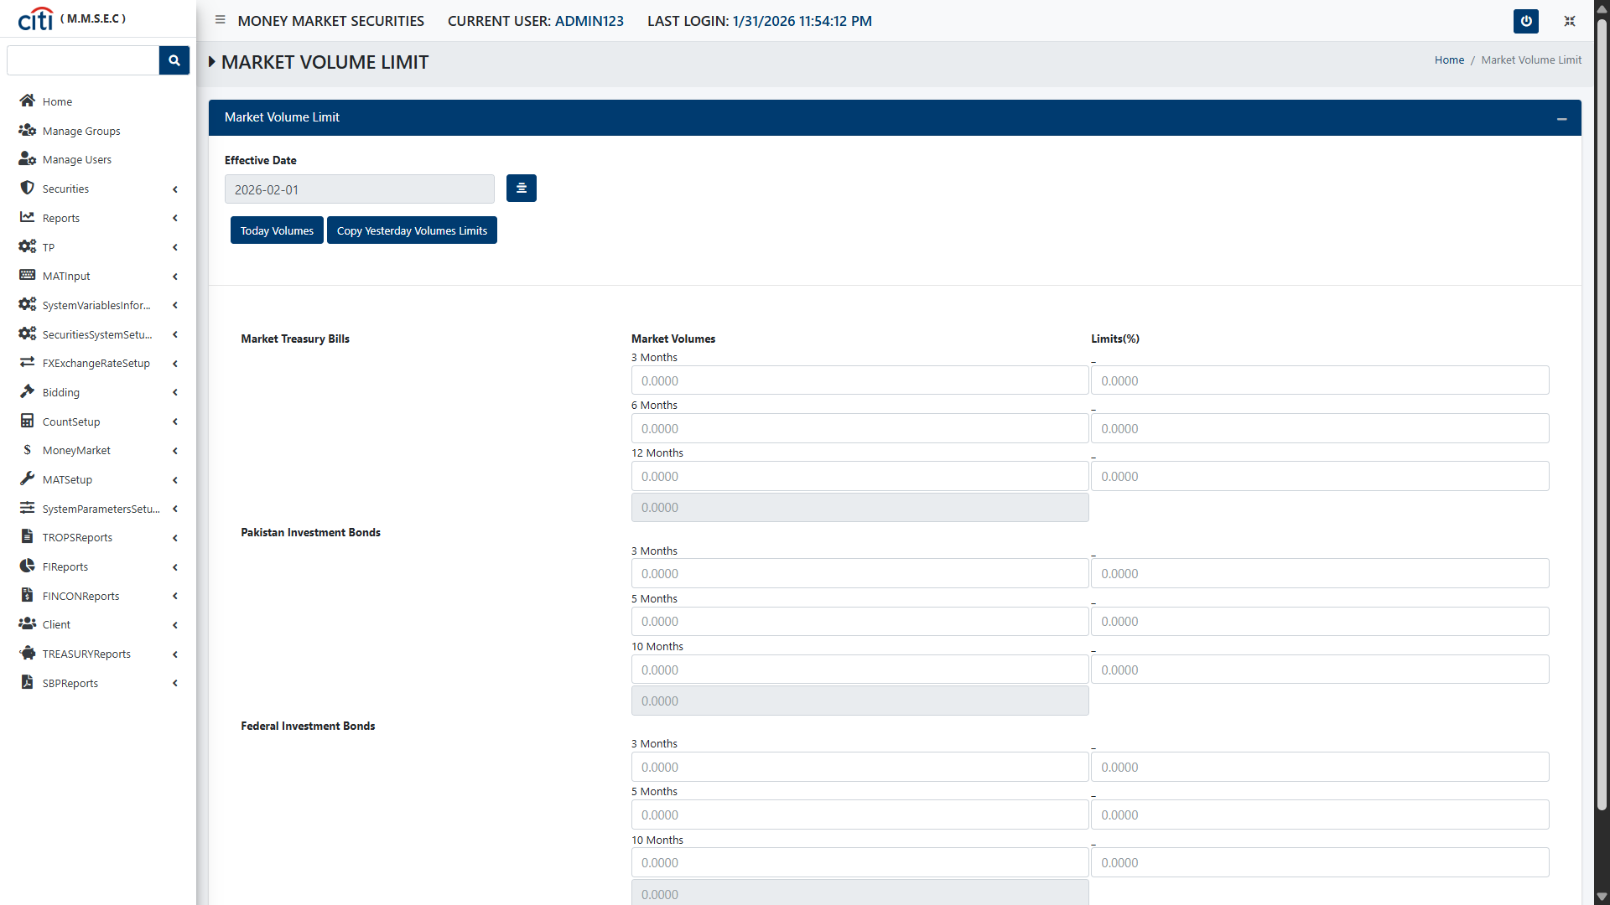
MAT INPUT
Market Volume Limit form
MMSEC
66

Slide 67
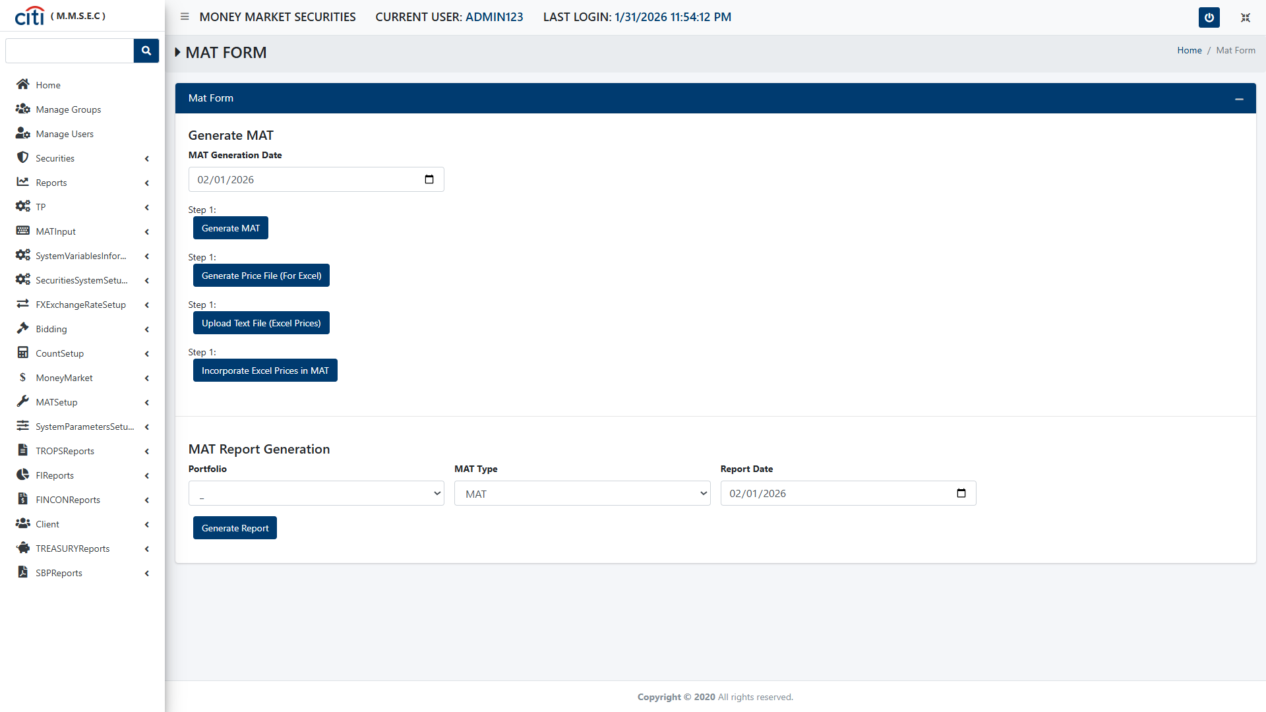
MAT INPUT
MAT Form
MMSEC
67

Slide 68
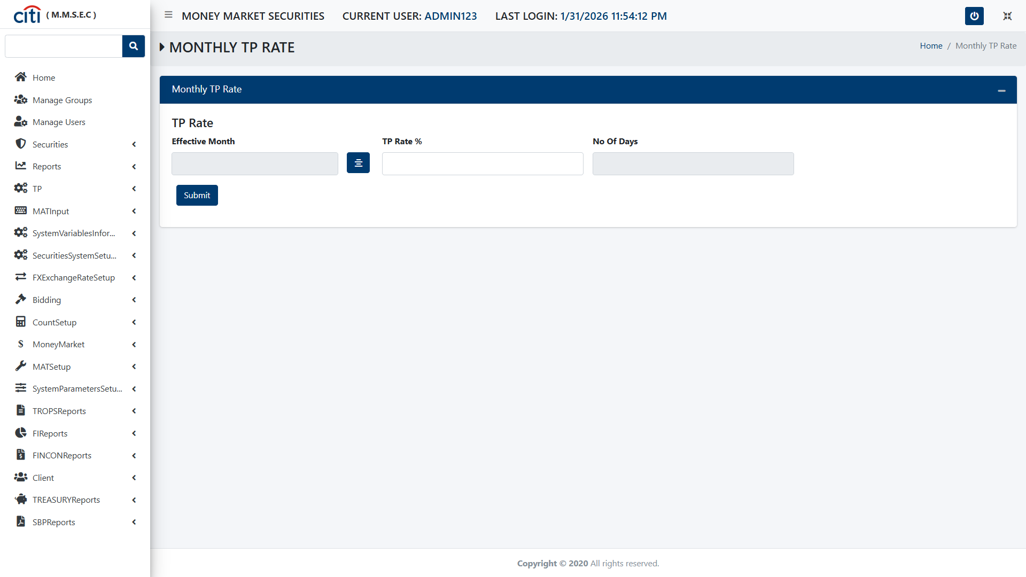
MAT INPUT
Monthly TP Rate form
MMSEC
68

Slide 69
06
System Variables Information
Core system variable configuration
MMSEC
69

Slide 70
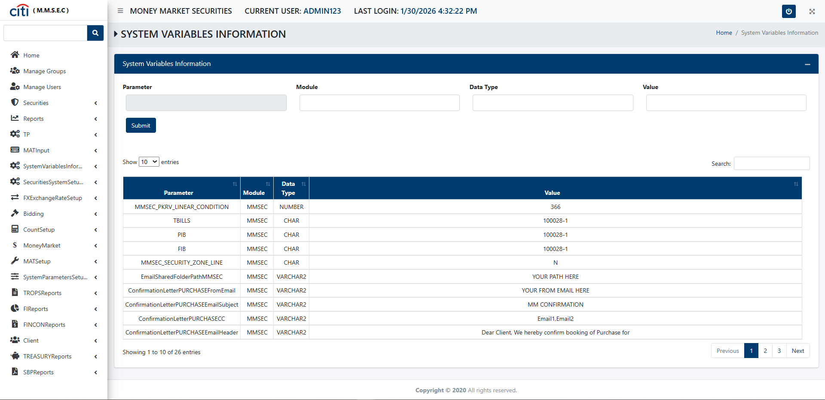
SYSTEM VARIABLES INFORMATION
System Variables Information form
MMSEC
70

Slide 71
07
Securities System Setup
Interest periods, portfolios, issues, and tenors
MMSEC
71

Slide 72
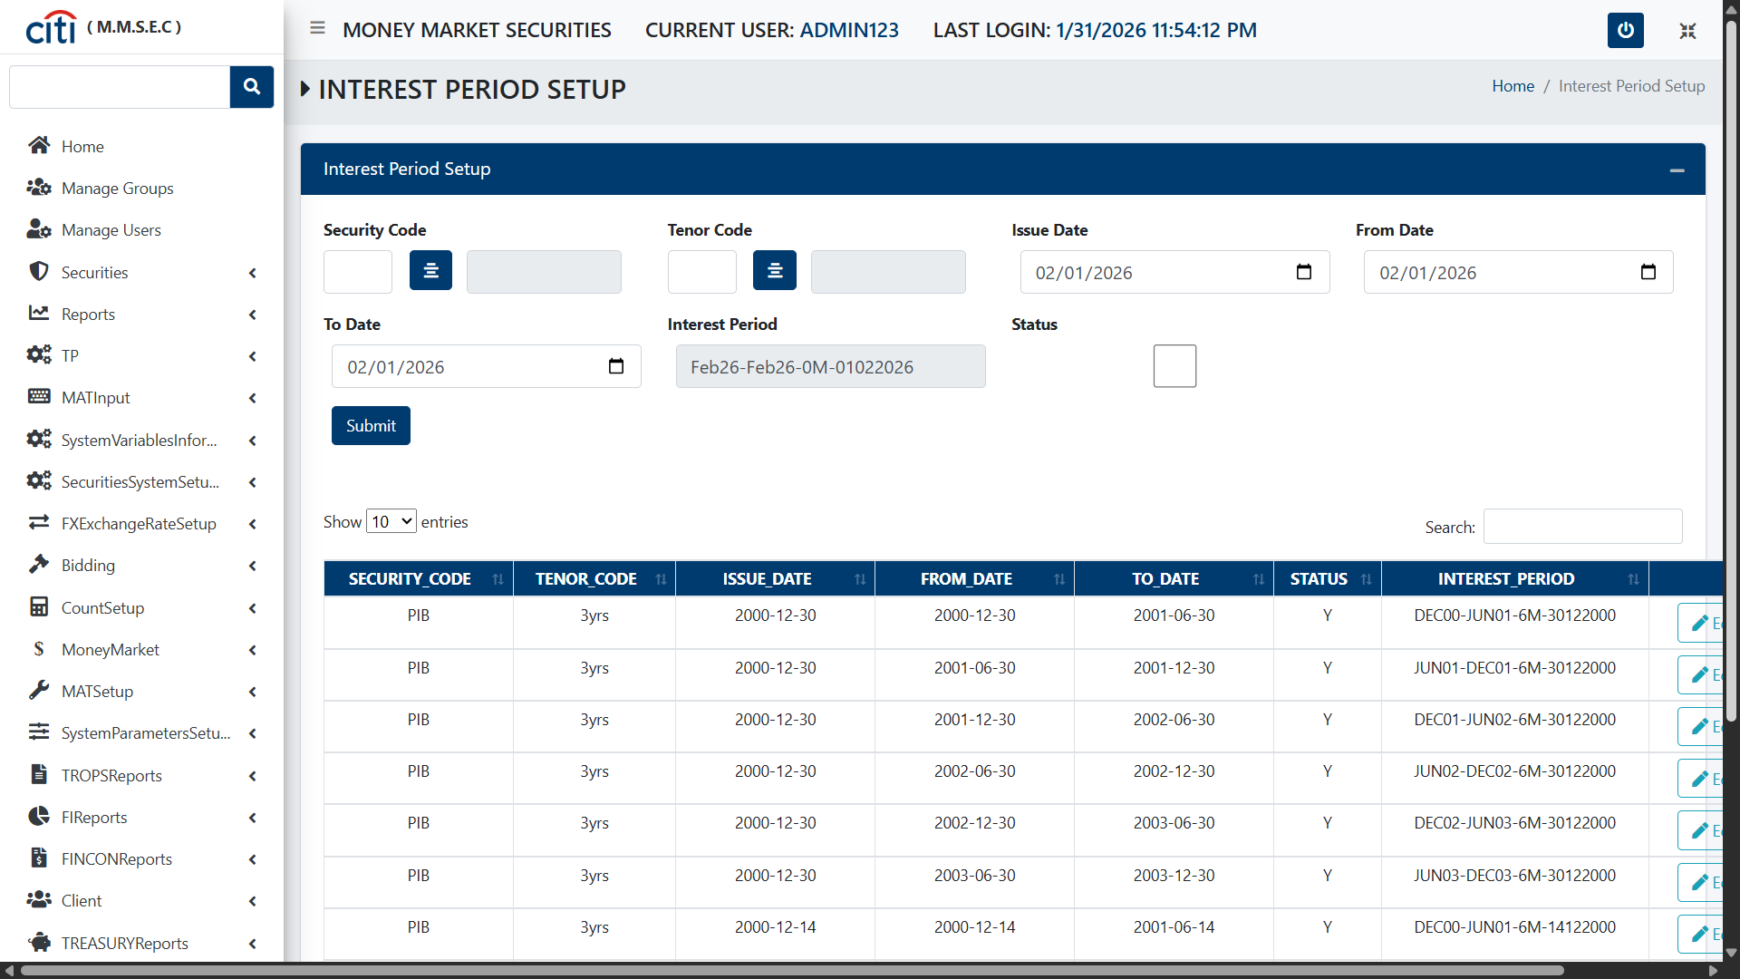
SECURITIES SYSTEM SETUP
Interest Period Setup form
MMSEC
72

Slide 73
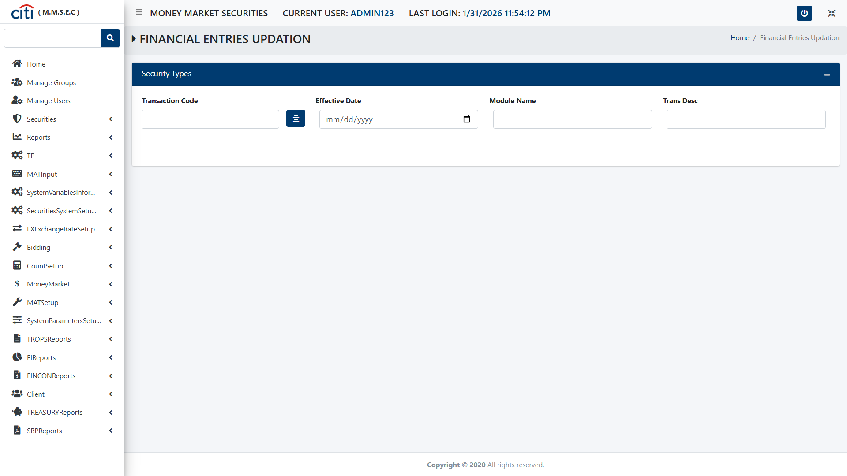
SECURITIES SYSTEM SETUP
Financial Entries Updation form
MMSEC
73

Slide 74
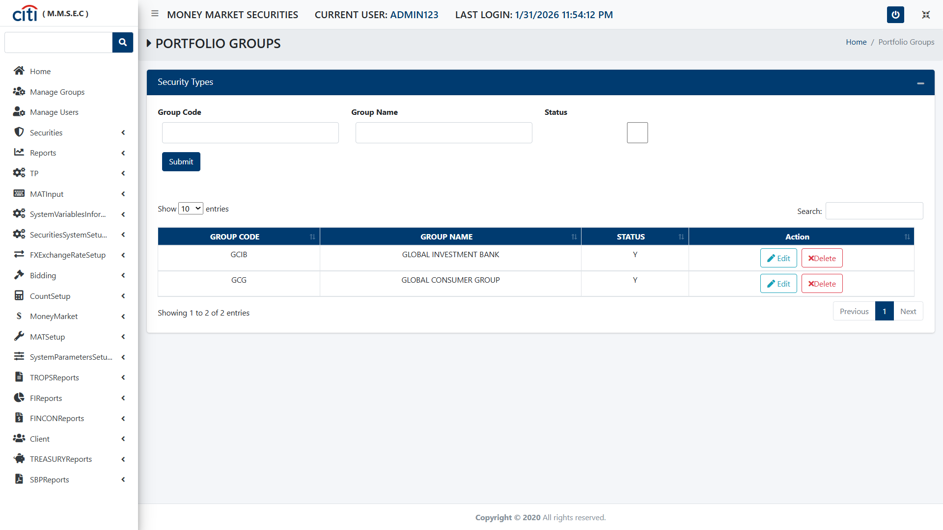
SECURITIES SYSTEM SETUP
Portfolio Groups form
MMSEC
74

Slide 75
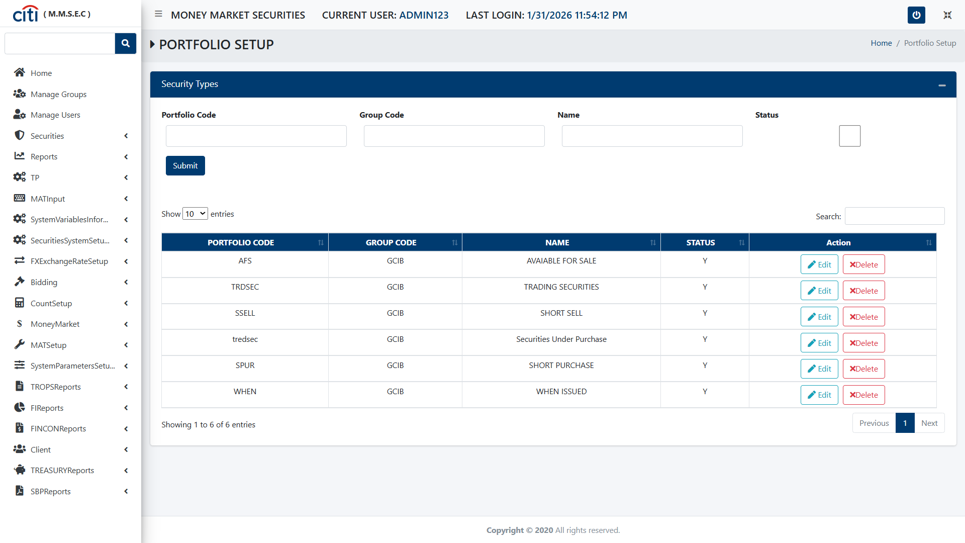
SECURITIES SYSTEM SETUP
Portfolio Setup form
MMSEC
75

Slide 76
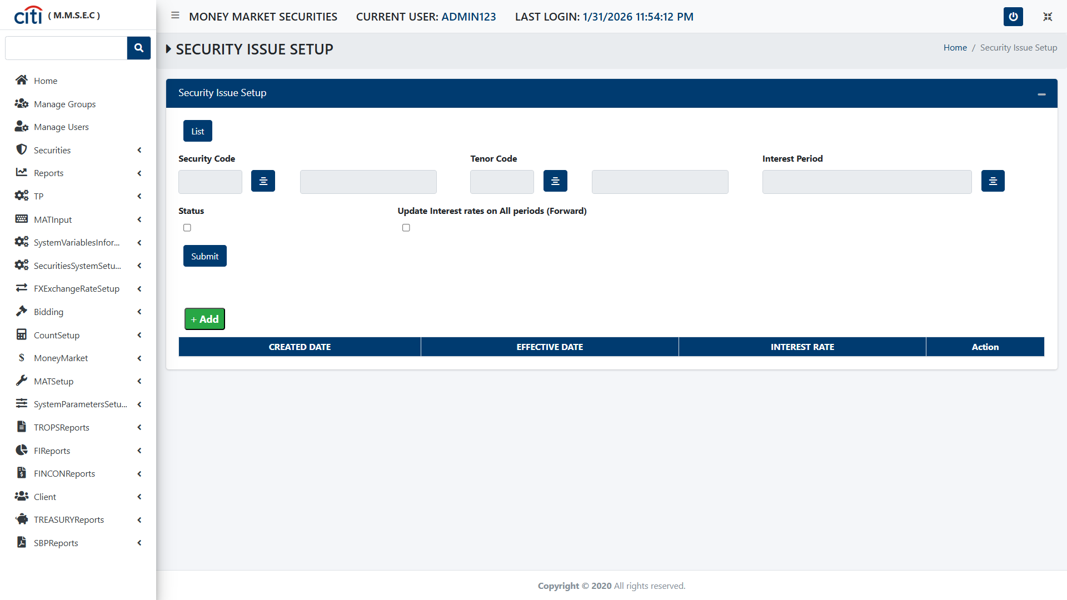
SECURITIES SYSTEM SETUP
Security Issue Setup form
MMSEC
76

Slide 77
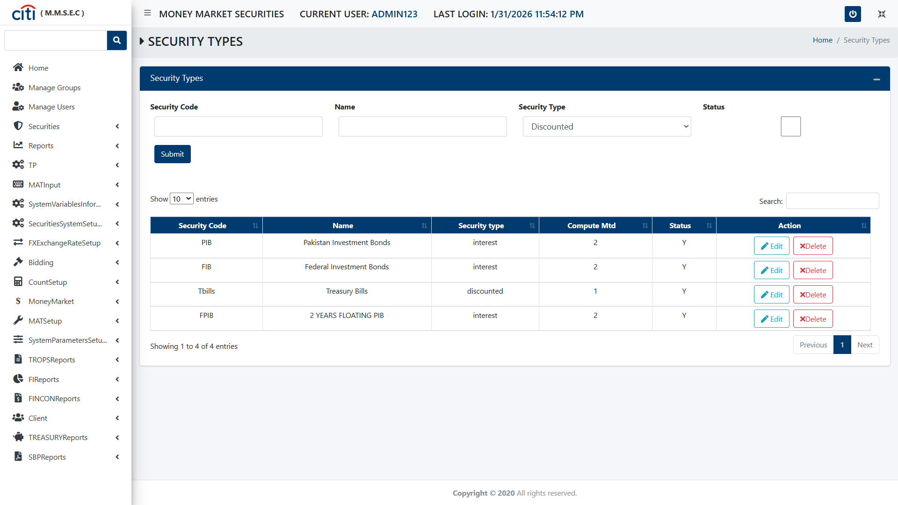
SECURITIES SYSTEM SETUP
Security Types form
MMSEC
77

Slide 78
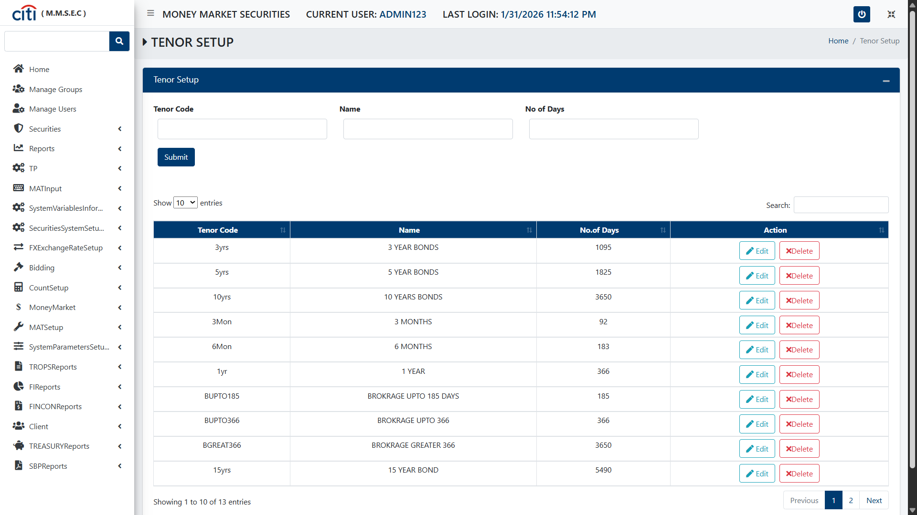
SECURITIES SYSTEM SETUP
Tenor Setup form
MMSEC
78

Slide 79
08
FX Rate Setup
Foreign exchange rate input and valuation support
MMSEC
79

Slide 80

FX RATE SETUP
FX Rates input form
MMSEC
80

Slide 81

09
Bidding
Money market bidding, acceptance, and tenor generation
MMSEC
81

Slide 82

BIDDING
Money Market Bidding results form
MMSEC
82

Slide 83

BIDDING
BID Acceptance form
MMSEC
83

Slide 84

BIDDING
Tenor Form Generation form
MMSEC
84

Slide 85

BIDDING
Bidding Preparation form
MMSEC
85

Slide 86

10
Counterparty Setup
Back officers, brokers, and counterparty records
MMSEC
86

Slide 87

COUNTERPARTY SETUP
Back Officer Setup form
MMSEC
87

Slide 88

COUNTERPARTY SETUP
Broker form
MMSEC
88

Slide 89

COUNTERPARTY SETUP
Counter Party setup form
MMSEC
89

Slide 90

11
Money Market
Money market deal capture and processing
MMSEC
90

Slide 91

MONEY MARKET
Money Market Deals form
MMSEC
91

Slide 92
12
MAT Setup
PKRV tenor configuration
MMSEC
92

Slide 93

MAT SETUP
PKRV Tenors form
MMSEC
93

Slide 94
13
System Parameters Setup
Core system parameter configuration
MMSEC
94

Slide 95

SYSTEM PARAMETERS SETUP
System Parameters form
MMSEC
95

Slide 96
14
TROPS Reports
Repo contracts, brokerage history, and receivables
MMSEC
96

Slide 97

TROPS REPORTS
Repo Contract form
MMSEC
97

Slide 98

TROPS REPORTS
Brokerage Deal History Report form
MMSEC
98

Slide 99

TROPS REPORTS
Brokerage Deal History report form
MMSEC
99

Slide 100

TROPS REPORTS
Reserve Interest Report form
MMSEC
100

Slide 101

TROPS REPORTS
Accountant Receivable Report form
MMSEC
101

Slide 102

TROPS REPORTS
History Report form
MMSEC
102

Slide 103

TROPS REPORTS
Day End Report form
MMSEC
103

Slide 104

TROPS REPORTS
Commitment to Purchase Security form
MMSEC
104

Slide 105

TROPS REPORTS
Commitment to Sales Security form
MMSEC
105

Slide 106

TROPS REPORTS
Commitment to Reverse Repo Security form
MMSEC
106

Slide 107
15
FI Reports
Repo, sale, reverse repo, and disposition reporting
MMSEC
107

Slide 108

FI REPORTS
Repo Form Own report
MMSEC
108

Slide 109

FI REPORTS
Sale Report form
MMSEC
109

Slide 110

FI REPORTS
Reverse repo report form
MMSEC
110

Slide 111

FI REPORTS
Disposition Report form
MMSEC
111

Slide 112

FI REPORTS
Cash Flow form
MMSEC
112

Slide 113

FI REPORTS
Purchase Report form
MMSEC
113

Slide 114
FI REPORTS
MSF R Portfolio form
MMSEC
114

Slide 115
16
FinCon Reports
Reverse repo, weekly position, and sale reporting
MMSEC
115

Slide 116

FINCON REPORTS
Reverse Repo form
MMSEC
116

Slide 117

FINCON REPORTS
Weekly Position form
MMSEC
117

Slide 118
FINCON REPORTS
Sale Report form
MMSEC
118

Slide 119

FINCON REPORTS
Purchase Report form
MMSEC
119

Slide 120

17
Client
Business partner information records
MMSEC
120

Slide 121

CLIENT
Business Partner Information form
MMSEC
121

Slide 122
18
Treasury Reports
Portfolio, position, disposition, and cash flow reports
MMSEC
122

Slide 123
TREASURY REPORTS
MSF R Portfolio
MMSEC
123

Slide 124

TREASURY REPORTS
Securities Position form
MMSEC
124

Slide 125

TREASURY REPORTS
Disposition Report form
MMSEC
125

Slide 126

TREASURY REPORTS
Cashflow form
MMSEC
126

Slide 127
19
State Bank of Pakistan Reports
SBP lending, PIB weekly, and encashment reports
MMSEC
127

Slide 128

STATE BANK OF PAKISTAN REPORTS
FIB PIB Weekly form
MMSEC
128

Slide 129

STATE BANK OF PAKISTAN REPORTS
Encashment Letter form
MMSEC
129

Slide 130

STATE BANK OF PAKISTAN REPORTS
SBP Daily Lending Report form
MMSEC
130

Slide 131
Thank You
Questions & discussion welcome
Developed by Zealous Technologies
zealoustechnologies.com

