Slide 1
ZEALOUS TECHNOLOGIES • PRODUCT OVERVIEW
Import Application
A secure, end-to-end digital platform for import operations, LCs, and compliance
Developed by Zealous Technologies
zealoustechnologies.com

Slide 2



OVERVIEW
Project Summary
Core Platform
Compliance & Integration
Reporting & Insight
A secure, web-based platform built on C# and .NET Core that digitizes the bank's import operations — LCs, contracts, bills, and FX processes.
Maker-checker approvals and configurable setups for branches, clients, insurance, currencies, HS codes, and LC types, integrated with CD Direct.
Automated import lifecycle workflows and real-time MIS, SBP, and audit reports improve speed, accuracy, and compliance.
IMPORT APPLICATION
2

Slide 3





CAPABILITIES
Key Functionality
A secure, scalable, and fully compliant digital workflow
Account & Role Management
Flexible Configuration
LC & Contract Management
Manage accounts with roles and maker-checker approvals
Configure branches, clients, insurance, currencies, HS codes, and LC types
Create and amend LCs and contracts, with CD Direct integration for contract reception
Import Bill Initiation
Automated FX & Payments
Real-Time Reporting
Initiate and track bills against LCs and contracts
Automate LC issuance, authorization, payments, and FX bookings
Generate real-time MIS, SBP, and audit reports from centralized dashboards with SSO
IMPORT APPLICATION
3

Slide 4



PLATFORM ENHANCEMENT
New User Creation Module
STEP 1
STEP 2
Dynamic User Creation
Portal Integration
Users can be created and managed through the new proposed dynamic module — replacing the previous static process.
This dynamic user-creation module will be incorporated directly into the Re Import Export Portal.
IMPORT APPLICATION
4

Slide 5






PLATFORM OVERVIEW
System Modules
Fifteen integrated modules power the complete import lifecycle
Manage Users
Setup Forms
LC Issuance
Import System for Citi User
Authorization
Contract Issuance
MIS Reports
Other Forms
Import Bill
Payment of Import Bill
AW Endorsement (SGTEE)
FX Booking
Holiday Setup
Business Partner Setup
Currency Setup
IMPORT APPLICATION
5

Slide 6
DEPLOYMENT
Hardware & Software Requirements
Preferable development environment: ASP.NET Core 6.
A Windows Server with IIS Manager installed is required to deploy the ASP.NET Core application.
Application | Specs | OS
Minimum | RAM: 8 GB • Cores: 4 • Storage (SSD): 50 GB | Any
Recommended | RAM: 16 GB • Cores: 8 • Storage (SSD): 50–100 GB | Any
IMPORT APPLICATION
6

Slide 7
01
User & Access Management
Secure sign-on, branches, groups, and application users
IMPORT APPLICATION
7

Slide 8
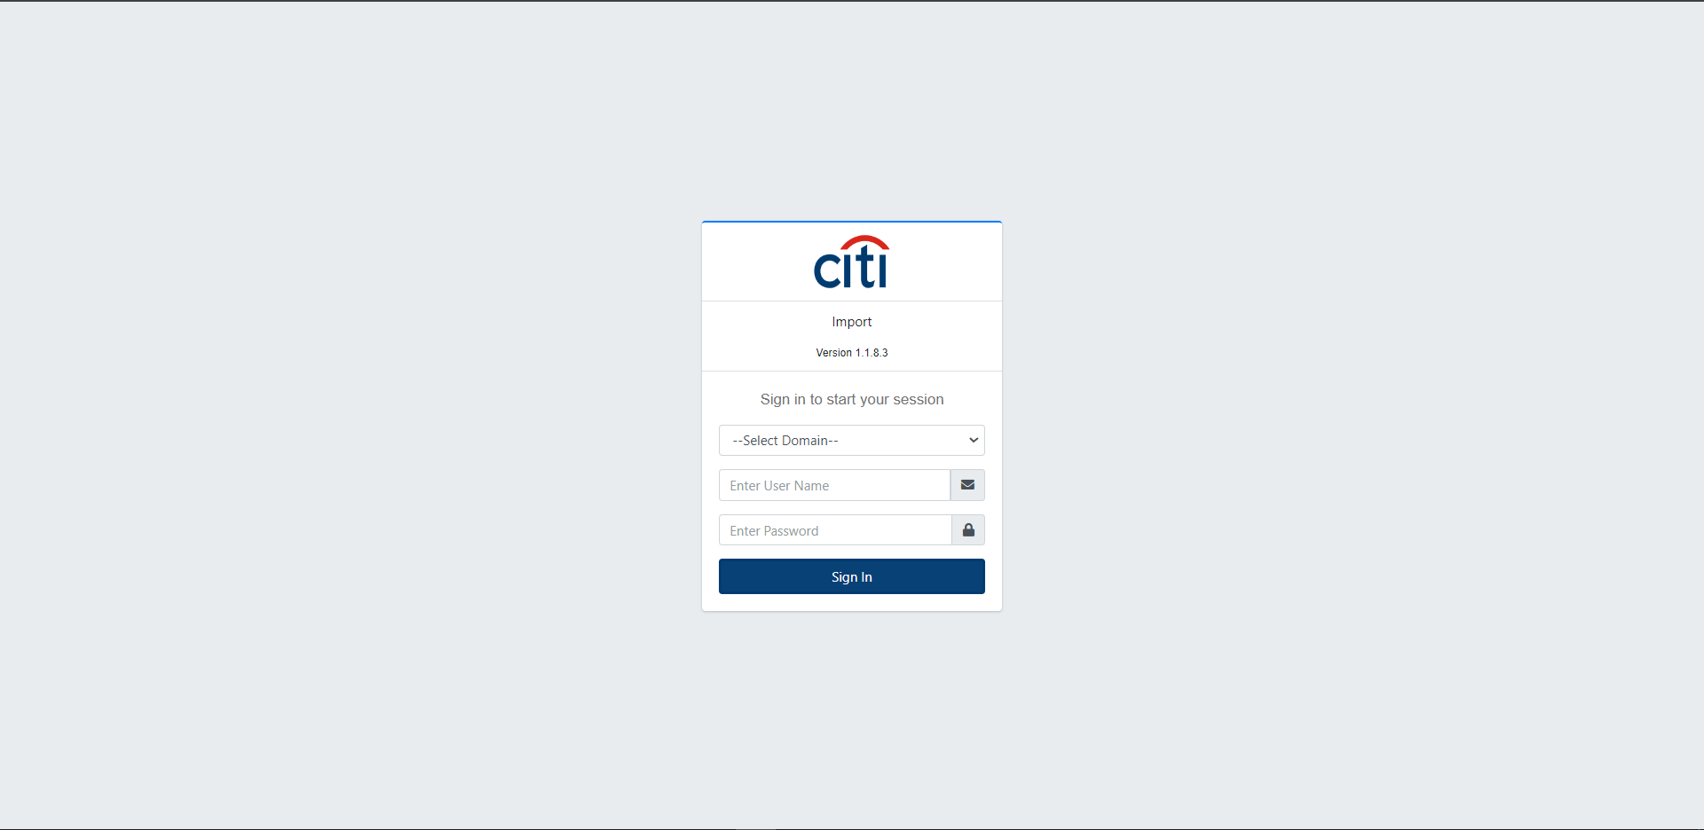

USER & ACCESS MANAGEMENT
Secure Login with SSO
Single Sign-On integration removes the need for manual User ID and password entry, streamlining secure access to the platform for every user.
IMPORT APPLICATION
8

Slide 9
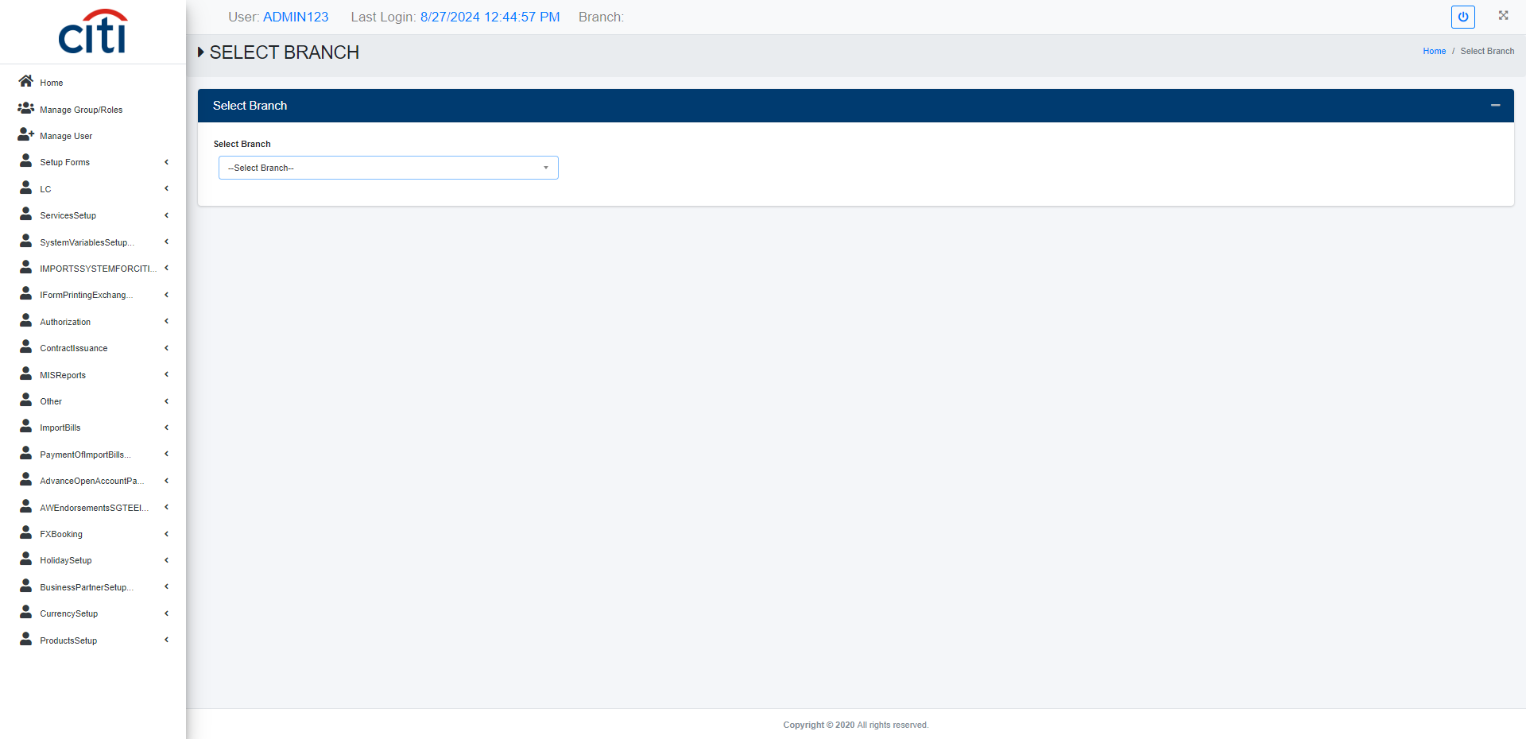
USER & ACCESS MANAGEMENT
Branch Select Form
IMPORT APPLICATION
9

Slide 10
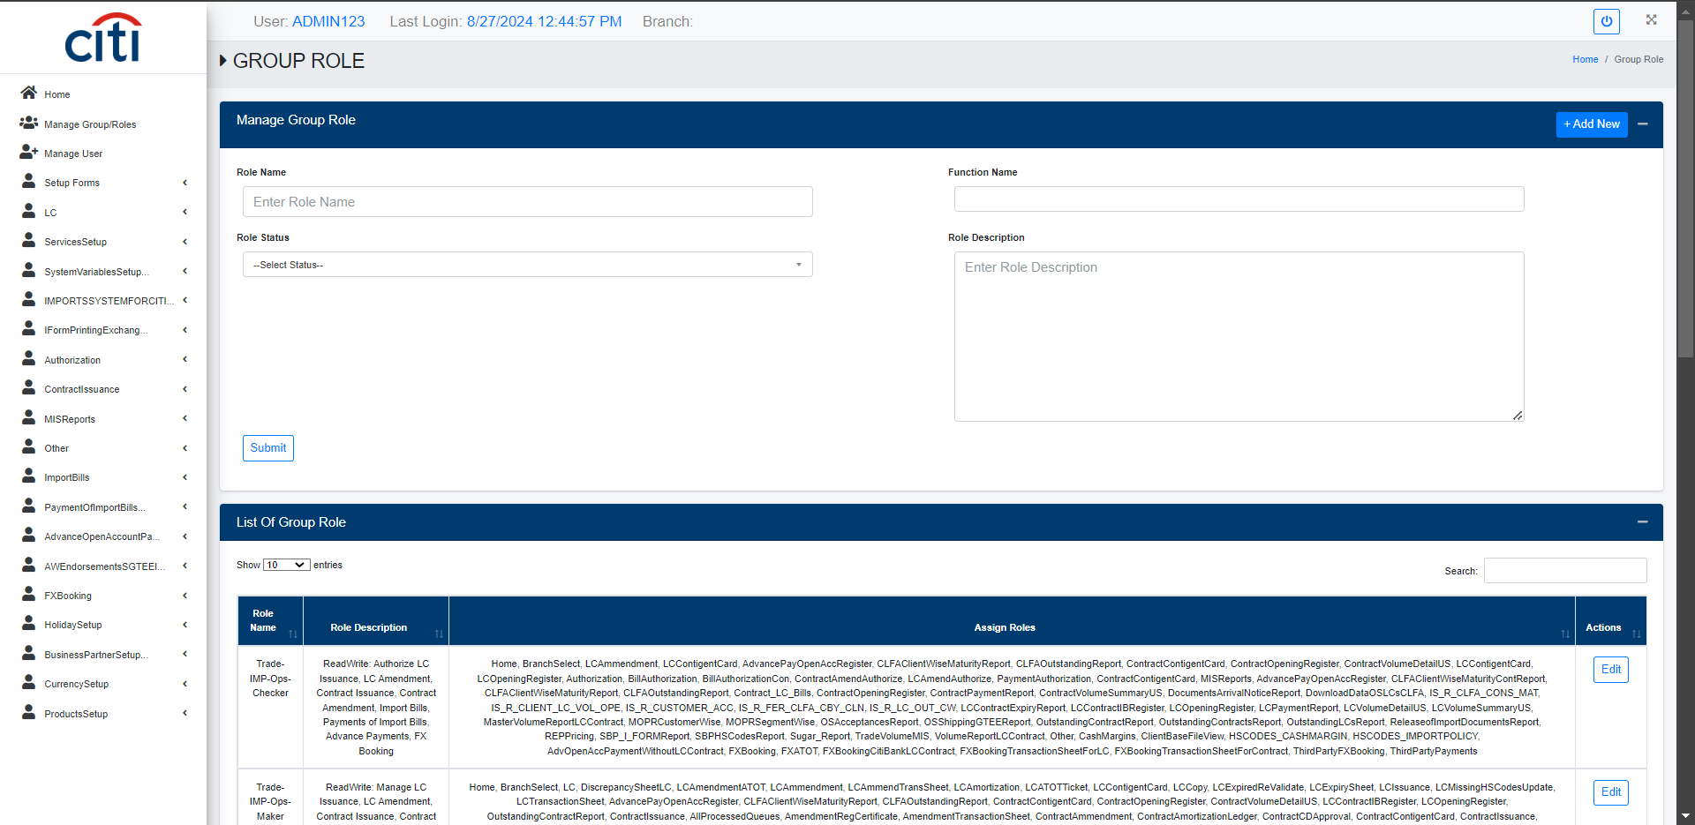
USER & ACCESS MANAGEMENT
Groups creation form which are further assigned to the application users
IMPORT APPLICATION
10

Slide 11
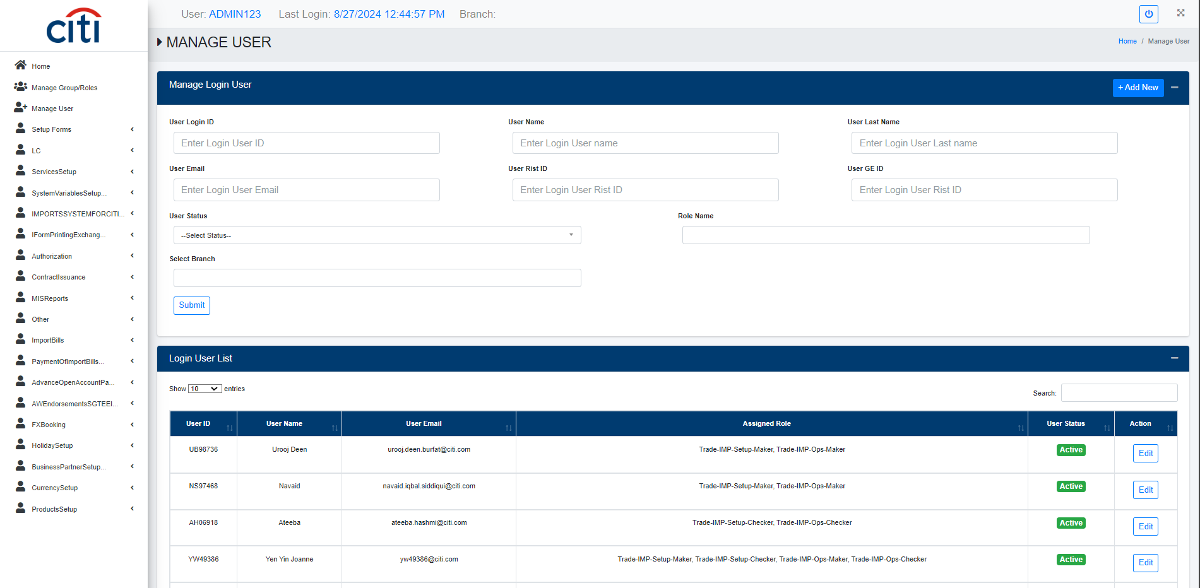
USER & ACCESS MANAGEMENT
Application user creation form
IMPORT APPLICATION
11

Slide 12
02
Setup Forms
Reference data for clients, costs, HS codes, insurance, and LC types
IMPORT APPLICATION
12

Slide 13
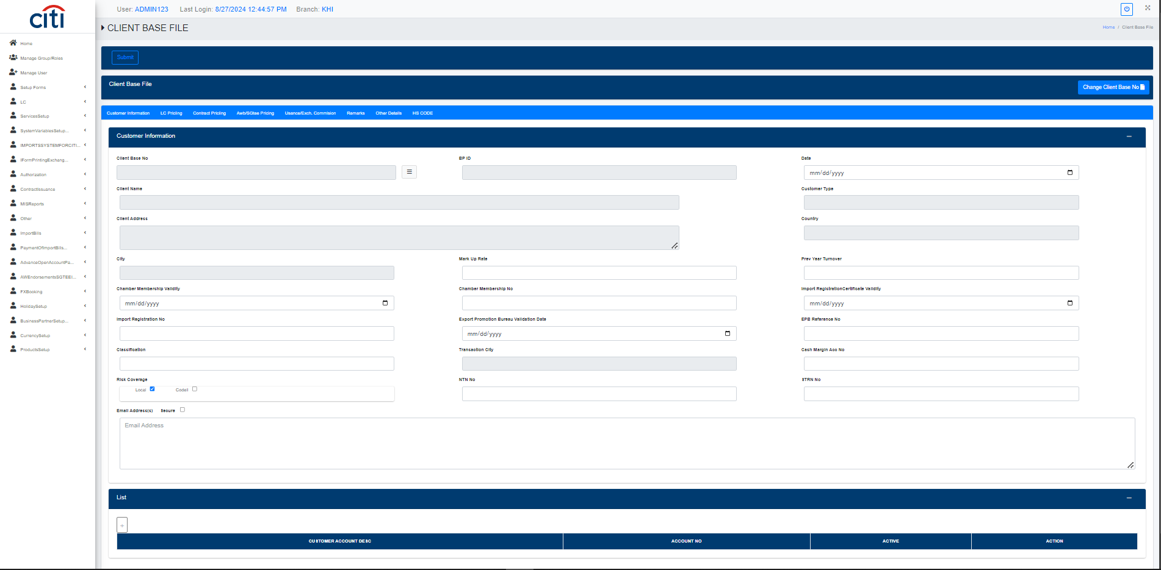
SETUP FORMS
Client Base File to update the existing client details
IMPORT APPLICATION
13

Slide 14
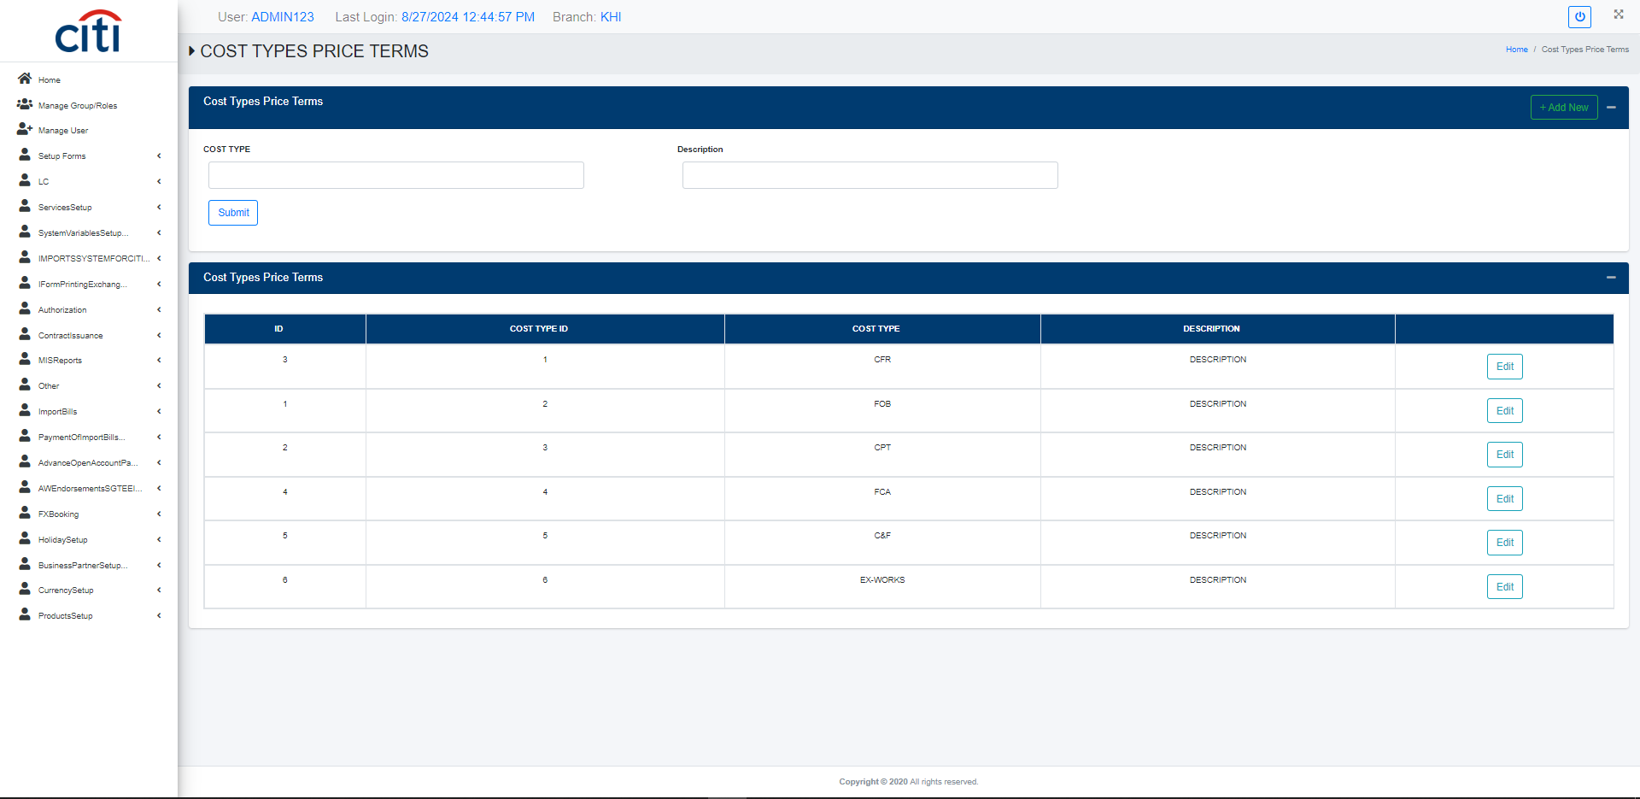
SETUP FORMS
Cost Type Setup form
IMPORT APPLICATION
14

Slide 15
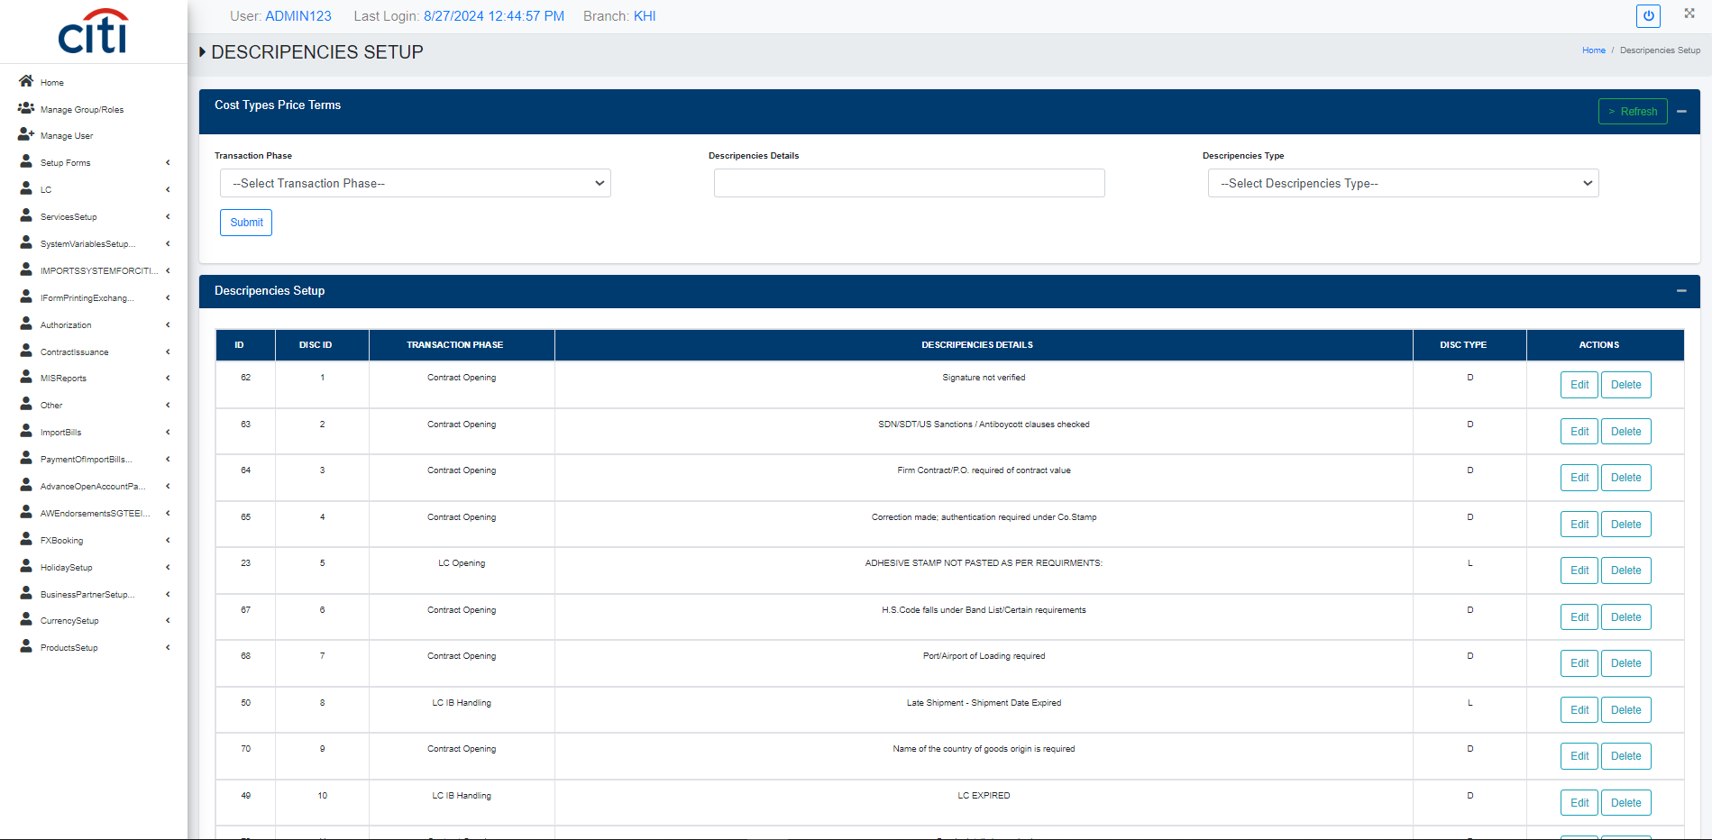
SETUP FORMS
Discrepancies Setup form
IMPORT APPLICATION
15

Slide 16
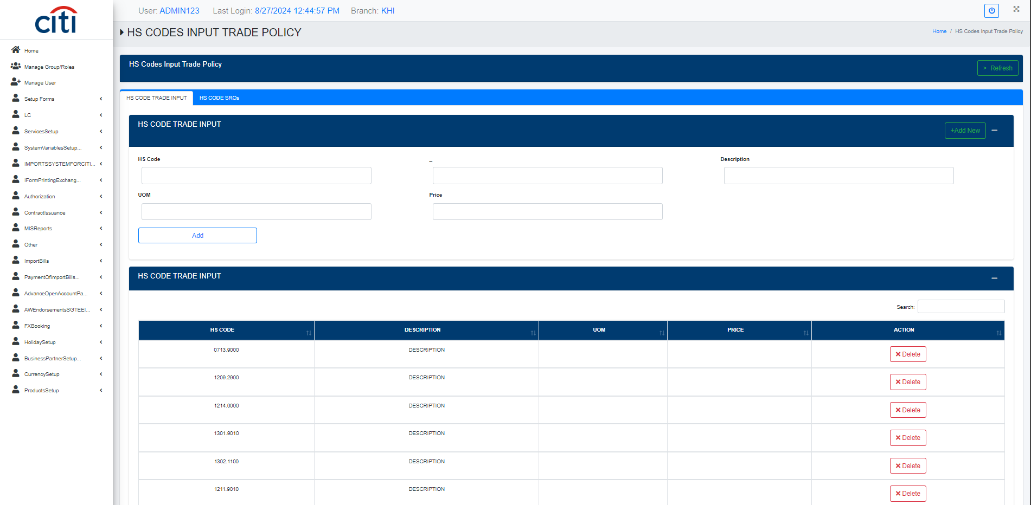
SETUP FORMS
Trade Policy Hs Code Setup form
IMPORT APPLICATION
16

Slide 17
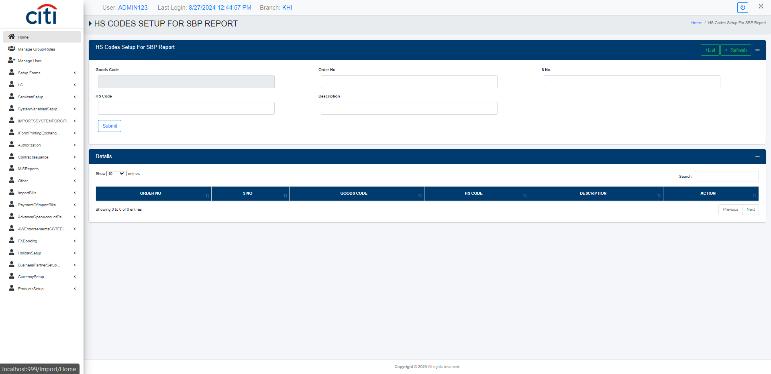
SETUP FORMS
SBP Report Hs Code Setup form
IMPORT APPLICATION
17

Slide 18
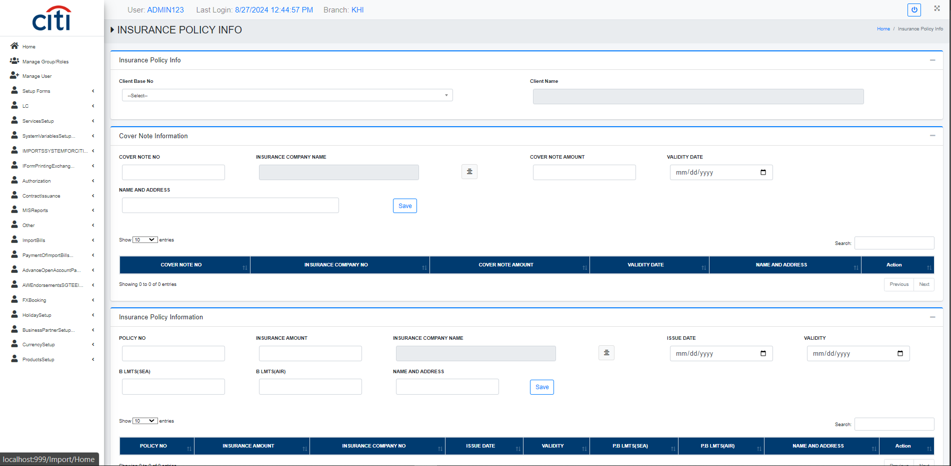
SETUP FORMS
Insurance Policies against the client are set up in this form
IMPORT APPLICATION
18

Slide 19
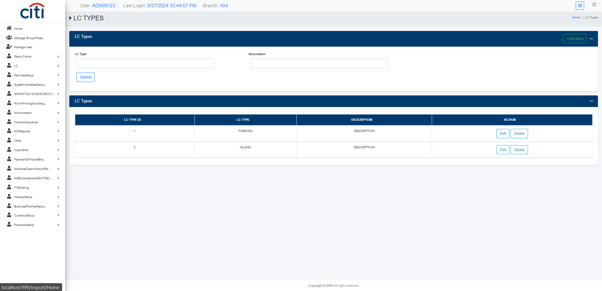
SETUP FORMS
LC type setup form
IMPORT APPLICATION
19

Slide 20
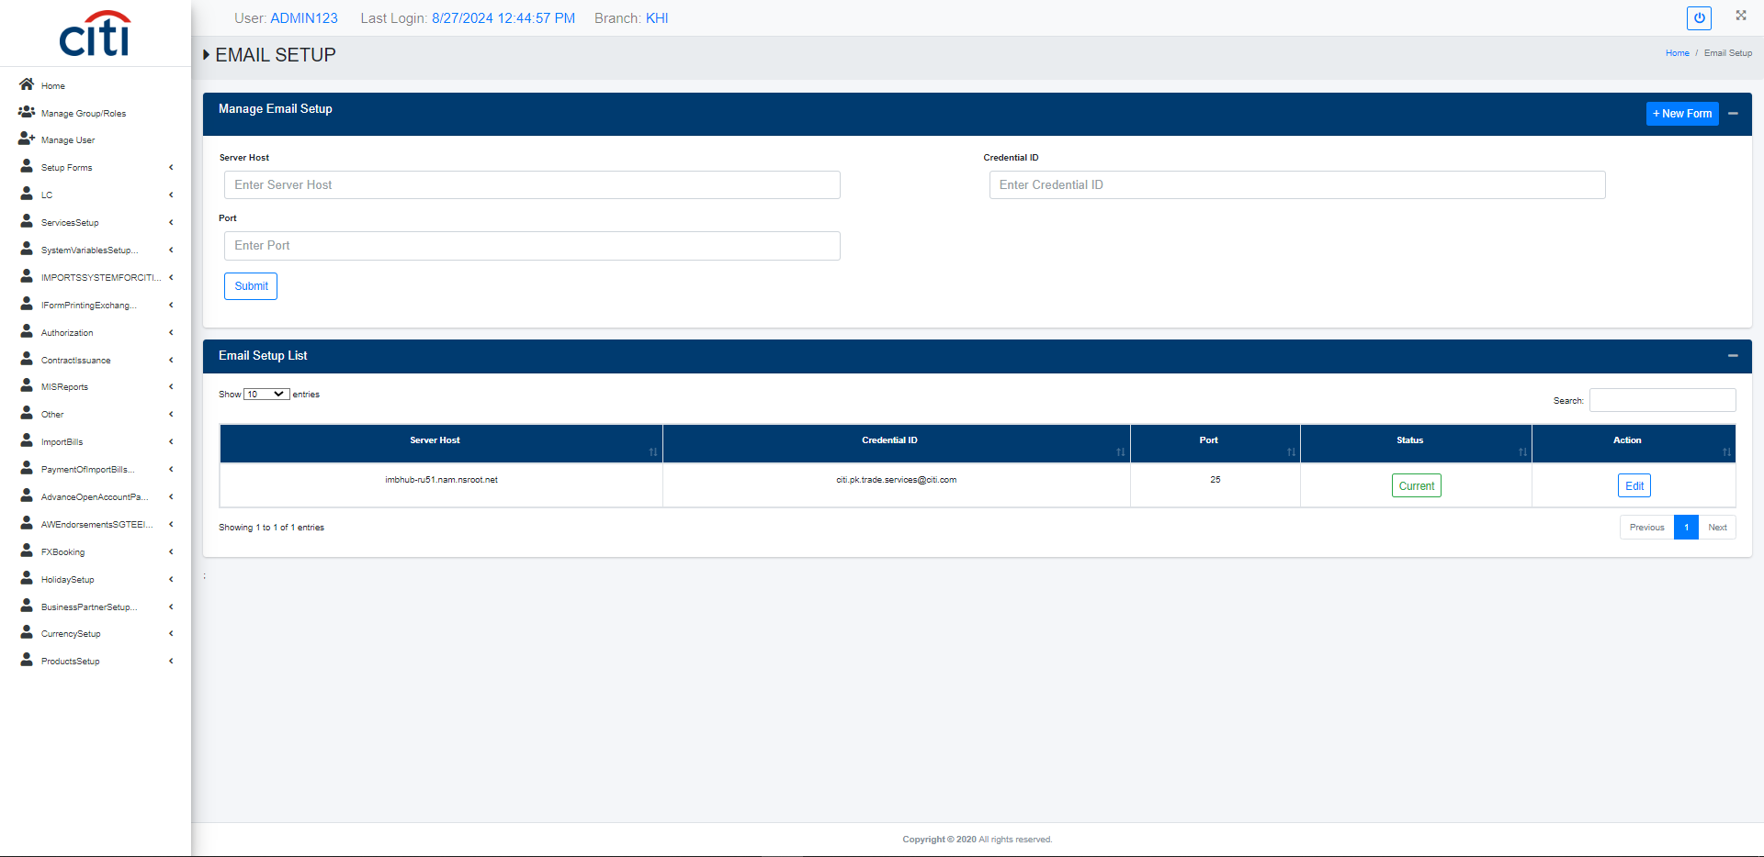
SETUP FORMS
Email Setup form
IMPORT APPLICATION
20

Slide 21
03
LC Issuance
Creation, amendment, and reporting for letters of credit
IMPORT APPLICATION
21

Slide 22
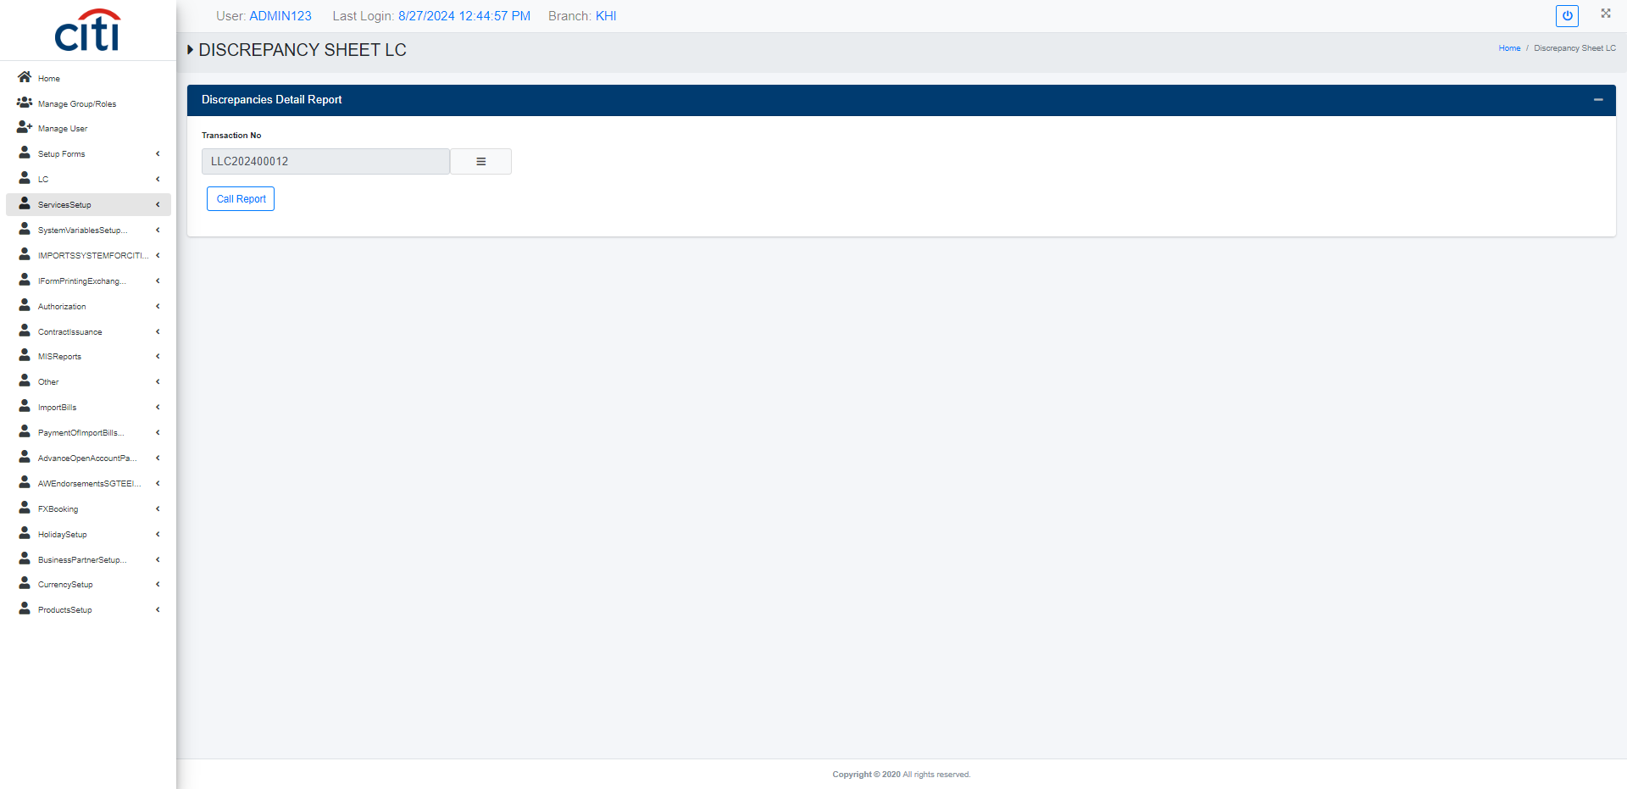
LC ISSUANCE
Discrepancies Sheet LC report
IMPORT APPLICATION
22

Slide 23
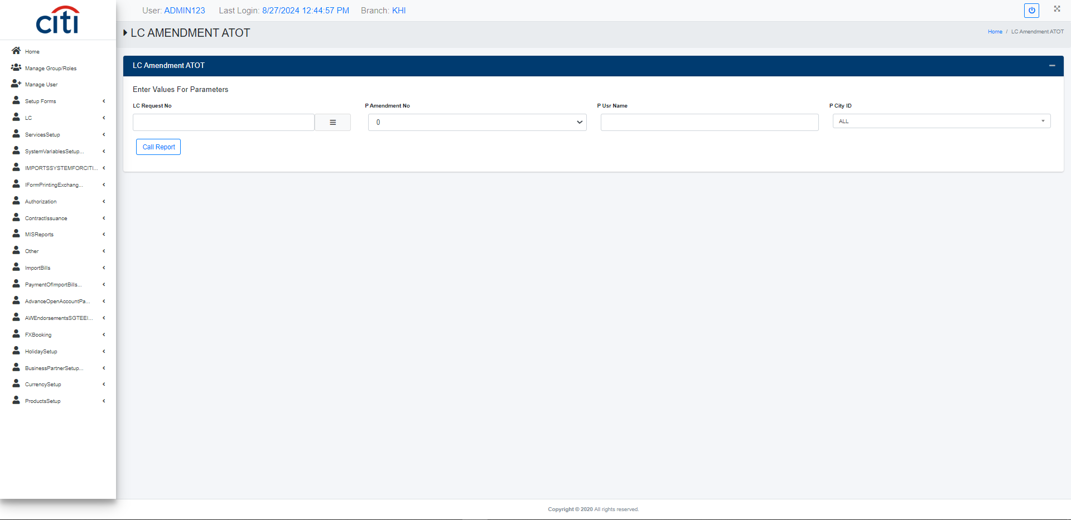
LC ISSUANCE
LC Amendment ATOT report
IMPORT APPLICATION
23

Slide 24
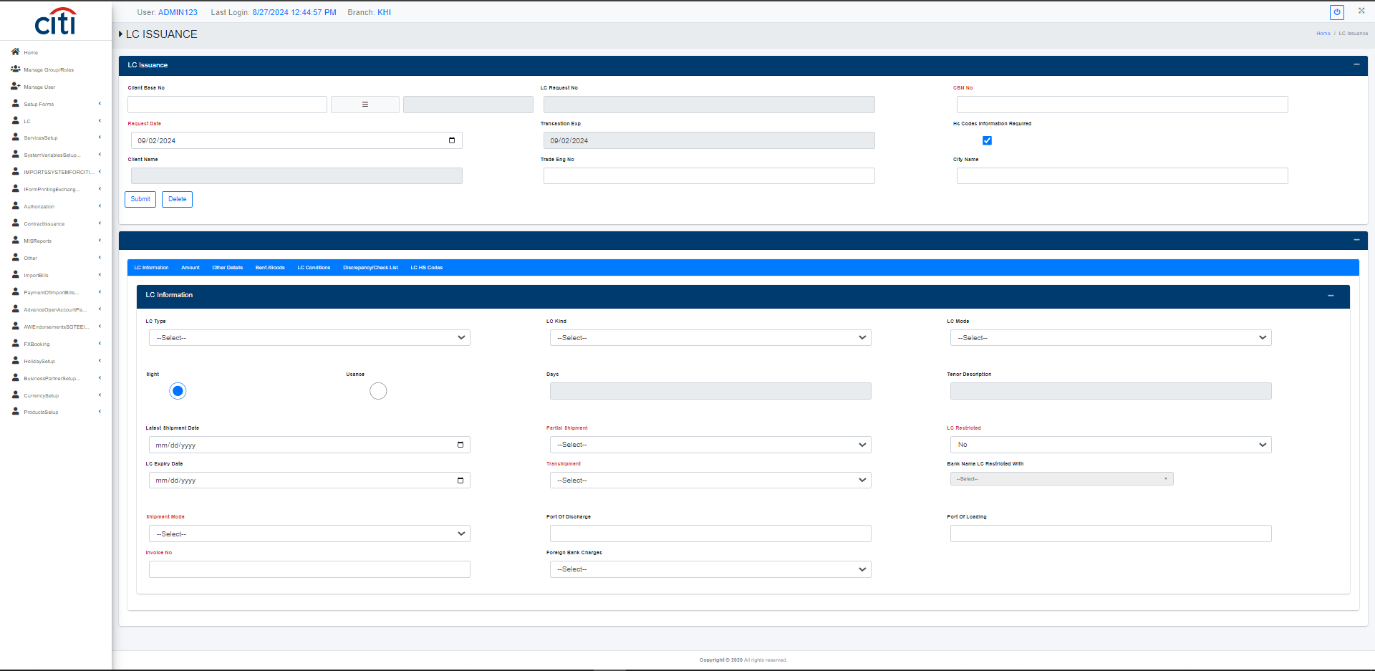
LC ISSUANCE
LC Issuance form
IMPORT APPLICATION
24

Slide 25
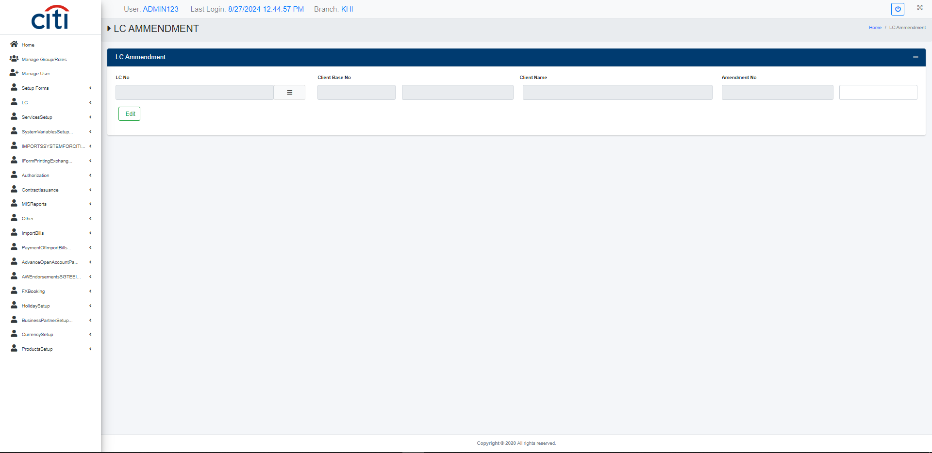
LC ISSUANCE
LC Amendment form
IMPORT APPLICATION
25

Slide 26
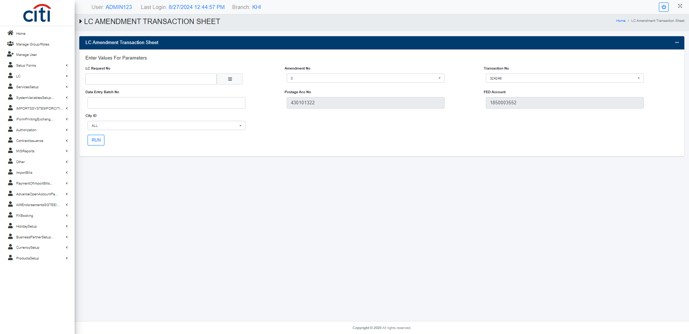
LC ISSUANCE
LC Amendment Transaction Sheet report
IMPORT APPLICATION
26

Slide 27
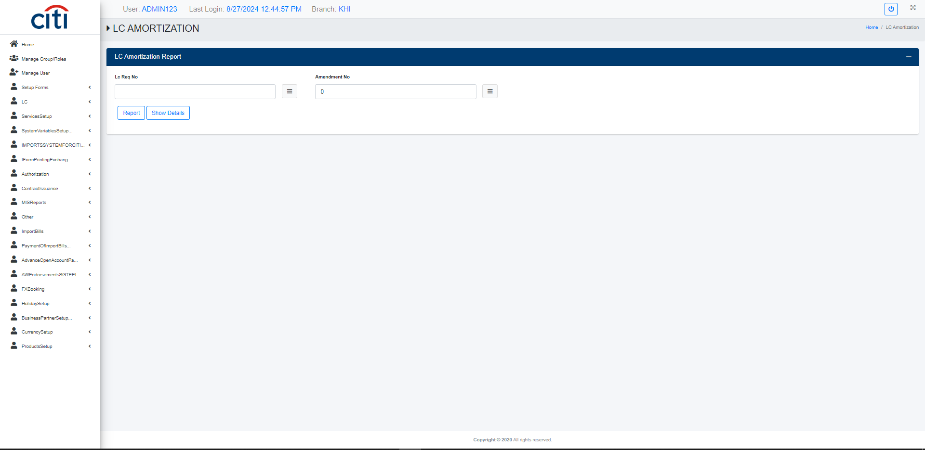
LC ISSUANCE
LC Amortization report
IMPORT APPLICATION
27

Slide 28
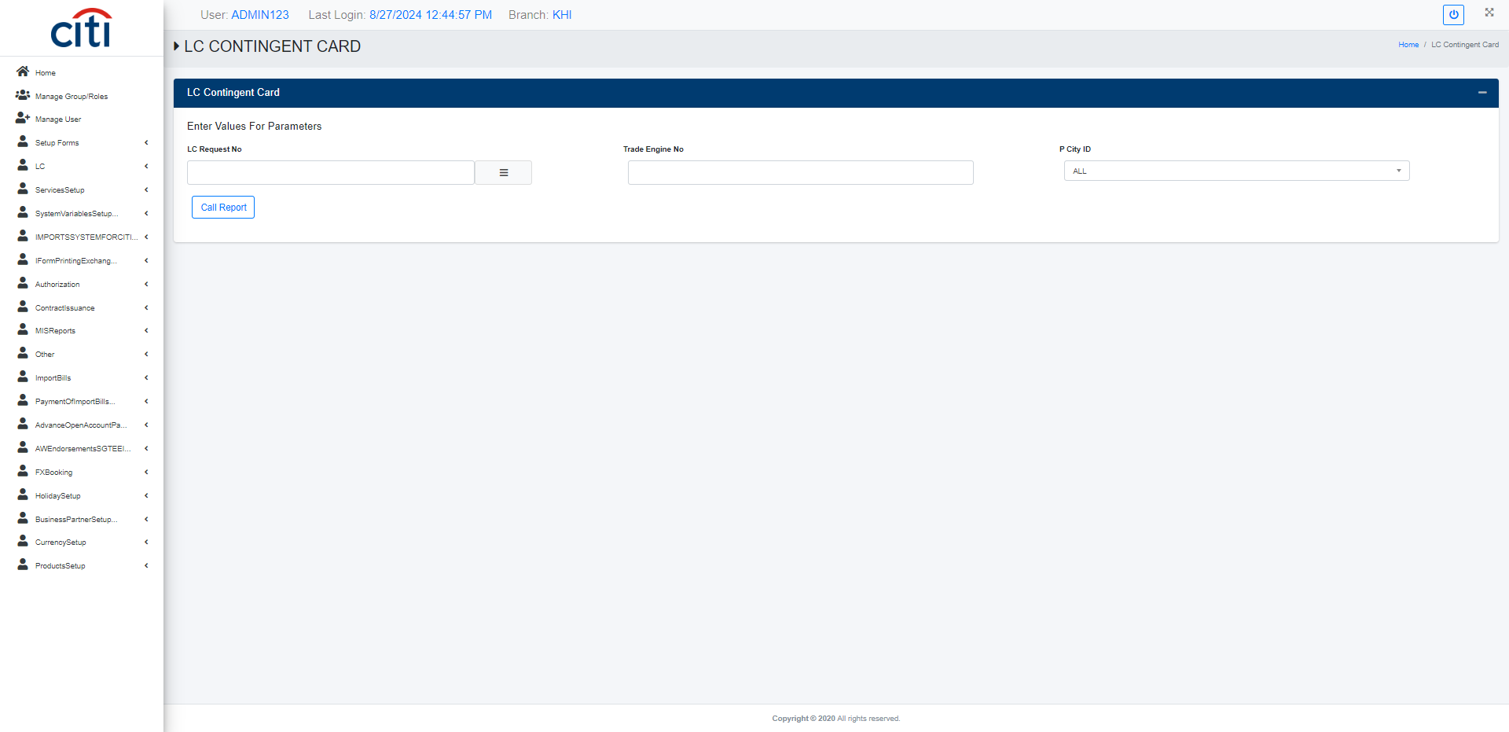
LC ISSUANCE
LC Contingent Card report
IMPORT APPLICATION
28

Slide 29
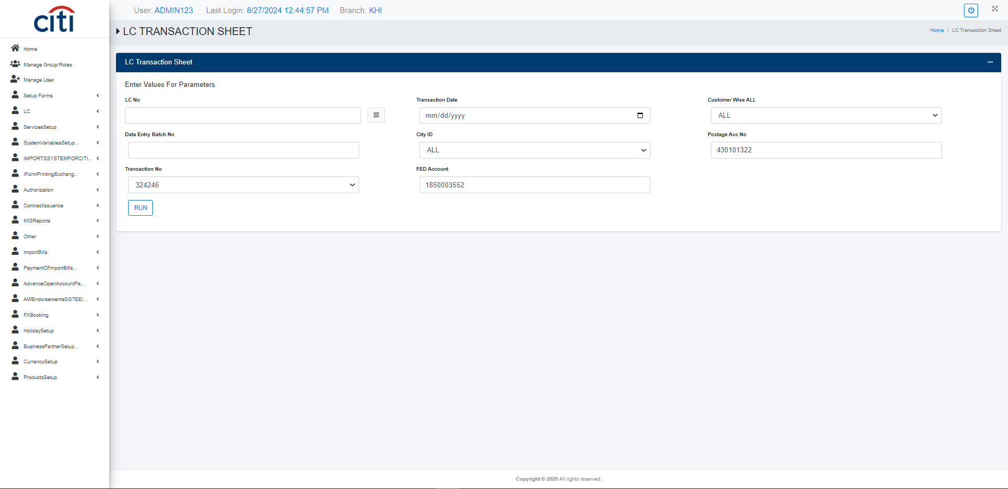
LC ISSUANCE
LC Transaction Sheet report
IMPORT APPLICATION
29

Slide 30
04
Import System for Citi User
Registers and volume reporting across LCs and contracts
IMPORT APPLICATION
30

Slide 31
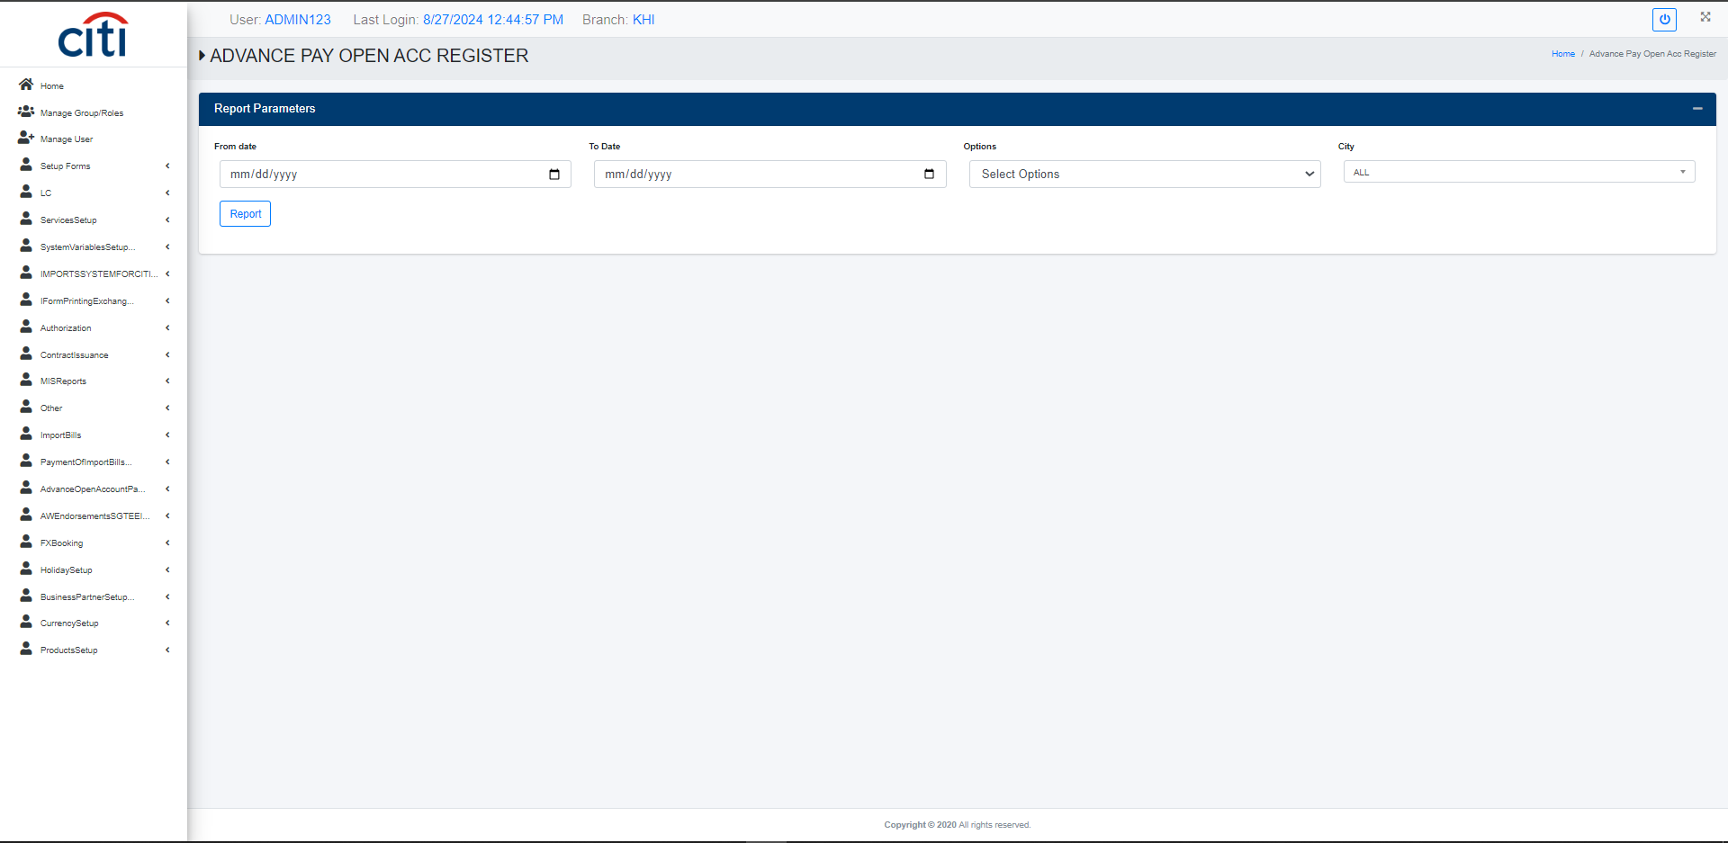
IMPORT SYSTEM FOR CITI USER
Advance payment open account register report
IMPORT APPLICATION
31

Slide 32
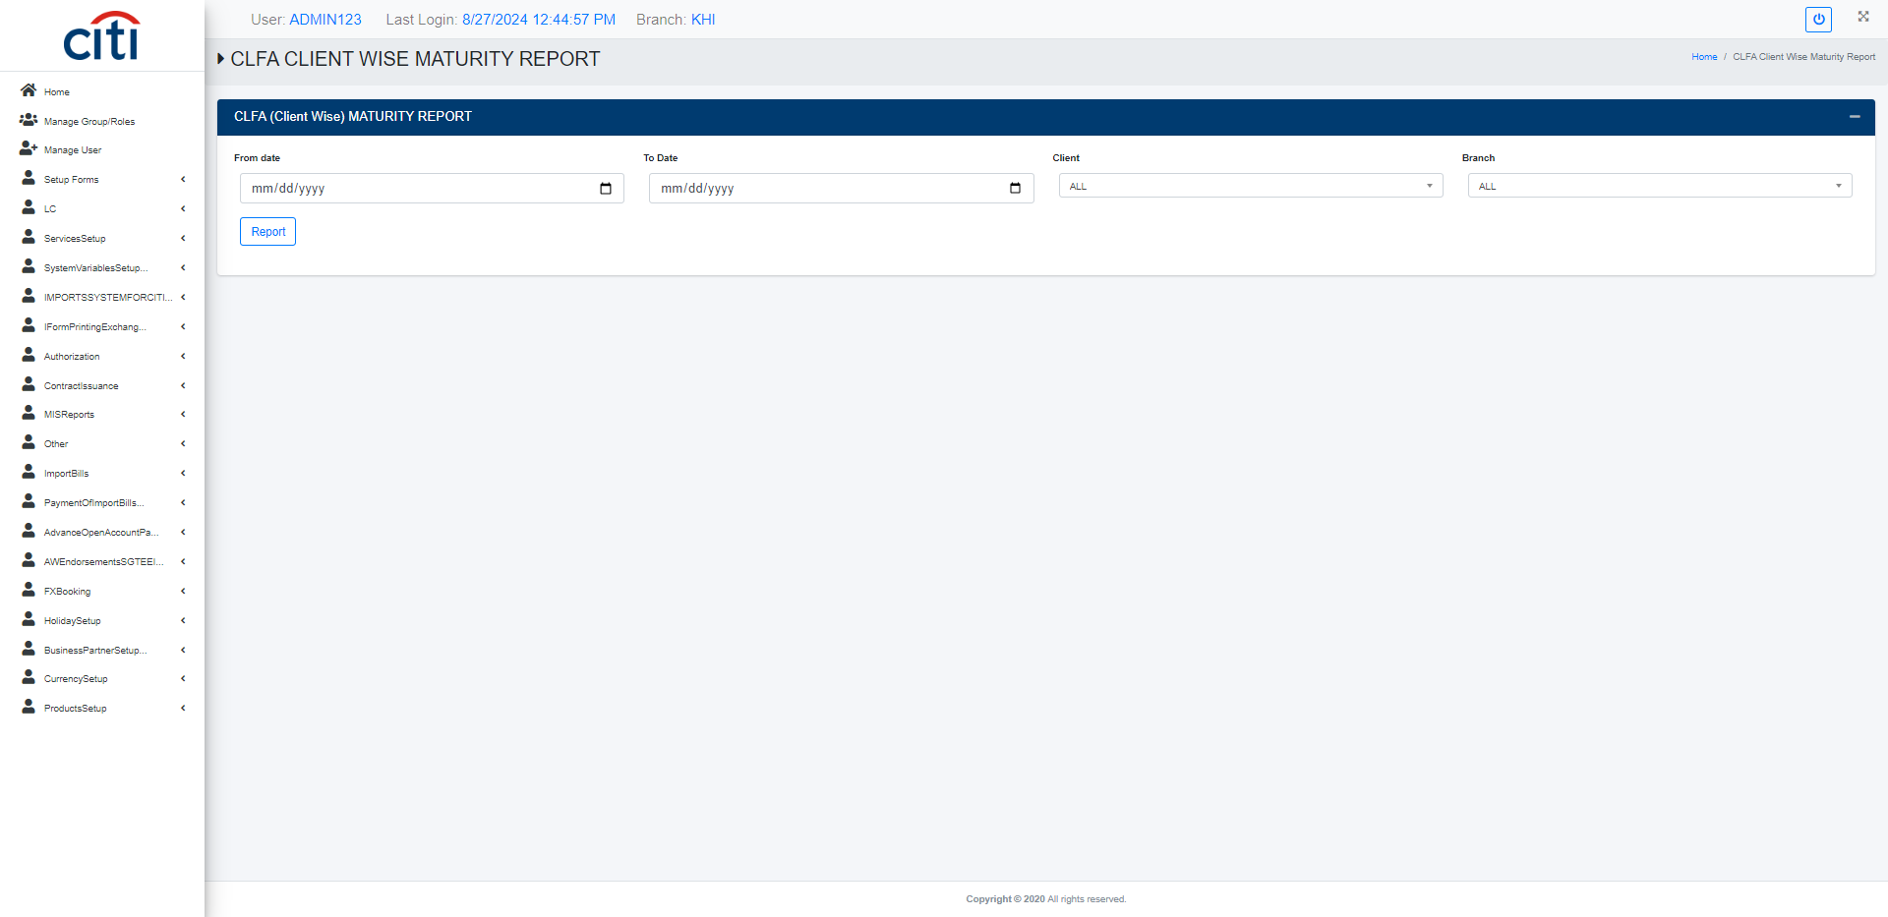
IMPORT SYSTEM FOR CITI USER
CLFA client wise maturity report
IMPORT APPLICATION
32

Slide 33

IMPORT SYSTEM FOR CITI USER
CLFA outstanding report
IMPORT APPLICATION
33

Slide 34
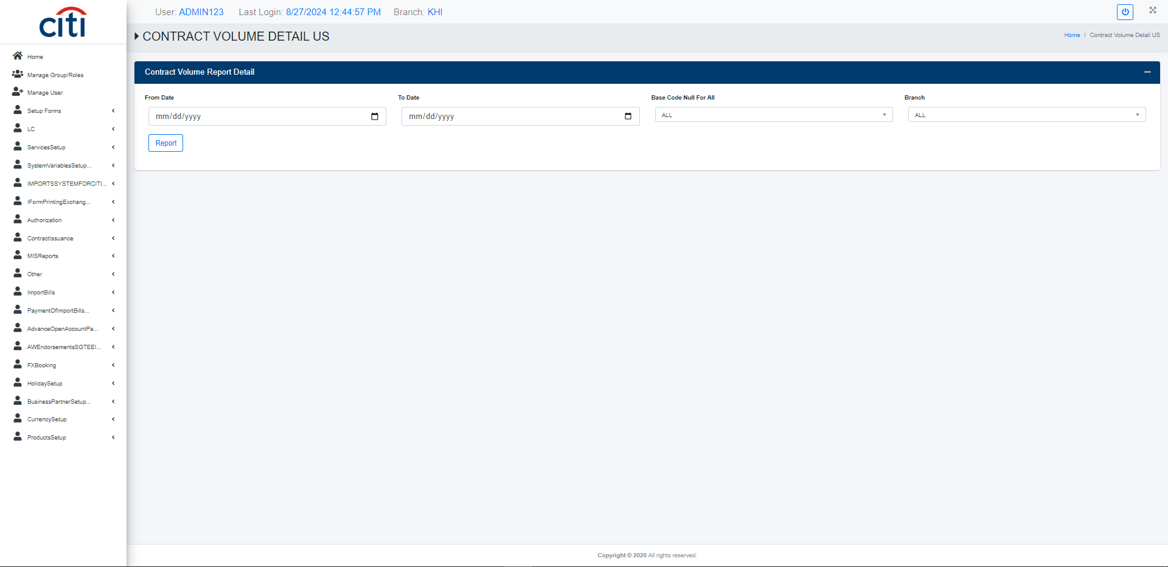
IMPORT SYSTEM FOR CITI USER
Contract opening register report
IMPORT APPLICATION
34

Slide 35
IMPORT SYSTEM FOR CITI USER
Contract volume details report
IMPORT APPLICATION
35

Slide 36
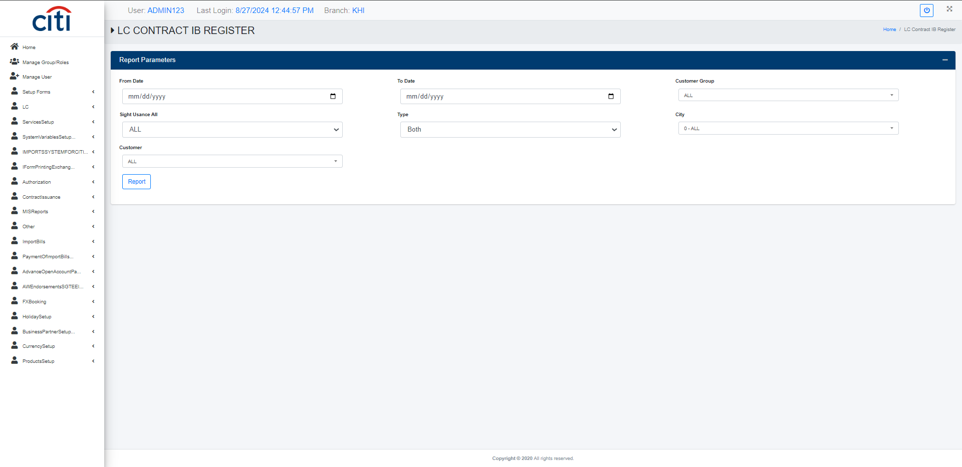
IMPORT SYSTEM FOR CITI USER
LC Contract IB register report
IMPORT APPLICATION
36

Slide 37
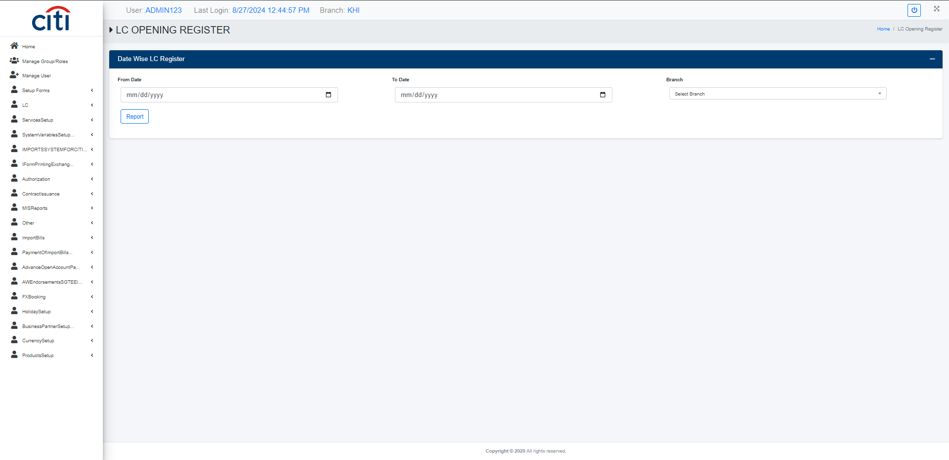
IMPORT SYSTEM FOR CITI USER
LC opening register report
IMPORT APPLICATION
37

Slide 38
05
Authorization
Maker-checker approval for bills, contracts, and payments
IMPORT APPLICATION
38

Slide 39
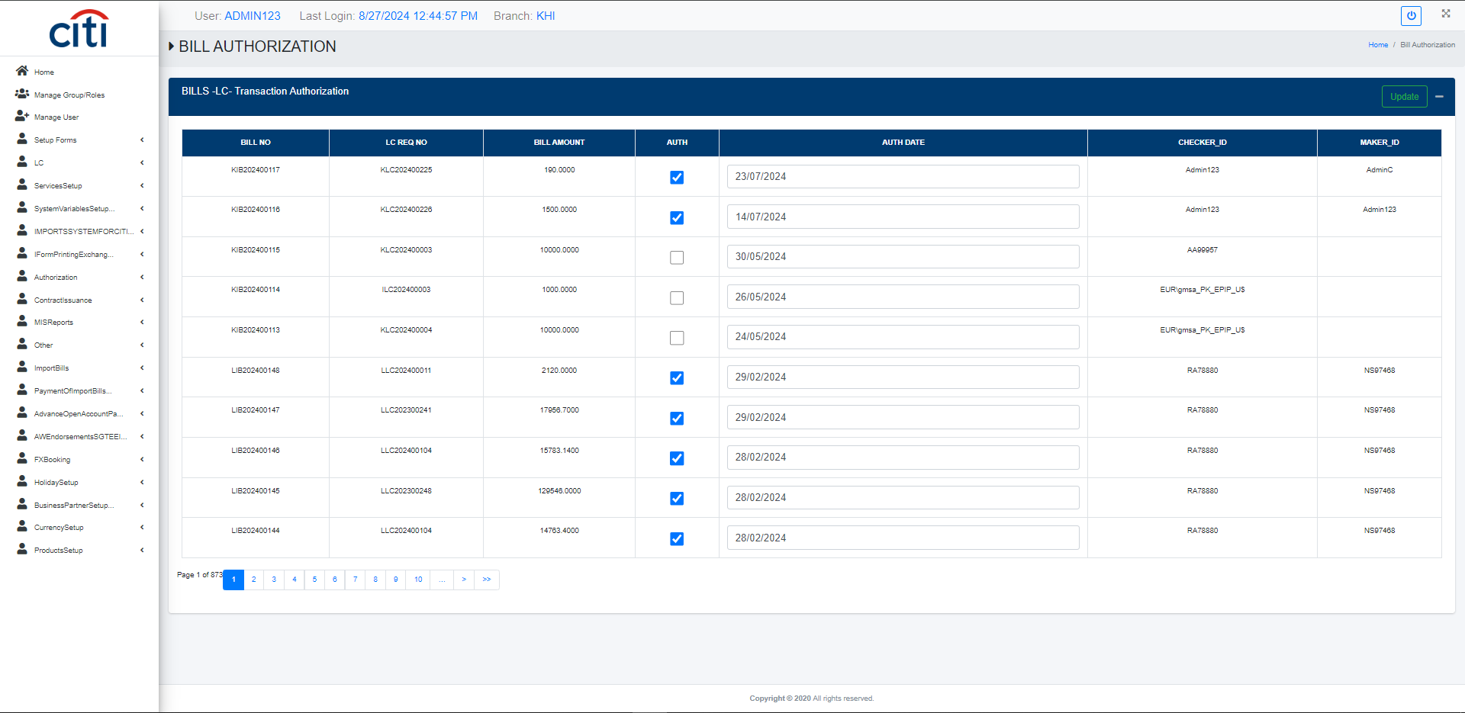
AUTHORIZATION
LC bill authorization form
IMPORT APPLICATION
39

Slide 40
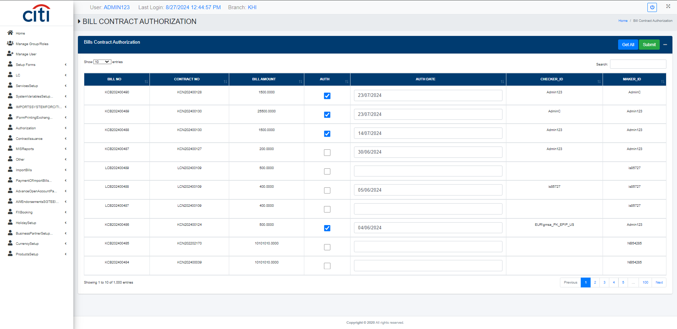
AUTHORIZATION
Contract bill authorization form
IMPORT APPLICATION
40

Slide 41
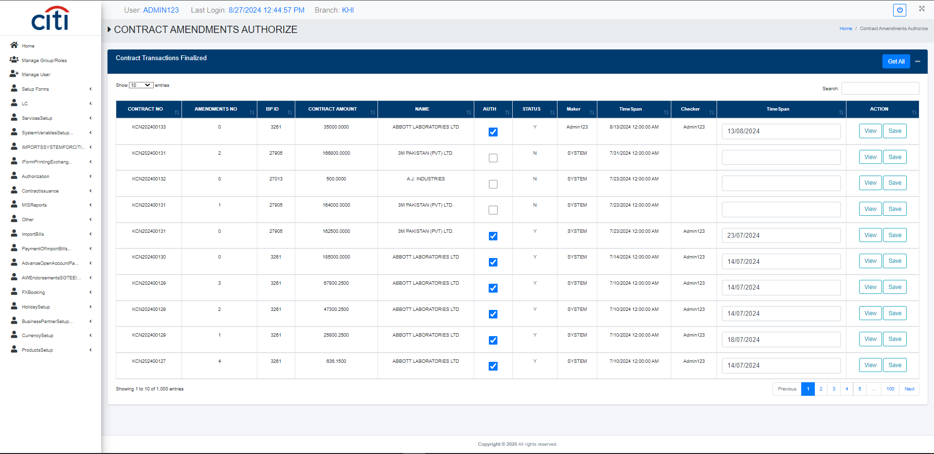
AUTHORIZATION
Contract Issuance/Amendment authorization form
IMPORT APPLICATION
41

Slide 42
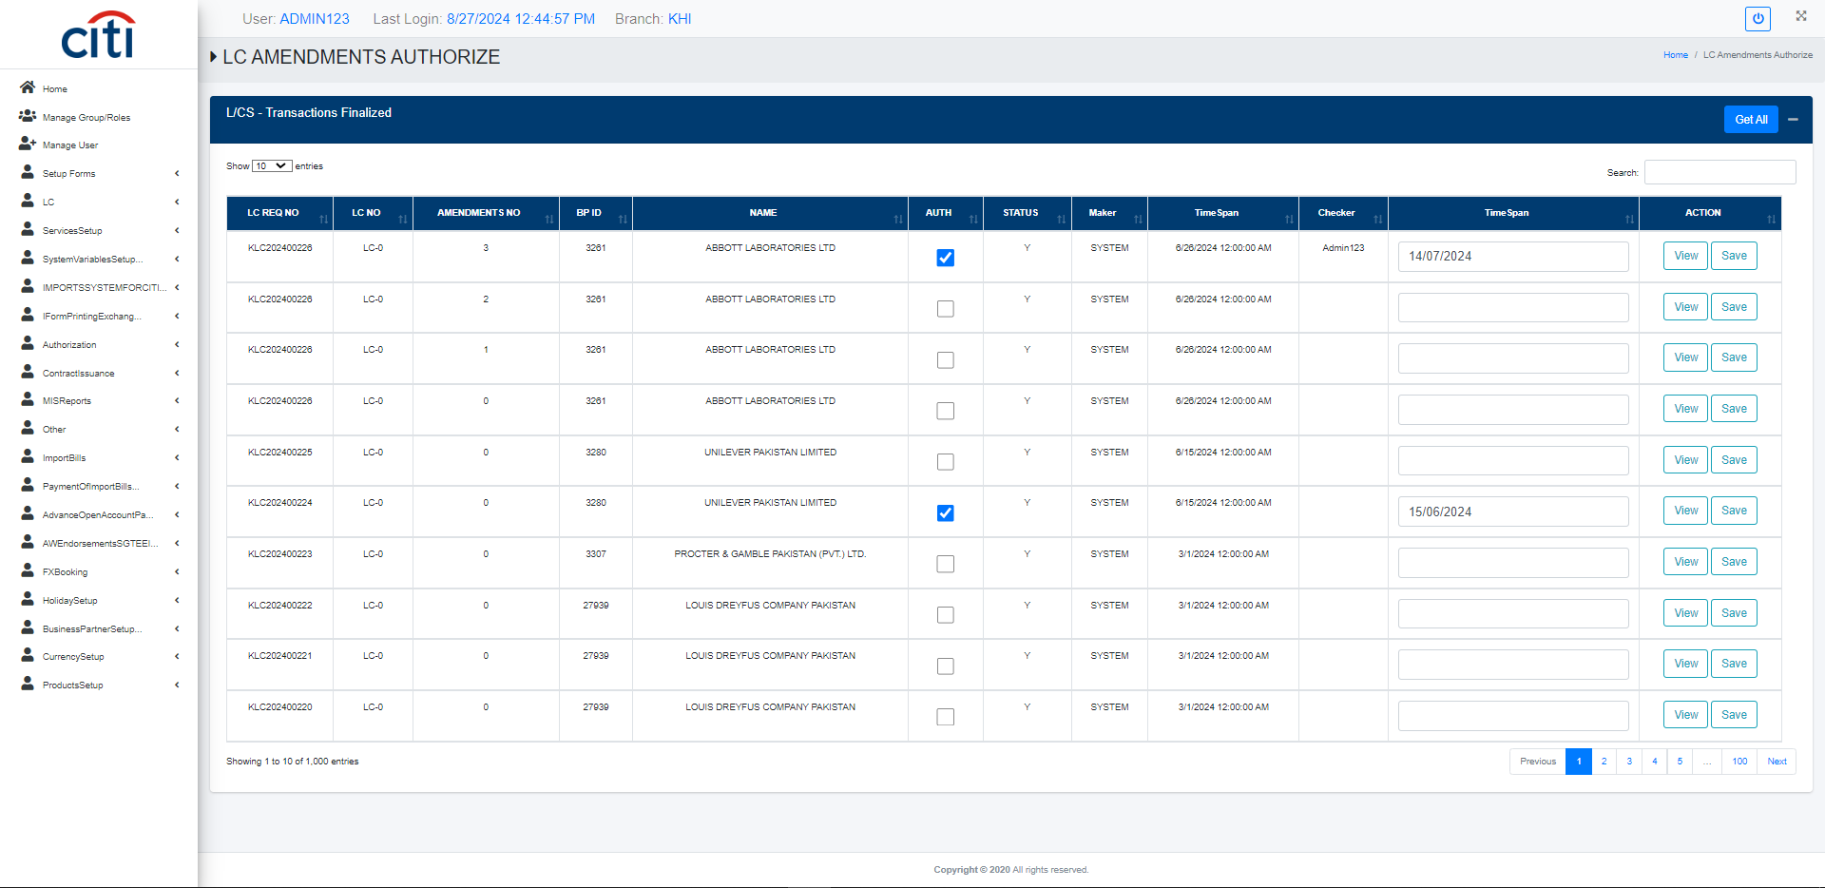
AUTHORIZATION
LC Issuance/Amendment authorization form
IMPORT APPLICATION
42

Slide 43
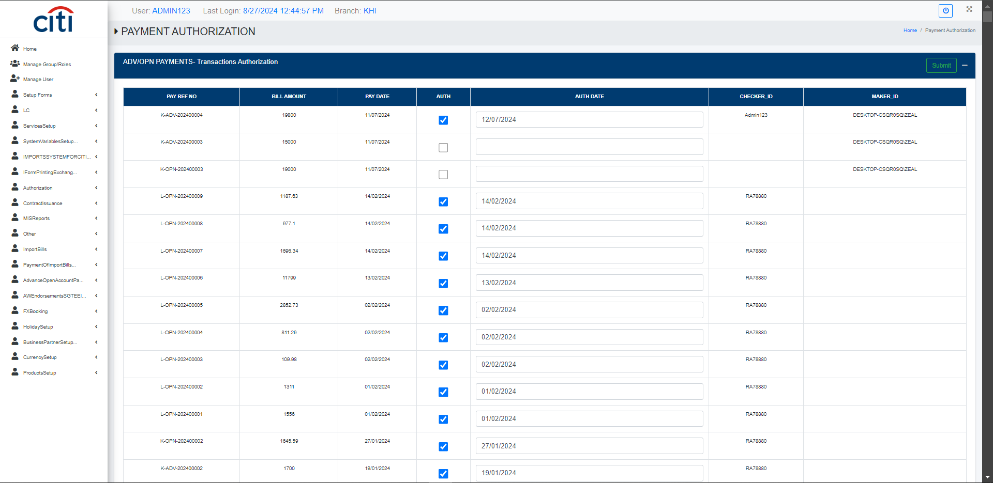
AUTHORIZATION
Payment authorization form
IMPORT APPLICATION
43

Slide 44
06
Contract Issuance
Contract issuance, amendment, and CitiDirect integration
IMPORT APPLICATION
44

Slide 45
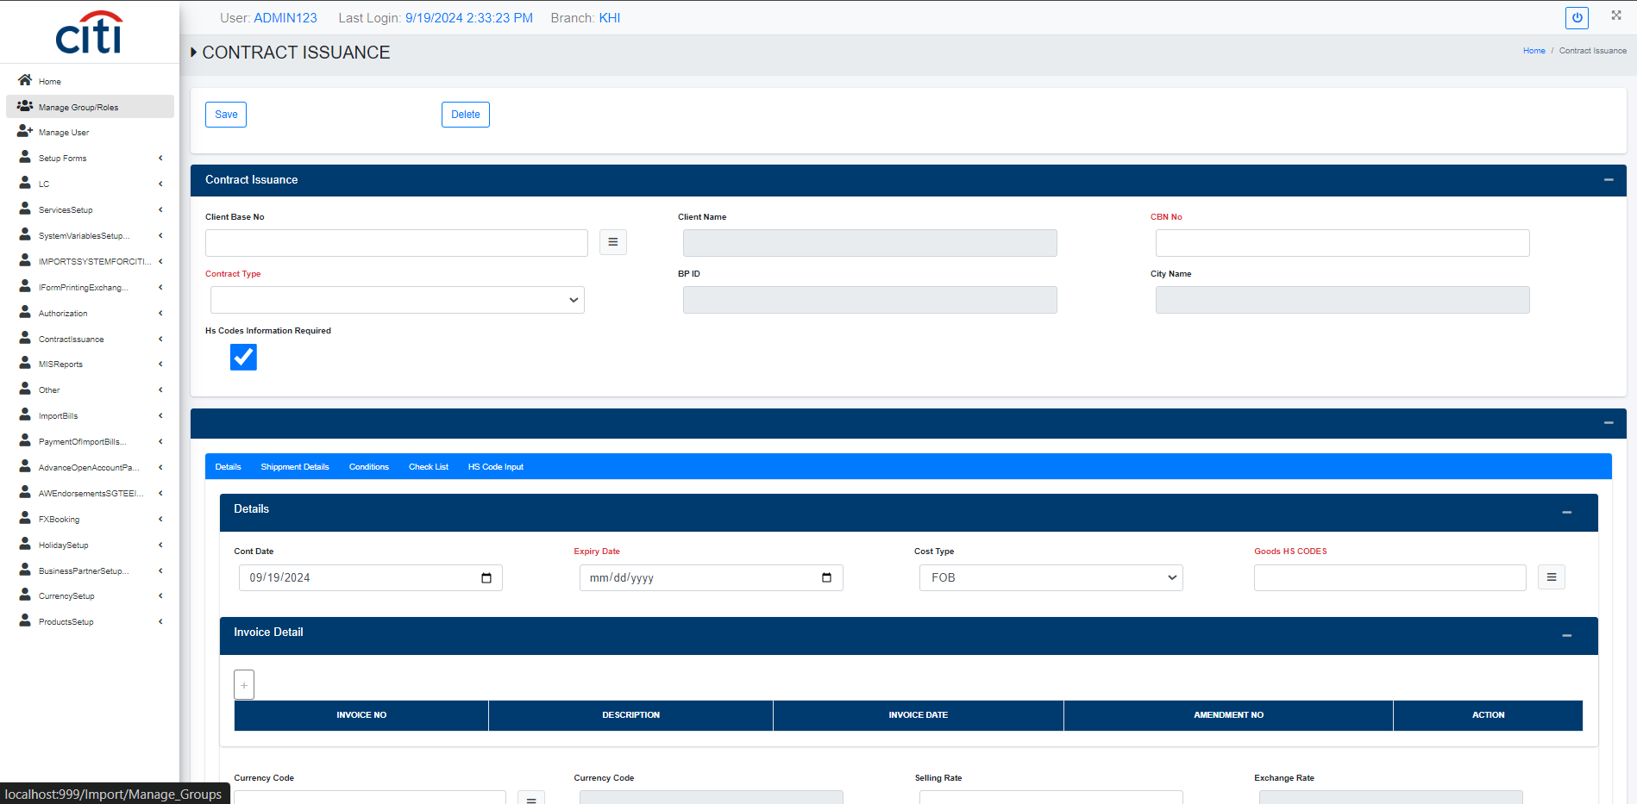
CONTRACT ISSUANCE
Contract Issuance form
IMPORT APPLICATION
45

Slide 46
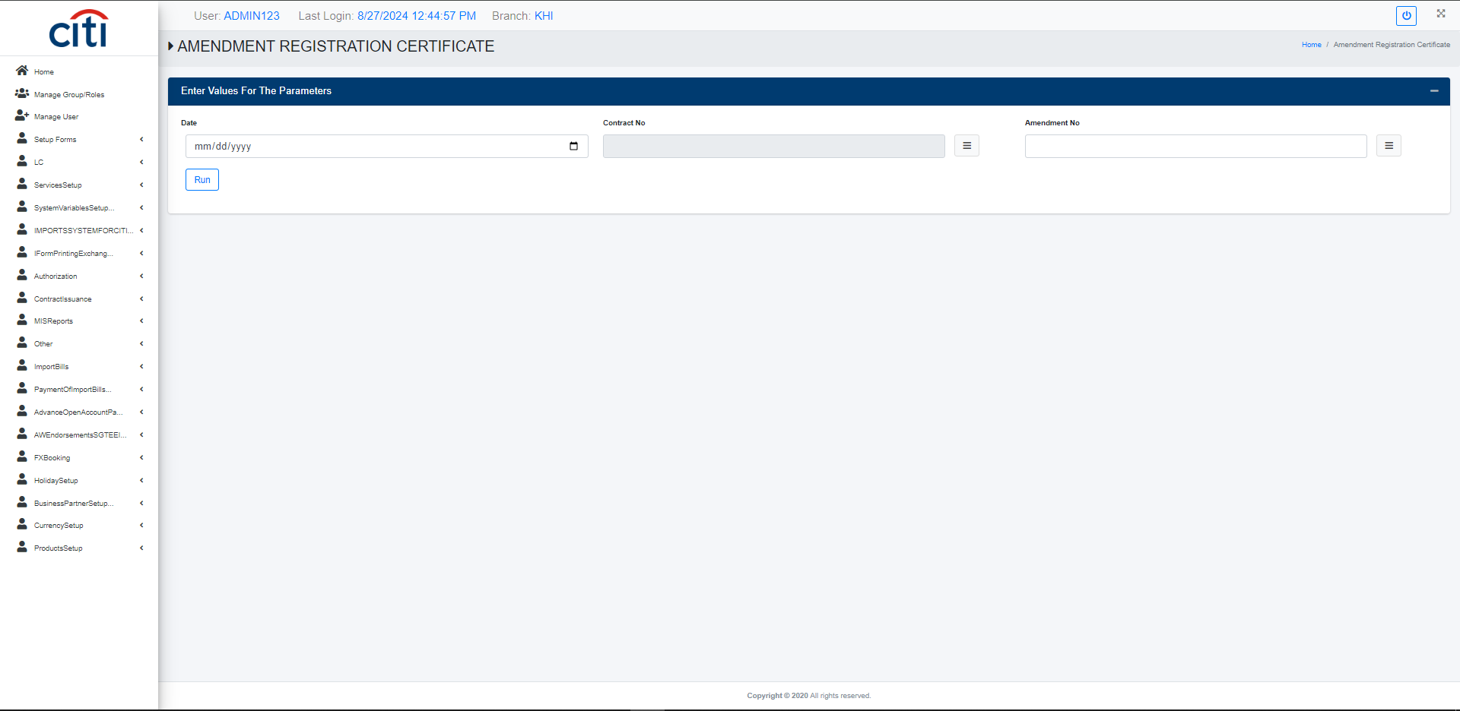
CONTRACT ISSUANCE
Contract amendment registeration certificate report
IMPORT APPLICATION
46

Slide 47

CONTRACT ISSUANCE
Contract amendment transaction sheet report
IMPORT APPLICATION
47

Slide 48
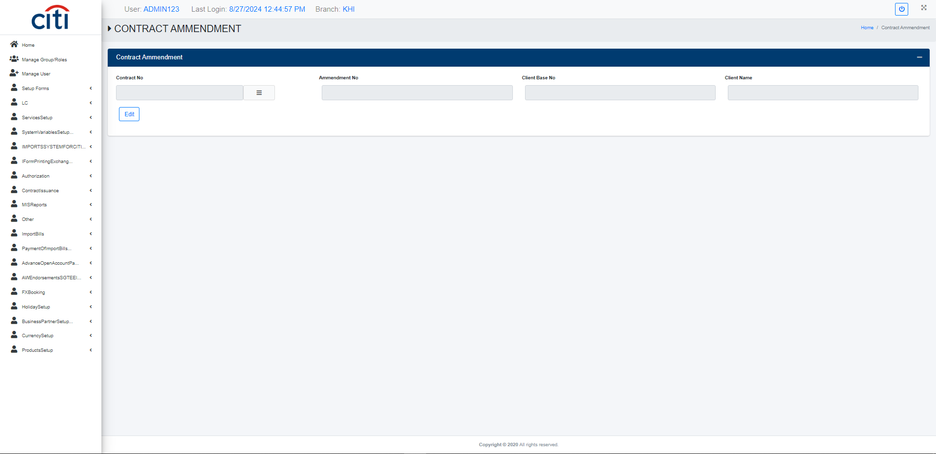
CONTRACT ISSUANCE
Contract amendment form
IMPORT APPLICATION
48

Slide 49
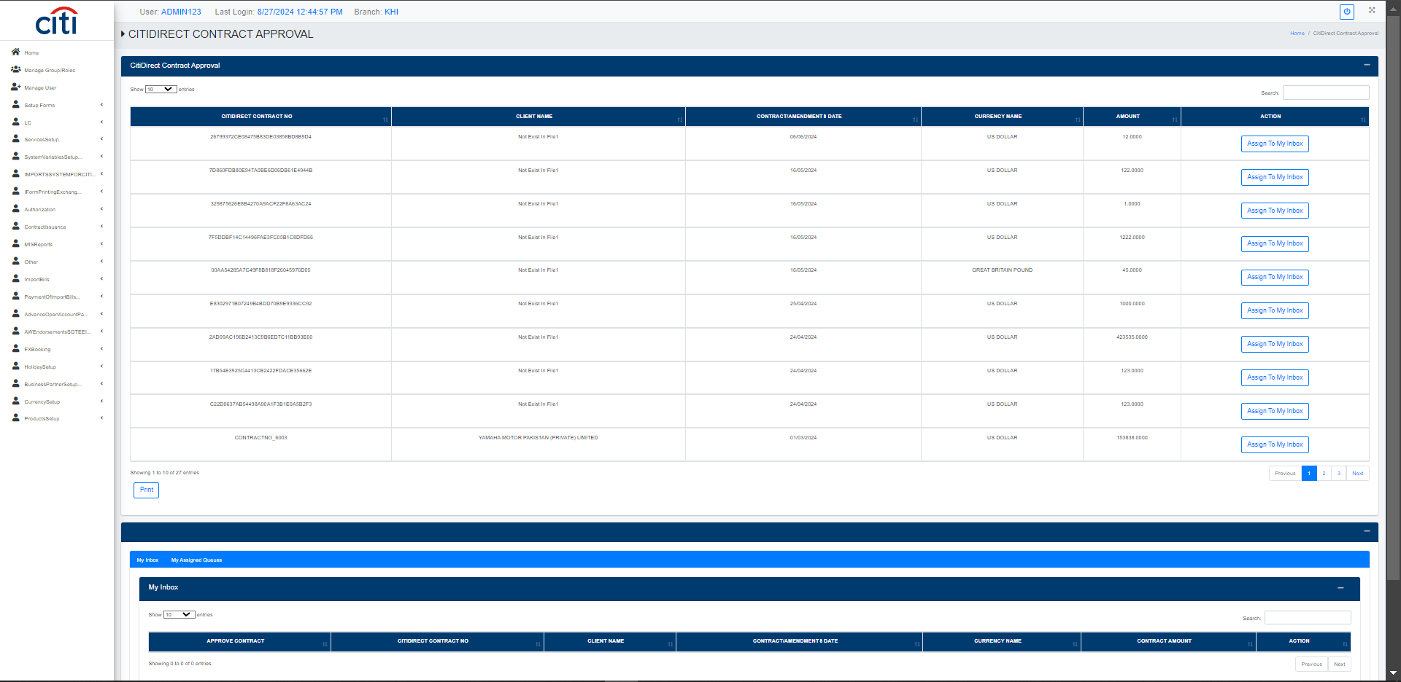
CONTRACT ISSUANCE
CitiDirect contract approval form
IMPORT APPLICATION
49

Slide 50
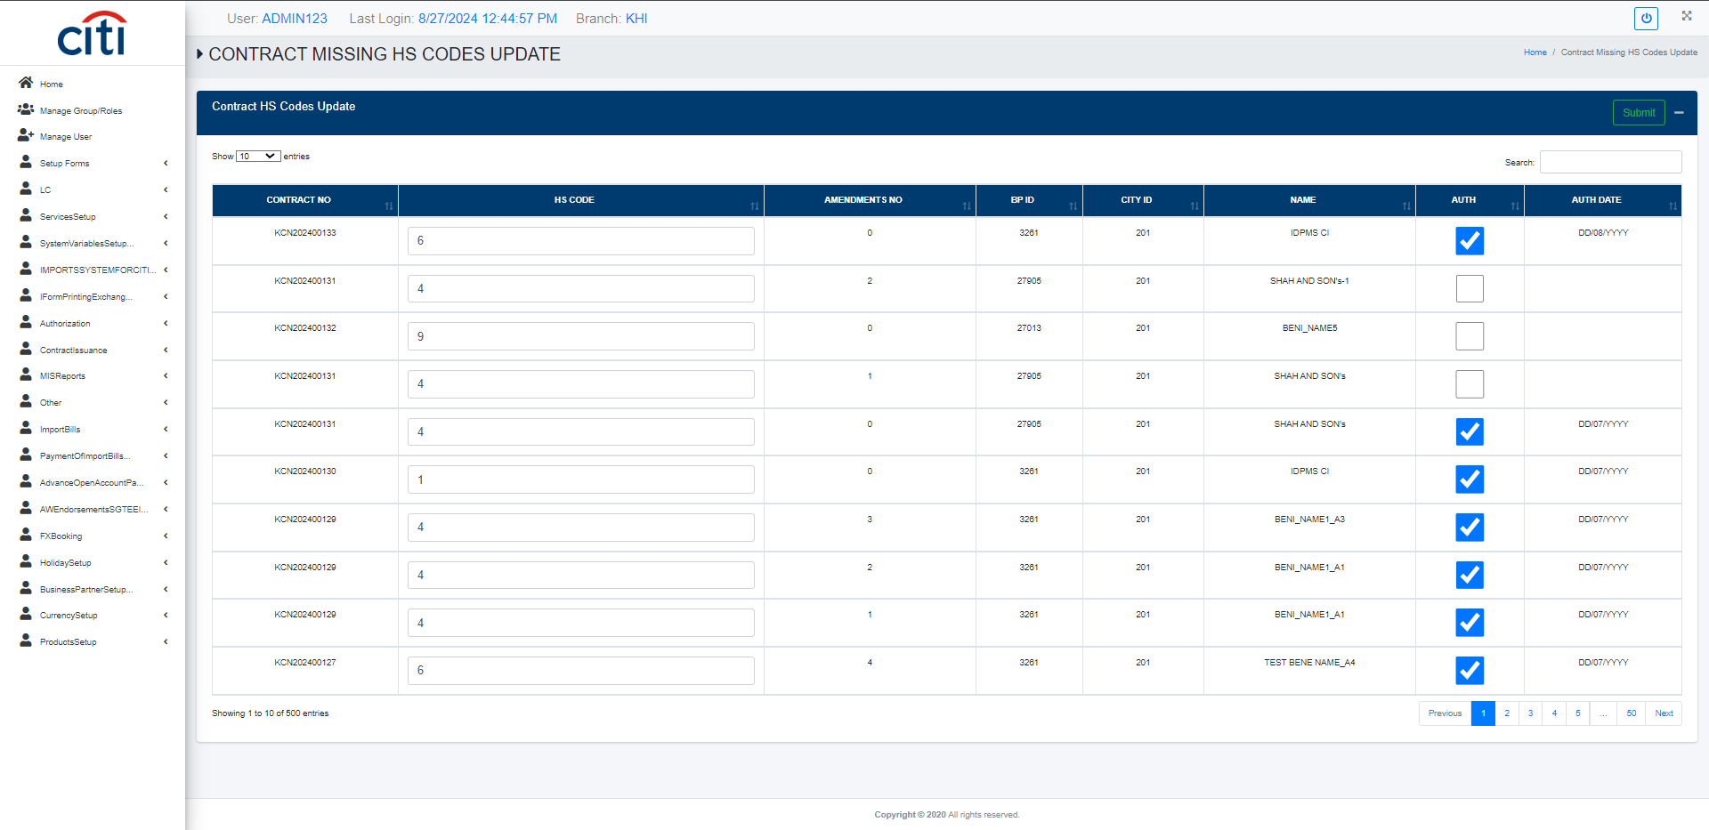
CONTRACT ISSUANCE
Contract missing hs codes update form
IMPORT APPLICATION
50

Slide 51

CONTRACT ISSUANCE
Contract registeration certificate report
IMPORT APPLICATION
51

Slide 52
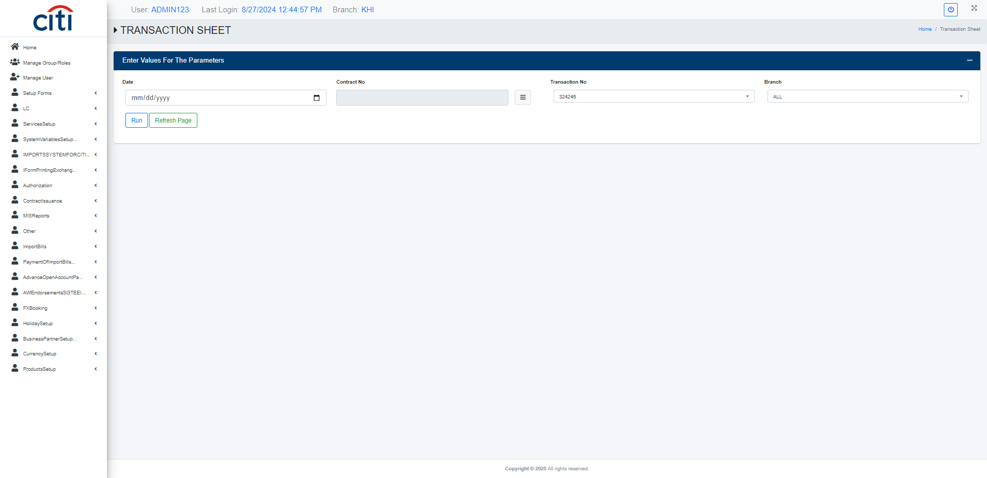
CONTRACT ISSUANCE
Contract transaction sheet report
IMPORT APPLICATION
52

Slide 53
07
MIS Reports
Management information across contracts, LCs, and users
IMPORT APPLICATION
53

Slide 54

MIS REPORTS
Advance payment open account register report
IMPORT APPLICATION
54

Slide 55
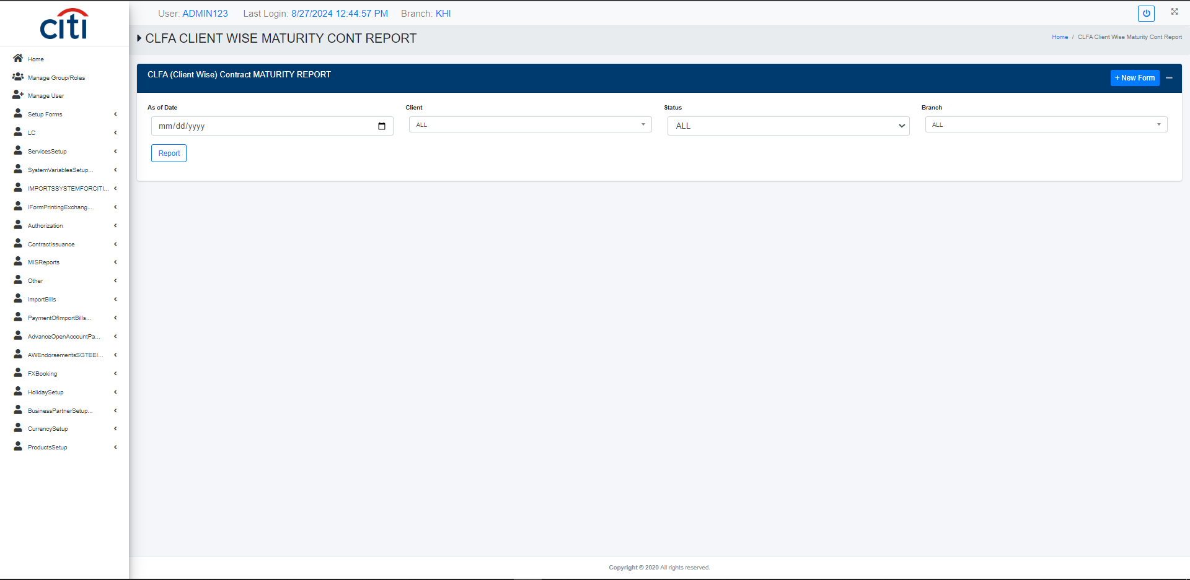
MIS REPORTS
CLFA client wise maturity contract report
IMPORT APPLICATION
55

Slide 56
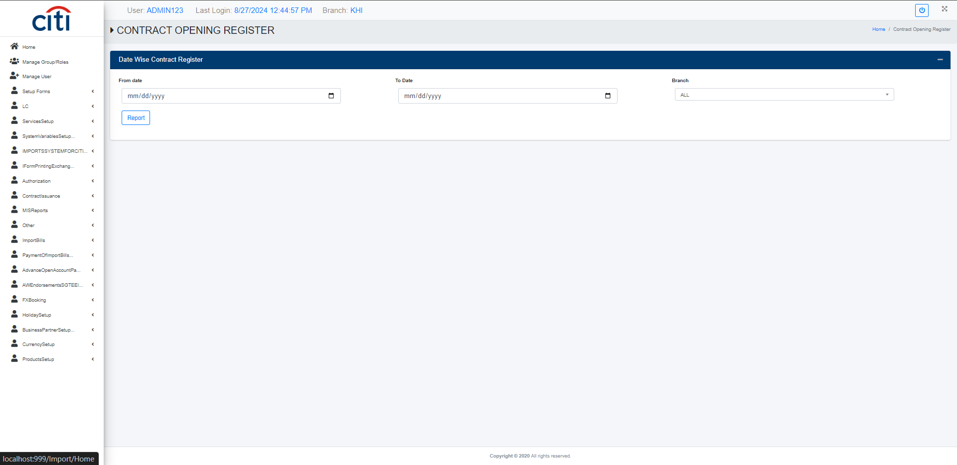
MIS REPORTS
Contract opening register report
IMPORT APPLICATION
56

Slide 57

MIS REPORTS
Contract payment report
IMPORT APPLICATION
57

Slide 58
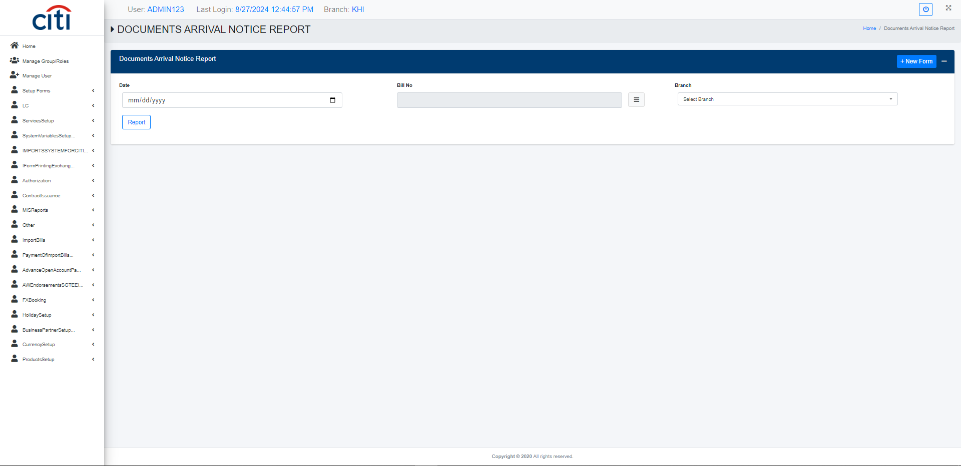
MIS REPORTS
Documents arrival notice report
IMPORT APPLICATION
58

Slide 59

MIS REPORTS
LC contract IB register report
IMPORT APPLICATION
59

Slide 60

MIS REPORTS
LC payment report
IMPORT APPLICATION
60

Slide 61

MIS REPORTS
LC volume detail report
IMPORT APPLICATION
61

Slide 62

MIS REPORTS
LC volume summary details report
IMPORT APPLICATION
62

Slide 63
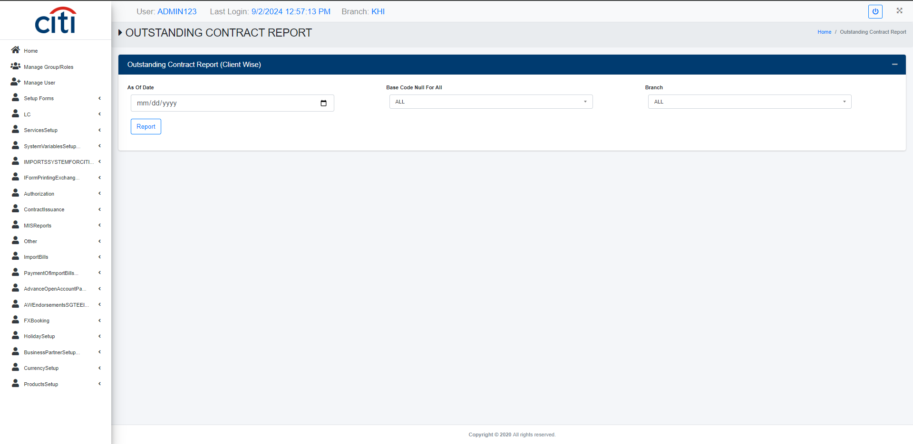
MIS REPORTS
Contract outstanding report
IMPORT APPLICATION
63

Slide 64
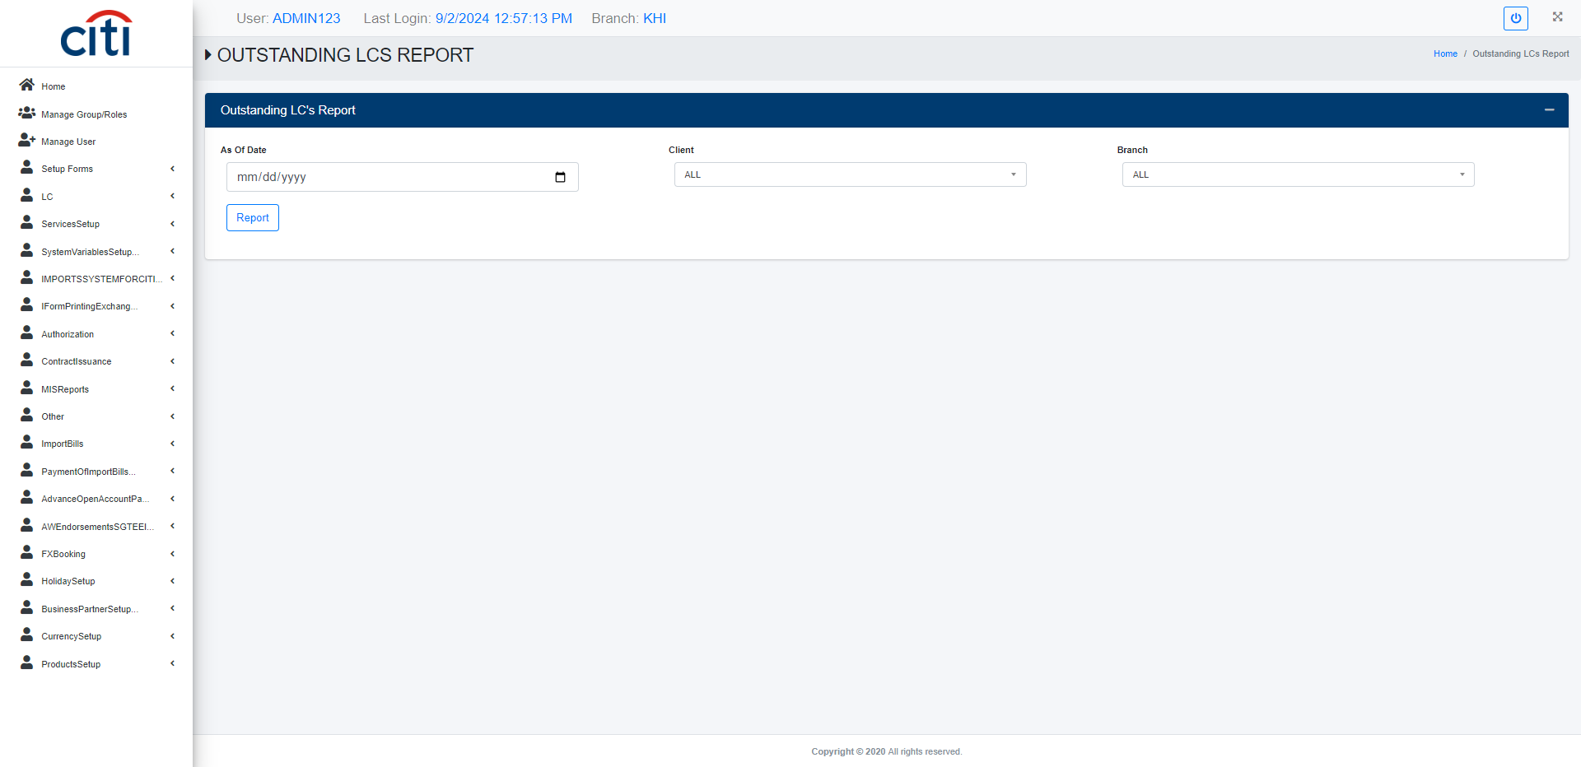
MIS REPORTS
LC outstanding report
IMPORT APPLICATION
64

Slide 65
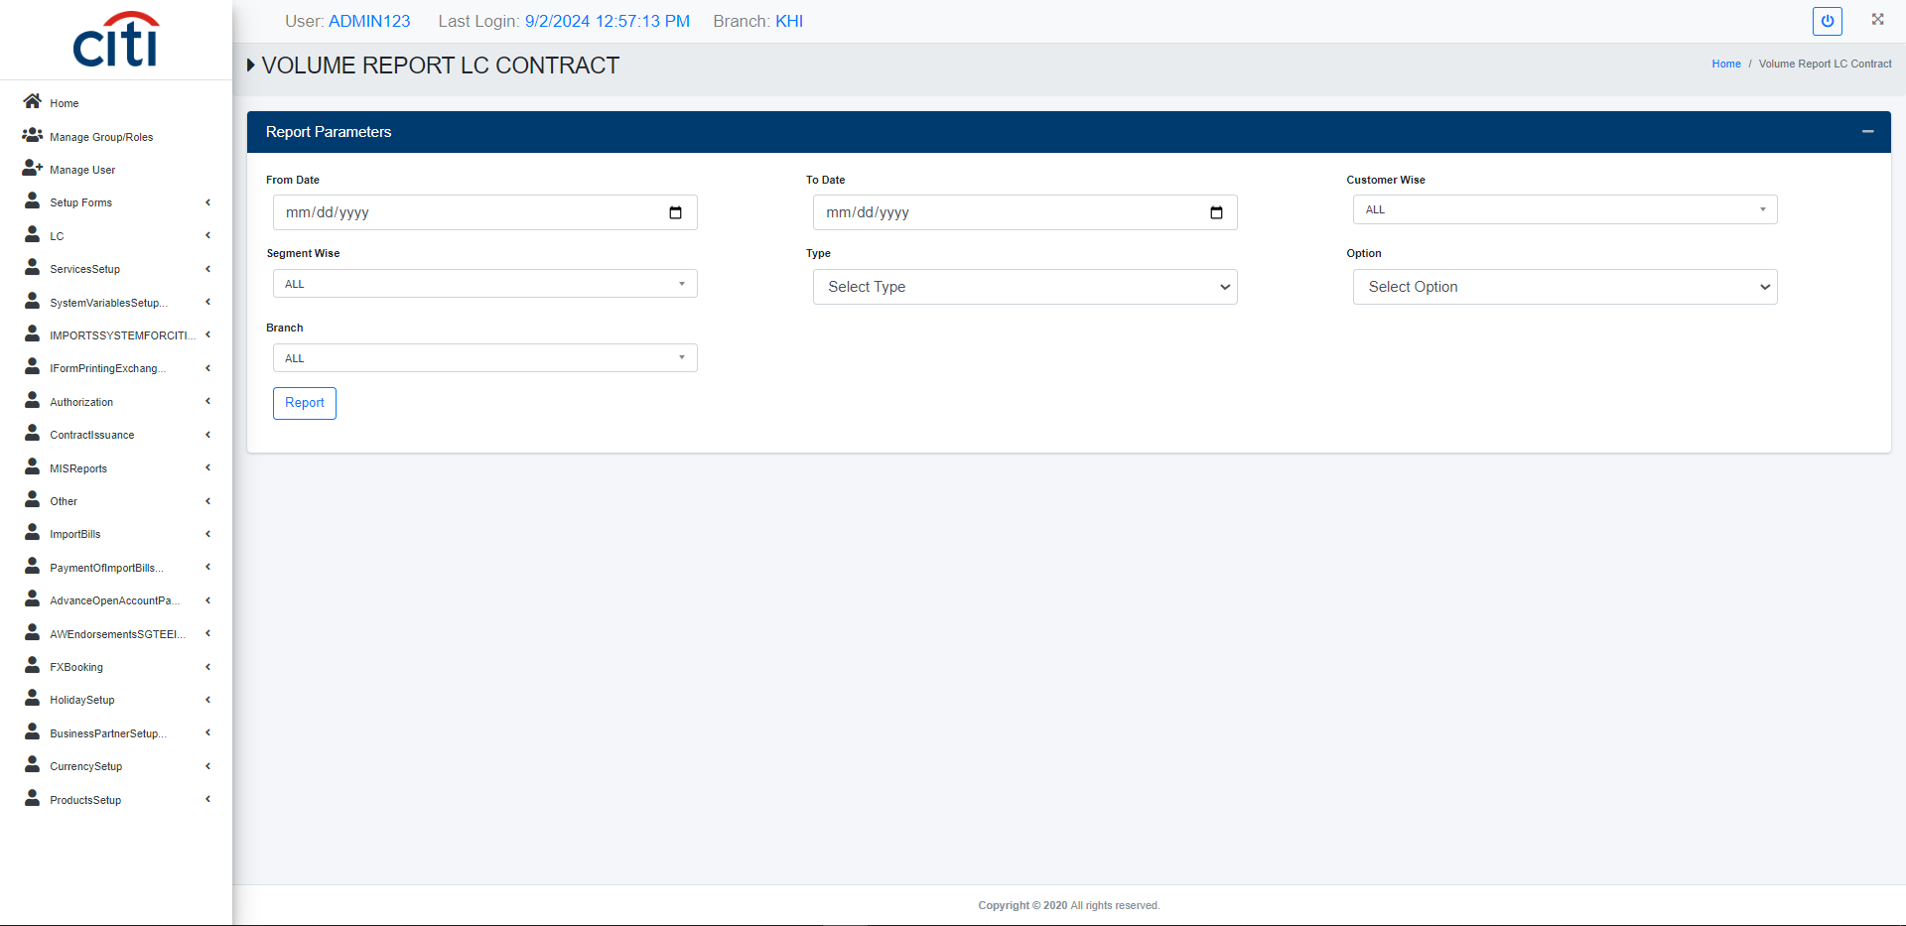
MIS REPORTS
LC/Contract volume report
IMPORT APPLICATION
65

Slide 66
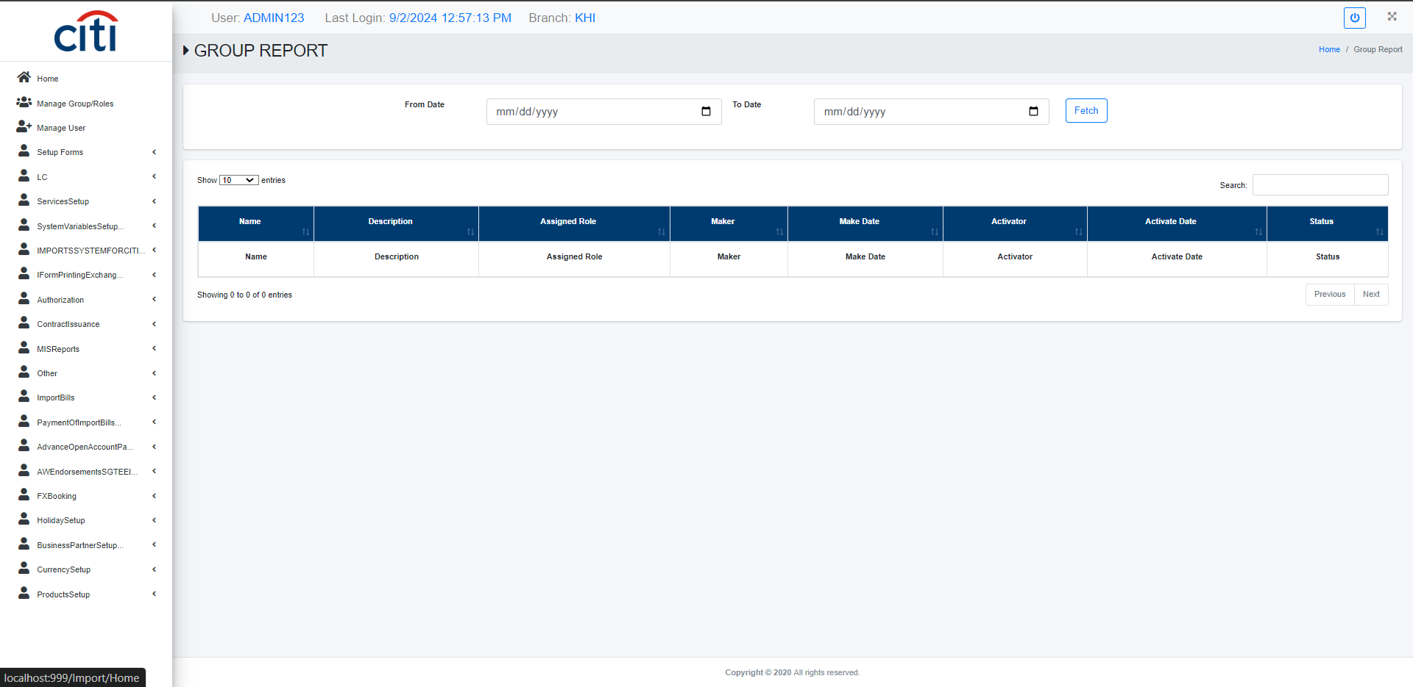
MIS REPORTS
Group modification report
IMPORT APPLICATION
66

Slide 67
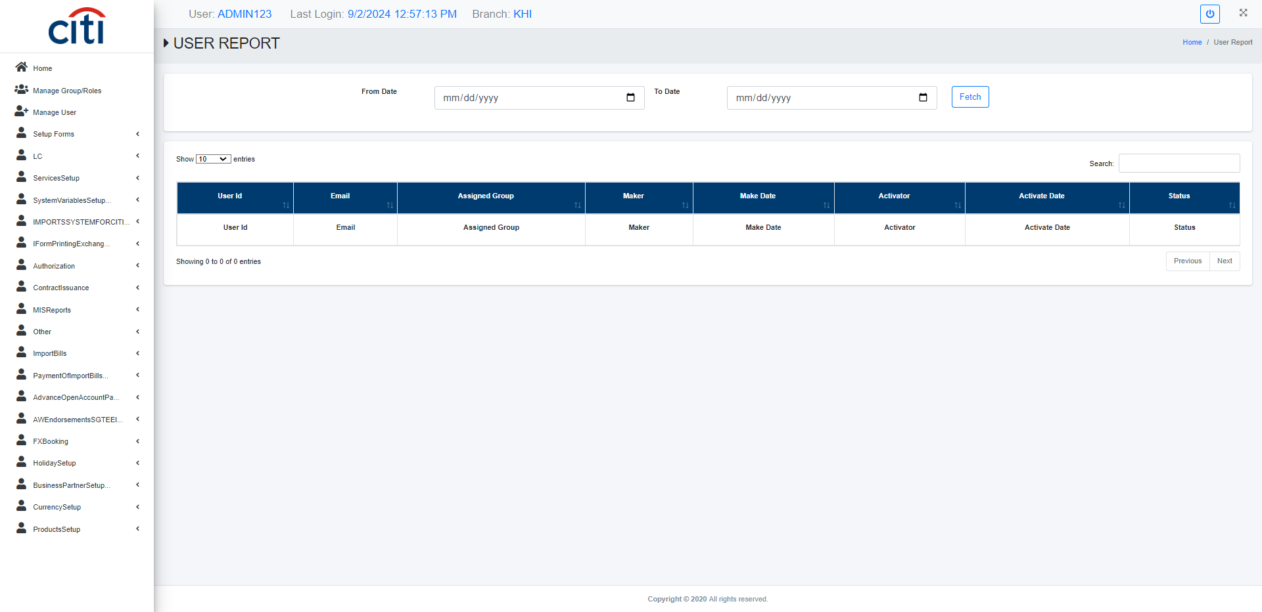
MIS REPORTS
User modification report
IMPORT APPLICATION
67

Slide 68
08
Other Forms
Cash margin, client, and HS code maintenance
IMPORT APPLICATION
68

Slide 69
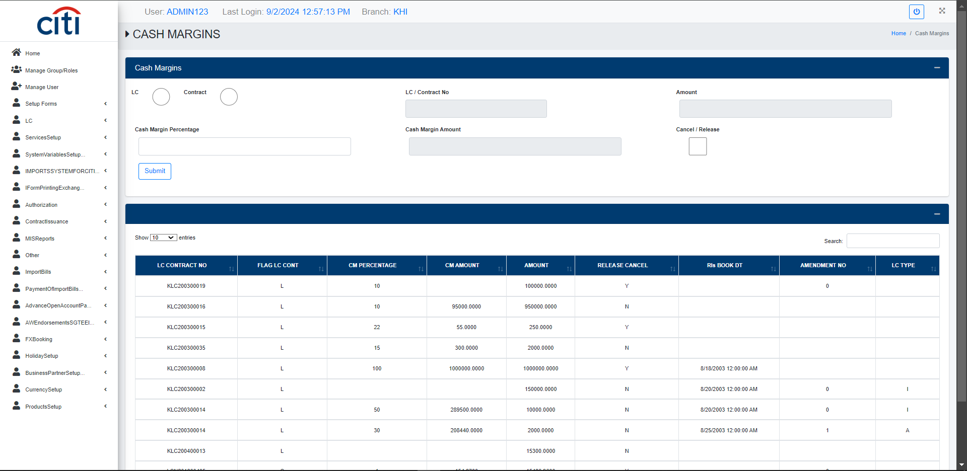
OTHER FORMS
Cash margin maintenance form
IMPORT APPLICATION
69

Slide 70
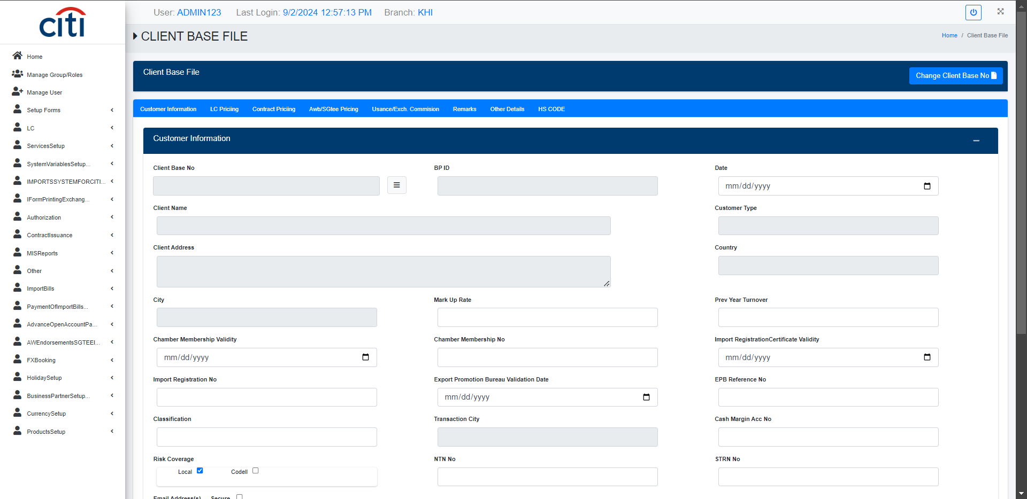
OTHER FORMS
Client detail modification form
IMPORT APPLICATION
70

Slide 71
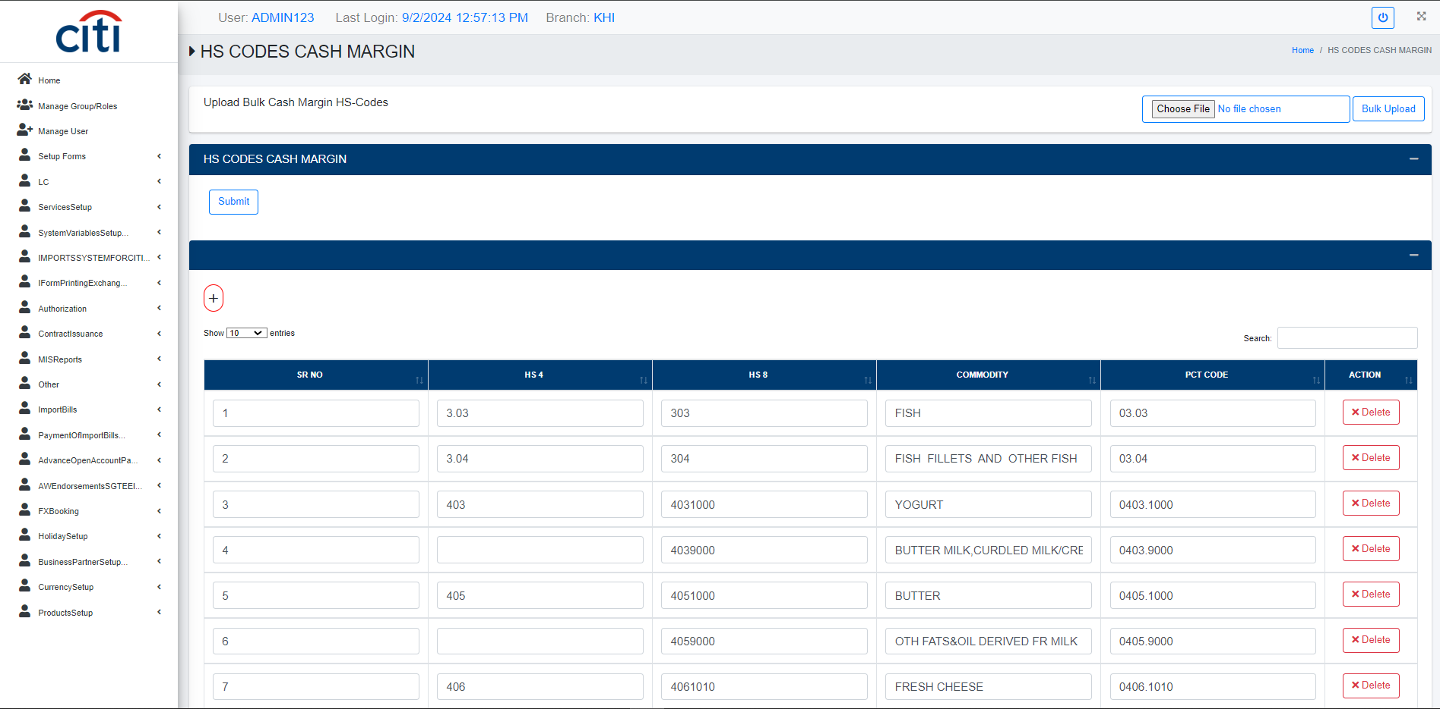
OTHER FORMS
HS Code cash margin maintenance form
IMPORT APPLICATION
71

Slide 72
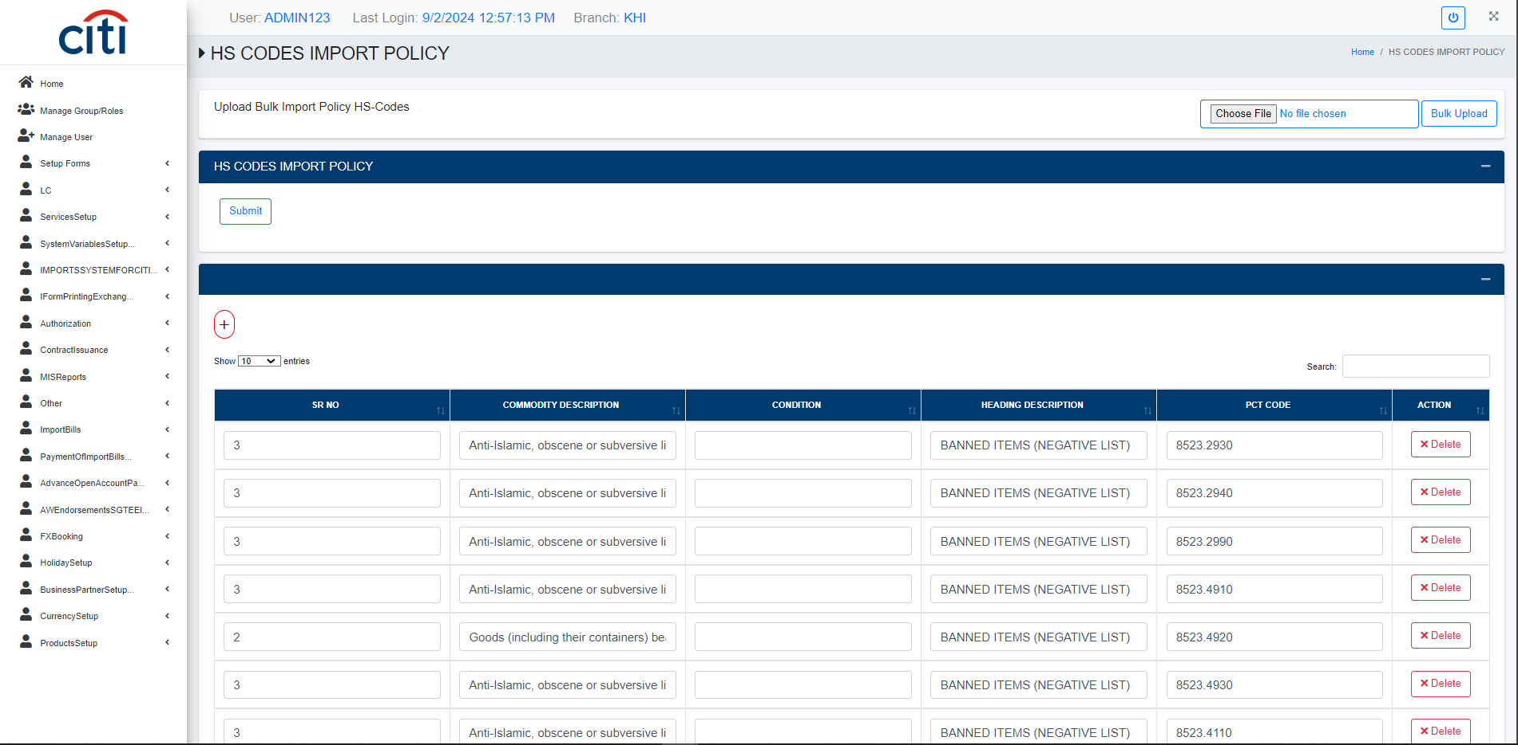
OTHER FORMS
Import policy hs code maintenance form
IMPORT APPLICATION
72

Slide 73
09
Import Bill
Documents, manifolds, and transaction sheets for import bills
IMPORT APPLICATION
73

Slide 74
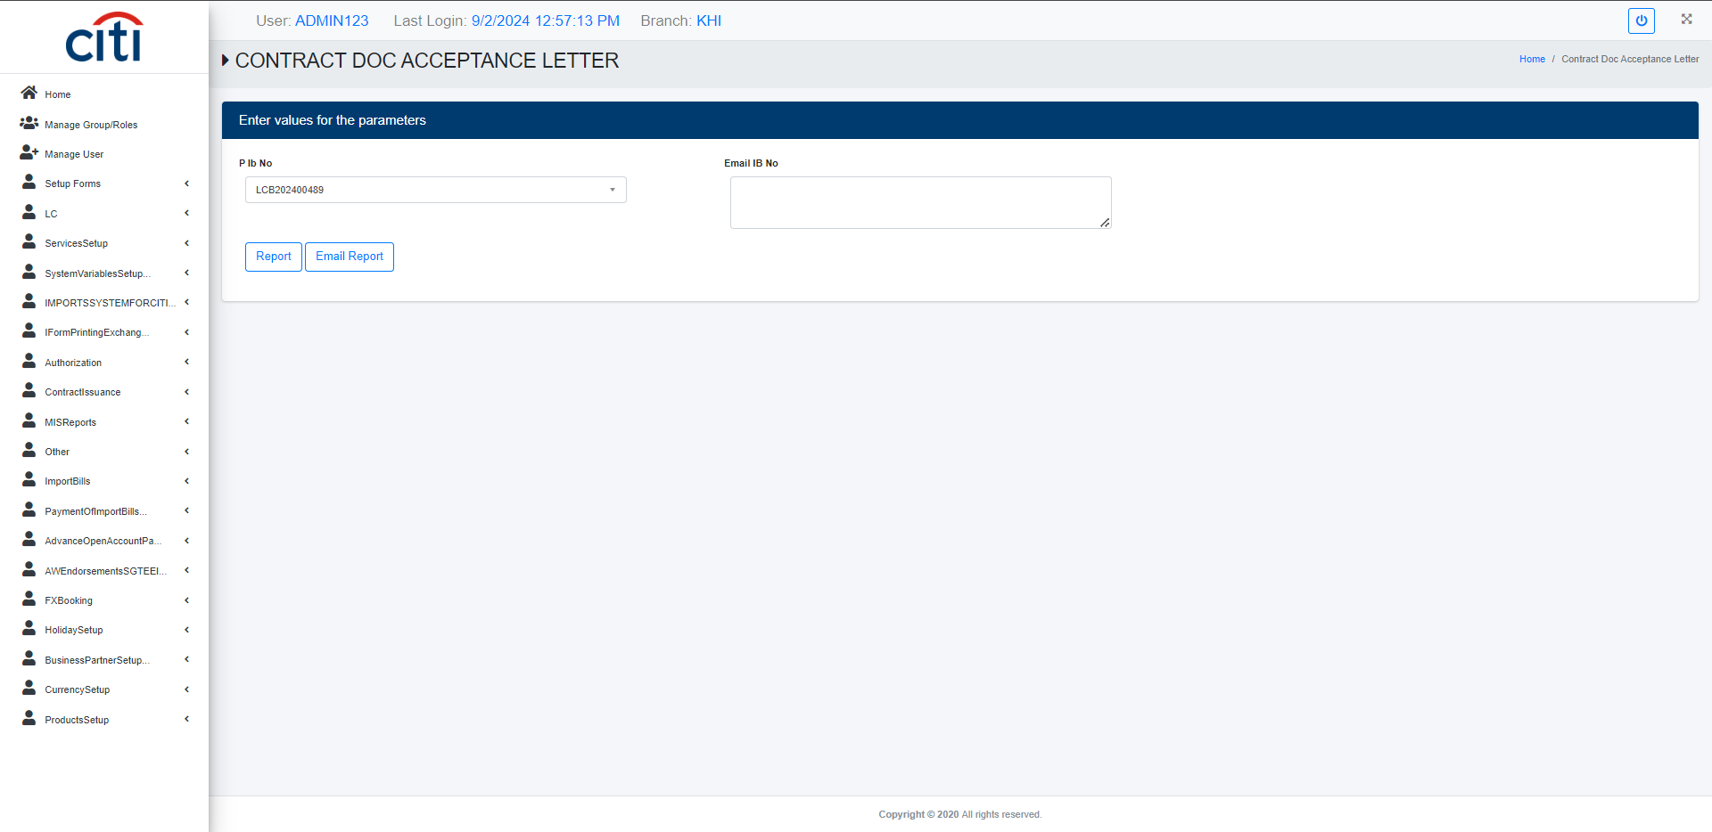
IMPORT BILL
Contract document acceptance letter report
IMPORT APPLICATION
74

Slide 75
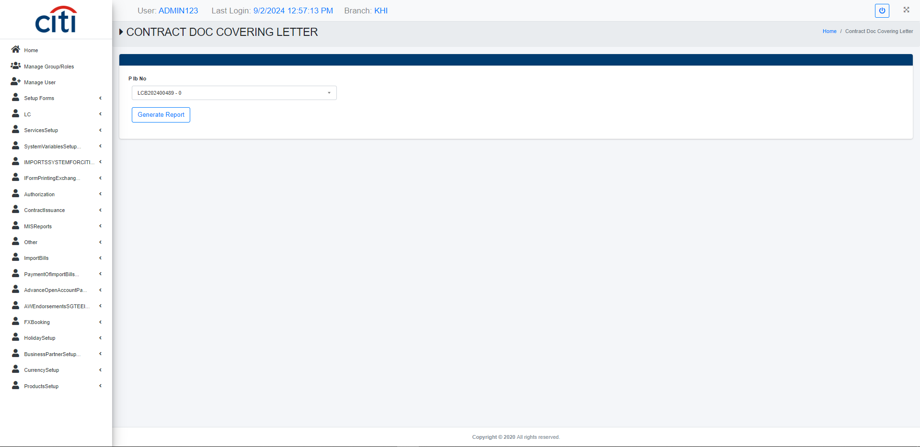
IMPORT BILL
Contract document covering letter report
IMPORT APPLICATION
75

Slide 76

IMPORT BILL
Sight Import bill manifold report
IMPORT APPLICATION
76

Slide 77

IMPORT BILL
Usance Import bill manifold report
IMPORT APPLICATION
77

Slide 78

IMPORT BILL
Import bill contract transaction sheet report
IMPORT APPLICATION
78

Slide 79

IMPORT BILL
LC/Contract Import bill issuance form
IMPORT APPLICATION
79

Slide 80
10
Payment of Import Bill
Payment transactions and retirement of import bills
IMPORT APPLICATION
80

Slide 81

PAYMENT OF IMPORT BILL
Contract payment transaction sheet report
IMPORT APPLICATION
81

Slide 82

PAYMENT OF IMPORT BILL
Import bill sight retirement payment transaction report
IMPORT APPLICATION
82

Slide 83

PAYMENT OF IMPORT BILL
Import bill usance retirement payment transaction report
IMPORT APPLICATION
83

Slide 84

PAYMENT OF IMPORT BILL
Payment of import bill form
IMPORT APPLICATION
84

Slide 85
11
AW Endorsement (SGTEE)
Endorsement issuance, cancellation, and transaction reporting
IMPORT APPLICATION
85

Slide 86

AW ENDORSEMENT (SGTEE)
AW Endorsement issuace form against LC/Contract
IMPORT APPLICATION
86

Slide 87

AW ENDORSEMENT (SGTEE)
AW Endorsement transaction sheet report
IMPORT APPLICATION
87

Slide 88

AW ENDORSEMENT (SGTEE)
Cancellation of contract AW endorsement issuance
IMPORT APPLICATION
88

Slide 89

AW ENDORSEMENT (SGTEE)
Cancellation of LC AW endorsement issuance
IMPORT APPLICATION
89

Slide 90
12
FX Booking
FX bookings and third-party payments against LCs and contracts
IMPORT APPLICATION
90

Slide 91

FX BOOKING
FX Booking ATOT report
IMPORT APPLICATION
91

Slide 92

FX BOOKING
FX Booking LC/Contract
IMPORT APPLICATION
92

Slide 93

FX BOOKING
FX Booking transaction sheet for LC report
IMPORT APPLICATION
93

Slide 94

FX BOOKING
FX Booking transaction sheet for contract report
IMPORT APPLICATION
94

Slide 95

FX BOOKING
Third party FX Booking form
IMPORT APPLICATION
95

Slide 96

FX BOOKING
Third party payments form
IMPORT APPLICATION
96

Slide 97
13
Holiday Setup
Holiday calendars and holiday type configuration
IMPORT APPLICATION
97

Slide 98

HOLIDAY SETUP
Holiday entry form
IMPORT APPLICATION
98

Slide 99

HOLIDAY SETUP
Holiday types form
IMPORT APPLICATION
99

Slide 100
14
Business Partner Setup
Reference data for partner types, geography, and classification
IMPORT APPLICATION
100

Slide 101

BUSINESS PARTNER SETUP
Business partner creation form
IMPORT APPLICATION
101

Slide 102

BUSINESS PARTNER SETUP
Business partners type setup
IMPORT APPLICATION
102

Slide 103

BUSINESS PARTNER SETUP
City information setup form
IMPORT APPLICATION
103

Slide 104

BUSINESS PARTNER SETUP
Communication type setup form
IMPORT APPLICATION
104

Slide 105

BUSINESS PARTNER SETUP
Industry type setup form
IMPORT APPLICATION
105

Slide 106

BUSINESS PARTNER SETUP
Occupation type setup form
IMPORT APPLICATION
106

Slide 107

BUSINESS PARTNER SETUP
Segment type setup form
IMPORT APPLICATION
107

Slide 108

BUSINESS PARTNER SETUP
State information setup form
IMPORT APPLICATION
108

Slide 109
15
Currency Setup
Exchange rates, rate definitions, and currency types
IMPORT APPLICATION
109

Slide 110

CURRENCY SETUP
Currency exchange rate maintenance form
IMPORT APPLICATION
110

Slide 111

CURRENCY SETUP
Currency rate definition setup form
IMPORT APPLICATION
111

Slide 112

CURRENCY SETUP
Currency type setup form
IMPORT APPLICATION
112

Slide 113
Thank You
Questions & discussion welcome
Developed by Zealous Technologies
zealoustechnologies.com

