Slide 1
ZEALOUS TECHNOLOGIES • PRODUCT OVERVIEW
iCore
Intranet Centralized Operations Repository Engine
A unified platform for FX, payments, tax, and reconciliation operations
Developed by Zealous Technologies
zealoustechnologies.com

Slide 2



OVERVIEW
Project Summary
Unified Financial Platform
Single Source of Truth
Operational Backbone
A high-performance platform that streamlines and optimizes critical operations for Citibank, consolidating FX, payment processing, tax compliance, and reconciliation.
Built to replace fragmented legacy systems, iCore provides a single source of truth for financial data — transparent, traceable, and secure.
Serves as the backbone of Citibank's operational efficiency and regulatory adherence across every consolidated process.
ICORE
2

Slide 3




OVERVIEW
Project Highlights & Impact
PROJECT HIGHLIGHTS
IMPACT
FX Centralization
Less Manual Effort
Centralizes foreign exchange management, real-time currency rates, and automated payment matching
Significantly reduces manual effort by automating reconciliation and payment clearing workflows
Dual-Level Approval
Stronger Security
An advanced User Management System where every transaction and update requires dual-level approval
Strengthens security through granular role-based access control and mandatory approval cycles
Accurate Tax Handling
Audit-Ready Data
100% accuracy in complex tax calculations, including WHT and Capital Gains Tax, with standardized billing
Empowers the bank with consistent, audit-ready data formats that meet regulatory standards
Cheque & Search Tools
Dedicated modules for cheque management and advanced search tools for rapid data verification
ICORE
3

Slide 4


PLATFORM
System Architecture
A robust, enterprise-grade solution built in C# and .NET Core, engineered for high performance, scalability, and flexibility across multiple banking departments.
Modular Service Architecture
.NET Core Framework
Responsive Interface
User Management, Tax Engine, and Reconciliation modules operate in sync while remaining independently scalable.
A modern, secure backend that protects sensitive financial data at high volume and high concurrency.
A reliable, responsive interface built for Citibank's Operations Team.
ICORE
4

Slide 5
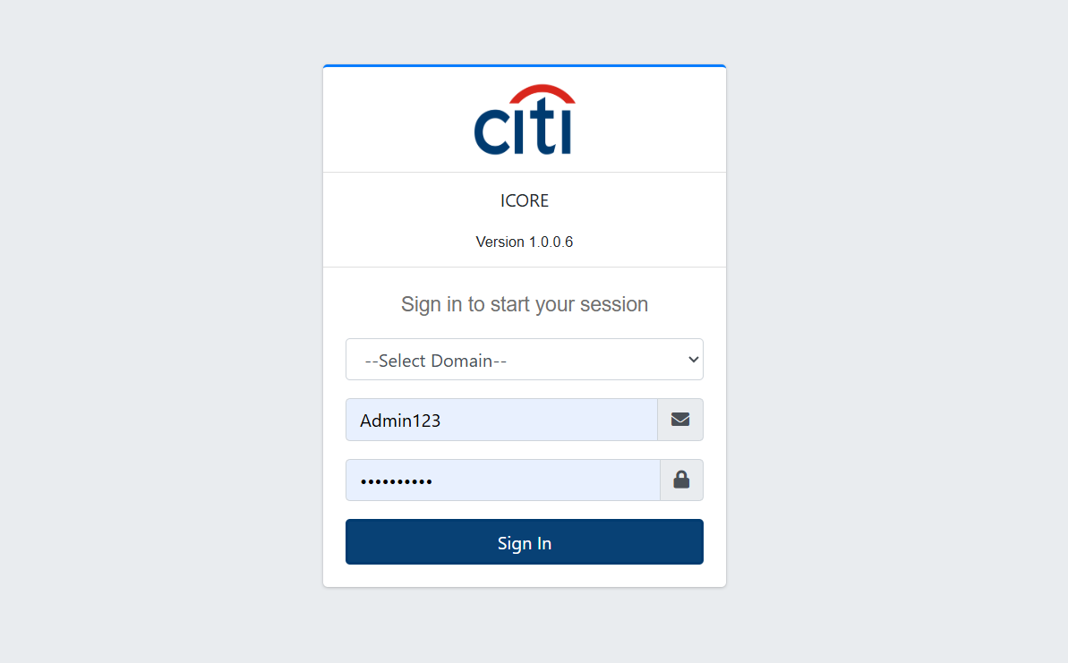

PROJECT SNIPS
Secure Sign-On
iCore uses a secure, centralized sign-on screen to authenticate every user before granting access to financial and operational data.
ICORE
5

Slide 6







PLATFORM OVERVIEW
System Modules
Fourteen integrated modules power the complete treasury and compliance lifecycle
User Management
FXCRS
IBFT
PRC
WHT
One Biller
Format 31
CGTSSBT
DPC
IBC
CGT SCORE
RCC
LEA Search
iCore Setup
ICORE
6

Slide 7
01
User Management
User account creation, roles, and access management
ICORE
7

Slide 8
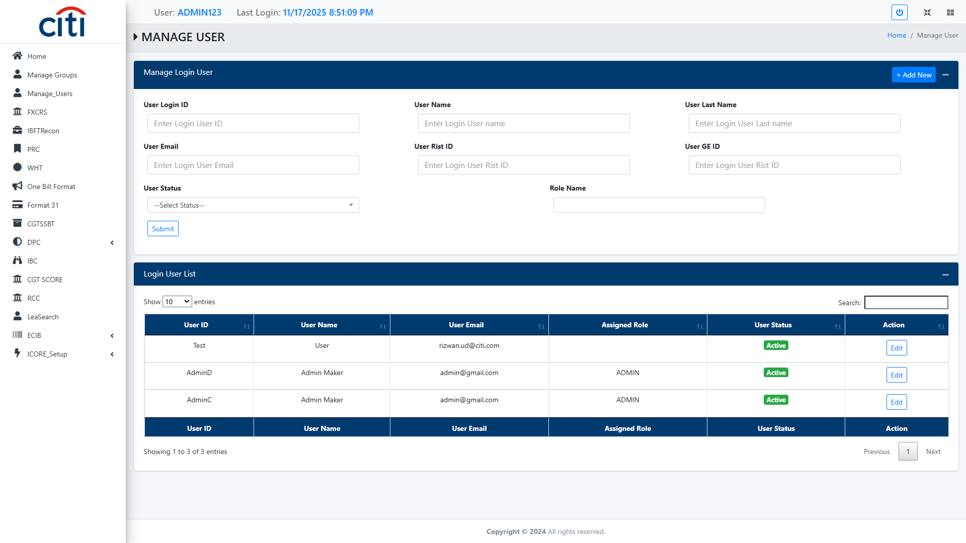
USER MANAGEMENT
User Mangement Form
ICORE
8

Slide 9
02
FXCRS
Daily FX position reporting to the State Bank of Pakistan
ICORE
9

Slide 10
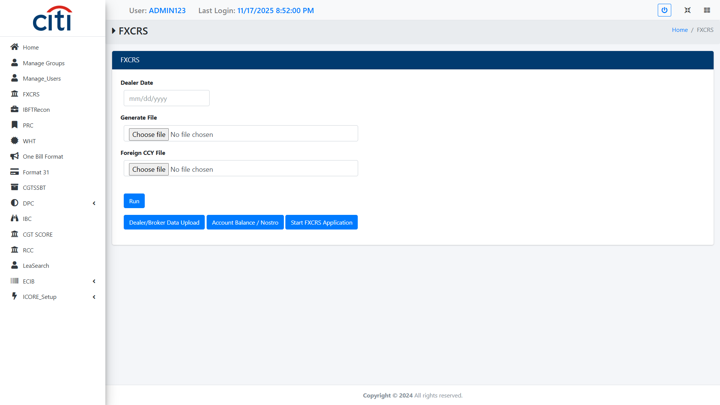
FXCRS
FXCRS required by the State Bank of Pakistan to all the Banks/Authorized Dealers for reporting their daily FX positions
ICORE
10

Slide 11
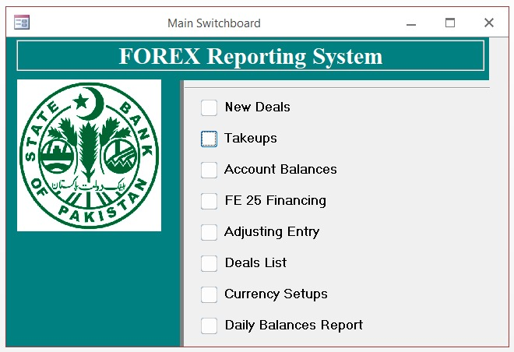
FXCRS
FXCRS in our ICORE web is just uploading data in their access database, below application open which user clicks on "Start FXCRS Application", this is their internal application which further uses data for processing and reporting to SBP
ICORE
11

Slide 12
03
IBFT
Reconciliation of interbank fund transfers across systems
ICORE
12

Slide 13
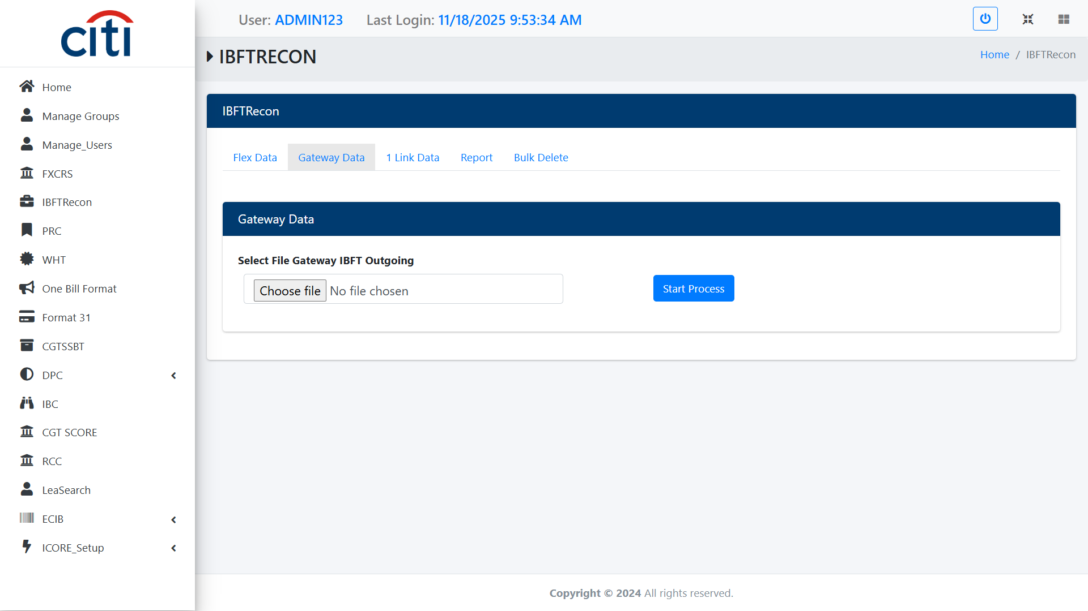
IBFT
Gateway IBFT Outgoing file upload field
ICORE
13

Slide 14
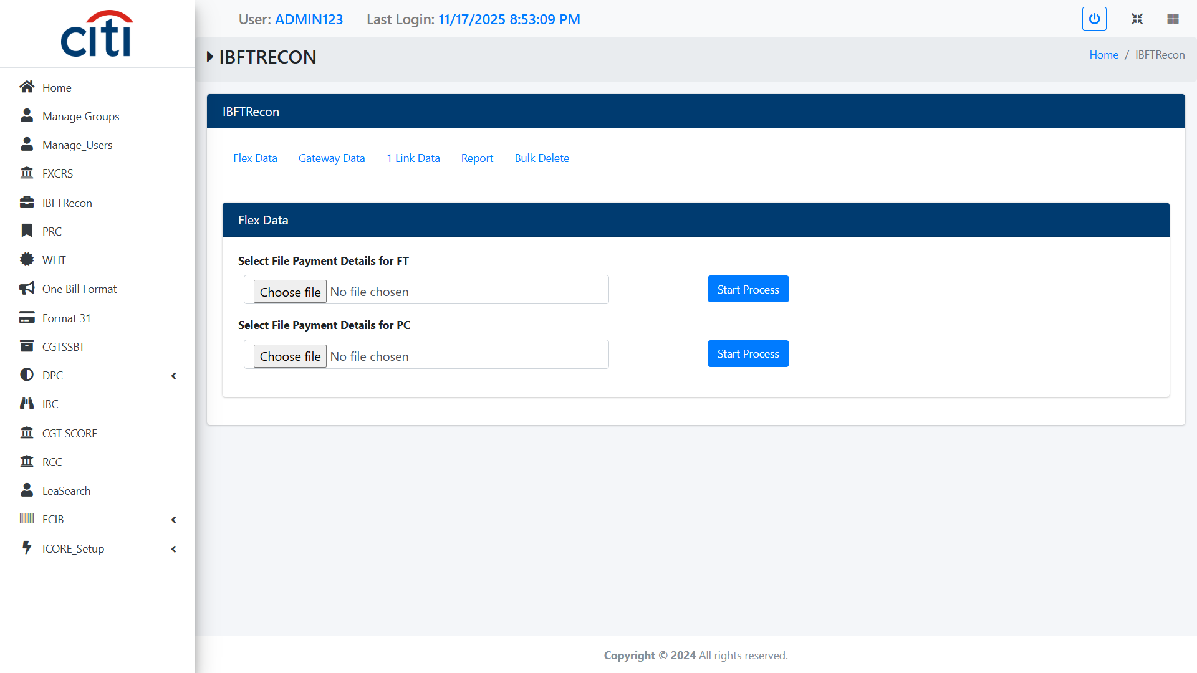
IBFT
IBFTRecon Supports reconciliation of interbank fund transfers across internal and external systems. Ensures accuracy, completeness, and timely settlement of transferred funds
ICORE
14

Slide 15

IBFT
1 Link Data file upload field
ICORE
15

Slide 16
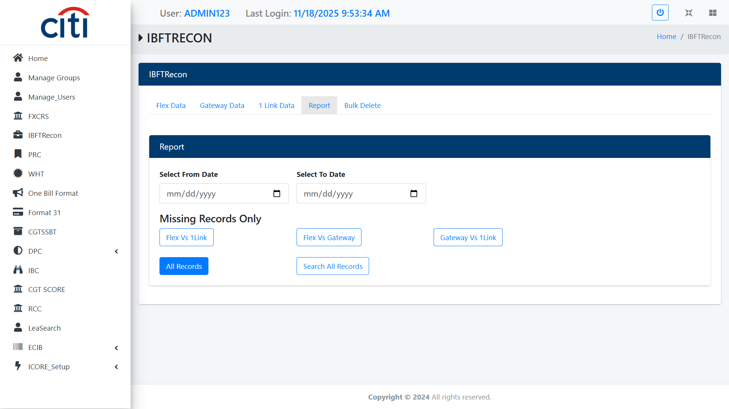
IBFT
IBFT Report Form
ICORE
16

Slide 17
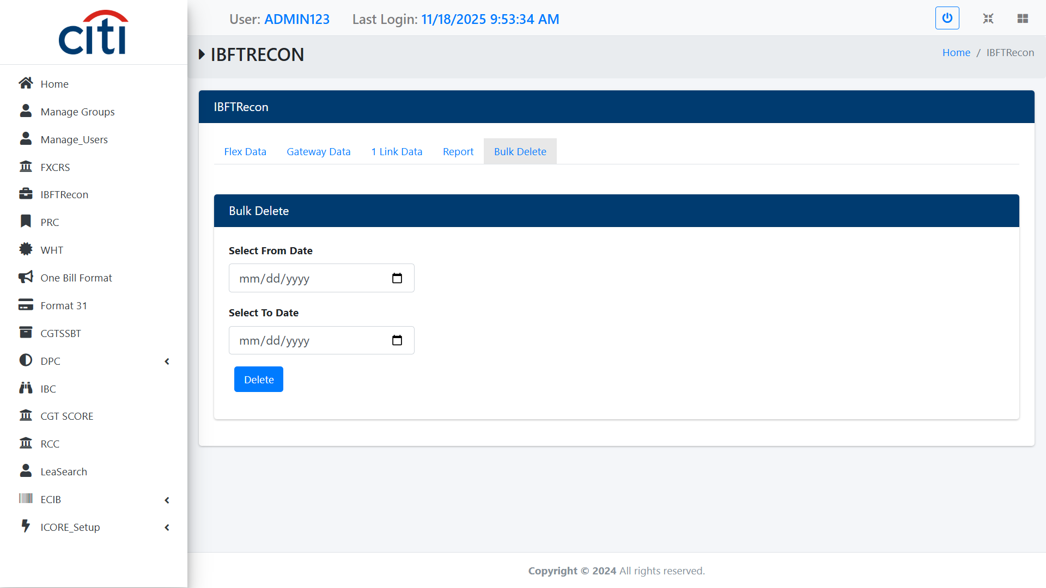
IBFT
IBFT Bulk Delete Form
ICORE
17

Slide 18
04
PRC
Reconciliation and clearing of high-volume payment transactions
ICORE
18

Slide 19
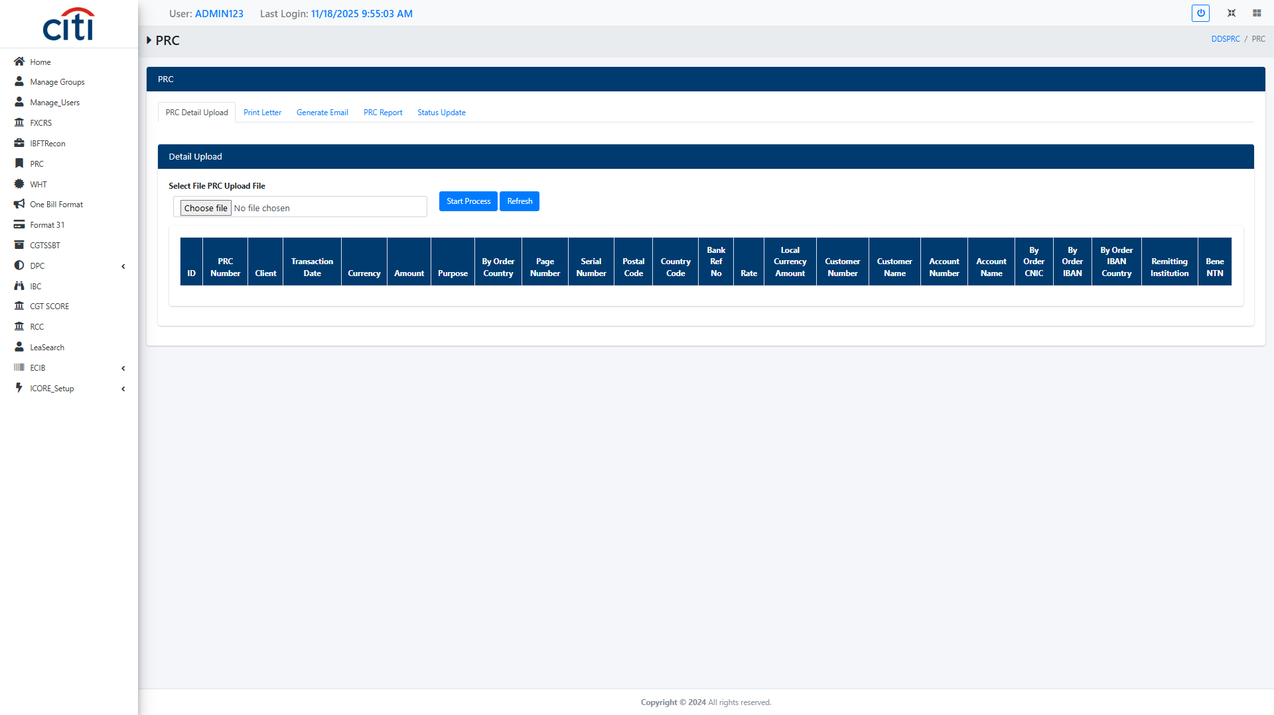
PRC
PRC Detail Upload file field Supports reconciliation and clearing of high-volume payment transactions. Ensures correct settlement, exception handling, and payment integrity
ICORE
19

Slide 20
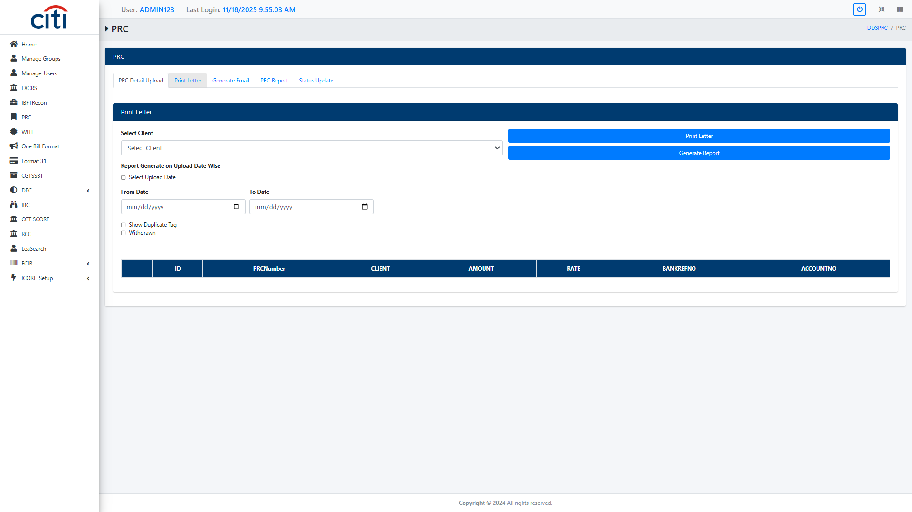
PRC
PRC Print Letter form
ICORE
20

Slide 21
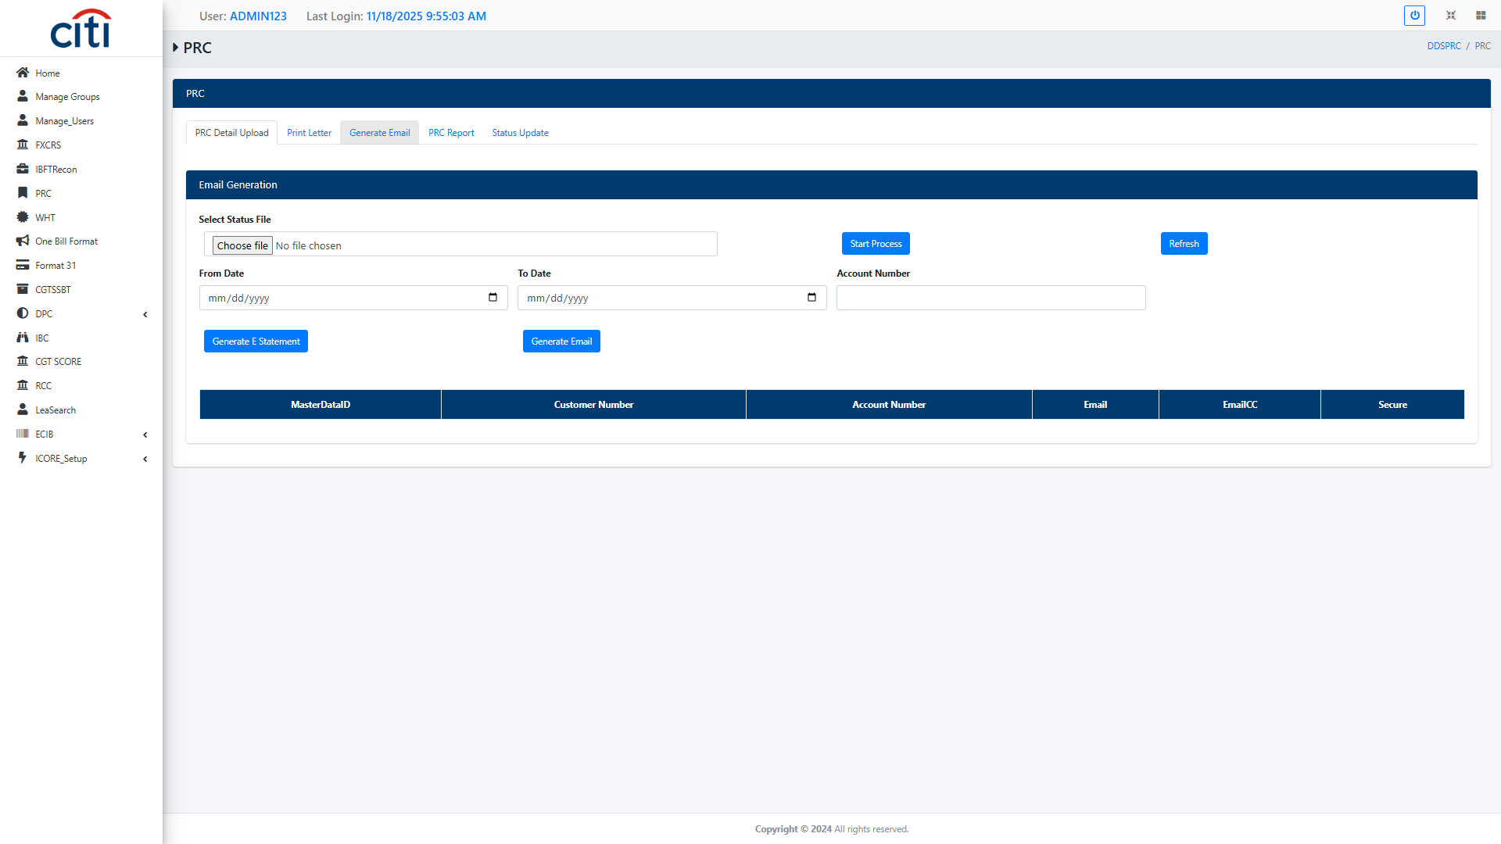
PRC
PRC Email Generation file field
ICORE
21

Slide 22
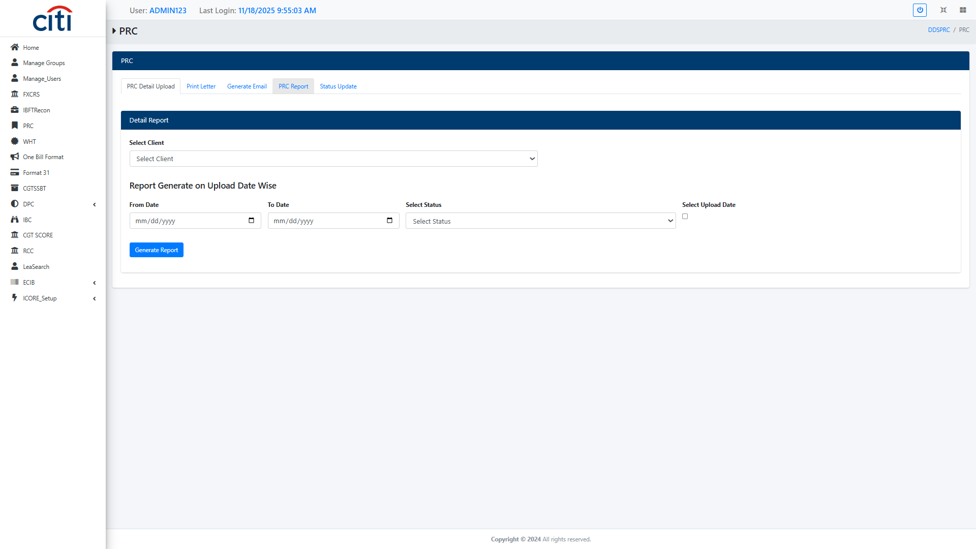
PRC
PRC Report form
ICORE
22

Slide 23
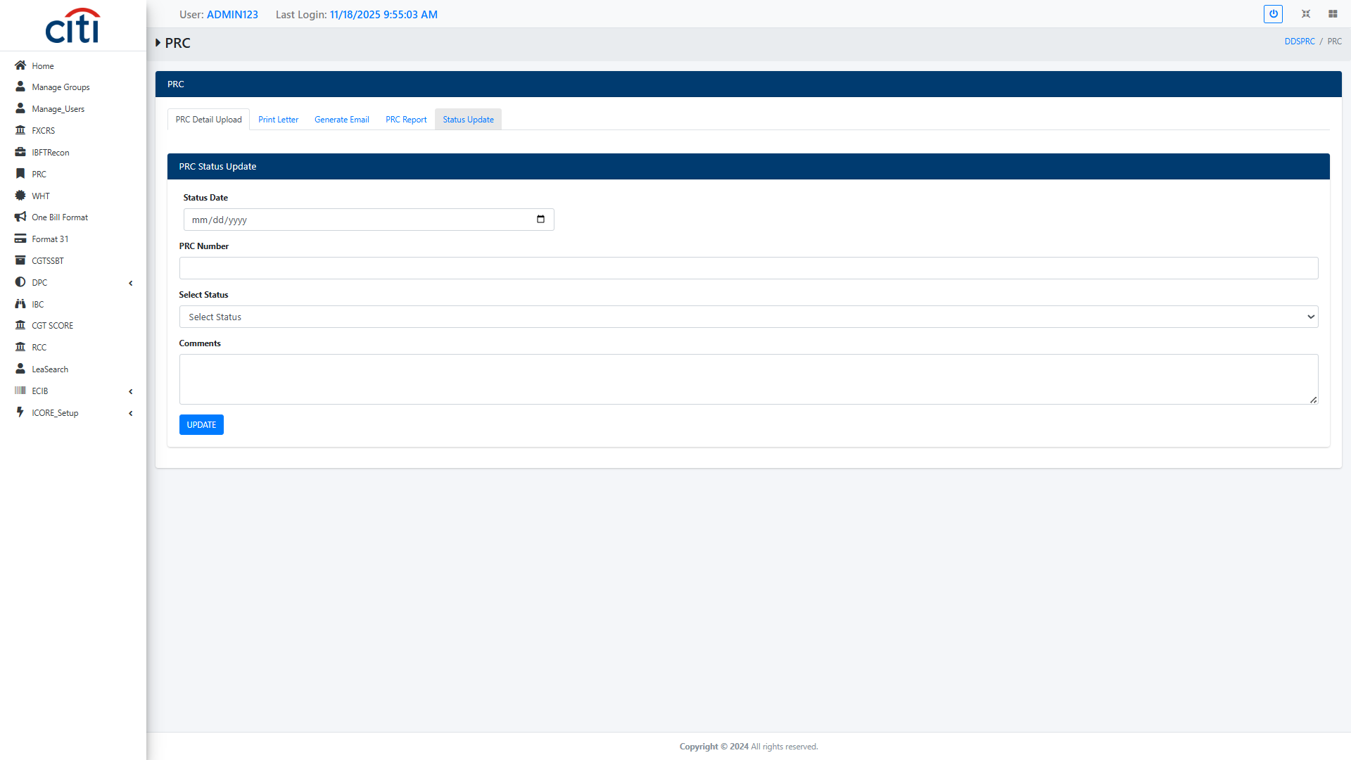
PRC
PRC Status Update form
ICORE
23

Slide 24
05
WHT (Withholding Tax)
Withholding tax calculation, deduction, and compliance tracking
ICORE
24

Slide 25
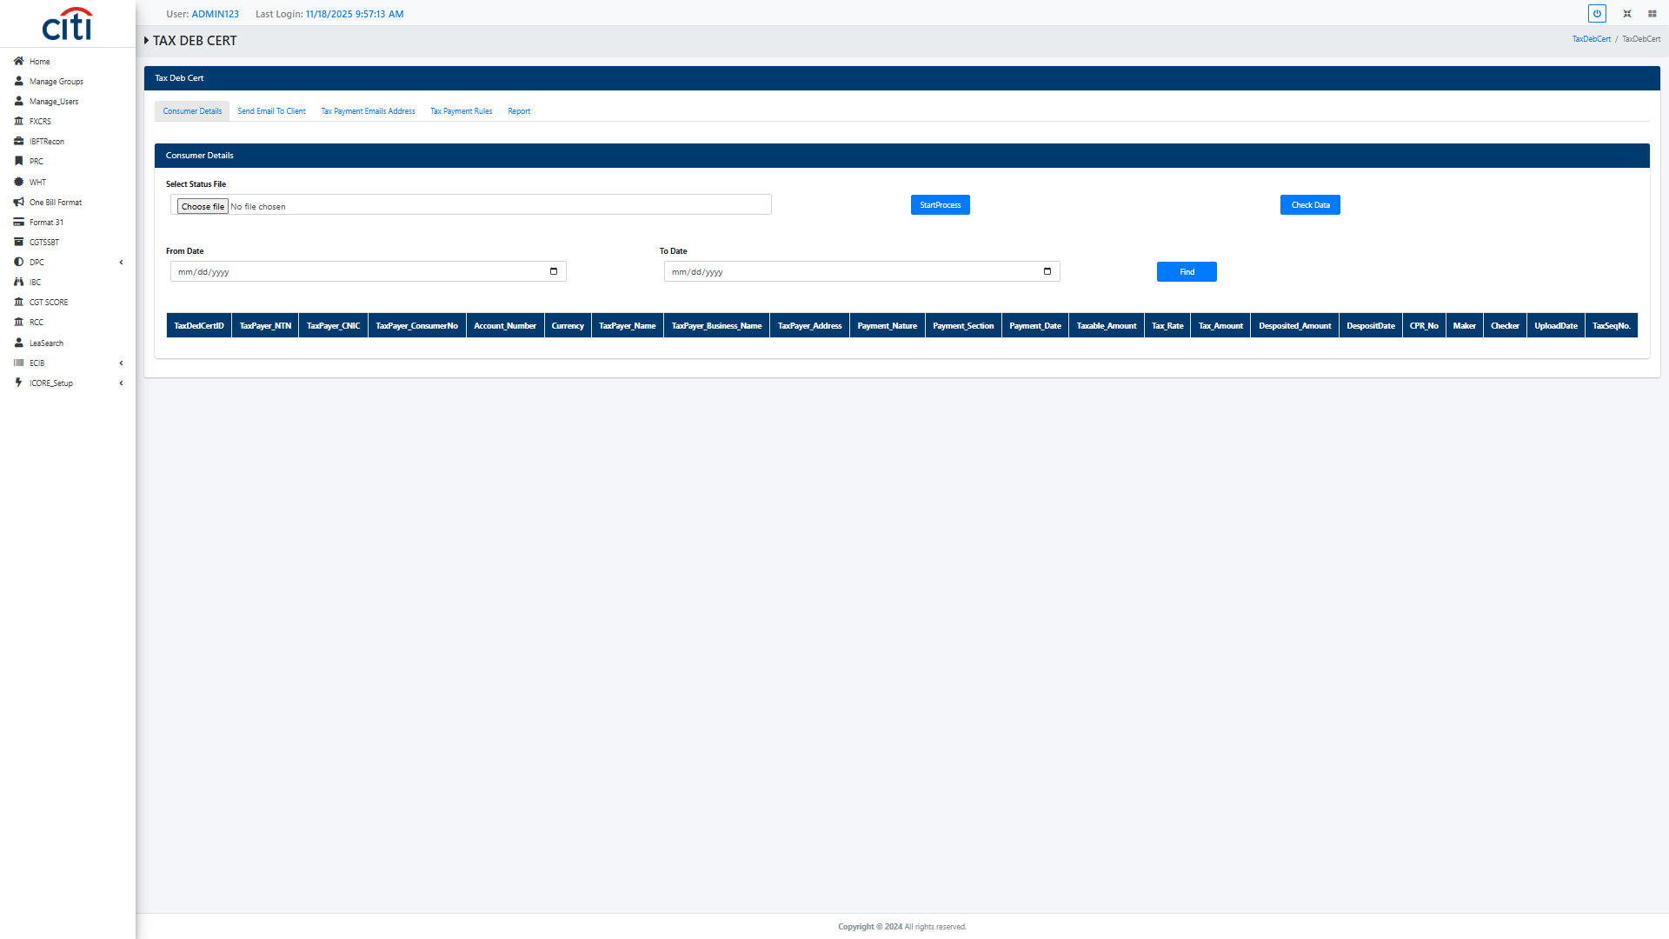
WHT (WITHHOLDING TAX)
Tax Deb Cert Consumer Detail file field Supports calculation, deduction, and tracking of withholding tax on applicable transactions. Ensures compliance with tax regulations and reporting requirements
ICORE
25

Slide 26
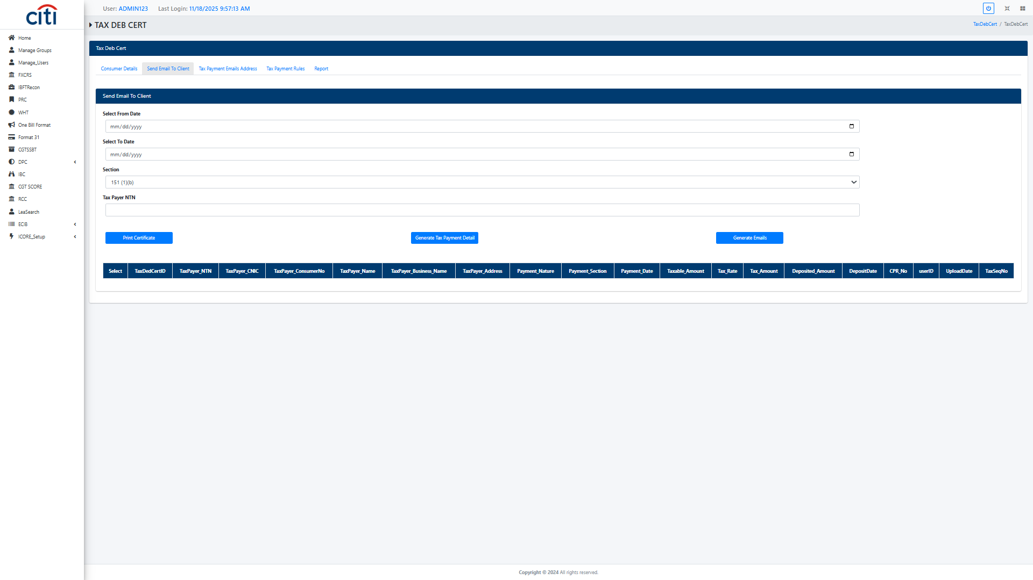
WHT (WITHHOLDING TAX)
Tax Debt Cert Email to Client form
ICORE
26

Slide 27
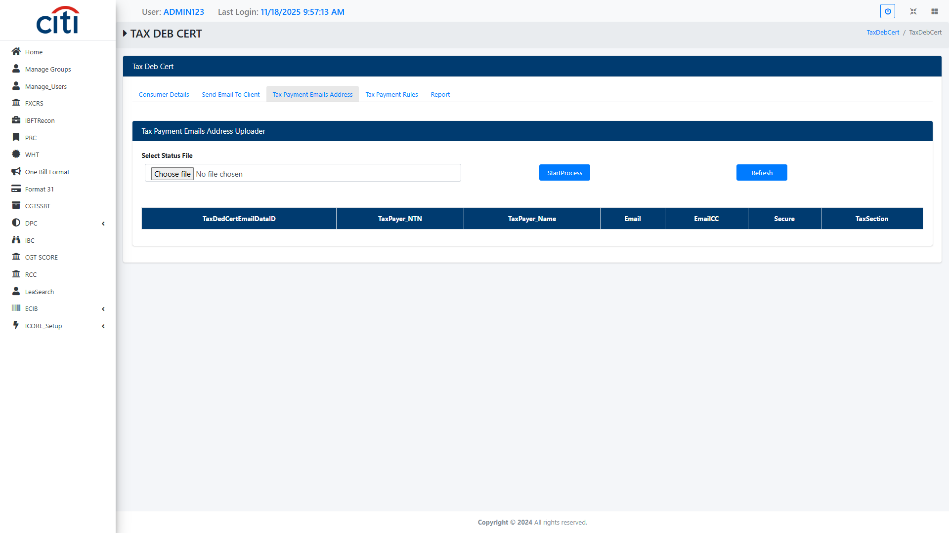
WHT (WITHHOLDING TAX)
Tax Payment Email Address Uploader file field
ICORE
27

Slide 28
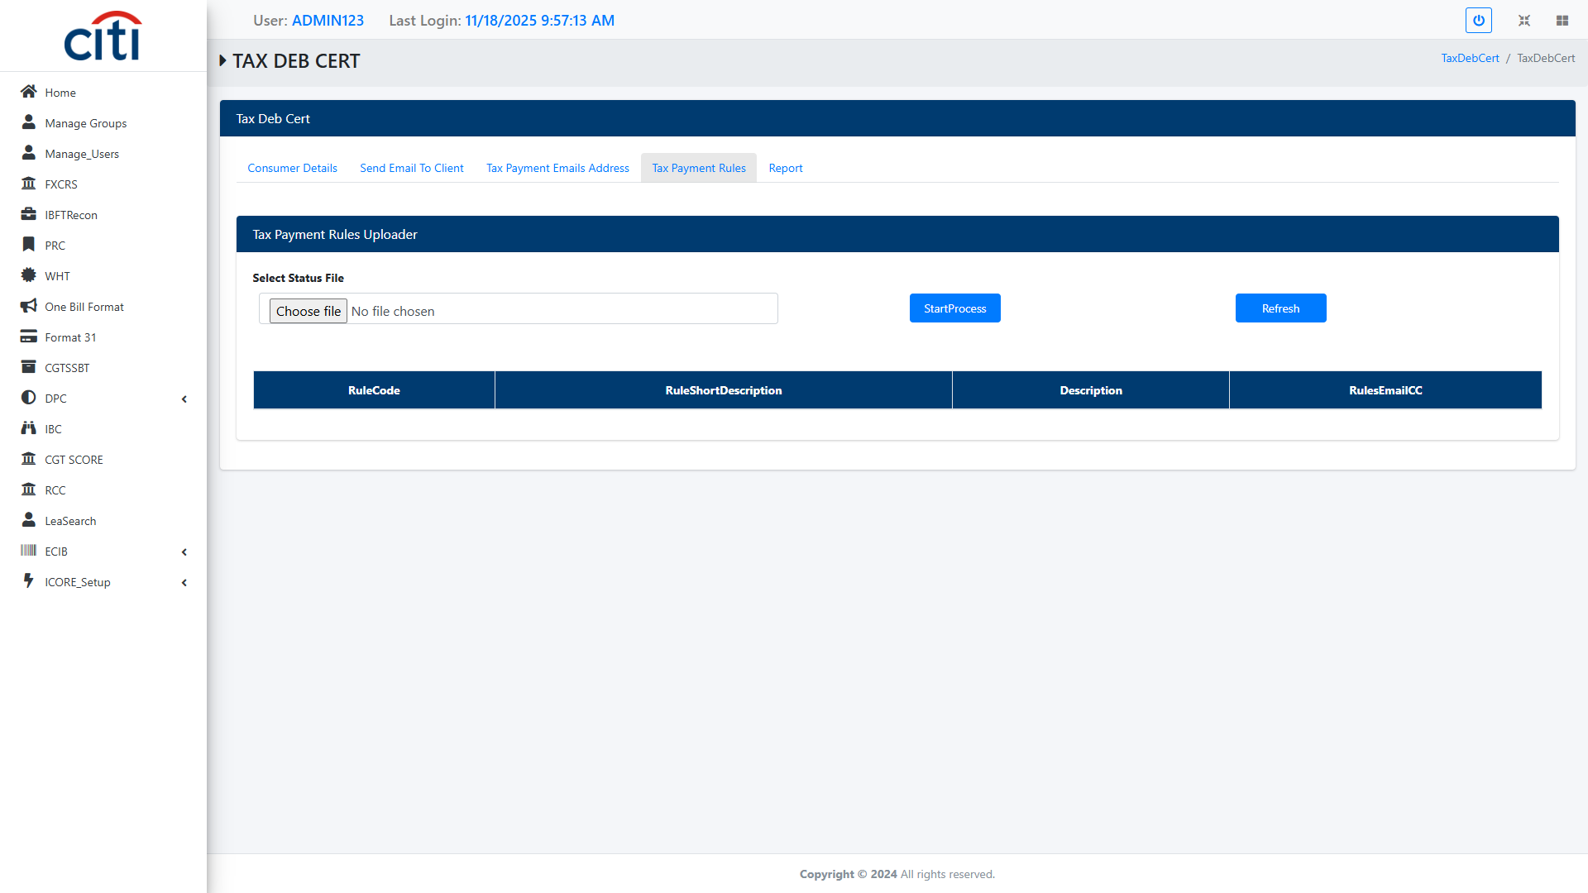
WHT (WITHHOLDING TAX)
Tax Payment Rules file uploader field
ICORE
28

Slide 29
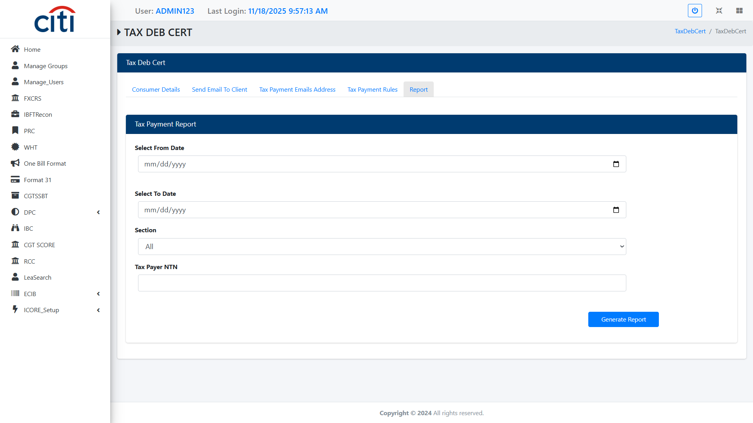
WHT (WITHHOLDING TAX)
Tax payment Report form
ICORE
29

Slide 30
06
One Biller
Consumer billing, handoff, and accounting entry generation
ICORE
30

Slide 31
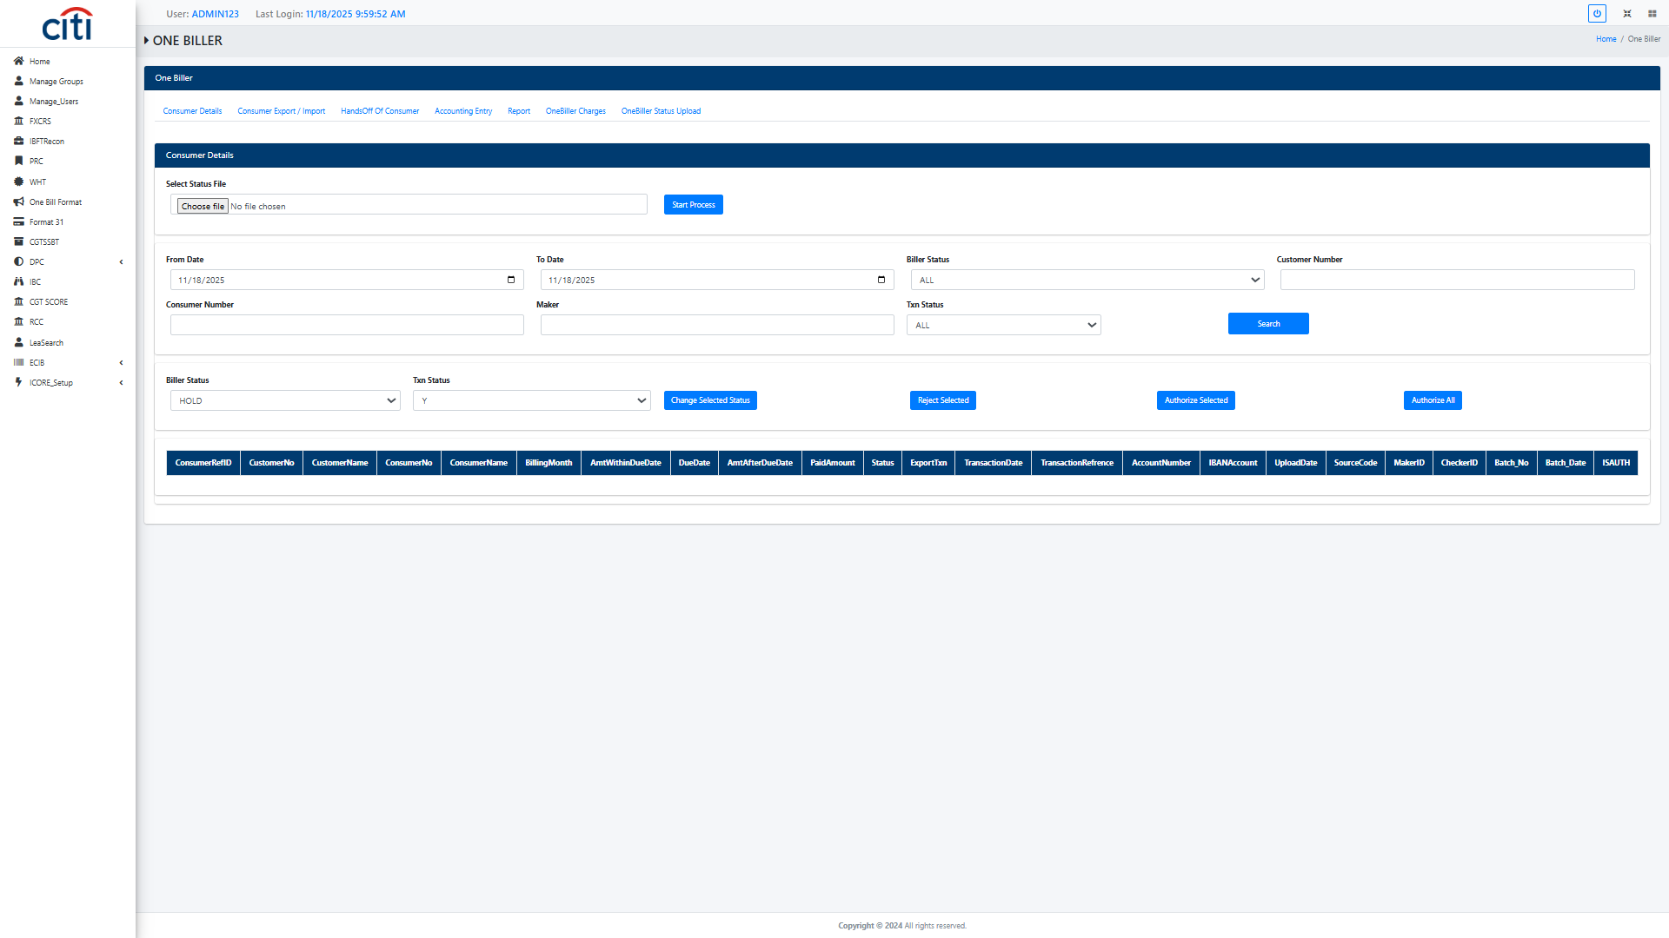
ONE BILLER
One Biller Consumer Detail form
ICORE
31

Slide 32
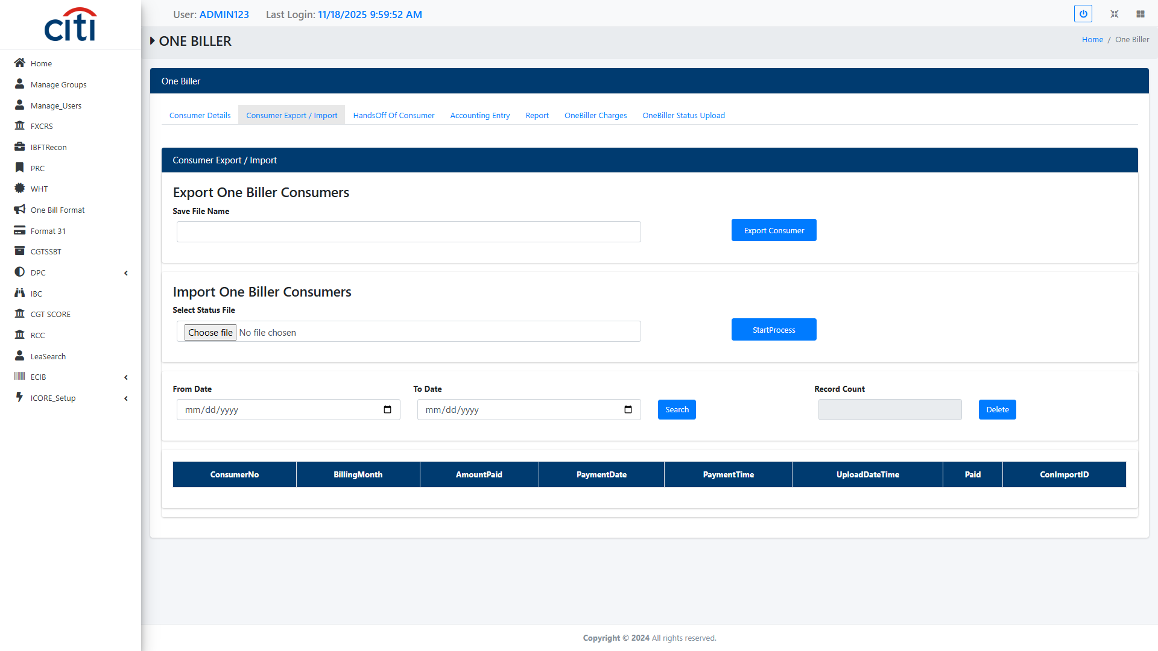
ONE BILLER
One Biller Consumer Export/Import file upload field
ICORE
32

Slide 33
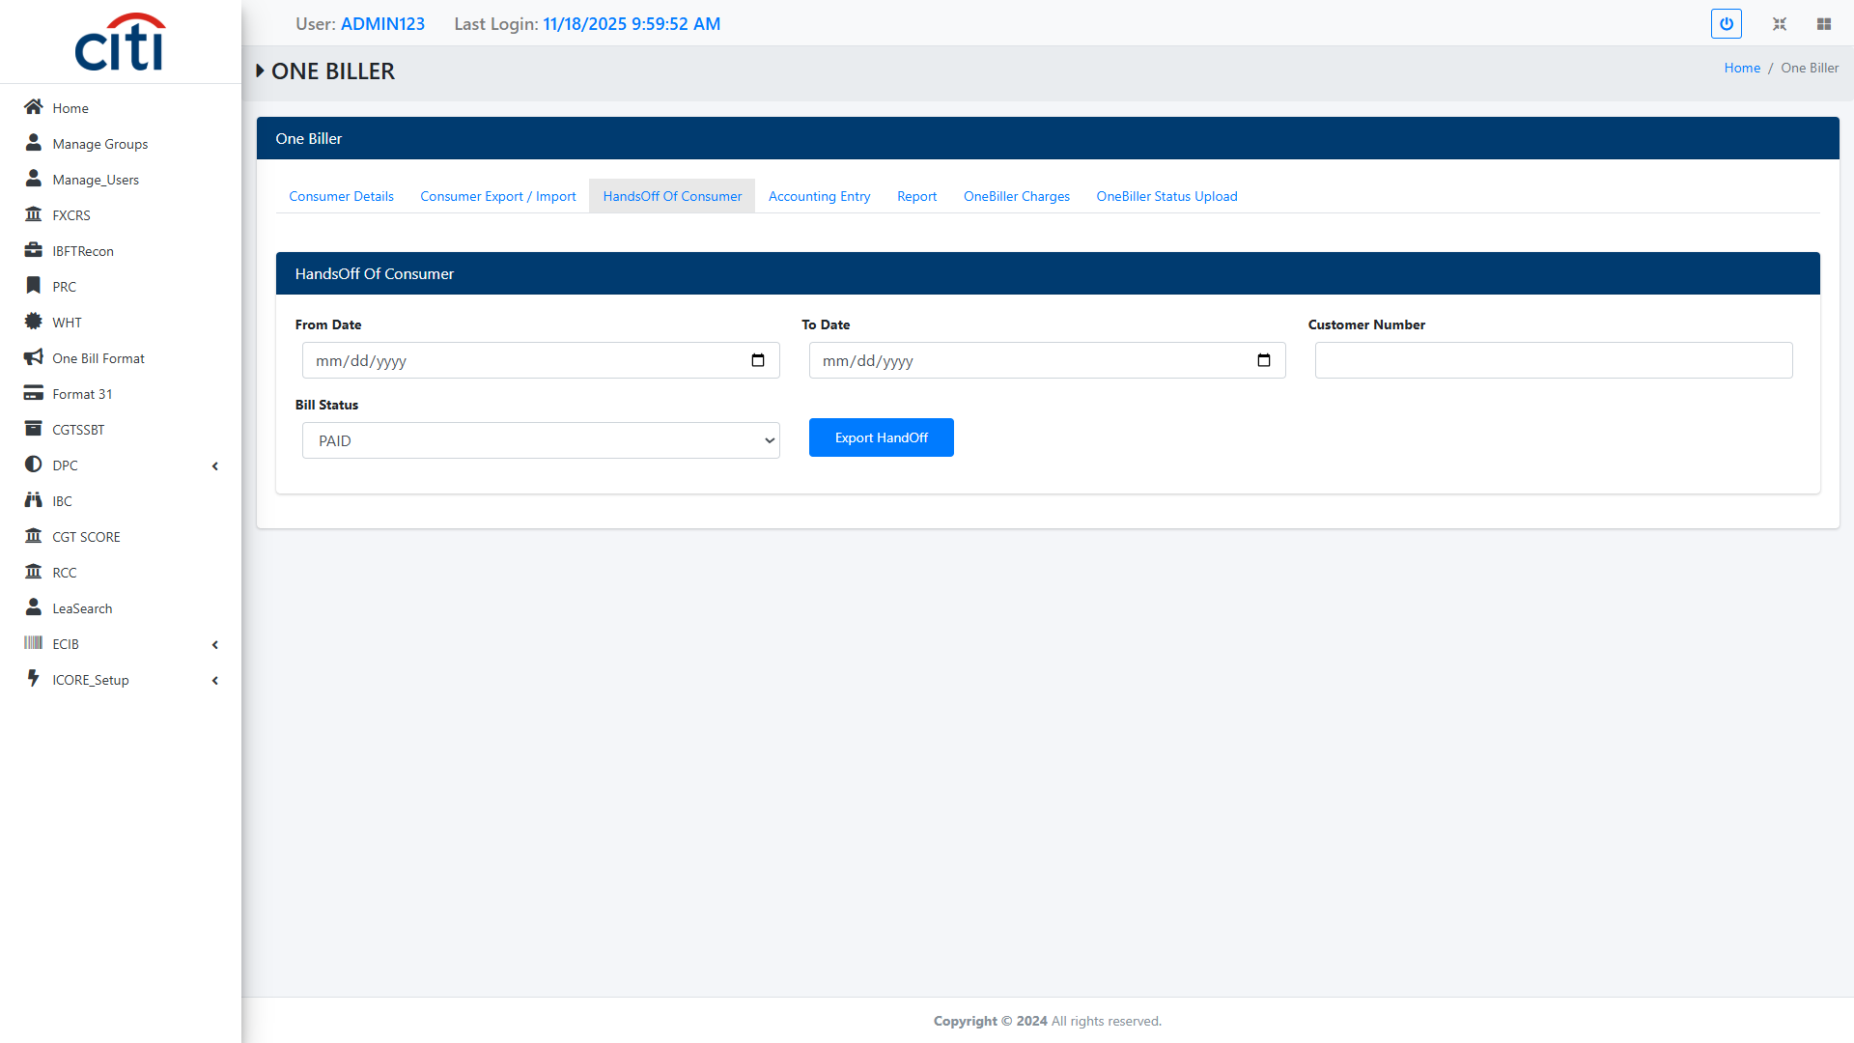
ONE BILLER
One Biller Handsoff of Consumer form
ICORE
33

Slide 34
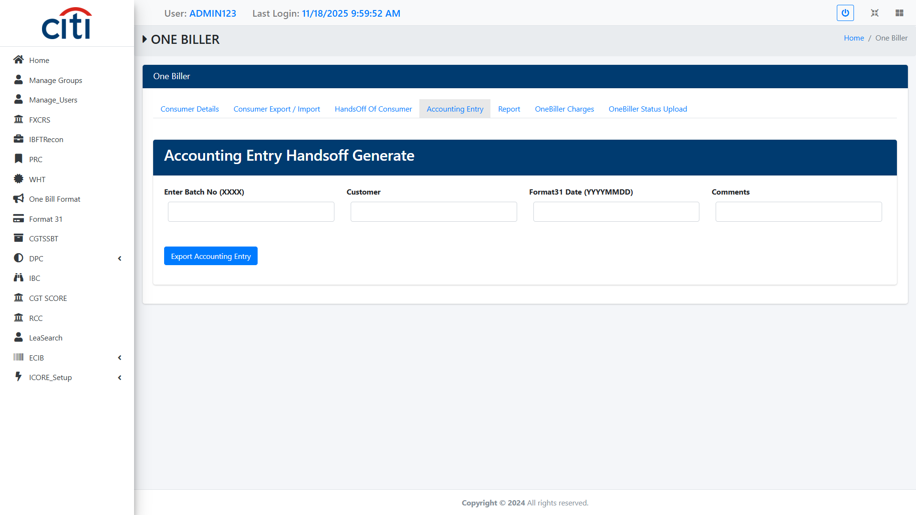
ONE BILLER
One Biller Accounting Entry Handsoff Generation form
ICORE
34

Slide 35
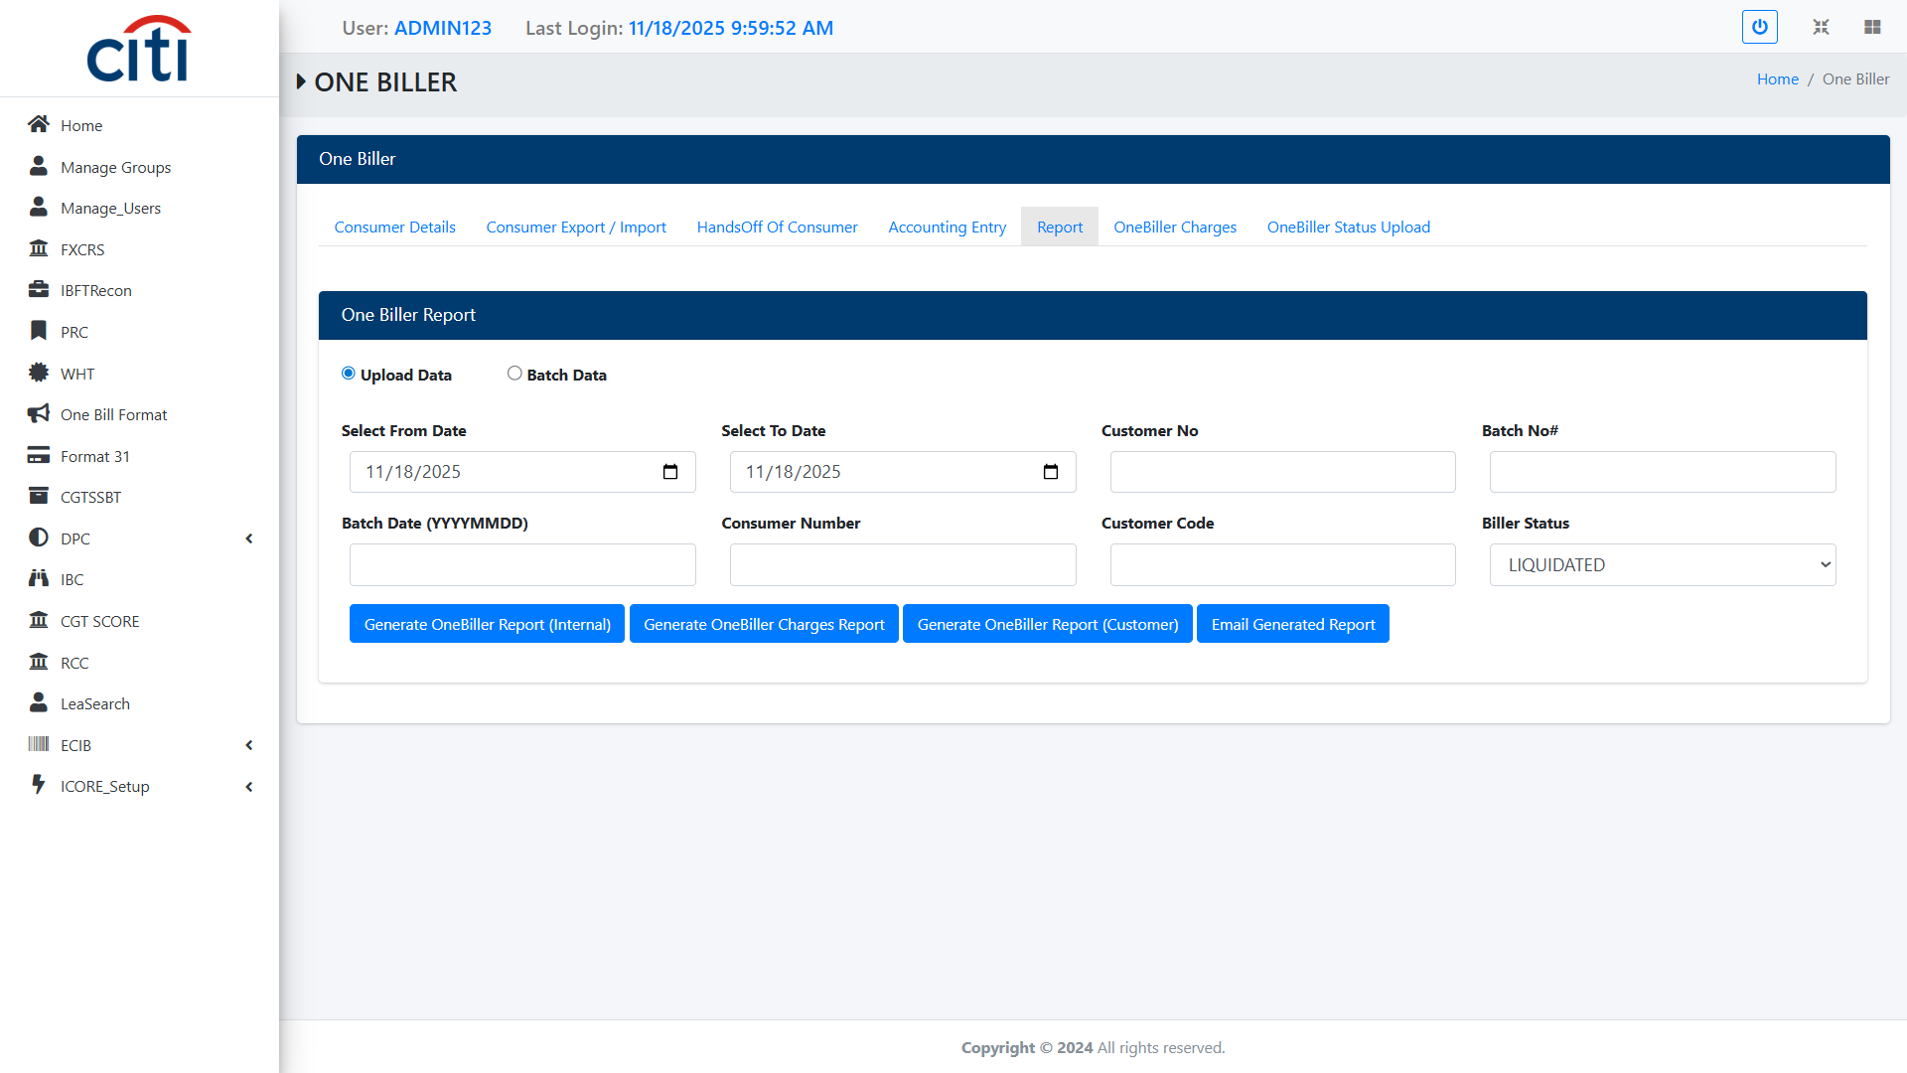
ONE BILLER
One Biller Report form
ICORE
35

Slide 36
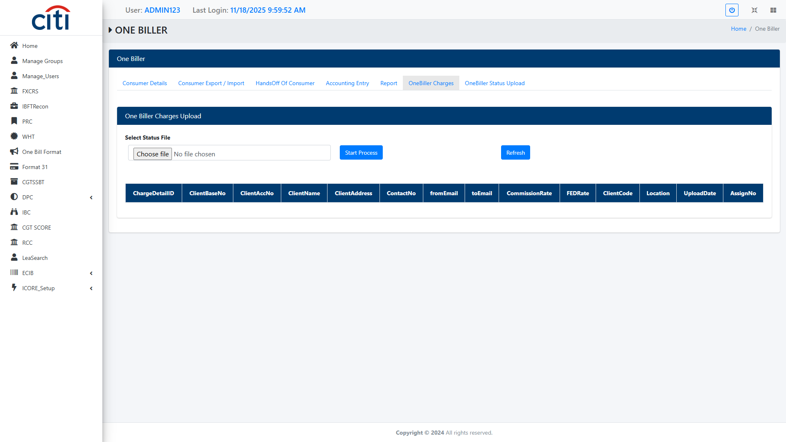
ONE BILLER
One Biller Charges file Upload field
ICORE
36

Slide 37
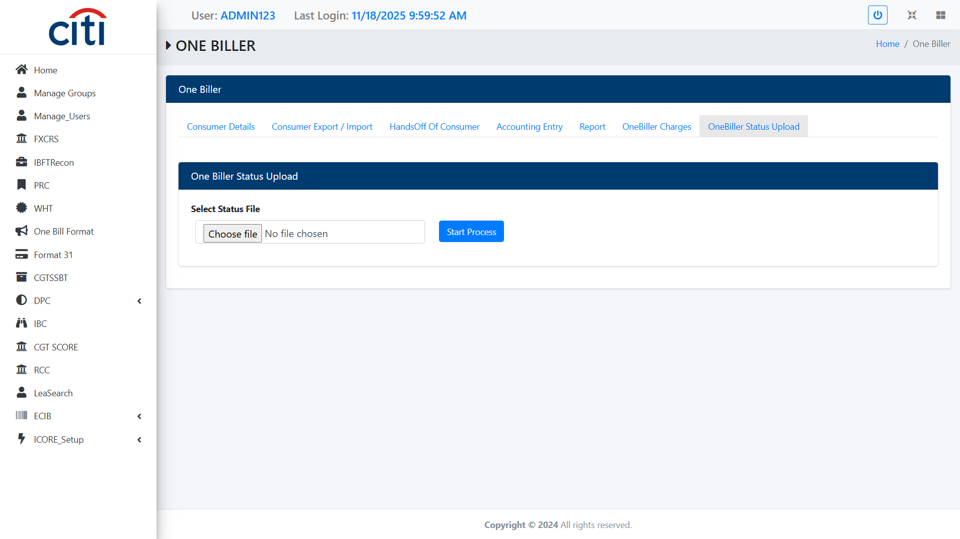
ONE BILLER
One Biller Status file upload field
ICORE
37

Slide 38
07
Format 31
Automated regulatory reporting across corporate clients
ICORE
38

Slide 39
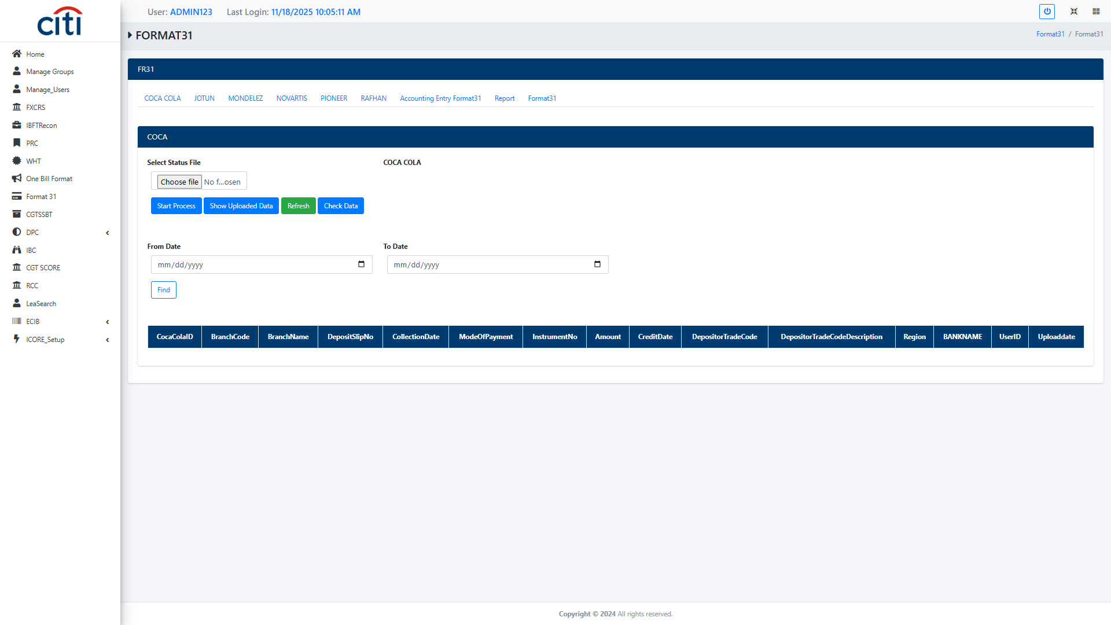
FORMAT 31
Format31 COCA COLA file field
ICORE
39

Slide 40
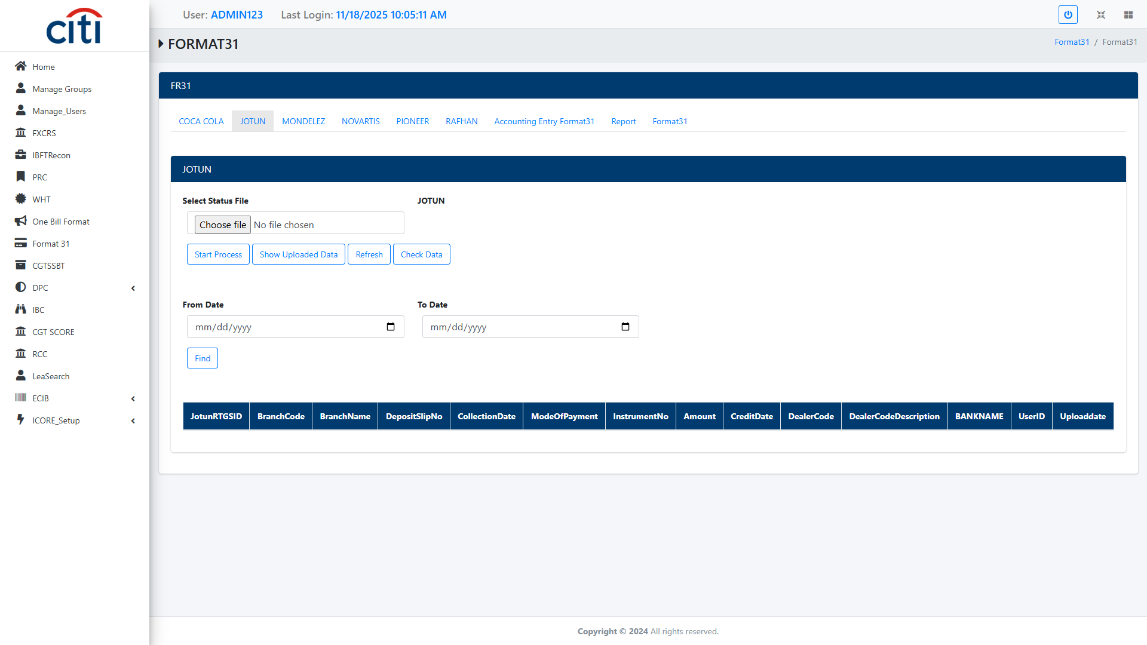
FORMAT 31
Format 31 Jotun file field
ICORE
40

Slide 41
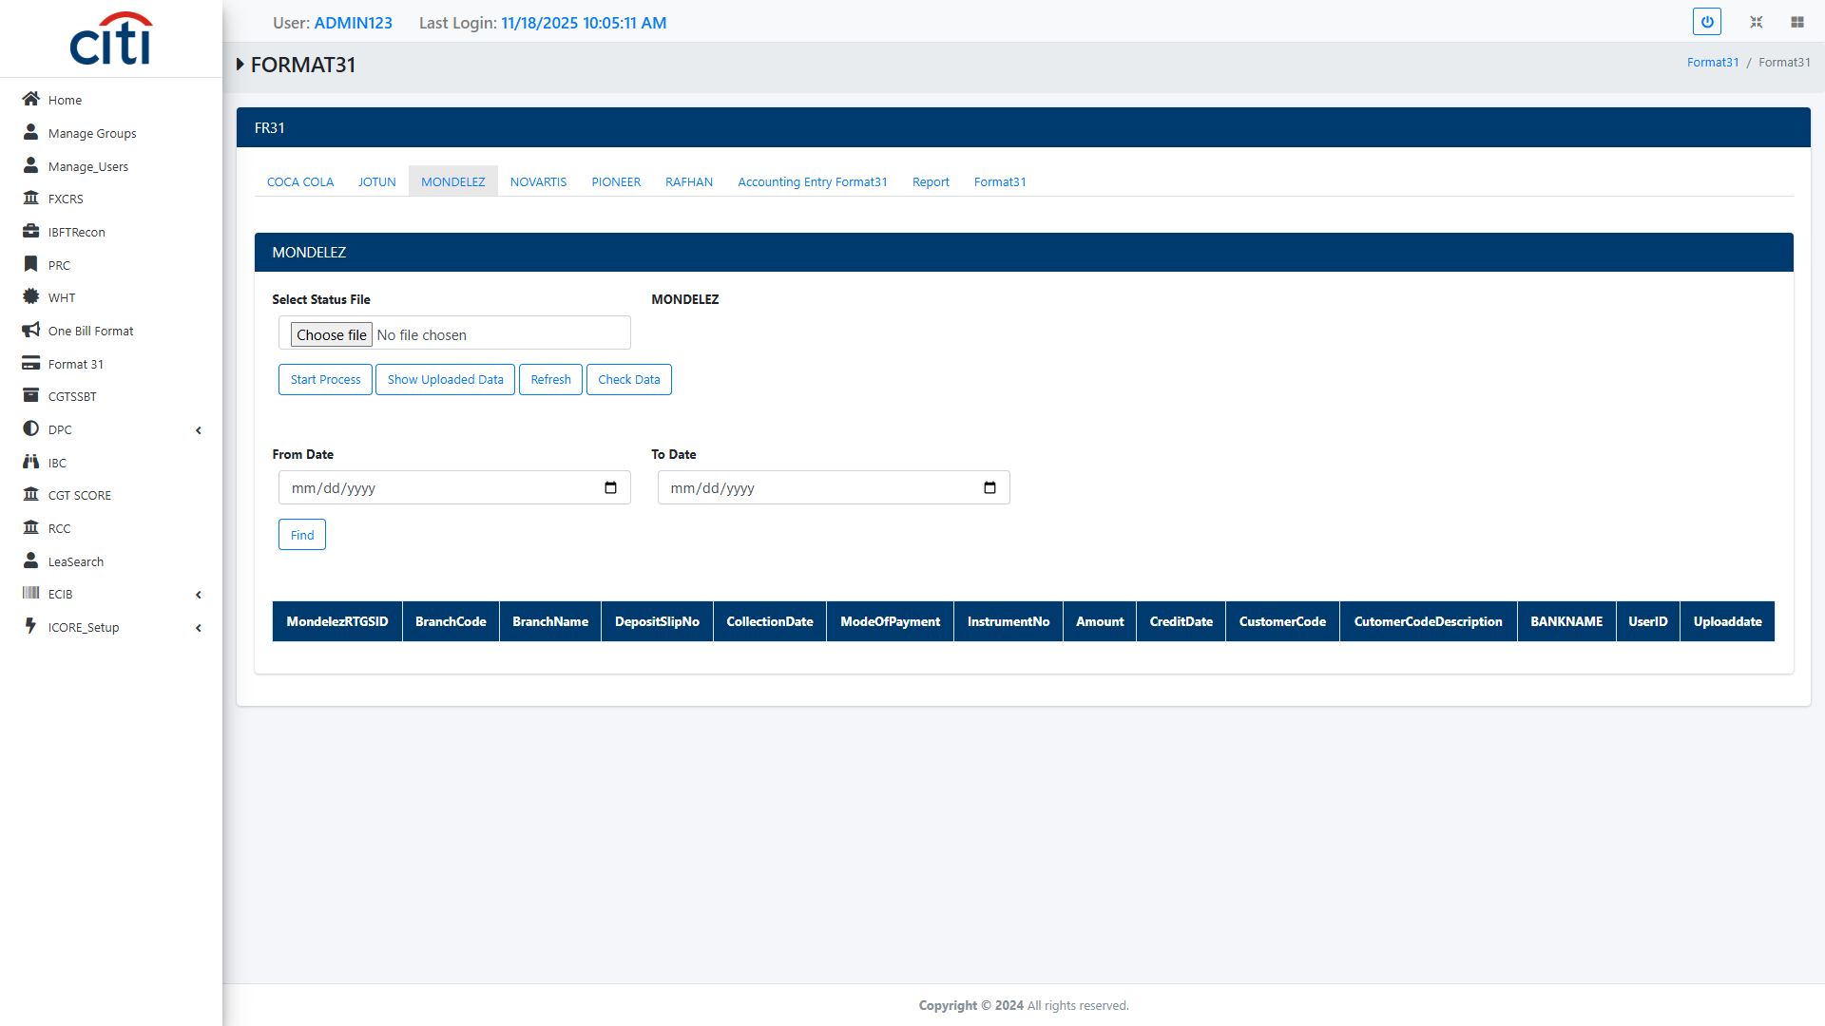
FORMAT 31
Format 31Mondelez file field
ICORE
41

Slide 42
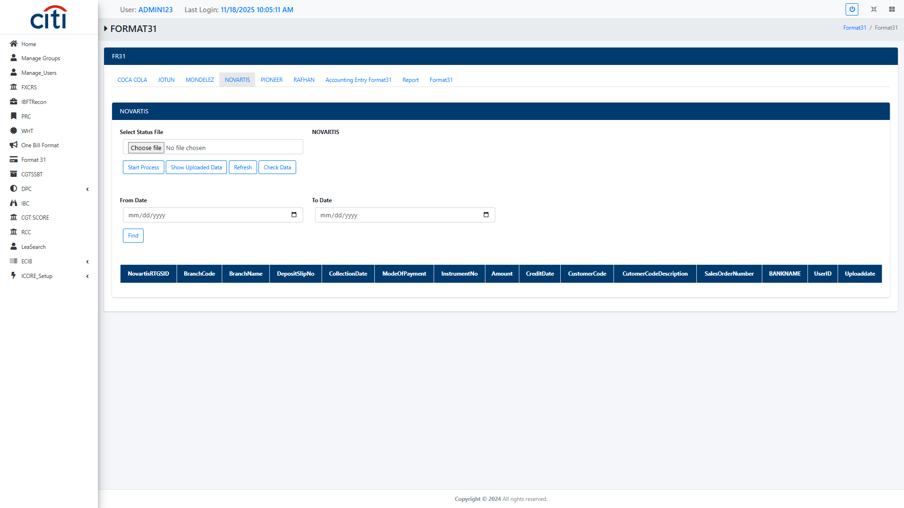
FORMAT 31
Format 31 Novatris file field
ICORE
42

Slide 43
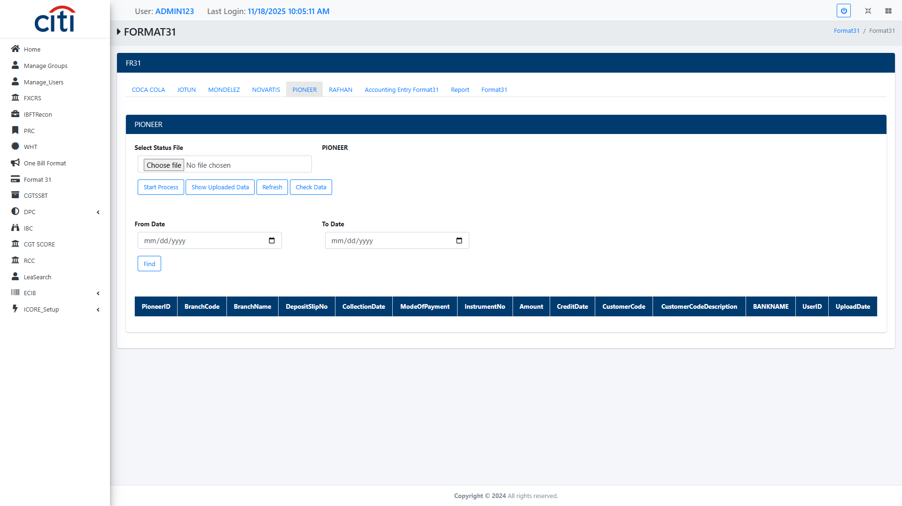
FORMAT 31
Format 31 Pioneer file field
ICORE
43

Slide 44
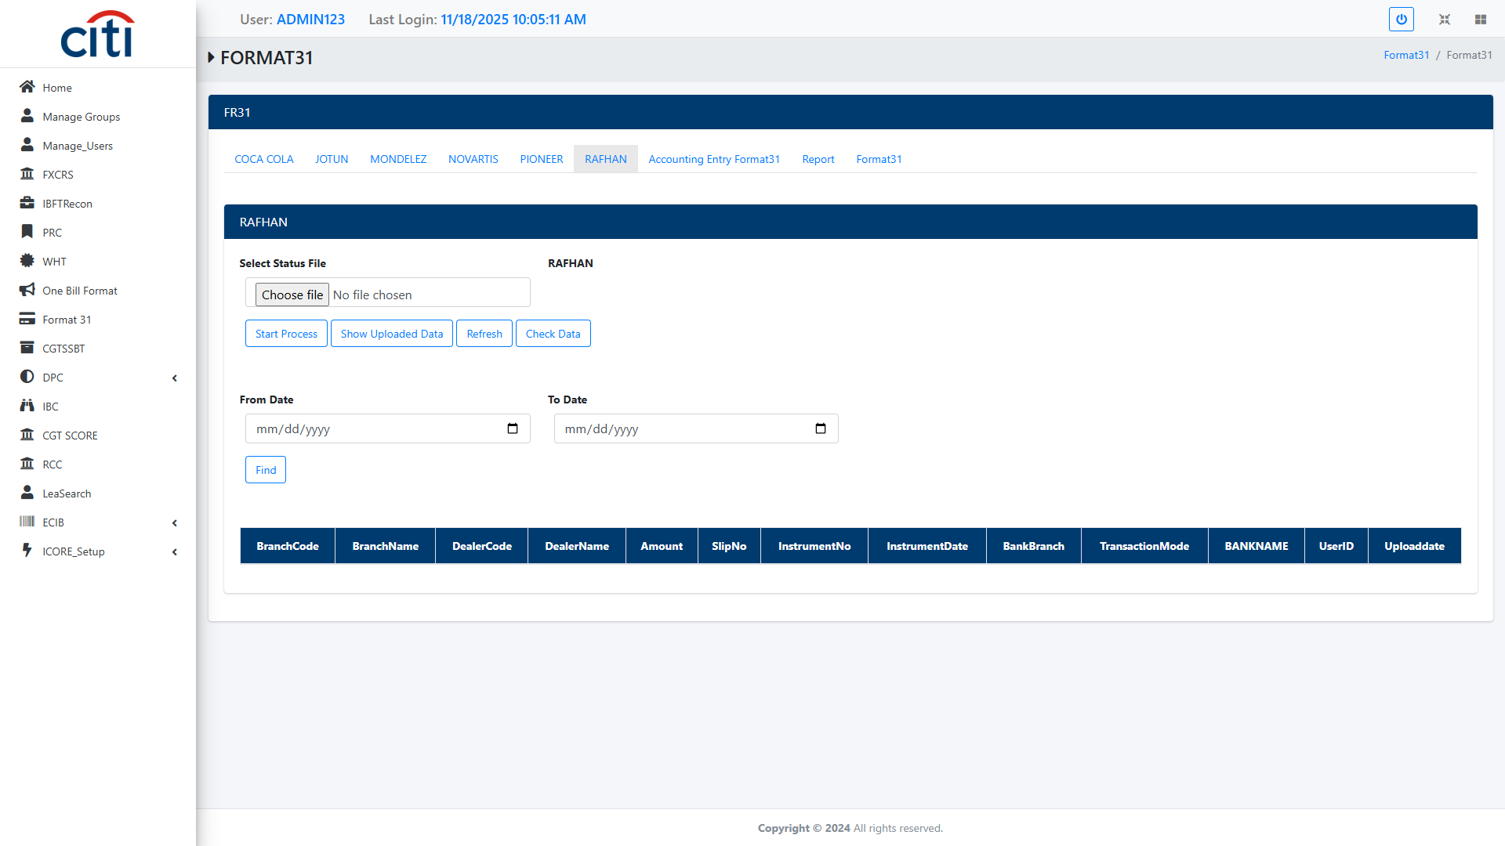
FORMAT 31
Format 31 Rafhan file field
ICORE
44

Slide 45
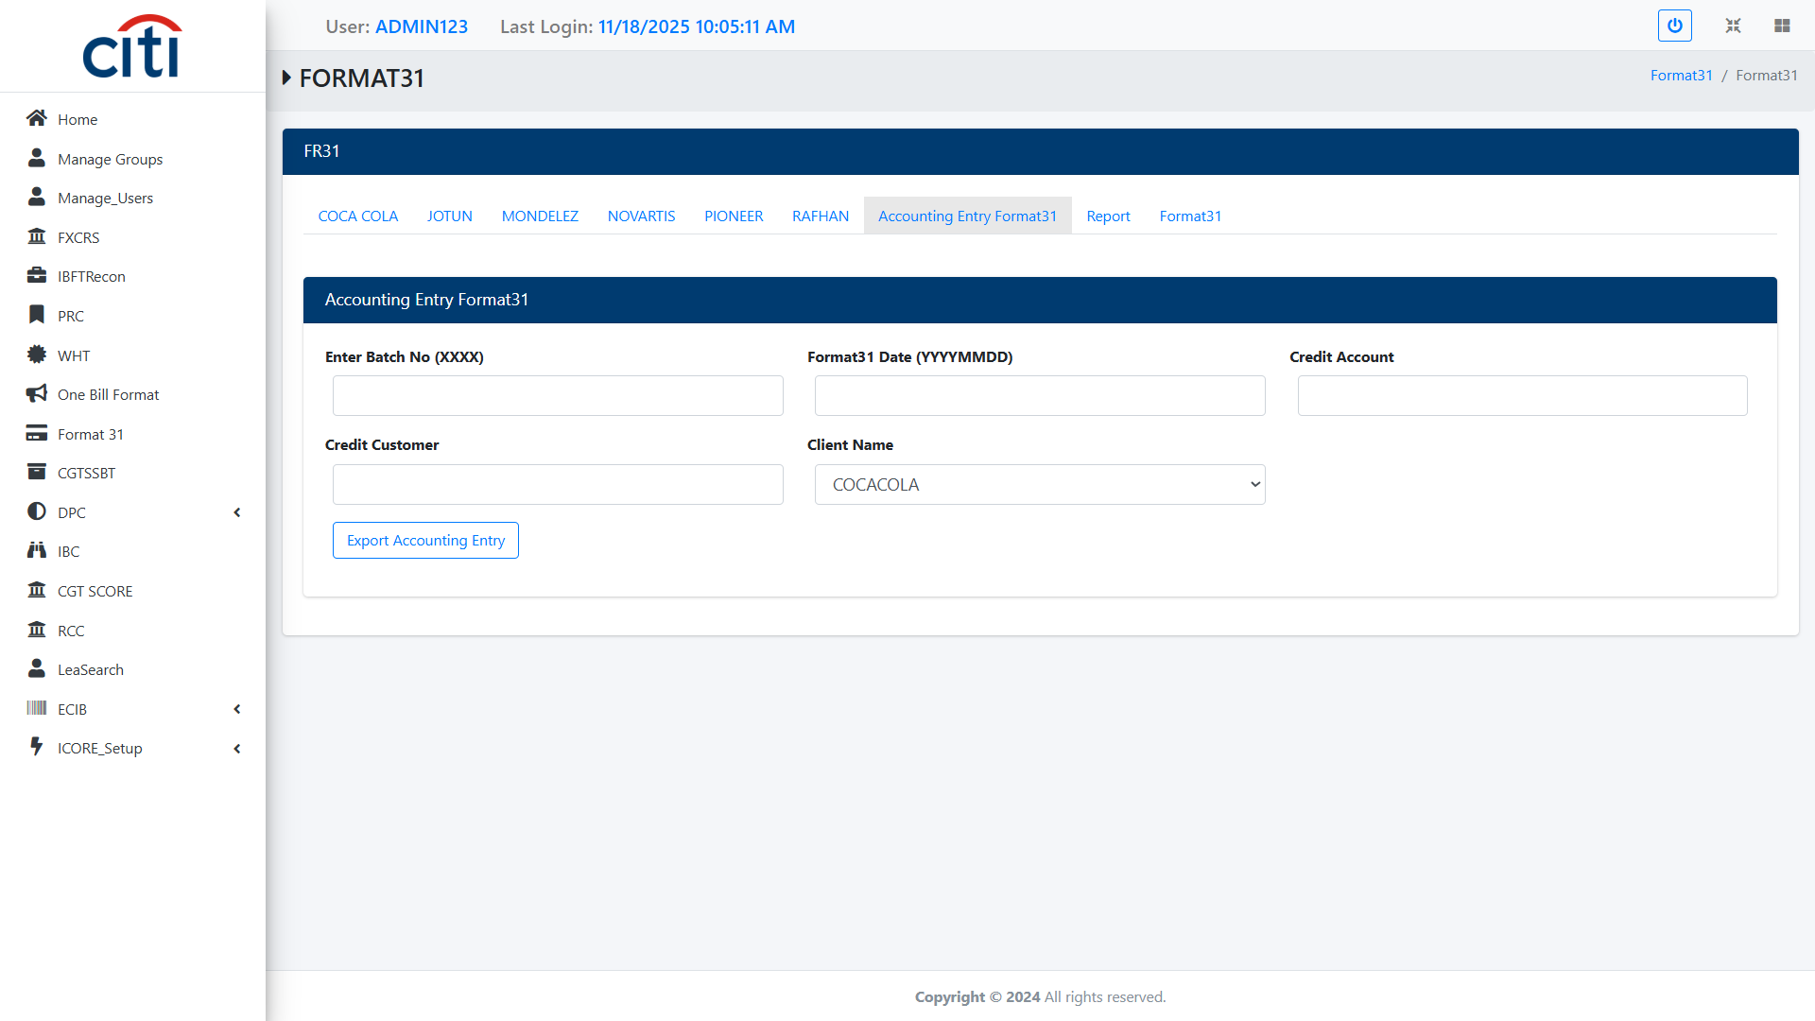
FORMAT 31
Format 31 Account Entry form
ICORE
45

Slide 46
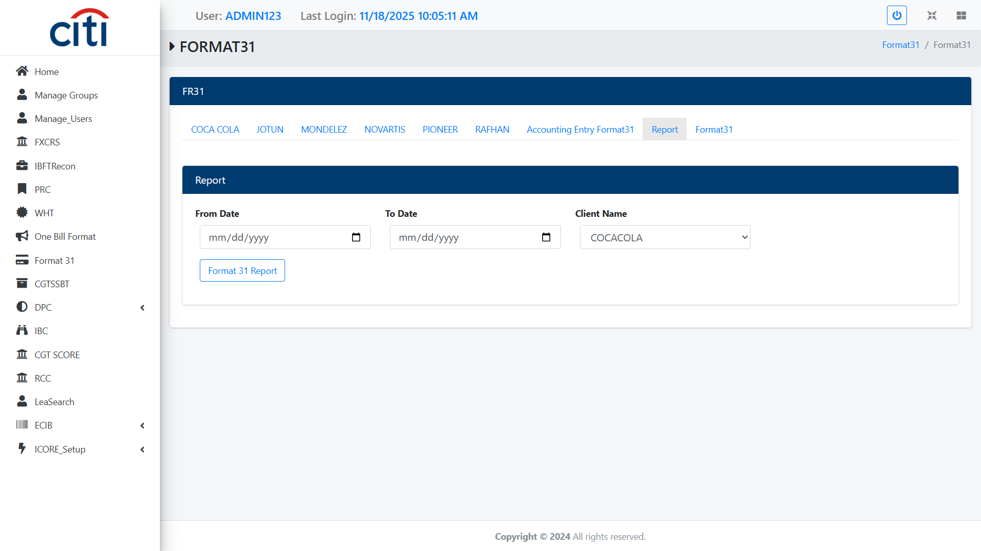
FORMAT 31
Format 31 Report
ICORE
46

Slide 47
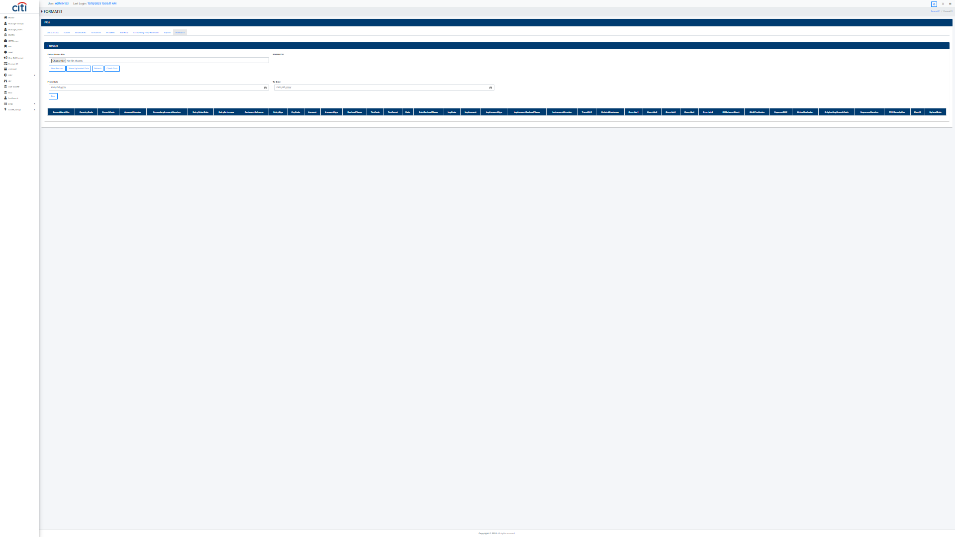
FORMAT 31
Format 31 file field
ICORE
47

Slide 48
08
CGTSSBT
Post-transaction settlement and back-office processing
ICORE
48

Slide 49
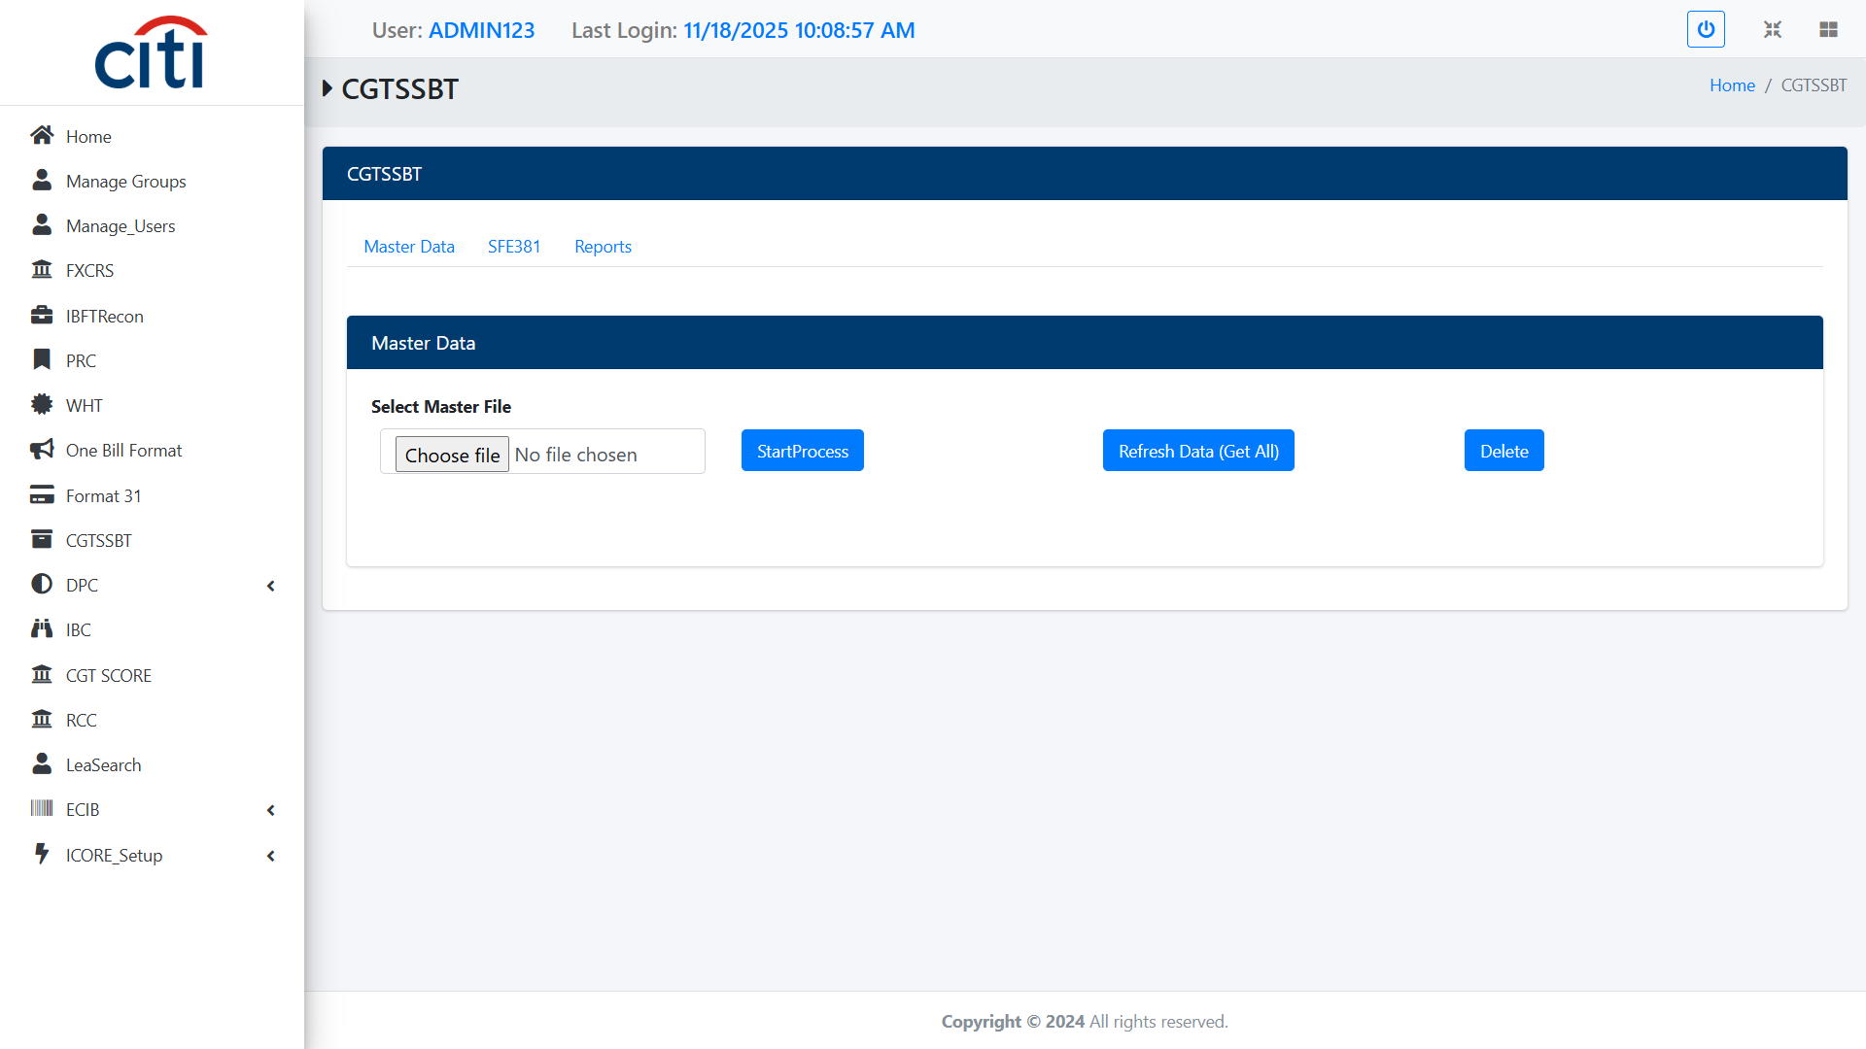
CGTSSBT
CGTSSBT Master Data file field Supports post-transaction settlement and back-office processing activities. Ensures operational accuracy and completion of transaction lifecycles
ICORE
49

Slide 50
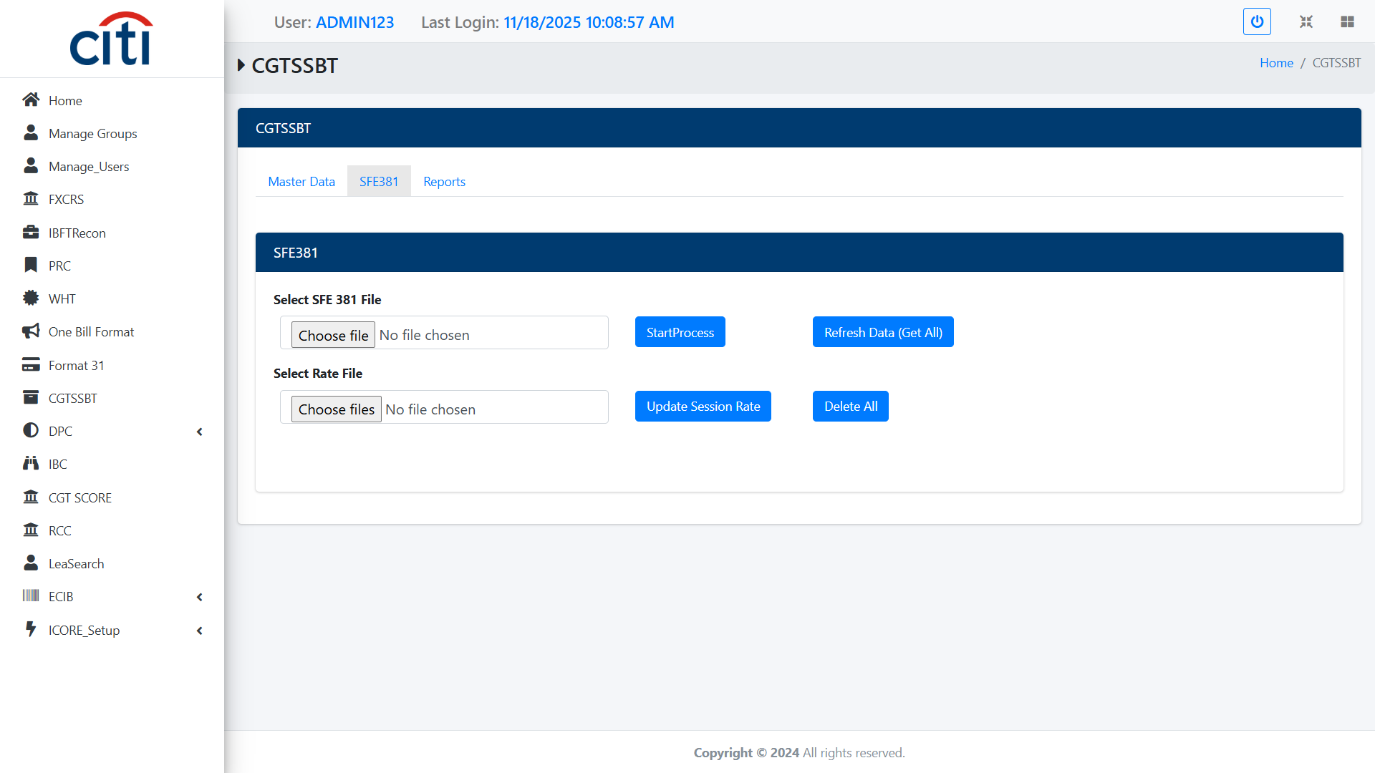
CGTSSBT
CGTSSBT SFE-381 file field
ICORE
50

Slide 51
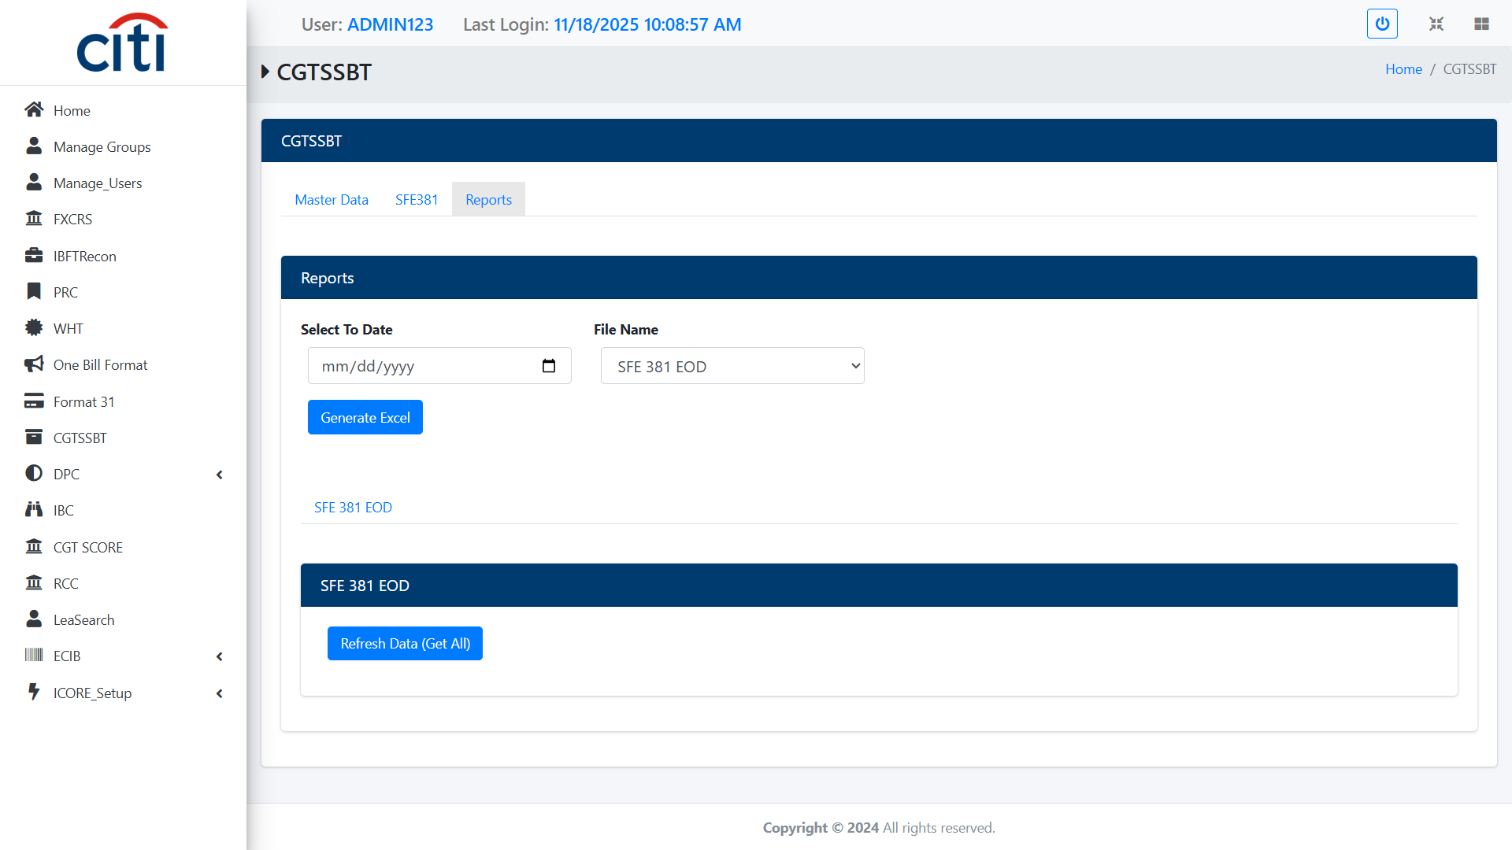
CGTSSBT
CGTSSBT Report
ICORE
51

Slide 52
09
DPC
Days-past-due threshold monitoring and bank system reporting
ICORE
52

Slide 53
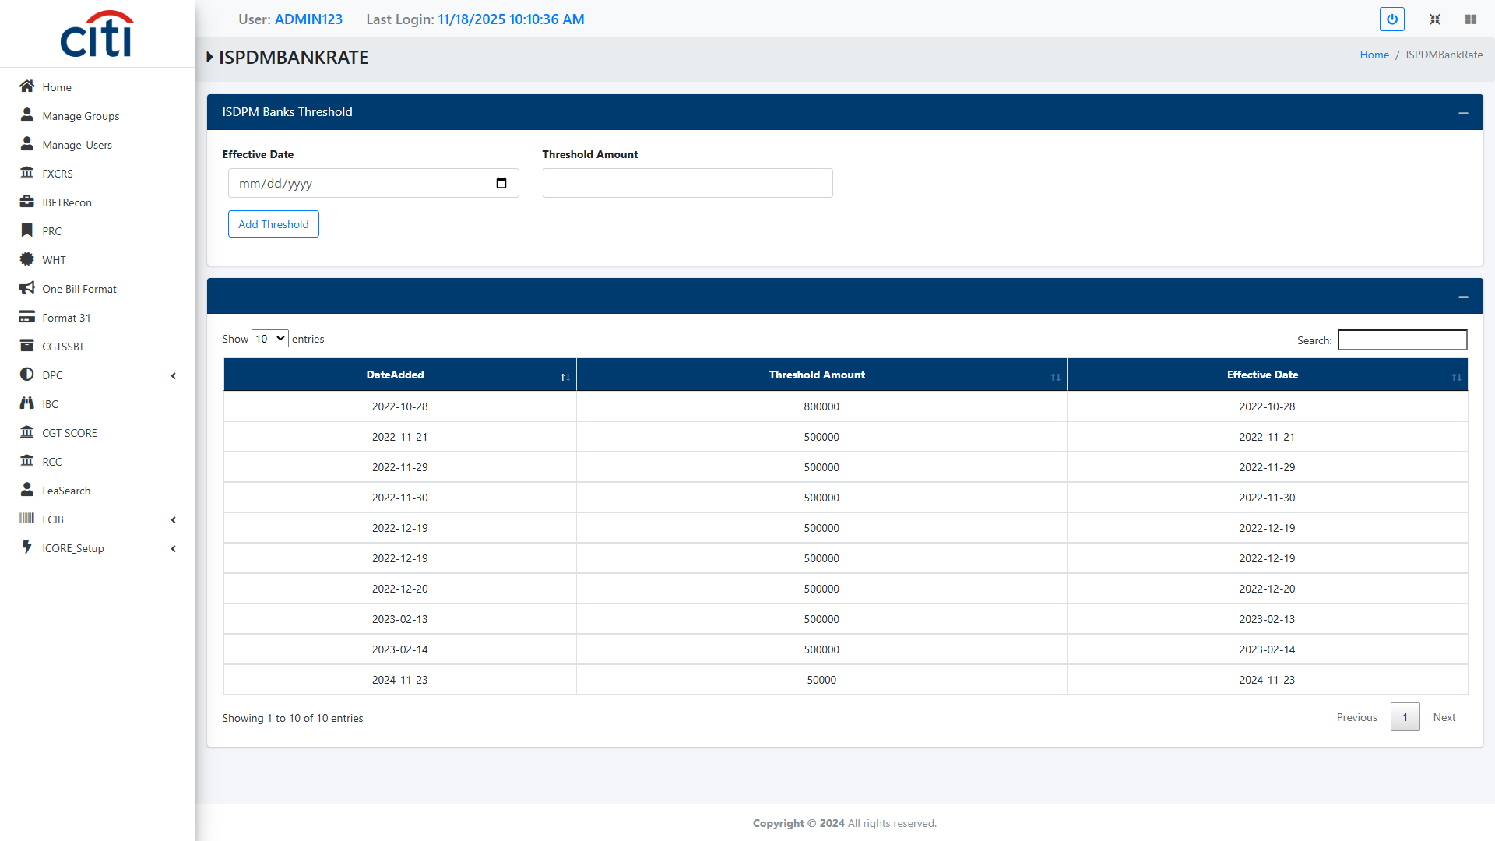
DPC
ISPDM Banks Threshold form
ICORE
53

Slide 54
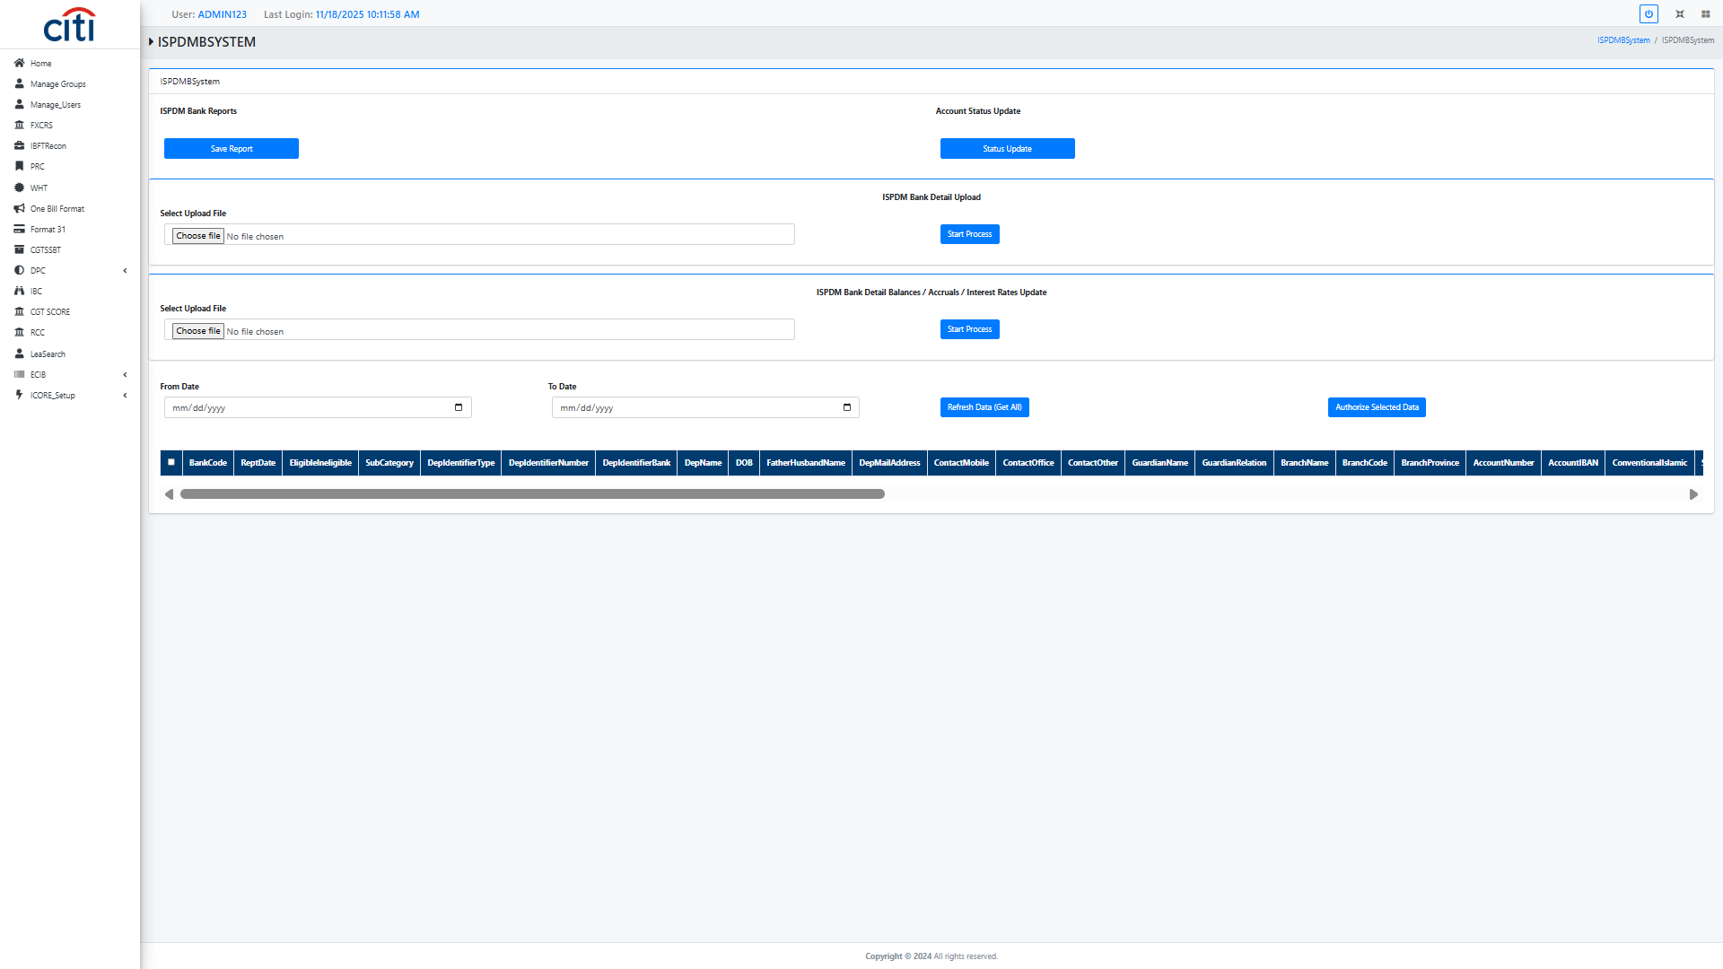
DPC
ISPDM Bank System Report
ICORE
54

Slide 55
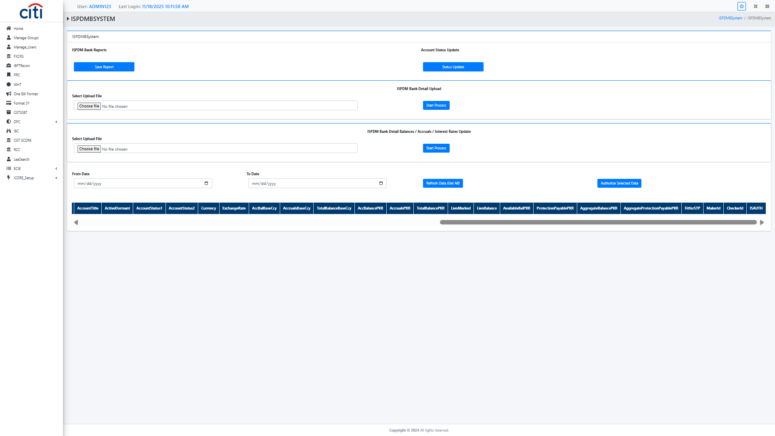
DPC
ISPDM Bank System Report
ICORE
55

Slide 56
10
IBC
Intra-bank cheque clearing and NIFT file processing
ICORE
56

Slide 57
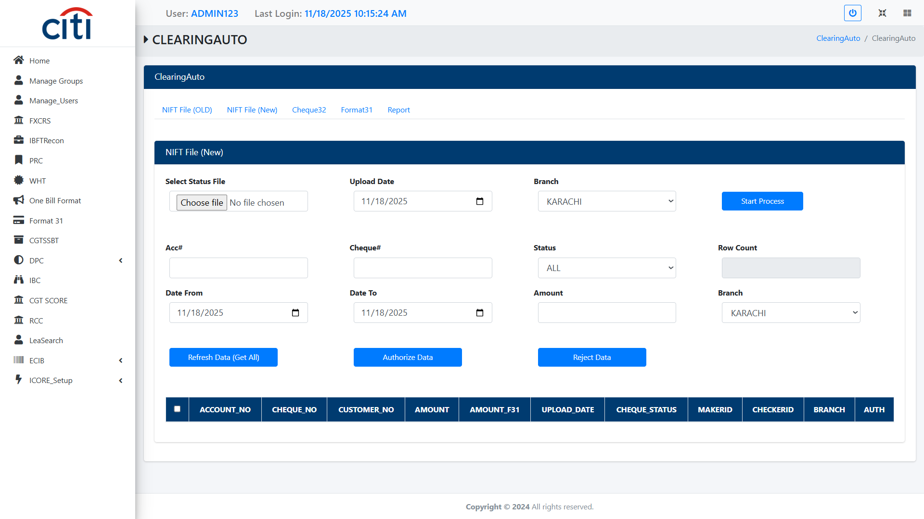
IBC
Clearing Auto NIFT file (old) field
ICORE
57

Slide 58

IBC
Clearing Auto NIFT file (new) field
ICORE
58

Slide 59
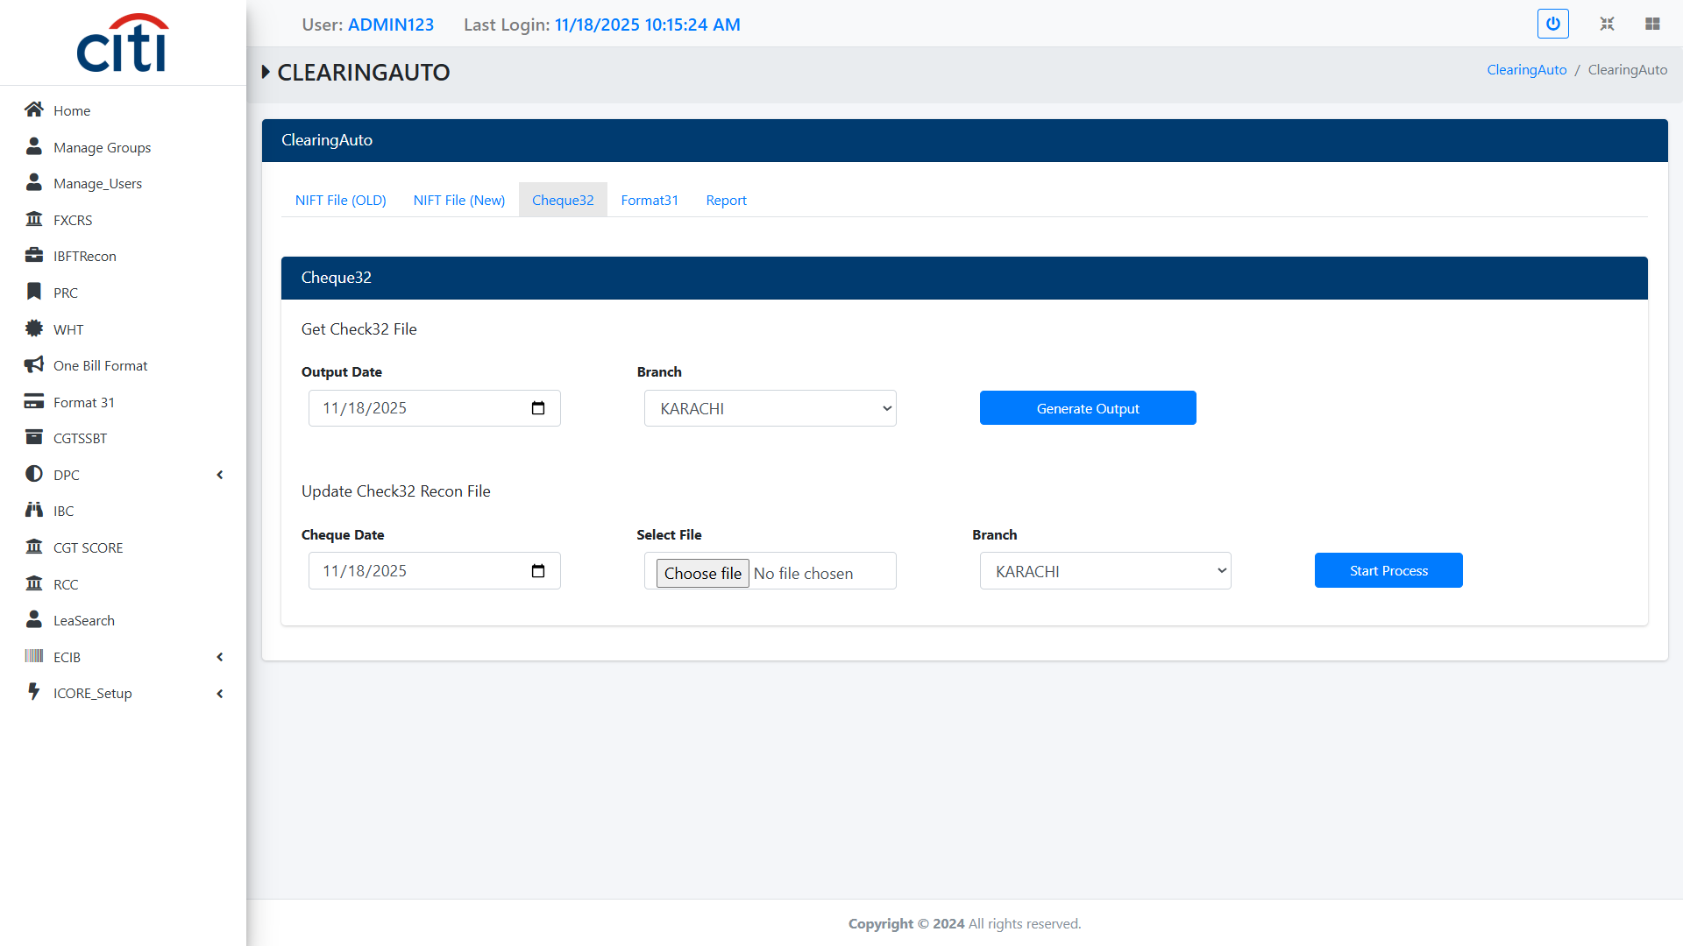
IBC
Clearing Auto Cheque 32
ICORE
59

Slide 60
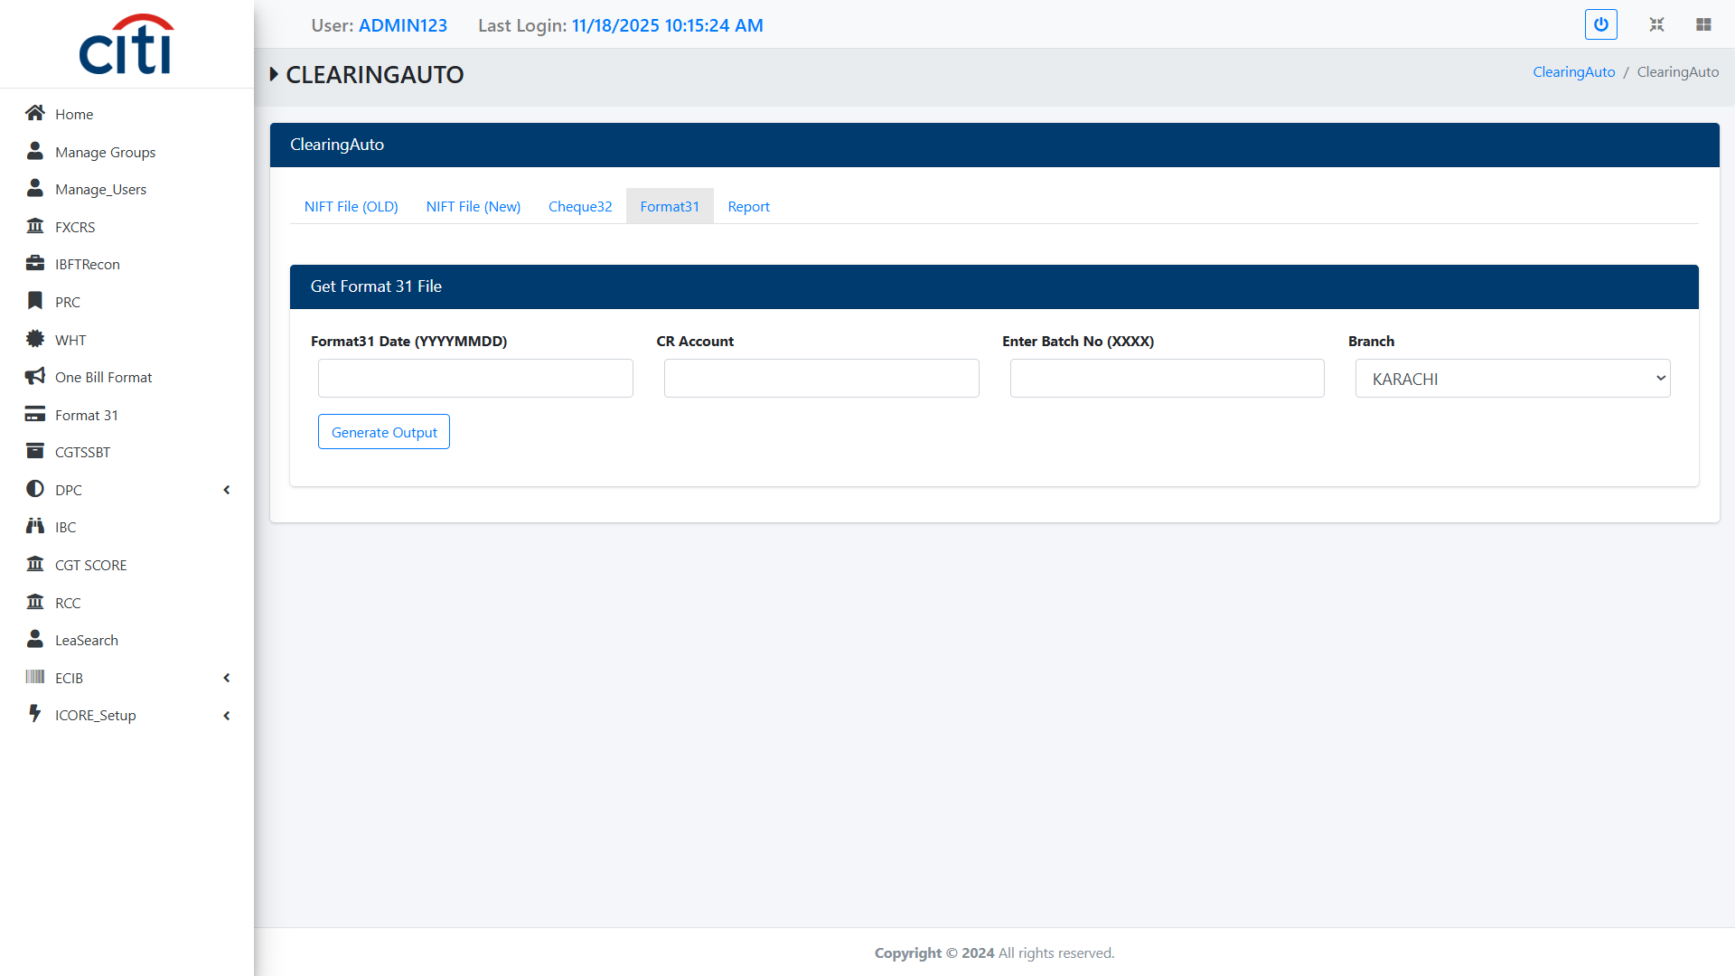
IBC
Clearing Auto Format 32 file
ICORE
60

Slide 61
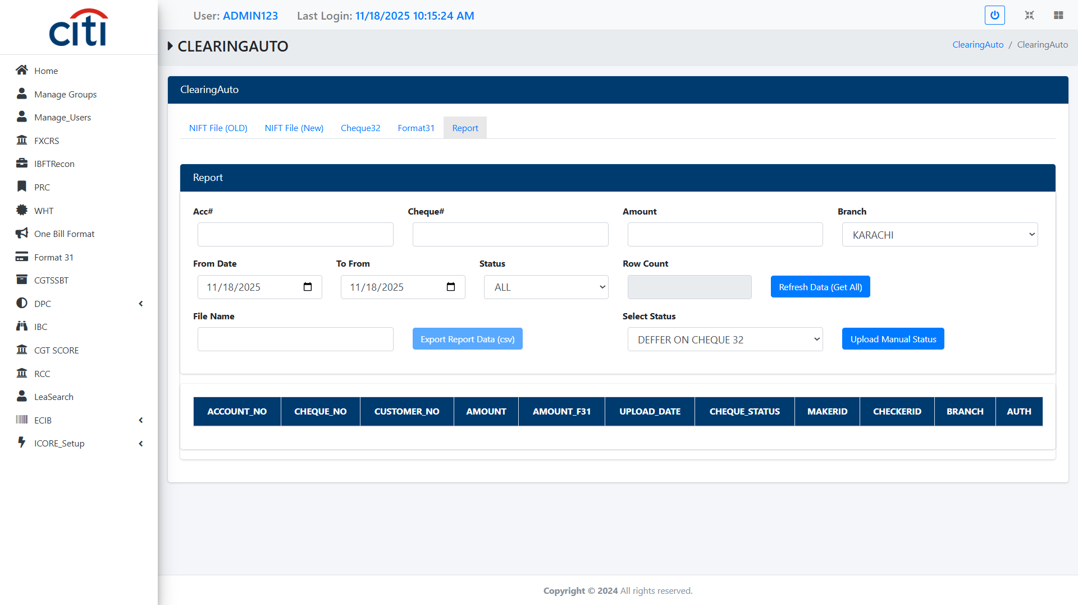
IBC
Clearing Auto Report
ICORE
61

Slide 62
11
CGT SCORE
Capital gains tax reporting system
ICORE
62

Slide 63
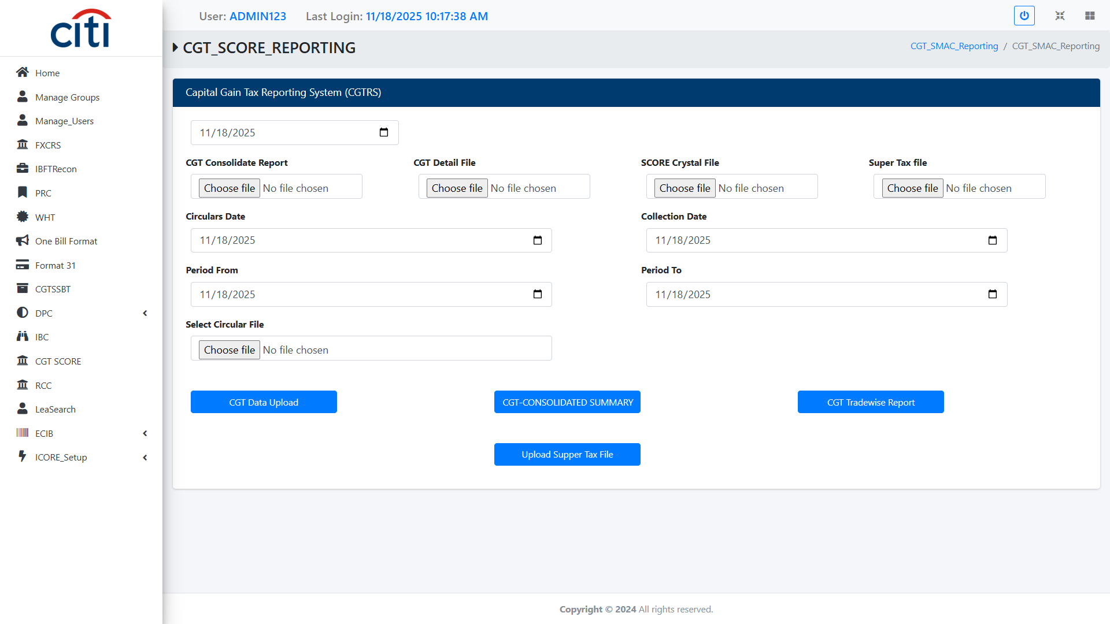
CGT SCORE
Capital Gain Tax Reporting System form
ICORE
63

Slide 64
12
RCC
Recovery and collection account and customer management
ICORE
64

Slide 65
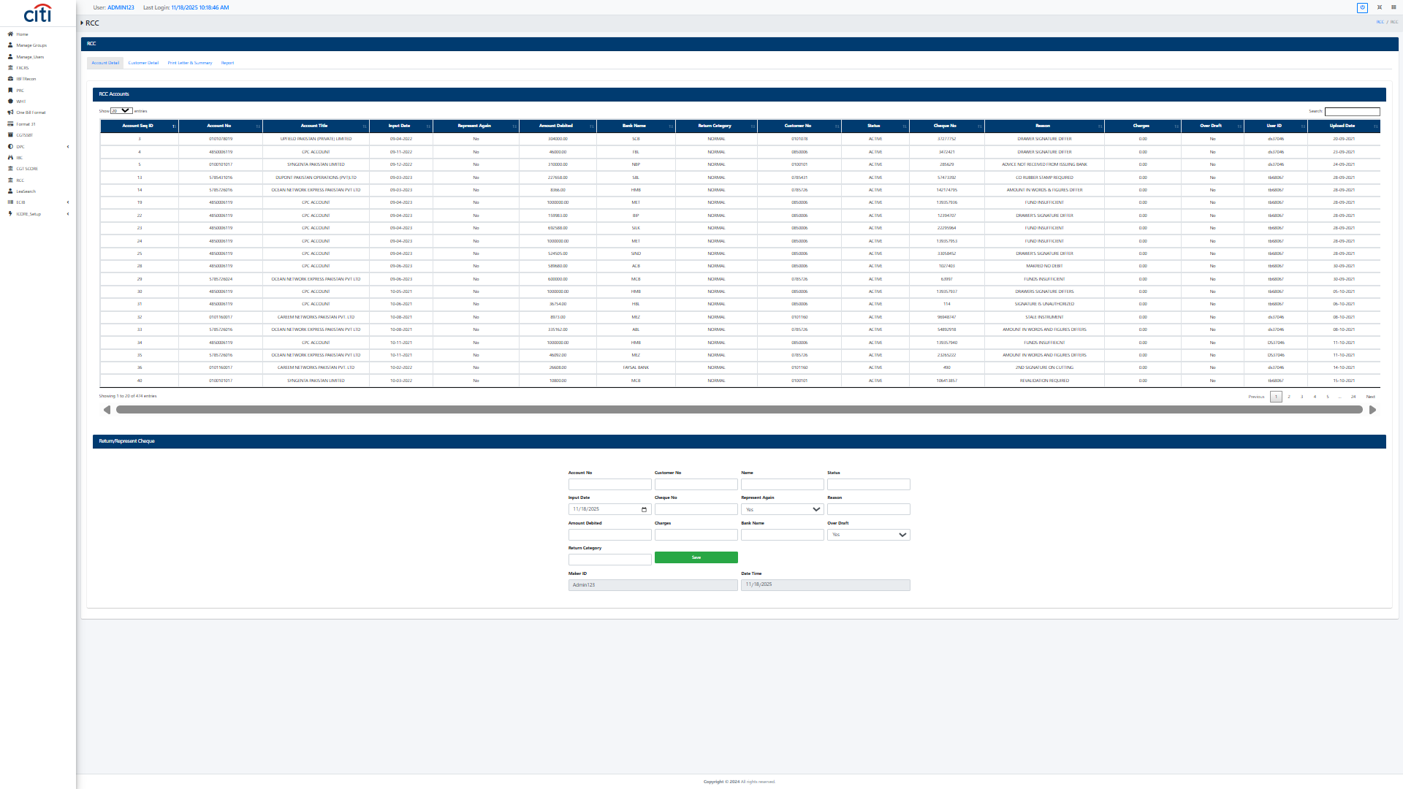
RCC
RCC Account Detail form
ICORE
65

Slide 66
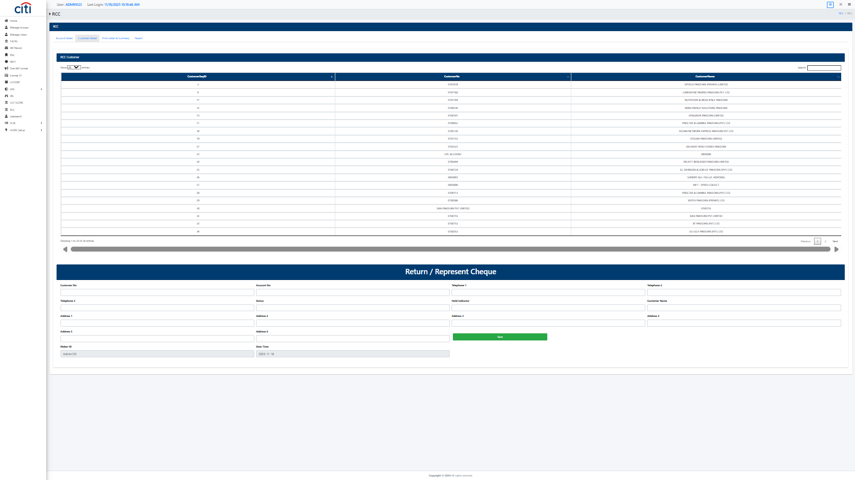
RCC
RCC Customer Detail form
ICORE
66

Slide 67
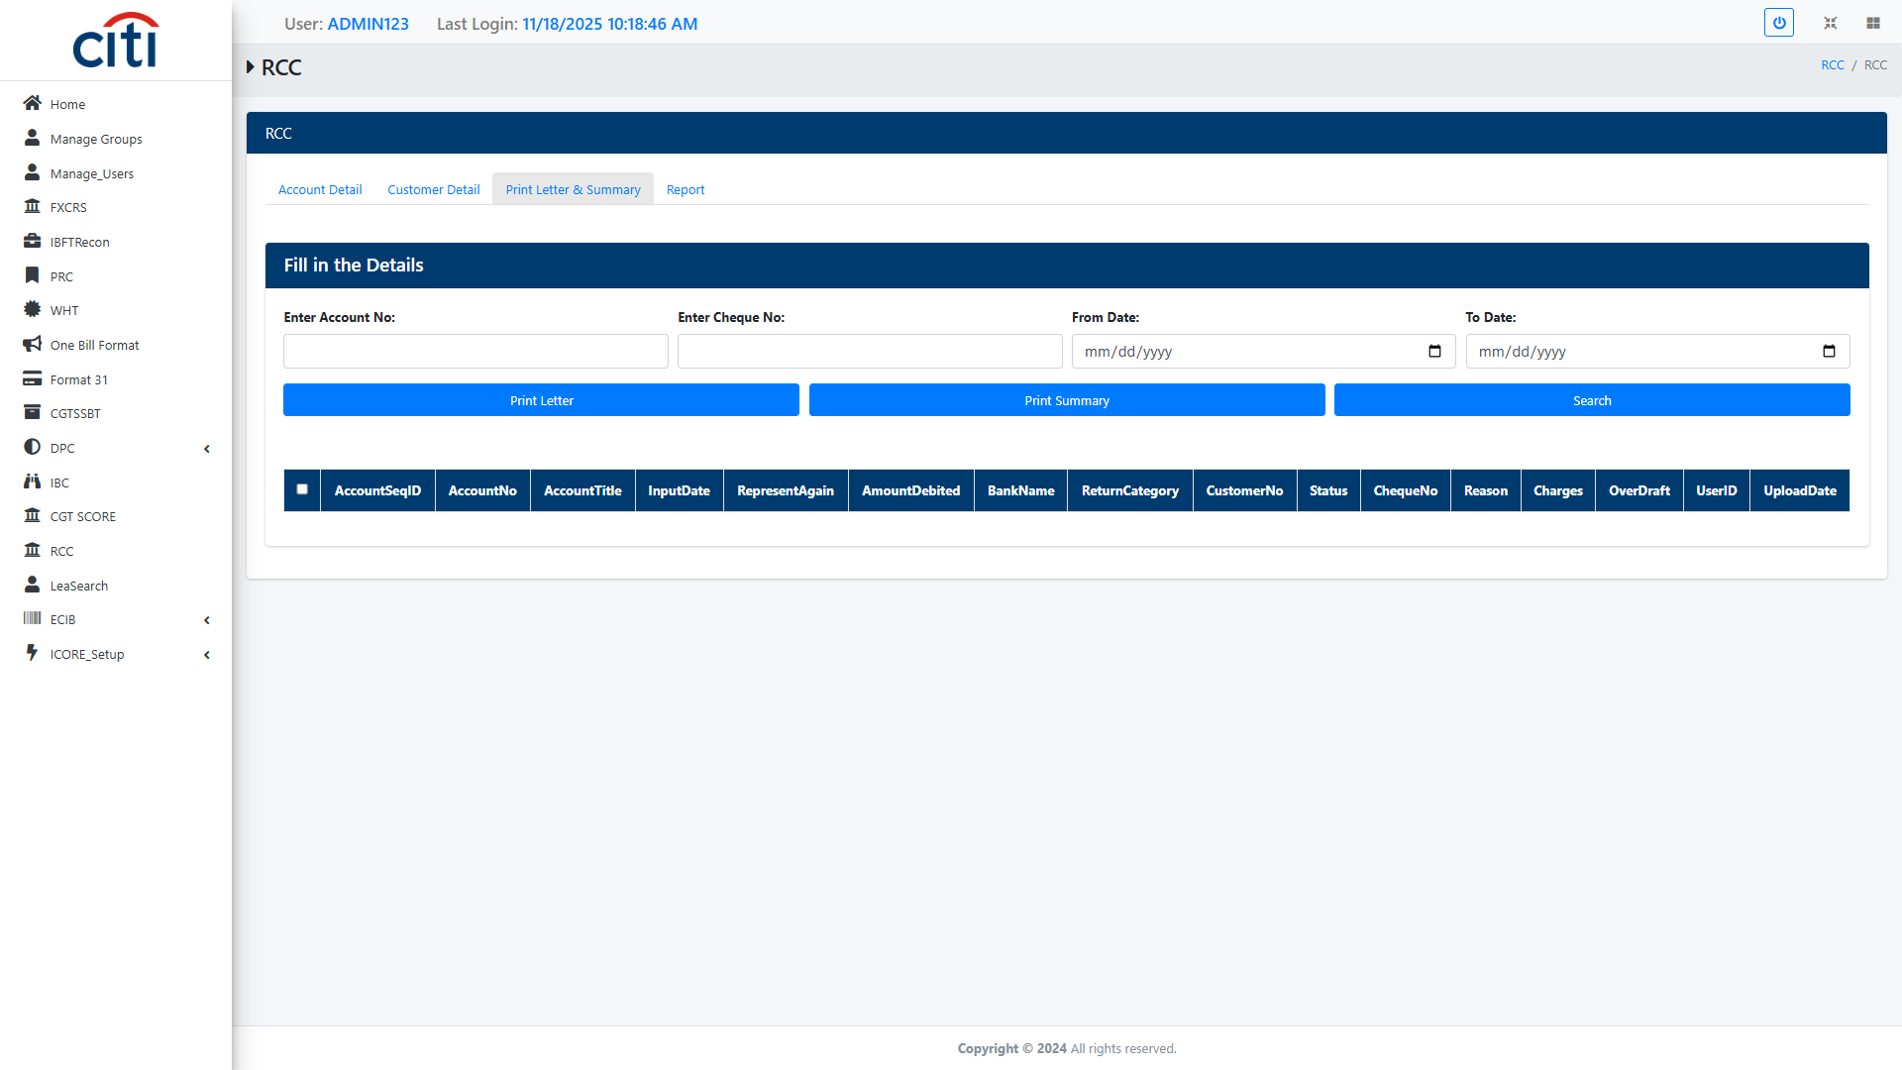
RCC
RCC Print Letter and Summary form
ICORE
67

Slide 68
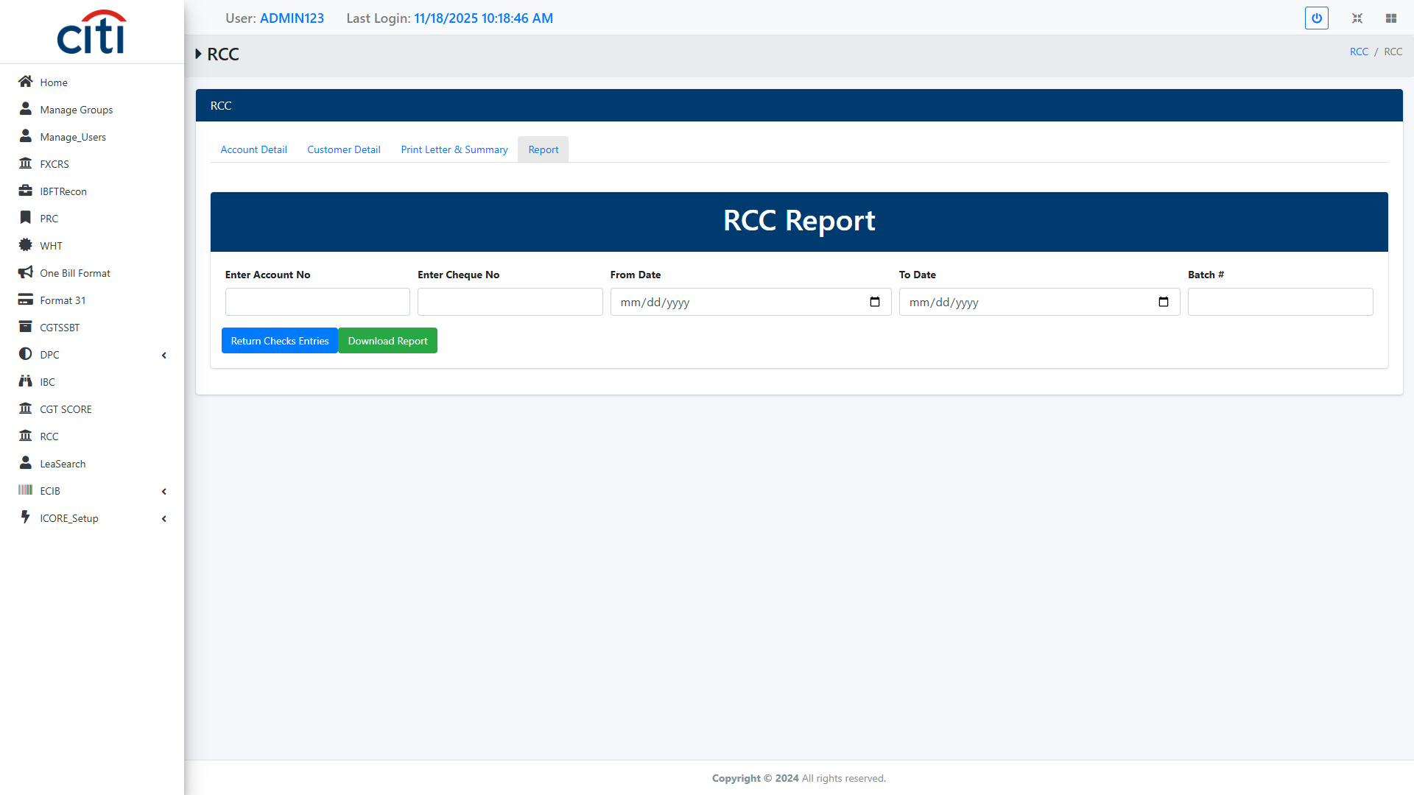
RCC
RCC Report
ICORE
68

Slide 69
13
LEA Search
Law enforcement agency label and GRB search tools
ICORE
69

Slide 70
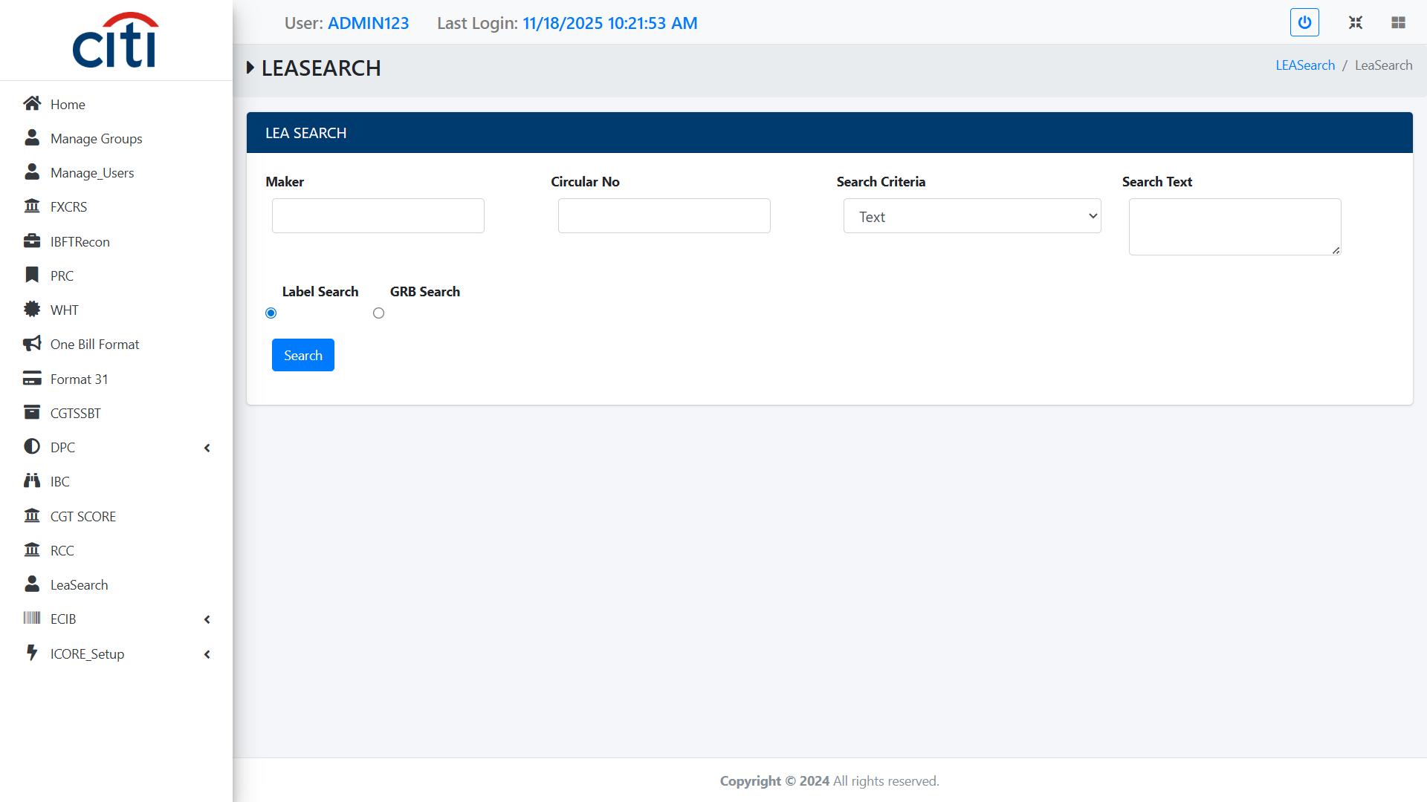
LEA SEARCH
LEA Label SEARCH form
ICORE
70

Slide 71

LEA SEARCH
LEA GRB SEARCH form
ICORE
71

Slide 72
14
iCore Setup
Email and system management configuration
ICORE
72

Slide 73

ICORE SETUP
Email Setup Form
ICORE
73

Slide 74

ICORE SETUP
System Management Setup form
ICORE
74

Slide 75
Thank You
Questions & discussion welcome
Developed by Zealous Technologies
zealoustechnologies.com

