Slide 1
ZEALOUS TECHNOLOGIES • PRODUCT OVERVIEW
FX Digitalization
End-to-End Digitalization of FX Cases
Developed by Zealous Technologies
zealoustechnologies.com

Slide 2
OVERVIEW
Introduction
Through the portal clients will be able to submit the relevant supporting as well as mandatory documentation as per SBP checklist. CitiBank wants to have a web-based solution/digital portal which will be called, FX Digitilization, where bank’s clients will be able to submit FX related cases. The same portal will be integrated with State Bank of Pakistan Online Portal for further submission to the State Bank.
FX DIGITALIZATION
2

Slide 3
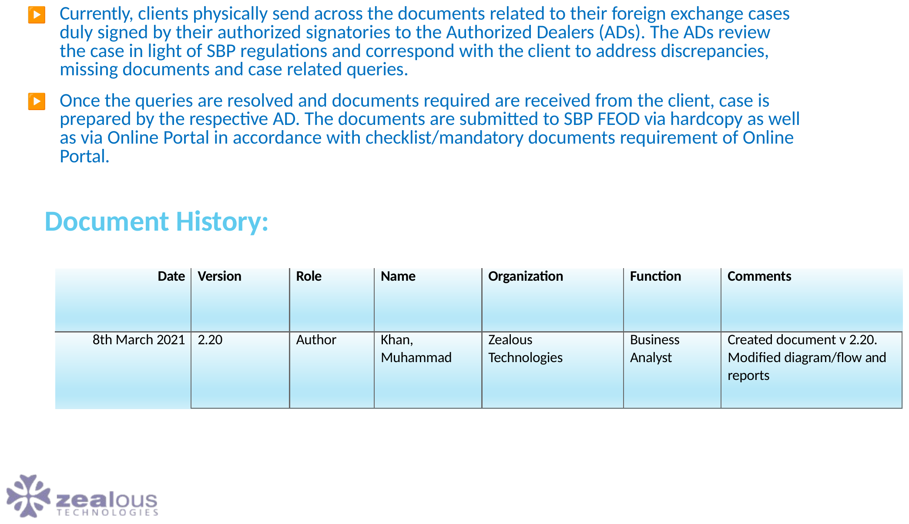
OVERVIEW
The Business Problem/Need
FX DIGITALIZATION
3

Slide 4
OVERVIEW
Objective & Scope
To develop a digital portal through which the bank’s clients will be able to submit FX related cases. The same portal will be integrated with SBP Online Portal for further submission to SBP/SBP BSC, if required.
User management (Client and bank officials)
Online case receipt along with scanned supporting documents
Validation & submission of referral and associate documents
Queries management
Approval/Rejection acknowledgement and its notifications
FX DIGITALIZATION
4

Slide 5
OVERVIEW
Description of Current System
Currently, clients physically send across the documents related to their foreign exchange cases duly signed by their authorized signatories to the Authorized Dealers (ADs). The ADs review the case in light of SBP regulations and correspond with the client to address discrepancies, missing documents and case related queries.
Once the queries are resolved and documents required are received from the client, case is prepared by the respective AD. The documents are submitted to SBP FEOD via hardcopy as well as via Online Portal in accordance with checklist/mandatory documents requirement of Online Portal.
FX DIGITALIZATION
5

Slide 6
OVERVIEW
Description of Future State
SBP/SBP BSC has encouraged all banks to develop an online portal for their clients whereby clients will be able to submit their cases online. The same portal will be integrated with SBP Online Portal for further submission to SBP, if required.
Through the portal clients will be able to submit the relevant supporting as well as mandatory documentation as per SBP checklist. Banks will review the cases online for onwards submission to SBP/SBP BSC.
FX DIGITALIZATION
6

Slide 7
OVERVIEW
Process High level Workflow
Client should be able to initiate approval request using Bank Portal/Bank app along with all scanned documents as attachment
Email alert will be sent to the customer about submission of case of respective bank.
Request should reach Bank Portal/Bank App, where the bank’s official will review the case and related documents submitted by the client
After review of the case and related documents, it should flow from Bank Portal/Bank App to SBP online portal
After moving to SBP Online Portal, the bank official will attach a scanned copy of duly signed covering letter with the case
The case, once approved/rejected/referred back by SBP, should reach to the Bank Portal/bank App
Bank can share approval/rejection/referral details with client through Bank Portal/bank App
Client should receive approval/rejection/referral details on Bank Portal
FX DIGITALIZATION
7

Slide 8
OVERVIEW
Expected Benefits
Enhanced client experience
Reduction in client queries
Reduction in overall TAT
Improved accuracy and reduction in discrepancies
Regulatory compliance
FX DIGITALIZATION
8

Slide 9
OVERVIEW
Process High level Workflow
The future process flow will vary from bank to bank owing to different organizational structure, SOPs and control mechanism put in place by each bank. However, a generalized workflow is given below for the reference of all.
Overall flow of the transaction will remain the same. However, bank’s client will be able to review the mandatory documentary requirements of the various type of cases on the portal and portal will not allow clients to proceed with submission without uploading the mandatory documents. This will significantly improve bank’s client experience and reduce the number of queries and responses going back and forth between bank and client
FX DIGITALIZATION
9

Slide 10
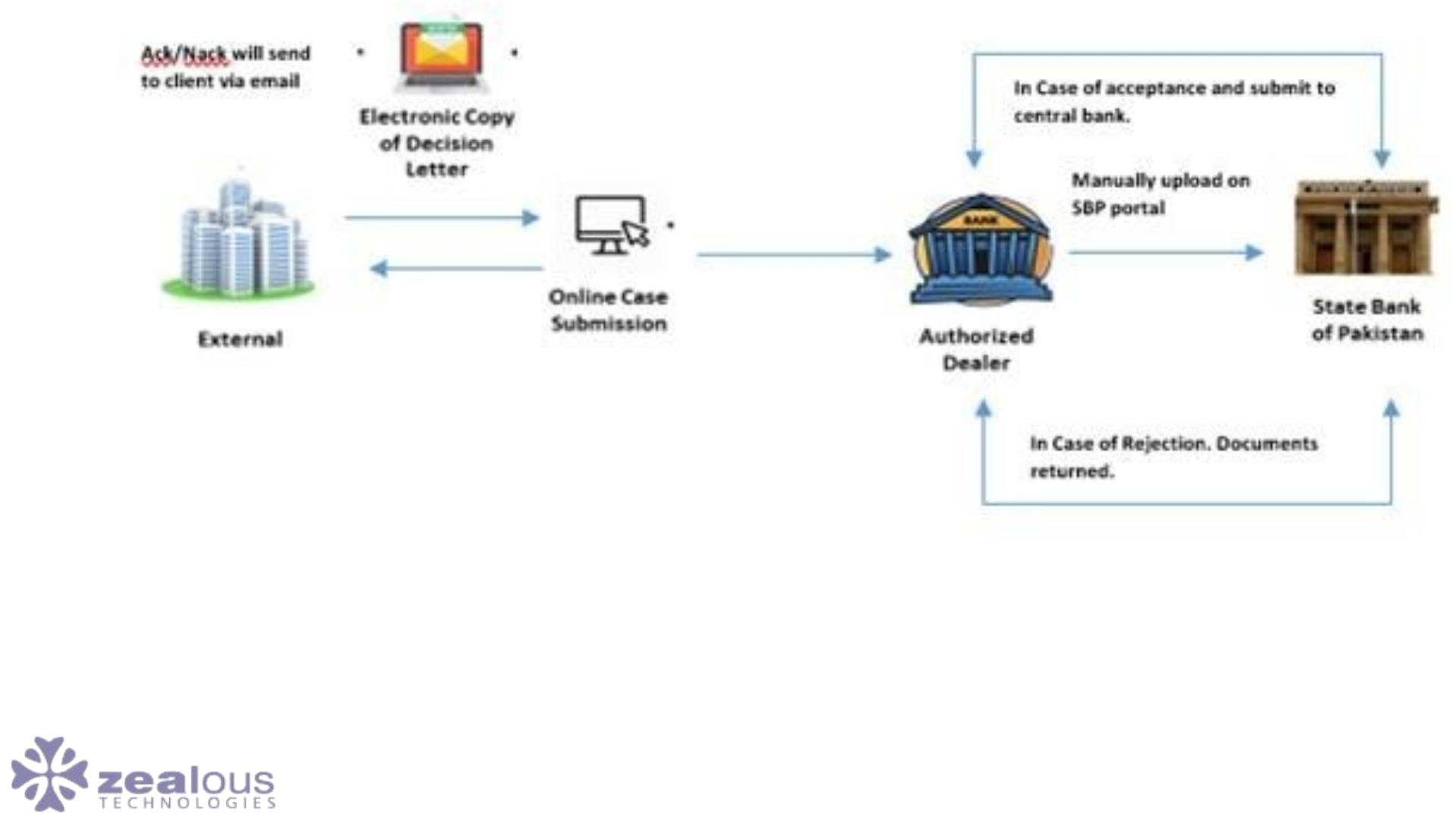
BUSINESS REQUIREMENTS
Process High level Workflow
FX DIGITALIZATION
10

Slide 11
BUSINESS REQUIREMENTS
Business Processes
The request for this part of the project encompasses the following features:
A web based portal is required to be established which will allow our clients to submit remittance approval cases.
Client Login
Clients will be required to create a new login ID and register for the first time using their approved email address.
The email address entered by the client has to be pre-fed into the portal’s database by the bank.
Any email address not available in the database has to be rejected by the portal and the user should not be allowed to register their login ID.
Once an ID is registered, a system generated email confirmation should be sent to the email address.
Password will be randomly generated upon each login attempt and sent across to the registered email address. Expiry time for the random password should be 3 minutes after which the user will have to re-generate a new password in order to login.
FX DIGITALIZATION
11

Slide 12
BUSINESS REQUIREMENTS
Admin
Bank’s employees will be provided access to the portal and will be able to login through a user ID and password. Access given to bank employees will be via GIDA.
Any changes in ID or respective user will be through GIDA. Which will have all rights to add or remove existing users along with Set up of account / Maintenance / Deletion or Addition
Maker and checker roles will be assigned to each user.
Users will be allowed to create a client profile using base code of the client as the unique identifier. (Falls under GIDA as per above mention process)
FX DIGITALIZATION
12

Slide 13
BUSINESS REQUIREMENTS
Admin
Client profile will allow up to 25 email addresses of the client to be fed and registered against a base code. A client registering for the first time will feed their email address on the portal. The portal will allow the client to proceed if the email address is active in the portal’s database. Check should be in place to alert the maker checker if the email address is already registered to another base code but should not prevent the users from creating it.
Client / User should Also have option to select desired TAB with respect to Unit wise (e.g. If they option to choose PnR Unit so all the cases that fall under the respective department should be visible to client.
Further, once respective Citi Department is selected then cases are subcategorized SBP Departments wise i.e. FEOD / EPD and so on, subject to nature of transaction and documents required
Similarly the above mention process to be made available for client
FX DIGITALIZATION
13

Slide 14
BUSINESS REQUIREMENTS
Admin
Users will be allowed to be linked to each Product stream. A single user cannot be assigned to more than one Product stream.
Users will be allowed to create case Templates on the portal linked to each Product stream. Each Template will have a unique title which will be in line with SBP defined Templates.
Portal should allow up to 500 templates to be created.
Users will be allowed to create fields under each template. The fields will have unique titles under each template and clients will be allowed to feed in data against each field.
Field characters length to be defined by the user.
User will be allowed to select field as mandatory or optional.
Users will be allowed to create a document upload list under each template. Client will be allowed to upload up to 10 attachments against each template with a maximum upload size of 200MB.
Apart from mandatory documents, SBP allows up to 5 additional documents that can be uploaded and each file cannot exceed 5mb or else we won’t be able to upload it. Similar approach to taken else it will contradict from SBP.
The process of creating or amending an existing template will be through a maker and checker process.
FX DIGITALIZATION
14

Slide 15
BUSINESS REQUIREMENTS
Front-end
Each Product steam should have six Queues. These include All Cases, In-scrutiny Cases, SBP submitted Cases Approved Cases, Discrepant Cases and Rejected Cases.
A client will be allowed to access a template against each Product steam and submit a case.
A unique Case Reference Number will be assigned to each case by the portal which will be visible to the client and the user. The format of the reference number should be aligned with the requirement of SBP.
Upon submission of a case, a system generated email will be sent to all registered email addresses under a client’s base code. Same notification be applicable when case is Discrepant / Approved / Decline / Under Processing / or any other status of case
Clients and users will be allowed to query a case using this reference number.
FX DIGITALIZATION
15

Slide 16
BUSINESS REQUIREMENTS
Front-end
The case will land in the In-Scrutiny Cases Queue by default.
User will have the option through a maker checker to change the status of a case and move it into a different Queue. User will also be required to provide comments at the time of change of Queue. Comments can be up to 1000 characters.
For each change in Queue of a case, a system generated email will be sent to all registered email addresses under a client’s base code i.e. Discrepant / Approved / Declined / Under Processing.
FX DIGITALIZATION
16

Slide 17
BUSINESS REQUIREMENTS
Front-end
Similar queue should be available internally within Citi with enhanced options to track case at each level from Maker to Final Concurrence (Respect Unit Heads / Regulatory Head / Compliance Head) once client request is received at Citi bucket
Maker scrutinize the documents provided by client (in ideal scenario if all docs are in order same will be moved to Checker queue
Checker will review the same and move the case to next queue to Unit Head
Similarly it will be pass on to Regulatory / Compliance Head respectively for the final concurrence before submission
At each stage of Queue there should be an option for notification to respective authority who will be reviewing the case along with comment box support by time/ date
After final feedback from all stake holder a notification to be received at all levels when request is ready for submission
FX DIGITALIZATION
17

Slide 18
BUSINESS REQUIREMENTS
Business Processes
Emails sent across by the portal should be through Citi’s exchange servers.
Clients login ID will be mapped to a base code and the logged in client can only see cases related to their company i.e. uploaded against their base code.
Client login ID to be blocked after three unsuccessful attempts. User (maker/checker) will be allowed to unblock a client ID.
Reactivation can also be done through Master ID
A replicate to SBP Portal set to be followed
ID Administration / Management shall be dealt by GIDA (Creation / Modification and any other activity related to it). However reactivation of block ID can be done through Master ID if required.
Two way authentication should be in place
FX DIGITALIZATION
18

Slide 19
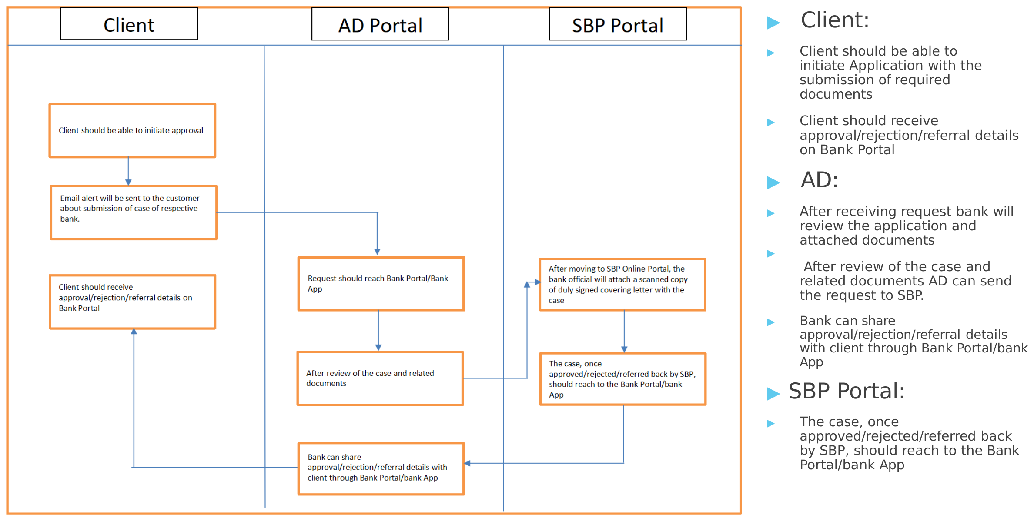
BUSINESS REQUIREMENTS
Process Distribution
FX DIGITALIZATION
19

Slide 20
BUSINESS AREAS & PROCESS
Business Area specifics
Cases pertain to approvals for remittances, policy related approvals
Operations | FE Overdue Monitoring and Enforcement | Government Schemes | F.E. ALLOCATION
Commercial Remittances | Export Overdue Cases | SUGAR | GOVT REMITTANCES
Private Remittances |  | UREA
Bank Guarantees/SBLC |  | WHEAT
Trade Related Cases |  | TEXTILE
Designation & Acknowledgement |  | NON-TEXTILE
Exchange Entitlement Certificate
FX DIGITALIZATION
20

Slide 21
BUSINESS AREAS & PROCESS
Trade Related Cases
Trade Related Cases
Designation & Acknowledgement
Permission for Utilization of Time Barred Advance Payment
IT Related Designation
Royalty & Technical Assistance Agreements
Permission for Refund of Advance Payment
Service Level Agreements signed with the parent company/ related parties abroad
Permission to Return Rejected/Frustrated Cargo
Open Account Imports
FX DIGITALIZATION
21

Slide 22
BUSINESS AREAS & PROCESS
Exchange Entitlement Certificate
Exchange Entitlement Certificate
FE Overdue Monitoring & Enforcement
Loan Related Cases
Export Overdue Cases
Equity Related Cases
Modification in EORS
Closure of E-Form from EORS or WeBOC
Extension in Realization Period of E Forms
Adjustment of Overdue Cases against Advance Payment
Re-Import of Exported Goods
FX DIGITALIZATION
22

Slide 23
BUSINESS AREAS & PROCESS
Government Schemes
SUGAR | UREA | WHEAT | TEXTILE | NON-TEXTILE
Freight Support Against Export of Sugar | Quota Approval against Export of Urea | Subsidy on Export of Wheat | DUTY DRAWBACK OF TAXES 16-17 | Drawback of Levies and Local Taxes Order 2017
Quota Approval against Export of Sugar | Ammendments in Already Approved Quota against Export of Urea |  | DUTY DRAWBACK OF TAXES 17-18 | Local Taxes and Levies Drawback 17-18
Ammendments in Already Approved Quota against Export of Sugar
FX DIGITALIZATION
23

Slide 24
BUSINESS AREAS & PROCESS
F.E. ALLOCATION
Govt Remittances
GOVT REMITTANCES
FE Allocation Import
FE Allocation Remittance of PSEs
FE ALLOCATION Remittance of Classified Organizations
FE ALLOCATION FE PERMITS
FE ALLOCATION LOAN REPAYMENT
FE ALLOCATION Remittance of Armed Forces
FE ALLOCATION Fresh Imports
FX DIGITALIZATION
24

Slide 25
BUSINESS AREAS & PROCESS
Case Submission Form
Department (Select One): | Foreign Exchange and Operations Department (FEOD)
Case Category (Select One): | Government Schemes
Case Type (Select One): | Private Remittances
Case Title (Select One): | Other Private Remittance of Chapter 16
Form Fields:
All Required Fields: | As Per Taxonomy Sheet
All Required Documents: | As Per Taxonomy Sheet
FX DIGITALIZATION
25

Slide 26
BUSINESS AREAS & PROCESS
Case Title Required Documents Type & Importance
Required Documents list will be provided by SBP or regulatory compliance of AD and requirements might be different according to the case type.
Example:
Case Title | Required Documents | Type | Importance
Remittances relating to Professional/Consultancy/Advisory Services fee | Input Documents: Applicant Request Agreement. Addendum (if any) Invoice/Debit Note Form “M” Proof of Services Delivered. Advance Payment Undertaking. Finance Division’s letter: FE allocation or NOC Previous SBP Approval. Certificate of Incorporation Pattern of Share Holding Tax Exemption Certificate Travelling Documents Any Other Documents | PDF PDF PDF PDF PDF PDF PDF PDF PDF PDF PDF PDF PDF ANY | Mandatory Mandatory Optional Mandatory Mandatory Optional Optional Optional Optional Optional Optional Optional Optional Optional
 | Output Documents: - FEOD-SBP(BSC) Approval Letter
FX DIGITALIZATION
26

Slide 27
BUSINESS AREAS & PROCESS
Commercial Remittances Data Fields
Applicant / Beneficiary Fields
Transaction Fields
Approval Fields
Field Name
Requested Amount
SBP Approval No & Date
Applicant's Name
Form M No.
Payment Plan for Remaining
NTN
Purchase Order No & Date (if
any)
Services available Locally
Address
Amount of PO
Justification for hiring Foreign Service provider.
Brief Profile
Invoice No & Date
Applicable Tax Rate
Email ID
Amount of Invoice
Tax will be borne by
Ownership Structure
Purpose of Agreement
Reference of FE Instruction
Beneficiary Name
Validity Period of Agreement
Recommendation of AD
Address
Details of Addendum (If any)
Waiver/Special Permission.
Country
Nature and Scope of Services
Brief Profile
Reference of Clause of
Agreement
Email ID
Total Contract Amount
Ownership Structure
Reference of Clause
Relationship B/W Applicant and Beneficiary
Payment Terms
Currency
Total Amount Remitted till date (if any)
FX DIGITALIZATION
27

Slide 28
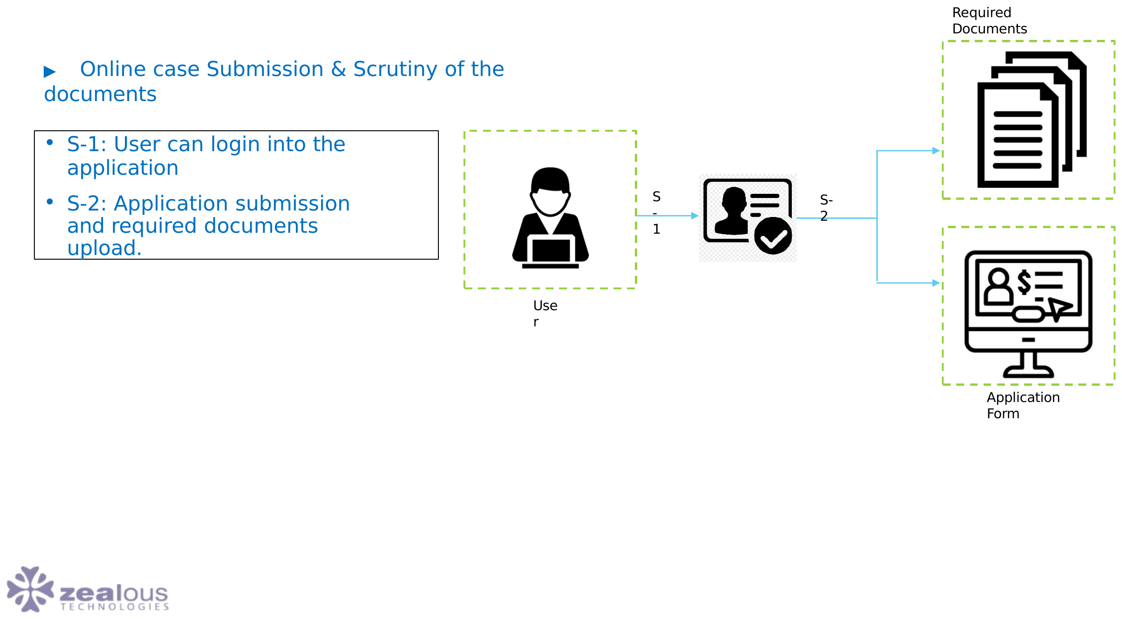
BUSINESS AREAS & PROCESS
Step 1
FX DIGITALIZATION
28

Slide 29
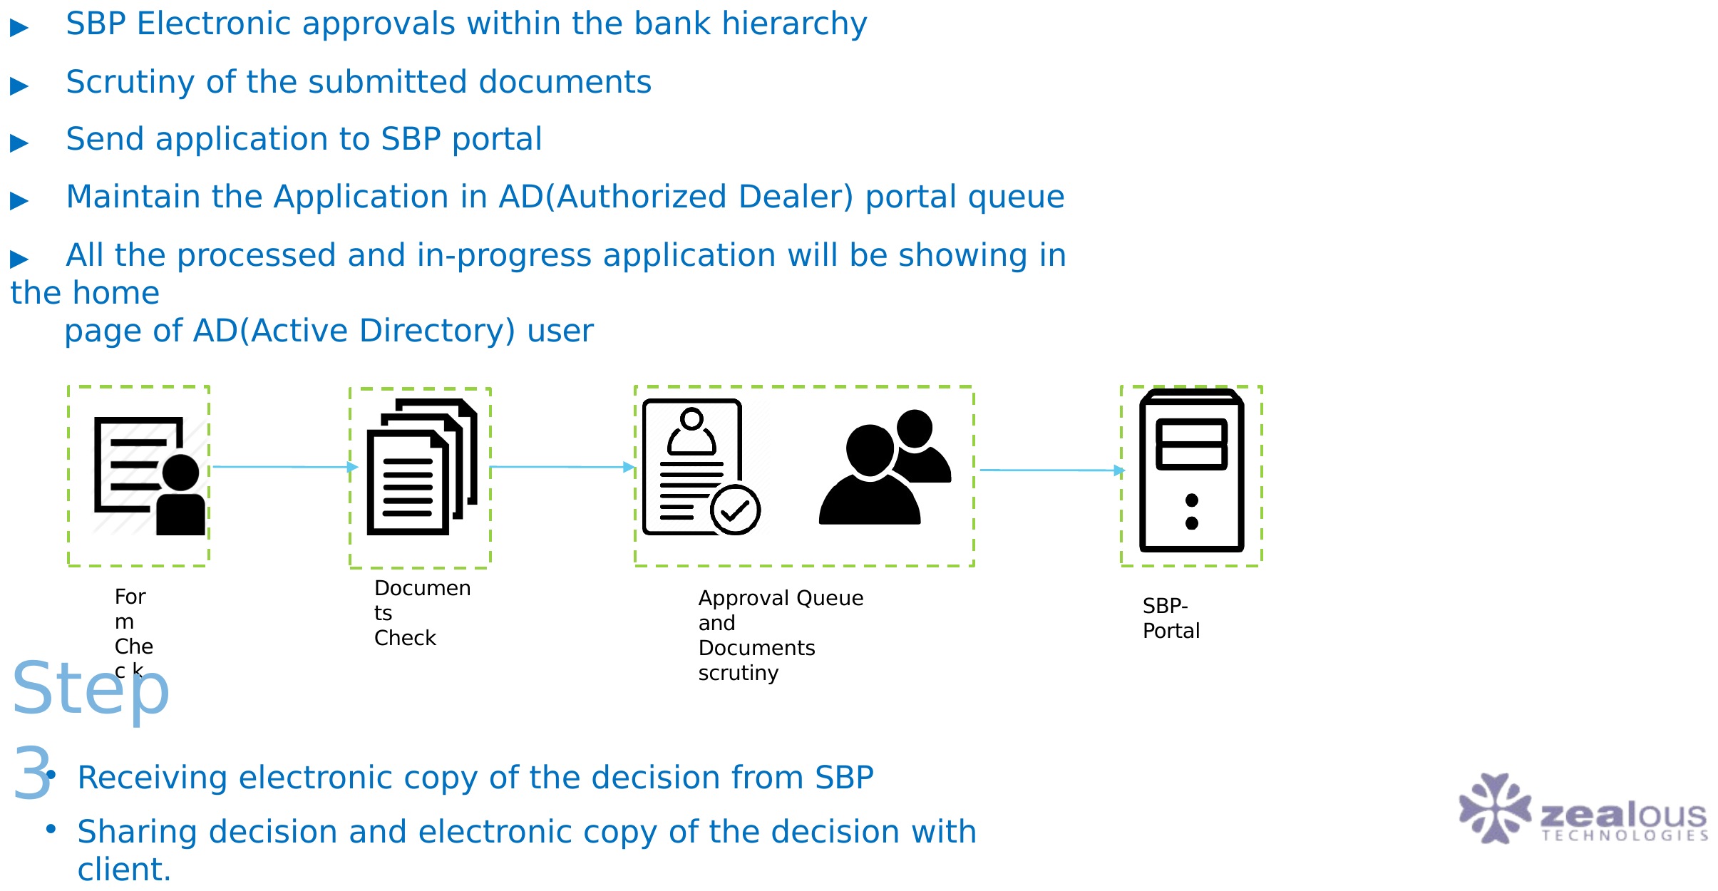
BUSINESS AREAS & PROCESS
Step 2
FX DIGITALIZATION
29

Slide 30
SYSTEM REQUIREMENTS
User Requirements
Bank – Administrator
User Profile (Setup)
Bank – Maker
Bank – Authoriser
Bank – View
Client – Maker
Client – Authoriser
Client – View
FX DIGITALIZATION
30

Slide 31
SYSTEM REQUIREMENTS
Data Domain - Content and Purpose
Complete case detail and purpose of payment
Complete documents based on the checklist and attached by client based on purpose of payment
Client and their counter party information
Product and supporting data / documents which would be submit to SBP/SBP BSC
Access Management in term off Admin activity to add / delete / amend users
User profile (Maker / Checker) would be required for User setup and customer setup prospective
Maker profile to perform maker activity based on profile rights
Checker profile to perform checker activity based on profile
FX DIGITALIZATION
31

Slide 32
SYSTEM REQUIREMENTS
Authentication and Single Sign On
Bank ID must be used for authentication, where technically possible. In other cases, there must be a way to identify the Bank ID of the individual who owns the account (user id) used for authentication throughout the lifecycle of the underlying process or transaction.
FX DIGITALIZATION
32

Slide 33
SYSTEM REQUIREMENTS
Access Request
A formal request form with an approval workflow must be established to request access to the system. It must identify the Bank ID of the individual who needs access to the system. This form must include the permissions (roles / entitlements) required to access
FX DIGITALIZATION
33

Slide 34
SYSTEM REQUIREMENTS
Requirements TBD-Recovery Expectations
Recovery time (Site Failure] | TBD / NA
Recovery time (Application/Component Failure) | TBD / NA
Data Currency (Best Case) | TBD / NA
Data Currency (Worst Case) | TBD / NA
FX DIGITALIZATION
34

Slide 35
SYSTEM REQUIREMENTS
Backup and Retention
Backup
Expected restoration time
Data Retention and Access
Daily backup retention period
Weekly backup retention period
Monthly backup retention period
Yearly backup retention period
FX DIGITALIZATION
35

Slide 36
SYSTEM REQUIREMENTS
Access, Transaction & Audit Controls
Access Rights Requirements
Audit Trail Requirements
Administrative user will be responsible to add / delete / amend users
Alert / Notification message needs to be reported through email and same needs to be update in system.
User profile (Maker / Checker) would be required for User setup and customer setup prospective
Complete audit trail should be maintained for all activities along with time stamp of relevant actions.
Maker profile to perform maker activity based on profile rights
Checker profile to perform checker activity based on profile
View Profile to only view the information (no access to add/edit/change/delete/extract)
Transaction Controls Requirements
As per each Citibank internal control mechanism.
FX DIGITALIZATION
36

Slide 37
SYSTEM REQUIREMENTS
Performance and Non Functional Requirements
FX digitalization web portal will make sure the following performance related requirement as per the bank standard process and norms.
Volumes
Potential Growth
Performance
Exception Handling
Usability
System Availability
Help and Training
Information Security Requirements
General information Security
Authorization and Access Control
Audit Logging and Alerts
Security Administration
FX DIGITALIZATION
37

Slide 38
SYSTEM REQUIREMENTS
Regulatory, Audit and Data Retention Requirements
Regulatory / Legal Requirements
Data Standards Adoption (Mandatory non functional requirement)
It is the responsibility of each individual bank to consult with their Legal Department regarding compliance of their portal/system with all applicable laws, rules & regulations.
As per SBP guidelines
Data and Document Retention Requirements
As per SBP guidelines
KYC and AML Requirements
As per SBP guidelines
Data Privacy Requirements
As per SBP guidelines
FX DIGITALIZATION
38

Slide 39
SYSTEM REQUIREMENTS
Reports
Users will be allowed to generate a system report of All cases.
Parameters to generate a report can be against a case reference number, base code, time period, queue status and product stream.
Retention period of data to be in line with central bank regulations.
Report to be visible on the system and downloadable in PDF and XLS.
Report to include case history i.e. time stamp of the case moving under each queue, field data and static client data.
Approved / Decline / Under Processing or Scrutiny / Case Ref Number / Client Wise
/ Unit Wise / Year Wise.
FX DIGITALIZATION
39

Slide 40
REPORTING & SPECIFICATION
Application Specification
Microsoft technologies stack based solution
Easy management feature
Monitoring and controlling features
Advanced Reporting dashboard
FX DIGITALIZATION
40

Slide 41
REPORTING & SPECIFICATION
Value Proposed
Providing top quality Integrated transaction posting / data sharing platform
Accessibility to a last-minute data before sharing / submitting to SBP.
Use technology and business practices of banking standards to control and monitor user actions
Offer customized dashboard and reports.
FX DIGITALIZATION
41

Slide 42
REPORTING & SPECIFICATION
Application Operating Models
Complete work flow system requires to be designed from submission of cases by clients to approval from SBP/SBPBSC and interim management thereof
Search
Reporting
Monitoring Options
FX DIGITALIZATION
42

Slide 43
REPORTING & SPECIFICATION
Project Delivery Plan
Project Elicitation
FSD preparation against BRD
Project plan
Share wireframes of the UI and work flow
Development
Dev Testing
BA Testing
Demo
Deployment UAT
Bug Fix
Production Deployment
Support
FX DIGITALIZATION
43

Slide 44
REPORTING & SPECIFICATION
Development Methodology
Agile:
Proposed solution will be developed using Agile manifesto.
Iterative or agile life cycles are composed of several iterations or incremental steps towards the completion of a project. Iterative approaches are frequently used in software development projects to promote velocity and adaptability since the benefit of iteration is that we can adjust as we go along rather than following a linear path. One of the aims of an agile or iterative approach is to release benefits throughout the process rather than only at the end. At the core, agile projects should exhibit central values and behaviors of trust, flexibility, empowerment and collaboration.
FX DIGITALIZATION
44

Slide 45
REPORTING & SPECIFICATION
Considering the Agile Manifesto outlines 4 Core Values
1. Individuals and interactions over processes and tools
2. Working software over comprehensive documentation
3. Customer collaboration over contract negotiation
4. Responding to change over following a plan
FX DIGITALIZATION
45

Slide 46
REPORTING & SPECIFICATION
Key components of Agile project.
User stories
Put simply, a user story is a high-level definition of a work request. It contains just enough information so the team can produce a reasonable estimate of the effort required to accomplish the request. This short, simple description is written from the user’s perspective and focuses on outlining what your client wants (their goals) and why.
Sprints
Sprints are a short iteration, usually between one to three weeks to complete, where teams work on tasks determined in the sprint planning meeting. As we move forward, the idea is to continuously repeat these sprints until your product is feature ready. Once the sprint is over, we review the product see what is and isn’t working, make adjustments, and begin another sprint to improve the product or service.
Agile board
An Agile board helps your team track the progress of the project. This can be a whiteboard with sticky notes, or a function within project management software.
Backlog
FX DIGITALIZATION
46
As project requests are added through your intake system, they become outstanding stories in the backlog. During Agile planning sessions, our team will estimate story points to each task. During sprint planning, stories in the backlog are moved into the sprint to be completed during the iteration. Managing the backlog is a vital role for project managers in an Agile environment.

Slide 47
REPORTING & SPECIFICATION
Documentation & Responsibilities
Pha se | Docume nts | Responsibil ity
Project Initiation | Project Charter Project Plan | IX
Operational Analysis Solution Design | Functional Design User Responsibility Matrix | IX
Training | Train the Trainer – Super Users User Manual (UPKs) – End users | IX
UAT | Test Scripts | IX
Go-Live | System Setup | IX
FX DIGITALIZATION
47

Slide 48
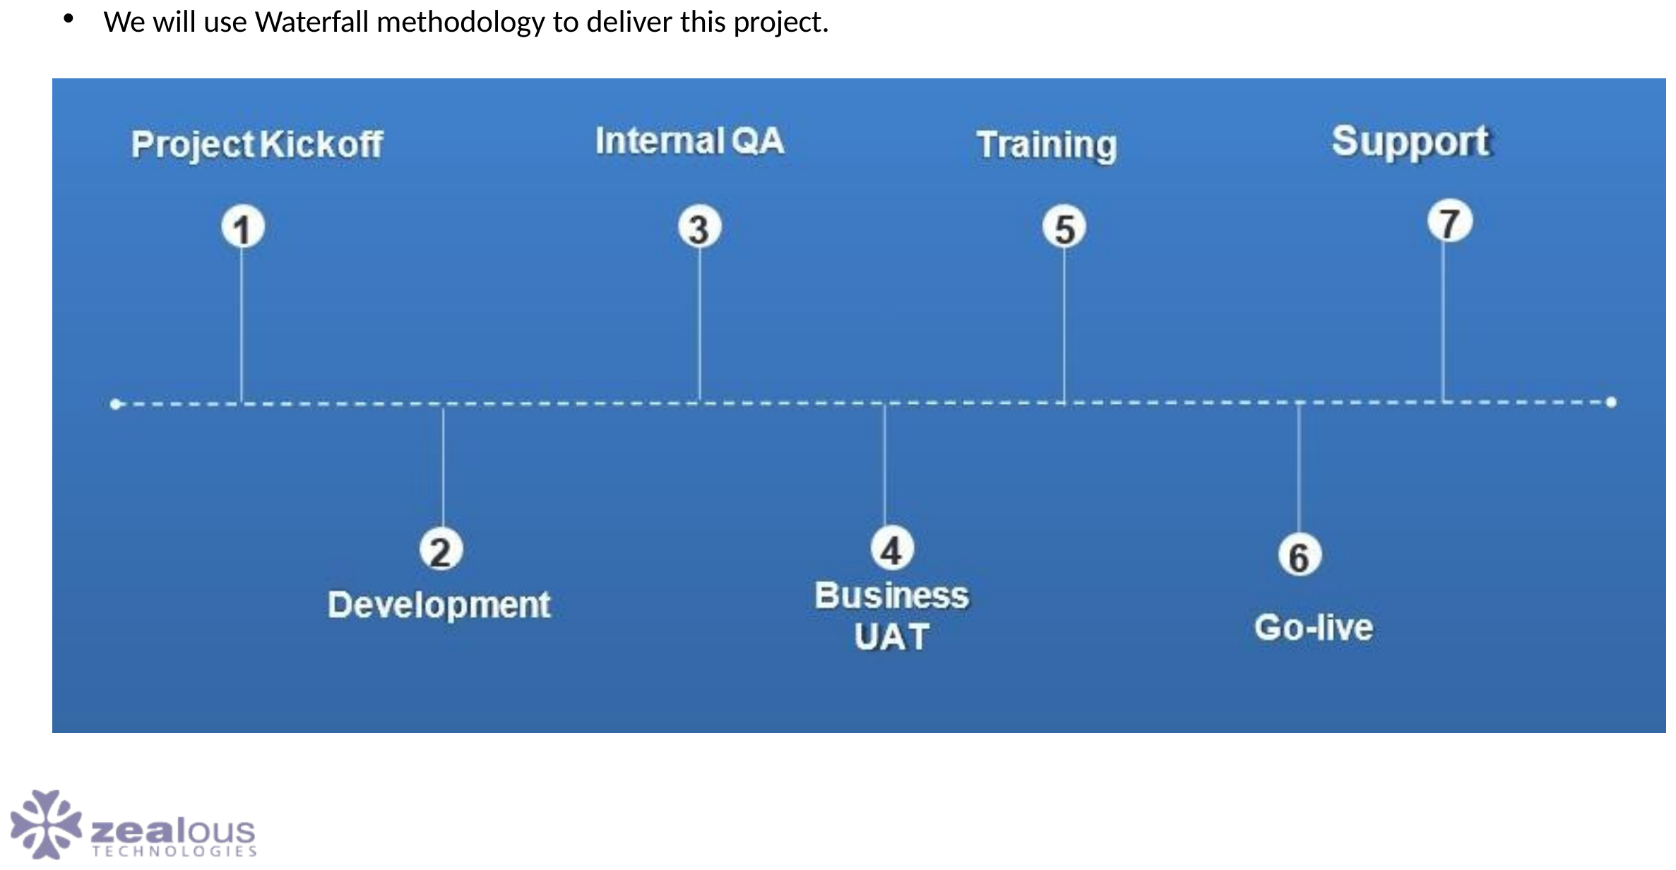
PROJECT DELIVERY
Project Delivery Process
FX DIGITALIZATION
48

Slide 49
PROJECT DELIVERY
Delivery Team
Project Management
Development
Project Manager
Sr. Software Engineers
UI / UX
Jr. Software Engineers
Front-End Developers
Jr. Software Engineers
DevOps Architect
QA
FX DIGITALIZATION
49

Slide 50
PROJECT DELIVERY
General Assumptions
The standard business flows and product features will serve as the base for the implementation
The implementation is based on-perm
The project would be executed in an on-site / off-site model
A comprehensive list of assumptions and final timeline & estimates will be provided after a due scoping exercise
UAT & Production servers should be provided by the bank
Any new requirement after the scope if locked will be considered as change request
Citibank local CTI responsible for the infrastructure management
FX DIGITALIZATION
50

Slide 51
PROJECT DELIVERY
Hardware Specification
Operating Systems
Software Requirement
Windows Server 2012 SP1 (Full Server or Server Core)
IIS Module
MS SQL 2012 / 2016
Windows Server 2012 R2 (Full Server or Server Core)
Windows Server 2016 (Full Server, Server Core, or Nano Server)
Hardware Environment
Processor:
RAM : 32 GB (minimum), 64 GB (recommended)
Hard disk: up to 600 GB of available space may be required.
FX DIGITALIZATION
51

Slide 52
PROJECT DELIVERY
Specials
Communication through Active Directory
Maker Checker at every level
Email mechanism
User Portfolio Management
10/12 reports minimum (as per requirement)
FX DIGITALIZATION
52

Slide 53

01
Application Flow
FX Web Portal login and administrative setup forms
FX DIGITALIZATION
53

Slide 54
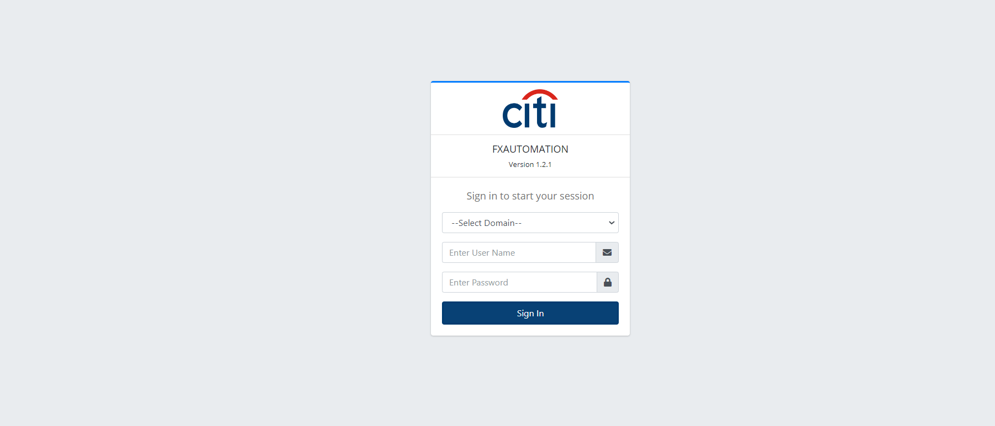
APPLICATION FLOW
FX Web Portal — Login
FX DIGITALIZATION
54

Slide 55
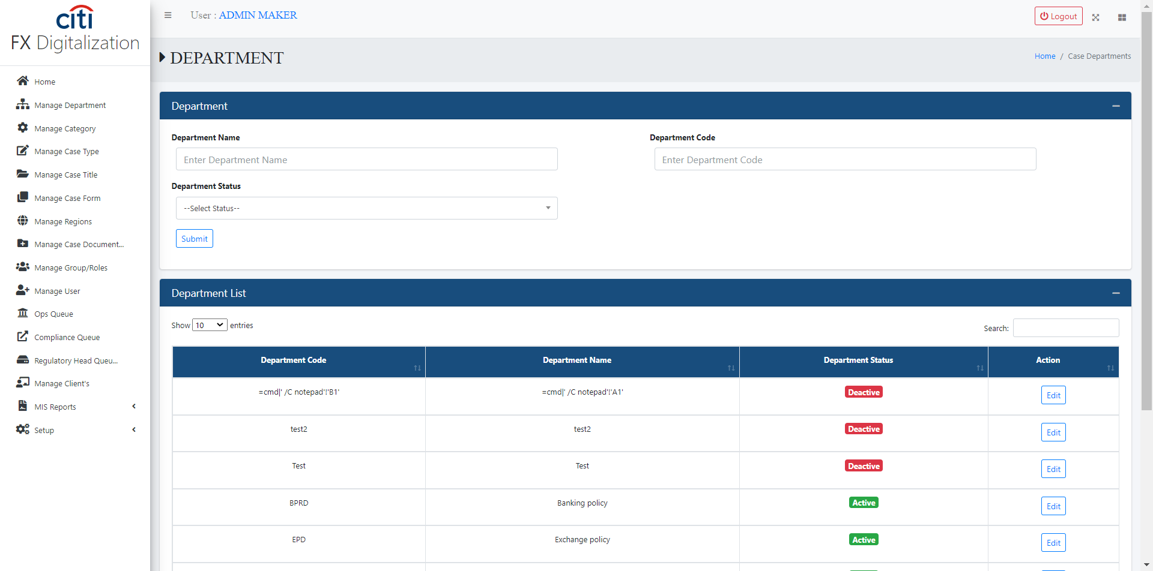
APPLICATION FLOW
Manage Department form
FX DIGITALIZATION
55

Slide 56
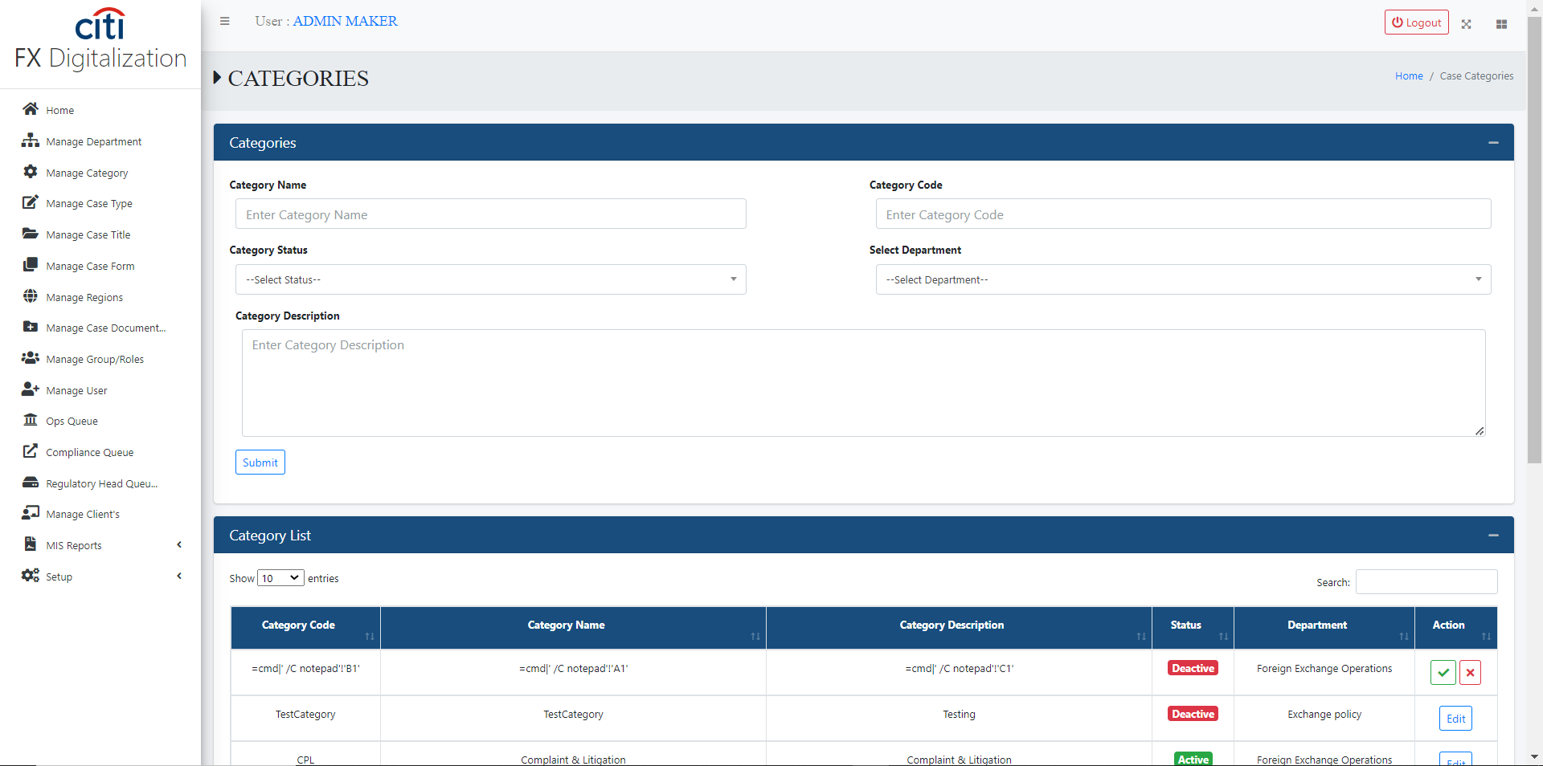
APPLICATION FLOW
Manage Categories form
FX DIGITALIZATION
56

Slide 57
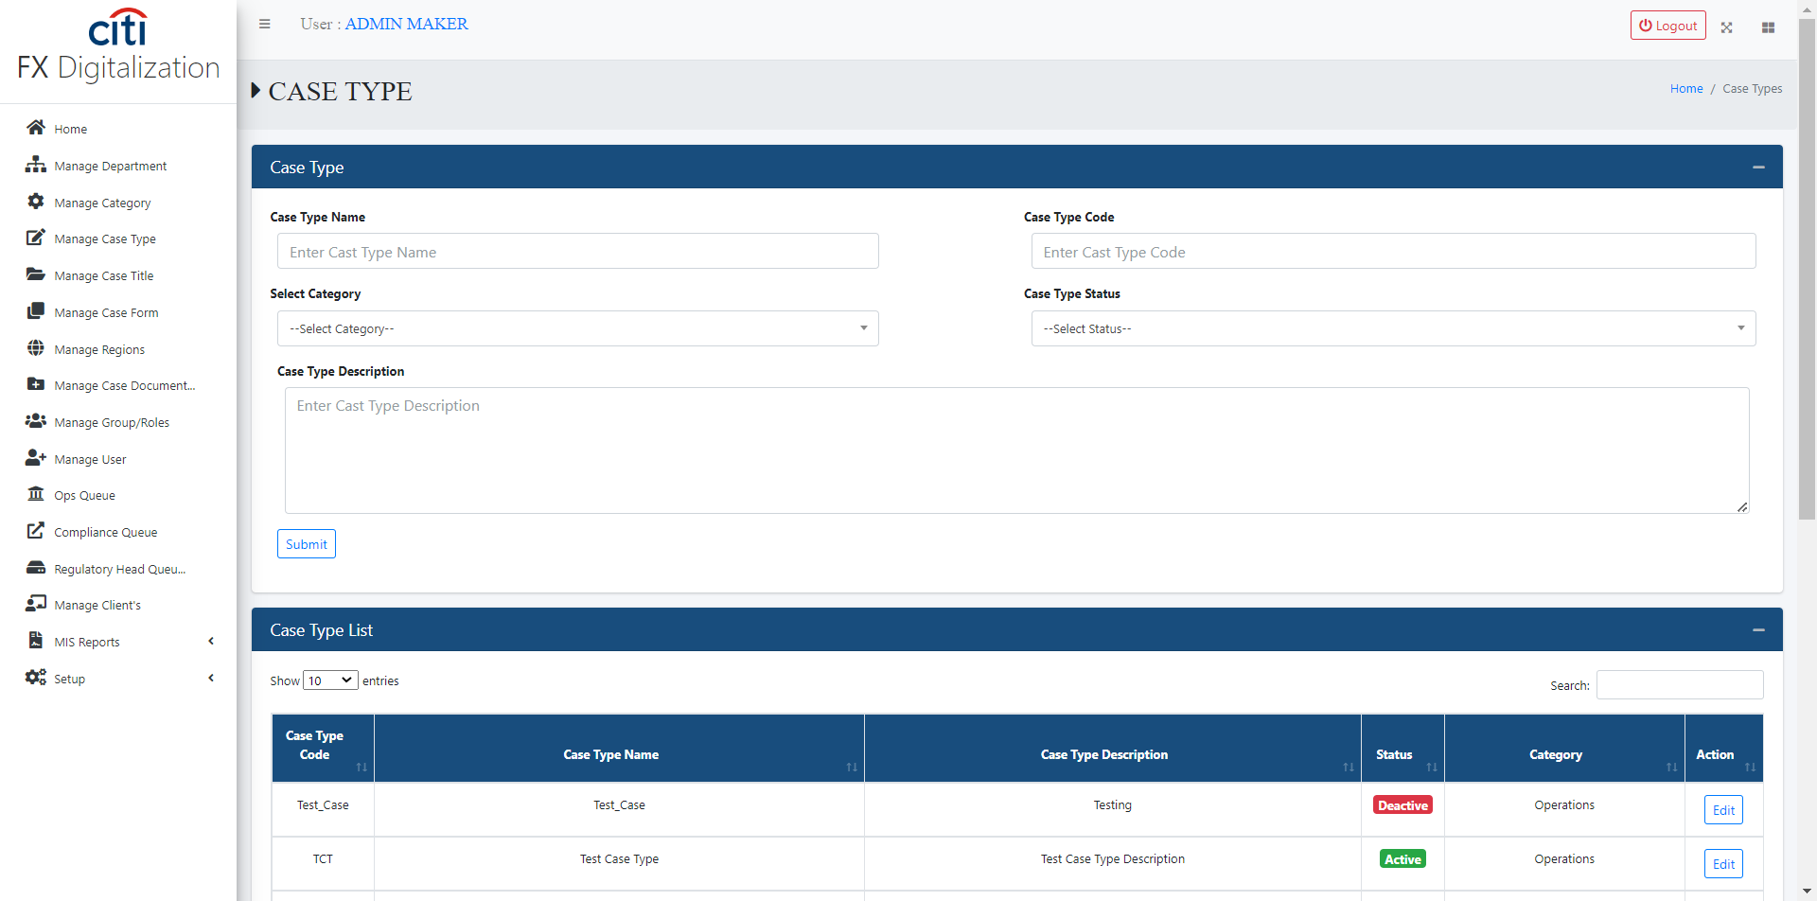
APPLICATION FLOW
Manage Case Type form
FX DIGITALIZATION
57

Slide 58
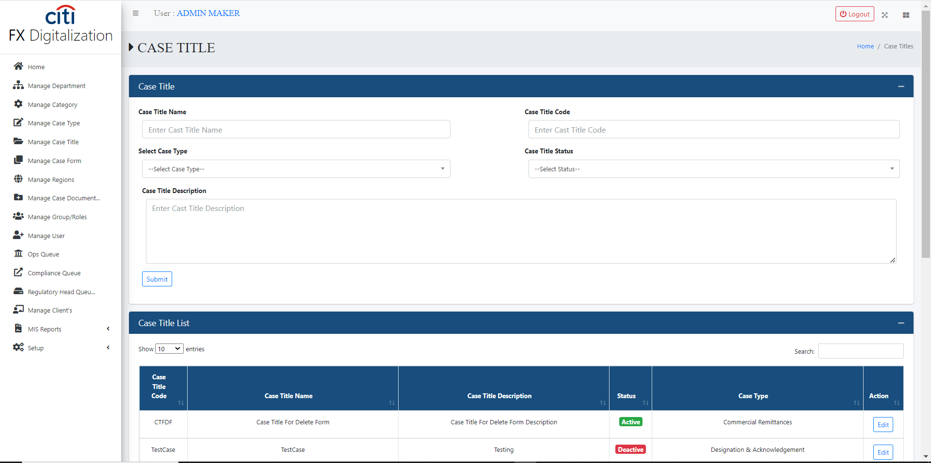
APPLICATION FLOW
Manage Case Title form
FX DIGITALIZATION
58

Slide 59
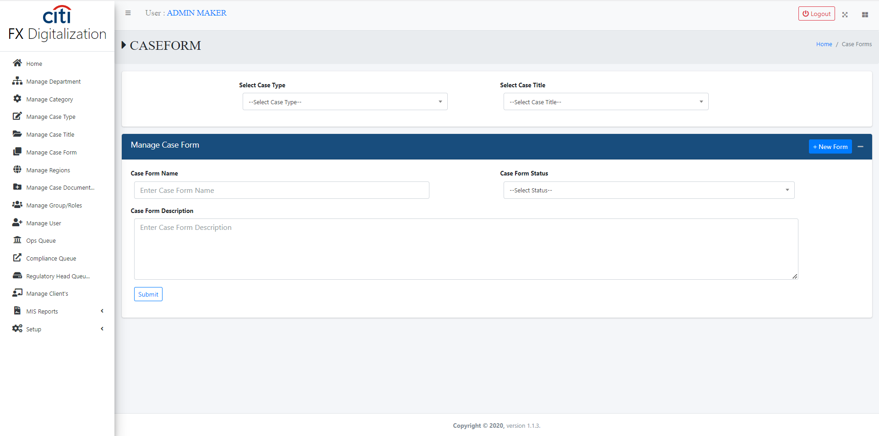
APPLICATION FLOW
Case Form master information form
FX DIGITALIZATION
59

Slide 60
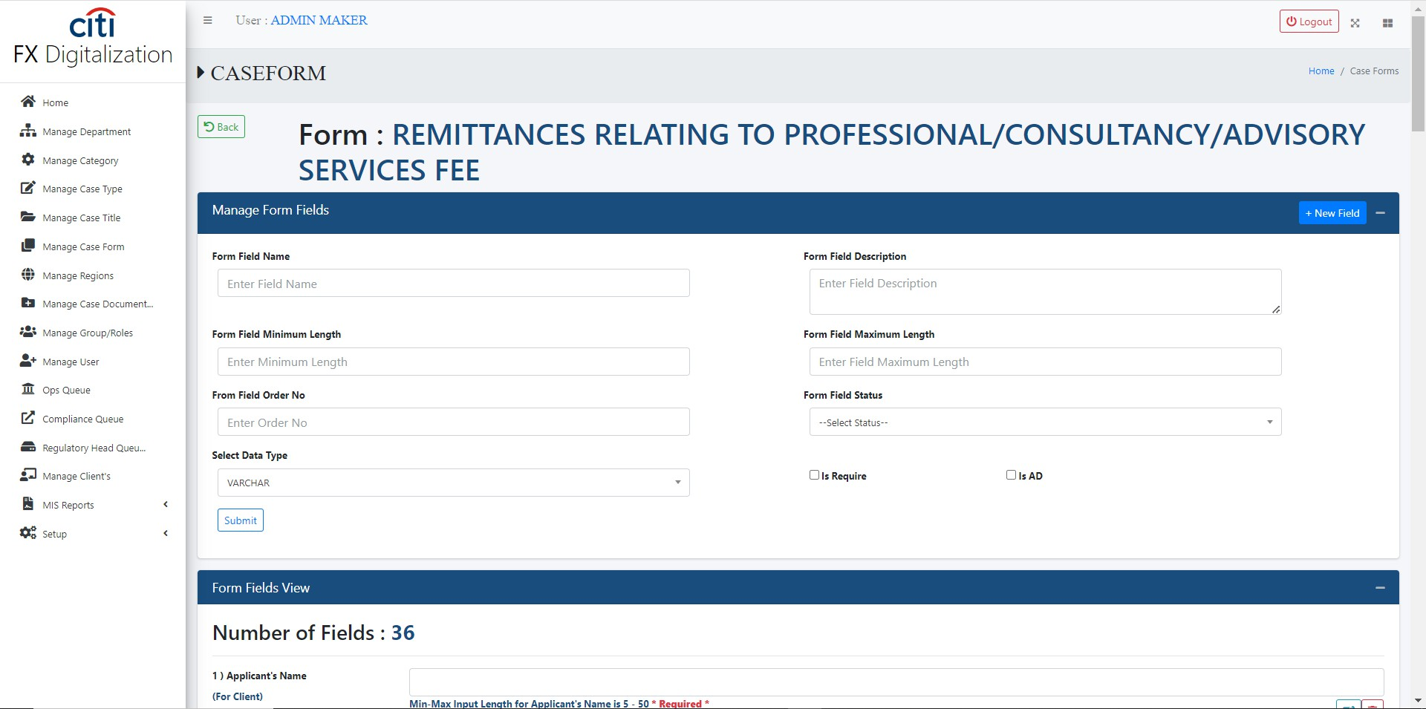
APPLICATION FLOW
Case Form fields form
FX DIGITALIZATION
60

Slide 61
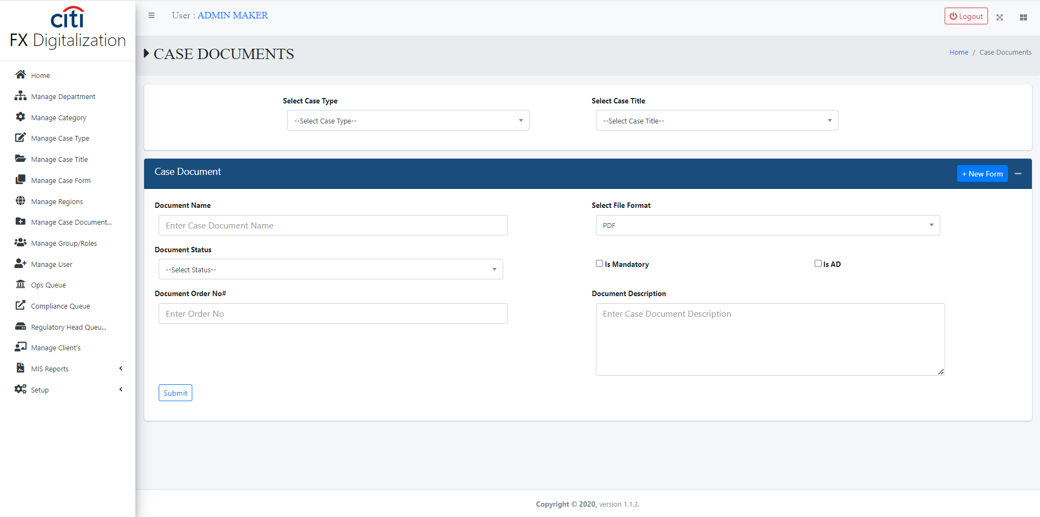
APPLICATION FLOW
Case Form document form
FX DIGITALIZATION
61

Slide 62
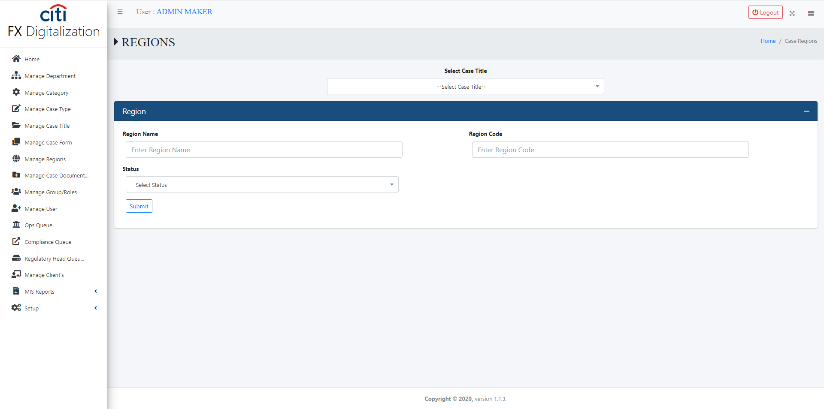
APPLICATION FLOW
Regions form
FX DIGITALIZATION
62

Slide 63
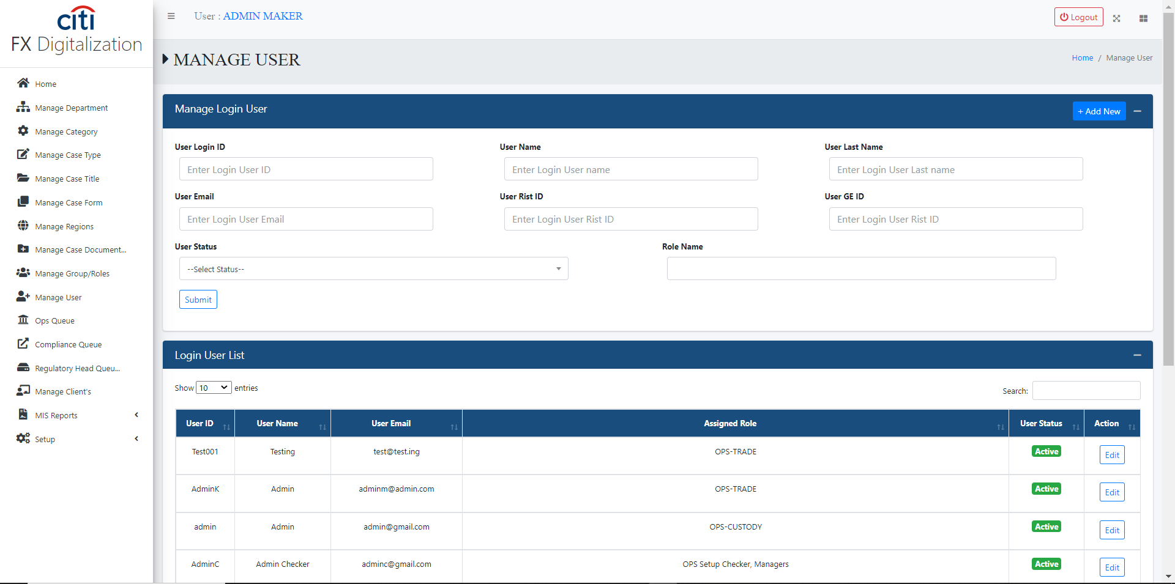
APPLICATION FLOW
User management form
FX DIGITALIZATION
63

Slide 64
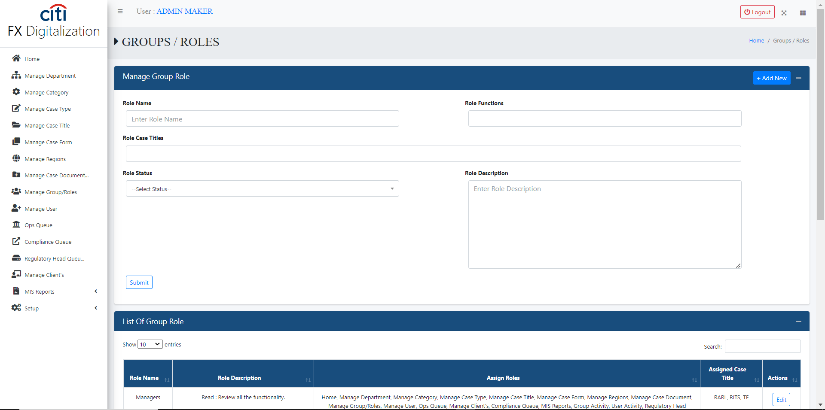
APPLICATION FLOW
Role management form
FX DIGITALIZATION
64

Slide 65
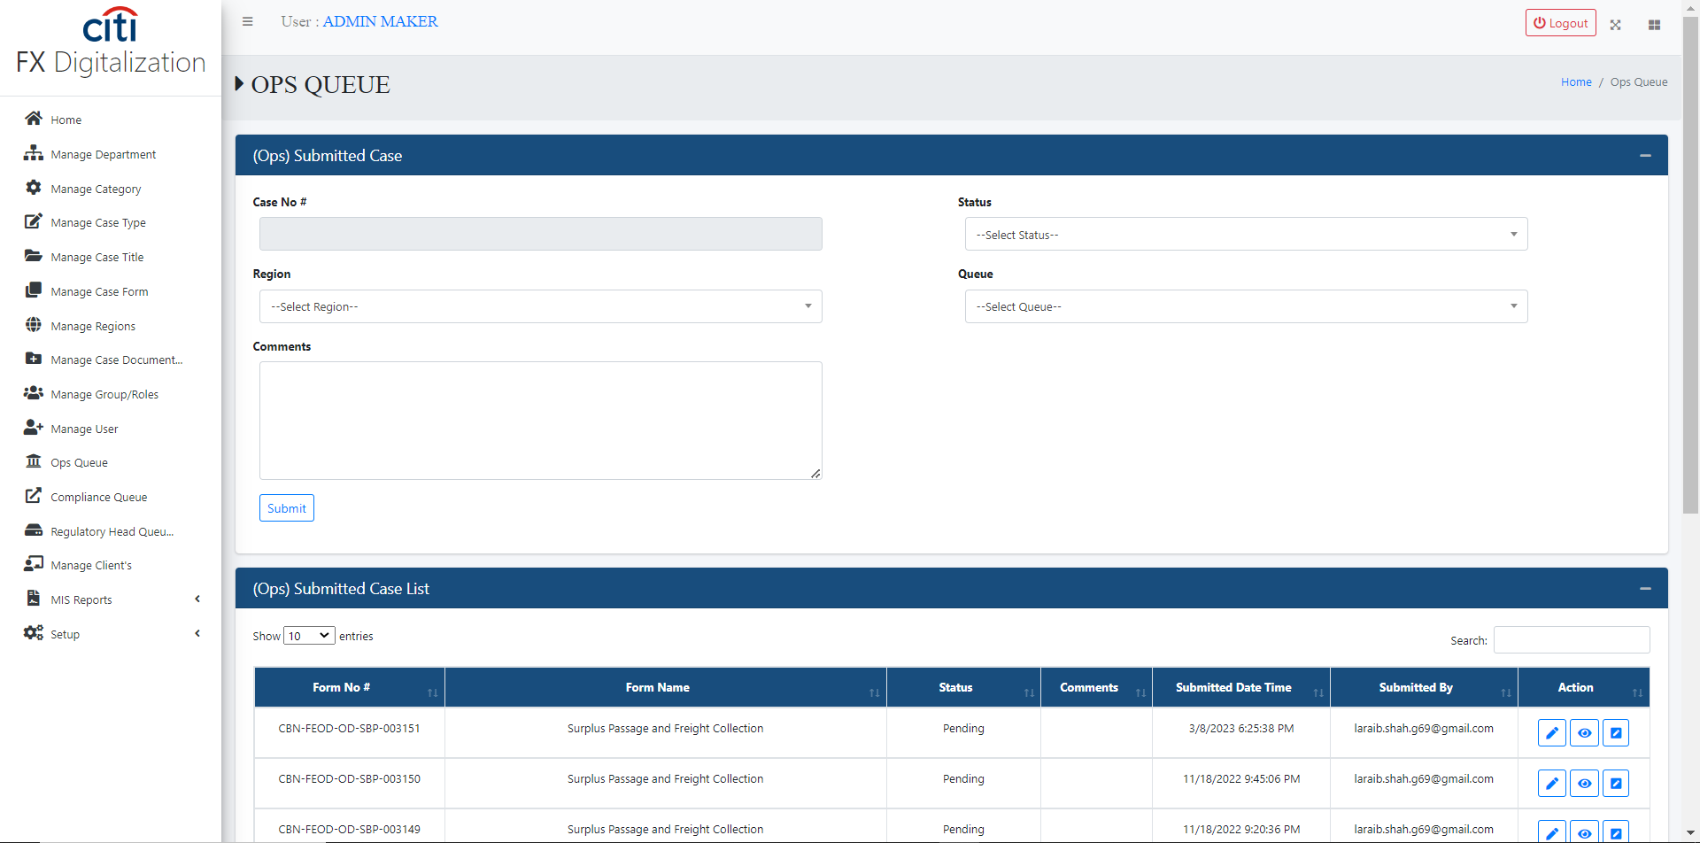
APPLICATION FLOW
Ops Queue cases listed in this form
FX DIGITALIZATION
65

Slide 66
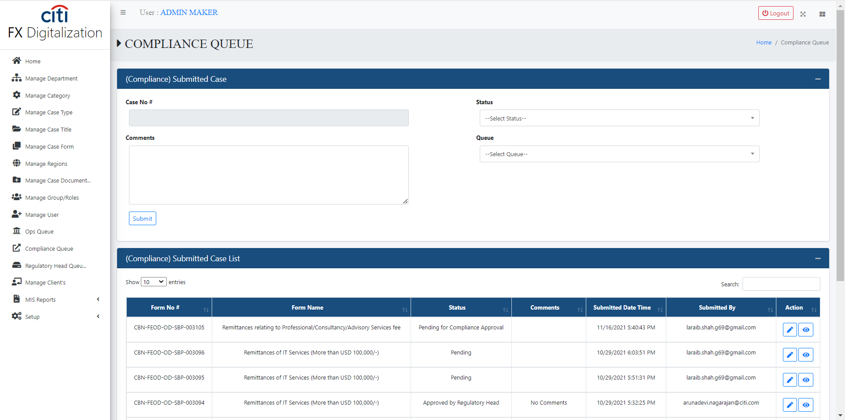
APPLICATION FLOW
Compliance Queue cases listed in this form
FX DIGITALIZATION
66

Slide 67
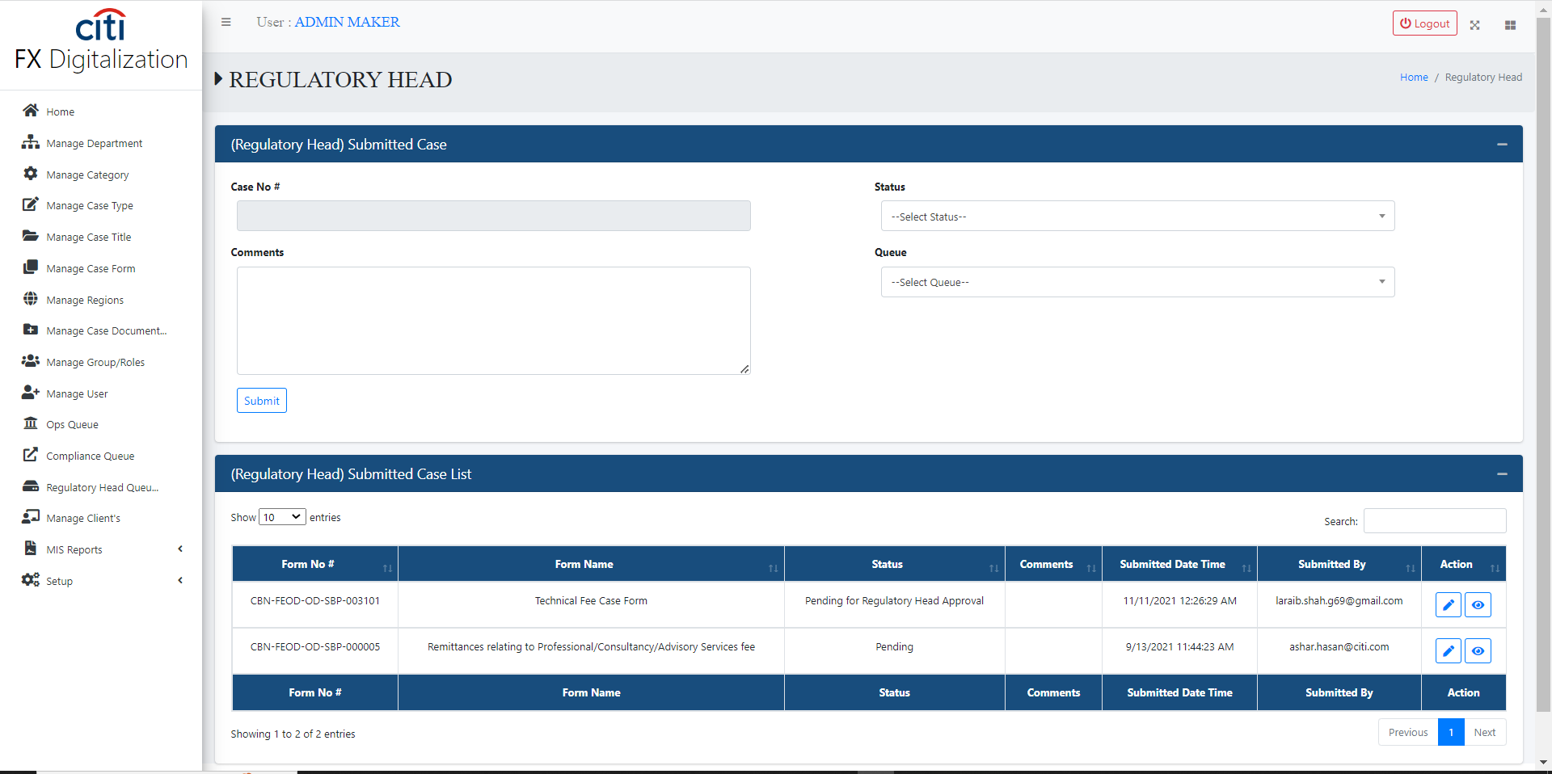
APPLICATION FLOW
Regulatory Queue cases listed in this form
FX DIGITALIZATION
67

Slide 68
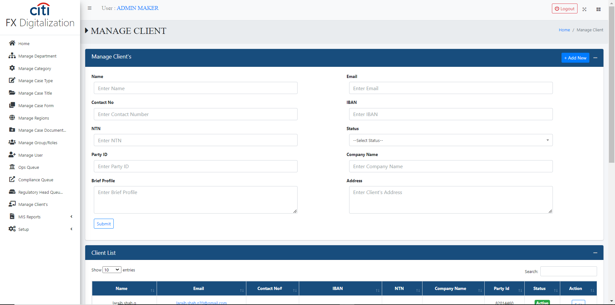
APPLICATION FLOW
Clients management form
FX DIGITALIZATION
68

Slide 69

02
Reports
Group, user, and case activity logs
FX DIGITALIZATION
69

Slide 70
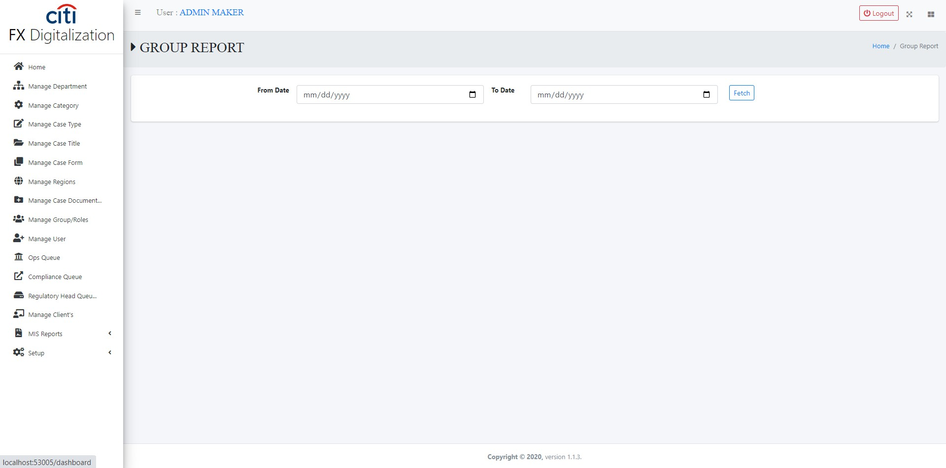
REPORTS
Group activity log report
FX DIGITALIZATION
70

Slide 71
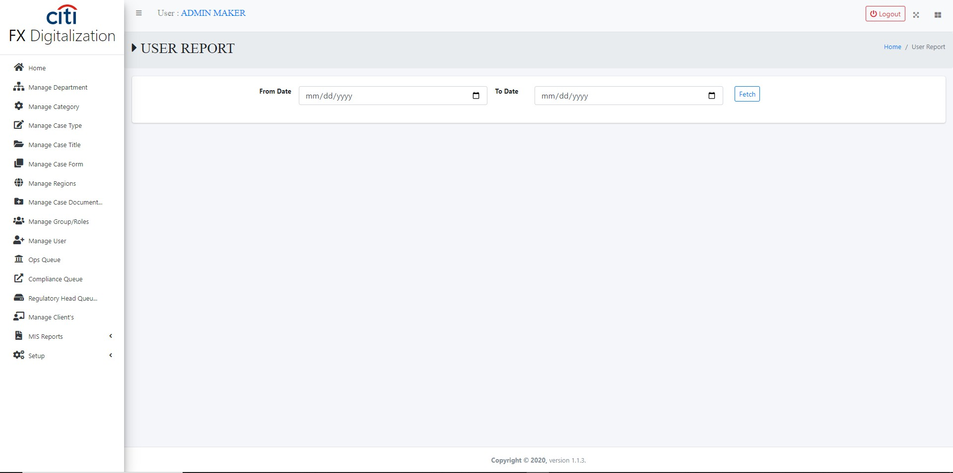
REPORTS
User activity log report
FX DIGITALIZATION
71

Slide 72
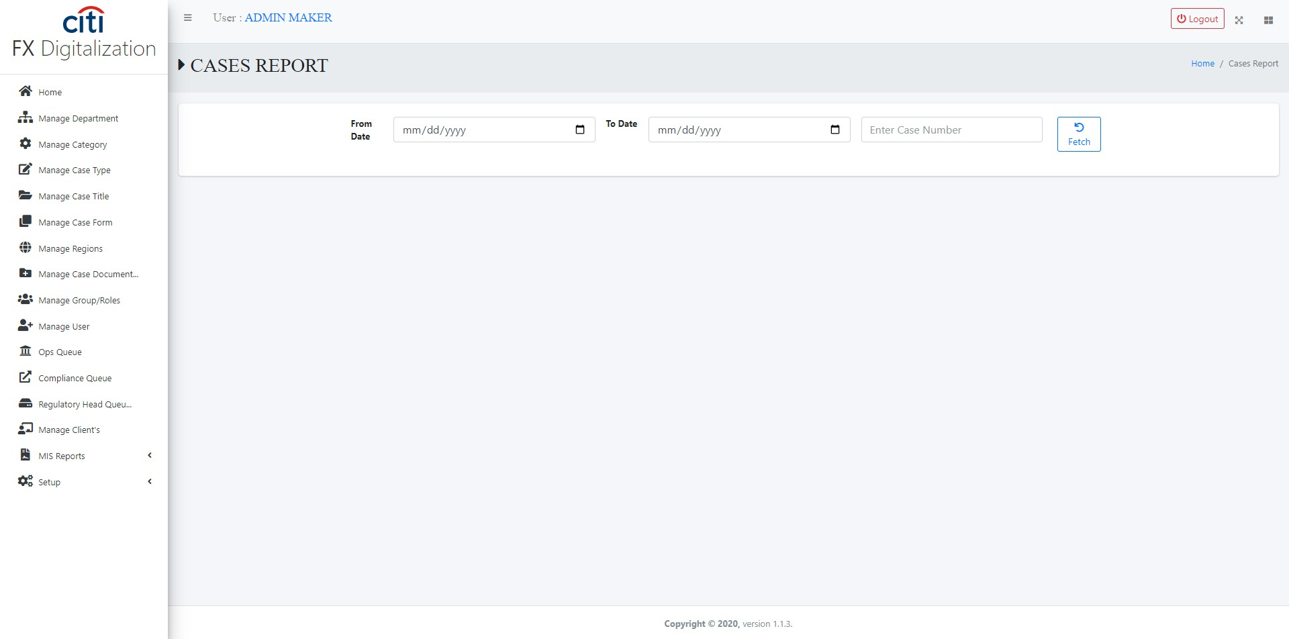
REPORTS
Case activity log report
FX DIGITALIZATION
72

Slide 73
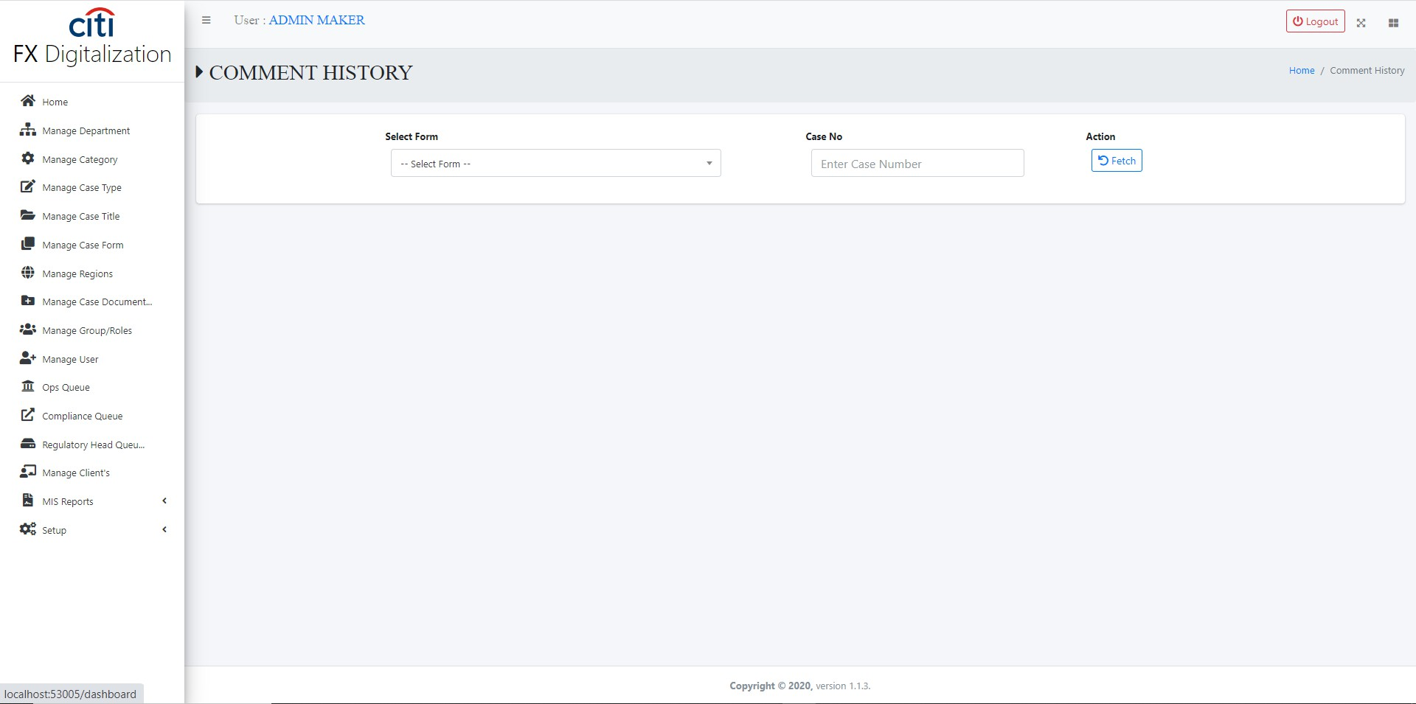
REPORTS
Comments against document report
FX DIGITALIZATION
73

Slide 74
03
Setup Forms
Email and system configuration
FX DIGITALIZATION
74

Slide 75
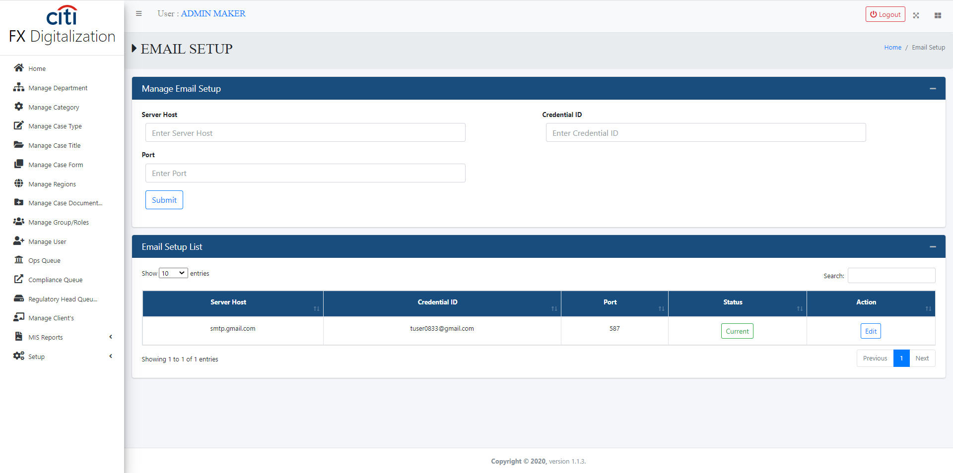
SETUP FORMS
Email setup form
FX DIGITALIZATION
75

Slide 76
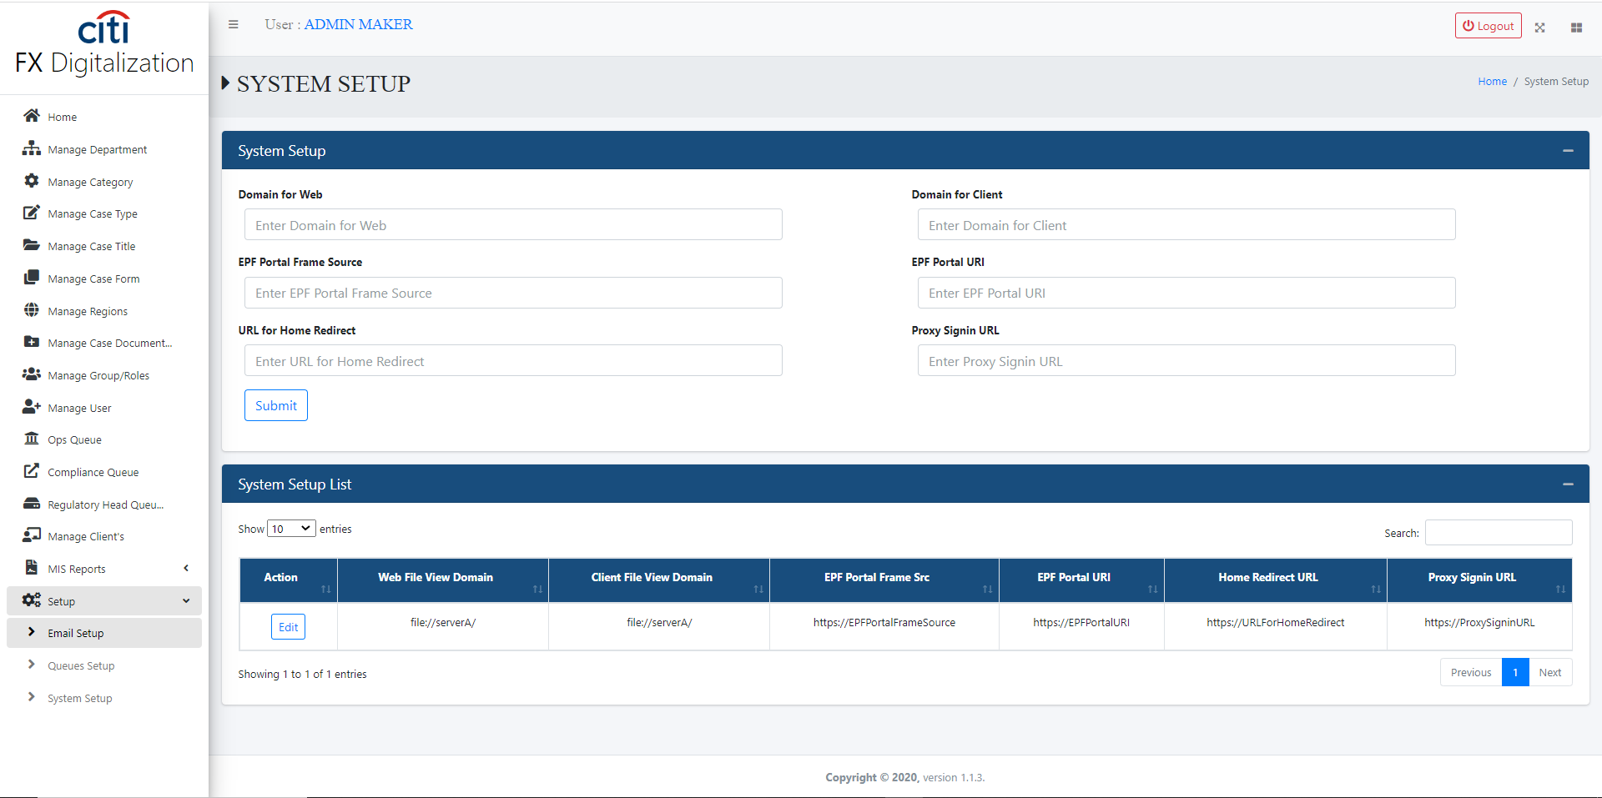
SETUP FORMS
System setup form
FX DIGITALIZATION
76

Slide 77

04
Client Portal
Case submission, drafts, and review screens for bank clients
FX DIGITALIZATION
77

Slide 78
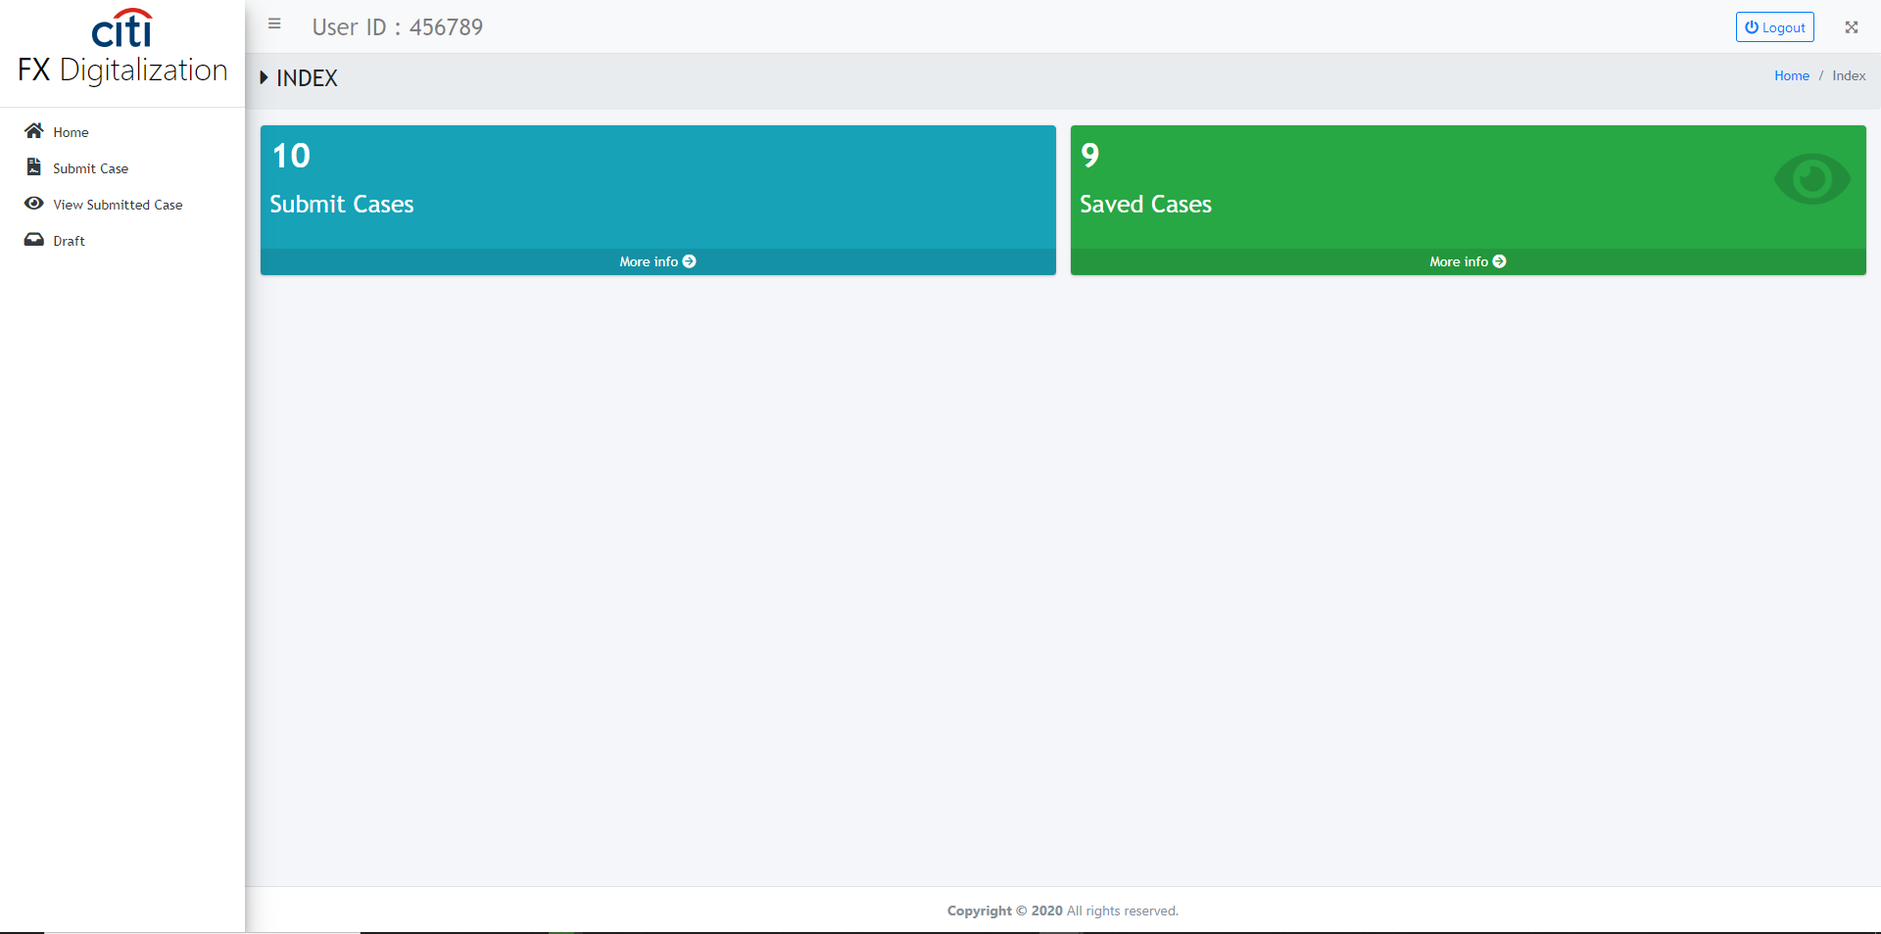
CLIENT PORTAL
Home screen
FX DIGITALIZATION
78

Slide 79
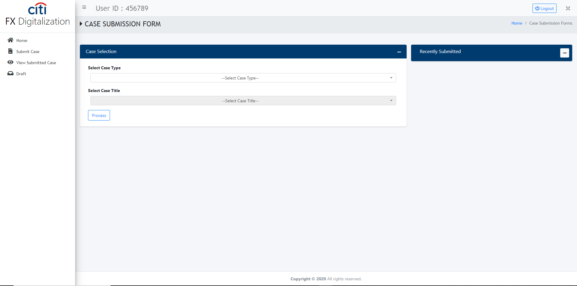
CLIENT PORTAL
Case submit/draft form
FX DIGITALIZATION
79

Slide 80
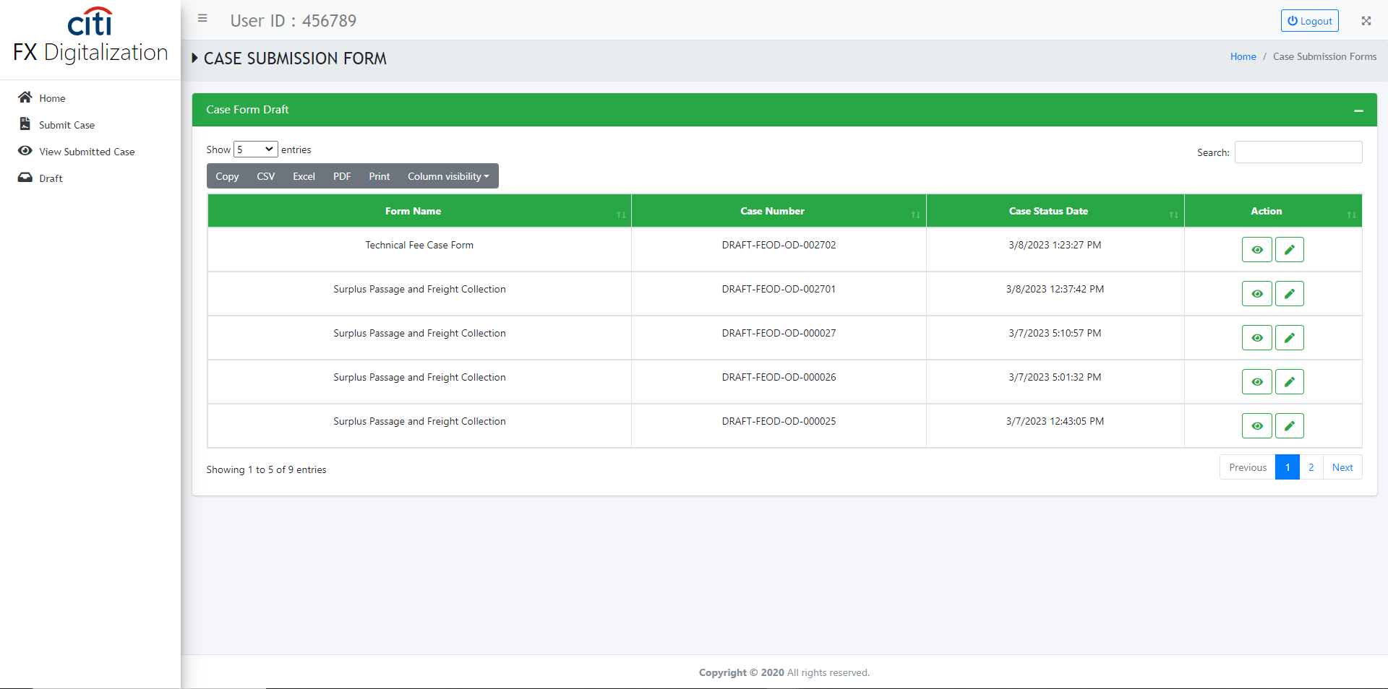
CLIENT PORTAL
Draft case view/edit form
FX DIGITALIZATION
80

Slide 81
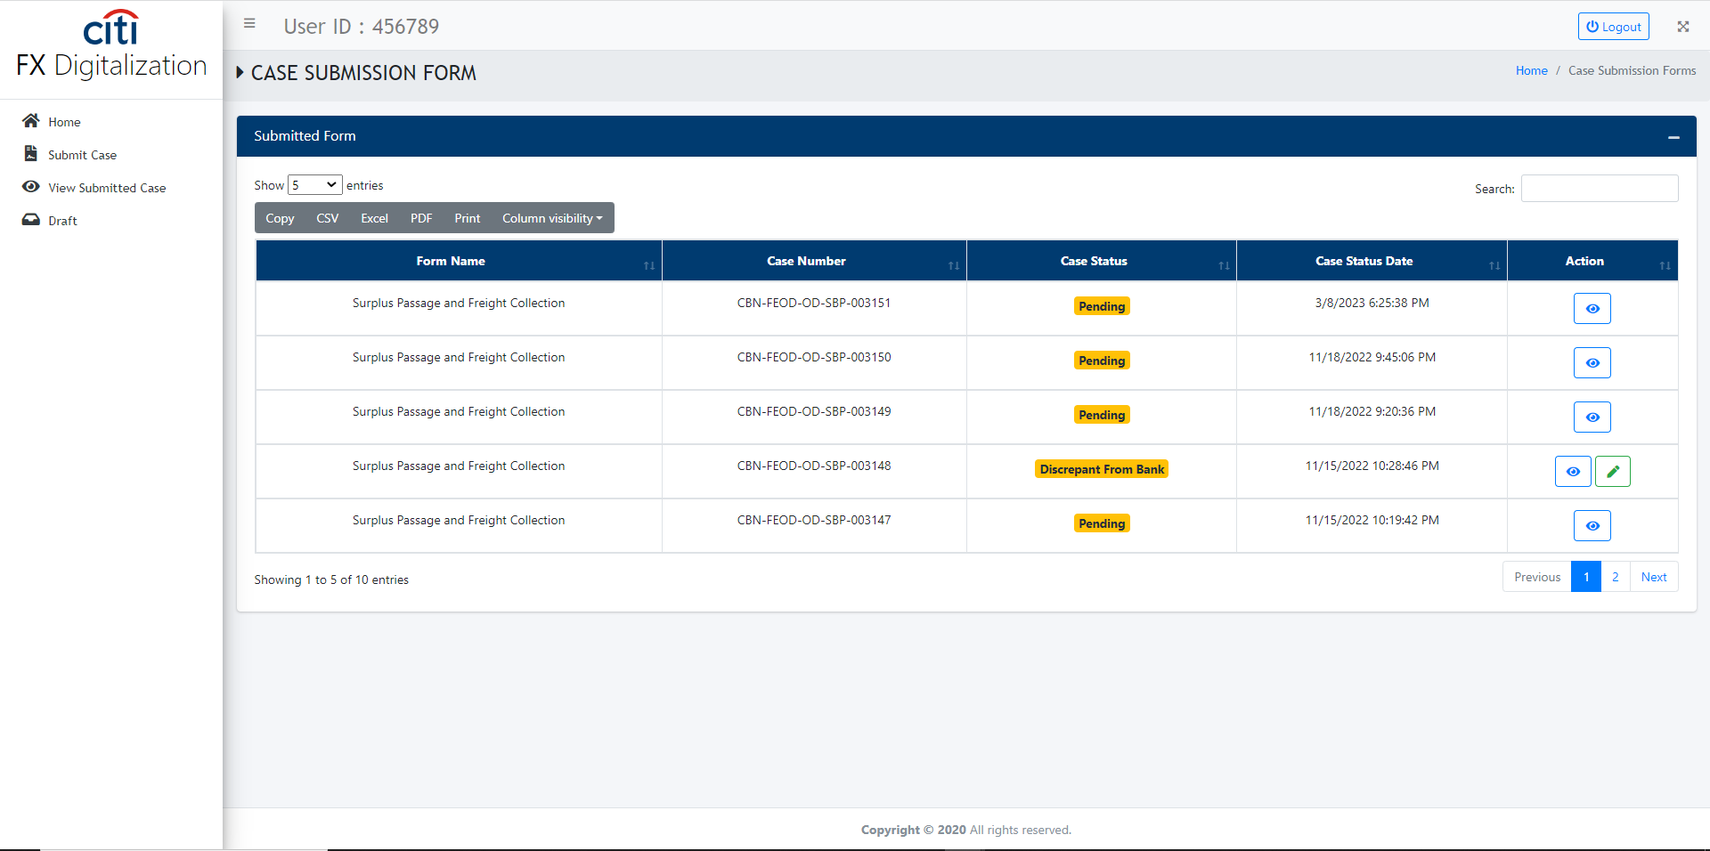
CLIENT PORTAL
Submitted case view/edit form
FX DIGITALIZATION
81

Slide 82
Thank You
Questions & discussion welcome
Developed by Zealous Technologies
zealoustechnologies.com

