Slide 1
ZEALOUS TECHNOLOGIES • PRODUCT OVERVIEW
Export Application
A secure, end-to-end digital platform for export operations, compliance, and reporting
Developed by Zealous Technologies
zealoustechnologies.com

Slide 2



OVERVIEW
Project Summary
Core Platform
Compliance & Workflow
Reporting & Insight
A secure, high-performance platform built on C# and .NET Core that digitizes the bank's export operations end to end — E-Forms, FX bookings, and payments.
Maker-checker approvals, dynamic user management, and configurable setups keep every transaction aligned with SBP regulatory standards.
Real-time MIS, SBP, and operational reports improve turnaround time, transparency, and the overall client experience.
EXPORT APPLICATION
2

Slide 3





CAPABILITIES
Key Functionality
A secure, scalable, and fully compliant digital workflow
Account & Role Management
Flexible Configuration
E-Form Initiation
Manage accounts with roles and maker-checker approvals
Configure currency, export, holiday, scrutiny, and other setups
Initiate and manage E-Forms with integrated authorization
FX & Payment Tracking
Real-Time Reporting
Centralized Dashboards
Track FX bookings and payments end to end
Generate real-time MIS, SBP, and operational reports
Faster approvals and monitoring from one dashboard
EXPORT APPLICATION
3

Slide 4



PLATFORM ENHANCEMENT
New User Creation Module
STEP 1
STEP 2
Dynamic User Creation
Portal Integration
Users can be created and managed through the new proposed dynamic module — replacing the previous static process.
This dynamic user-creation module will be incorporated directly into the Re Import Export Portal.
EXPORT APPLICATION
4

Slide 5






PLATFORM OVERVIEW
System Modules
Ten integrated modules power the complete export lifecycle
Manage Users
Business Partner Setup
Currency Setup
E-Form Setup
Export Setup
Holiday Setup
Scrutiny Setup
Bill Tracking
Transact Report
Internal Reports
EXPORT APPLICATION
5

Slide 6

DEPLOYMENT
Hardware & Software Requirements
Preferable development environment: ASP.NET Core 6.
A Windows Server with IIS Manager installed is required to deploy the ASP.NET Core application.
Application | Specs | OS
Minimum | RAM: 8 GB • Cores: 4 • Storage (SSD): 50 GB | Any
Recommended | RAM: 16 GB • Cores: 8 • Storage (SSD): 50–100 GB | Any
EXPORT APPLICATION
6

Slide 7
01
User & Access Management
Secure sign-on, branches, groups, and application users
EXPORT APPLICATION
7

Slide 8
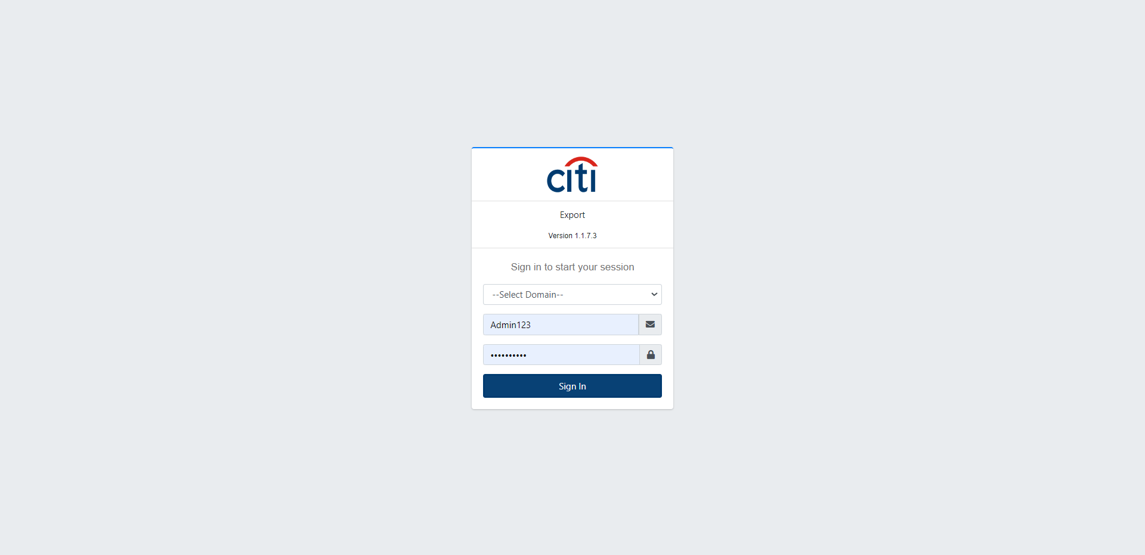

USER & ACCESS MANAGEMENT
Secure Login with SSO
Single Sign-On integration removes the need for manual User ID and password entry, streamlining secure access to the platform for every user.
EXPORT APPLICATION
8

Slide 9
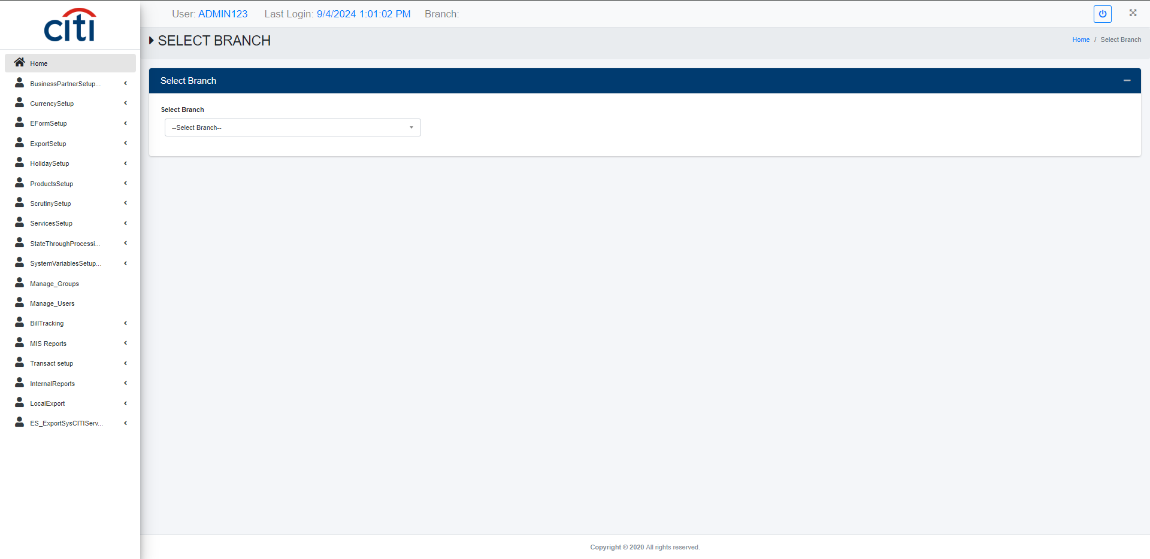
USER & ACCESS MANAGEMENT
Branch Select Form
EXPORT APPLICATION
9

Slide 10
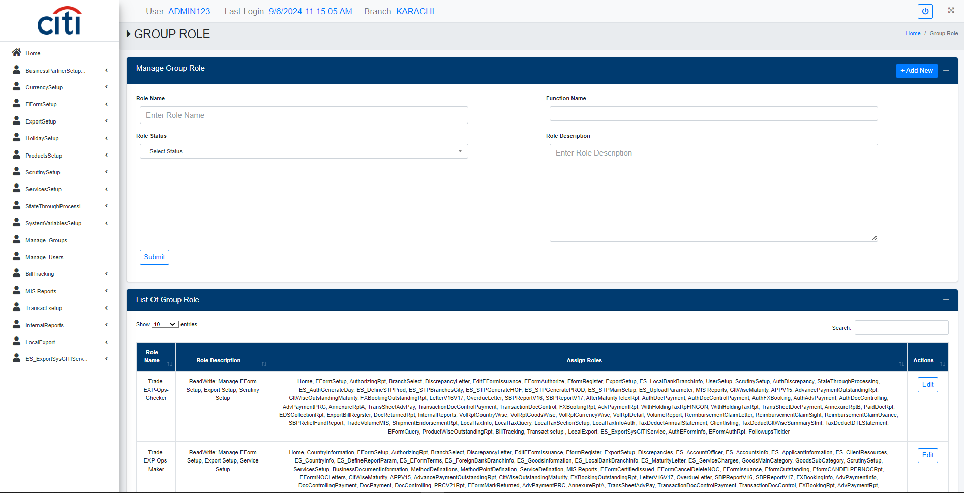
USER & ACCESS MANAGEMENT
Groups creation form which are further assigned to the application users
EXPORT APPLICATION
10

Slide 11
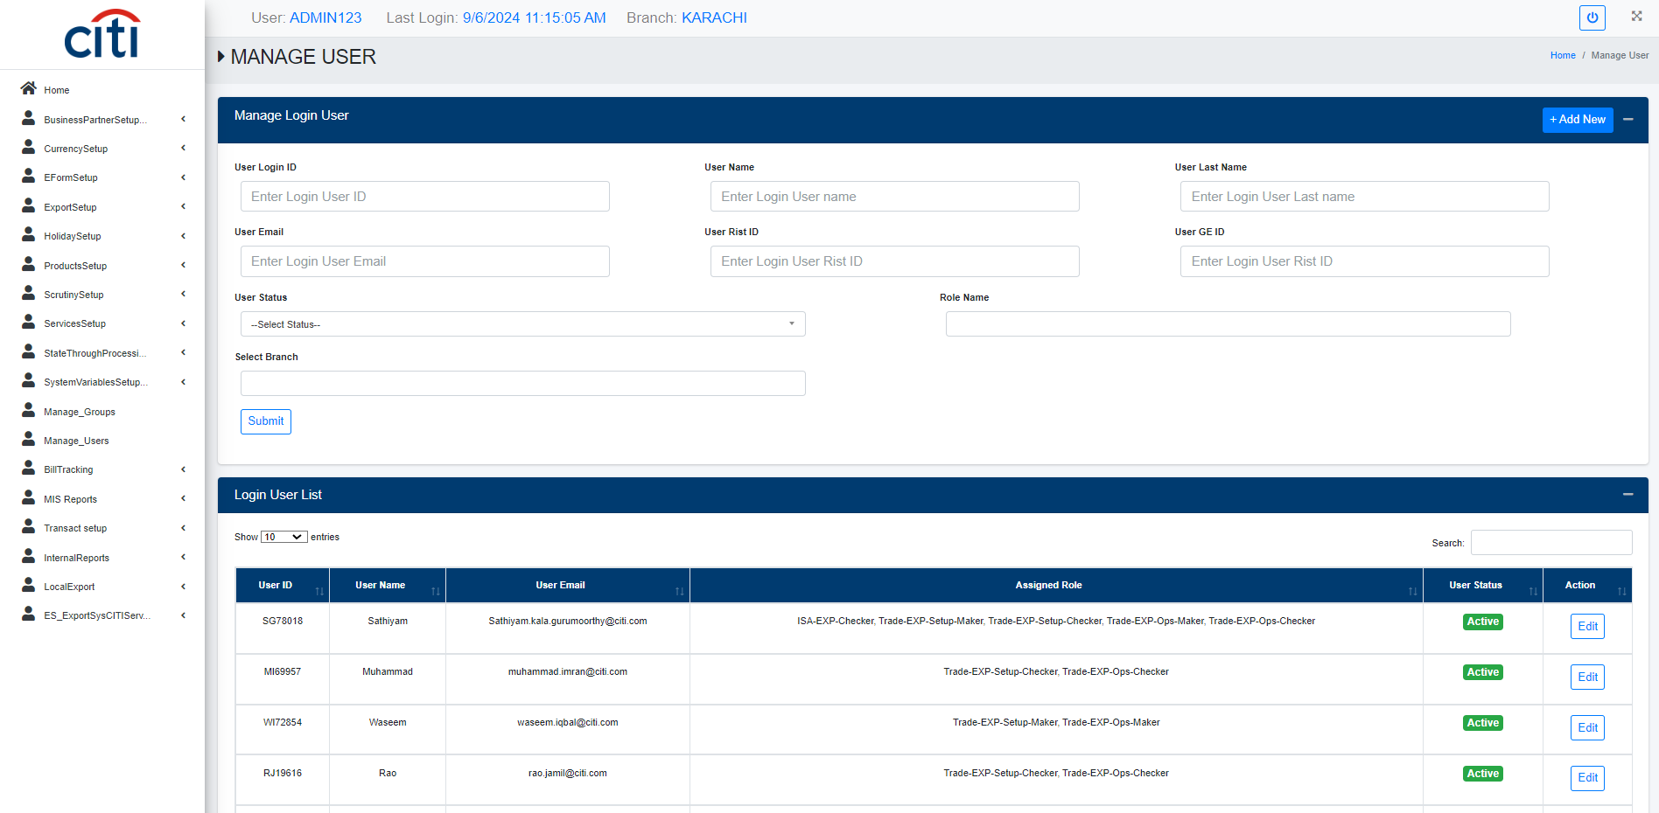
USER & ACCESS MANAGEMENT
Application user creation form
EXPORT APPLICATION
11

Slide 12
02
Business Partner Setup
Reference data for partner types, geography, and classification
EXPORT APPLICATION
12

Slide 13
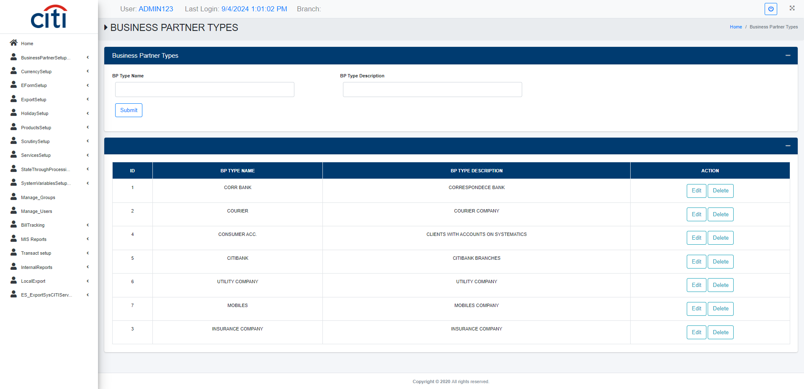
BUSINESS PARTNER SETUP
Business partner types setup form
EXPORT APPLICATION
13

Slide 14
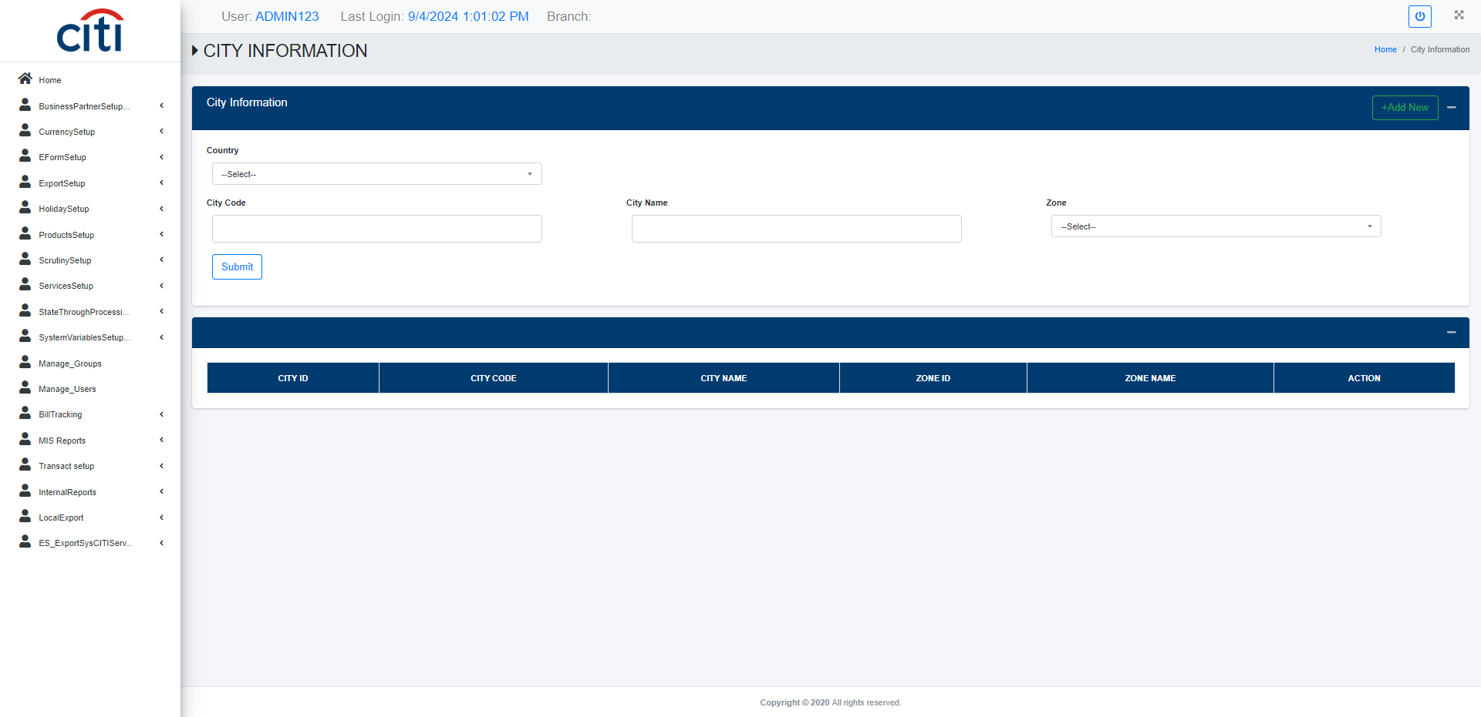
BUSINESS PARTNER SETUP
City information setup form
EXPORT APPLICATION
14

Slide 15
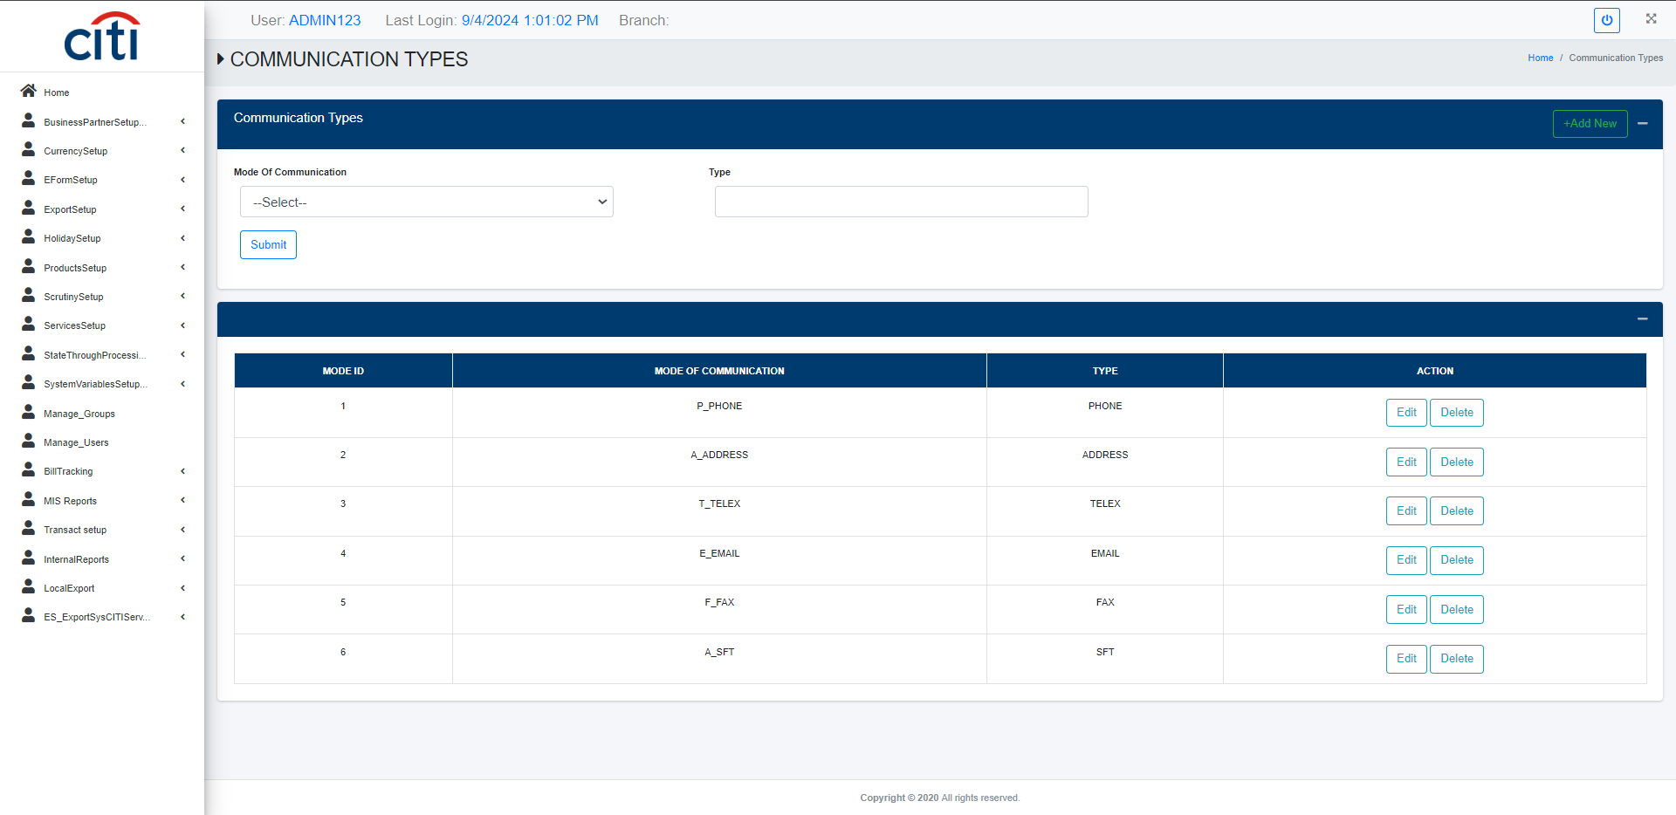
BUSINESS PARTNER SETUP
Communication types setup form
EXPORT APPLICATION
15

Slide 16
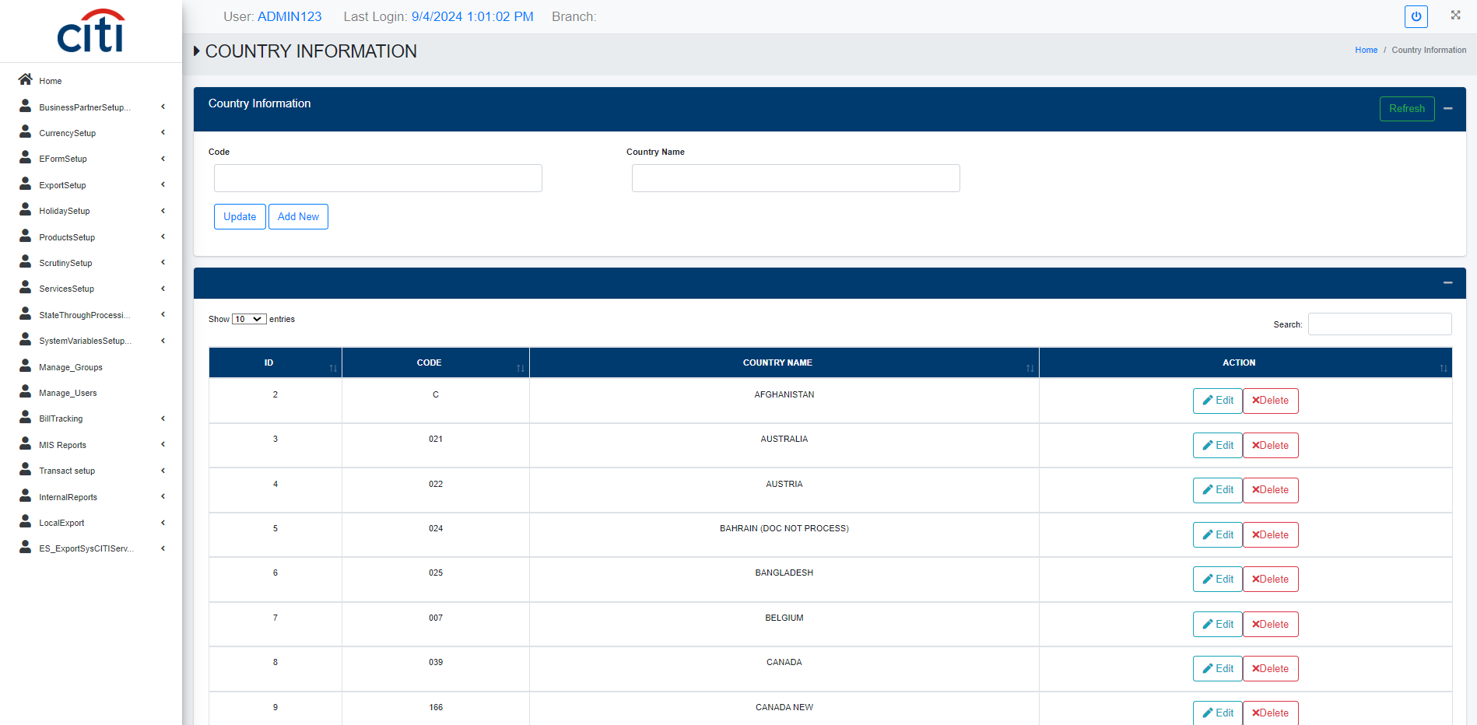
BUSINESS PARTNER SETUP
Country information setup form
EXPORT APPLICATION
16

Slide 17
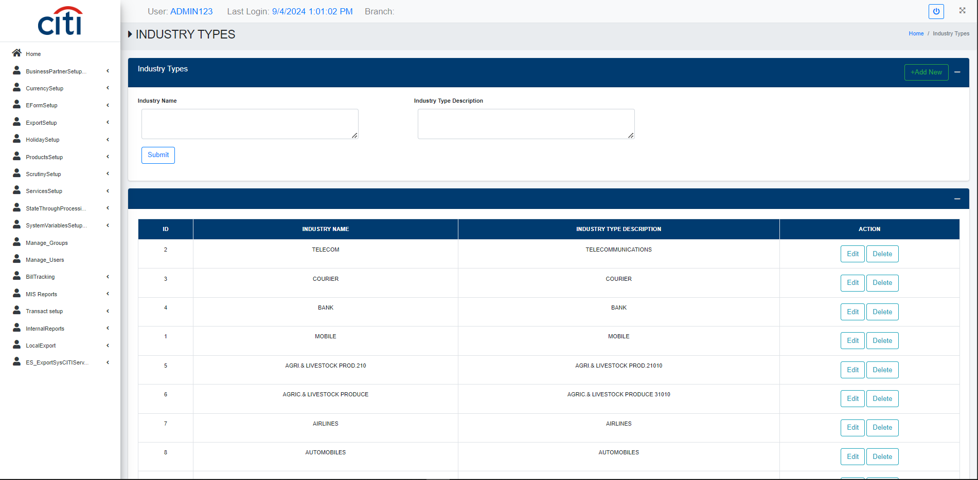
BUSINESS PARTNER SETUP
Industry types setup form
EXPORT APPLICATION
17

Slide 18
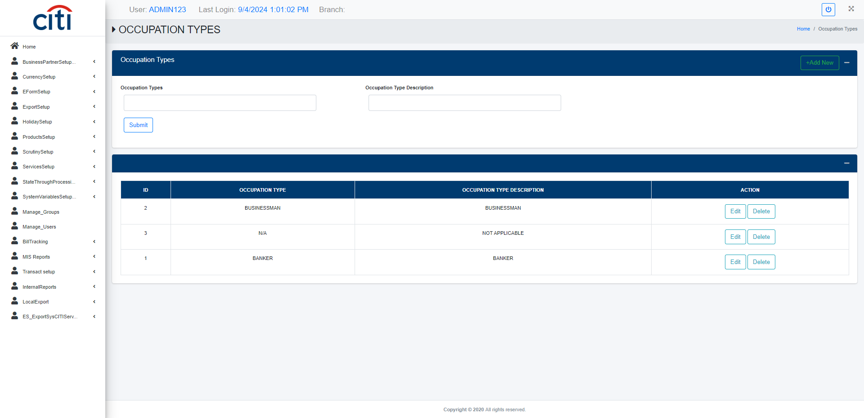
BUSINESS PARTNER SETUP
Occupation types setup form
EXPORT APPLICATION
18

Slide 19
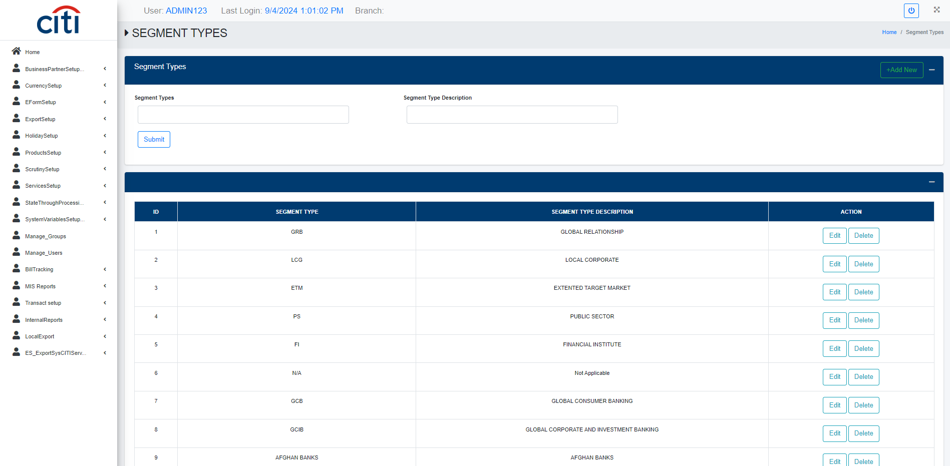
BUSINESS PARTNER SETUP
Segment types setup form
EXPORT APPLICATION
19

Slide 20

BUSINESS PARTNER SETUP
State information setup form
EXPORT APPLICATION
20

Slide 21
03
Currency Setup
Exchange rates, rate definitions, and currency types
EXPORT APPLICATION
21

Slide 22
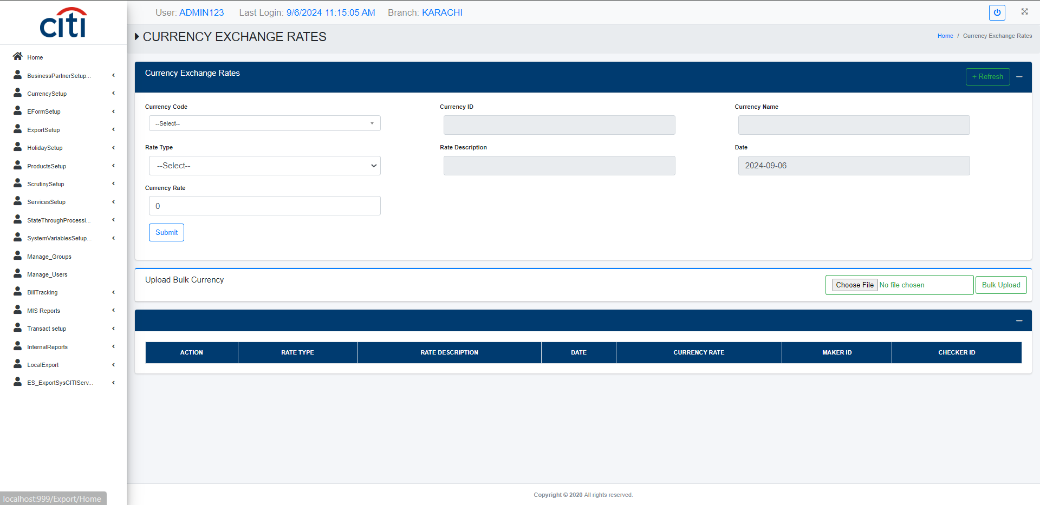
CURRENCY SETUP
Currency exchange rate maintenance form
EXPORT APPLICATION
22

Slide 23
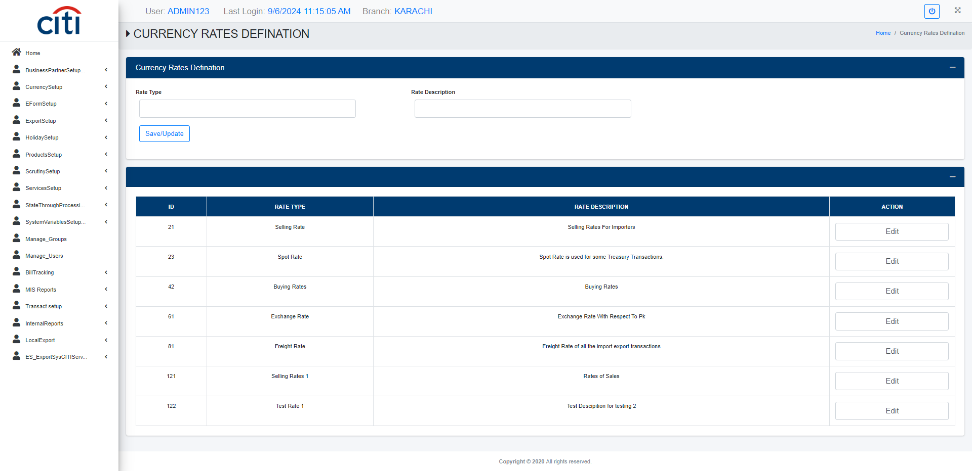
CURRENCY SETUP
Currency rate definitions setup form
EXPORT APPLICATION
23

Slide 24
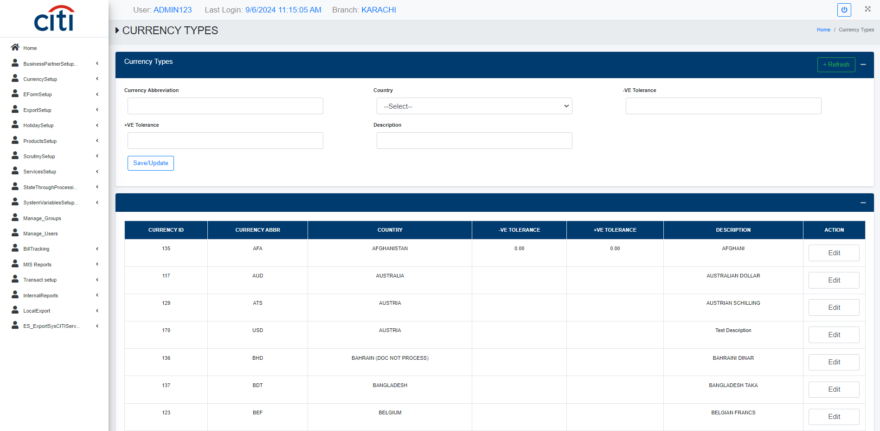
CURRENCY SETUP
Currency types setup form
EXPORT APPLICATION
24

Slide 25
04
E-Form Setup
Initiation, authorization, and reporting for E-Forms
EXPORT APPLICATION
25

Slide 26
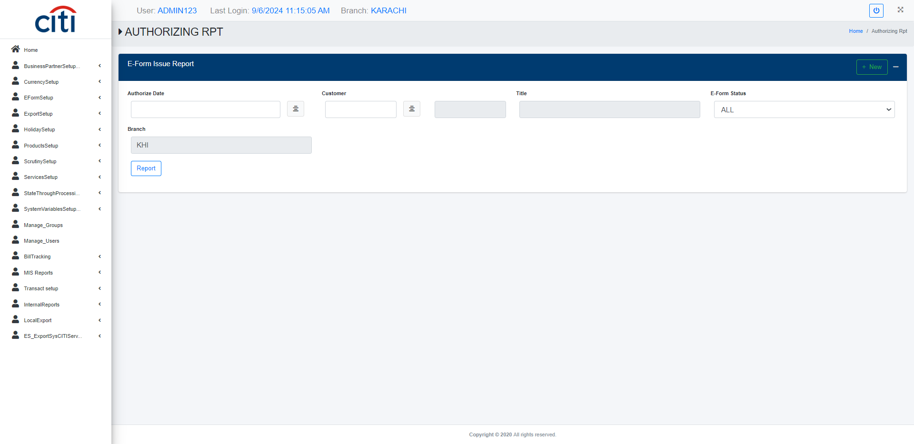
E-FORM SETUP
E-Form authorizing report
EXPORT APPLICATION
26

Slide 27
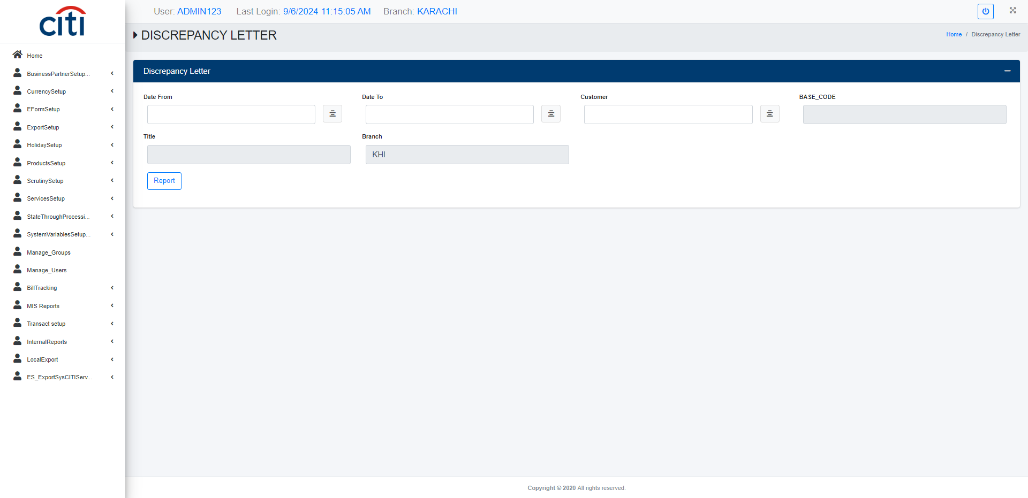
E-FORM SETUP
E-Form discrepancy letter report
EXPORT APPLICATION
27

Slide 28
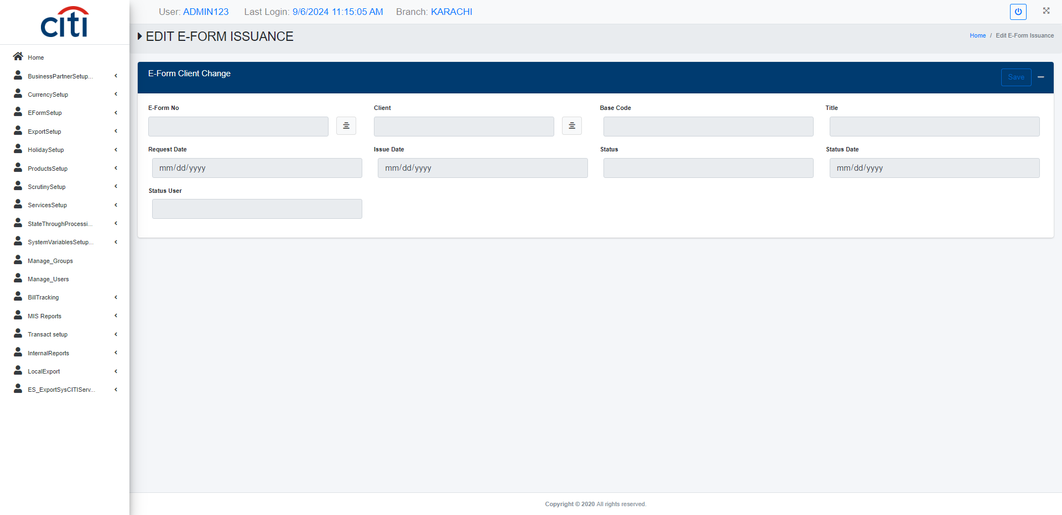
E-FORM SETUP
Edit/Modify submitted E-Forms
EXPORT APPLICATION
28

Slide 29
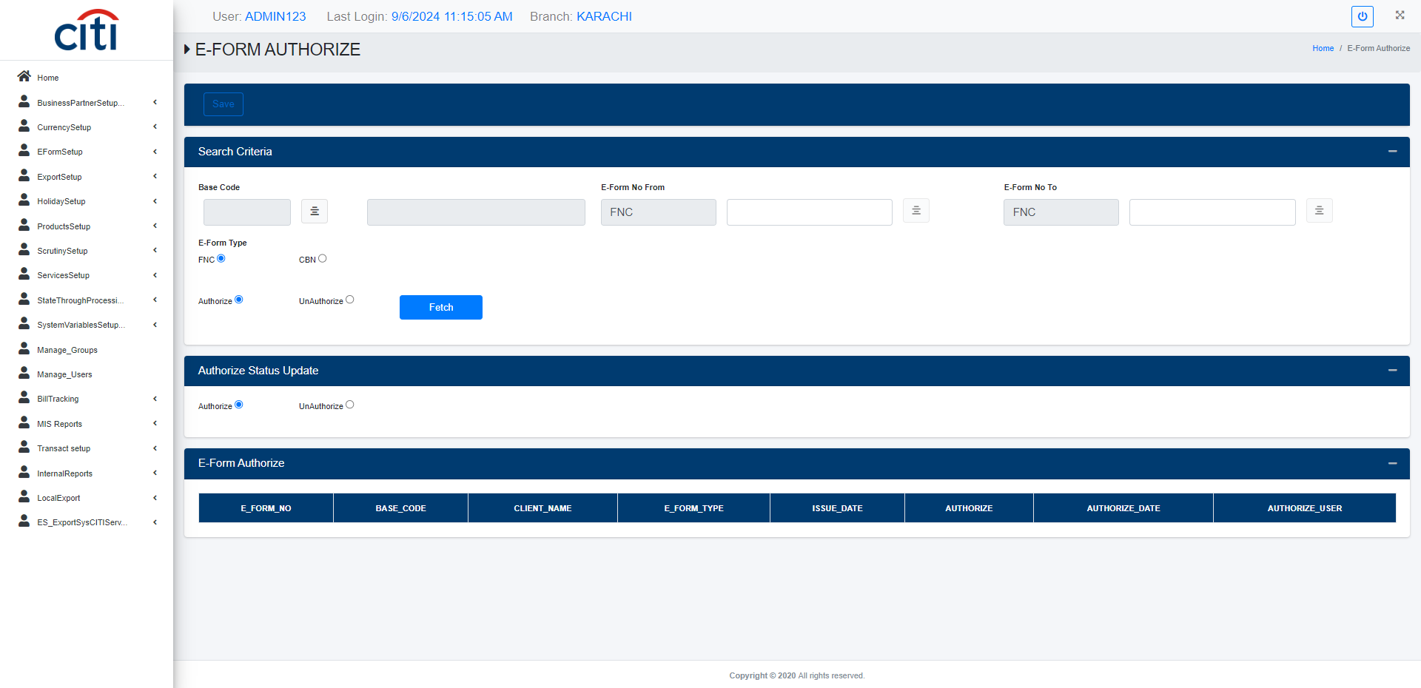
E-FORM SETUP
Authorization of submitted E-Forms
EXPORT APPLICATION
29

Slide 30
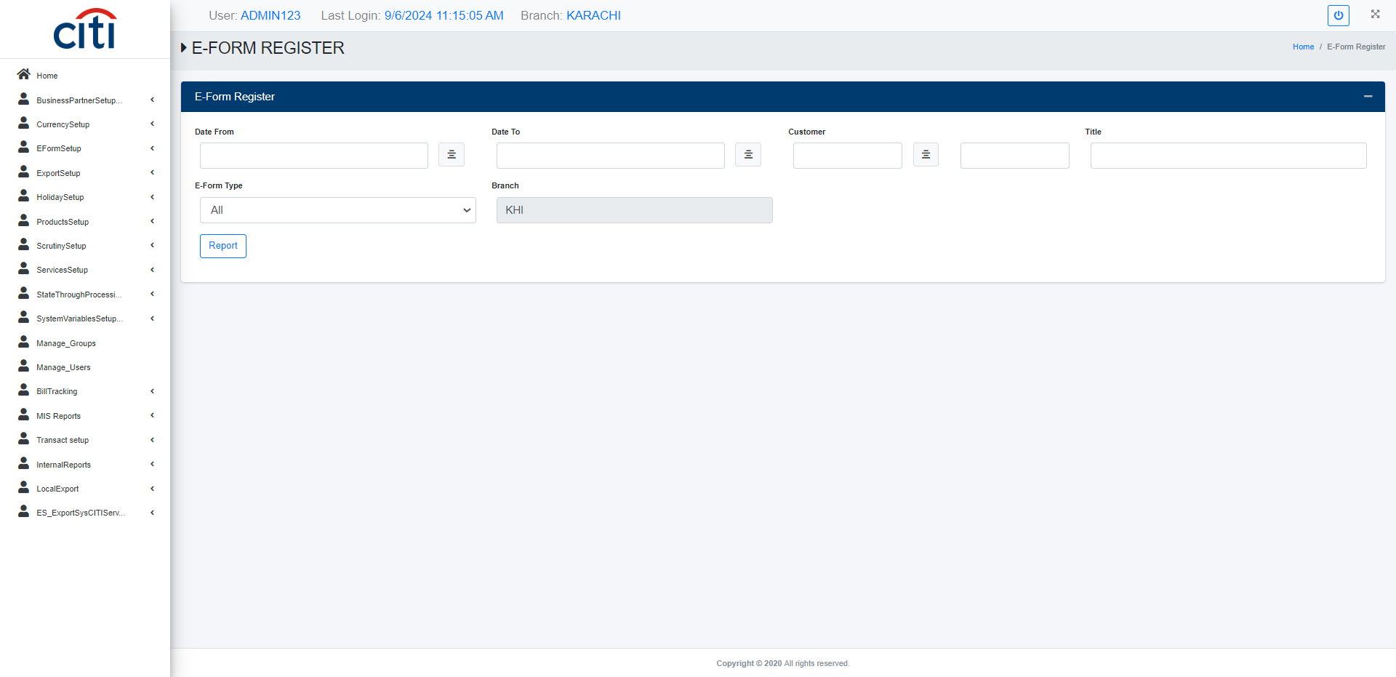
E-FORM SETUP
E-Form register form
EXPORT APPLICATION
30

Slide 31
05
Export Setup
Core reference data powering the export workflow
EXPORT APPLICATION
31

Slide 32
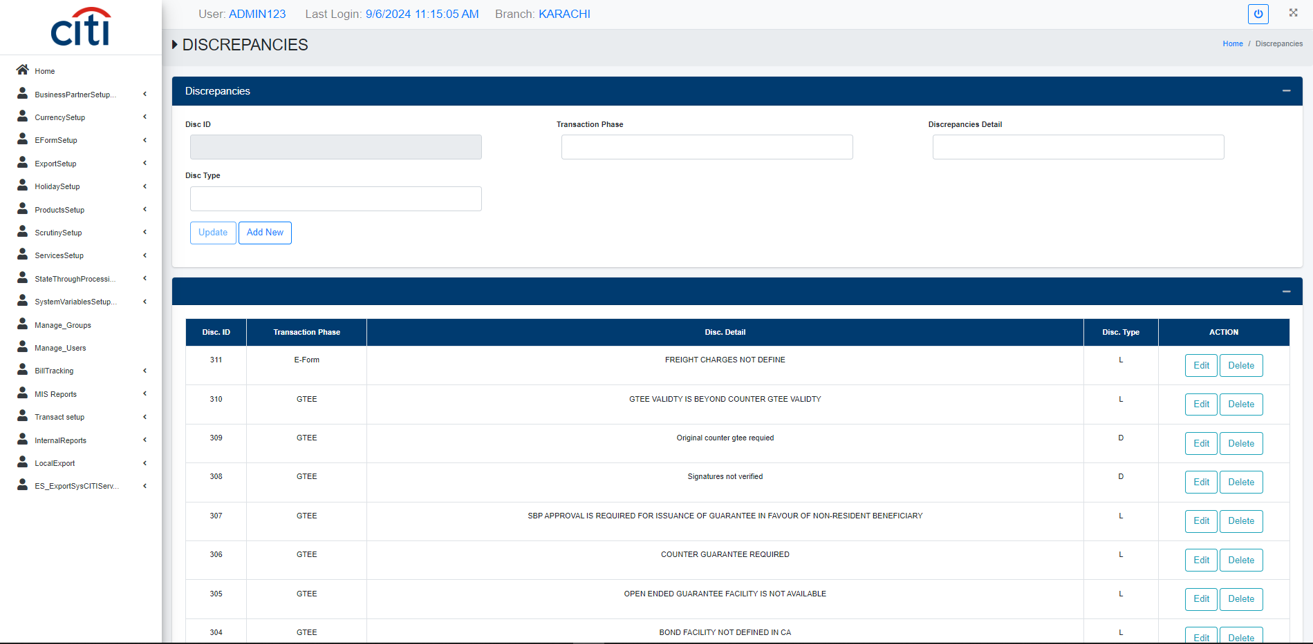
EXPORT SETUP
Discrepancies setup form
EXPORT APPLICATION
32

Slide 33

EXPORT SETUP
Account officer setup form
EXPORT APPLICATION
33

Slide 34
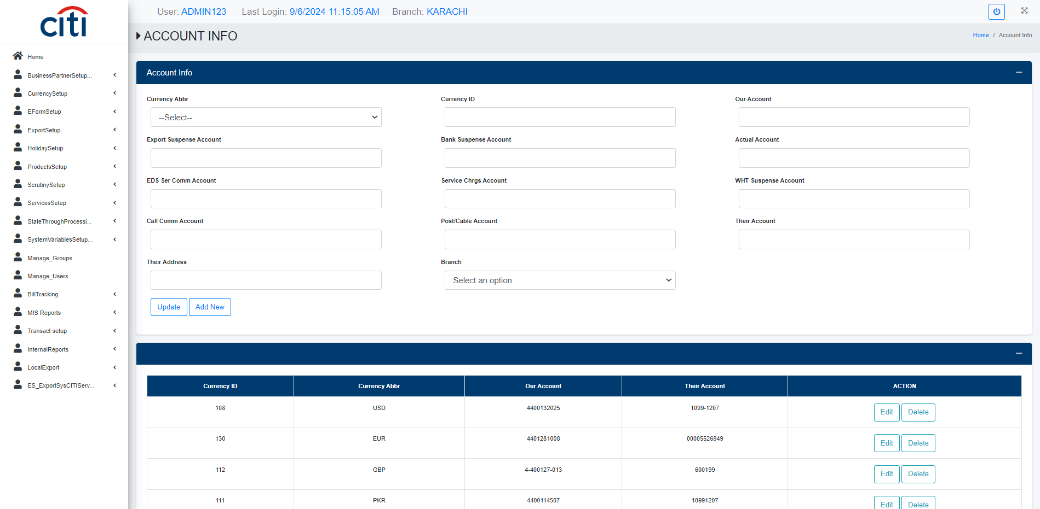
EXPORT SETUP
Account information setup form
EXPORT APPLICATION
34

Slide 35
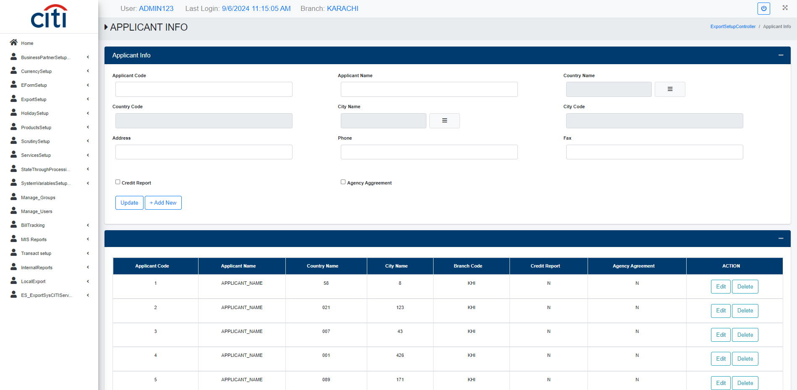
EXPORT SETUP
Application information setup form
EXPORT APPLICATION
35

Slide 36
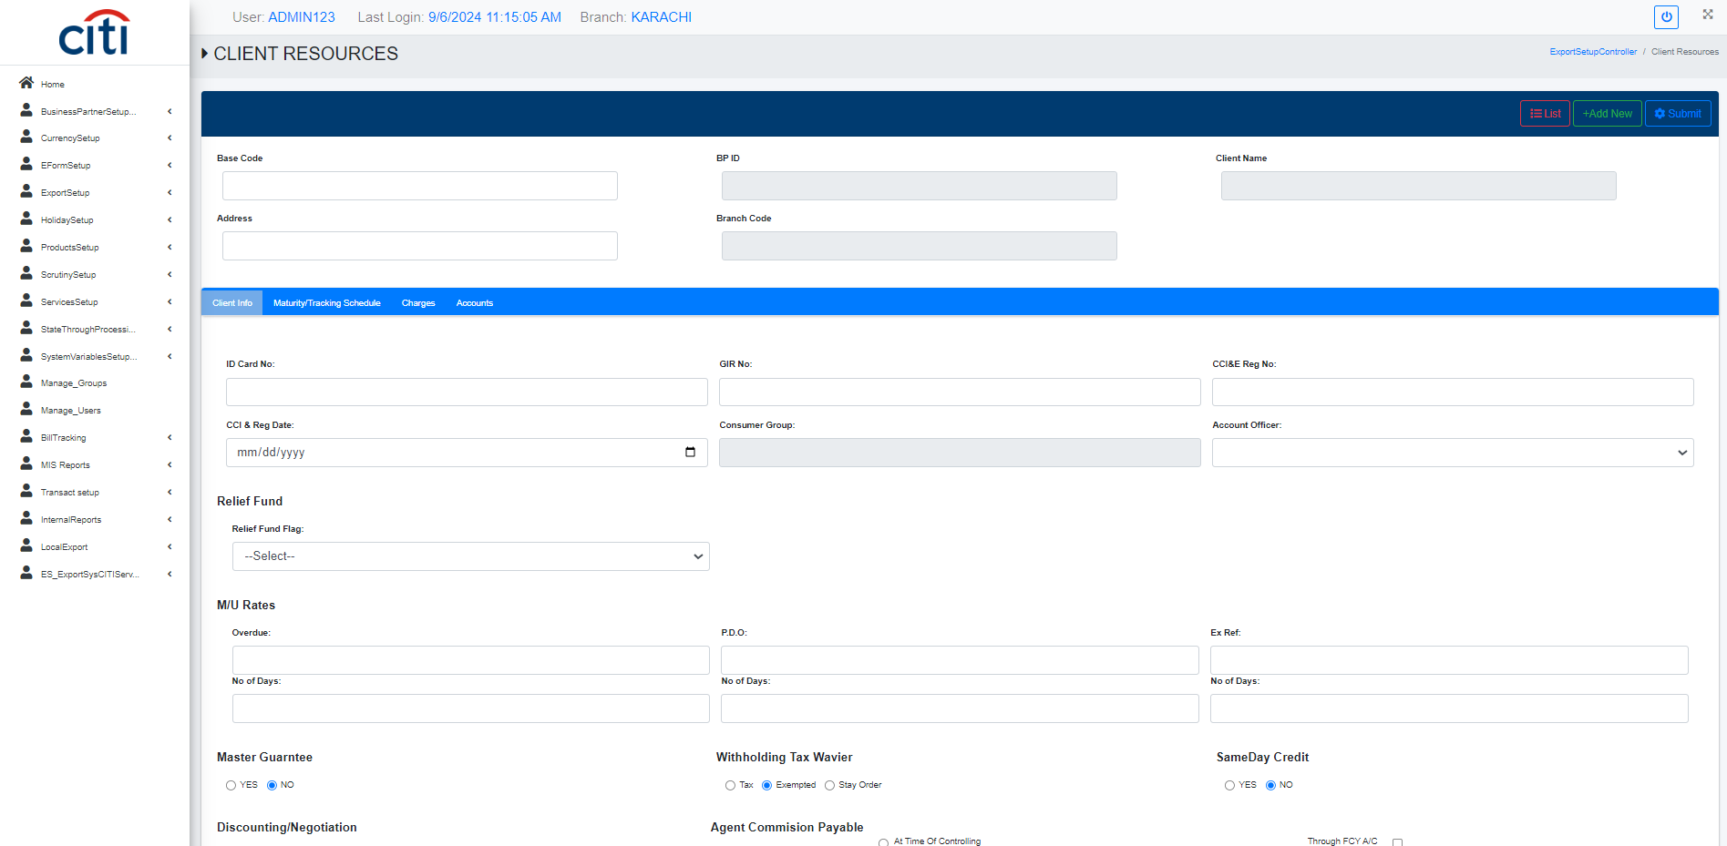
EXPORT SETUP
Client resources setup form
EXPORT APPLICATION
36

Slide 37

EXPORT SETUP
Country information setup form
EXPORT APPLICATION
37

Slide 38

EXPORT SETUP
E-Form type setup form
EXPORT APPLICATION
38

Slide 39
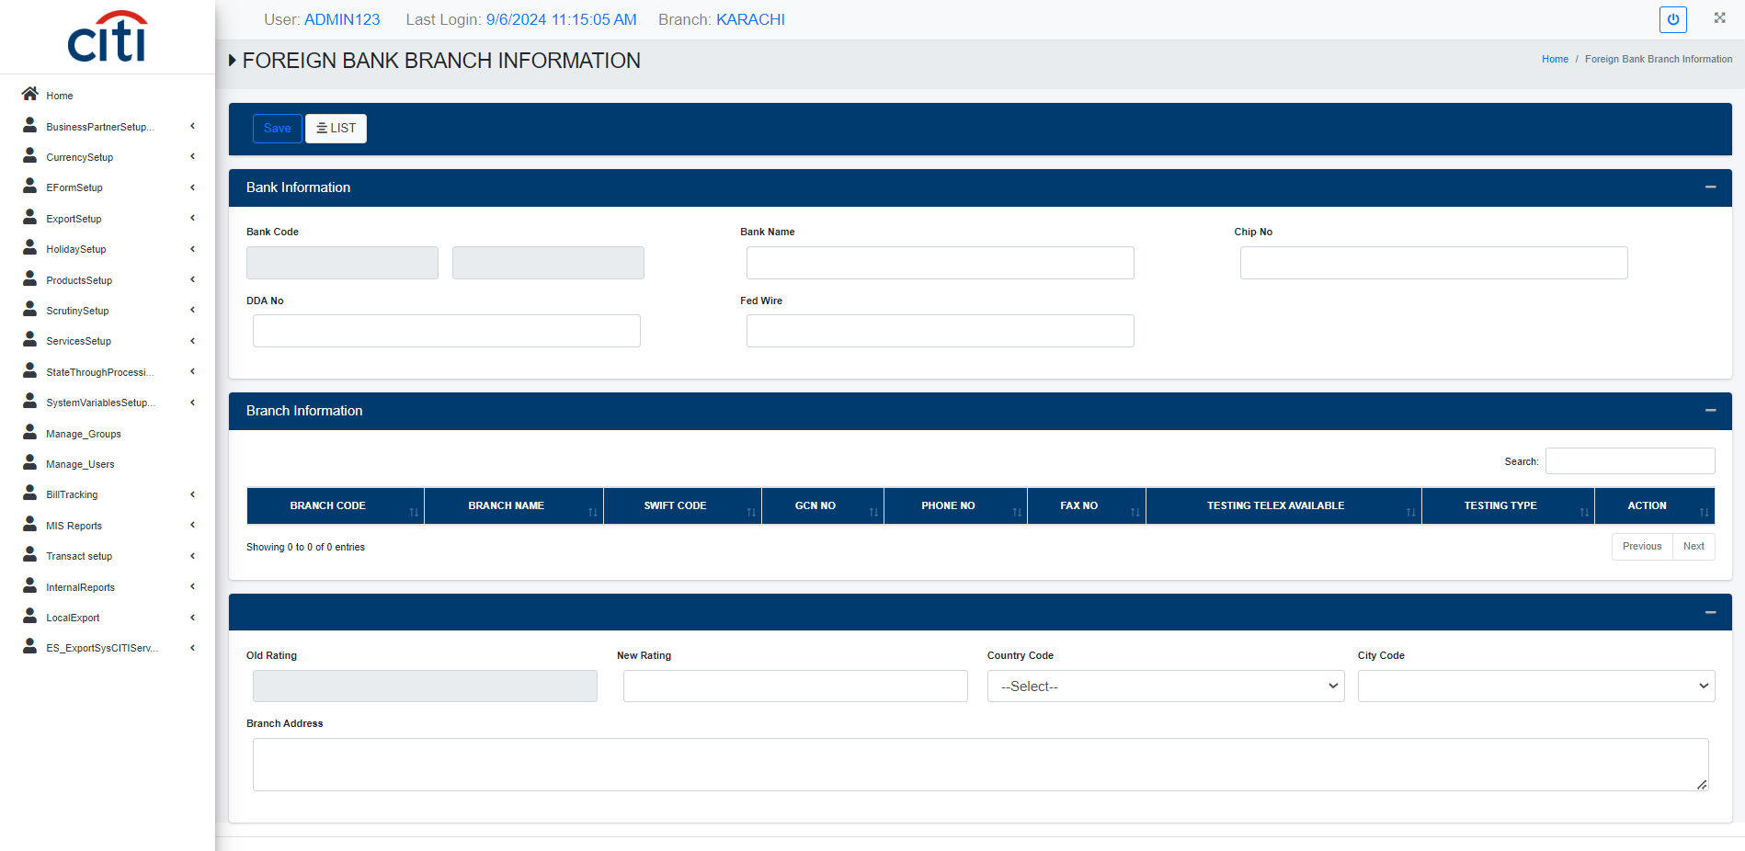
EXPORT SETUP
Foreign branch information form
EXPORT APPLICATION
39

Slide 40
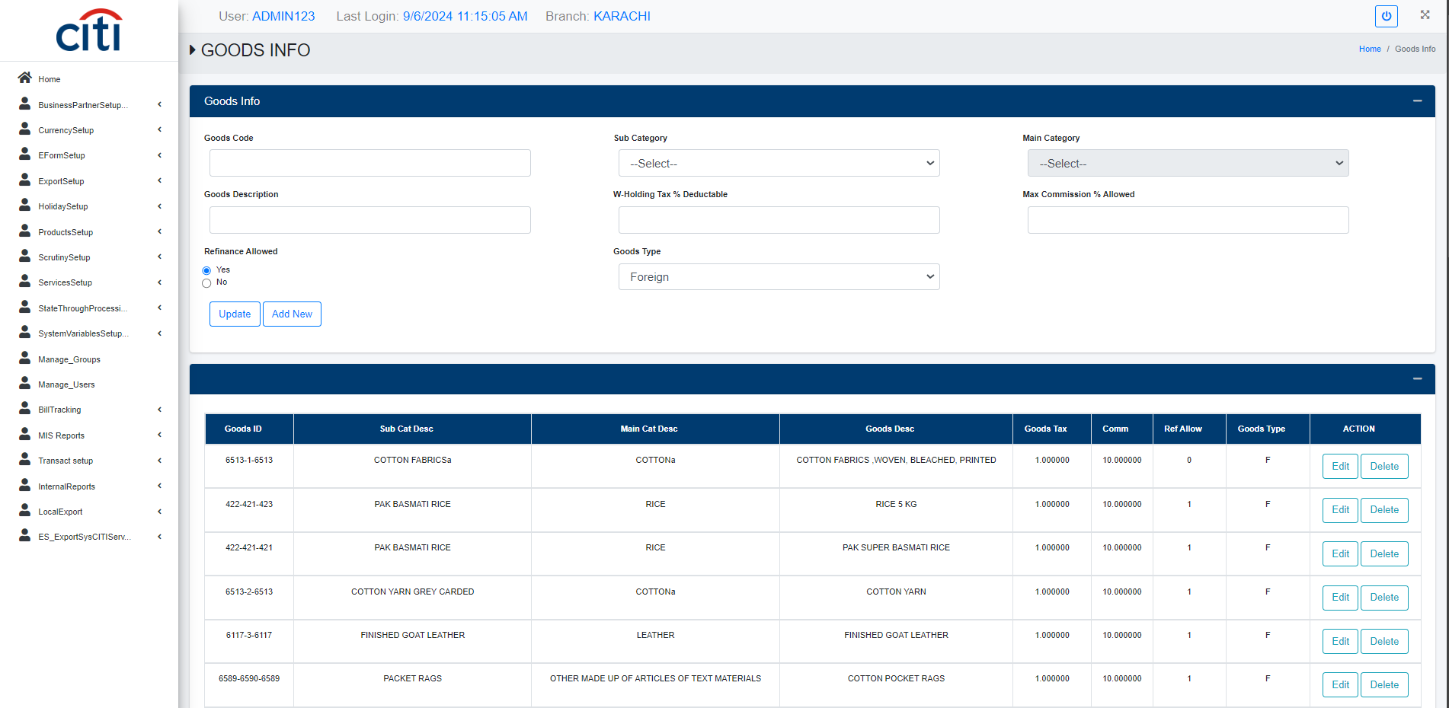
EXPORT SETUP
Goods information setup form
EXPORT APPLICATION
40

Slide 41
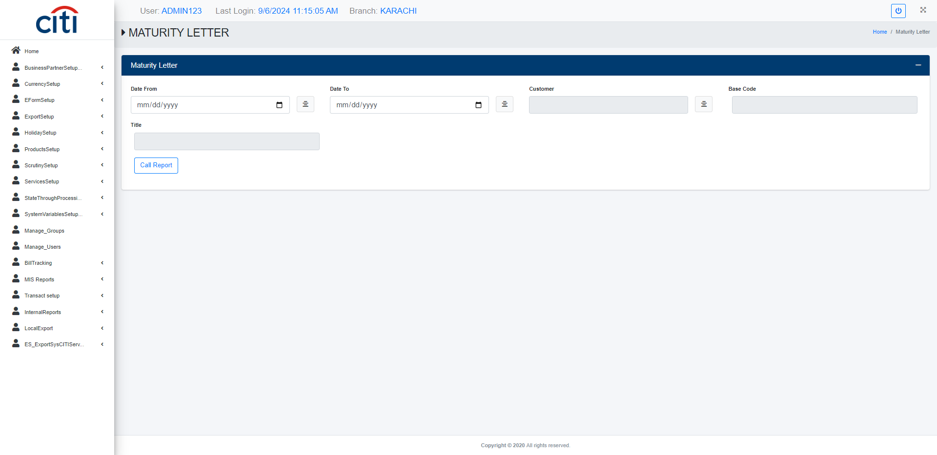
EXPORT SETUP
Maturity letter report
EXPORT APPLICATION
41

Slide 42
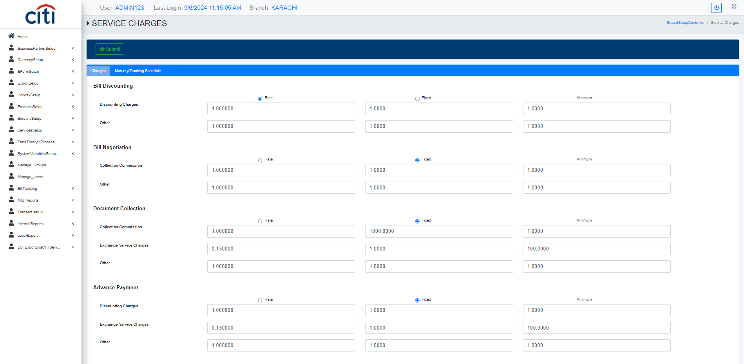
EXPORT SETUP
Service charges setup form
EXPORT APPLICATION
42

Slide 43
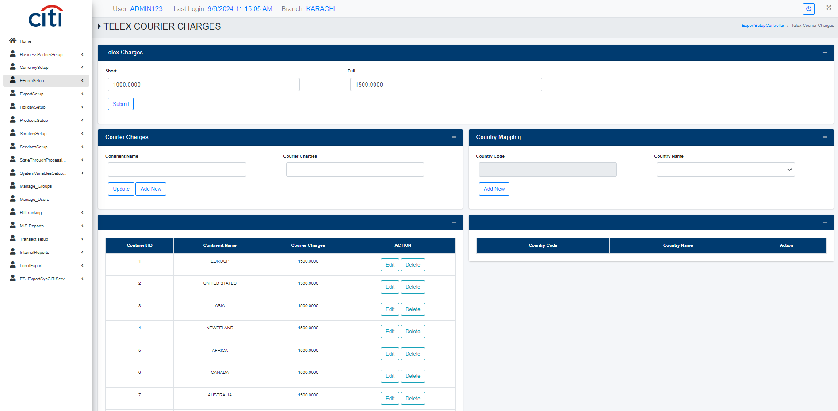
EXPORT SETUP
Telex courier charges setup form
EXPORT APPLICATION
43

Slide 44
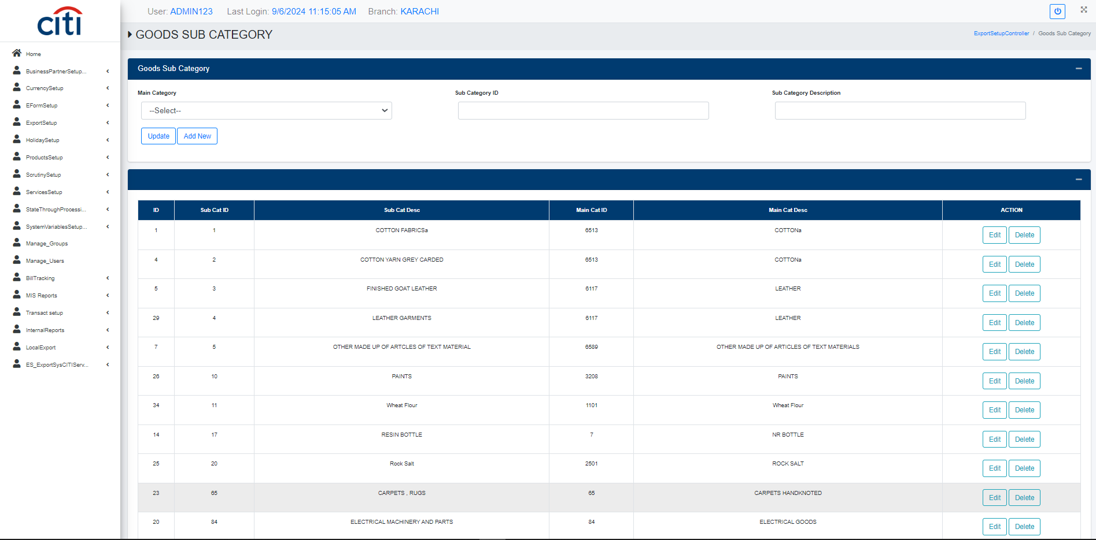
EXPORT SETUP
Goods sub category setup form
EXPORT APPLICATION
44

Slide 45
06
Holiday Setup
Holiday calendars and holiday type configuration
EXPORT APPLICATION
45

Slide 46
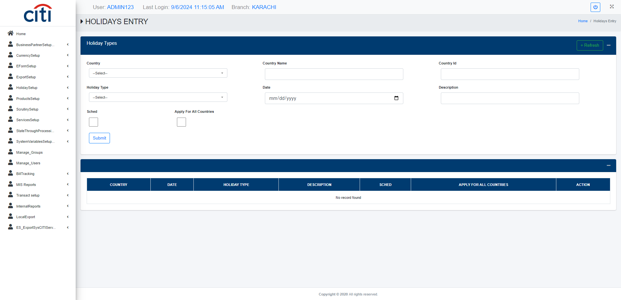
HOLIDAY SETUP
Holiday entry form
EXPORT APPLICATION
46

Slide 47
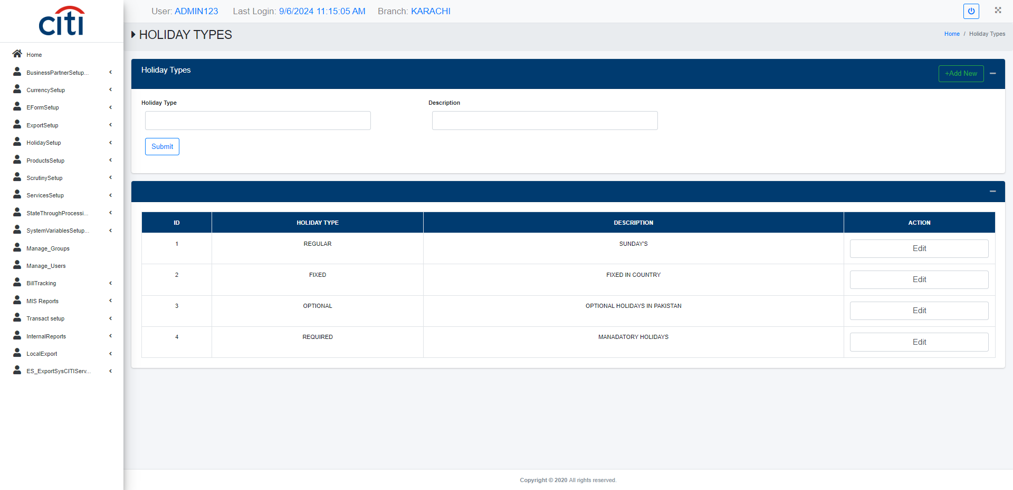
HOLIDAY SETUP
Holiday type setup form
EXPORT APPLICATION
47

Slide 48
07
Scrutiny Setup
Discrepancy authorization, courier, and document handling
EXPORT APPLICATION
48

Slide 49
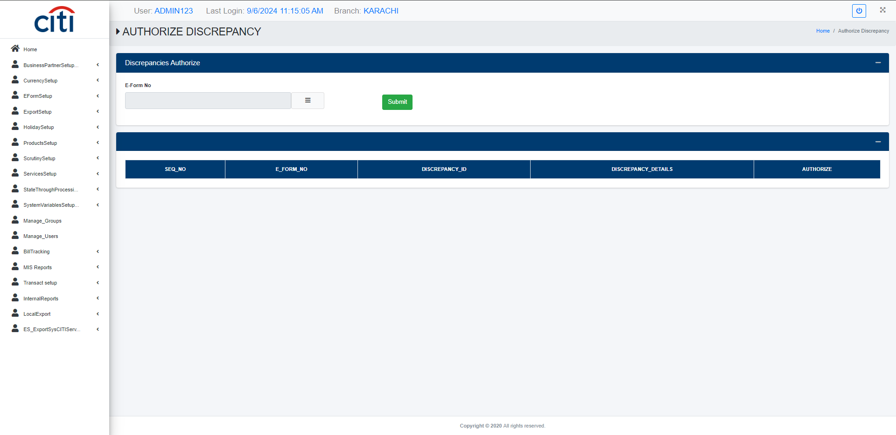
SCRUTINY SETUP
Authorization of discrepancy form
EXPORT APPLICATION
49

Slide 50
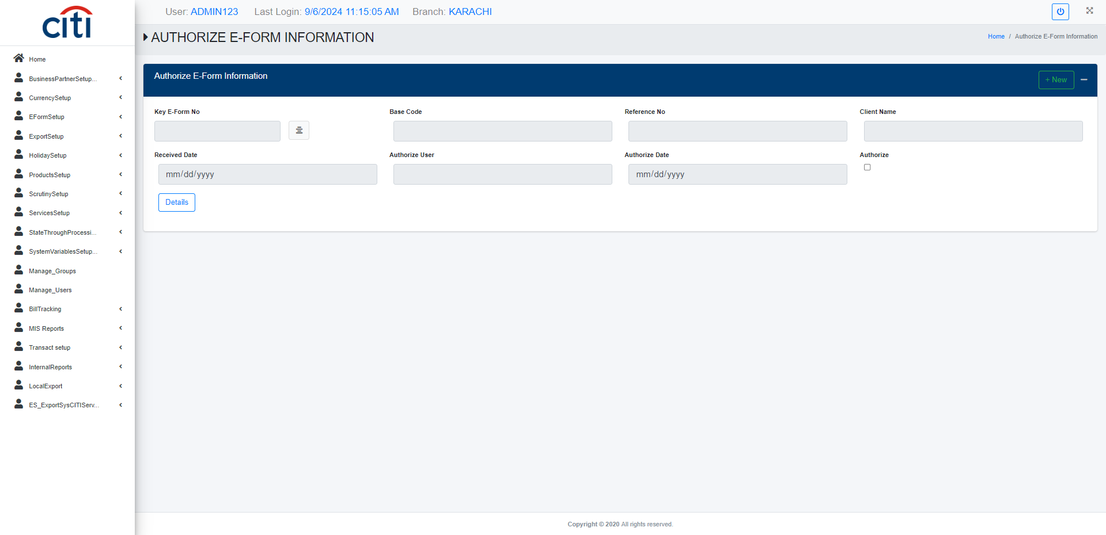
SCRUTINY SETUP
Authorization of E-Form information form
EXPORT APPLICATION
50

Slide 51
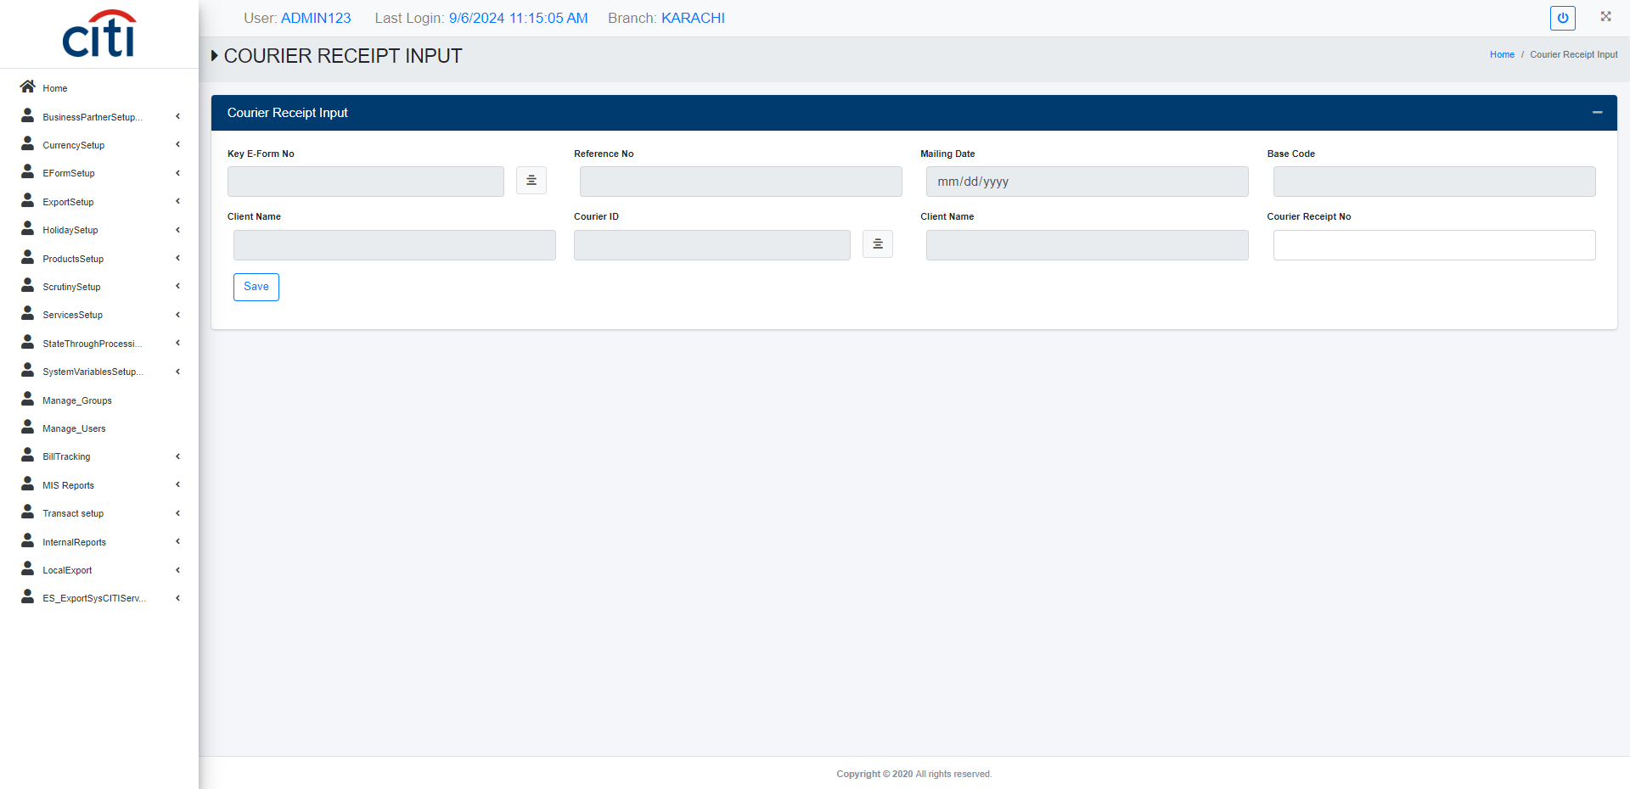
SCRUTINY SETUP
Courier receipt input form
EXPORT APPLICATION
51

Slide 52
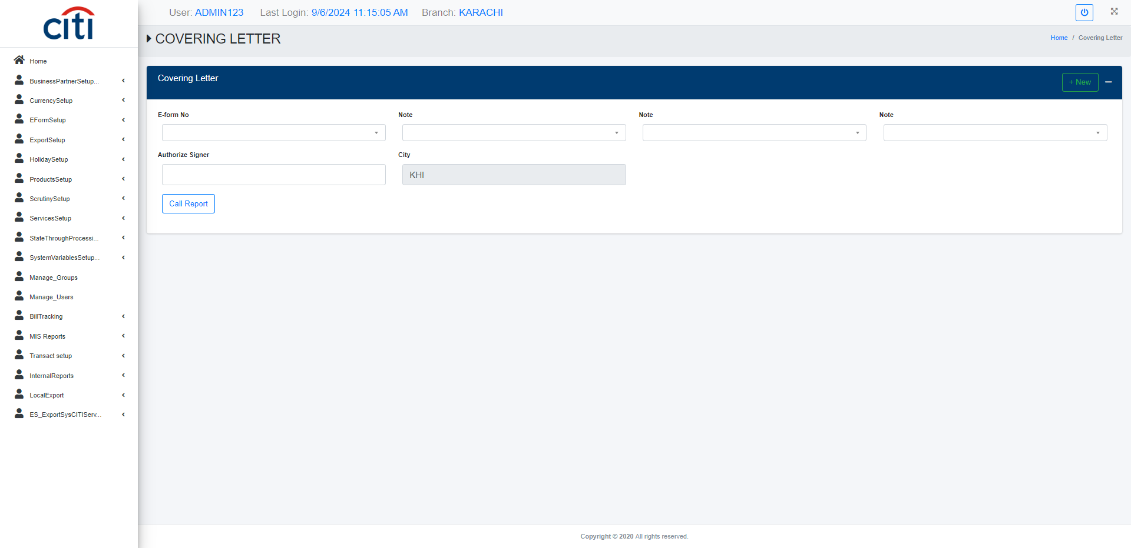
SCRUTINY SETUP
Covering letter report
EXPORT APPLICATION
52

Slide 53

SCRUTINY SETUP
Document discrepancies report
EXPORT APPLICATION
53

Slide 54
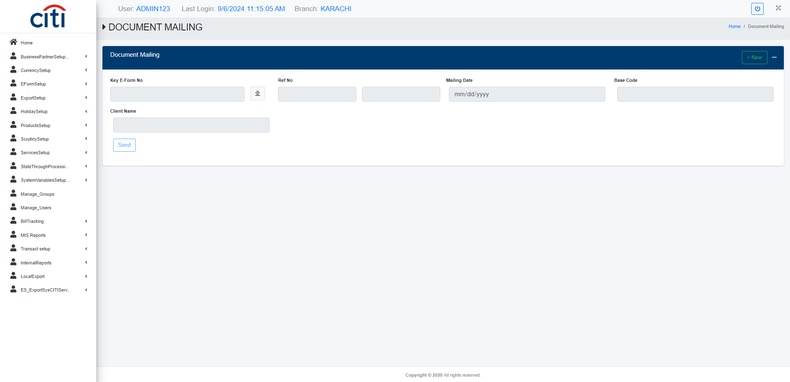
SCRUTINY SETUP
Document mailing form
EXPORT APPLICATION
54

Slide 55
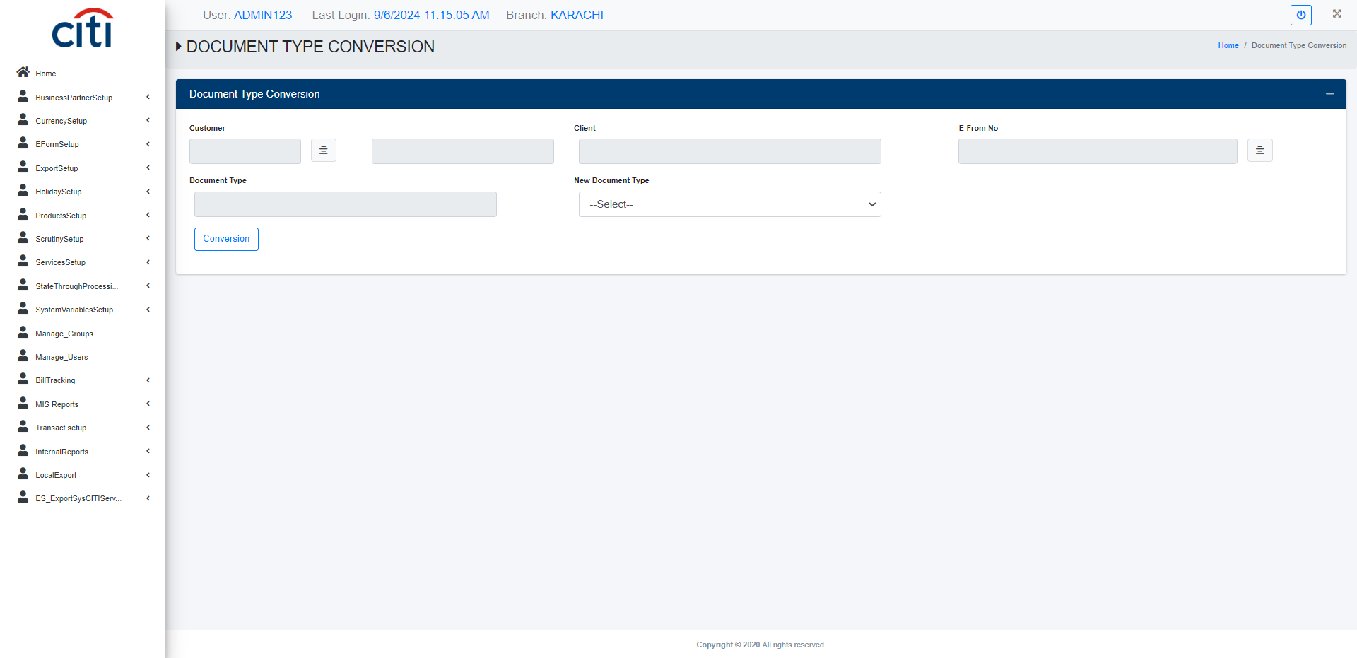
SCRUTINY SETUP
Document type conversion form
EXPORT APPLICATION
55

Slide 56
08
Bill Tracking
Maturity, inventory, NOC, and SBP regulatory reporting
EXPORT APPLICATION
56

Slide 57
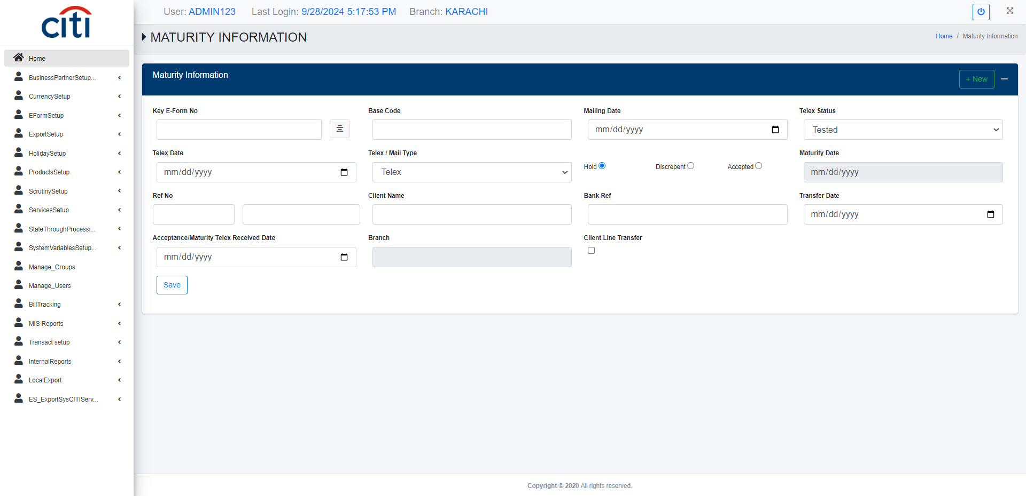
BILL TRACKING
Maturity information form
EXPORT APPLICATION
57

Slide 58
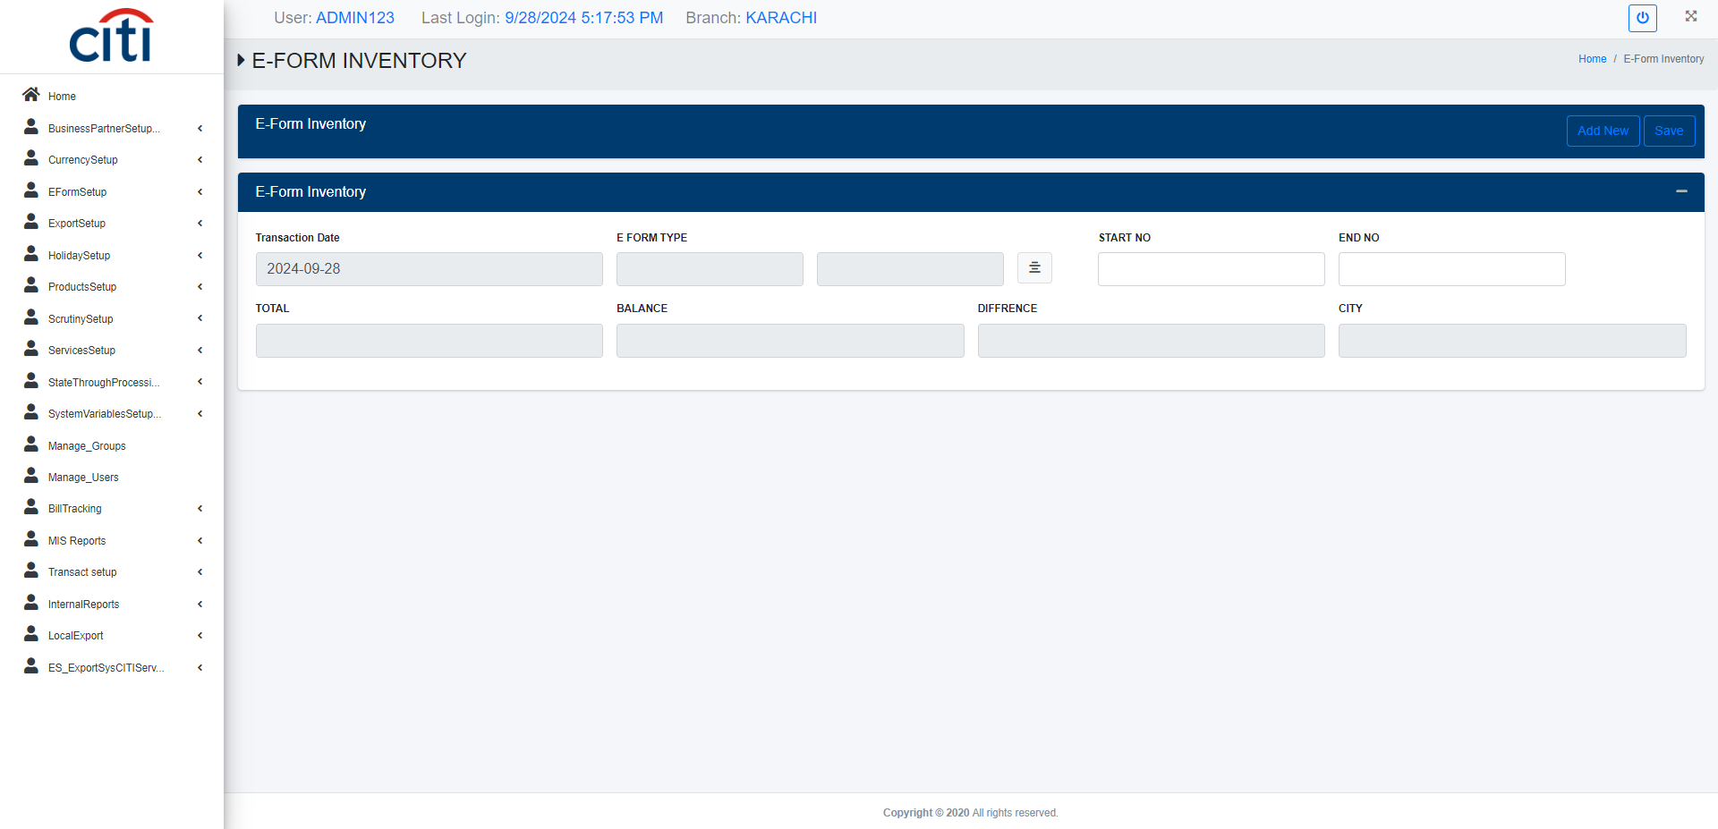
BILL TRACKING
E-Form inventory setup form
EXPORT APPLICATION
58

Slide 59
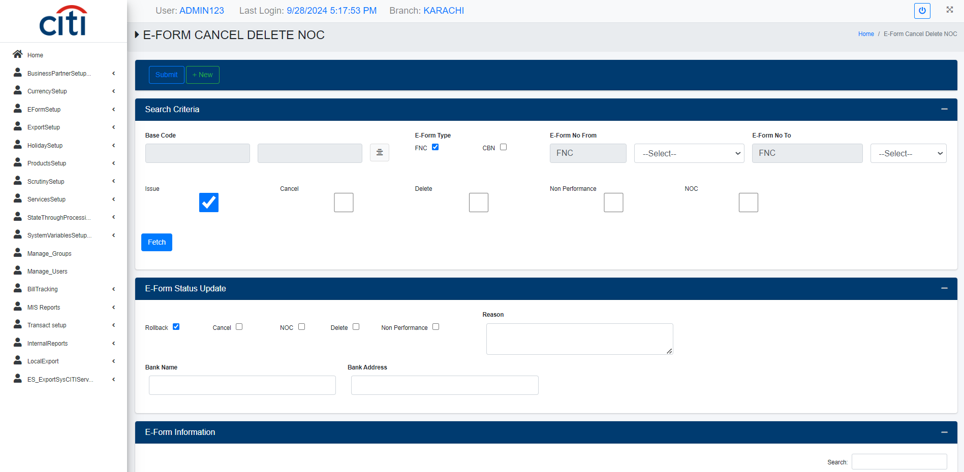
BILL TRACKING
E-Form cancel/delete NOC form
EXPORT APPLICATION
59

Slide 60
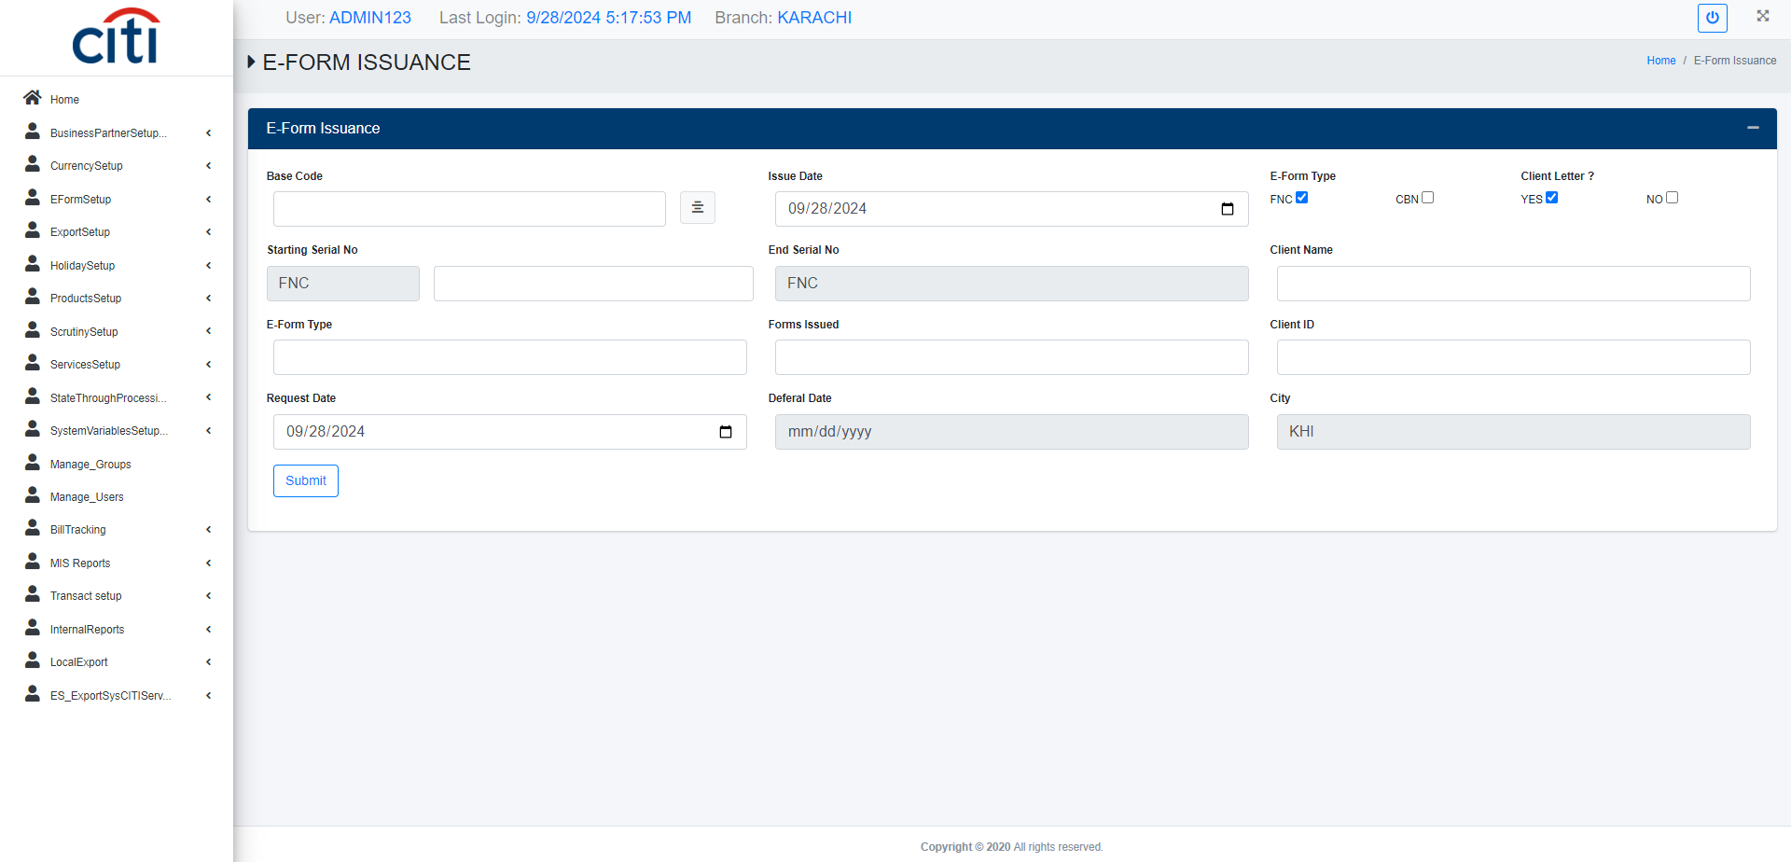
BILL TRACKING
E-Form issuance form
EXPORT APPLICATION
60

Slide 61
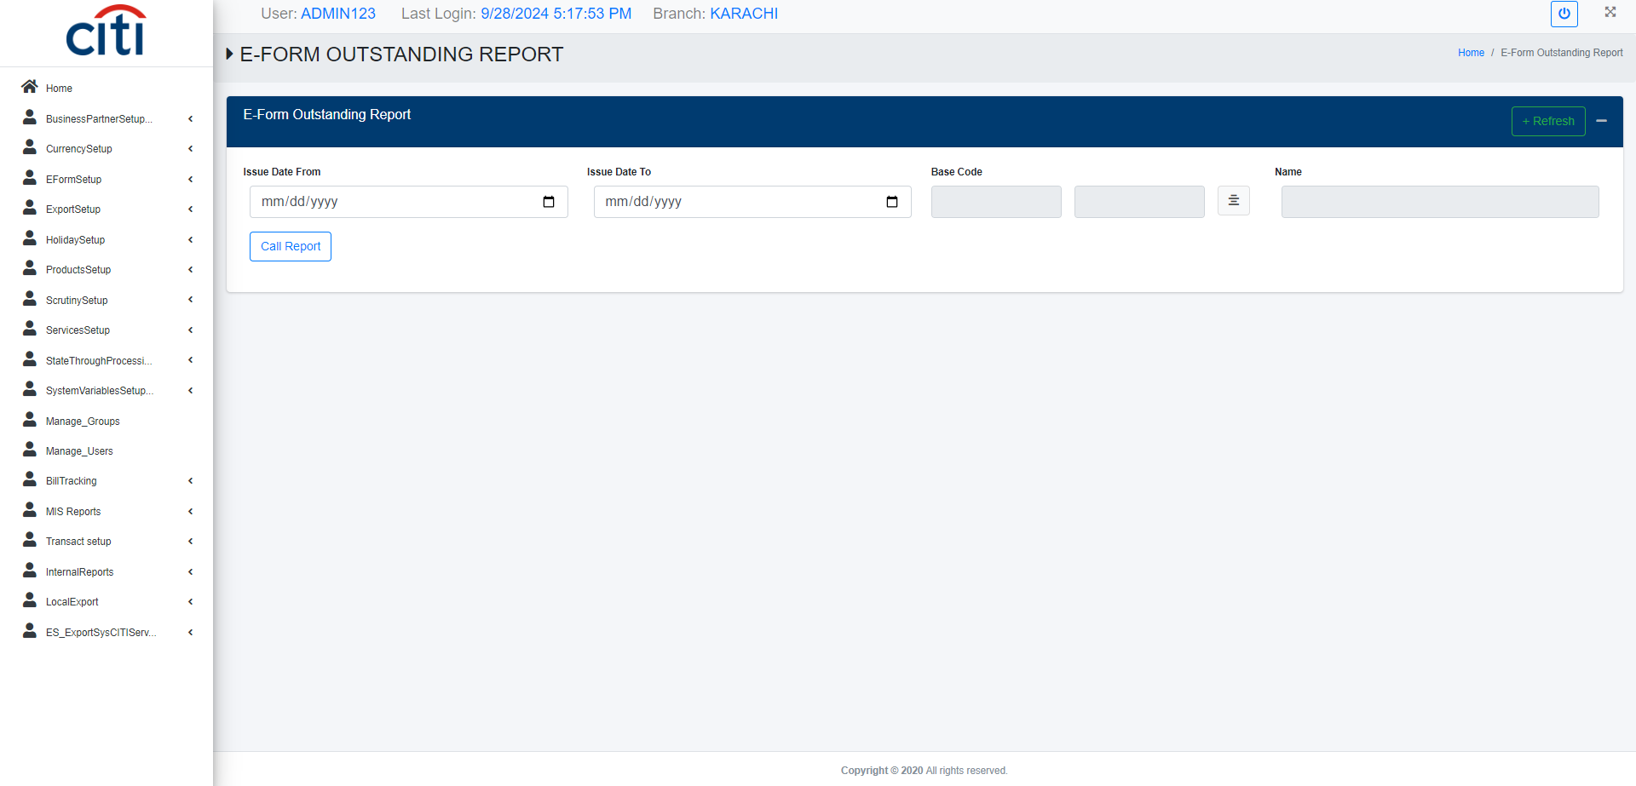
BILL TRACKING
E-Form outstanding report
EXPORT APPLICATION
61

Slide 62
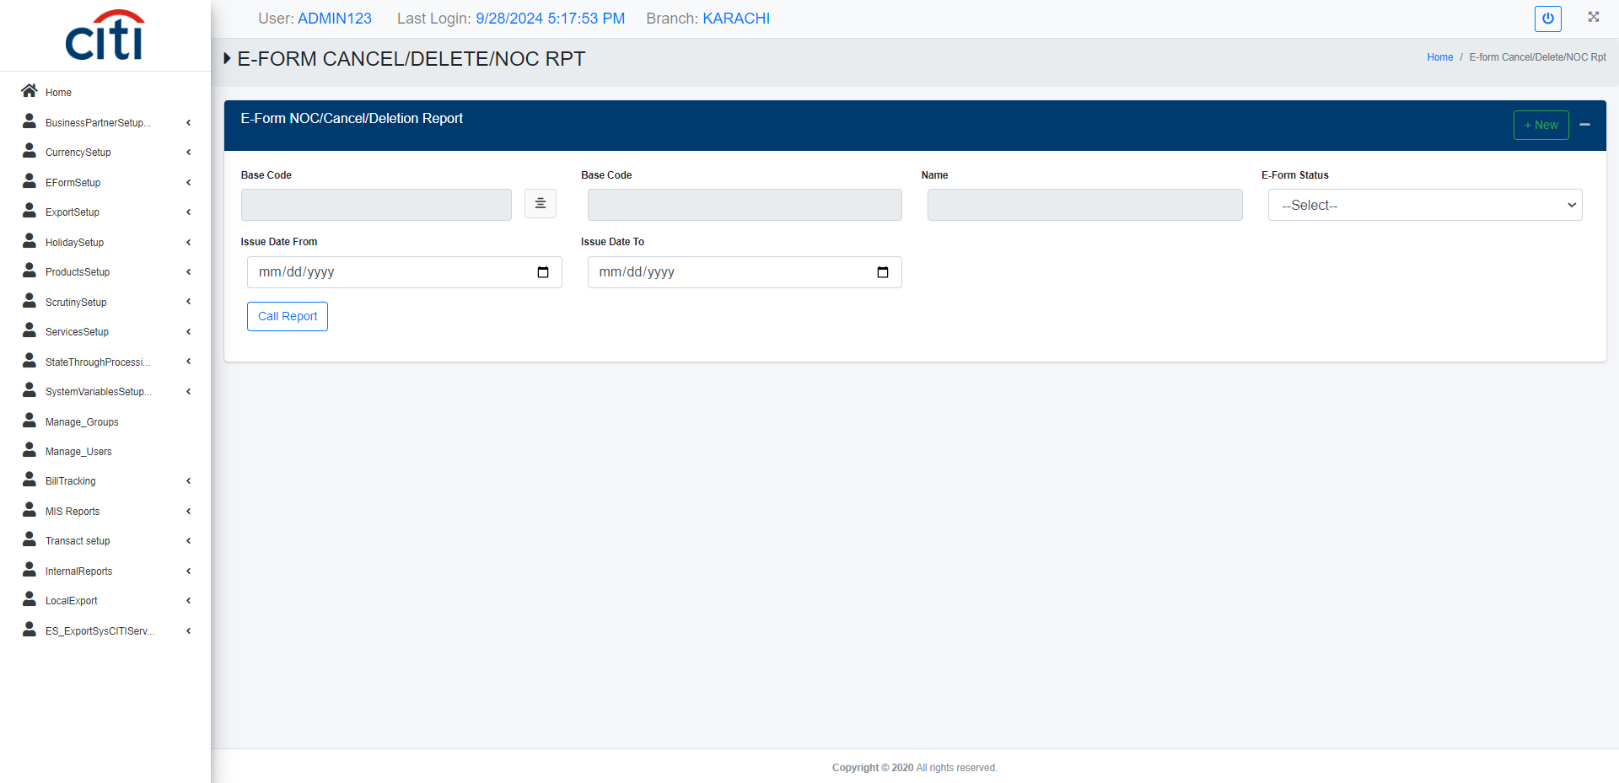
BILL TRACKING
E-Form cancel/delete NOC report
EXPORT APPLICATION
62

Slide 63
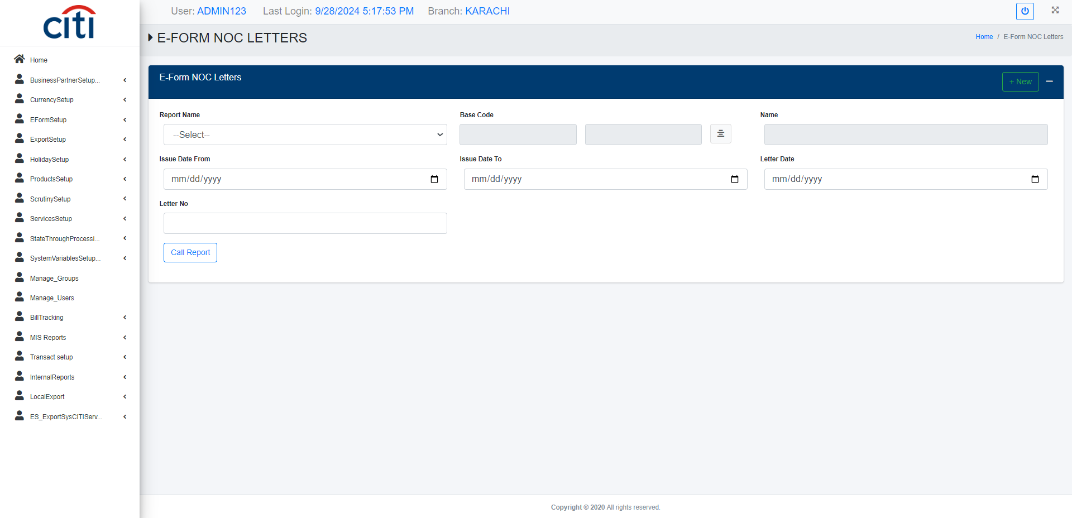
BILL TRACKING
E-Form NOC letter report
EXPORT APPLICATION
63

Slide 64
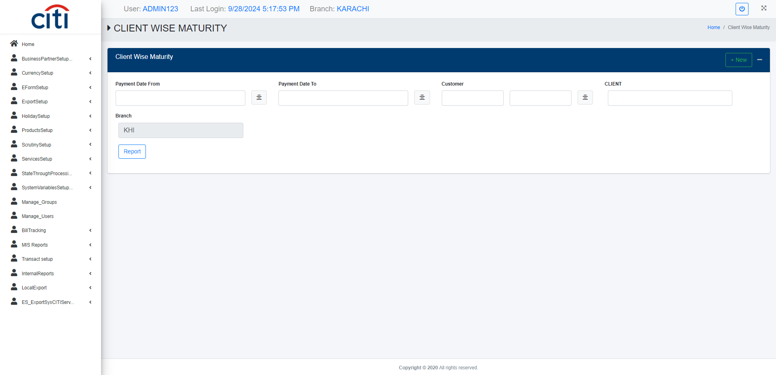
BILL TRACKING
Client wise maturity report
EXPORT APPLICATION
64

Slide 65
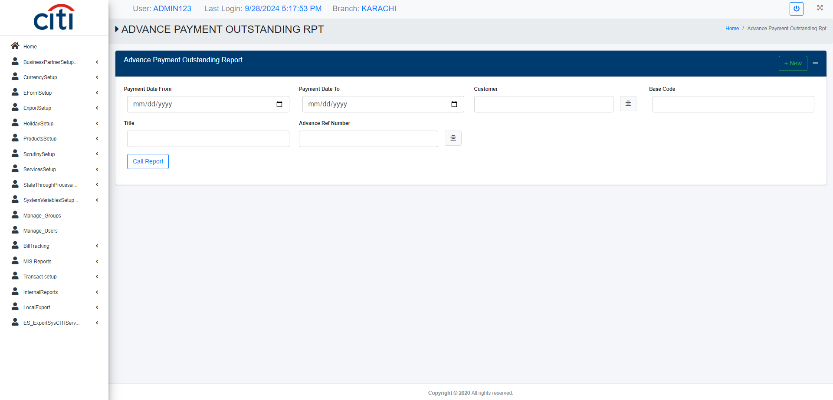
BILL TRACKING
Advance payment outstanding report
EXPORT APPLICATION
65

Slide 66
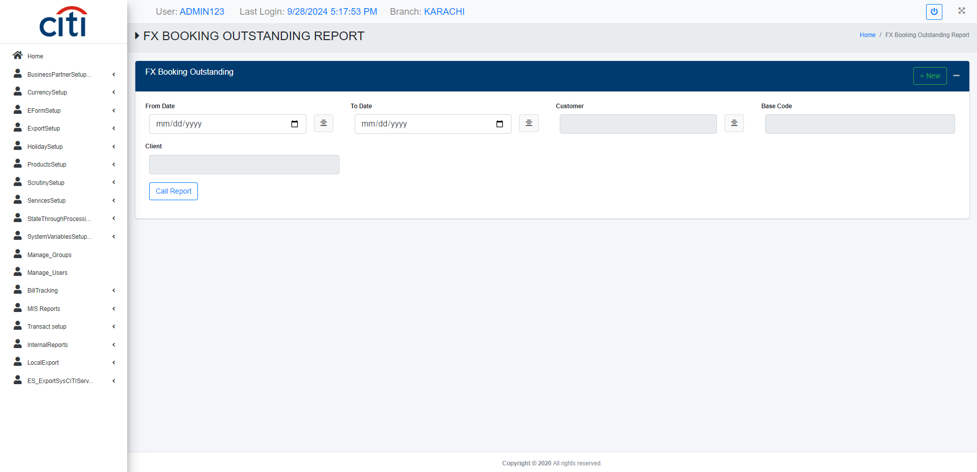
BILL TRACKING
FX booking outstanding report
EXPORT APPLICATION
66

Slide 67
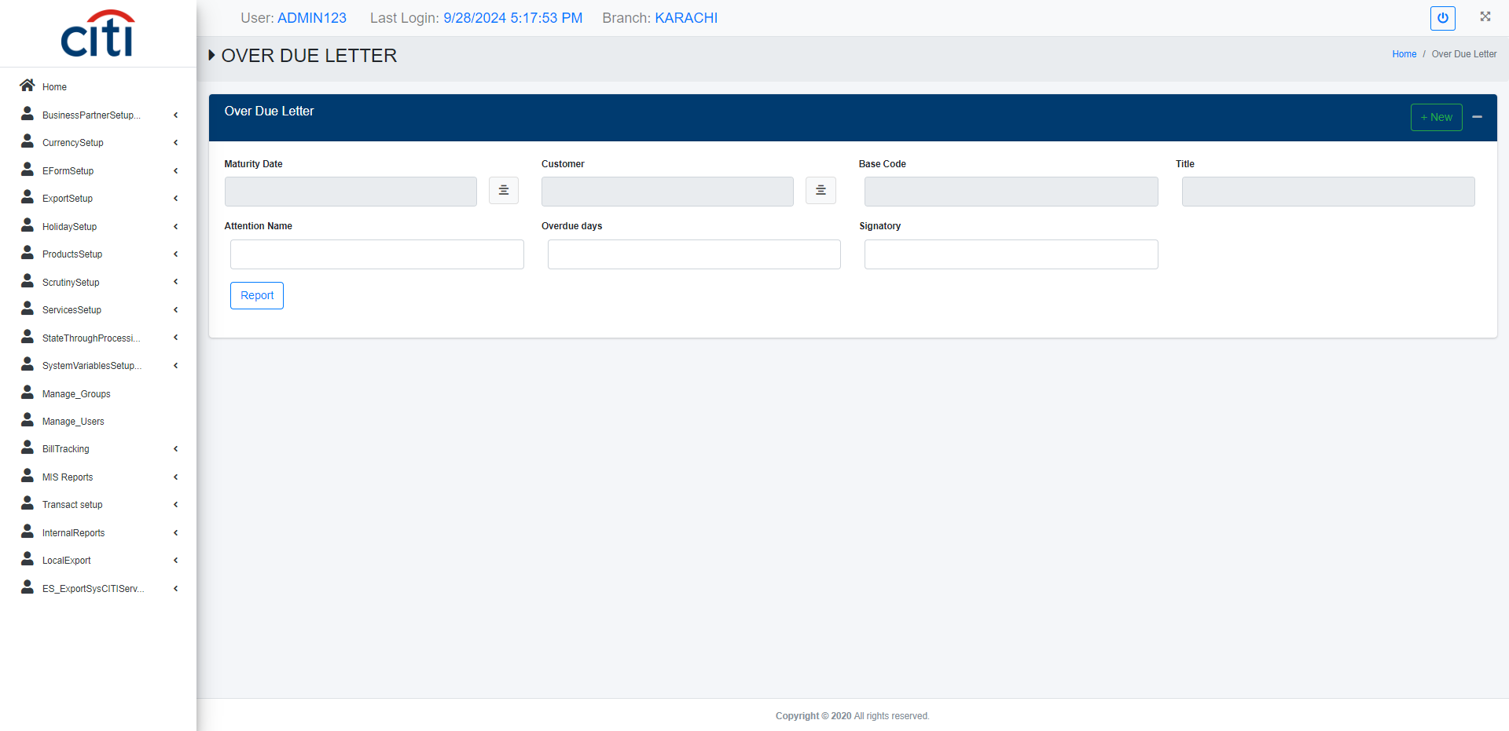
BILL TRACKING
Over due letter report
EXPORT APPLICATION
67

Slide 68
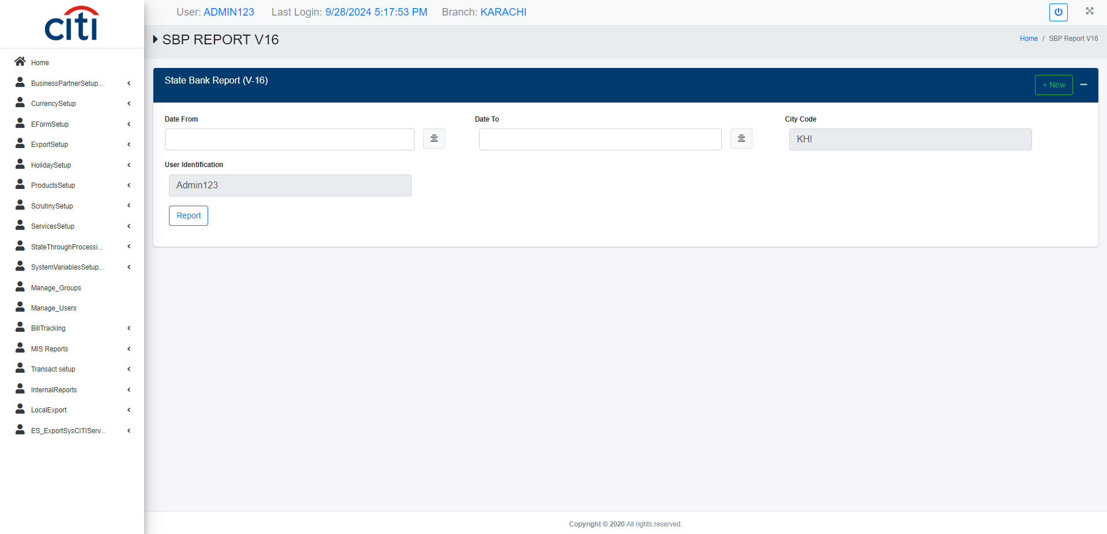
BILL TRACKING
SBP V16 report
EXPORT APPLICATION
68

Slide 69

BILL TRACKING
SBP V17 report
EXPORT APPLICATION
69

Slide 70
09
Transact Report
FX bookings, advance payments, and document payments
EXPORT APPLICATION
70

Slide 71
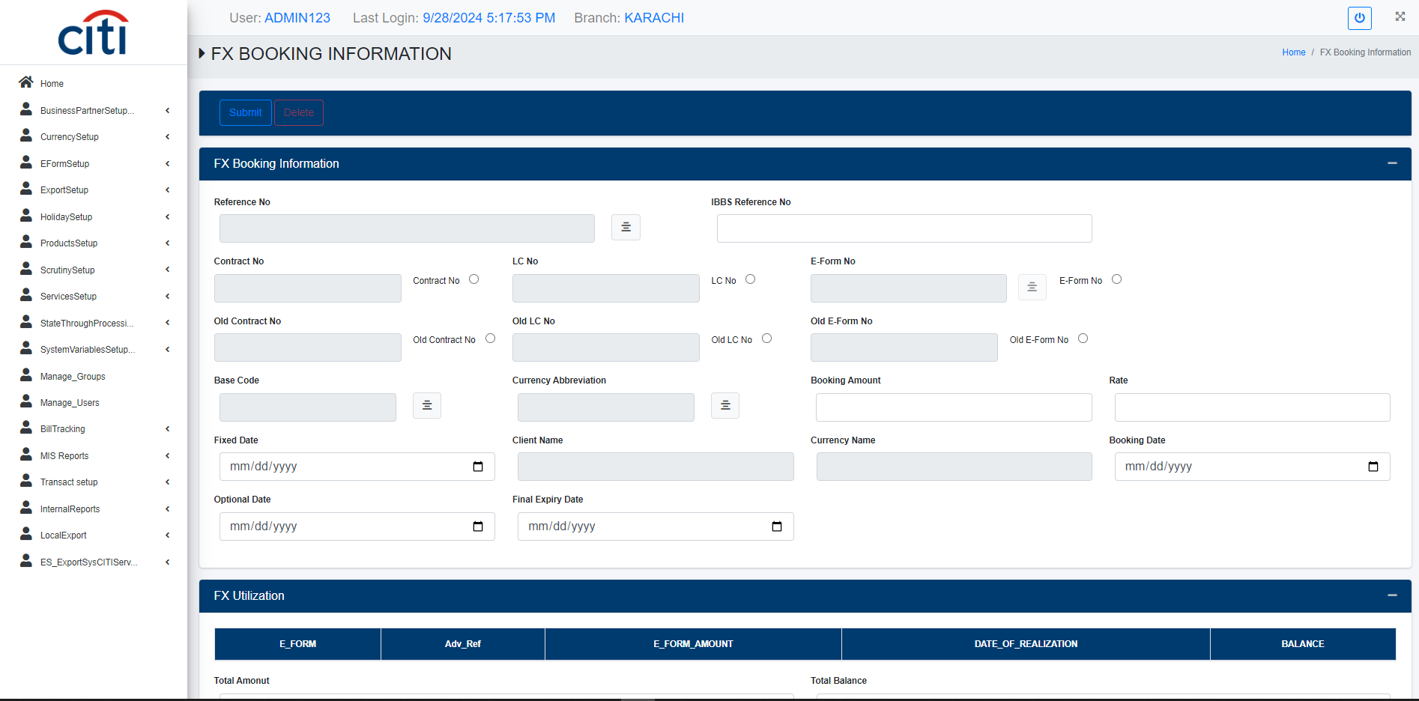
TRANSACT REPORT
FX booking information form
EXPORT APPLICATION
71

Slide 72

TRANSACT REPORT
Advance payment information form
EXPORT APPLICATION
72

Slide 73

TRANSACT REPORT
Authorization of document payment form
EXPORT APPLICATION
73

Slide 74

TRANSACT REPORT
Document payment form
EXPORT APPLICATION
74

Slide 75

TRANSACT REPORT
Authorization of FX booking form
EXPORT APPLICATION
75

Slide 76

TRANSACT REPORT
Authorization of advance payment form
EXPORT APPLICATION
76

Slide 77

TRANSACT REPORT
With holding tax report
EXPORT APPLICATION
77

Slide 78

TRANSACT REPORT
Advance payment report
EXPORT APPLICATION
78

Slide 79

TRANSACT REPORT
Transaction sheet of document payment report
EXPORT APPLICATION
79

Slide 80

TRANSACT REPORT
Annexure B report
EXPORT APPLICATION
80

Slide 81
10
Internal Reports
Volume and trade analytics across the export portfolio
EXPORT APPLICATION
81

Slide 82

INTERNAL REPORTS
Volume of country wise report
EXPORT APPLICATION
82

Slide 83

INTERNAL REPORTS
Volume of goods wise report
EXPORT APPLICATION
83

Slide 84

INTERNAL REPORTS
Volume of currency wise report
EXPORT APPLICATION
84

Slide 85

INTERNAL REPORTS
Volume detail report
EXPORT APPLICATION
85

Slide 86

INTERNAL REPORTS
SBP relief fund report
EXPORT APPLICATION
86

Slide 87

INTERNAL REPORTS
Trade volume MIS report
EXPORT APPLICATION
87

Slide 88
Thank You
Questions & discussion welcome
Developed by Zealous Technologies
zealoustechnologies.com

