Slide 1
ZEALOUS TECHNOLOGIES • PRODUCT OVERVIEW
ECIB
Electronic Credit Information Bureau
Centralized credit records for informed lending decisions
Developed by Zealous Technologies
zealoustechnologies.com

Slide 2



OVERVIEW
Project Summary
Centralized Credit Platform
Comprehensive Credit Data
Creditworthiness Assessment
A centralized financial information platform maintained by the State Bank of Pakistan to hold comprehensive credit records for individuals and companies.
Stores and manages credit-related data such as loans, credit cards, repayment history, and defaults.
Enables financial institutions to assess creditworthiness before approving loans or financing facilities.
ECIB
2

Slide 3





OVERVIEW
Project Highlights & Impact
PROJECT HIGHLIGHTS
IMPACT
Consolidated Credit Records
Informed Lending
Loan details, credit cards, repayment history, and default records for individuals and corporates
Supports informed lending decisions with accurate, centralized credit information
ECIB Report Retrieval
Financial institutions can retrieve ECIB reports to evaluate customer creditworthiness
Reduced Credit Risk
Highlights negative ECIB records that may affect a customer's ability to obtain new credit
Role-Based Access Control
Uses the User Management System with dual-level approval for all data creation and updates
Stronger Data Integrity
Strengthens data integrity and security through mandatory approval workflows
Controlled Data Access
Ensures controlled access to sensitive credit data to prevent unauthorized modifications
ECIB
3

Slide 4
PLATFORM
System Architecture
Enterprise-Grade Platform
Integrated Access Control
Developed using C# and .NET Core, following an enterprise-grade architecture focused on security, stability, and scalability.
Integrates the existing User Management module to enforce approval controls and role-based access, ensuring credit data is protected and managed in compliance with institutional requirements.
ECIB
4

Slide 5
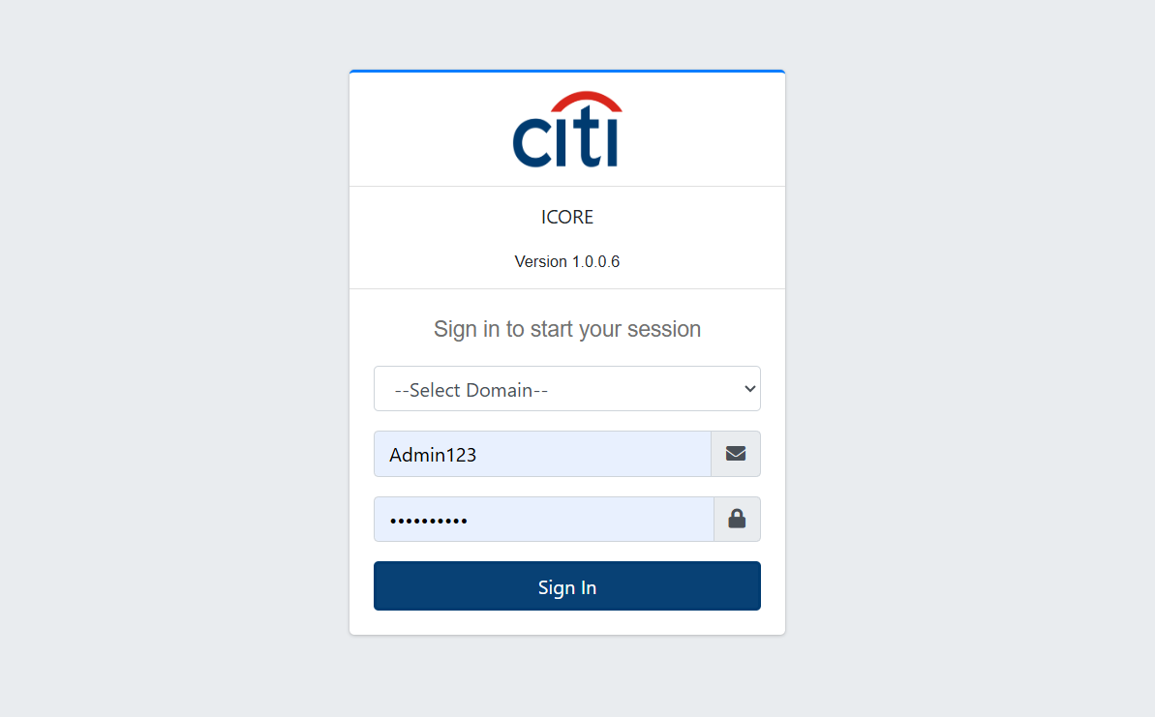

PROJECT SNIPS
Secure Sign-On
ECIB uses a secure, centralized sign-on screen to authenticate every user before granting access to credit data.
ECIB
5

Slide 6


PLATFORM OVERVIEW
System Modules
Seven integrated modules power the complete credit information lifecycle
ECIB
Non Financial
Setup Forms
ECIB Uploads
Reports
ICORE Setup
ISA Reports
ECIB
6

Slide 7
01
Non Financial
SECP and non-financial template upload forms
ECIB
7

Slide 8
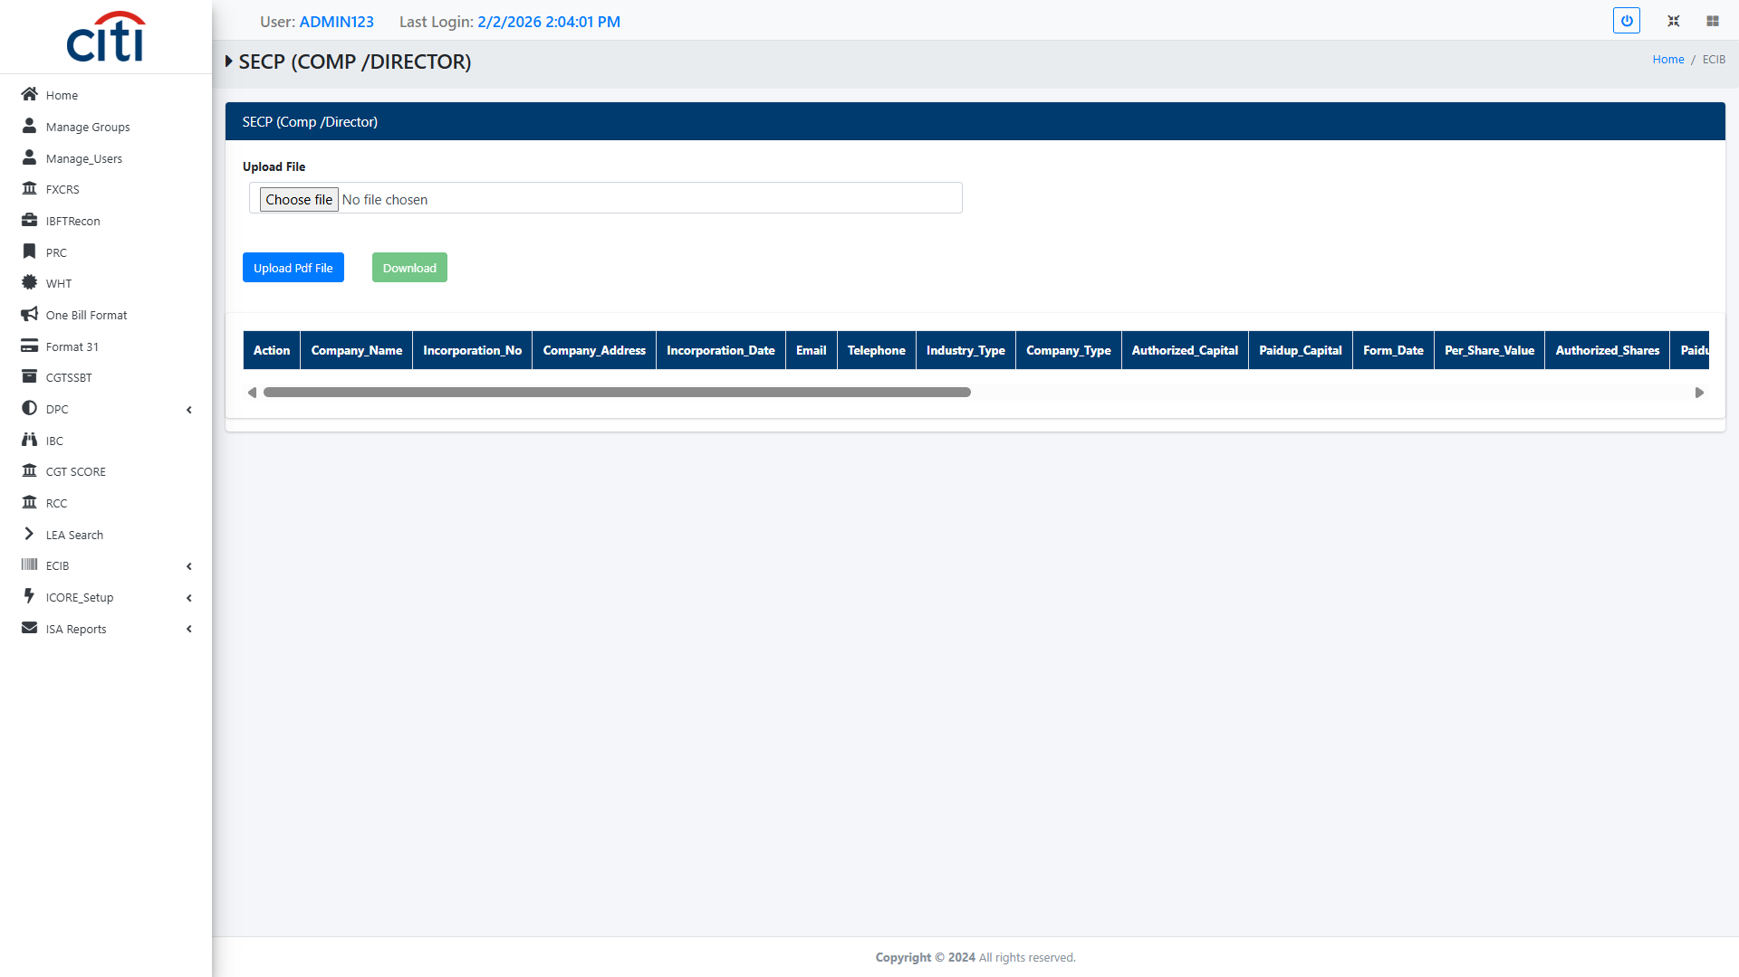
NON FINANCIAL
SECP (Security and exchange commission of Pakistan) Upload Form
ECIB
8

Slide 9
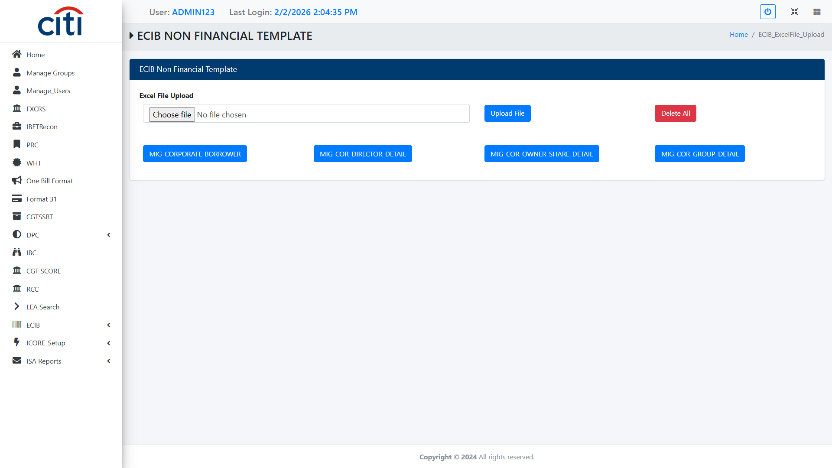
NON FINANCIAL
ECIB Non Financial Template Upload Form
ECIB
9

Slide 10
02
Setup Forms
Annexures, GL codes, customer, and loan detail setup
ECIB
10

Slide 11
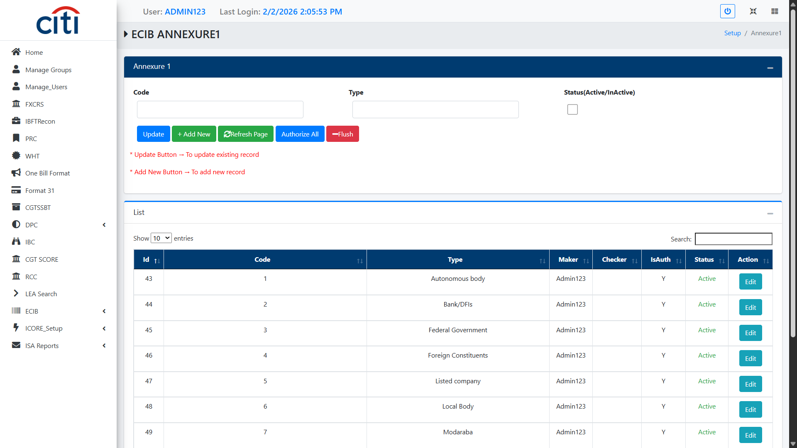
SETUP FORMS
ECIB Annexure 1
ECIB
11

Slide 12
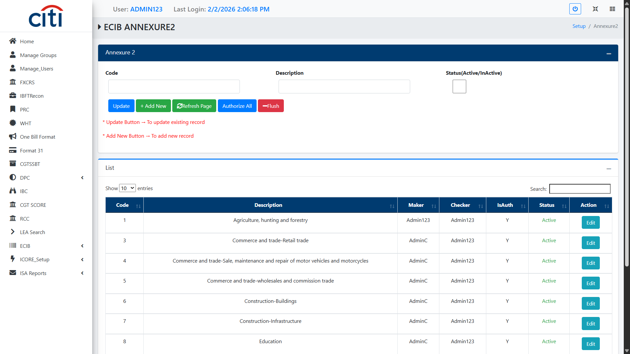
SETUP FORMS
ECIB Annexure 2 Form
ECIB
12

Slide 13
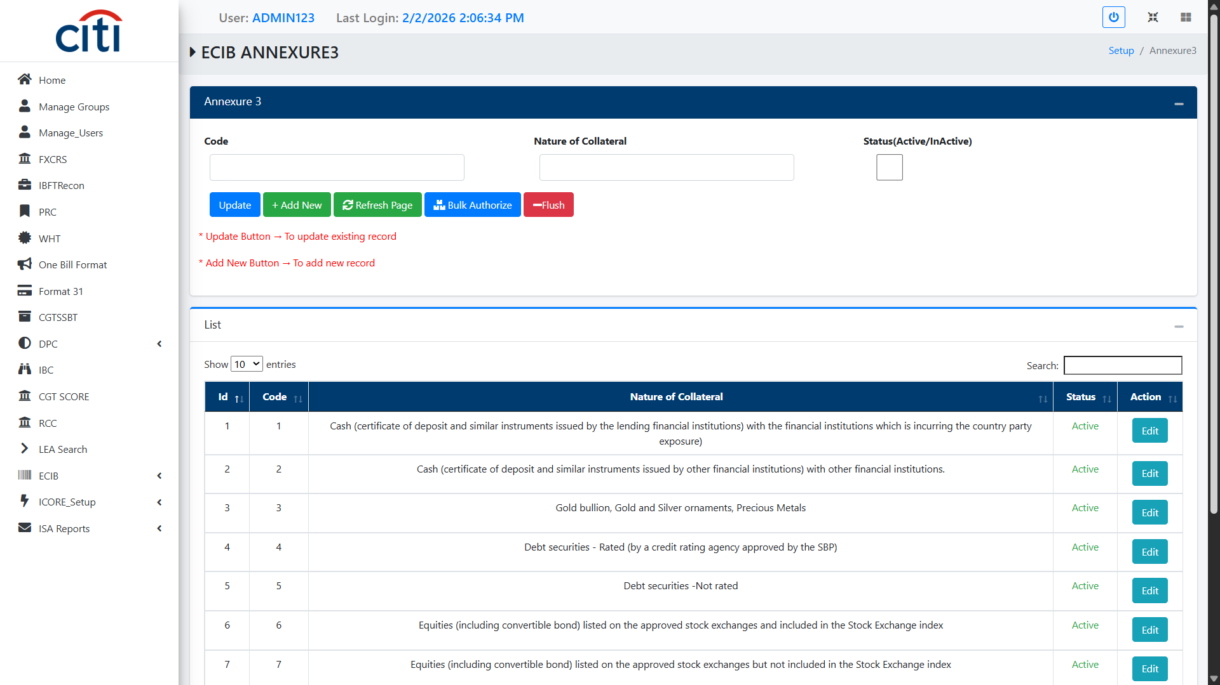
SETUP FORMS
ECIB Annexure 3 Form
ECIB
13

Slide 14
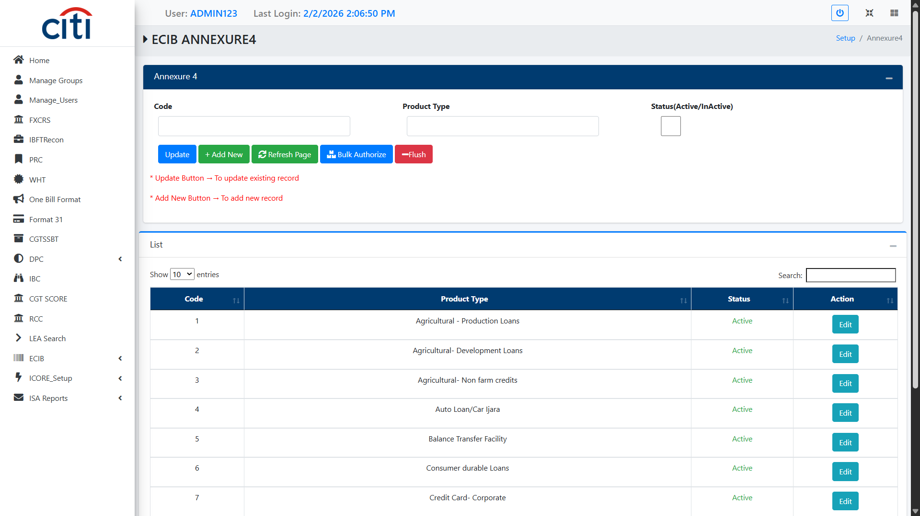
SETUP FORMS
ECIB Annexure 4
ECIB
14

Slide 15
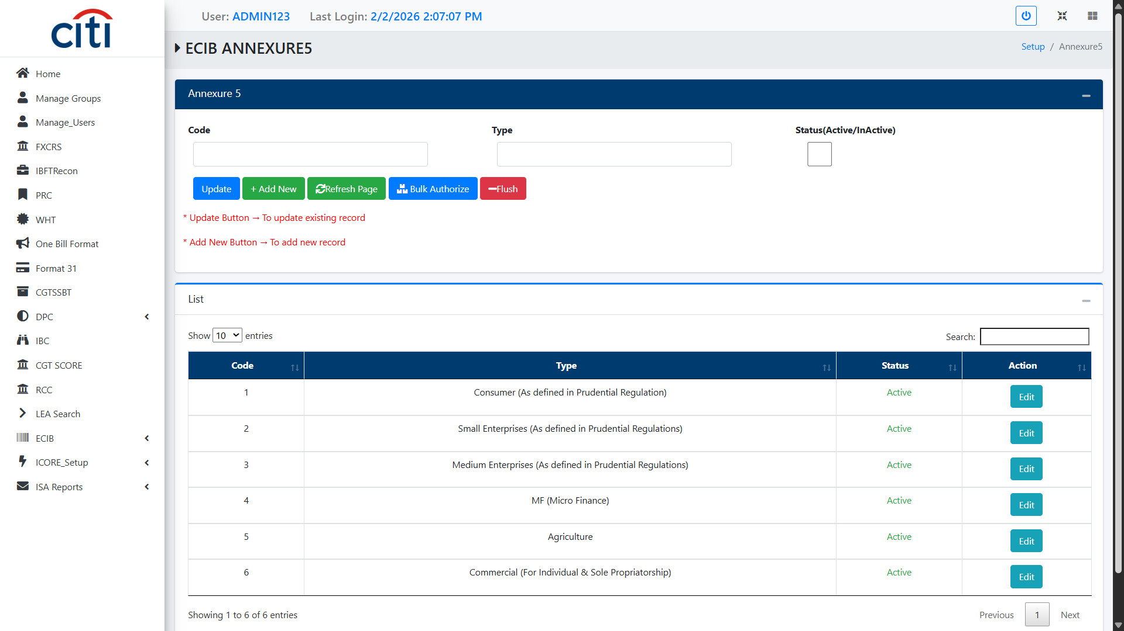
SETUP FORMS
ECIB Annexure 5
ECIB
15

Slide 16
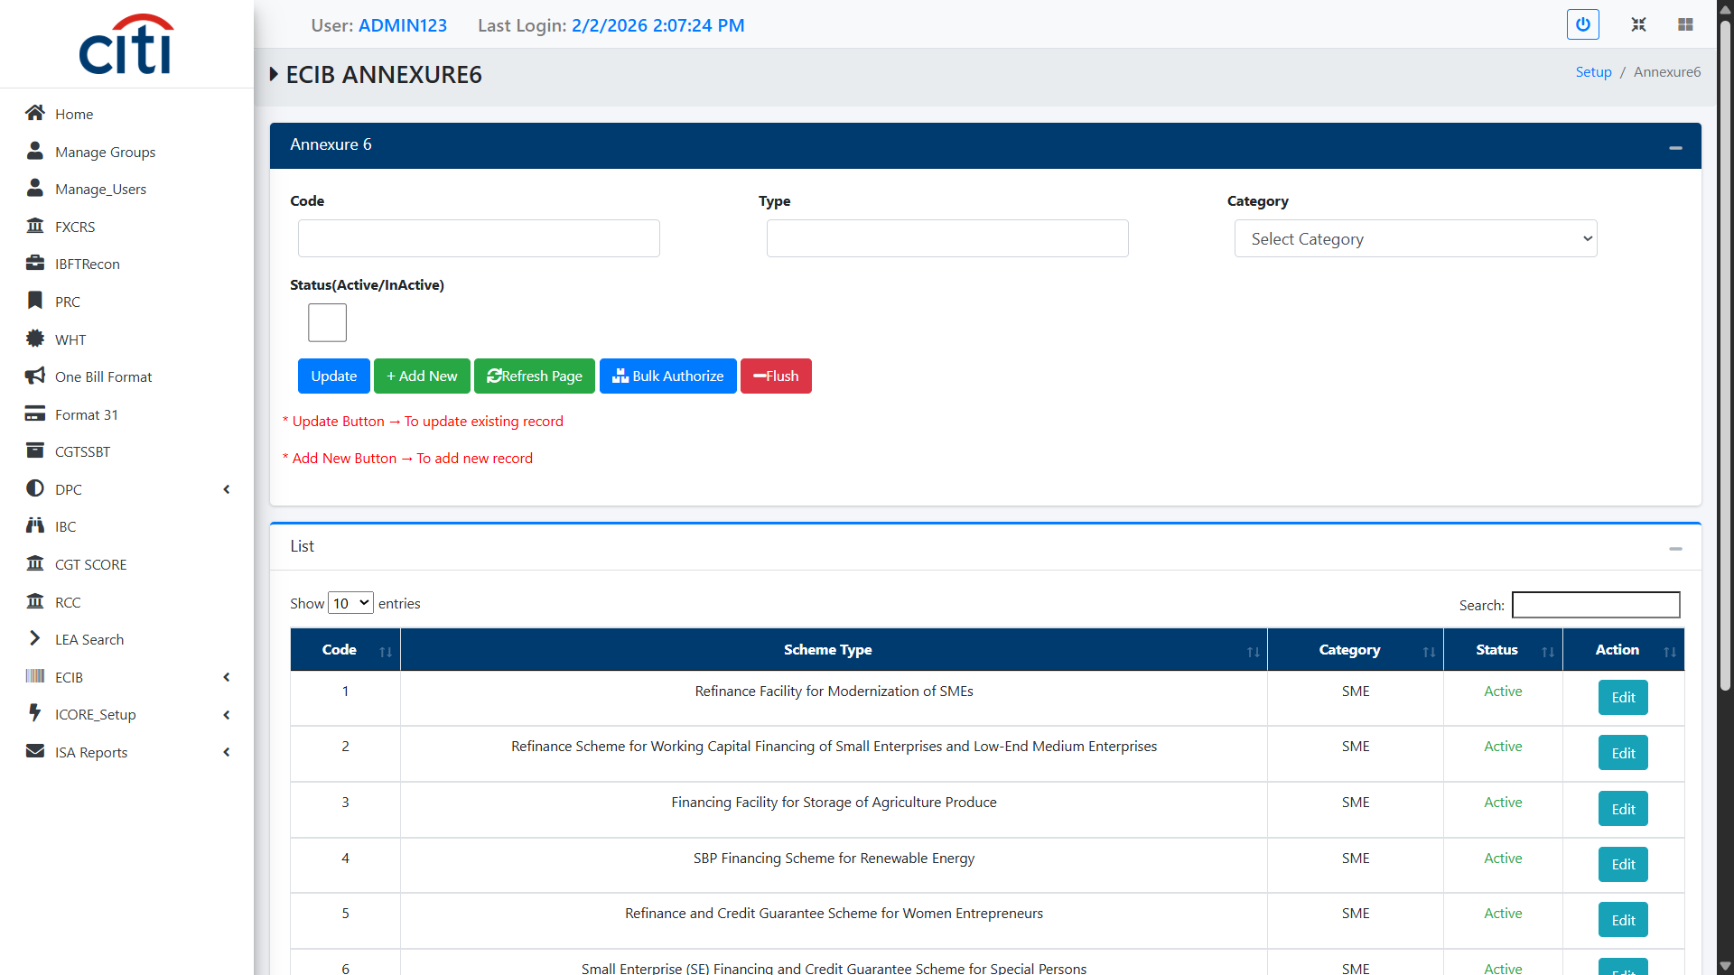
SETUP FORMS
ECIB Annexure 6
ECIB
16

Slide 17
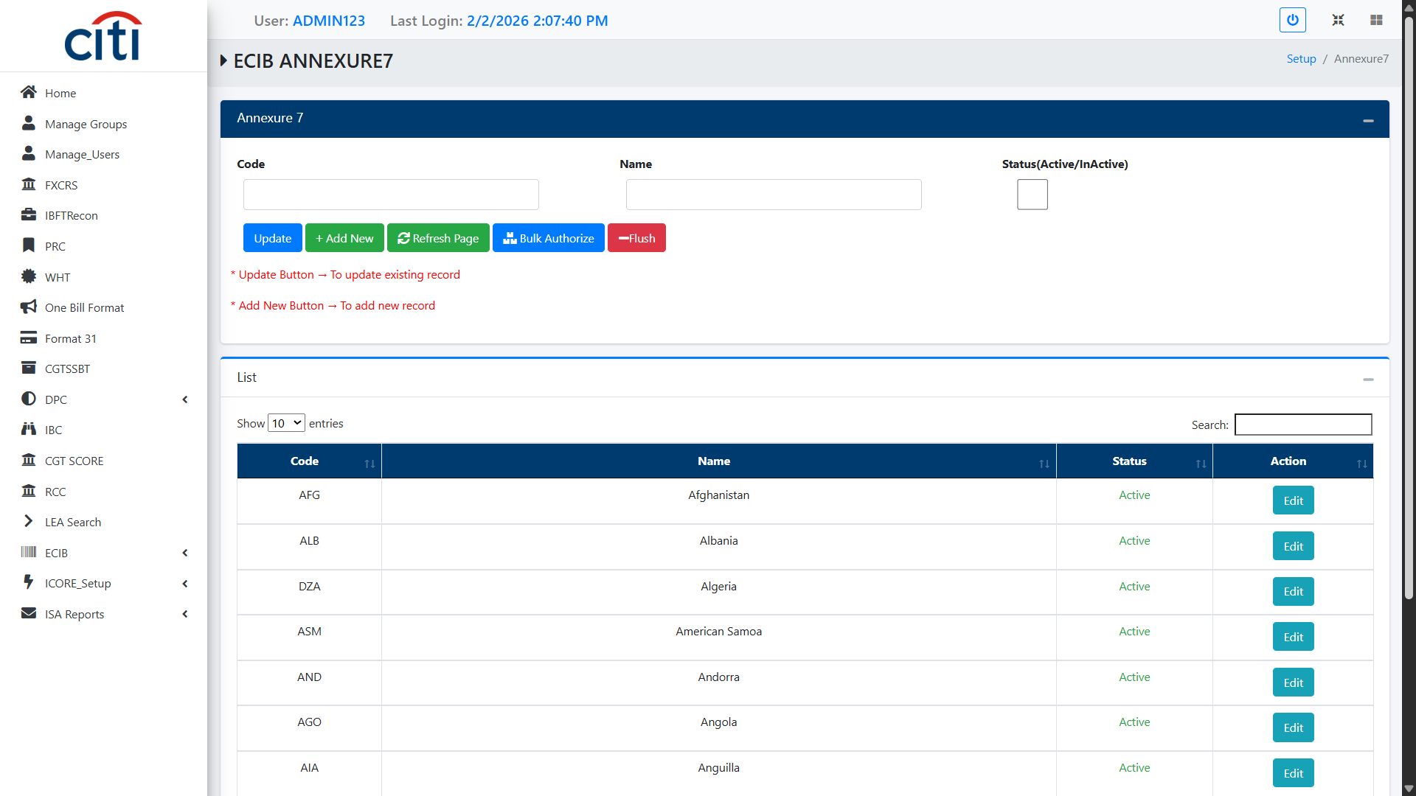
SETUP FORMS
ECIB Annexure 7
ECIB
17

Slide 18
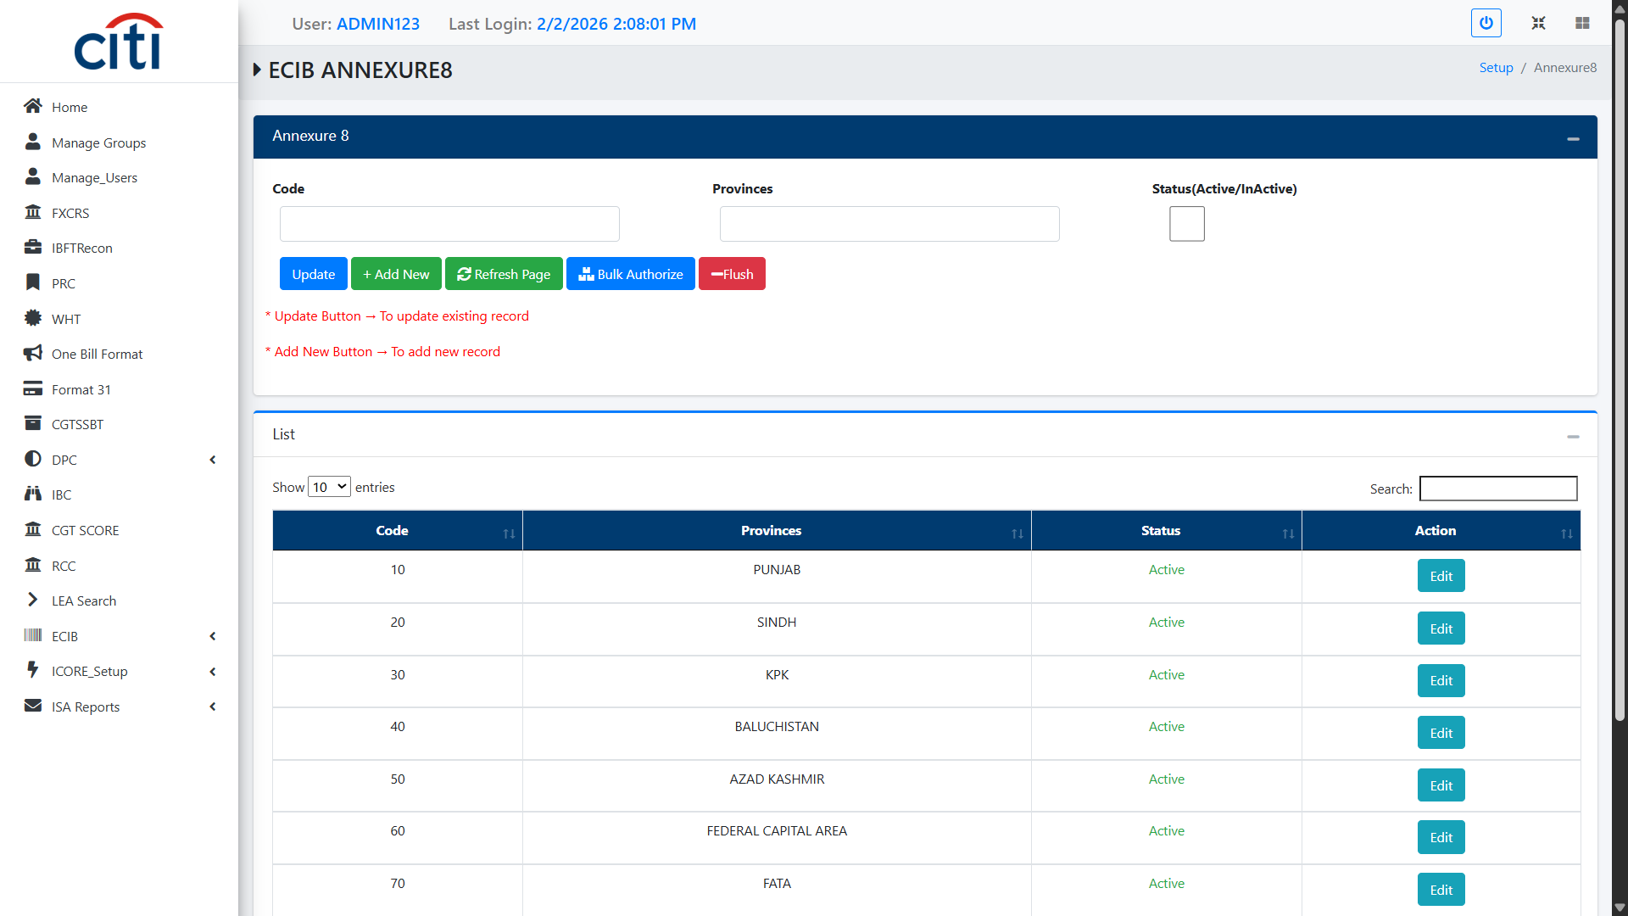
SETUP FORMS
ECIB Annexure 8
ECIB
18

Slide 19
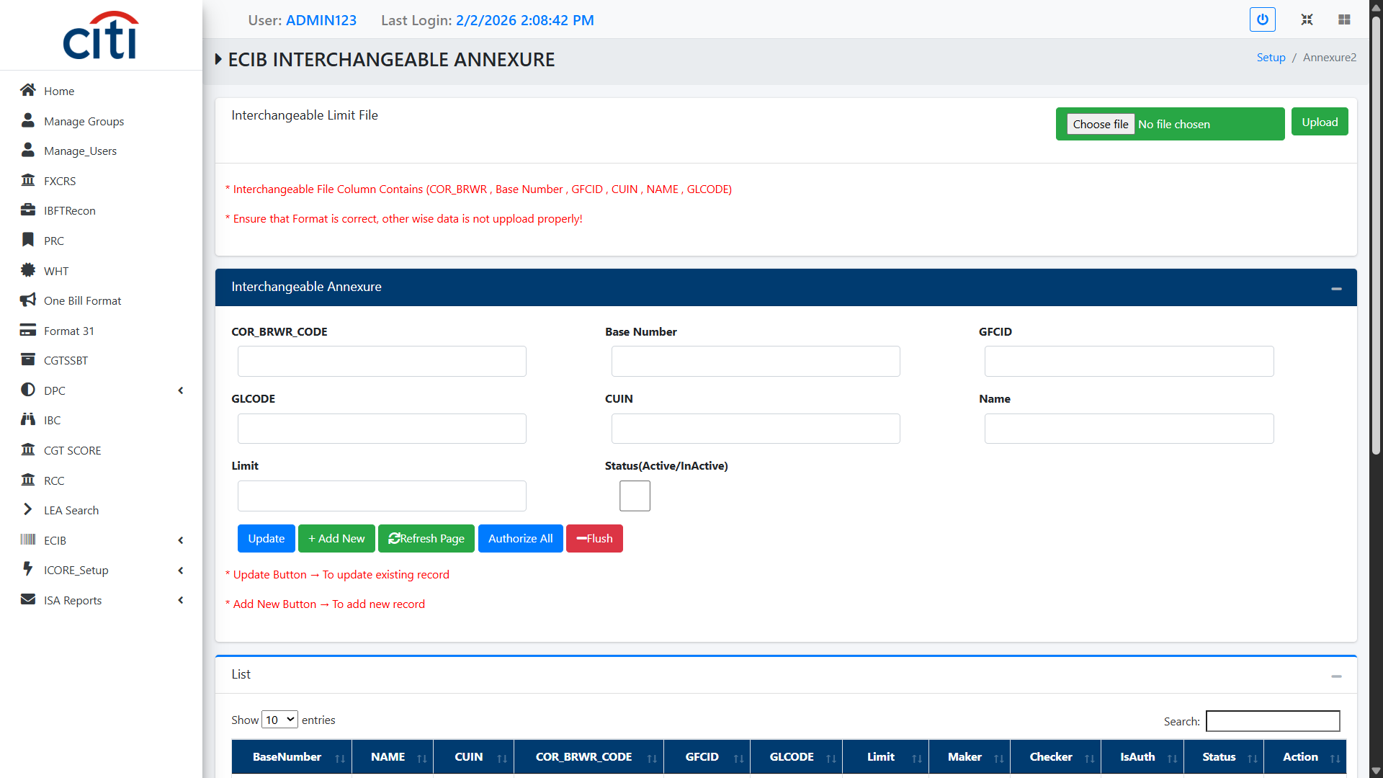
SETUP FORMS
ECIB Interchangeable Annexure
ECIB
19

Slide 20
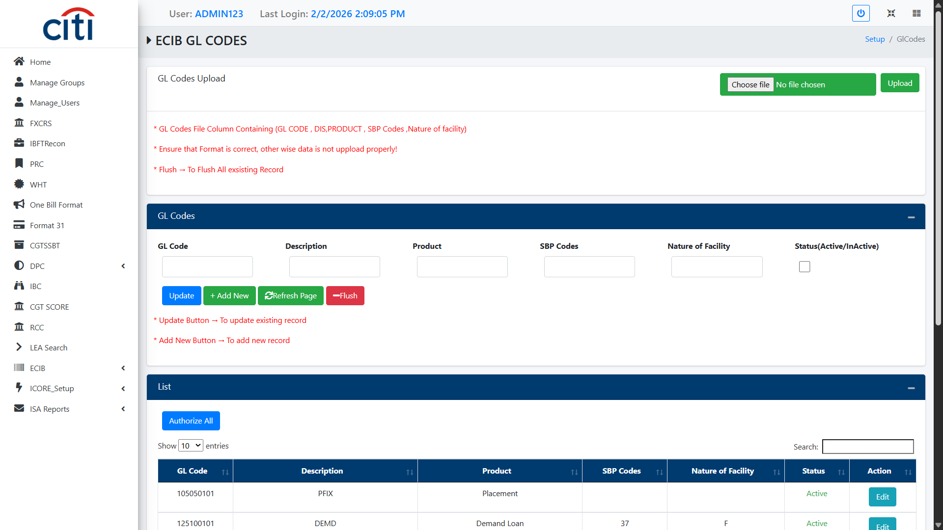
SETUP FORMS
ECIB GL Codes Upload
ECIB
20

Slide 21
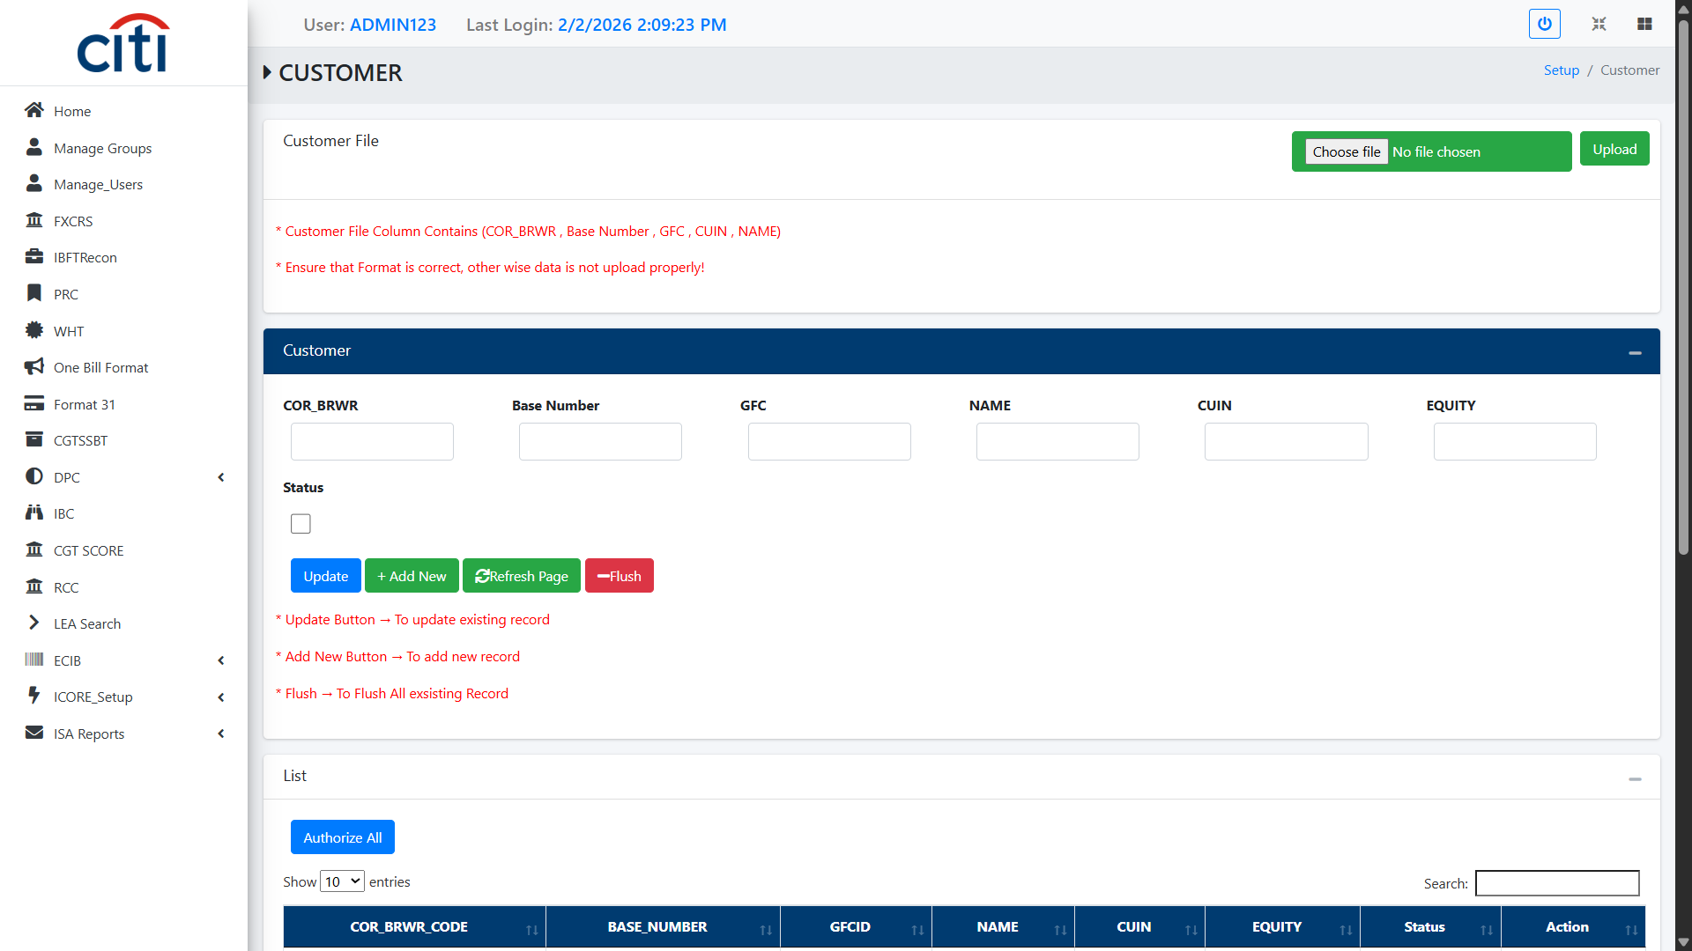
SETUP FORMS
Customer Detail Upload
ECIB
21

Slide 22
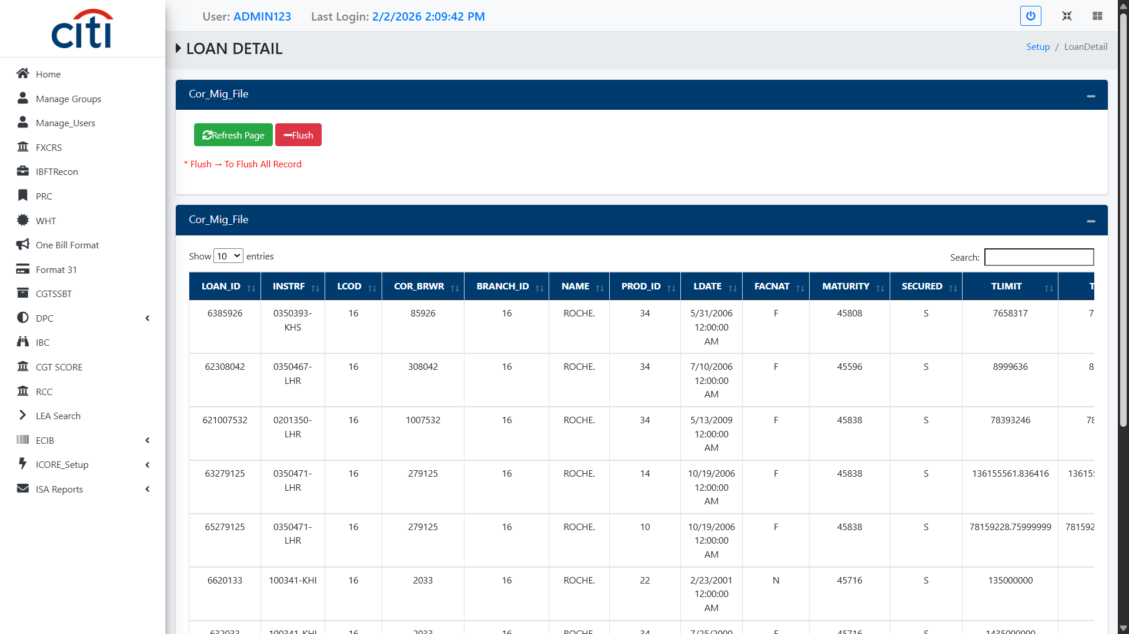
SETUP FORMS
Loan Detail Upload
ECIB
22

Slide 23
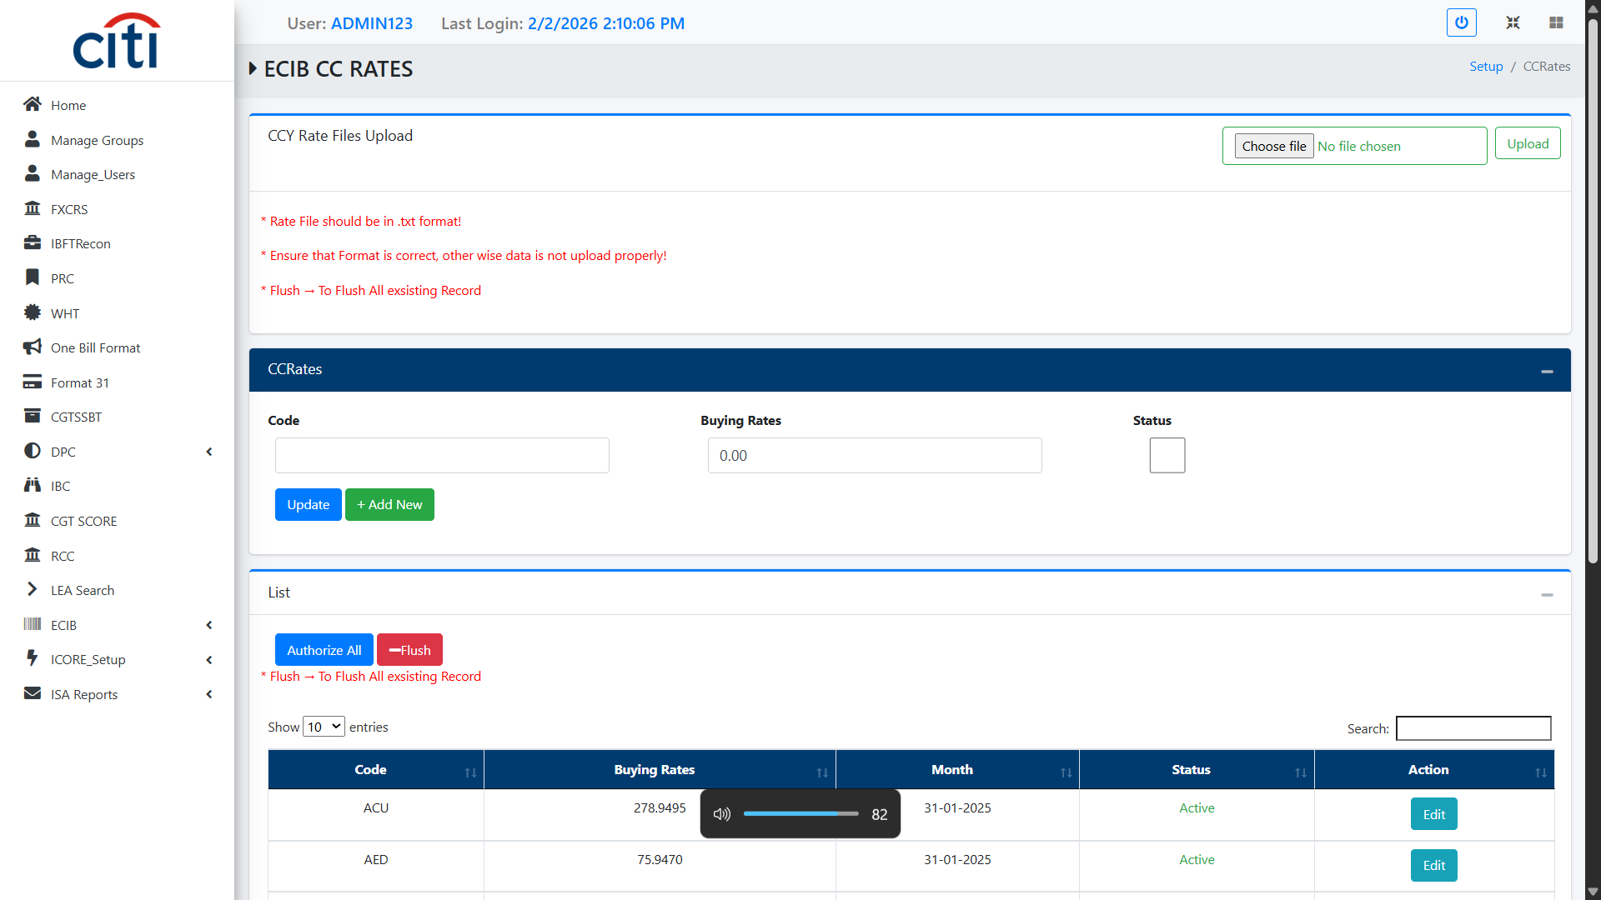
SETUP FORMS
ECIB CC Rates Upload
ECIB
23

Slide 24
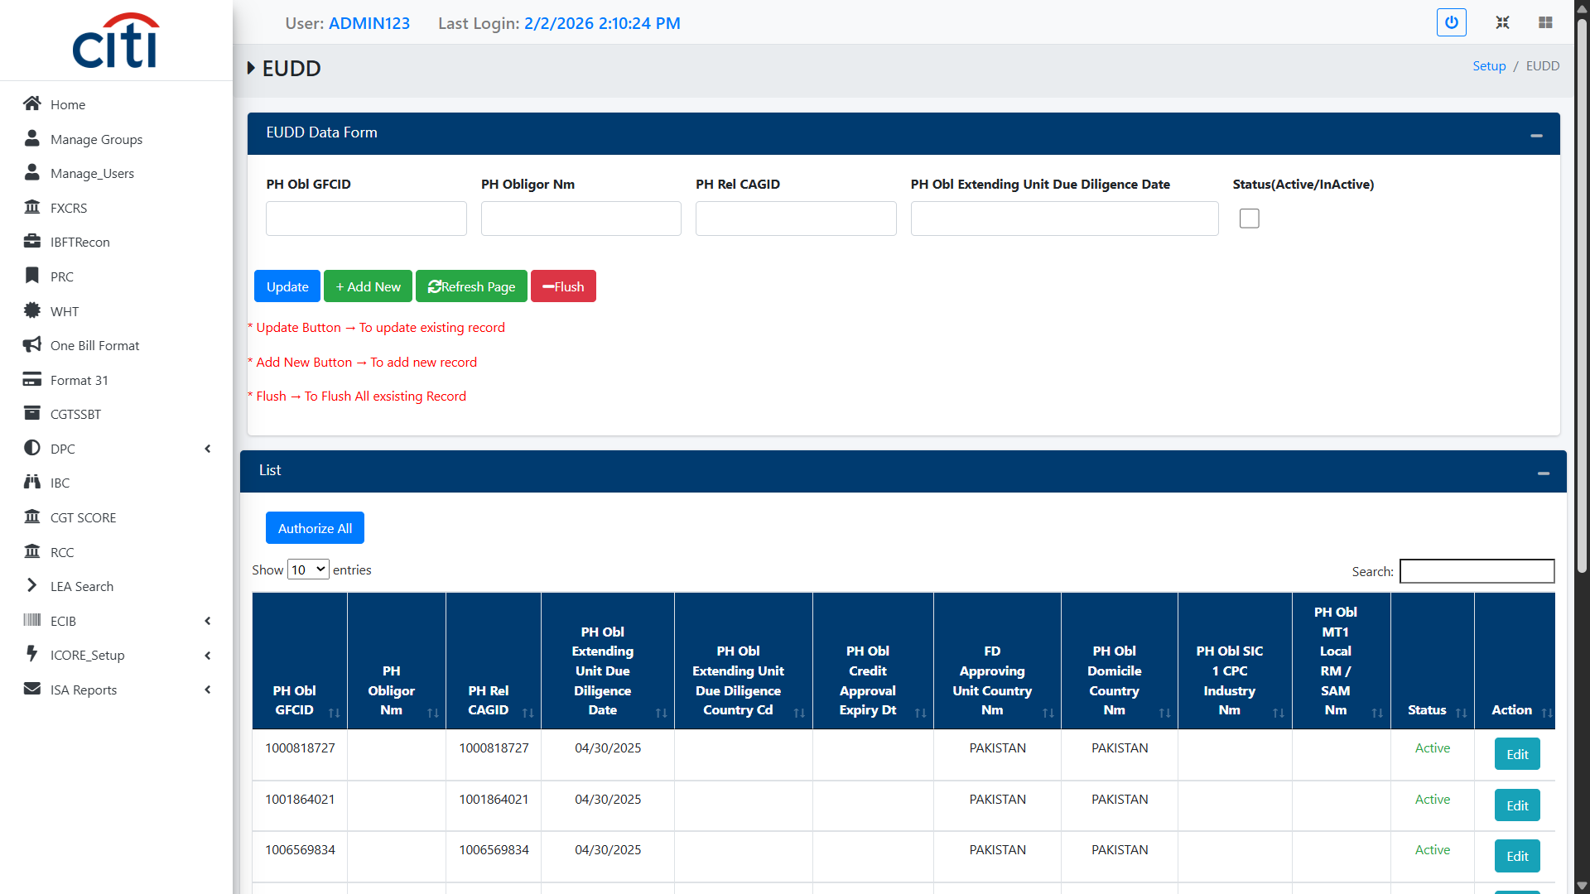
SETUP FORMS
EUDD Form
ECIB
24

Slide 25
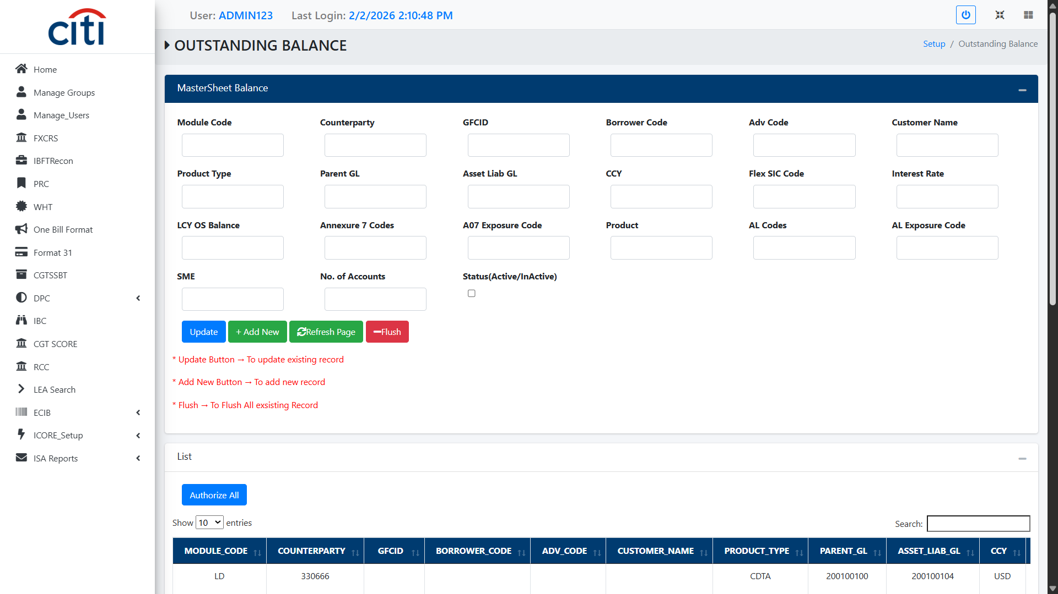
SETUP FORMS
Outstanding Balance Form
ECIB
25

Slide 26
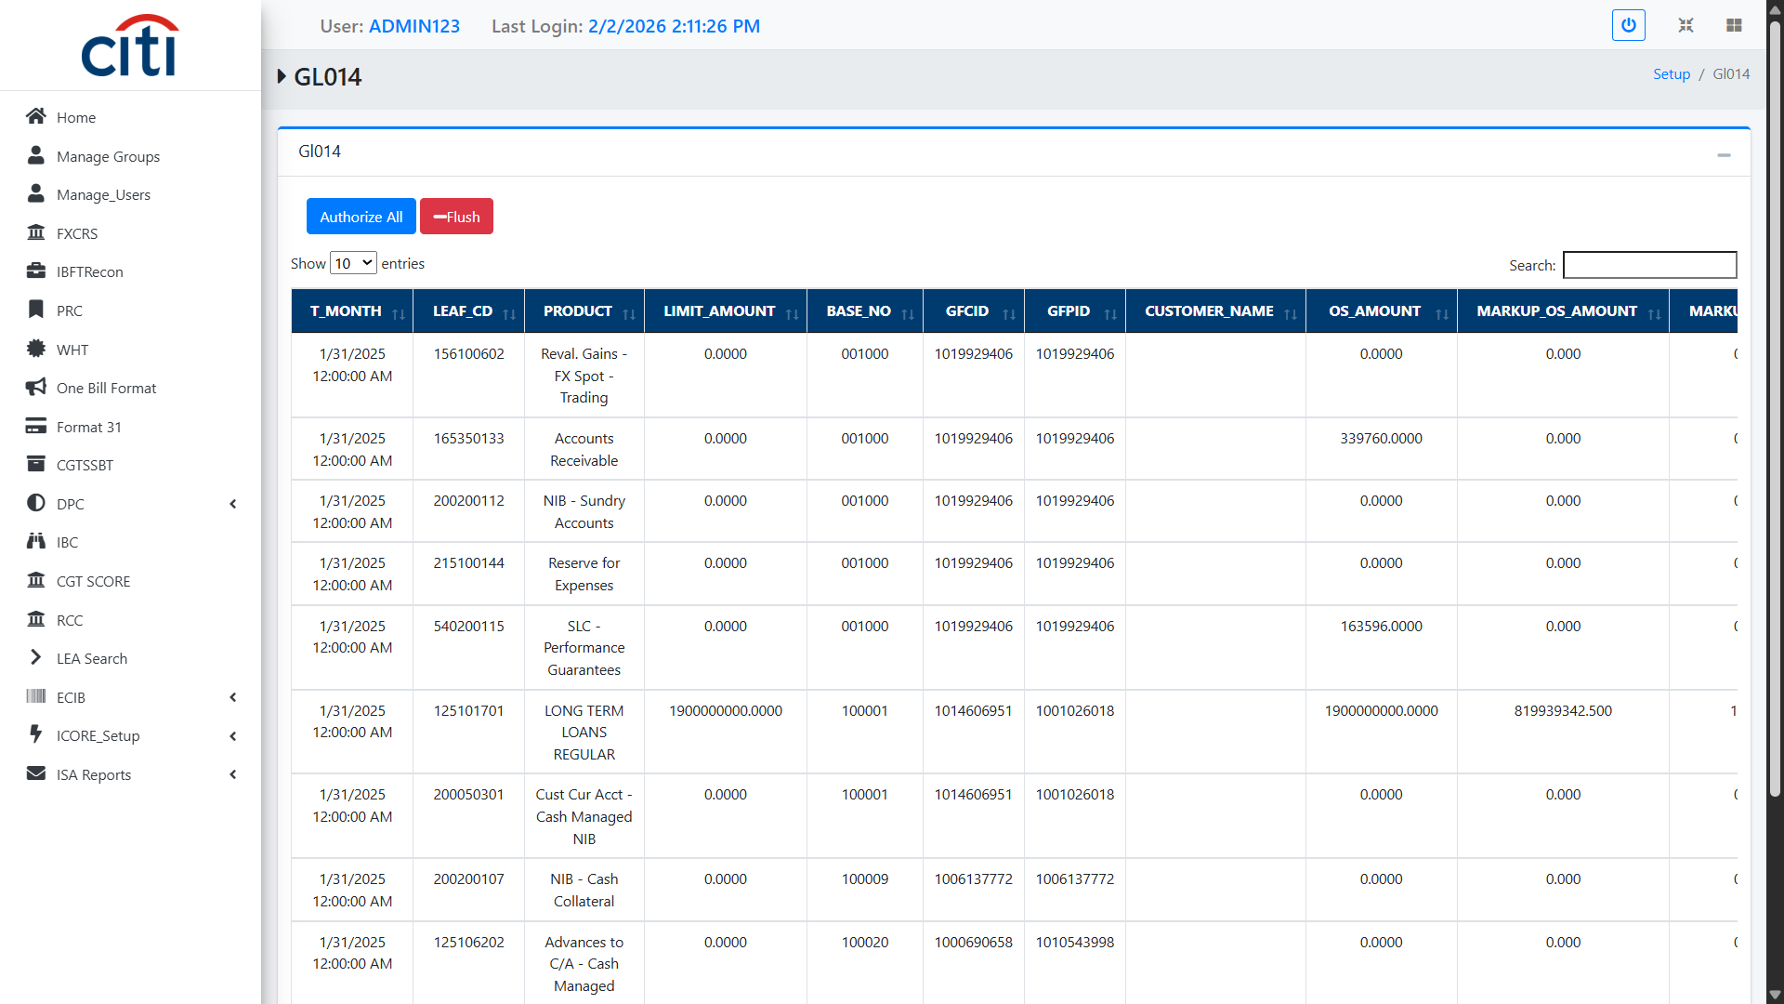
SETUP FORMS
GL04 Form
ECIB
26

Slide 27
03
ECIB Uploads
Mapping uploads for annexures, master sheets, and GL codes
ECIB
27

Slide 28
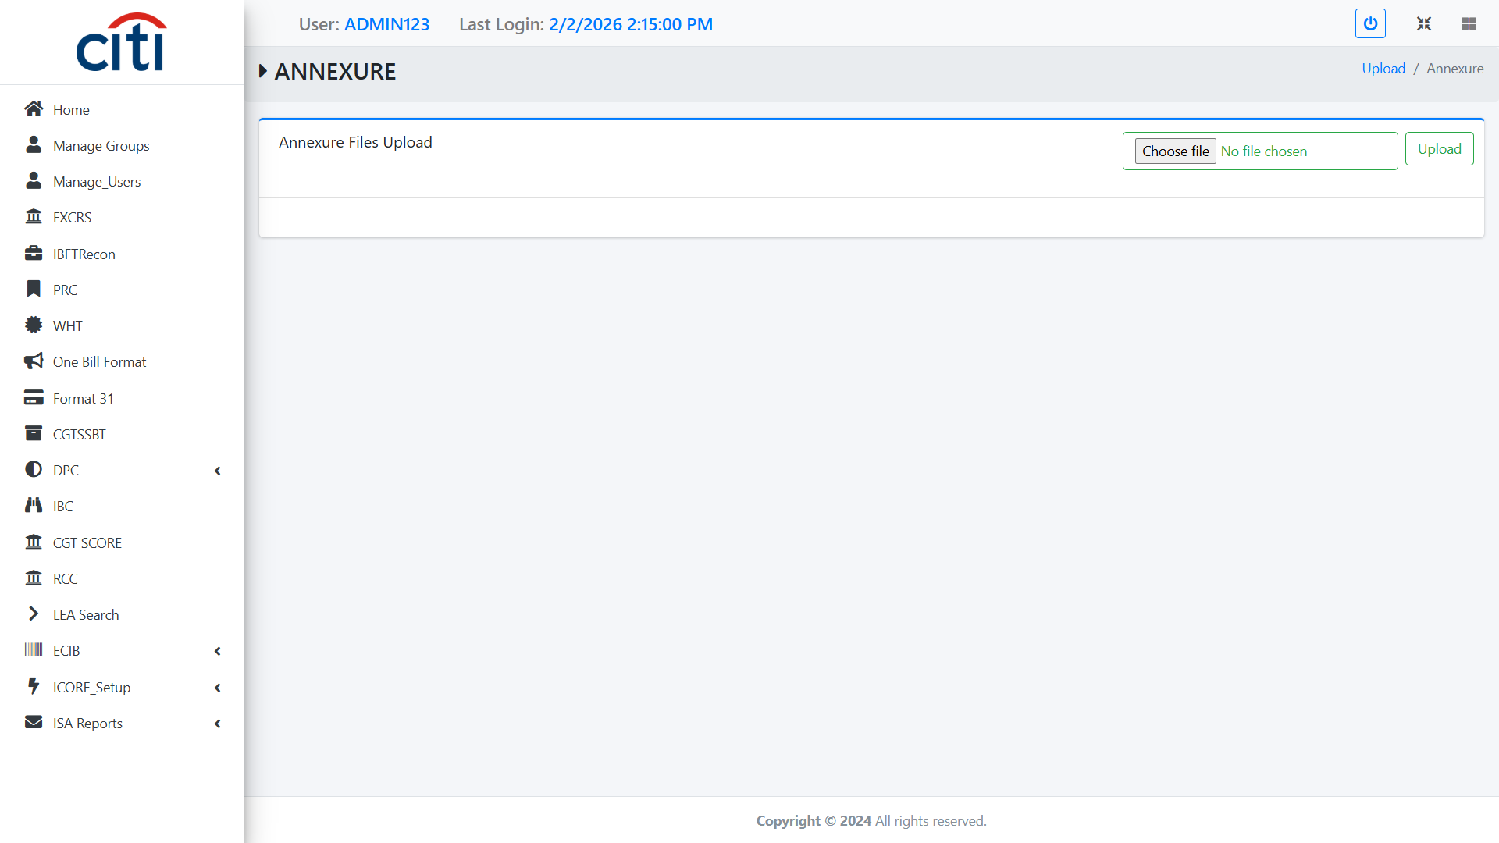
ECIB UPLOADS
Annexure Upload Form
ECIB
28

Slide 29
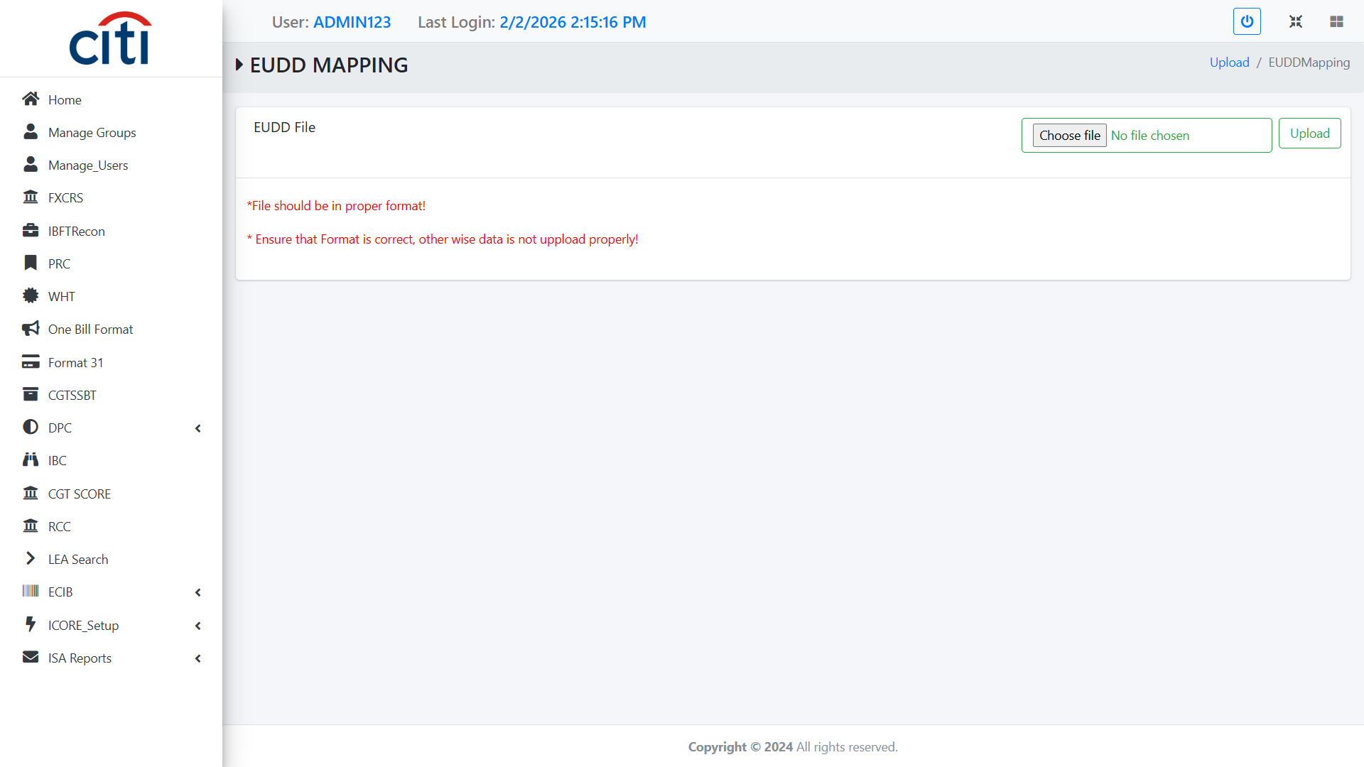
ECIB UPLOADS
EUDD Mapping Upload Form
ECIB
29

Slide 30
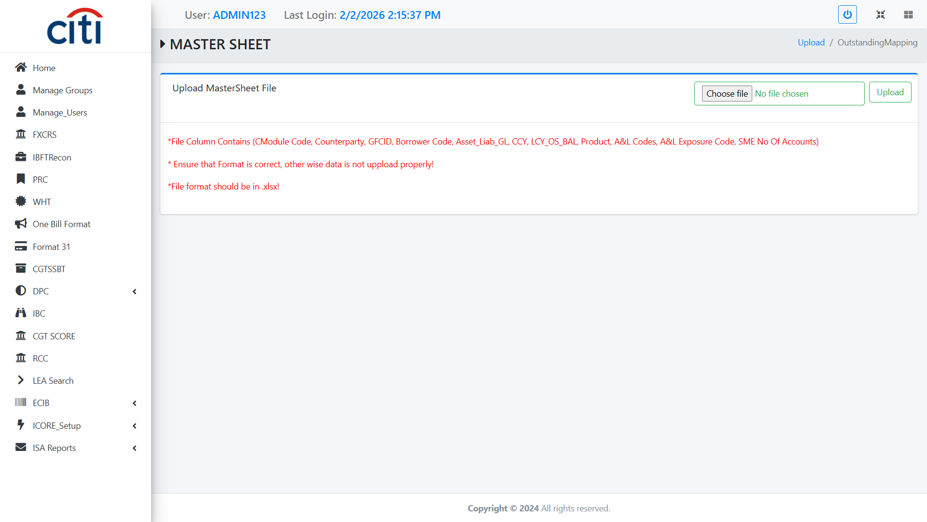
ECIB UPLOADS
Master Sheet Upload Form
ECIB
30

Slide 31
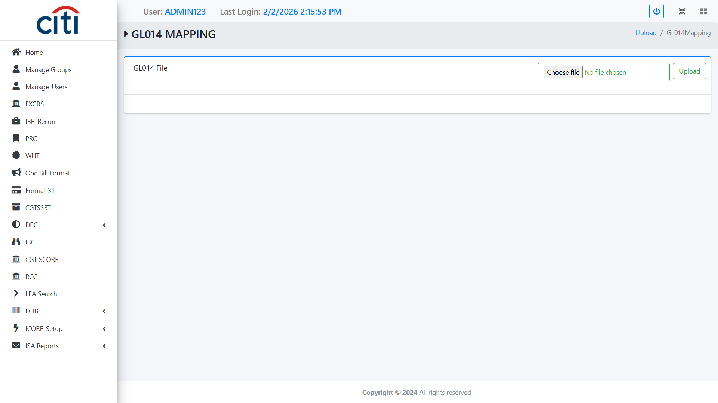
ECIB UPLOADS
GL014 Mapping Upload Form
ECIB
31

Slide 32
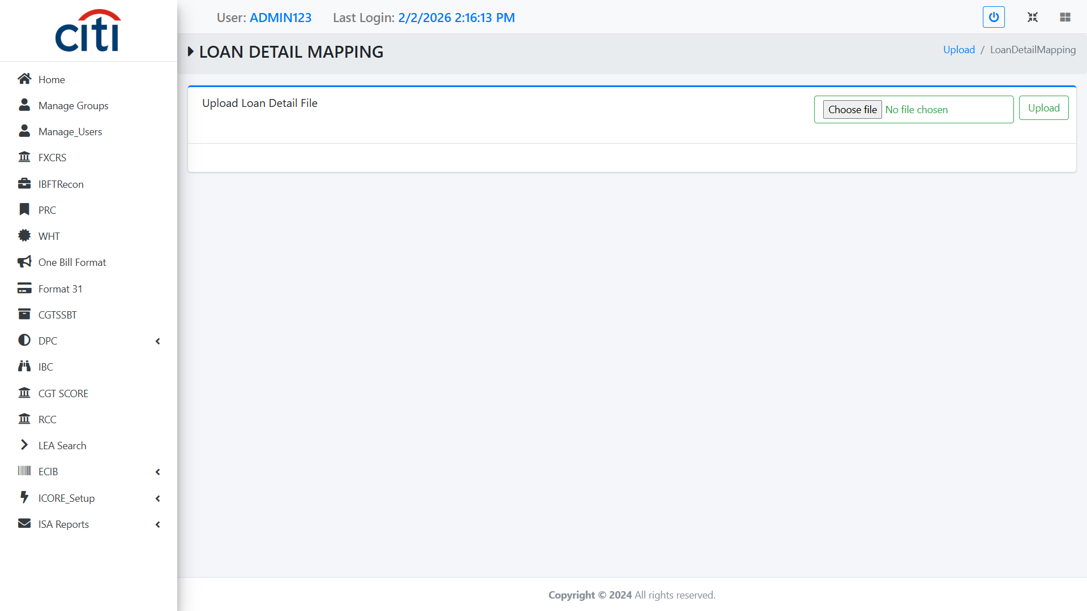
ECIB UPLOADS
Loan Detail Mapping Upload Form
ECIB
32

Slide 33
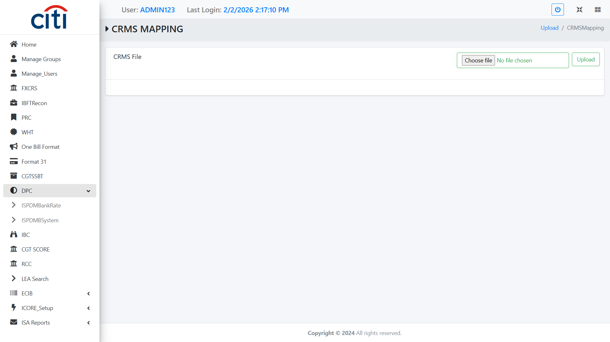
ECIB UPLOADS
CRMS Mapping Upload Form
ECIB
33

Slide 34

ECIB UPLOADS
SBLC Mapping Upload Form
ECIB
34

Slide 35
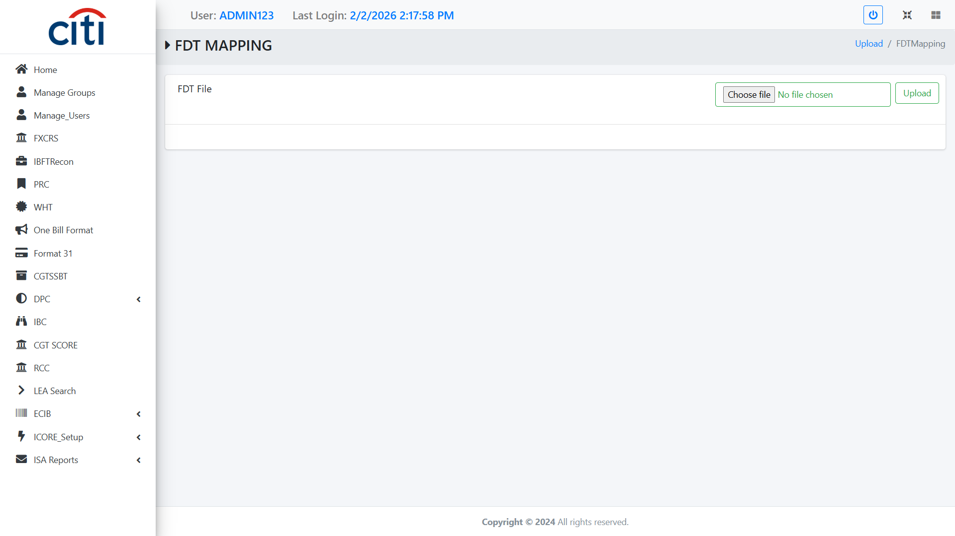
ECIB UPLOADS
FDT Mapping Upload Form
ECIB
35

Slide 36
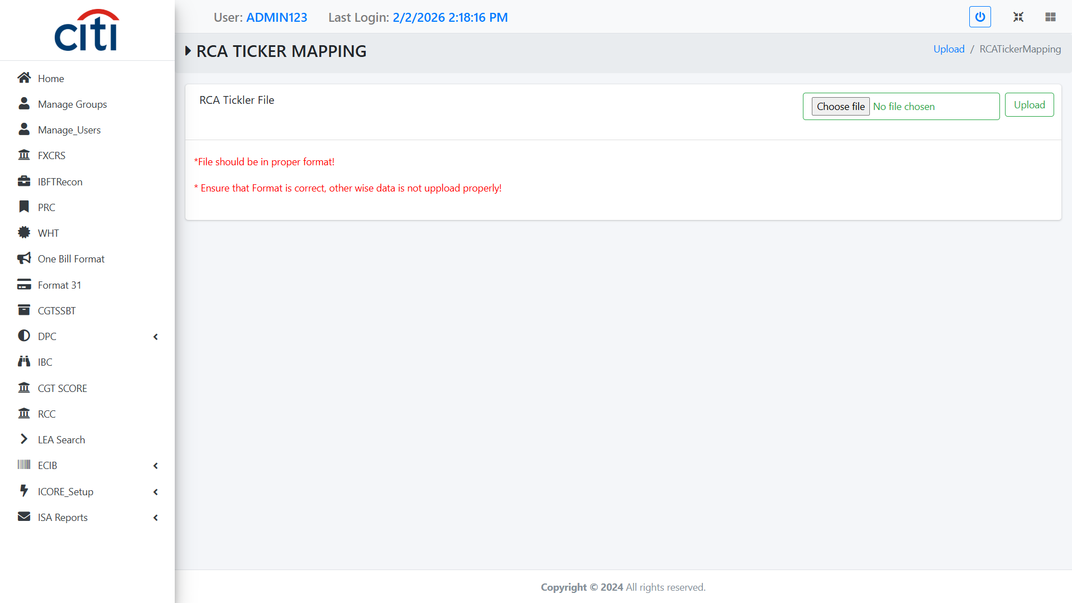
ECIB UPLOADS
RCA Ticker Mapping Upload
ECIB
36

Slide 37

ECIB UPLOADS
Equity DRM Mapping Form
ECIB
37

Slide 38
04
Reports
Financial reporting across ECIB submissions
ECIB
38

Slide 39
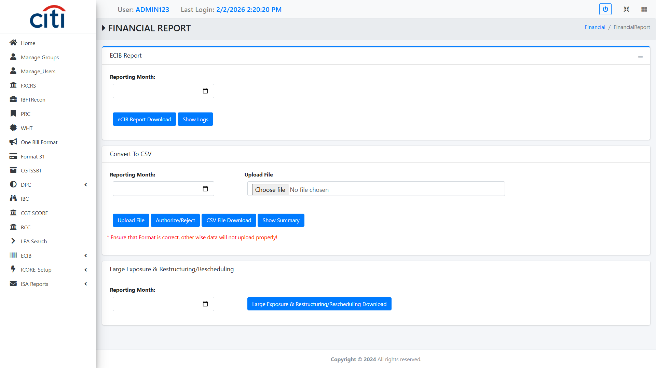
REPORTS
Financial Report Form
ECIB
39

Slide 40
Thank You
Questions & discussion welcome
Developed by Zealous Technologies
zealoustechnologies.com

