Slide 1
ZEALOUS TECHNOLOGIES • PRODUCT OVERVIEW
CHRIS
Centralized Human Resource Information System
A unified platform for employee data, payroll, and personnel management
Developed by Zealous Technologies
zealoustechnologies.com

Slide 2



OVERVIEW
Project Summary
Unified HR Platform
Full Lifecycle Automation
Data Integrity & Security
A high-performance platform purpose-built for the Operations Team, centralizing employee data, payroll, and personnel management into a single interface.
Streamlines the entire employee lifecycle — from hiring and onboarding to promotions and payroll — eliminating manual record-keeping.
Modernizes legacy HR processes with a focus on security and data integrity across all branches, supporting the bank's digital transformation goals.
CHRIS
2

Slide 3




OVERVIEW
Project Highlights & Impact
PROJECT HIGHLIGHTS
IMPACT
Roles & Approvals
Fewer Errors
Robust user-role management with maker-checker functionality for every HR action
Automated workflows and mandatory approvals reduce payroll and personnel record errors
Structured Workflows
Full Compliance
Regular & contract hiring, summer interns, promotions, and department transfers
Transparent, traceable audit trail aligned with bank policy and regulation
Automated Calculations
Better Decisions
Income tax, allowances, and deductions computed accurately and on time
Comprehensive reporting suite for payroll, compensation, and user logs
Flexible Hierarchies
Manage branches, categories, departments, and designations
CHRIS
3

Slide 4

PLATFORM
System Architecture
A web-based, secure enterprise-grade platform built in C# and .NET Core to manage high-concurrency HR operations with maximum stability and performance.
Centralized Database
Logic Tier
Reporting Engine
Unified record-keeping for all personnel data, handled with the highest level of security.
Enforces business rules for hiring, increments, and tax calculations.
Generates real-time payroll and audit logs, integrating seamlessly with other banking systems.
CHRIS
4

Slide 5
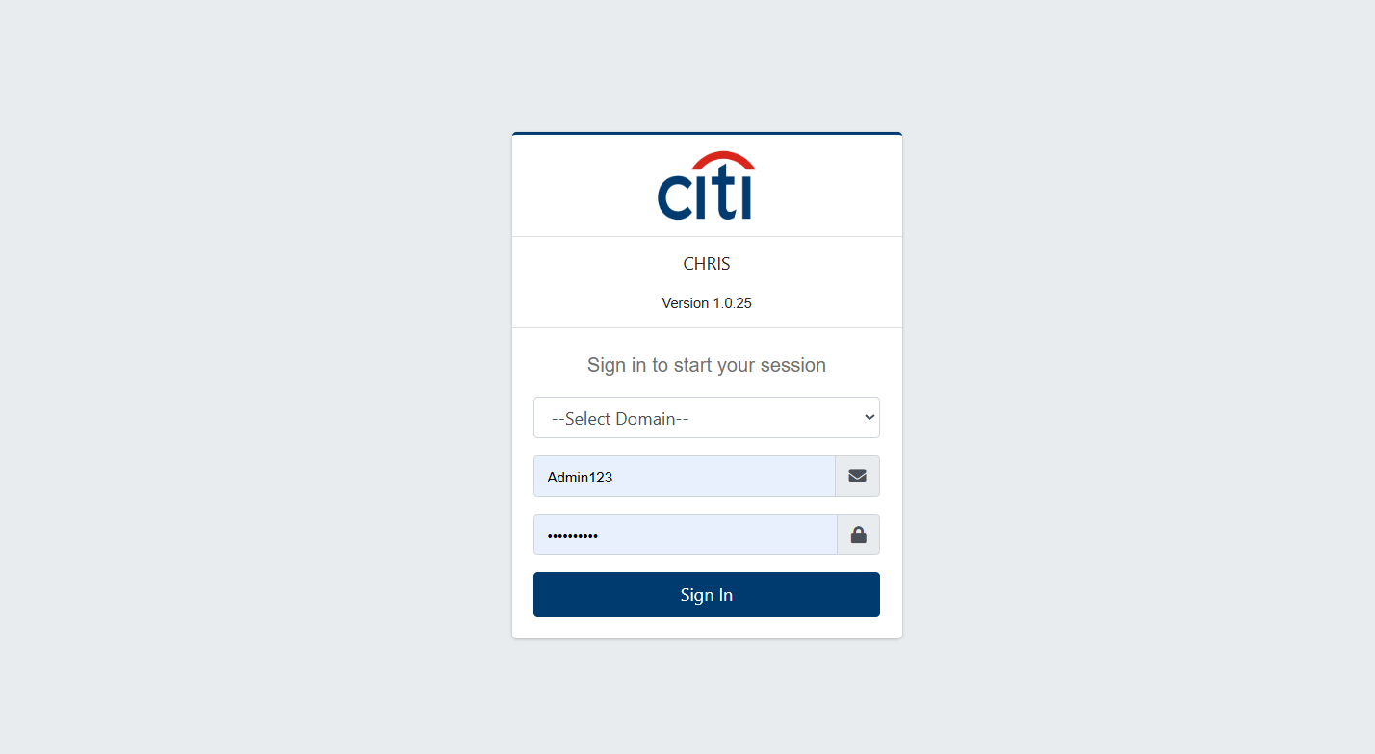

PROJECT SNIPS
Secure Sign-On
CHRIS uses a secure, centralized sign-on screen to authenticate every user before granting access to HR and payroll data.
CHRIS
5

Slide 6








PLATFORM OVERVIEW
System Modules
Seventeen integrated modules power the complete HR lifecycle
Manage Groups
Manage Users
Setup
Personnel Report
Payroll Reports
Finance Reports
Processing
Query
Tax Closing
PFund
Personnel
Gratuity
Interest Differential
Medical Insurance
Payroll
Finance
Setup Report
CHRIS
6

Slide 7
01
Setup Forms
Reference data for groups, categories, branches, and compensation setups
CHRIS
7

Slide 8
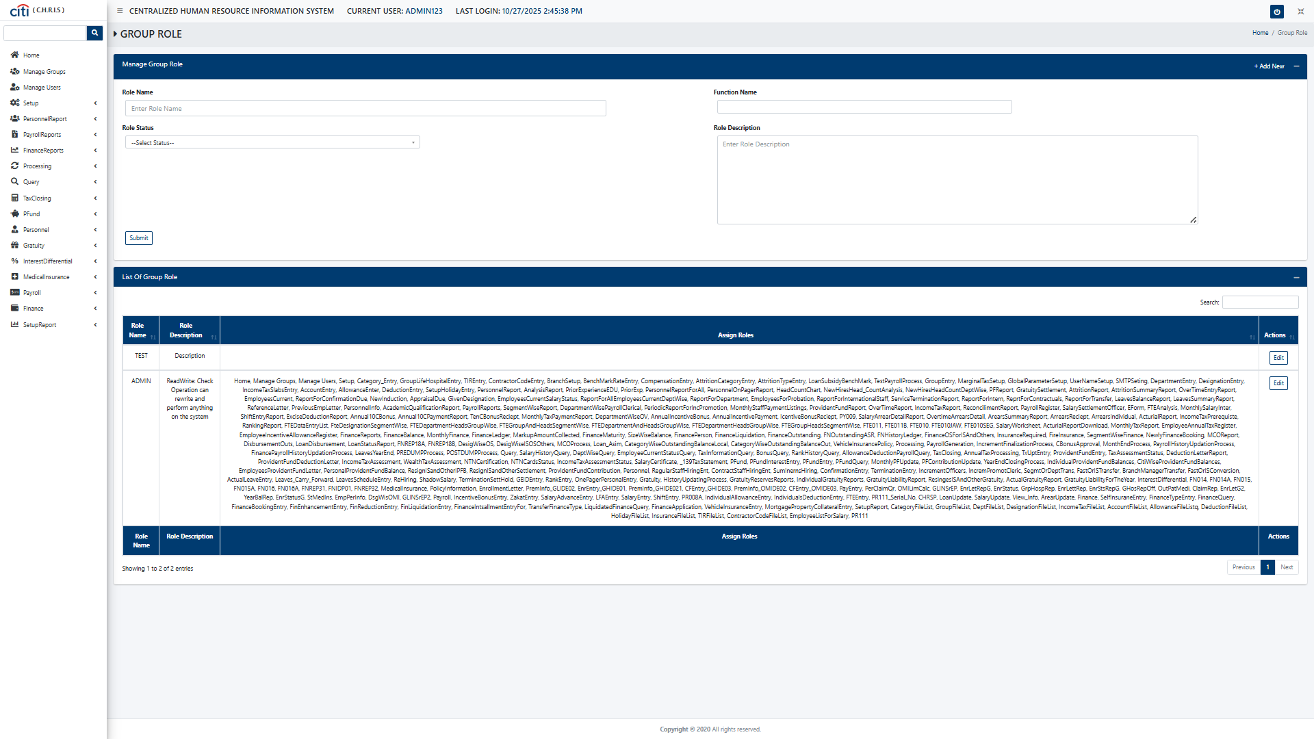
SETUP FORMS
Manage Group Role Setup form
CHRIS
8

Slide 9
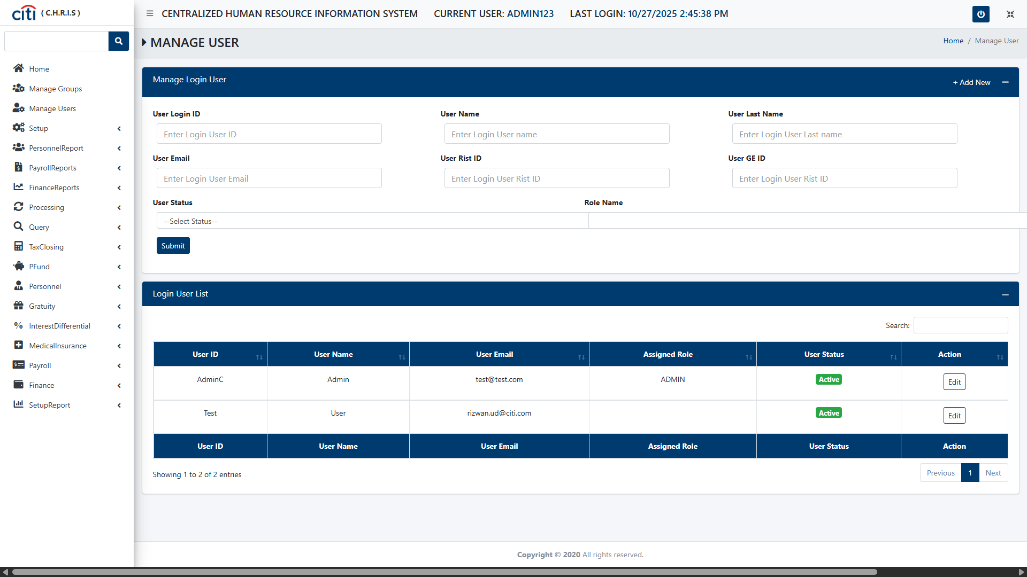
SETUP FORMS
Manage login User Setup form
CHRIS
9

Slide 10
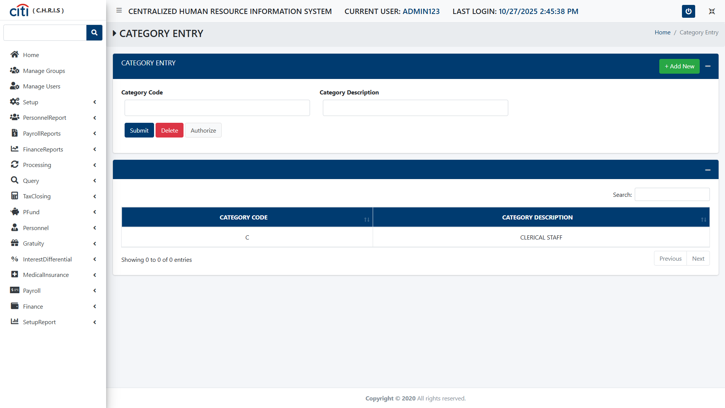
SETUP FORMS
Category Entry Setup form
CHRIS
10

Slide 11
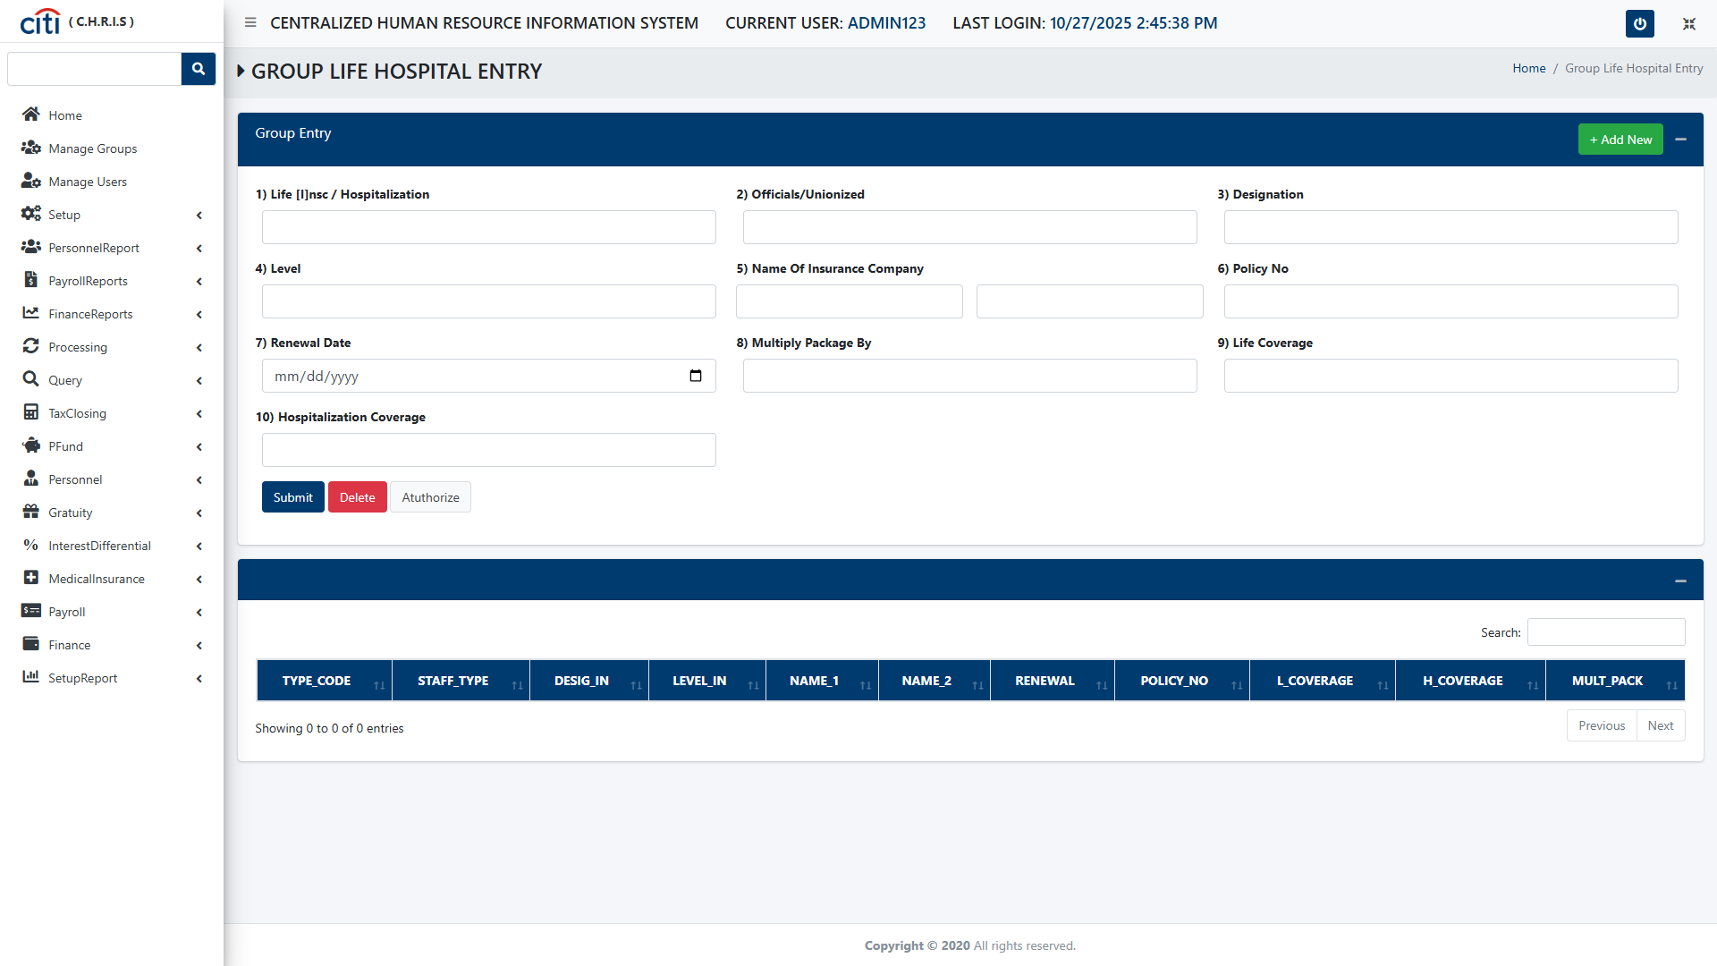
SETUP FORMS
Group Life Hospital Entry form
CHRIS
11

Slide 12
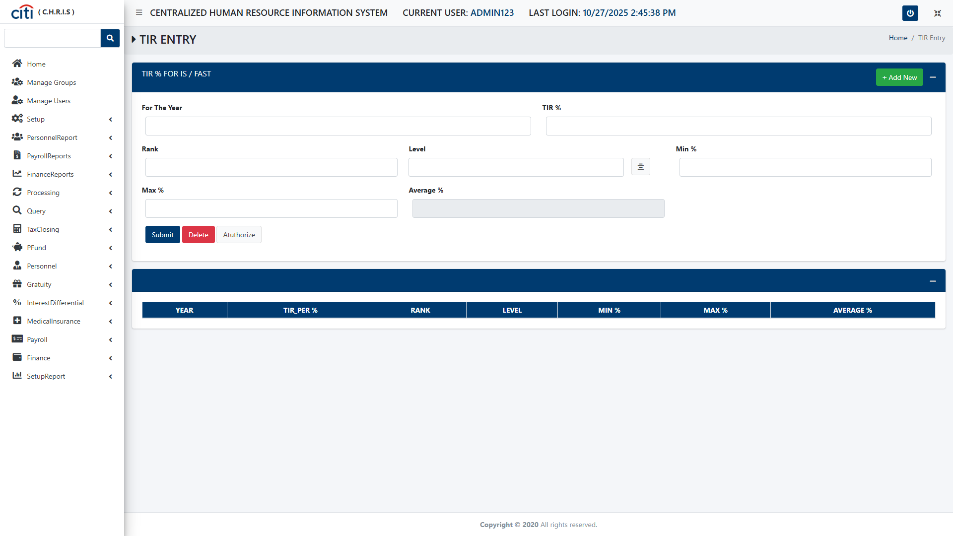
SETUP FORMS
TIR Entry form
CHRIS
12

Slide 13
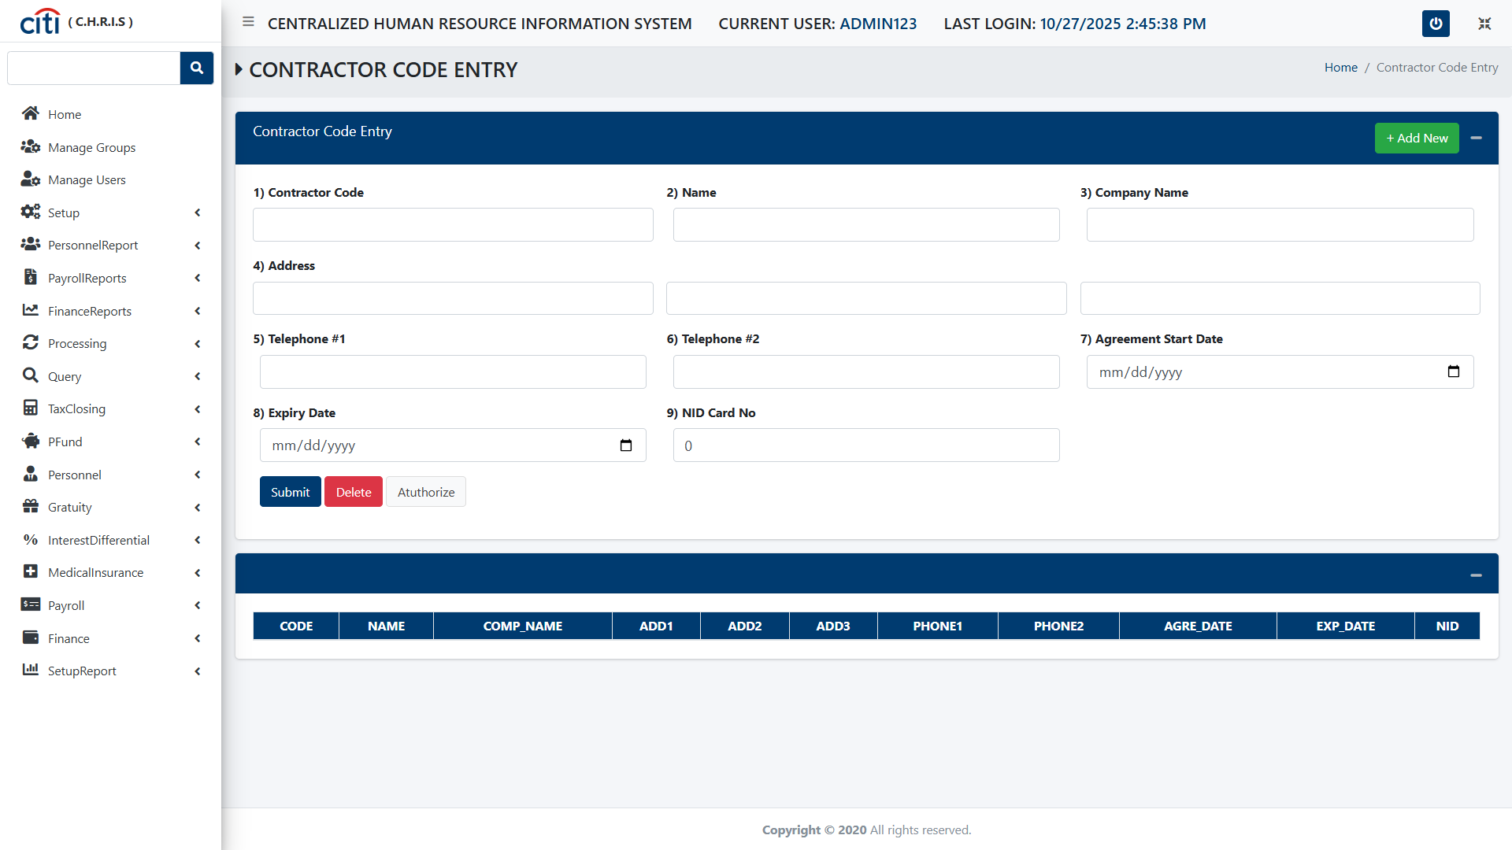
SETUP FORMS
Contractor Code Entry form
CHRIS
13

Slide 14
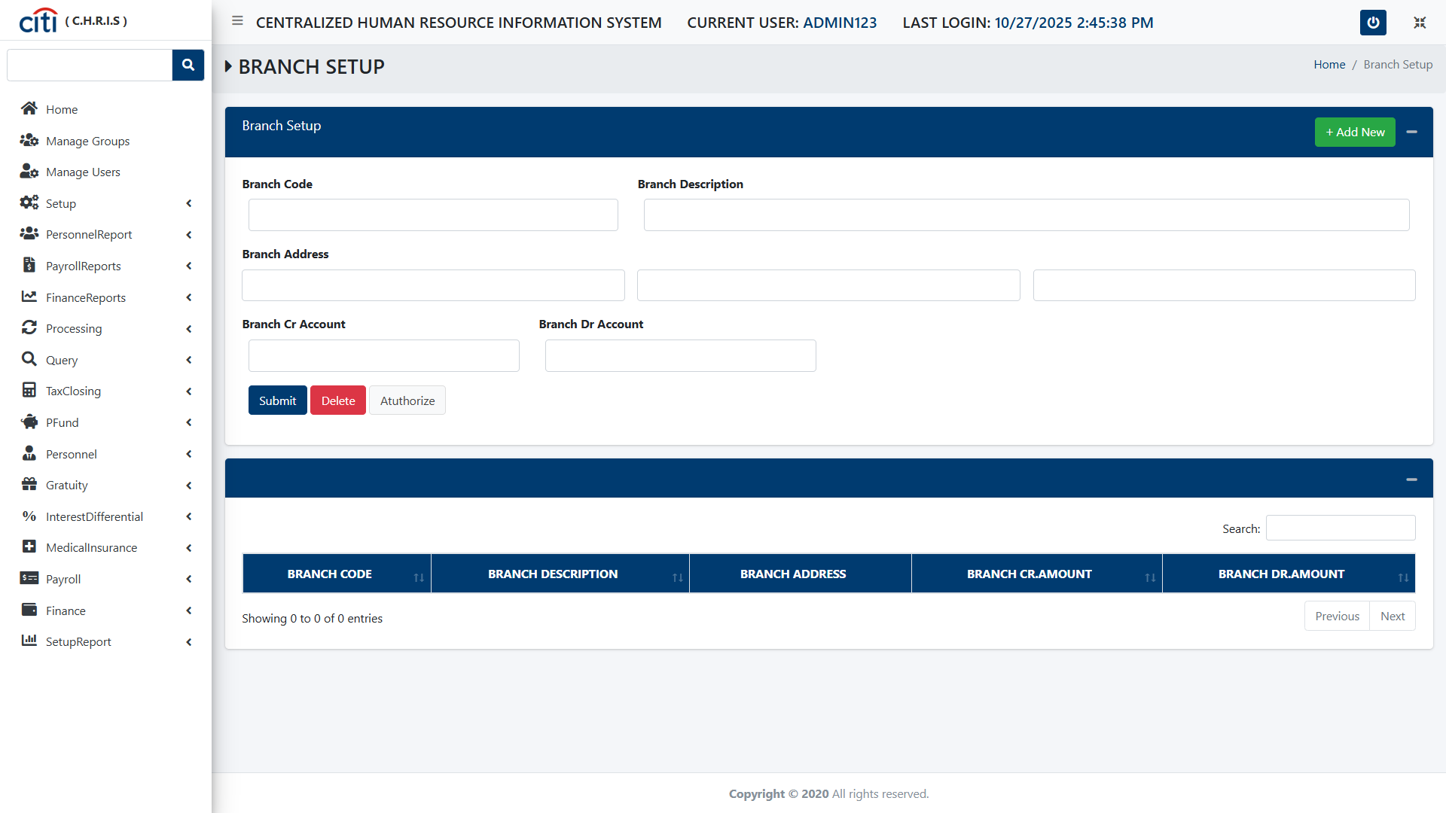
SETUP FORMS
Branch Setup form
CHRIS
14

Slide 15
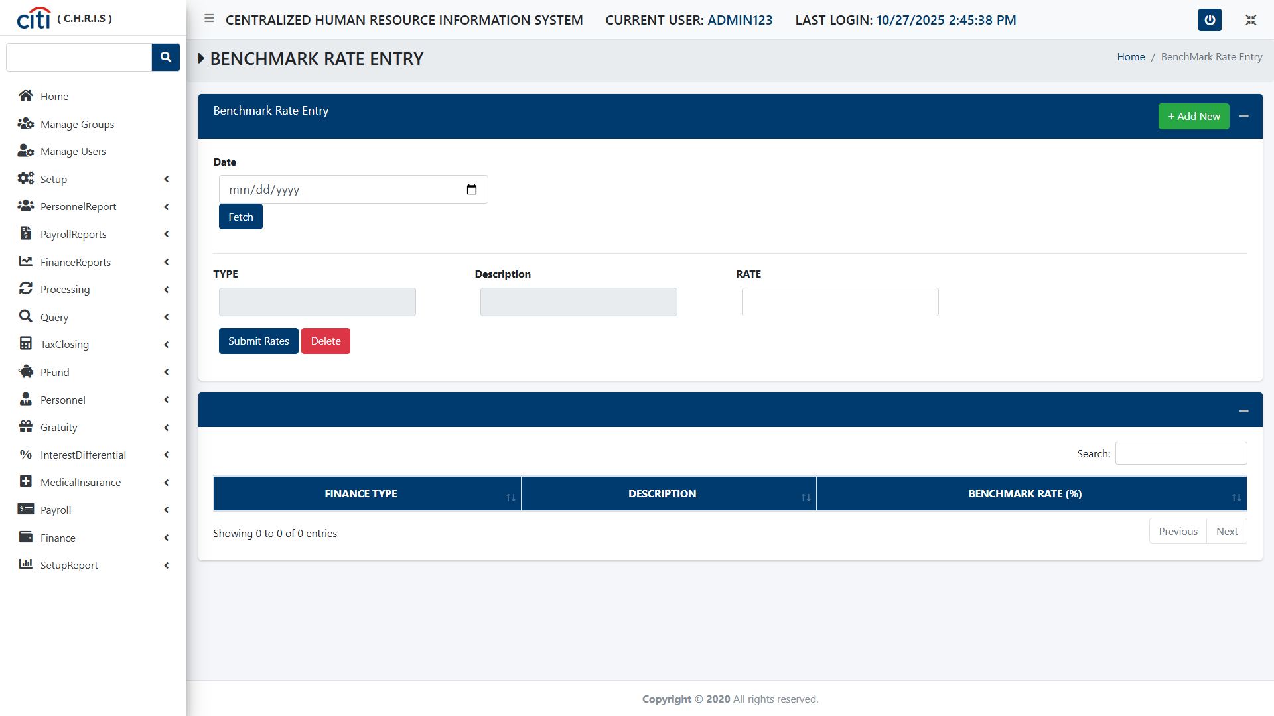
SETUP FORMS
Benchmark Rate Entry form
CHRIS
15

Slide 16
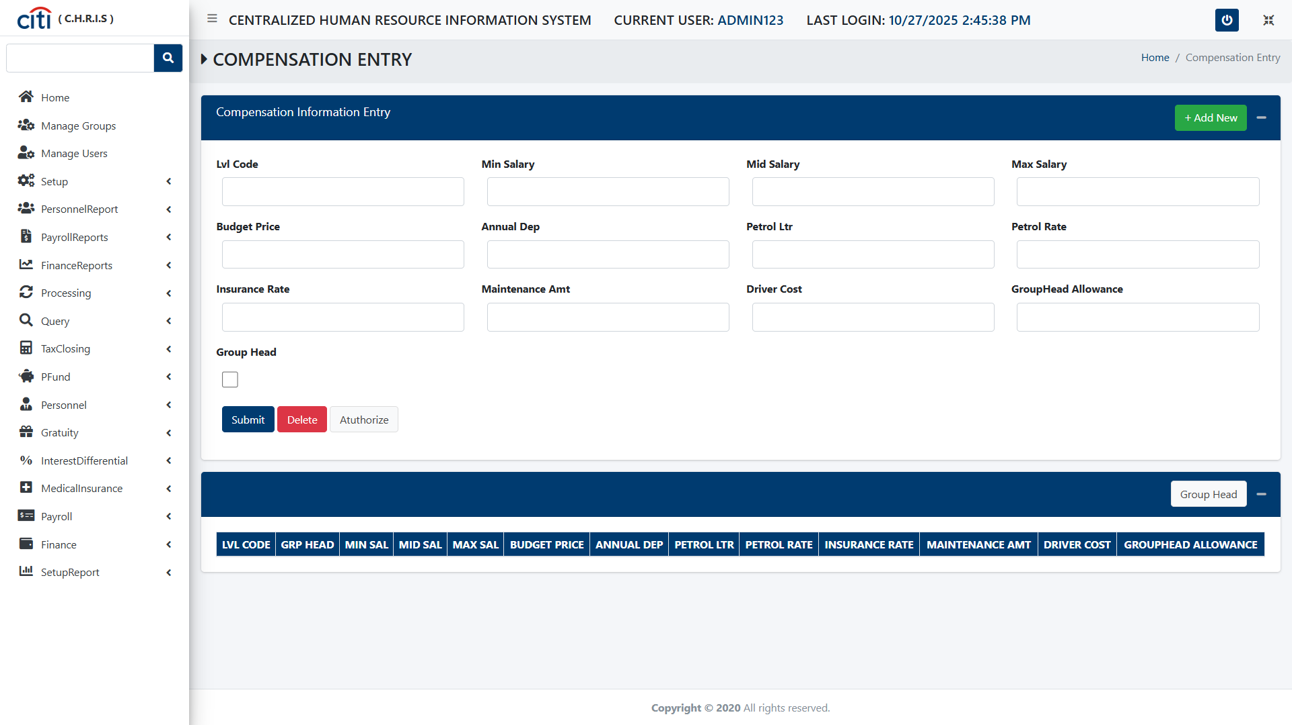
SETUP FORMS
Compensation Information Entry form
CHRIS
16

Slide 17
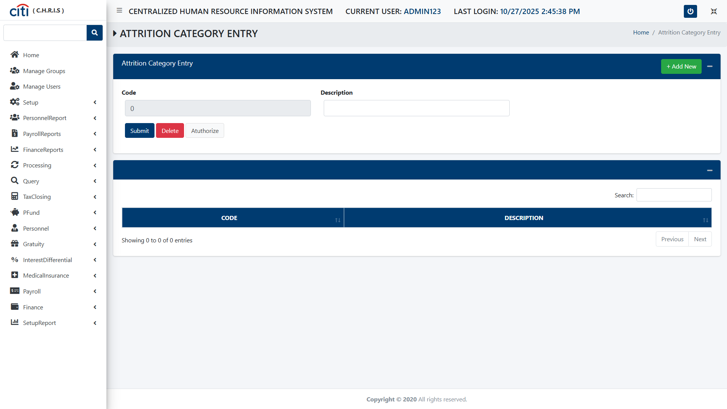
SETUP FORMS
Attrition Category Entry form
CHRIS
17

Slide 18
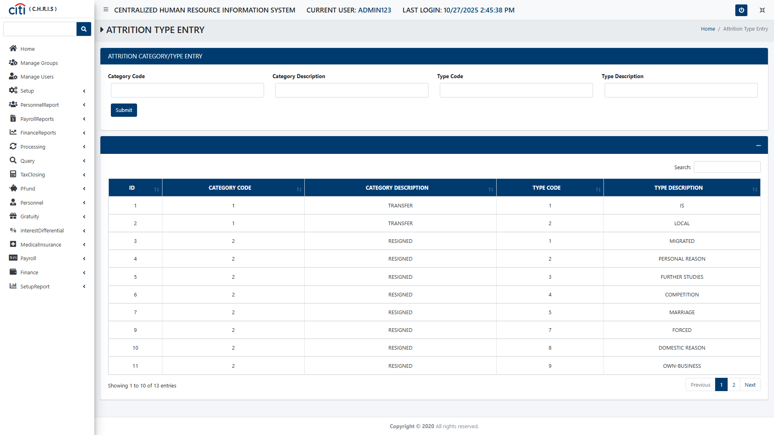
SETUP FORMS
Attrition Category Type Entry form
CHRIS
18

Slide 19
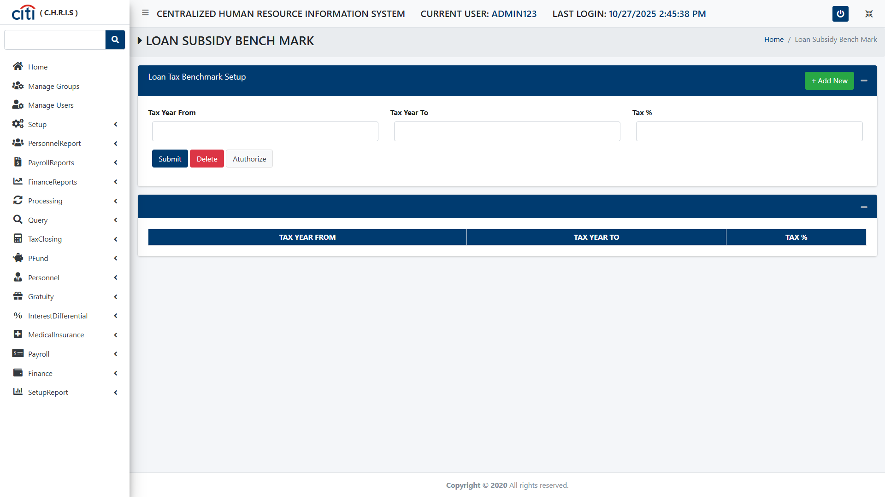
SETUP FORMS
Loan Tax Benchmark Setup form
CHRIS
19

Slide 20
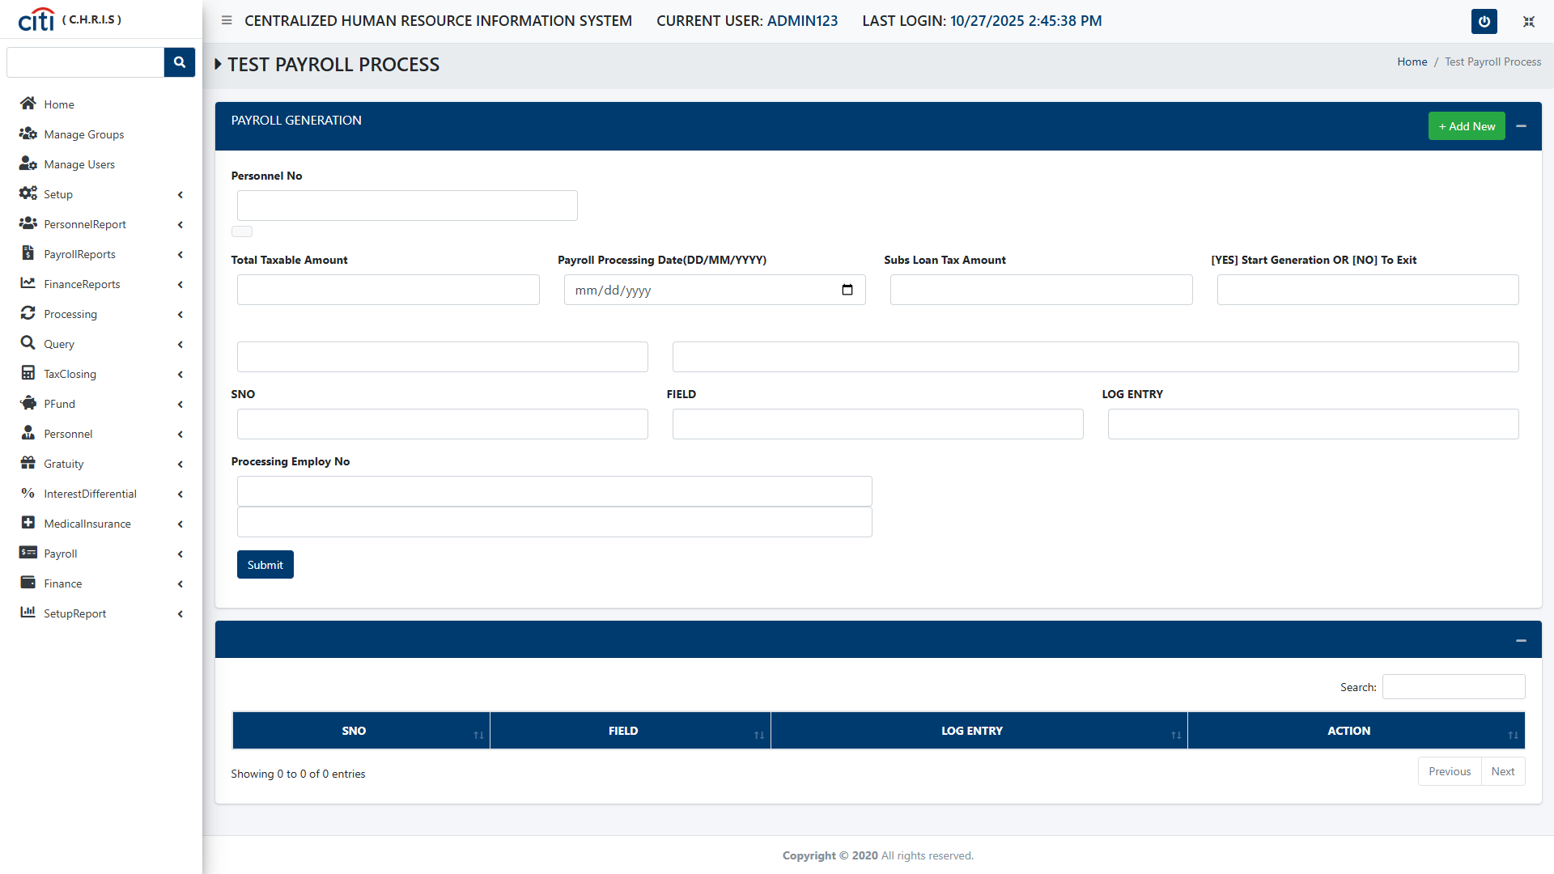
SETUP FORMS
Payroll Generation form
CHRIS
20

Slide 21
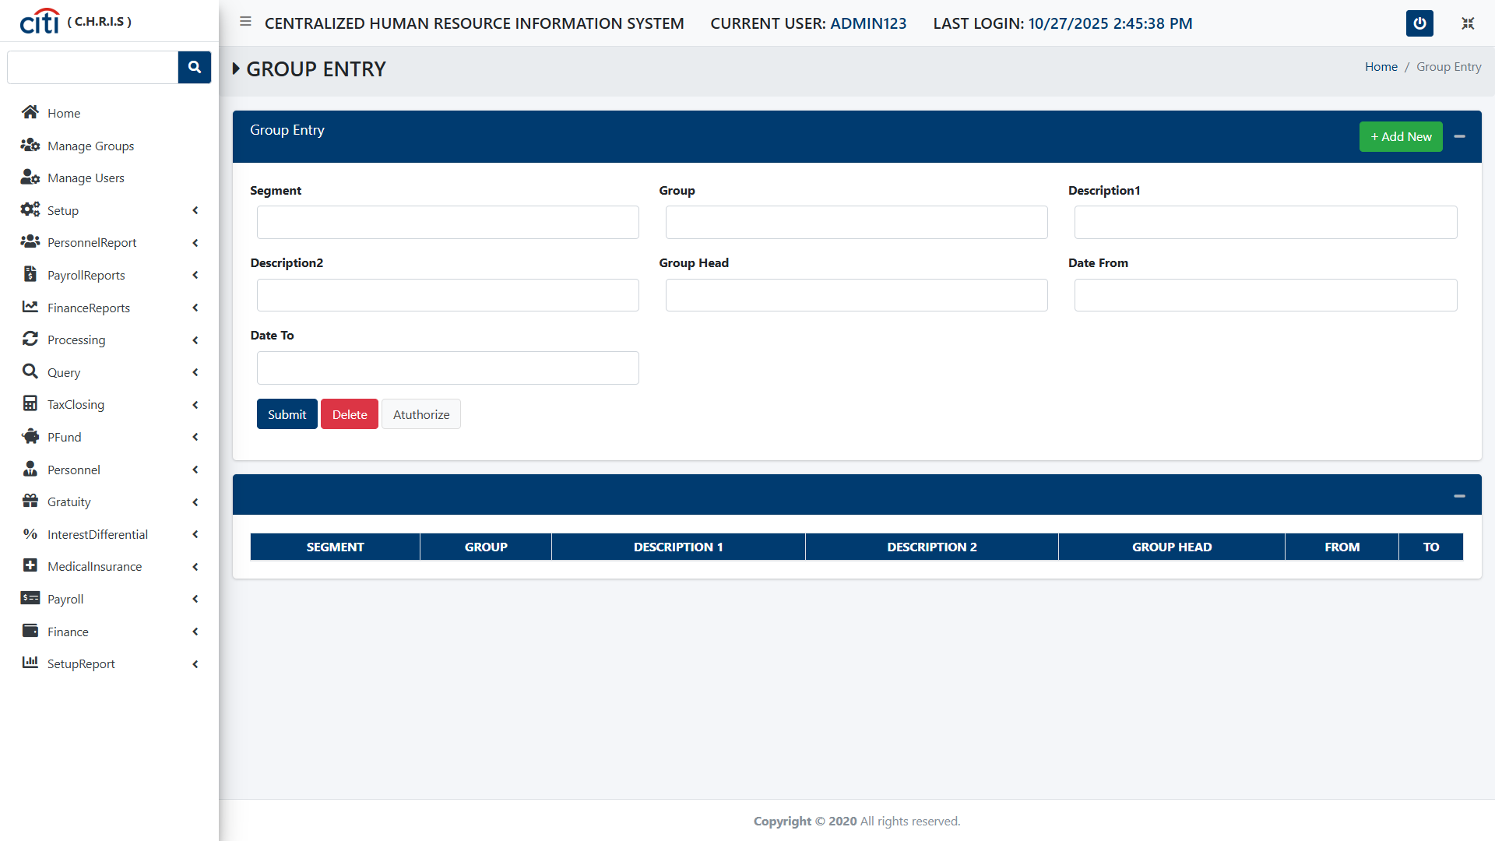
SETUP FORMS
Group Entry form
CHRIS
21

Slide 22
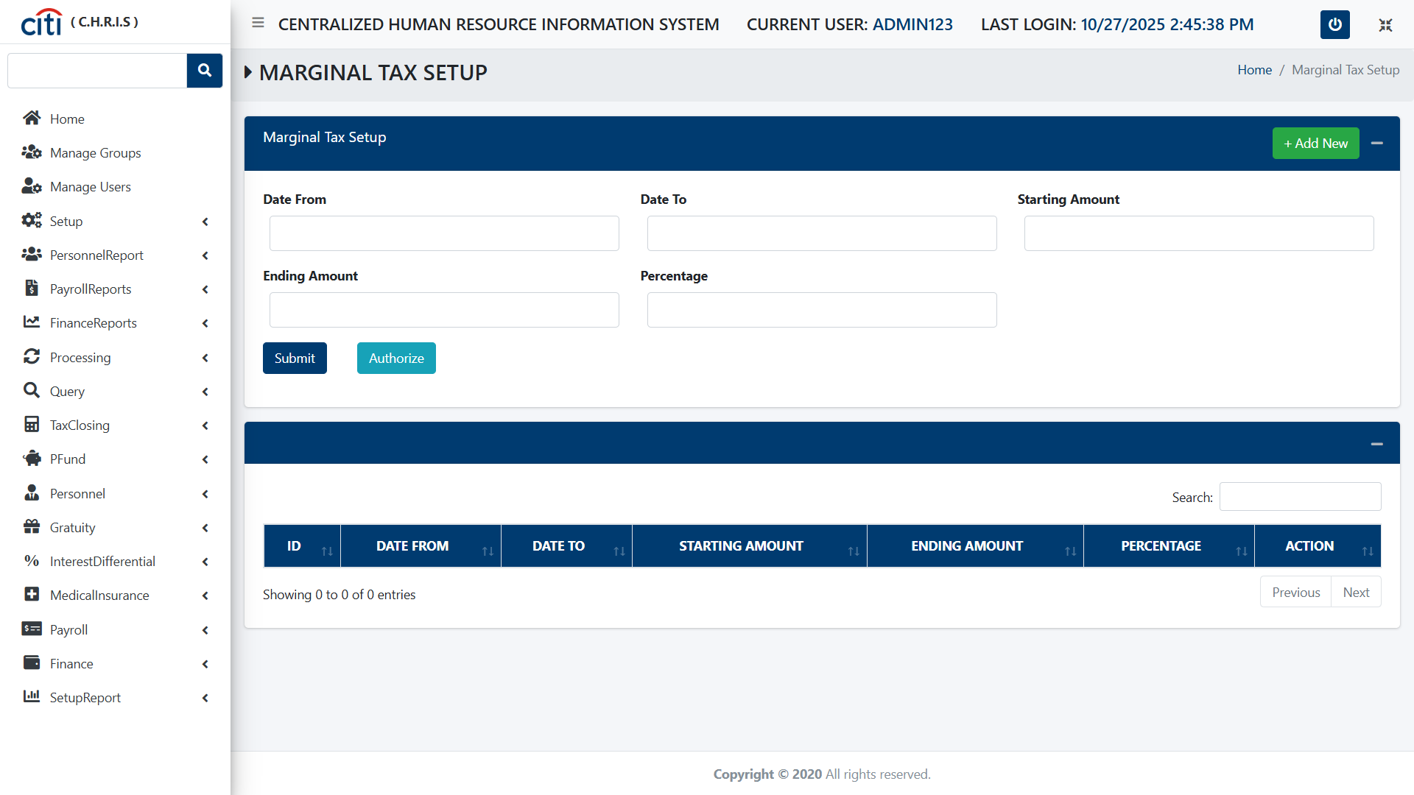
SETUP FORMS
Marginal Tax Setup form
CHRIS
22

Slide 23
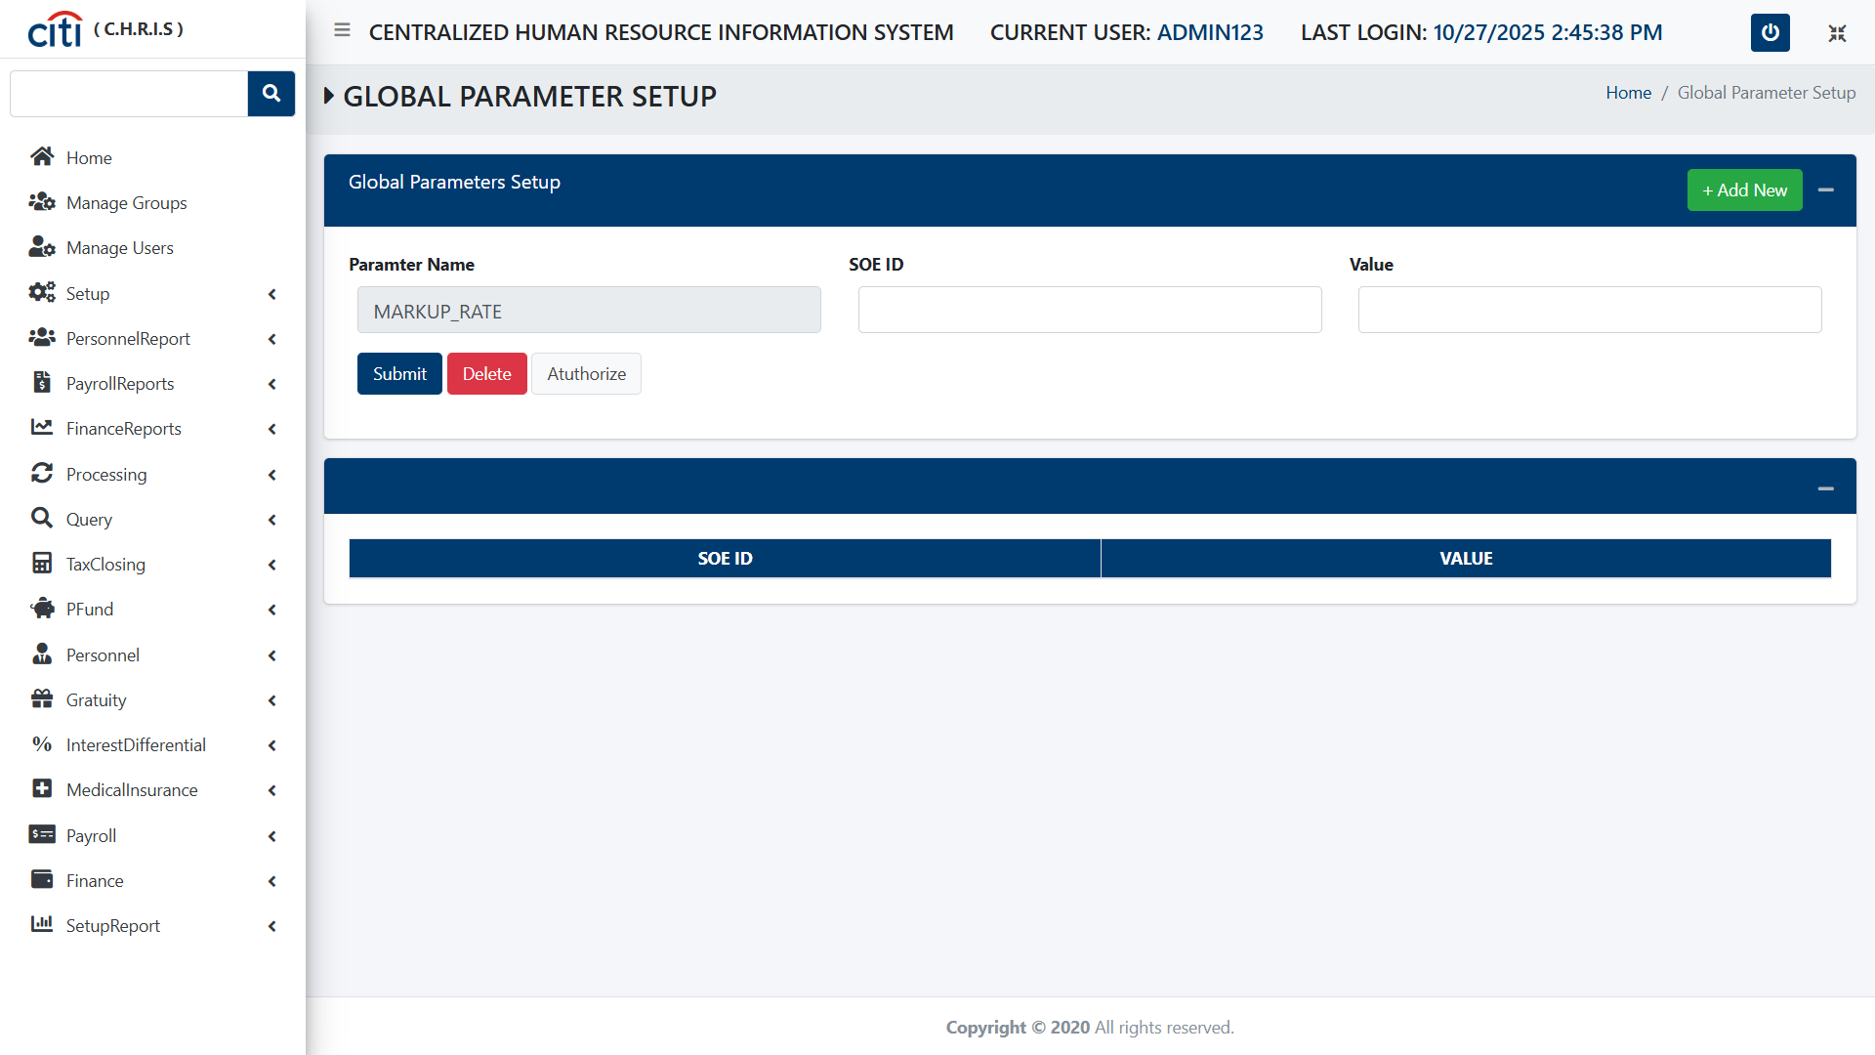
SETUP FORMS
Global
CHRIS
23

Slide 24
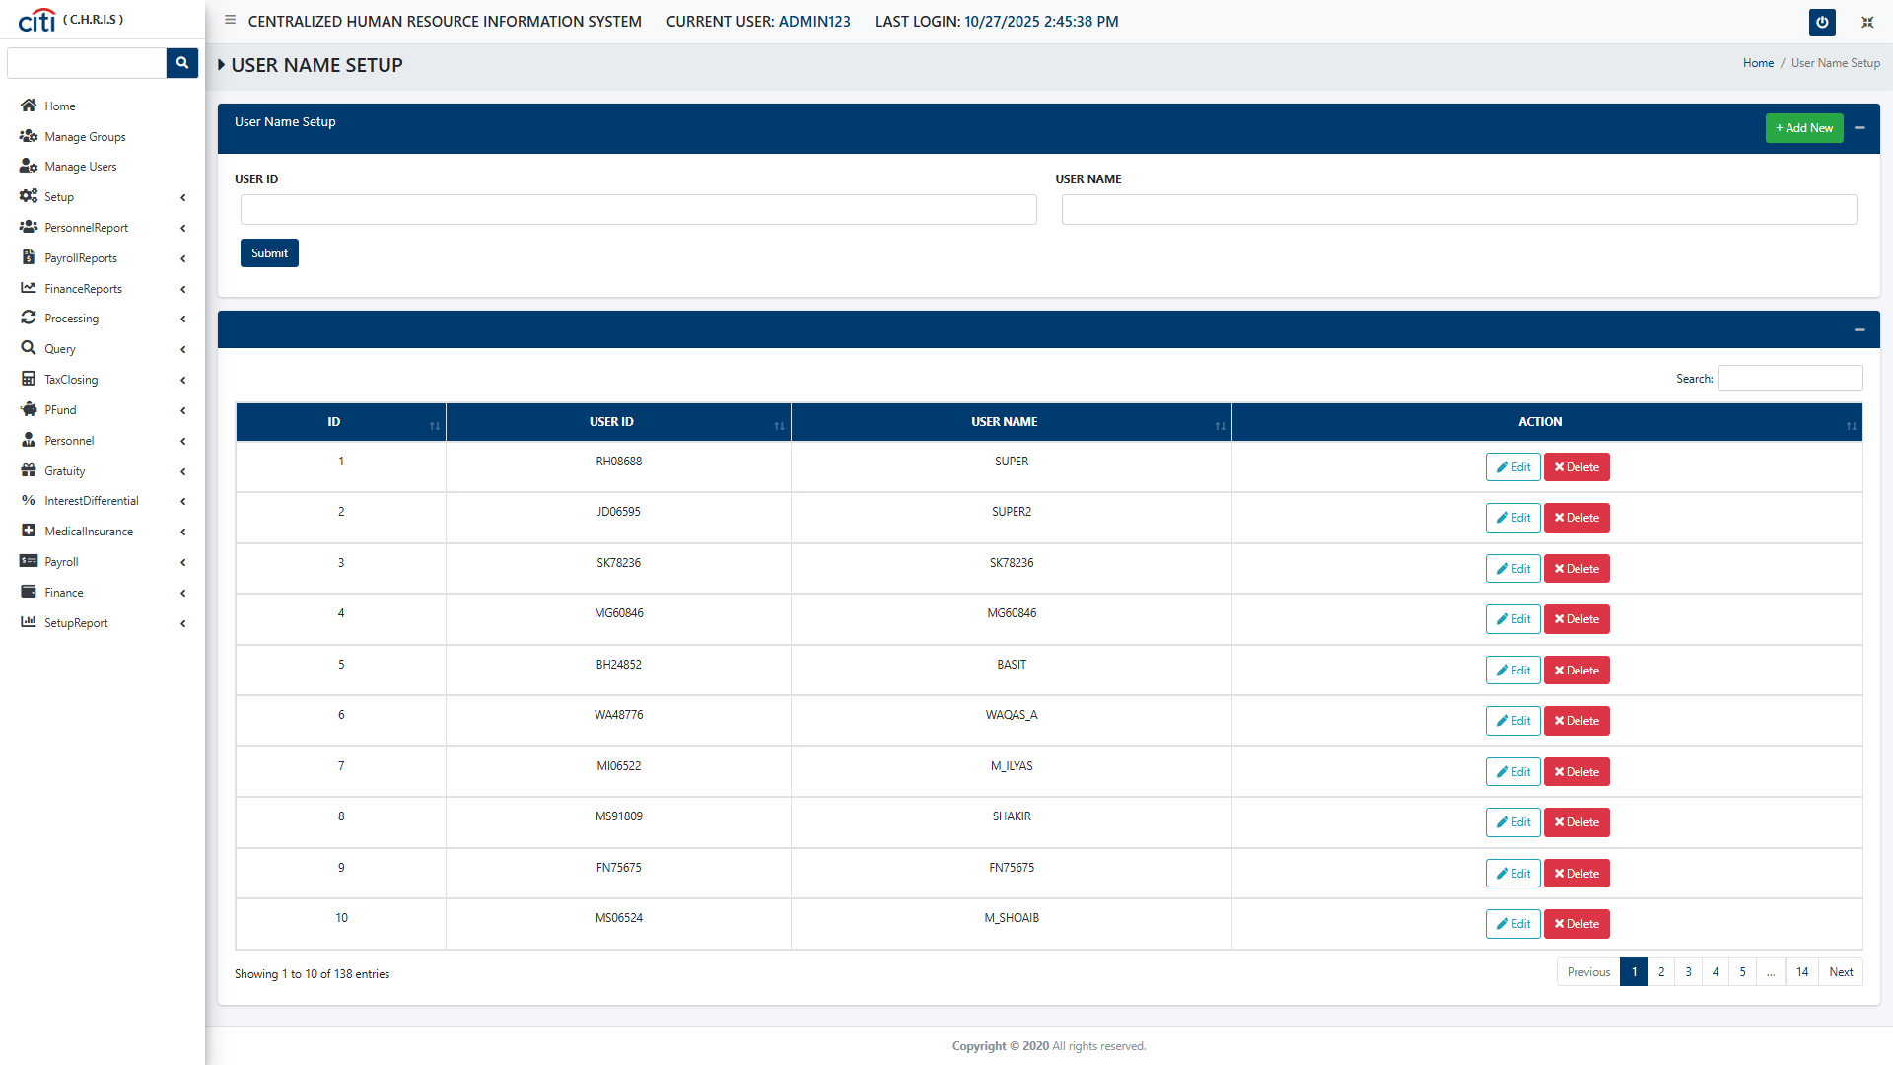
SETUP FORMS
User Name Setup form
CHRIS
24

Slide 25
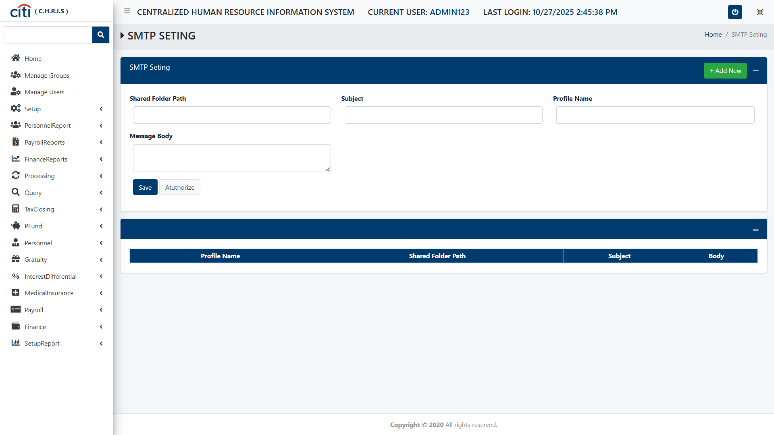
SETUP FORMS
SMTP Setting form
CHRIS
25

Slide 26
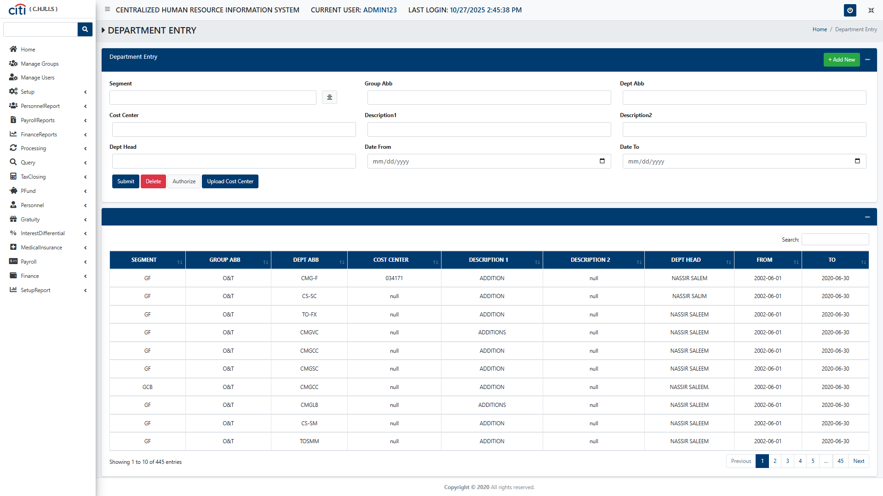
SETUP FORMS
Department Entry form
CHRIS
26

Slide 27
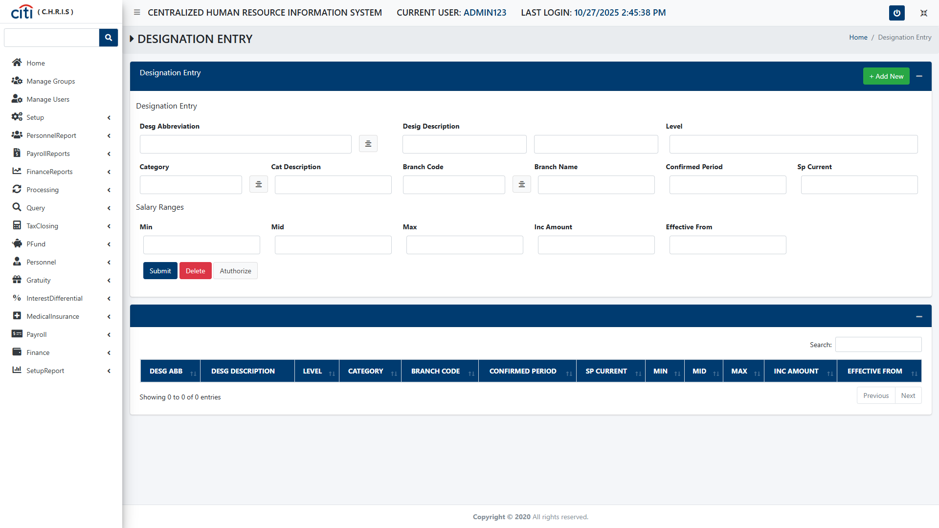
SETUP FORMS
Designation Entry form
CHRIS
27

Slide 28
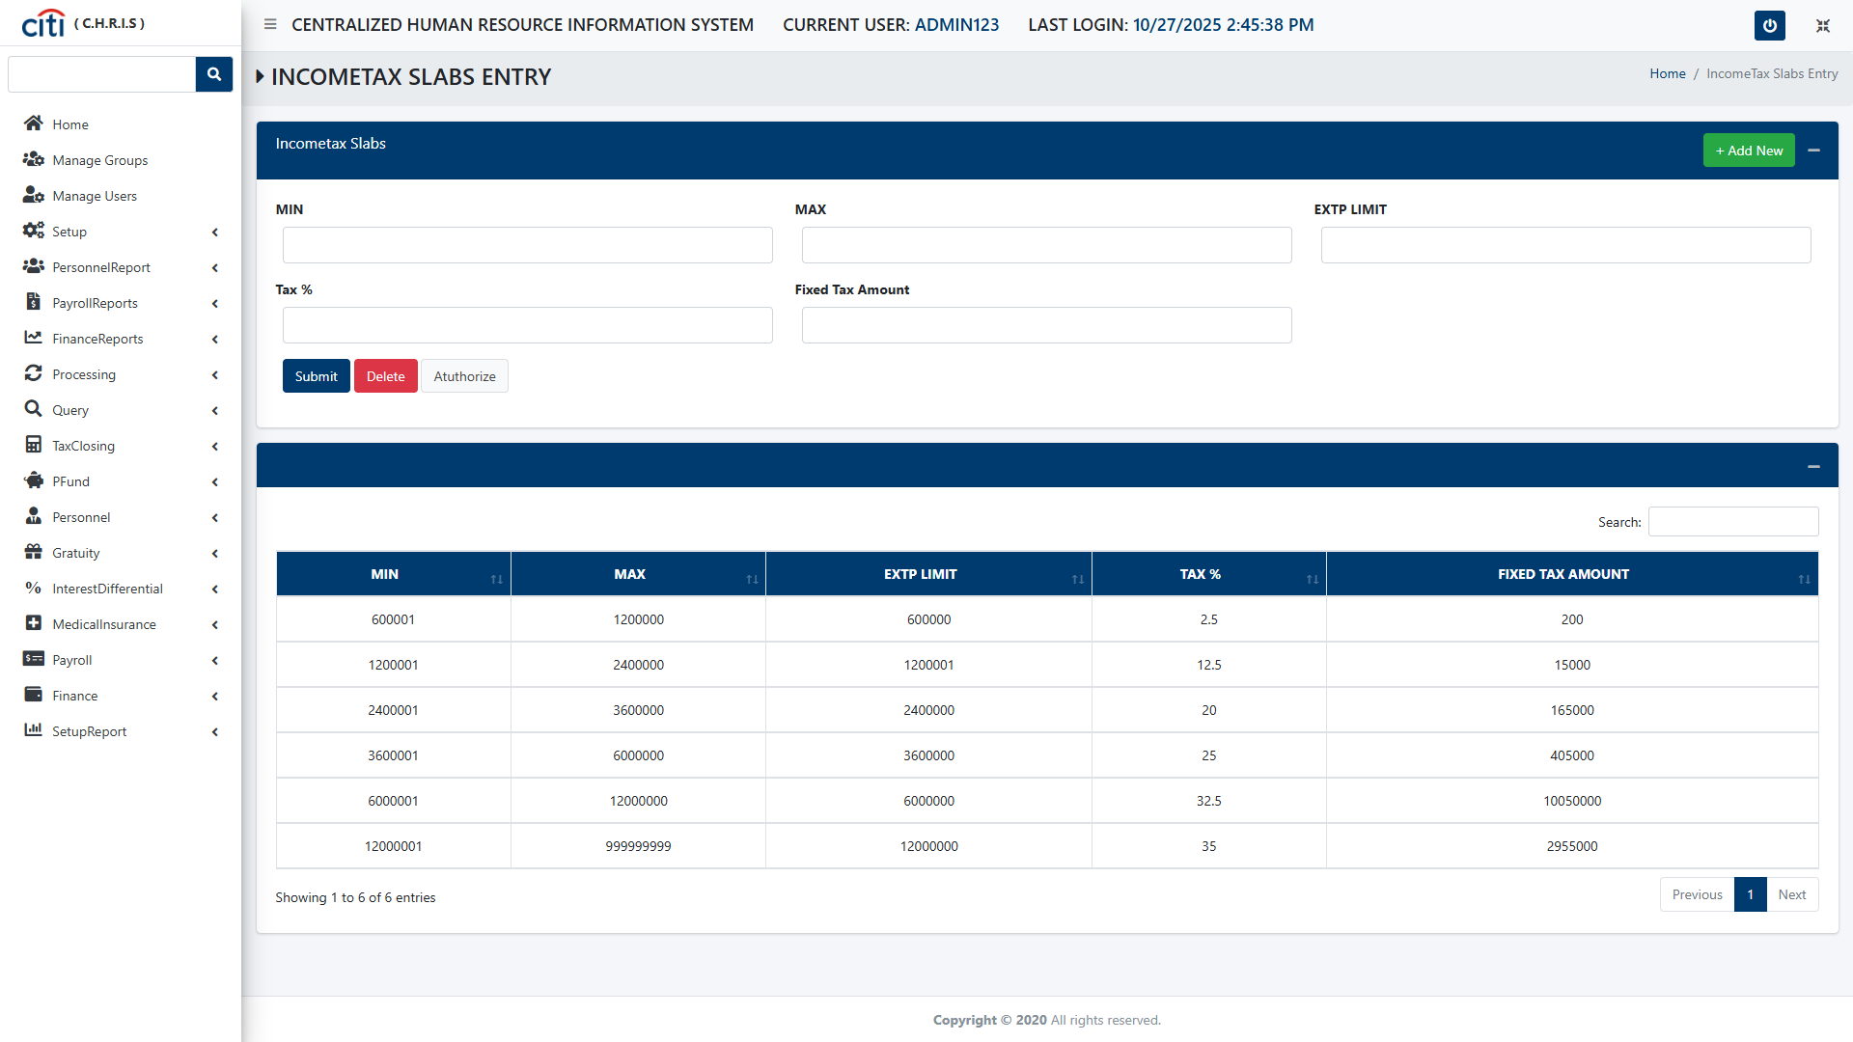
SETUP FORMS
Income Tax Slabs Entry form
CHRIS
28

Slide 29
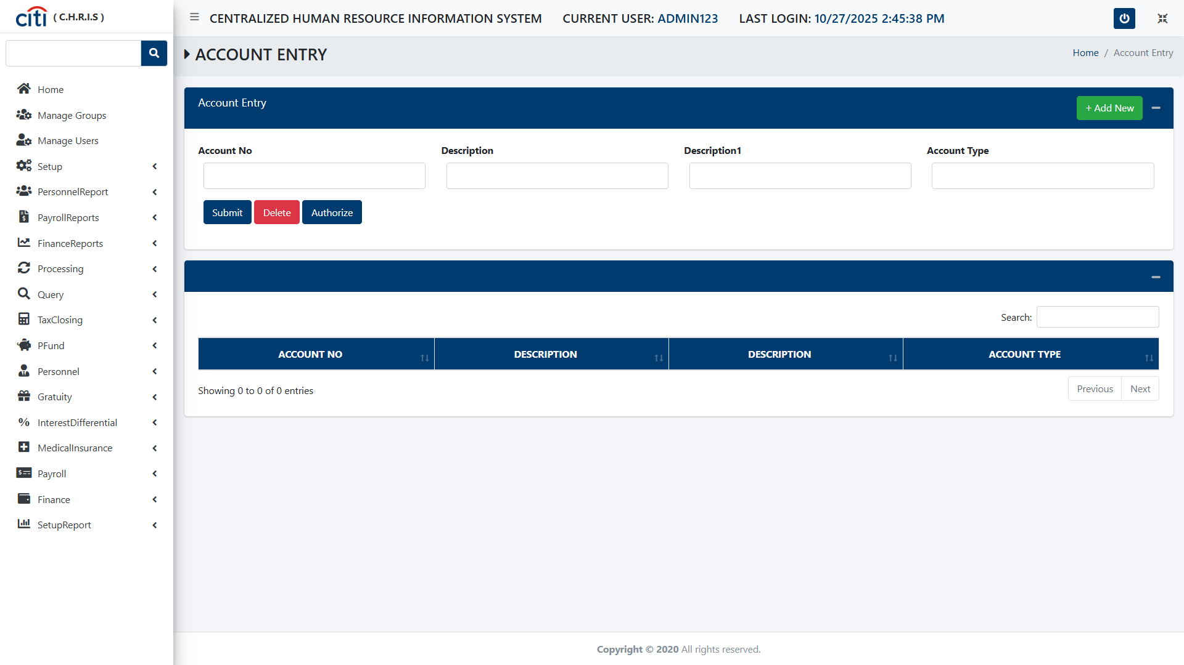
SETUP FORMS
Account Entry form
CHRIS
29

Slide 30
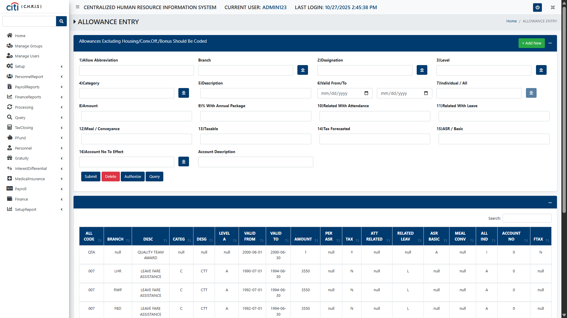
SETUP FORMS
Allowance Entry form
CHRIS
30

Slide 31
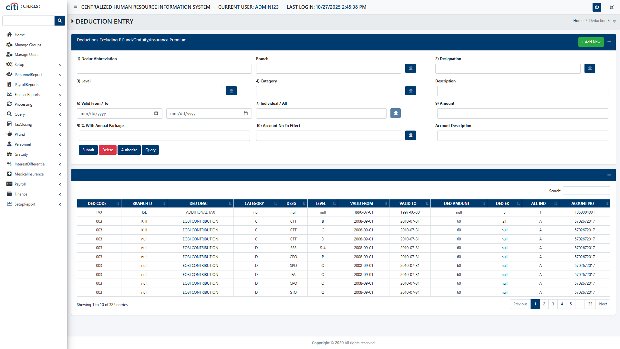
SETUP FORMS
Deduction Entry form
CHRIS
31

Slide 32
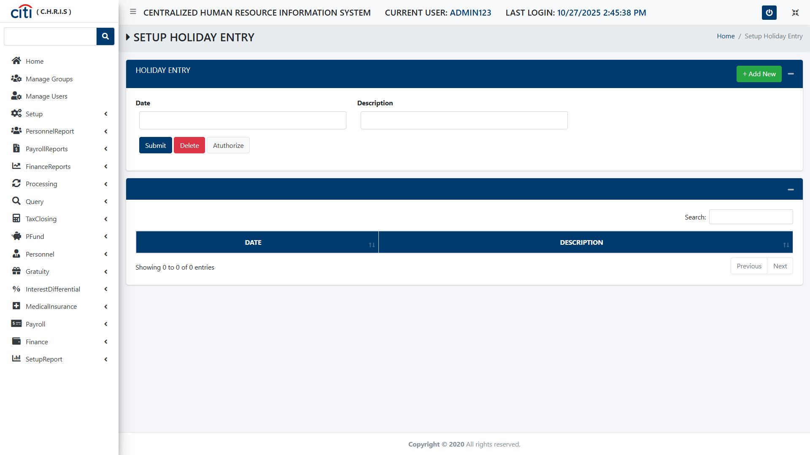
SETUP FORMS
Holiday Entry Setup form
CHRIS
32

Slide 33
02
Personnel Report
Personnel demographics, headcount, and workforce analytics
CHRIS
33

Slide 34
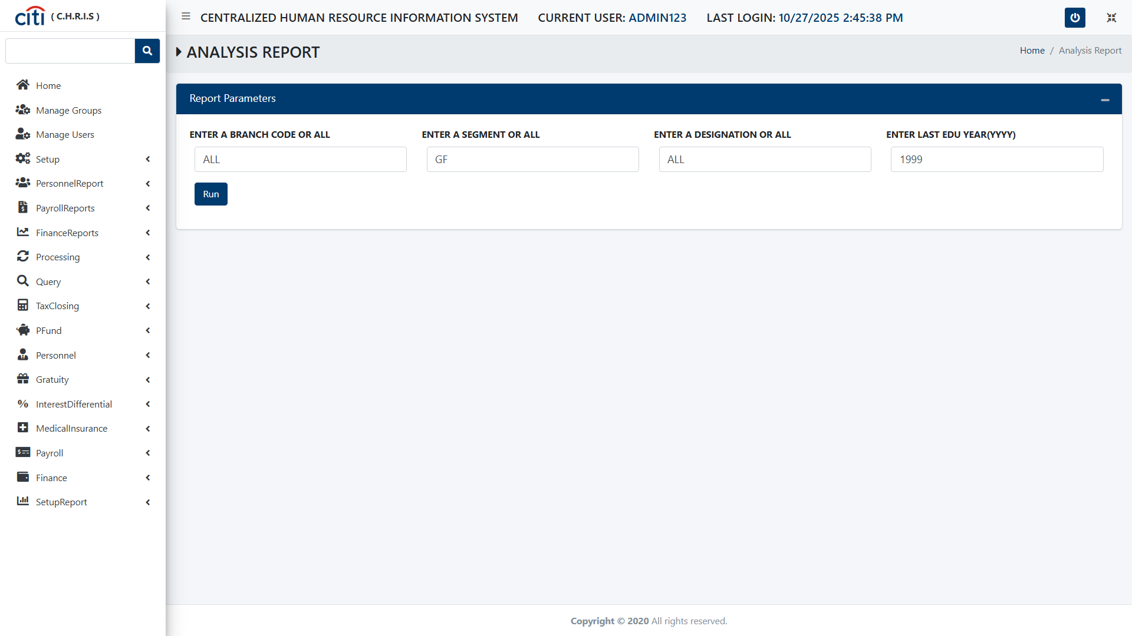
PERSONNEL REPORT
Analysis Parameters Report
CHRIS
34

Slide 35
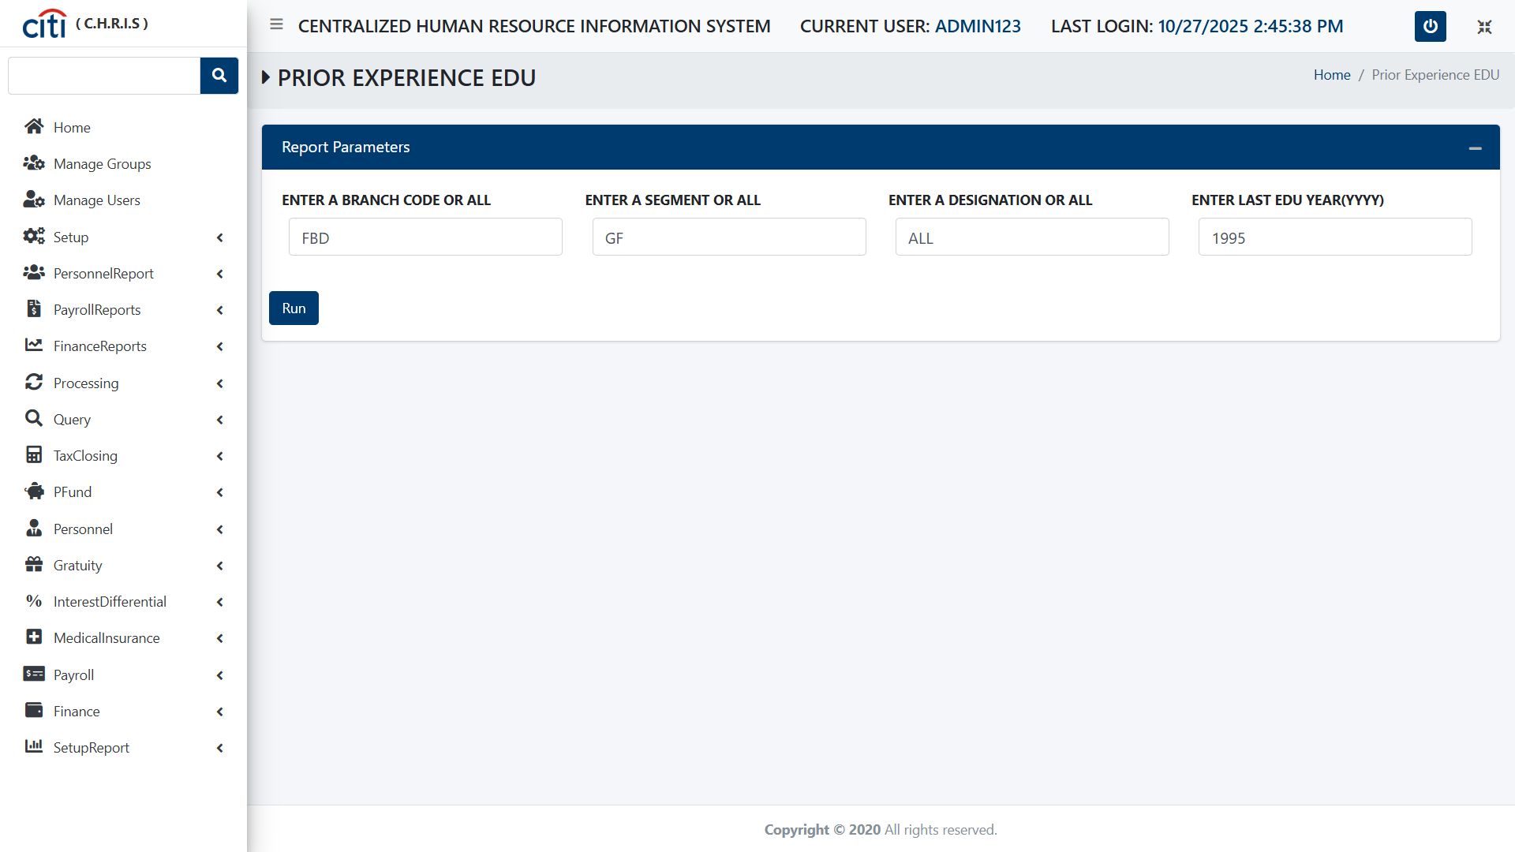
PERSONNEL REPORT
Prior Experience EDU report
CHRIS
35

Slide 36
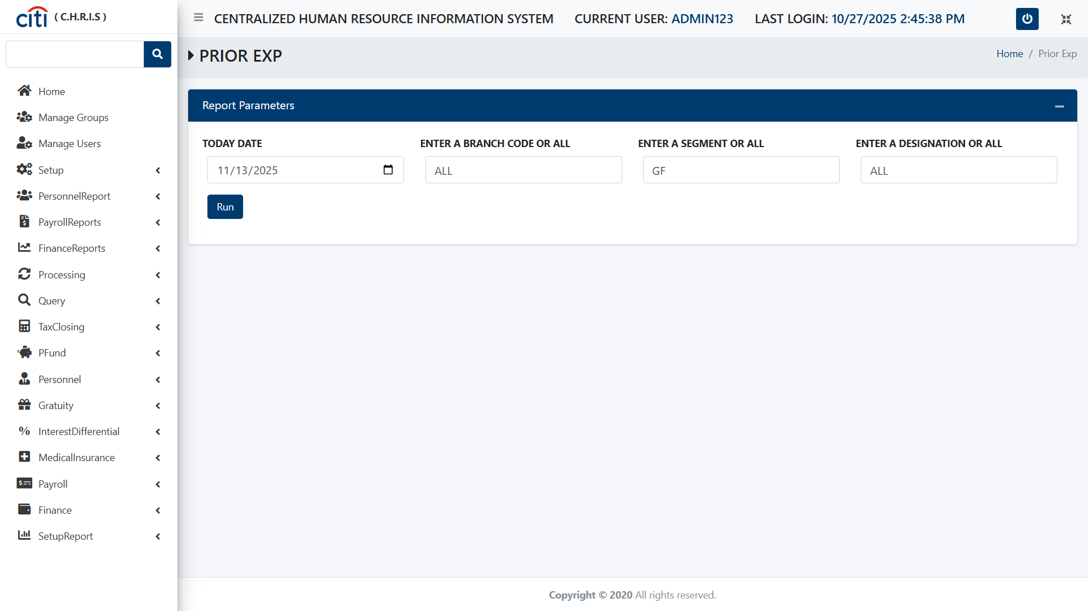
PERSONNEL REPORT
Prior Experience Report
CHRIS
36

Slide 37
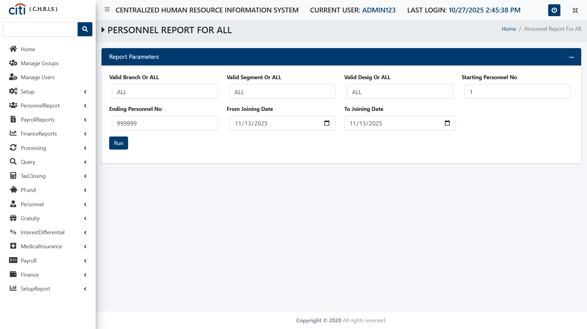
PERSONNEL REPORT
Personal Report form
CHRIS
37

Slide 38
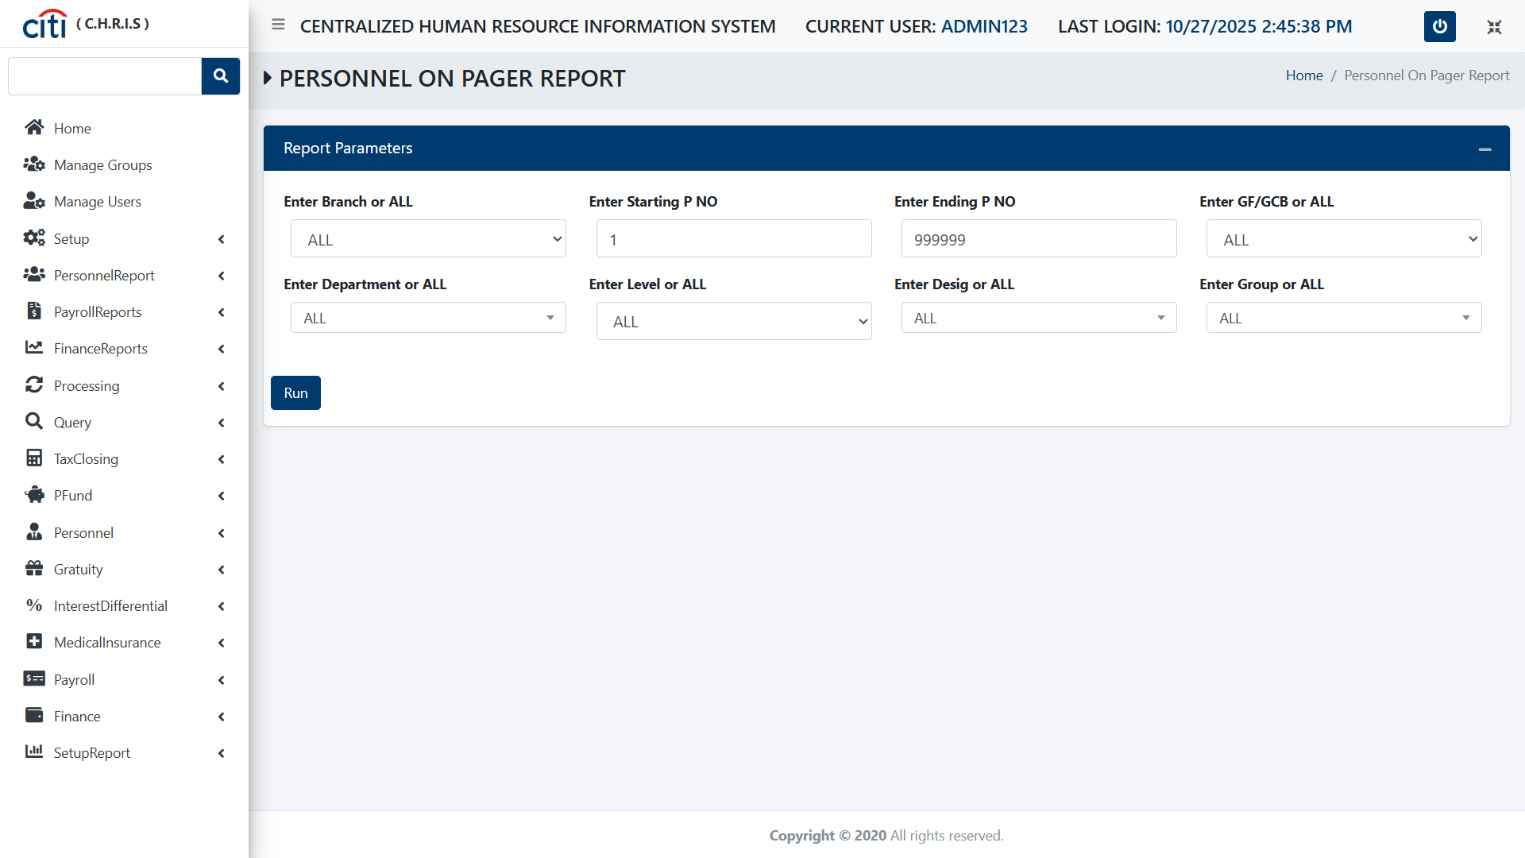
PERSONNEL REPORT
Personnel On Pager Report
CHRIS
38

Slide 39

PERSONNEL REPORT
Head Count Chart form
CHRIS
39

Slide 40
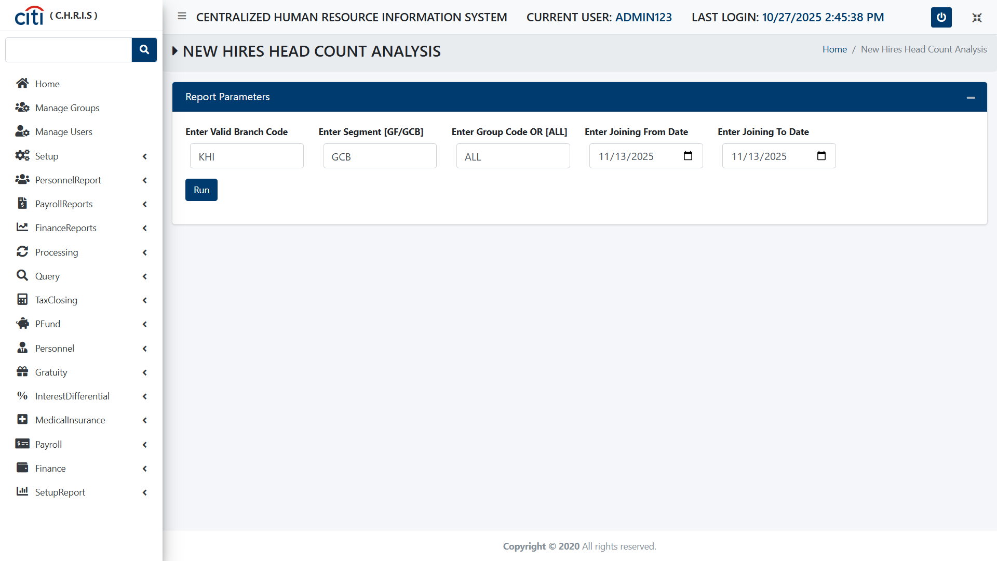
PERSONNEL REPORT
New Hires Head Count Analysis form
CHRIS
40

Slide 41
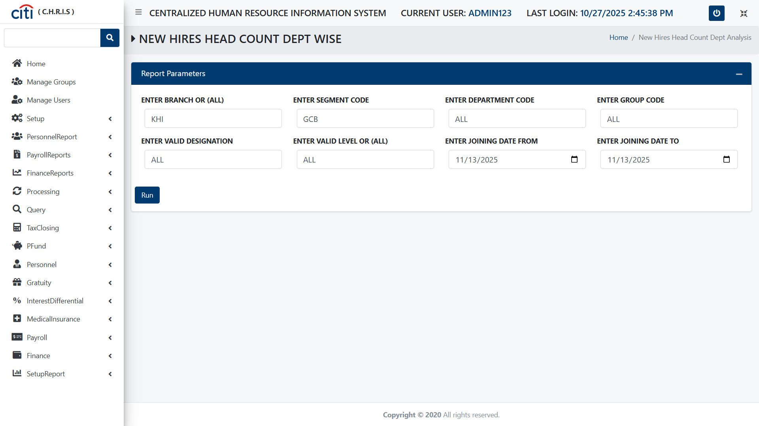
PERSONNEL REPORT
New Hires Head Count Department Wise form
CHRIS
41

Slide 42
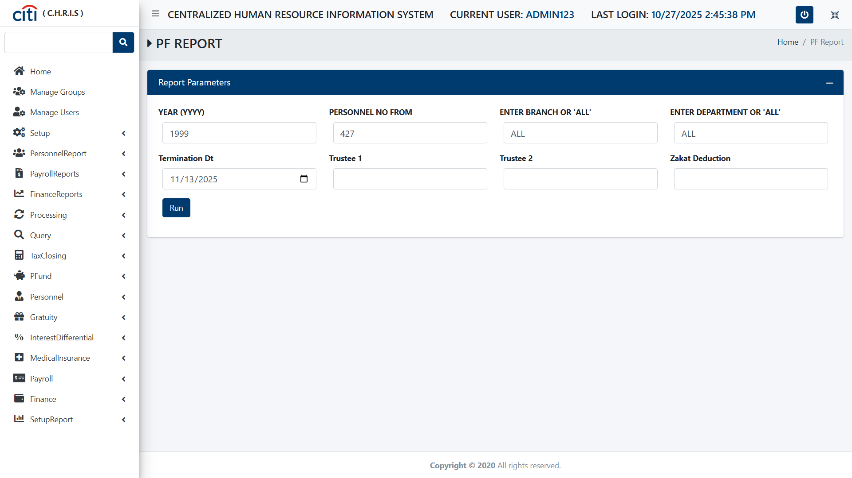
PERSONNEL REPORT
Provident Fund Report form
CHRIS
42

Slide 43
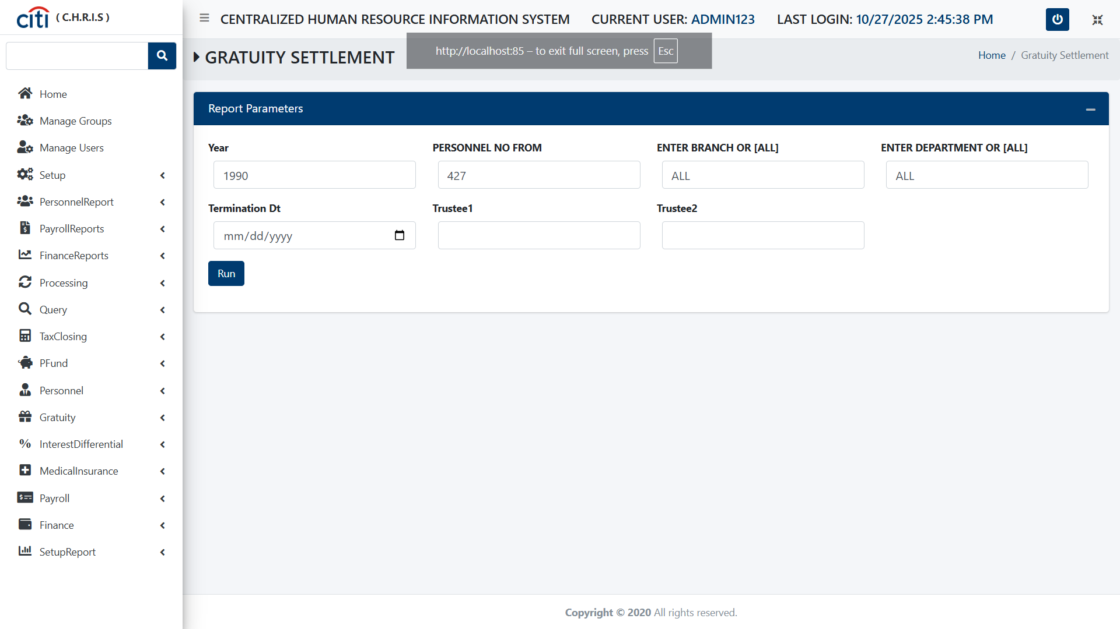
PERSONNEL REPORT
Gratuity Settlement form
CHRIS
43

Slide 44
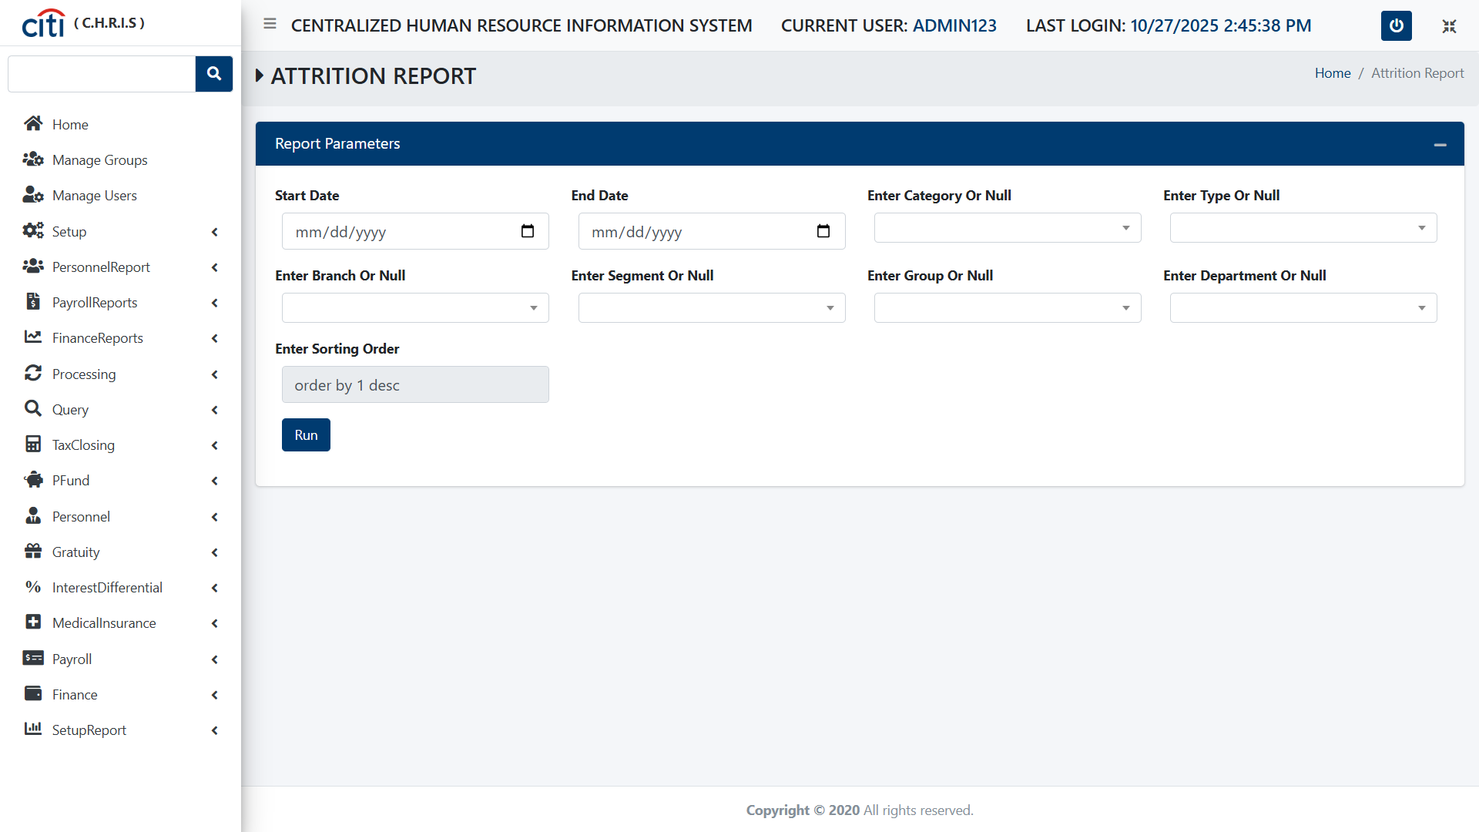
PERSONNEL REPORT
Attrition Report form
CHRIS
44

Slide 45
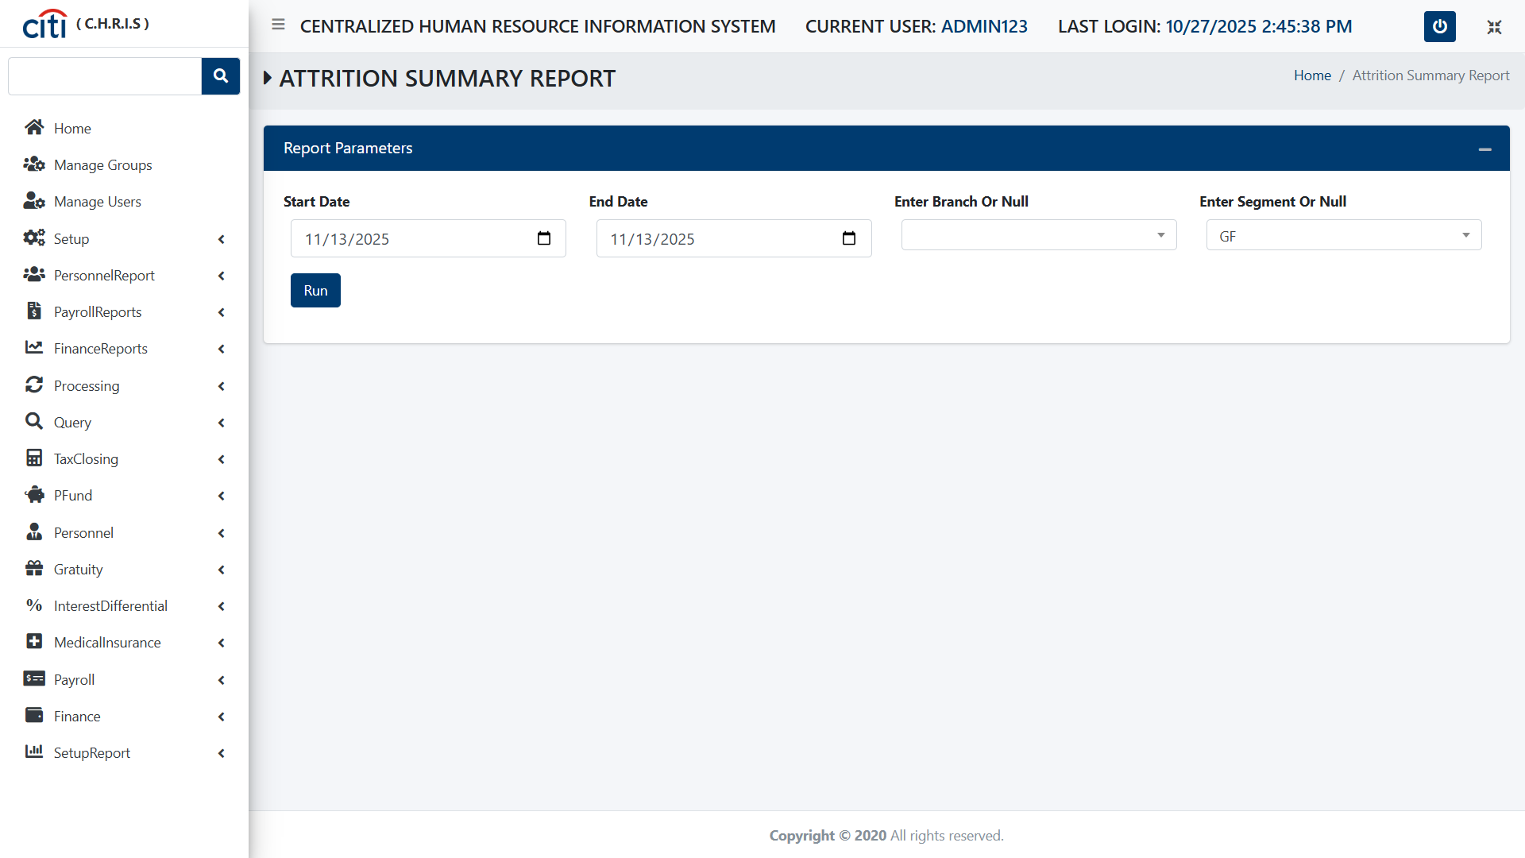
PERSONNEL REPORT
Attrition Summary Report form
CHRIS
45

Slide 46
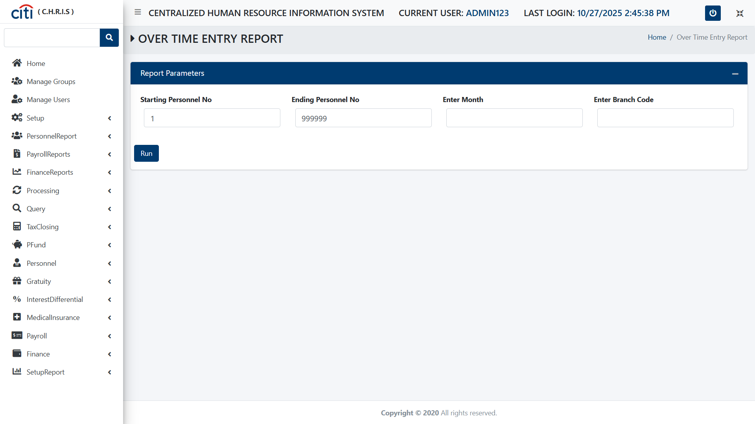
PERSONNEL REPORT
Overtime Entry Report form
CHRIS
46

Slide 47
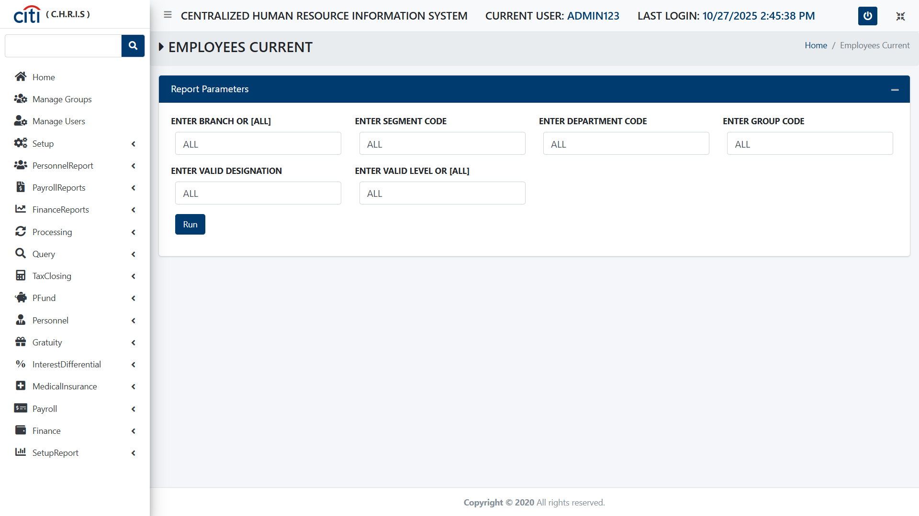
PERSONNEL REPORT
Employees Current Count Report form
CHRIS
47

Slide 48
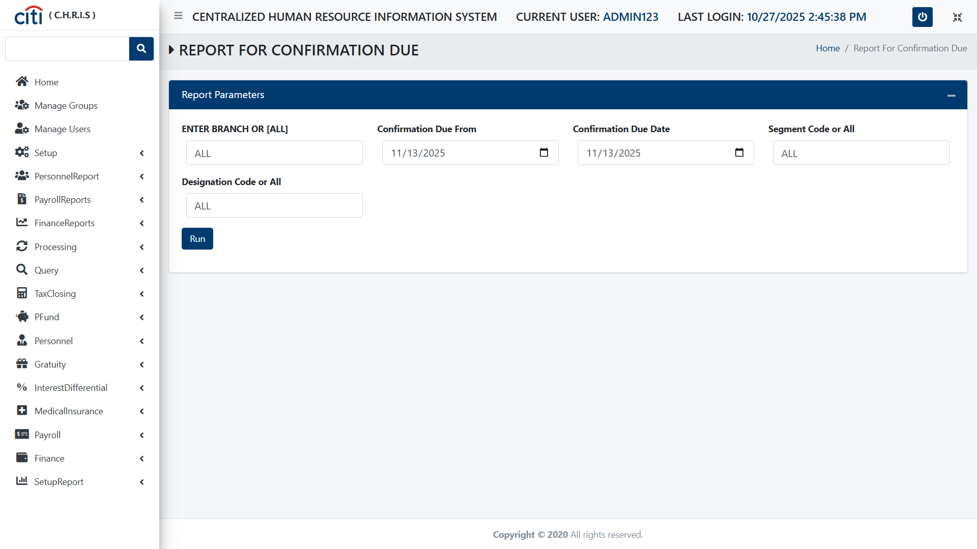
PERSONNEL REPORT
Report for Confirmation Due Report form
CHRIS
48

Slide 49

PERSONNEL REPORT
New Induction Report
CHRIS
49

Slide 50

PERSONNEL REPORT
Appraisal Due Report form
CHRIS
50

Slide 51

PERSONNEL REPORT
Given Designation Report
CHRIS
51

Slide 52
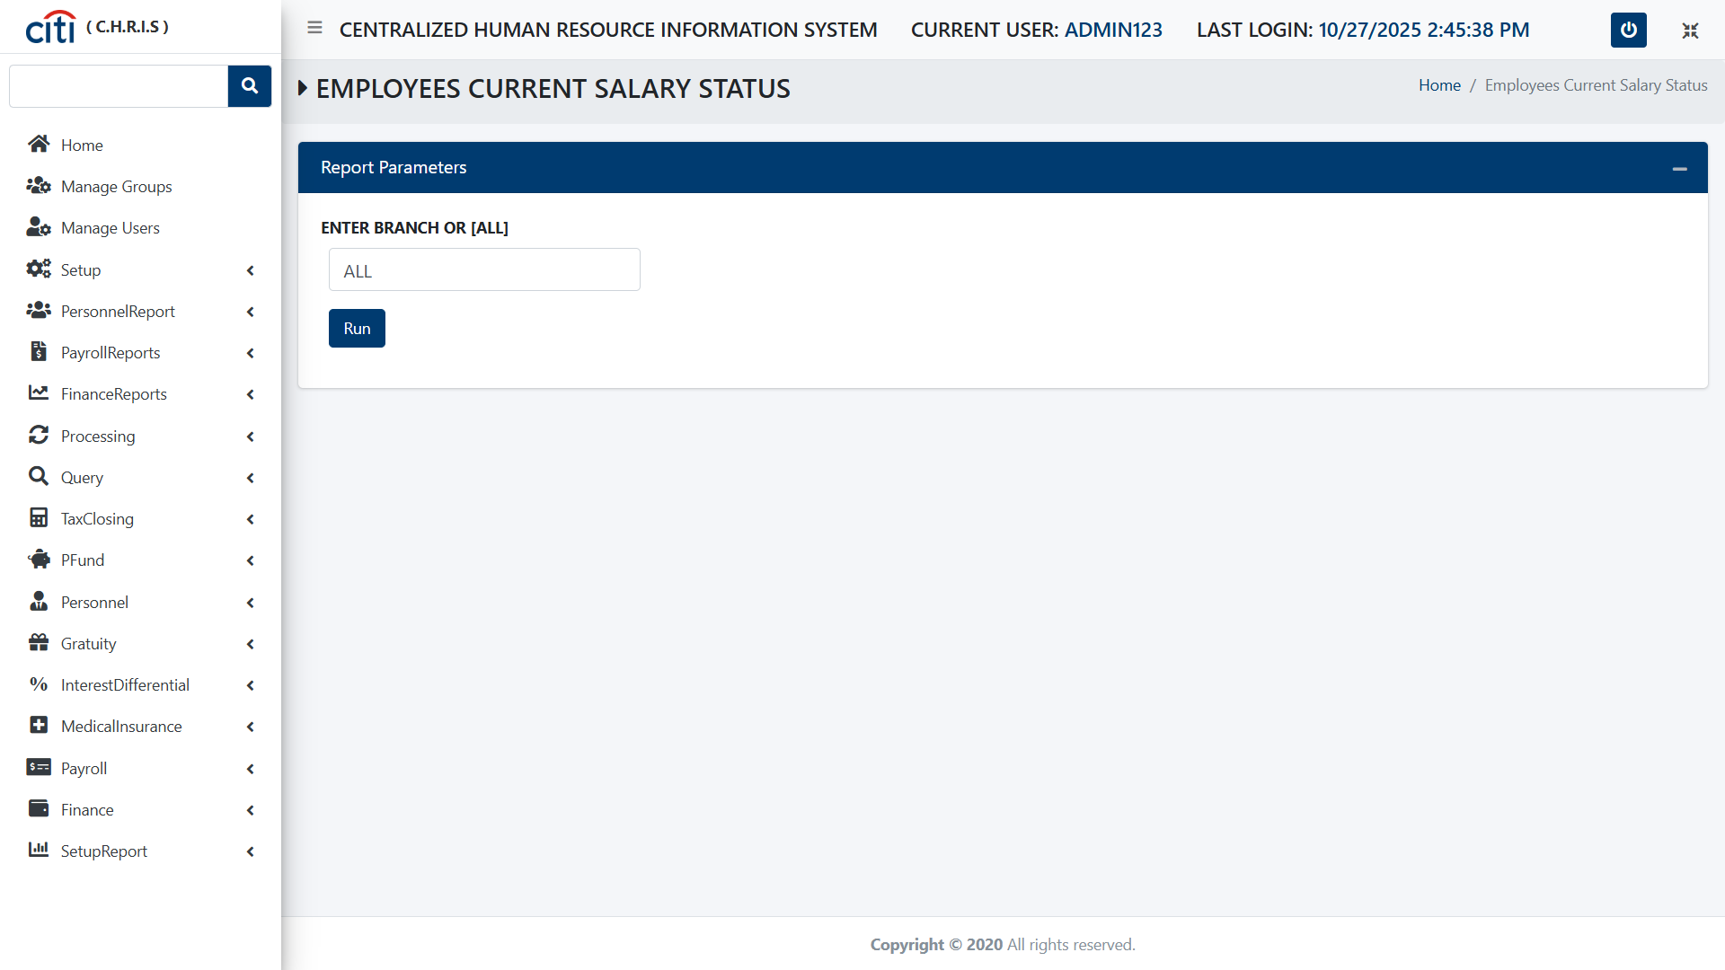
PERSONNEL REPORT
Employees Current Salary Status Report
CHRIS
52

Slide 53
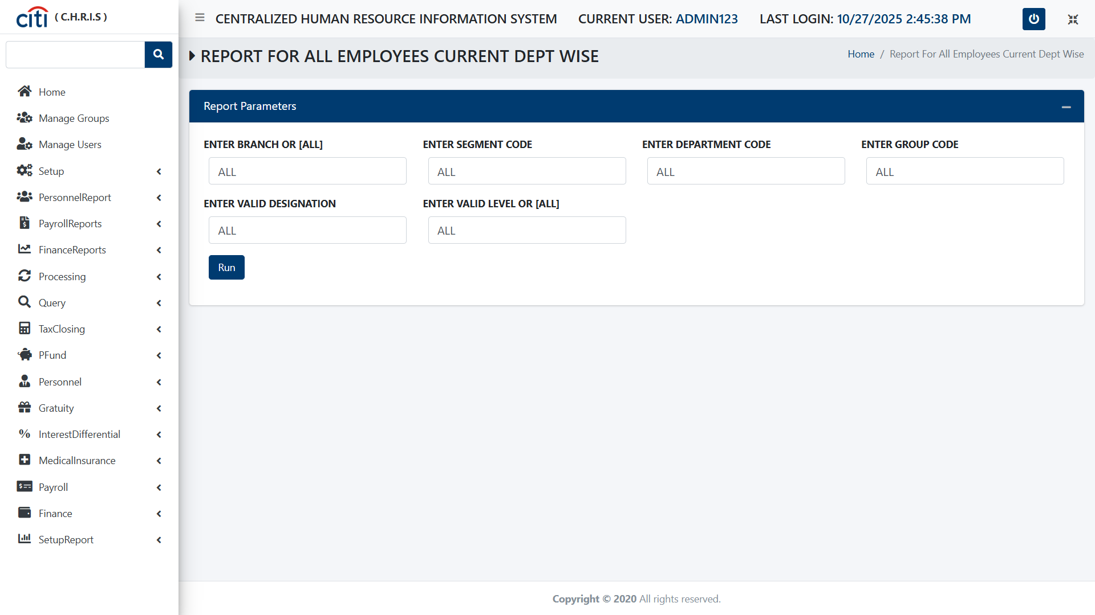
PERSONNEL REPORT
Report For All Current Employess Department Wise Report
CHRIS
53

Slide 54

PERSONNEL REPORT
Department Report form
CHRIS
54

Slide 55
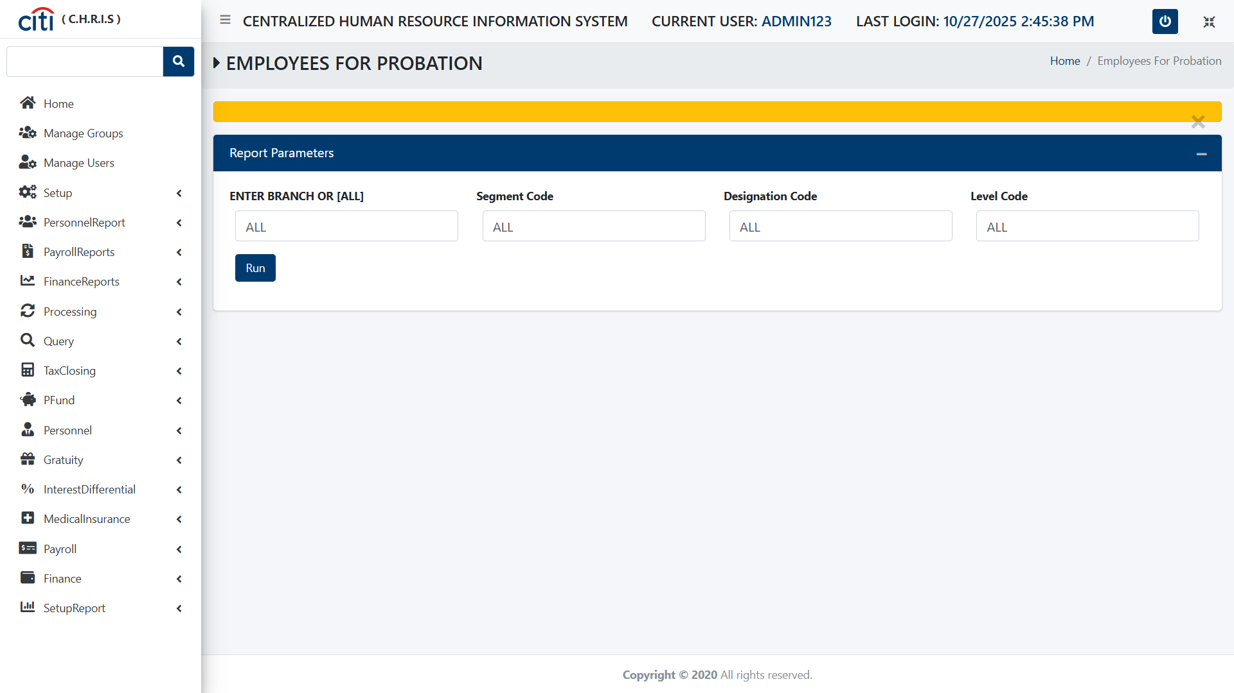
PERSONNEL REPORT
Employees for Probabtion Report
CHRIS
55

Slide 56
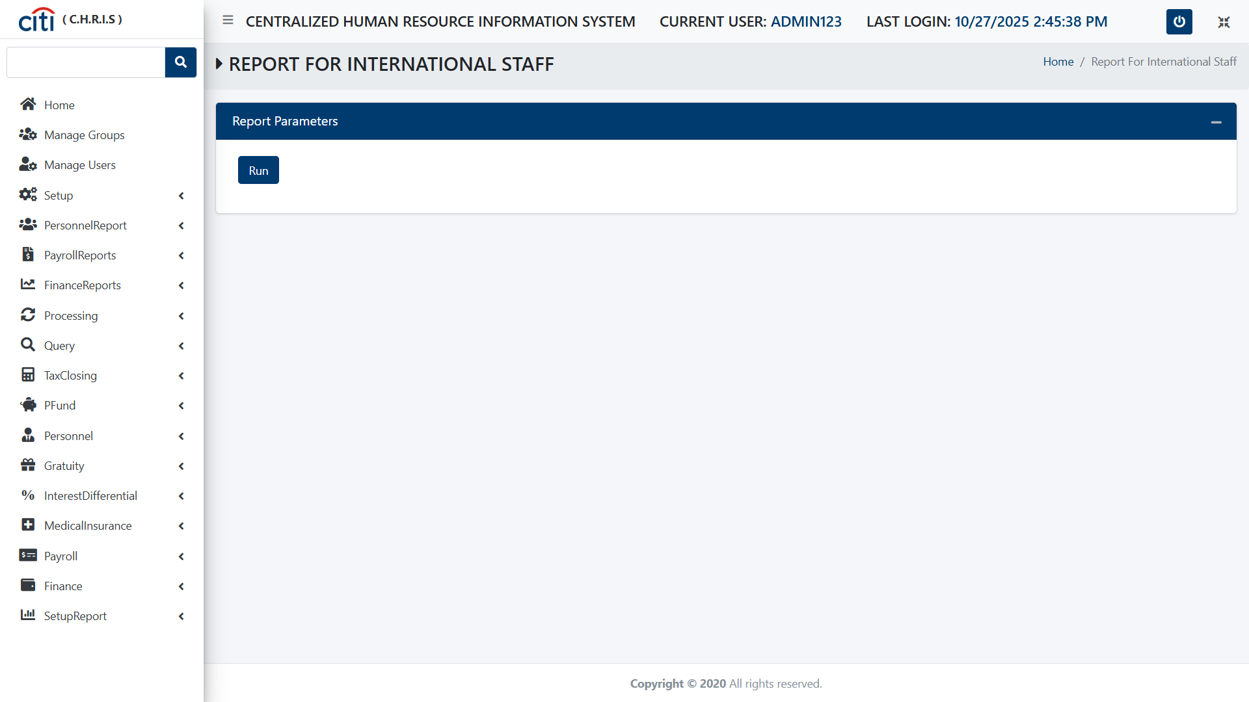
PERSONNEL REPORT
Report for International Staff Report
CHRIS
56

Slide 57
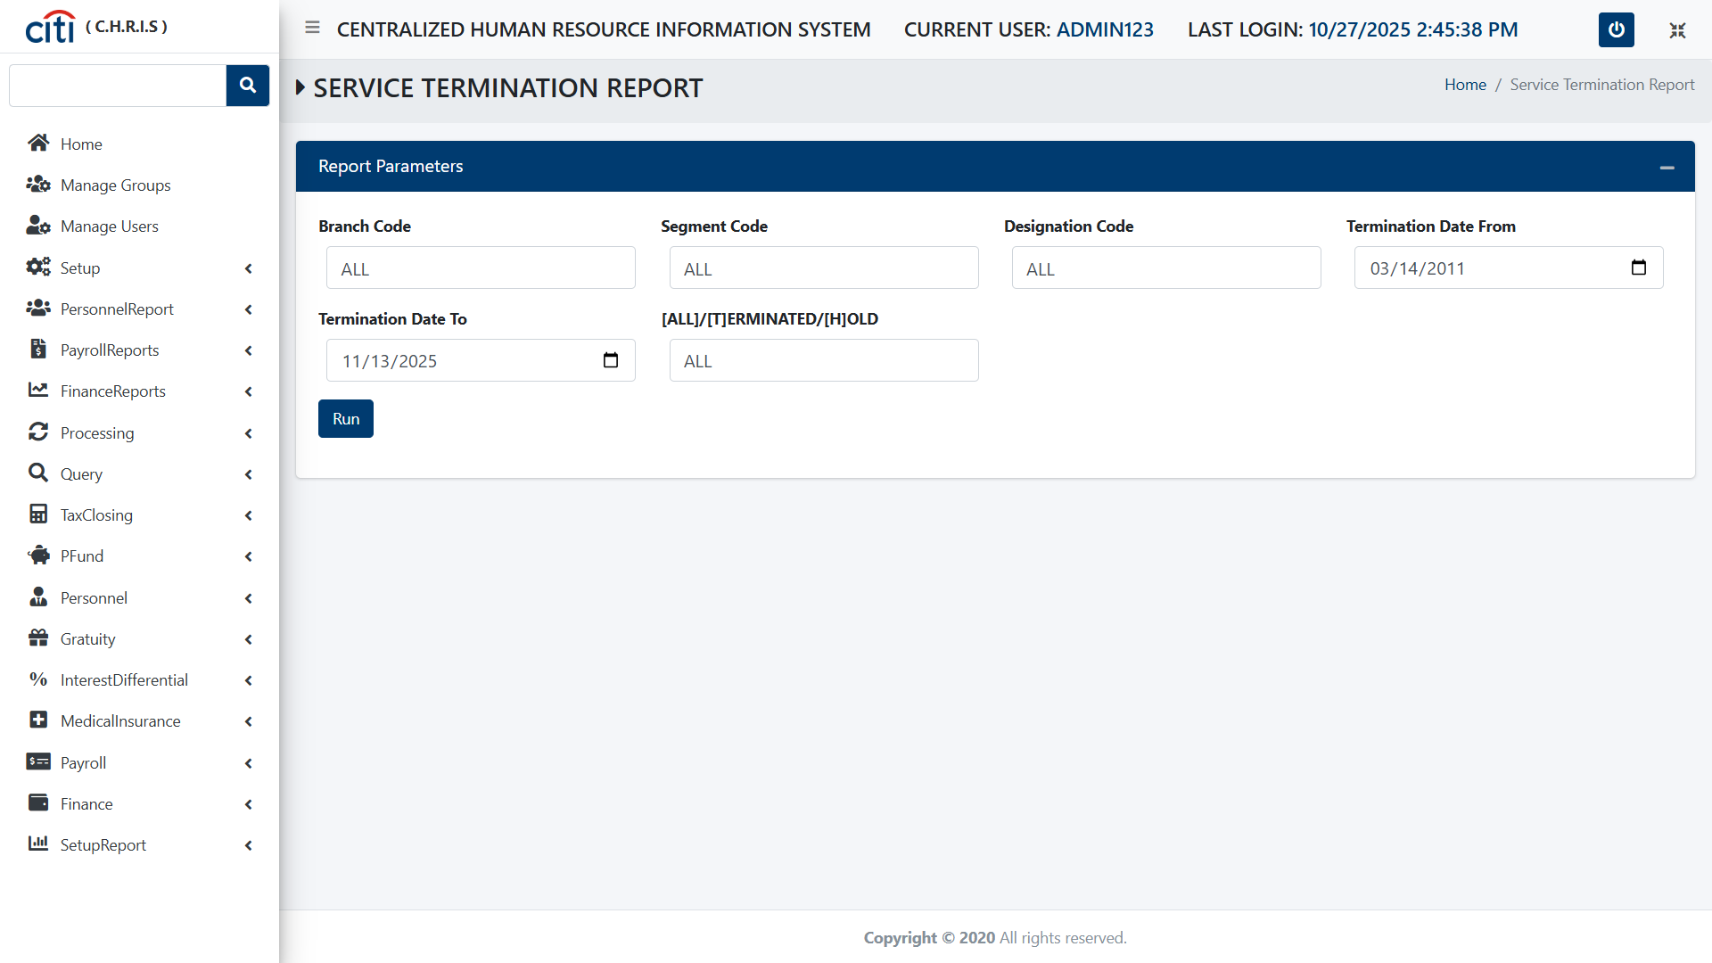
PERSONNEL REPORT
Service Termination Report
CHRIS
57

Slide 58

PERSONNEL REPORT
Report for Intern Form
CHRIS
58

Slide 59

PERSONNEL REPORT
Report for Contractual Employees
CHRIS
59

Slide 60

PERSONNEL REPORT
Report for Transfer Employees form
CHRIS
60

Slide 61
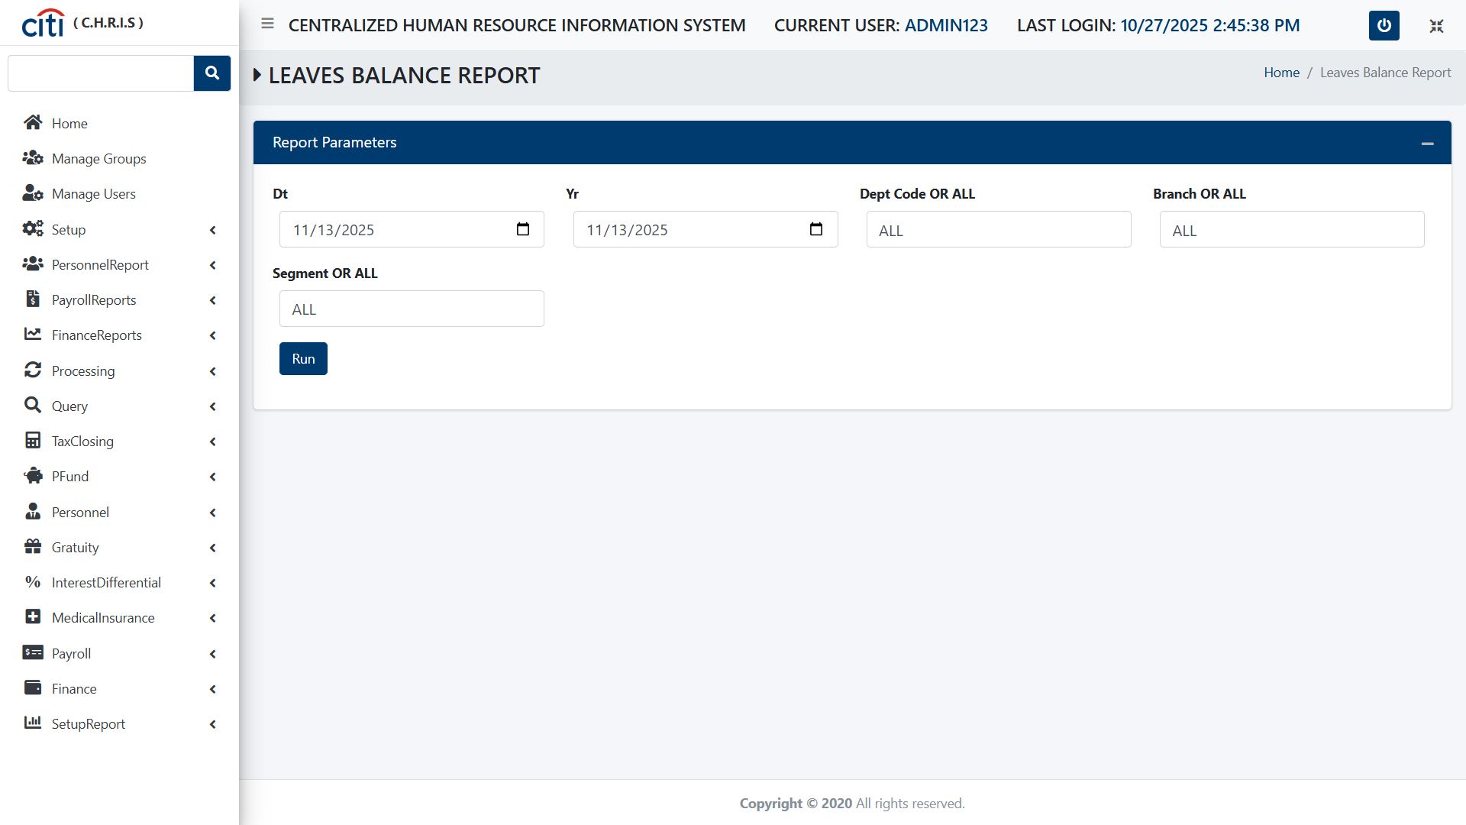
PERSONNEL REPORT
Leaves Balance Report form
CHRIS
61

Slide 62
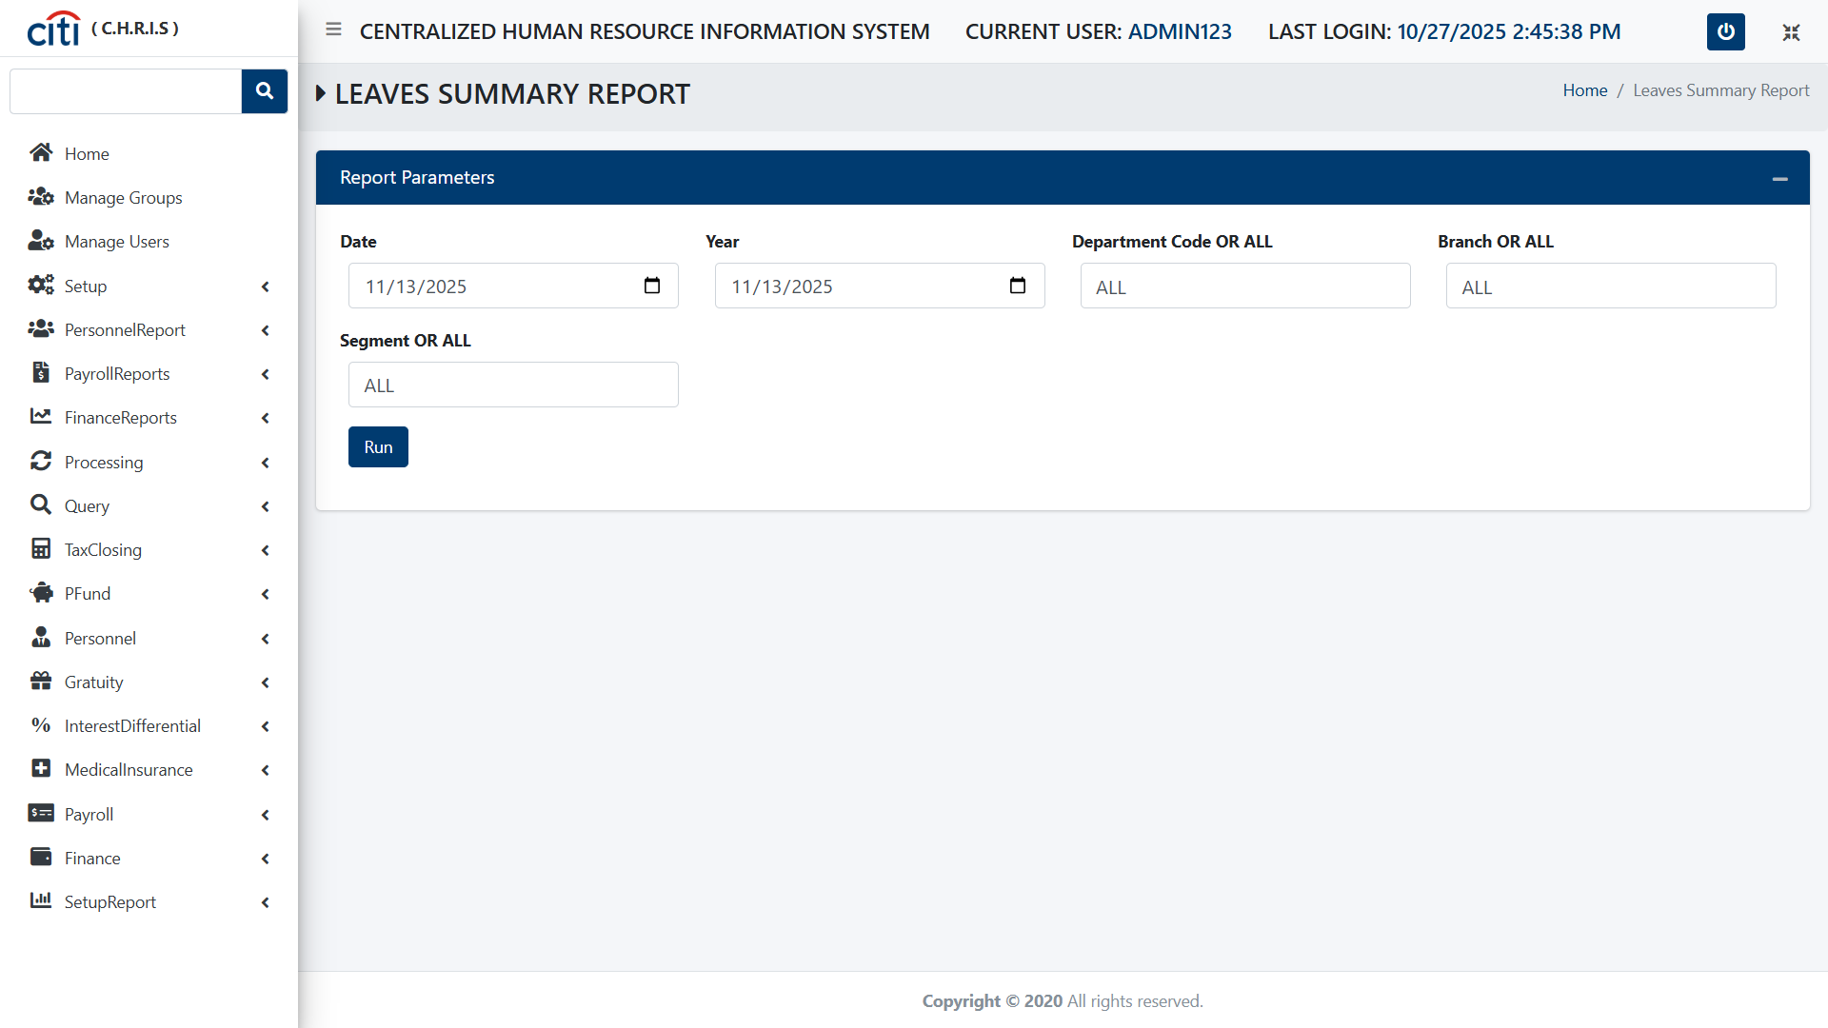
PERSONNEL REPORT
Leaves Summary Report form
CHRIS
62

Slide 63

PERSONNEL REPORT
Referrence Letter form
CHRIS
63

Slide 64

PERSONNEL REPORT
Previous Employement Letter form
CHRIS
64

Slide 65
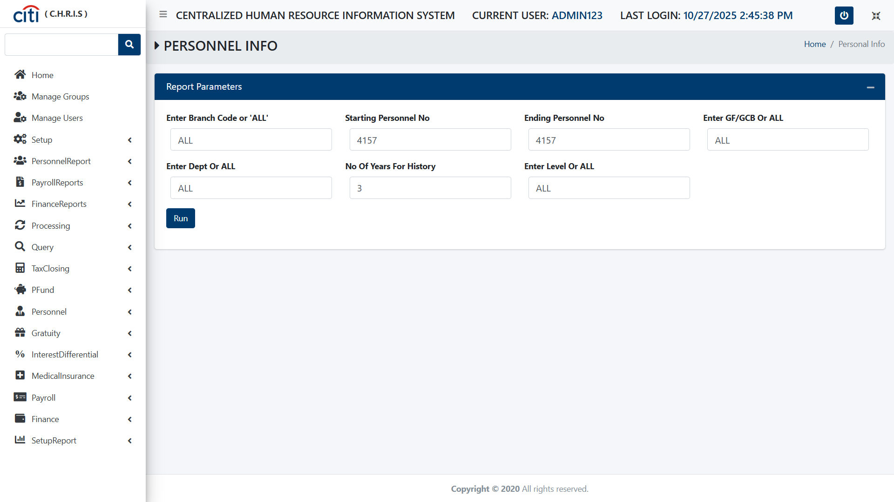
PERSONNEL REPORT
Personnel Informational form
CHRIS
65

Slide 66

PERSONNEL REPORT
Academic Qualification Report form
CHRIS
66

Slide 67
03
Payroll Report
Payroll registers, tax, arrears, and FTE reporting
CHRIS
67

Slide 68

PAYROLL REPORT
Segment Wise Report form
CHRIS
68

Slide 69

PAYROLL REPORT
Department Wise Payroll Clerical form
CHRIS
69

Slide 70
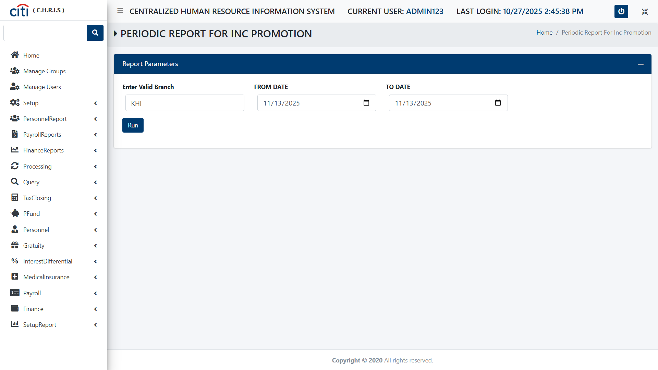
PAYROLL REPORT
Periodic Report for INC Promotion form
CHRIS
70

Slide 71

PAYROLL REPORT
Monthly Staff Payment Listings form
CHRIS
71

Slide 72

PAYROLL REPORT
Provident Fund Report form
CHRIS
72

Slide 73

PAYROLL REPORT
Overtime Report form
CHRIS
73

Slide 74
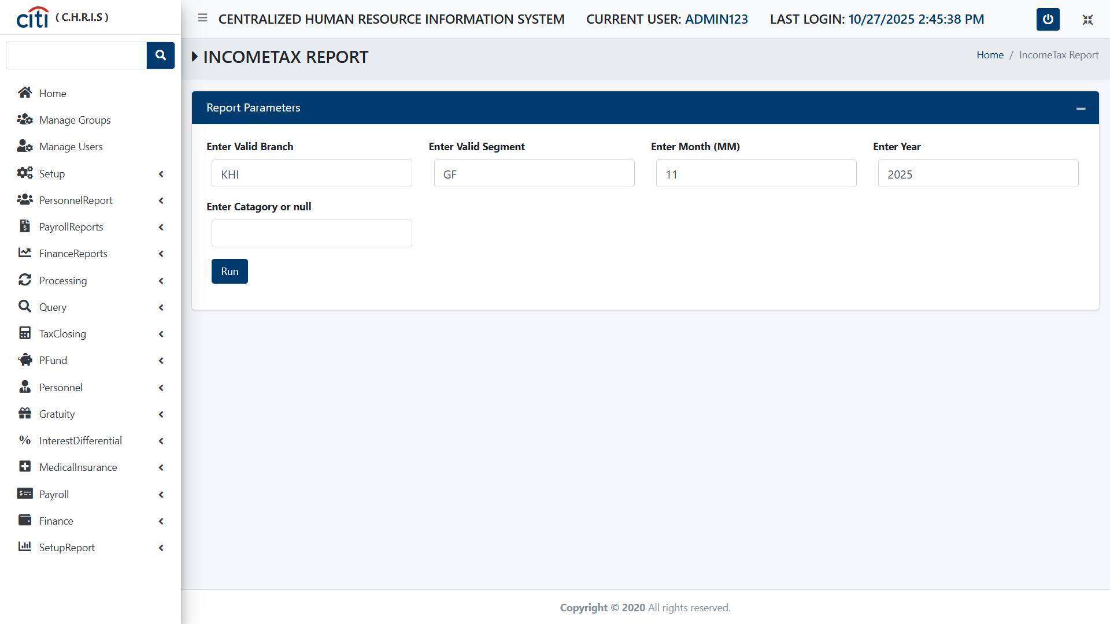
PAYROLL REPORT
Income Tax Report form
CHRIS
74

Slide 75

PAYROLL REPORT
Reconciliment Report form
CHRIS
75

Slide 76

PAYROLL REPORT
Payroll Register form
CHRIS
76

Slide 77

PAYROLL REPORT
Salary Settlement Officer form
CHRIS
77

Slide 78

PAYROLL REPORT
E Form
CHRIS
78

Slide 79

PAYROLL REPORT
FTE Analysis form
CHRIS
79

Slide 80

PAYROLL REPORT
Monthly Salary Inter form
CHRIS
80

Slide 81

PAYROLL REPORT
Shift Entry Report form
CHRIS
81

Slide 82

PAYROLL REPORT
Excise Deduction Report form
CHRIS
82

Slide 83

PAYROLL REPORT
Annual 10 C Bonus form
CHRIS
83

Slide 84

PAYROLL REPORT
Annual 10 C Payment Report form
CHRIS
84

Slide 85

PAYROLL REPORT
10 C Bonus Reciept form
CHRIS
85

Slide 86

PAYROLL REPORT
Monthly Tax Payment Report
CHRIS
86

Slide 87

PAYROLL REPORT
Department Wise OV form
CHRIS
87

Slide 88

PAYROLL REPORT
Annual Incentive Bonus form
CHRIS
88

Slide 89

PAYROLL REPORT
Annual Incentive Payment form
CHRIS
89

Slide 90

PAYROLL REPORT
Incentive Bonus Receipt form
CHRIS
90

Slide 91

PAYROLL REPORT
PY009 form
CHRIS
91

Slide 92

PAYROLL REPORT
Salary Arrear Detail Report form
CHRIS
92

Slide 93

PAYROLL REPORT
Overtime Arrears Detail form
CHRIS
93

Slide 94

PAYROLL REPORT
Arrears Summary Report form
CHRIS
94

Slide 95

PAYROLL REPORT
Arrears Reciept form
CHRIS
95

Slide 96

PAYROLL REPORT
Arrears Summary Report form
CHRIS
96

Slide 97

PAYROLL REPORT
Acturial Report form
CHRIS
97

Slide 98

PAYROLL REPORT
Income Tax Prerequisite form
CHRIS
98

Slide 99

PAYROLL REPORT
Ranking Report form
CHRIS
99

Slide 100

PAYROLL REPORT
FTE Data Entry List form
CHRIS
100

Slide 101

PAYROLL REPORT
FTE Designation Segment Wise form
CHRIS
101

Slide 102

PAYROLL REPORT
FTE Department Head Group Wise form
CHRIS
102

Slide 103

PAYROLL REPORT
FTE Group and Heads Segment Wise form
CHRIS
103

Slide 104

PAYROLL REPORT
FTE Department and Heads Group Wise form
CHRIS
104

Slide 105

PAYROLL REPORT
FTE Group Heads Segment Wise form
CHRIS
105

Slide 106

PAYROLL REPORT
FTE011 form
CHRIS
106

Slide 107

PAYROLL REPORT
FTE011B form
CHRIS
107

Slide 108

PAYROLL REPORT
FTE010 form
CHRIS
108

Slide 109

PAYROLL REPORT
FTE010 JAW form
CHRIS
109

Slide 110

PAYROLL REPORT
FTE 010 Segment form
CHRIS
110

Slide 111

PAYROLL REPORT
Salary Worksheet form
CHRIS
111

Slide 112

PAYROLL REPORT
Acturial Report Download form
CHRIS
112

Slide 113

PAYROLL REPORT
Monthly Tax Report form
CHRIS
113

Slide 114

PAYROLL REPORT
Employee Annual Tax Register form
CHRIS
114

Slide 115

PAYROLL REPORT
ATR Incentive Allow form
CHRIS
115

Slide 116

PAYROLL REPORT
Employee List for Salary form
CHRIS
116

Slide 117
04
Finance Reports
Employee financing, loans, and insurance reporting
CHRIS
117

Slide 118

FINANCE REPORTS
Finance Balance Report form
CHRIS
118

Slide 119

FINANCE REPORTS
Monthly Finance Report
CHRIS
119

Slide 120

FINANCE REPORTS
Finance Ledger Report
CHRIS
120

Slide 121

FINANCE REPORTS
Markup Amount Collected Report
CHRIS
121

Slide 122

FINANCE REPORTS
Finance Maturity Report form
CHRIS
122

Slide 123

FINANCE REPORTS
Segment Wise Finance Report
CHRIS
123

Slide 124

FINANCE REPORTS
Finance Person Report
CHRIS
124

Slide 125

FINANCE REPORTS
Finance Liquidation Report
CHRIS
125

Slide 126

FINANCE REPORTS
Finance Outstanding Report
CHRIS
126

Slide 127

FINANCE REPORTS
Finance Outstanding With ASR Report
CHRIS
127

Slide 128

FINANCE REPORTS
Finance History Ledger Report
CHRIS
128

Slide 129

FINANCE REPORTS
Finance OS for IS and Others report
CHRIS
129

Slide 130

FINANCE REPORTS
Insurance Required Report form
CHRIS
130

Slide 131

FINANCE REPORTS
Fire Insurance Report form
CHRIS
131

Slide 132

FINANCE REPORTS
Segment Wise Finance Report
CHRIS
132

Slide 133

FINANCE REPORTS
Newly Finance Booking Report
CHRIS
133

Slide 134

FINANCE REPORTS
MCO Report form
CHRIS
134

Slide 135

FINANCE REPORTS
Disbursement Outs Report
CHRIS
135

Slide 136

FINANCE REPORTS
Loan Disbursement Report
CHRIS
136

Slide 137

FINANCE REPORTS
Loan Status Report form
CHRIS
137

Slide 138

FINANCE REPORTS
FNREP 18A form
CHRIS
138

Slide 139

FINANCE REPORTS
FNREP 188 form
CHRIS
139

Slide 140

FINANCE REPORTS
Designation Wise OS form
CHRIS
140

Slide 141

FINANCE REPORTS
Designation Wise IS OS others form
CHRIS
141

Slide 142

FINANCE REPORTS
MCO Process form
CHRIS
142

Slide 143

FINANCE REPORTS
Loan Asim form
CHRIS
143

Slide 144

FINANCE REPORTS
Category Wise Outstanding Balance Local
CHRIS
144

Slide 145

FINANCE REPORTS
Category Wise Outstanding Balance Out Report
CHRIS
145

Slide 146

FINANCE REPORTS
Vehicle Insurance Policy Report
CHRIS
146

Slide 147

FINANCE REPORTS
Payroll Generation Report
CHRIS
147

Slide 148
05
Process
Month-end, year-end, and payroll history processing
CHRIS
148

Slide 149

PROCESS
Increment Finalization Process Report
CHRIS
149

Slide 150

PROCESS
10 C Bonus Approval Report
CHRIS
150

Slide 151

PROCESS
Month End Process Report
CHRIS
151

Slide 152

PROCESS
Payroll History Updation Process Report
CHRIS
152

Slide 153

PROCESS
Finance Payroll History Updation Process Report
CHRIS
153

Slide 154

PROCESS
Leaves at Year End Report
CHRIS
154

Slide 155

PROCESS
Pre Dump Process Report
CHRIS
155

Slide 156

PROCESS
Post Dump Process Report
CHRIS
156

Slide 157
06
Query
Ad hoc queries across salary, tax, and department data
CHRIS
157

Slide 158

QUERY
Salary History Query Report
CHRIS
158

Slide 159

QUERY
Department Wise Query Report
CHRIS
159

Slide 160

QUERY
Employee Current Status Query Report
CHRIS
160

Slide 161

QUERY
Tax Information Query Report
CHRIS
161

Slide 162

QUERY
Bonus Query Report
CHRIS
162

Slide 163

QUERY
Rank History Query Report
CHRIS
163

Slide 164

QUERY
Alowance Deduction Payroll Query Report
CHRIS
164

Slide 165
07
Tax Closing
Annual tax processing, assessment, and certification
CHRIS
165

Slide 166

TAX CLOSING
Annual Tax Processing Report
CHRIS
166

Slide 167

TAX CLOSING
Tax Update Entry Report
CHRIS
167

Slide 168

TAX CLOSING
Provident Fund Entry Report
CHRIS
168

Slide 169

TAX CLOSING
Tax Assessment Status Report
CHRIS
169

Slide 170

TAX CLOSING
Deduction Letter Report form
CHRIS
170

Slide 171

TAX CLOSING
Provident Fund Deduction Letter Report
CHRIS
171

Slide 172

TAX CLOSING
Income/Wealth Assessment Status Report
CHRIS
172

Slide 173

TAX CLOSING
Wealth Tax Assessment Report
CHRIS
173

Slide 174

TAX CLOSING
NTN Certification Report
CHRIS
174

Slide 175

TAX CLOSING
NTN Card Status Report
CHRIS
175

Slide 176

TAX CLOSING
Income Tax Assessment Status Report
CHRIS
176

Slide 177

TAX CLOSING
Salary Certificate Report
CHRIS
177

Slide 178

TAX CLOSING
139 Tax Statement Report
CHRIS
178

Slide 179
08
Provident Fund
Provident fund entries, contributions, and balances
CHRIS
179

Slide 180

PROVIDENT FUND
Provident Fund Interest Entry Report
CHRIS
180

Slide 181

PROVIDENT FUND
Provident Fund Entry Report
CHRIS
181

Slide 182

PROVIDENT FUND
Provident Fund Module Query Report
CHRIS
182

Slide 183

PROVIDENT FUND
Monthly Provident Fund Update Report
CHRIS
183

Slide 184

PROVIDENT FUND
Provident Fund Contribution Update Report
CHRIS
184

Slide 185
09
Personnel
Hiring, transfers, promotions, and personnel lifecycle entries
CHRIS
185

Slide 186

PERSONNEL
Year End Closing Process Report
CHRIS
186

Slide 187

PERSONNEL
Induvidual Provident Fund Report
CHRIS
187

Slide 188

PERSONNEL
CITI Wise Provident Fund Balances Report
CHRIS
188

Slide 189

PERSONNEL
Employees Provident Fund Letter Report
CHRIS
189

Slide 190

PERSONNEL
Personal Provident Fund Balance Report
CHRIS
190

Slide 191

PERSONNEL
Resign I Sand Other IPFB Report
CHRIS
191

Slide 192

PERSONNEL
Resign I Sand Other Settlement Report
CHRIS
192

Slide 193

PERSONNEL
Provident Fund Contribution Report
CHRIS
193

Slide 194

PERSONNEL
Regular Staff Hiring Entry Report
CHRIS
194

Slide 195

PERSONNEL
Contract Staff Hiring ENT Report
CHRIS
195

Slide 196

PERSONNEL
Summer Interns Hiring Report
CHRIS
196

Slide 197

PERSONNEL
Confirmation Entry Report
CHRIS
197

Slide 198

PERSONNEL
Termination Entry Report
CHRIS
198

Slide 199

PERSONNEL
Increment Officers Report
CHRIS
199

Slide 200

PERSONNEL
Increment Promotion Cleric Report
CHRIS
200

Slide 201

PERSONNEL
Segment or Department Transfer Report
CHRIS
201

Slide 202

PERSONNEL
Fast OR IS Transfer Report
CHRIS
202

Slide 203

PERSONNEL
Branch Manager Transfer Report
CHRIS
203

Slide 204

PERSONNEL
Fast OR IS Conversion Report
CHRIS
204

Slide 205

PERSONNEL
Actual Leave Entry Report
CHRIS
205

Slide 206

PERSONNEL
Leaves Carried Forward Report
CHRIS
206

Slide 207

PERSONNEL
Leaves Schedule Entry Report
CHRIS
207

Slide 208

PERSONNEL
RE-Hiring form
CHRIS
208

Slide 209

PERSONNEL
Shadow Salary
CHRIS
209

Slide 210

PERSONNEL
Termination SETT Hold REport
CHRIS
210

Slide 211

PERSONNEL
GEID Entry Report
CHRIS
211

Slide 212

PERSONNEL
Rank Entry Report
CHRIS
212

Slide 213

PERSONNEL
One Pager Personal Entry Report
CHRIS
213

Slide 214
10
Gratuity
Gratuity reserves, liabilities, and settlement reporting
CHRIS
214

Slide 215

GRATUITY
History Updating Process Report
CHRIS
215

Slide 216

GRATUITY
Gratuity Reserves Reports
CHRIS
216

Slide 217

GRATUITY
Individual Gratuity Reports
CHRIS
217

Slide 218

GRATUITY
Gratuity Liability Report
CHRIS
218

Slide 219

GRATUITY
Resigns and other Gratuity Report
CHRIS
219

Slide 220

GRATUITY
Actual Gratuity Report
CHRIS
220

Slide 221

GRATUITY
Gratuity Liability for the Year
CHRIS
221

Slide 222
11
Interest Differential
Country codes, exchange rates, and interest differential processing
CHRIS
222

Slide 223

INTEREST DIFFERENTIAL
Country Code
CHRIS
223

Slide 224

INTEREST DIFFERENTIAL
Country Code Authorization
CHRIS
224

Slide 225

INTEREST DIFFERENTIAL
LS Other Company
CHRIS
225

Slide 226

INTEREST DIFFERENTIAL
LS Other Authorization
CHRIS
226

Slide 227

INTEREST DIFFERENTIAL
Dollar Rate Entry form
CHRIS
227

Slide 228

INTEREST DIFFERENTIAL
Dollar Rate Authorization Report
CHRIS
228

Slide 229

INTEREST DIFFERENTIAL
FNREP 31
CHRIS
229

Slide 230

INTEREST DIFFERENTIAL
Interest Differential Process Report
CHRIS
230

Slide 231

INTEREST DIFFERENTIAL
FNREP 32
CHRIS
231

Slide 232
12
Medical Insurance
Enrollment, premiums, and claims for medical and hospital insurance
CHRIS
232

Slide 233

MEDICAL INSURANCE
Enrollment Letter
CHRIS
233

Slide 234

MEDICAL INSURANCE
Premium Information GLIDE 02
CHRIS
234

Slide 235

MEDICAL INSURANCE
Enrollment Entry GHID 01
CHRIS
235

Slide 236

MEDICAL INSURANCE
Premium Information GHIDE 02
CHRIS
236

Slide 237

MEDICAL INSURANCE
CF Entry GHIDE 03
CHRIS
237

Slide 238

MEDICAL INSURANCE
Premium Information OMIDE 02
CHRIS
238

Slide 239

MEDICAL INSURANCE
CF Entry OMIDE 03
CHRIS
239

Slide 240

MEDICAL INSURANCE
Pay Entry
CHRIS
240

Slide 241

MEDICAL INSURANCE
Per Claim QR
CHRIS
241

Slide 242

MEDICAL INSURANCE
OMI LIM Calculation
CHRIS
242

Slide 243

MEDICAL INSURANCE
GLINS REP
CHRIS
243

Slide 244

MEDICAL INSURANCE
ENR LET REP G
CHRIS
244

Slide 245

MEDICAL INSURANCE
ENR Status
CHRIS
245

Slide 246

MEDICAL INSURANCE
GRP HOSP REP
CHRIS
246

Slide 247

MEDICAL INSURANCE
ENR Letter Rep
CHRIS
247

Slide 248

MEDICAL INSURANCE
ENR STS REP G
CHRIS
248

Slide 249

MEDICAL INSURANCE
ENR STS REP G
CHRIS
249

Slide 250
MEDICAL INSURANCE
ENR Letter Rep
CHRIS
250

Slide 251

MEDICAL INSURANCE
Out PAT Medi
CHRIS
251

Slide 252

MEDICAL INSURANCE
Claim Report
CHRIS
252

Slide 253

MEDICAL INSURANCE
ENR LETG 2
CHRIS
253

Slide 254

MEDICAL INSURANCE
Year Balance Report
CHRIS
254

Slide 255

MEDICAL INSURANCE
ENR Status G
CHRIS
255

Slide 256

MEDICAL INSURANCE
ST Medical Insurance
CHRIS
256

Slide 257

MEDICAL INSURANCE
Employee PER Information
CHRIS
257

Slide 258

MEDICAL INSURANCE
DSG WIS OMI
CHRIS
258

Slide 259

MEDICAL INSURANCE
GLINS REP 2
CHRIS
259

Slide 260
13
Payroll
Salary, allowance, deduction, and incentive entries
CHRIS
260

Slide 261

PAYROLL
Incentive Bonus Entry Report
CHRIS
261

Slide 262

PAYROLL
Zakat Entry form
CHRIS
262

Slide 263

PAYROLL
Salary Advance Entry form
CHRIS
263

Slide 264

PAYROLL
LFA Entry form
CHRIS
264

Slide 265

PAYROLL
Salary Entry Report
CHRIS
265

Slide 266

PAYROLL
Shift Entry form
CHRIS
266

Slide 267

PAYROLL
Induvidual Allowance Entry form
CHRIS
267

Slide 268

PAYROLL
Individual Deduction Entry form
CHRIS
268

Slide 269

PAYROLL
FTE Entry form
CHRIS
269

Slide 270

PAYROLL
PR 111 Serial Number form
CHRIS
270

Slide 271

PAYROLL
CHRSP
CHRIS
271

Slide 272

PAYROLL
Loan Update form
CHRIS
272

Slide 273

PAYROLL
Salary Update form
CHRIS
273

Slide 274

PAYROLL
View Tax Details form
CHRIS
274

Slide 275

PAYROLL
Arrear Update Report
CHRIS
275

Slide 276

PAYROLL
PR 111
CHRIS
276

Slide 277
14
Finance
Employee financing, loans, and collateral management
CHRIS
277

Slide 278

FINANCE
Self Insurance Entry
CHRIS
278

Slide 279

FINANCE
Finance Type Entry
CHRIS
279

Slide 280

FINANCE
Finance Query
CHRIS
280

Slide 281

FINANCE
Finace Booking Entry
CHRIS
281

Slide 282

FINANCE
FIN Enhancement Entry
CHRIS
282

Slide 283

FINANCE
FIN Reduction Entry
CHRIS
283

Slide 284

FINANCE
FIN Liquidation Entry
CHRIS
284

Slide 285

FINANCE
Finance Installment Entry Form
CHRIS
285

Slide 286

FINANCE
Transfer Finance Type
CHRIS
286

Slide 287

FINANCE
Liquidation Finance Query
CHRIS
287

Slide 288

FINANCE
Finance Application Report
CHRIS
288

Slide 289

FINANCE
Vehicle Insurance Entry Report
CHRIS
289

Slide 290

FINANCE
Mortgage Property Collateral Entry Report
CHRIS
290

Slide 291
15
Setup Report
Reference file listings across categories, departments, and designations
CHRIS
291

Slide 292

SETUP REPORT
Category File List
CHRIS
292

Slide 293

SETUP REPORT
Department File List
CHRIS
294

Slide 294

SETUP REPORT
Designation File List Report
CHRIS
295

Slide 295

SETUP REPORT
Income Tax File List Report
CHRIS
296

Slide 296

SETUP REPORT
Account File List Report
CHRIS
297

Slide 297

SETUP REPORT
Allowance File List Report
CHRIS
298

Slide 298

SETUP REPORT
Deduction File List Report
CHRIS
299

Slide 299

SETUP REPORT
Holiday File List Report
CHRIS
300

Slide 300

SETUP REPORT
Insurance File List Report
CHRIS
301

Slide 301

SETUP REPORT
TIR File List Report form
CHRIS
302

Slide 302
Thank You
Questions & discussion welcome
Developed by Zealous Technologies
zealoustechnologies.com

